Slide 1
感恩遇见，相互成就，本课件资料仅供您个人参考、教学使用，严禁自行在网络传播，违者依知识产权法追究法律责任。
更多教学资源请关注
公众号：溯恩高中英语
知识产权声明

Slide 2
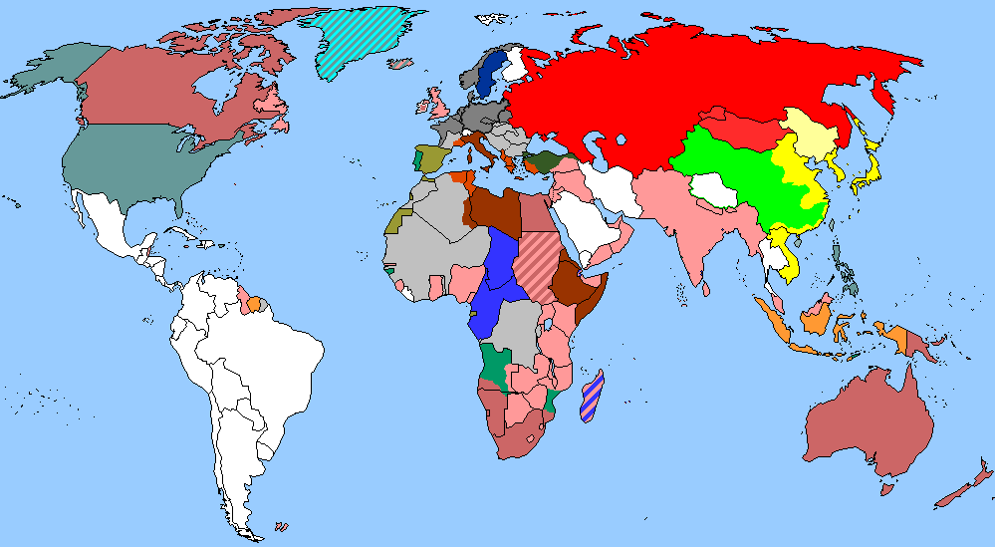
The World
November 16th-30th, 2022

Slide 3
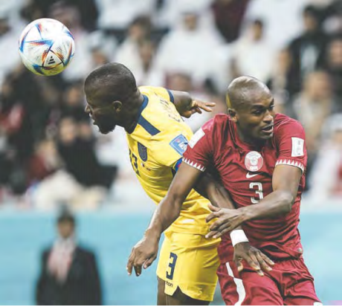
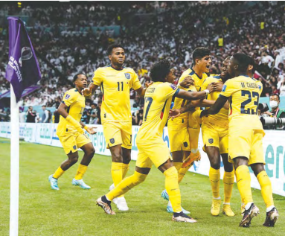
1. Host Qatar revels in opener, then suffers deflating defeat
东道主卡塔尔在揭幕战中纵情狂欢，随后遭遇惨败

Slide 4
语篇填空
《华盛顿邮报》2022年11月21日 D1&D8版面
The 22nd World Cup hatched Sunday in a setting ___________ once would have seemed far-fetched: in a small city amid the vast sands along the Persian Gulf coast 45 minutes north of Doha, at a stadium with two rows of camels posing _________ (dutiful) beneath riders outside and after an opening ceremony that managed to include Morgan Freeman, Jung Kook and an _________ (adore) floating cartoon figure in a thawb.
That made it all a bit jarring ______ the first match suffered swaths of empty seats through a drowsy second half, as though large portions of the 67,372 had fled to concessions to make a run on the nonalcoholic beer. Qatar became the first World Cup host _______ (lose) an opening match, and even as so many fans capitulated early, they told of an experience far better than nonalcoholic beer.
They ____________ (stream) into the stadium shortly before sunset for this World Cup deemed laughable even 12 years ago when the tiny country bid ____ it, and few seemed to have any illusions about the nation’s odds of beating Ecuador.
But the team’s __________ (prospect) were beside the point. “It feels amazing,” al-Fakhro said, _________ (stand) among the crowd. “We can show people our culture.” “A dream has come true,” Sara Althawadi said as she ________ (join) her sister to watch the match.
that / which
dutifully
adorable
when
to lose
had streamed
for
prospects
standing
joined

Slide 5
词汇讲解
1. capitulate: to agree to do sth that you have been refusing to do for a long time 屈服；屈从
They were finally forced to capitulate to the terrorists' demands.
他们最后被迫屈从恐怖分子的要求。
2. illusion: a false idea or belief, especially about sb or about a situationr
错误的观念；幻想
The idea of absolute personal freedom is an illusion.
绝对个人自由的观念是一种幻想。
翻译句子
我的全部生活历程证明我是从来不曾投降过。
The whole course of my life proves that I never capitulate.
翻译句子
房间里的镜子常给人一种空间增大的错觉。
Mirrors in a room often give an illusion of space.

Slide 6
句子翻译
Qatar became the first World Cup host to lose an opening match, and even as so many fans capitulated early, they told of an experience far better than nonalcoholic beer.
卡塔尔成为首个首场比赛失利的世界杯主办国，尽管很多球迷早早就投降了，但他们的经历比无酒精啤酒要好得多 。
翻译
They had streamed into the stadium shortly before sunset for this World Cup deemed laughable even 12 years ago when the tiny country bid for it, and few seemed to have any illusions about the nation’s odds of beating Ecuador.
在12年前这个小国申办世界杯时，人们还认为这届世界杯是可笑的，几乎没有人对该国击败厄瓜多尔的几率抱有任何幻想。
翻译

Slide 7
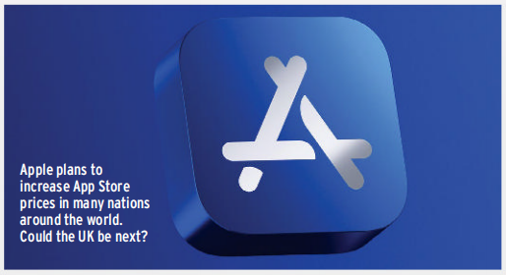
2. App Store Set for App Price Hike
苹果应用商店将上调应用价格

Slide 8
语篇填空
（《苹果科技杂志》 2022年11月版 8页）
MacFormat
Apple has announced to developers that it plans to increase App Store prices around the world. It will make for uncomfortable reading ______ (give) the cost of living crisis.
The change will affect apps and in-app purchases in _______ (vary) nations, including Chile, Japan, Pakistan, and Vietnam, plus any country that uses the euro as a currency. Apple did not specify how much prices are set to increase, but said the new fees will come ____ effect “as early as 5 October, 2022”.
Developers can price their apps according to set tiers, and it is those tiers ____ are changing. For example, the ____ (one) euro tier is going up from €0.99 to €1.19 (while the very highest tier listed will rise from €999 to €1,199). Apple added that developers can choose to keep prices the same for existing subscribers to their apps.
Right now, the UK does not seem ____________ (affect), but that doesn’t mean it won’t be in the future. Apple has increased App Store prices before in the UK, with prices ______ (rise) by around 25% in 2017. It is thought one reason ____ the current increases is the euro’s _________ (weak) against the dollar. With the pound also struggling in this regard, don’t be surprised if Apple soon _______ (follow) suit with price rises in the UK.
given
various
into
that
first
to be affected
rising
for
weakness
follows

Slide 9
词汇讲解
1. specify: to state sth, especially by giving an exact measurement, time, exact instructions, etc. 具体说明；明确规定；详述；详列
The contract clearly specifies who can operate the machinery. 合同明确规定谁可以操作机器。
2. tier: one of several levels in an organization or a system 阶层；等级
We have introduced an extra tier of administration. 我们额外增加了一层管理。
翻译句子
每种食谱都具体说明了所用鸡蛋的大小。
Each recipe specifies the size of egg to be used.
翻译句子
我不明白你为什么认为我们还需要一个管理层级。
I don’t understand why you think we need yet another tier of management.

Slide 10
句子翻译
The change will affect apps and in-app purchases in various nations, including Chile, Japan, Pakistan, and Vietnam, plus any country that uses the euro as a currency. Apple did not specify how much prices are set to increase, but said the new fees will come into effect “as early as 5 October, 2022”.
这一变化将影响到智利、日本、巴基斯坦和越南等多个国家的应用程序和应用内购买，以及任何使用欧元作为货币的国家。苹果公司没有具体说明涨价幅度，但表示新收费“最早将于2022年10月5日”生效。
翻译
Right now, the UK does not seem to be affected, but that doesn’t mean it won’t be in the future. Apple has increased App Store prices before in the UK, with prices rising by around 25% in 2017.
目前，英国似乎没有受到影响，但这并不意味着未来不会受到影响。苹果之前也在英国提高过App Store的价格，2017年的价格上涨了约25%。
翻译

Slide 11
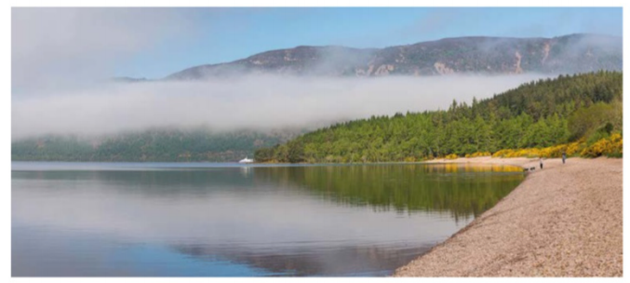
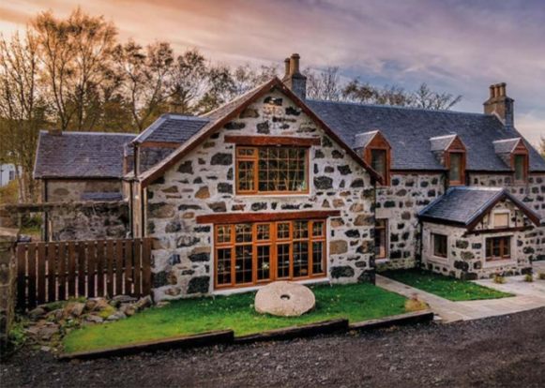
3. Scottish News and the Latest Travel Tips
苏格兰风土人情秀

Slide 12
语篇填空1
（《苏格兰杂志》 2022年11&12月版 9页）
located
New webcams _______ (locate) along the shores of Loch Ness mean that Nessie hunters can now keep an eye out for Nessie 365 days of the year, wherever they are. Cameras are now located at five locations around the famous loch, _________ (include) the Craigdarroch Hotel in Foyers and Drovers Lodge near Drumnadrochit.
Michael Golding, CEO at Visit Inverness Loch Ness, said: “We are delighted to be able to provide live footage of the beautiful Loch Ness every day of the year. For people all over the world to watch Loch Ness through the changing _______ (season) and get a glimpse of the beautiful scenery and abundant wildlife is very special. Of course, the webcams will also give Nessie fans another way of spotting our elusive and most popular resident!”
Tourism providers are also hoping the webcams will inspire people to visit the area ___ other reasons, too. Chris Taylor, Visit Scotland Regional Leadership Director, said:“By having the opportunity to see Loch Ness from so many different viewpoints, ______ (many) potential visitors will be inspired to travel to this beautiful part of the Highlands.”
including
seasons
for
more

Slide 13
语篇填空2
（《苏格兰杂志》 2022年11&12月版 9页）
Edinbane Lodge, the reputable restaurant with rooms on the Isle of Skye, has been awarded Four AA Rosettes-the only restaurant on Skye to receive the accolade and one of just six restaurants ____________ (award) Four AA Rosettes across Scotland.
Run by chef patron Calum Montgomery, ______ family bought the run-down hunting lodge in 2017 and set about restoring it, Edinbane ________ (build) up an excellent reputation for its food offering and rooms over the past few years. Calum sources produce from a community of family and friends, who, like him, _____________ (commit) to making the most of the island’s crofts, seas, and artisan production.
Upon receiving the award, Calum said: “It means so much to bring this award to my native island home for the first time - and of course, to even be mentioned in the same category ____ some of the UK’s most renowned restaurants is such an honour.”
to be awarded
whose
has built
are committed
as

Slide 14
词汇讲解1
1. glimpse: a look at sb/sth for a very short time, when you do not see the person or thing completely 一瞥；一看
I came up on deck to get my first glimpse of the island. 我登上甲板第一次看这岛。
2. elusive: difficult to find, define, or achieve 难找的；难以解释的；难以达到的
A solution to the problem of toxic waste is proving elusive. 有毒废料这个问题证明难以解决。
翻译句子
他一眼瞥见她在人群里。
He caught a glimpse of her in the crowd.
翻译句子
她设法得到了与那个难以捉摸的人的采访。
She managed to get an interview with that elusive man.

Slide 15
词汇讲解2
3. reputable: that people consider to be honest and to provide a good service 声誉好的；值得信赖的
I insured my property with an established, reputable company. 我找了一家地位稳固、信誉良好的保险公司投保我的房产。
4. accolade: praise or an award for an achievement that people admire 赞扬；奖赏；荣誉级
He won accolades as one of America’s top test pilots. 他作为美国顶级试飞员之一赢得了众多荣誉。
翻译句子
你通过一个声誉好的经销商来买车是明智的。
You are well advised to buy your car through a reputable dealer.
翻译句子
诺贝尔奖已成为科学界的最高荣誉。
The Nobel Prize has become the ultimate accolade in the sciences.

Slide 16
句子翻译
We are delighted to be able to provide live footage of the beautiful Loch Ness every day of the year. For people all over the world to watch Loch Ness through the changing seasons and get a glimpse of the beautiful scenery and abundant wildlife is very special.
我们很高兴能够提供一年中每天美丽的尼斯湖的实时镜头。对于世界各地的人们来说，在四季交替的时候观看尼斯湖，一睹美丽的风景和丰富的野生动物是非常特别的。
翻译
Run by chef patron Calum Montgomery, whose family bought the run-down hunting lodge in 2017 and set about restoring it, Edinbane has built up an excellent reputation for its food offering and rooms over the past few years.
爱丁堡酒店由厨师赞助人Calum Montgomery经营，他的家族在2017年买下了这座破败的狩猎小屋，并开始着手修复它。在过去几年里，爱丁堡酒店因提供的食物和客房而赢得了良好的声誉。
翻译

Slide 17
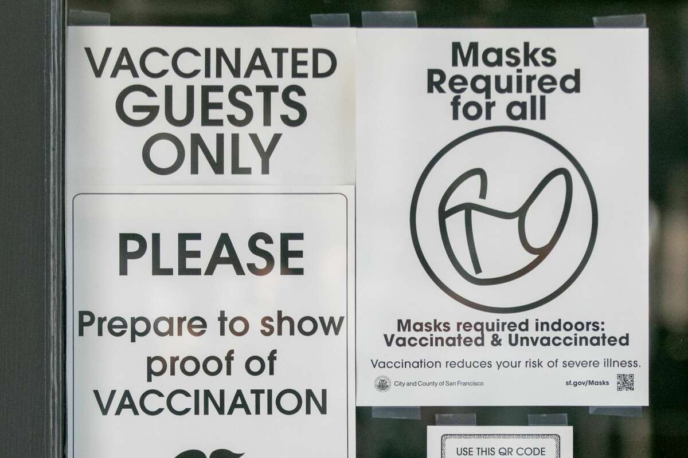
4. Los Angeles County returns to strongly urging indoor masking
洛杉矶县强烈建议市民室内戴口罩

Slide 18
语篇填空
（《洛杉矶时报》2022年11月20日 B3版面）
Amid a sustained rise in coronavirus transmission, Los Angeles County is once again strongly recommending wearing a mask in indoor public spaces.
The daily number of newly ________ (report) cases has jumped almost 70% from a month ago, though case rates are still well shy of previous ______ (wave) and officials continue to tout the benefits of available vaccines and therapeutics in warding off the worst COVID-19 has to offer. ________, the recent rise prompted the county to strengthen its call for indoor masking — from saying the practice is a matter of individual preference ___ advising it. “Indoor masking is, ____ it has been in the past during times of elevated transmission, strongly recommended for all individuals,” county health officer Dr. Muntu Davis ____ (say) Thursday.
__________ (specific), the county now encourages individuals _______ (wear) a well-fitting, high-quality mask in public indoor spaces; when aboard public transit; in correctional and detention facilities; and in homeless and emergency shelters. While still _______ (option) in those settings, masks remain mandatory in healthcare and congregate care facilities, as well as for those ____ have been exposed to COVID-19 during the last 10 days, according to Davis.
reported
waves
However
to
as
said
Specifically
to wear
optional
who

Slide 19
词汇讲解
1. tout: to try to persuade people that sb/sth is important or valuable by praising them /it 标榜；吹捧；吹嘘
She is being touted as the next leader of the party.
她被吹捧为该党的下一任领导人。
2. ward off: to protect or defend yourself against danger, illness, attack, etc.
防止，避免，使防止（危险、疾病、攻击等）
Mass burials are now under way in an effort to ward off an outbreak of cholera.
为防止霍乱爆发正在进行大规模掩埋。
翻译句子
3D打印被吹捧为下一个大事件。
3D printing is being touted as the next big thing.
翻译句子
她举起双手把他挡开。
She put up her hands to ward him off.

Slide 20
句子翻译
The daily number of newly reported cases has jumped almost 70% from a month ago, though case rates are still well shy of previous waves and officials continue to tout the benefits of available vaccines and therapeutics in warding off the worst COVID-19 has to offer.
每日新报告的病例数量比一个月前增加了近70%，不过比率仍远低于之前的程度，而且官员们继续标榜现有疫苗和治疗方法对预防最严重的新冠疫情的有效度。
翻译
The recent rise prompted the county to strengthen its call for indoor masking — from saying the practice is a matter of individual preference to advising it.
最近的（感染人数）上升促使该县加强了对室内戴口罩的呼吁——从之前说这种做法是个人选择到现在的强烈建议。
翻译

Slide 21
5. BBC新闻听写填空 11/30/22

Slide 22
听力填空
The Likud party of Israel’s prime minister-designate Benjamin Netanyahu has agreed to give a government _____ to the leader of an openly homophobic party. Avi Maoz will become the head of a new department for national Jewish _______.
Iran’s revolutionary guards are reported to have arrested a person described as the head of a network of people affiliated to the UK-based Iran International TV. The _________________ is accused of planning acts of sabotage.
22 people have gone on trial in Uzbekistan accused of taking part in protests that descended into ________ in July. The unrest started when the government announced plans to _____ the Karakalpakstan region of its ___________ status. At least twenty people died.
Bob Dylan has apologised to people who spent 600 dollars on ____________ of his latest book that weren’t actually signed by him. Dylan admitted that a machine called an autopen signed the books because he had a bad case of vertigo _____________ the effects of the pandemic.
At the football World Cup in Qatar, there’s been a ________ 3:3 draw between Serbia and Cameroon. In the day’s second match, South Korea are playing Ghana. Later, Brazil _______ Switzerland and Portugal face Uruguay.
post
identity
unnamed individual
violence
strip
autonomous
signed copies
combined with
dramatic
take on

Slide 23
词汇讲解
1. affiliate: (with/to sb/sth) to link a group, a company, or an organization very closely with another larger one 使隶属，使并入（较大的团体、公司、组织）
All youth groups will have to affiliate to the National Youth Agency.
所有青年团体必须并入全国青年事务处。
2. sabotage: the act of doing deliberate damage to equipment, transport, machines, etc. to prevent an enemy from using them, or to protest about sth
（为防止敌人利用或表示抗议而对设备、交通等进行的）蓄意毁坏
an act of economic/military/industrial sabotage 经济/军事/工业破坏活动
翻译句子
这家医院附属于当地大学。
The hospital is affiliated with/to the local university.
翻译句子
警方没有排除人为破坏的可能。
Police have not ruled out the possibility of saborage.

Slide 24
句子翻译
22 people have gone on trial in Uzbekistan accused of taking part in protests that descended into violence in July. The unrest started when the government announced plans to strip the Karakalpakstan region of its autonomous status.
翻译
乌兹别克斯坦有22人被指控参与7月演变为暴力的抗议活动。骚乱始于政府宣布计划剥夺卡拉卡尔帕克斯坦地区的自治地位。
Bob Dylan has apologised to people who spent 600 dollars on signed copies of his latest book that weren’t actually signed by him. Dylan admitted that a machine called an autopen signed the books because he had a bad case of vertigo combined with the effects of the pandemic.
鲍勃·迪伦已经向那些花了600美元买了并非他亲笔签名的签名书的人道歉。迪伦承认，一台名为自动签名的机器在书上替他签名，原因是他有严重的眩晕症，再加上疫情的影响。
翻译

