Slide 1
感恩遇见，相互成就，本课件资料仅供您个人参考、教学使用，严禁自行在网络传播，违者依知识产权法追究法律责任。
更多教学资源请关注
公众号：溯恩高中英语
知识产权声明

Slide 2
选择性必修一Unit 1
People of Achievement
Reading & Thinking
嵊州市高级中学 尹 娟

Slide 3
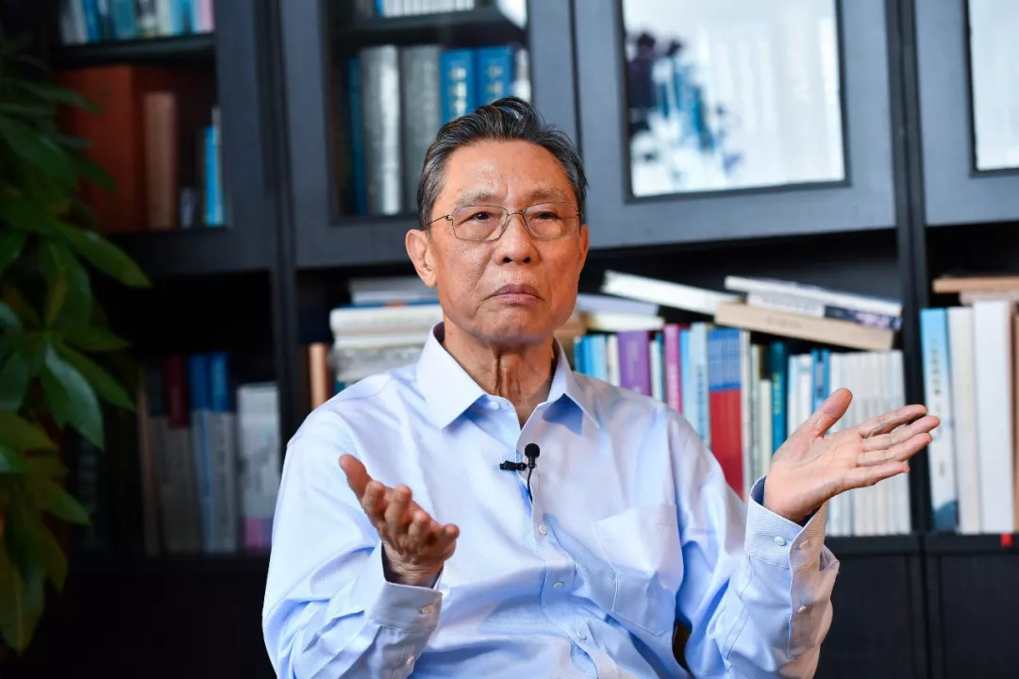
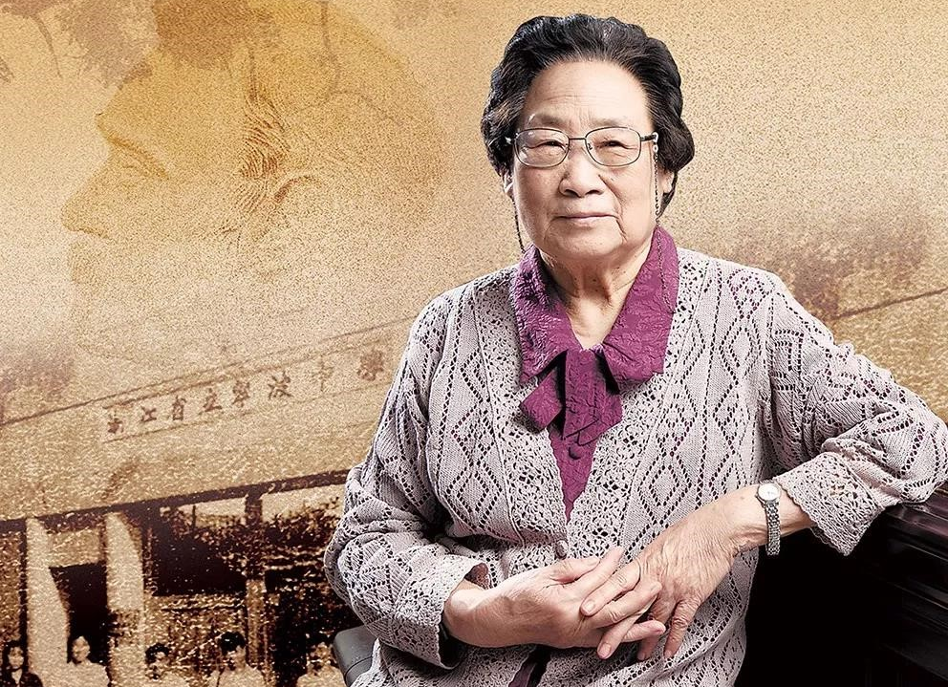
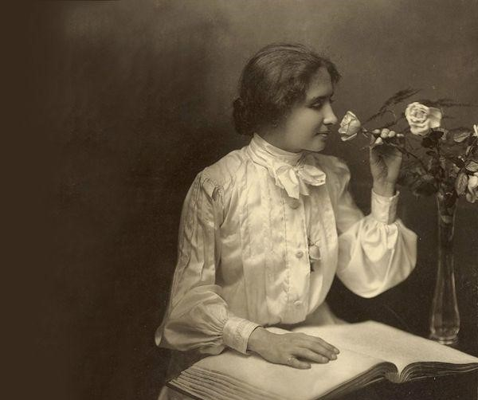
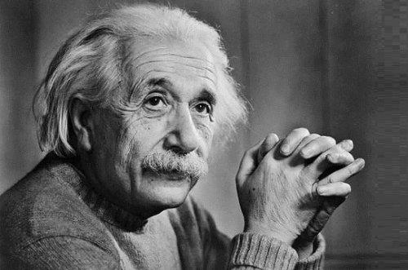
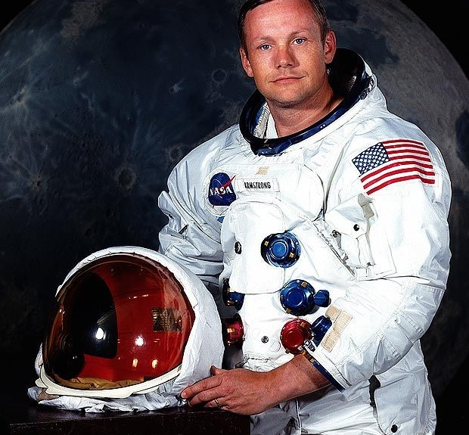
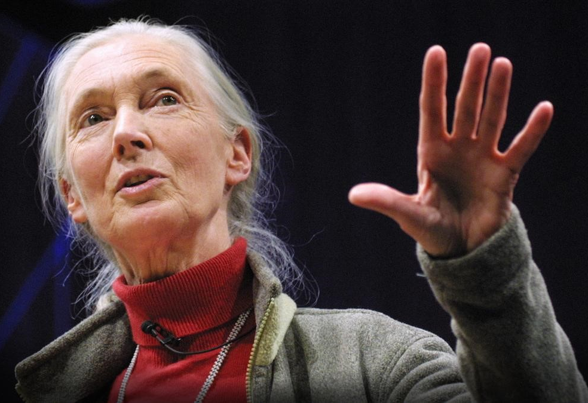
Do you know these people of achievement?
Zhong Nanshan
Tu Youyou
Helen Keller
Albert Einstein
Neil Armstrong
Jane Goodall

Slide 4
What are the qualities of these great people?
Can you use some descriptive words to describe them?
Descriptive word, a kind of adjective, adverb, v-ing etc., is used to describe the colors, states and modalities of people or objects vividly and specifically.
Try to become not a man of success, but try rather to become a man of value.
---Albert Einstein
courageous
talented
kind-hearted
devoted
considerate
diligent
selfless
persistent

Slide 5
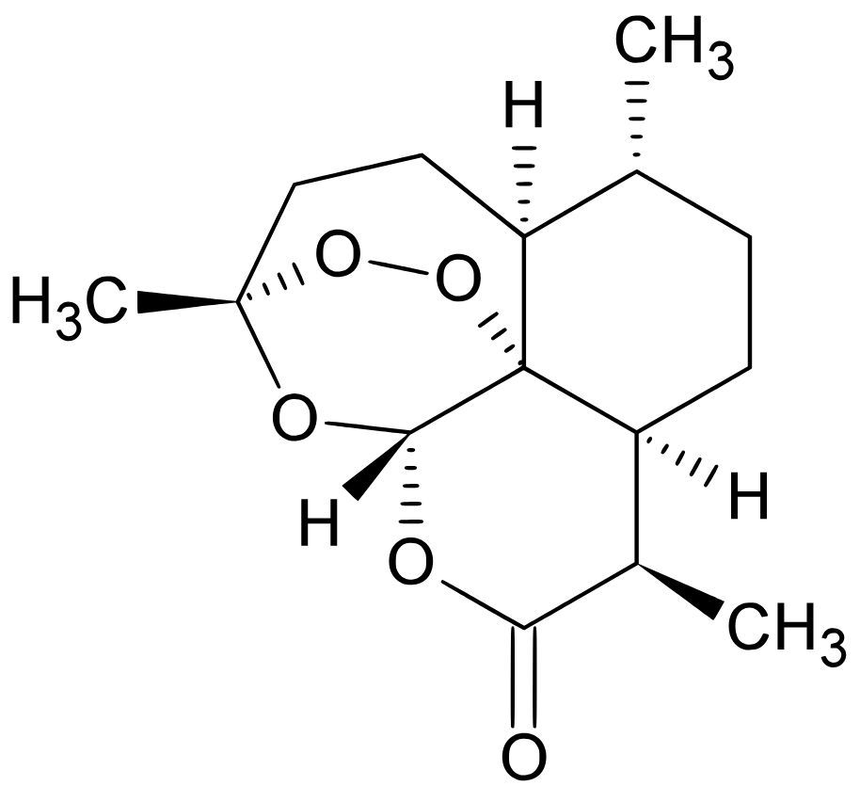
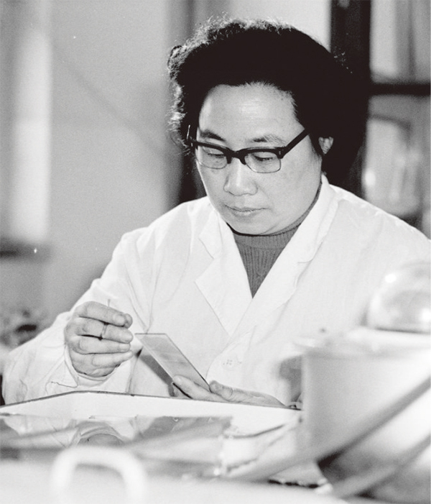
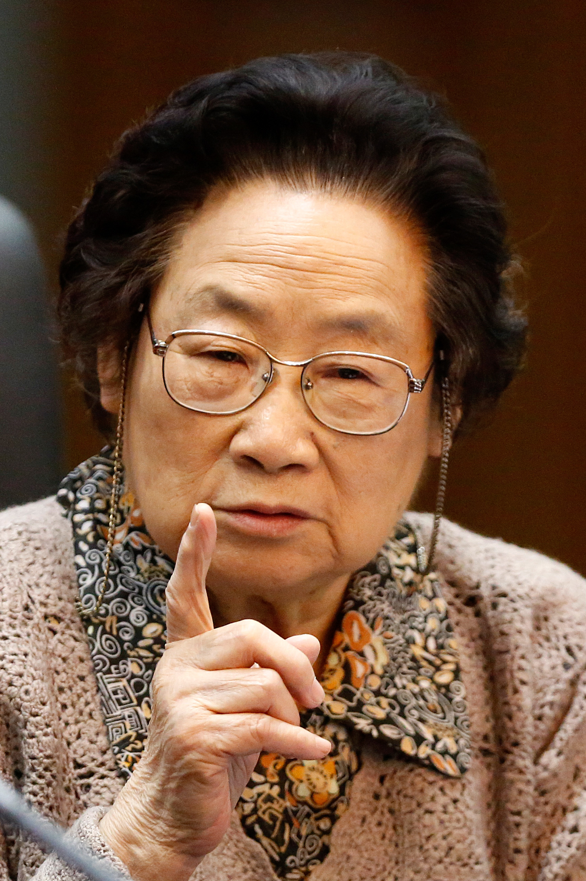
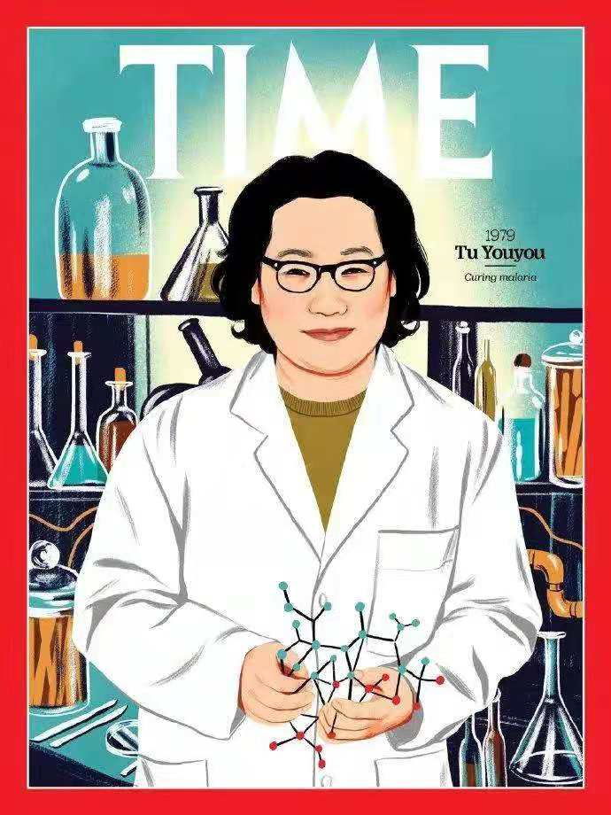
A person of great value

Slide 6
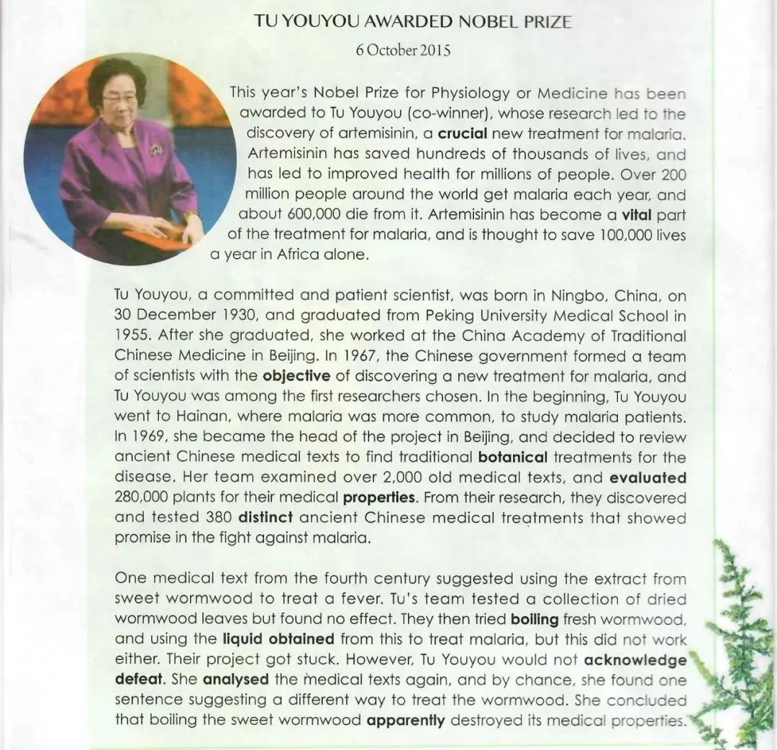
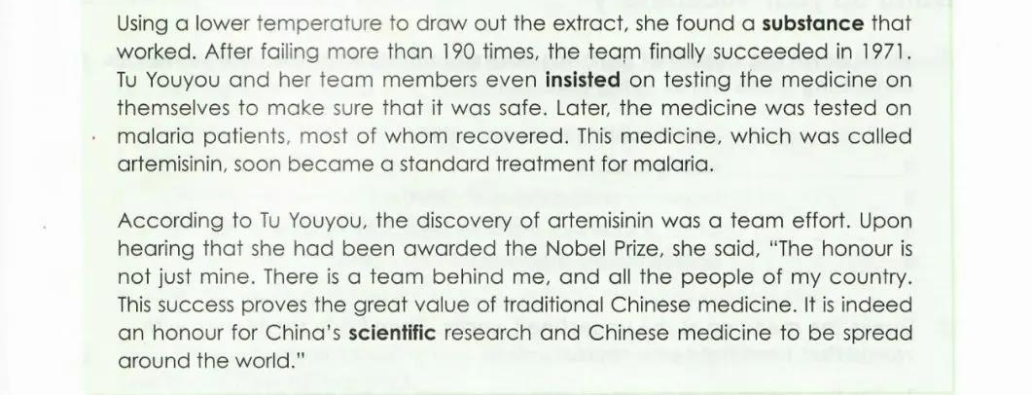
Where would you most likely find this passage?
The title
The date
News
In a newapaper
Story
The passage
News story
Story
The illustrations
News

Slide 7
P1: What's the news about?
Tu Youyou has been awarded this year's Nobel Prize for Physiology or Medicine for the discovery of artemisinin, a crucial new treatment for malaria.
malaria
over 200 million people around the world get malaria each year
A serious disease carried by mosquitoes, which causes periods of fever & shivering .
about 600, 000 die from it
artemisinin
has saved hundreds of thousands of lives
has led to improved health for millions of people
A crucial new treatment for malaria.
has become a vital part of the treatment for malaria
is thought to save 100, 000 lives a year in Africa alone

Slide 8
P2: Tu Youyou's personal profile & her study
Tu Youyou's personal profile
Birthplace
Birthdate
Education
Occupation
Personality
Her Mission
Ningbo, China
30 December 1930
graduated from Peking University Medical School
worked at the China Academy of Traditional Chinese Medicine in Beijing
committed and patient
To discover a new treatment for malaria
went to Hainan to study malaria patients
Fieldwork
examined over 2, 000 ancient Chinese medical texts
Her study
Literature rewiew
evaluated 280, 000 plants
discovered and tested 380 distinct ancient Chinese medical treatments
Proof test

Slide 9
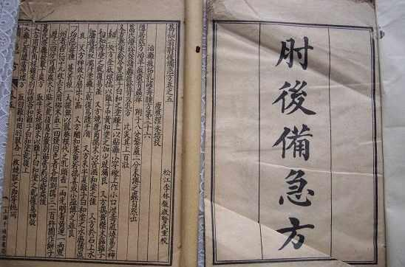
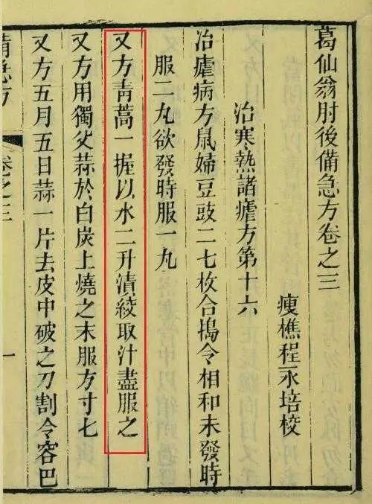
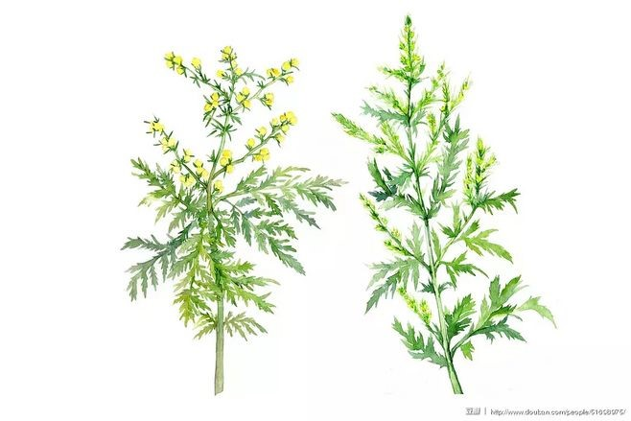
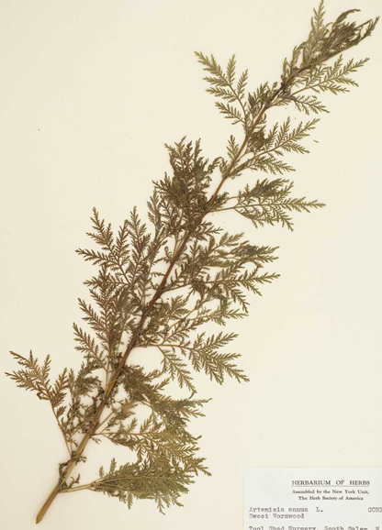
P3: Tu Youyou & her team's experiment
tested dried wormwood leaves
tried boiling fresh wormwood
Used a lower temperature to draw out the extract
failed more than 190 times
finally succeeded
tested the medicine on themselves

Slide 10
P3: How can you understand that Tu Youyou is a committed and patient scientist?
Personality | Supporting facts
committed
patient
In 1967, the Chinese government gave the mission to discover a new treatment for malaria.
In 1971, she finally succeeded.
She would not acknowledge defeat.
She analysed the medical texts again.
Tu Youyou and her team members even insisted on testing the medicine on themselves to make sure that it was safe.
examined over 2, 000 old medical texts
evaluated 280, 000 plants
discovered and tested 380 distinct ancient Chinese medical treatments
failed more than 190 times

Slide 11
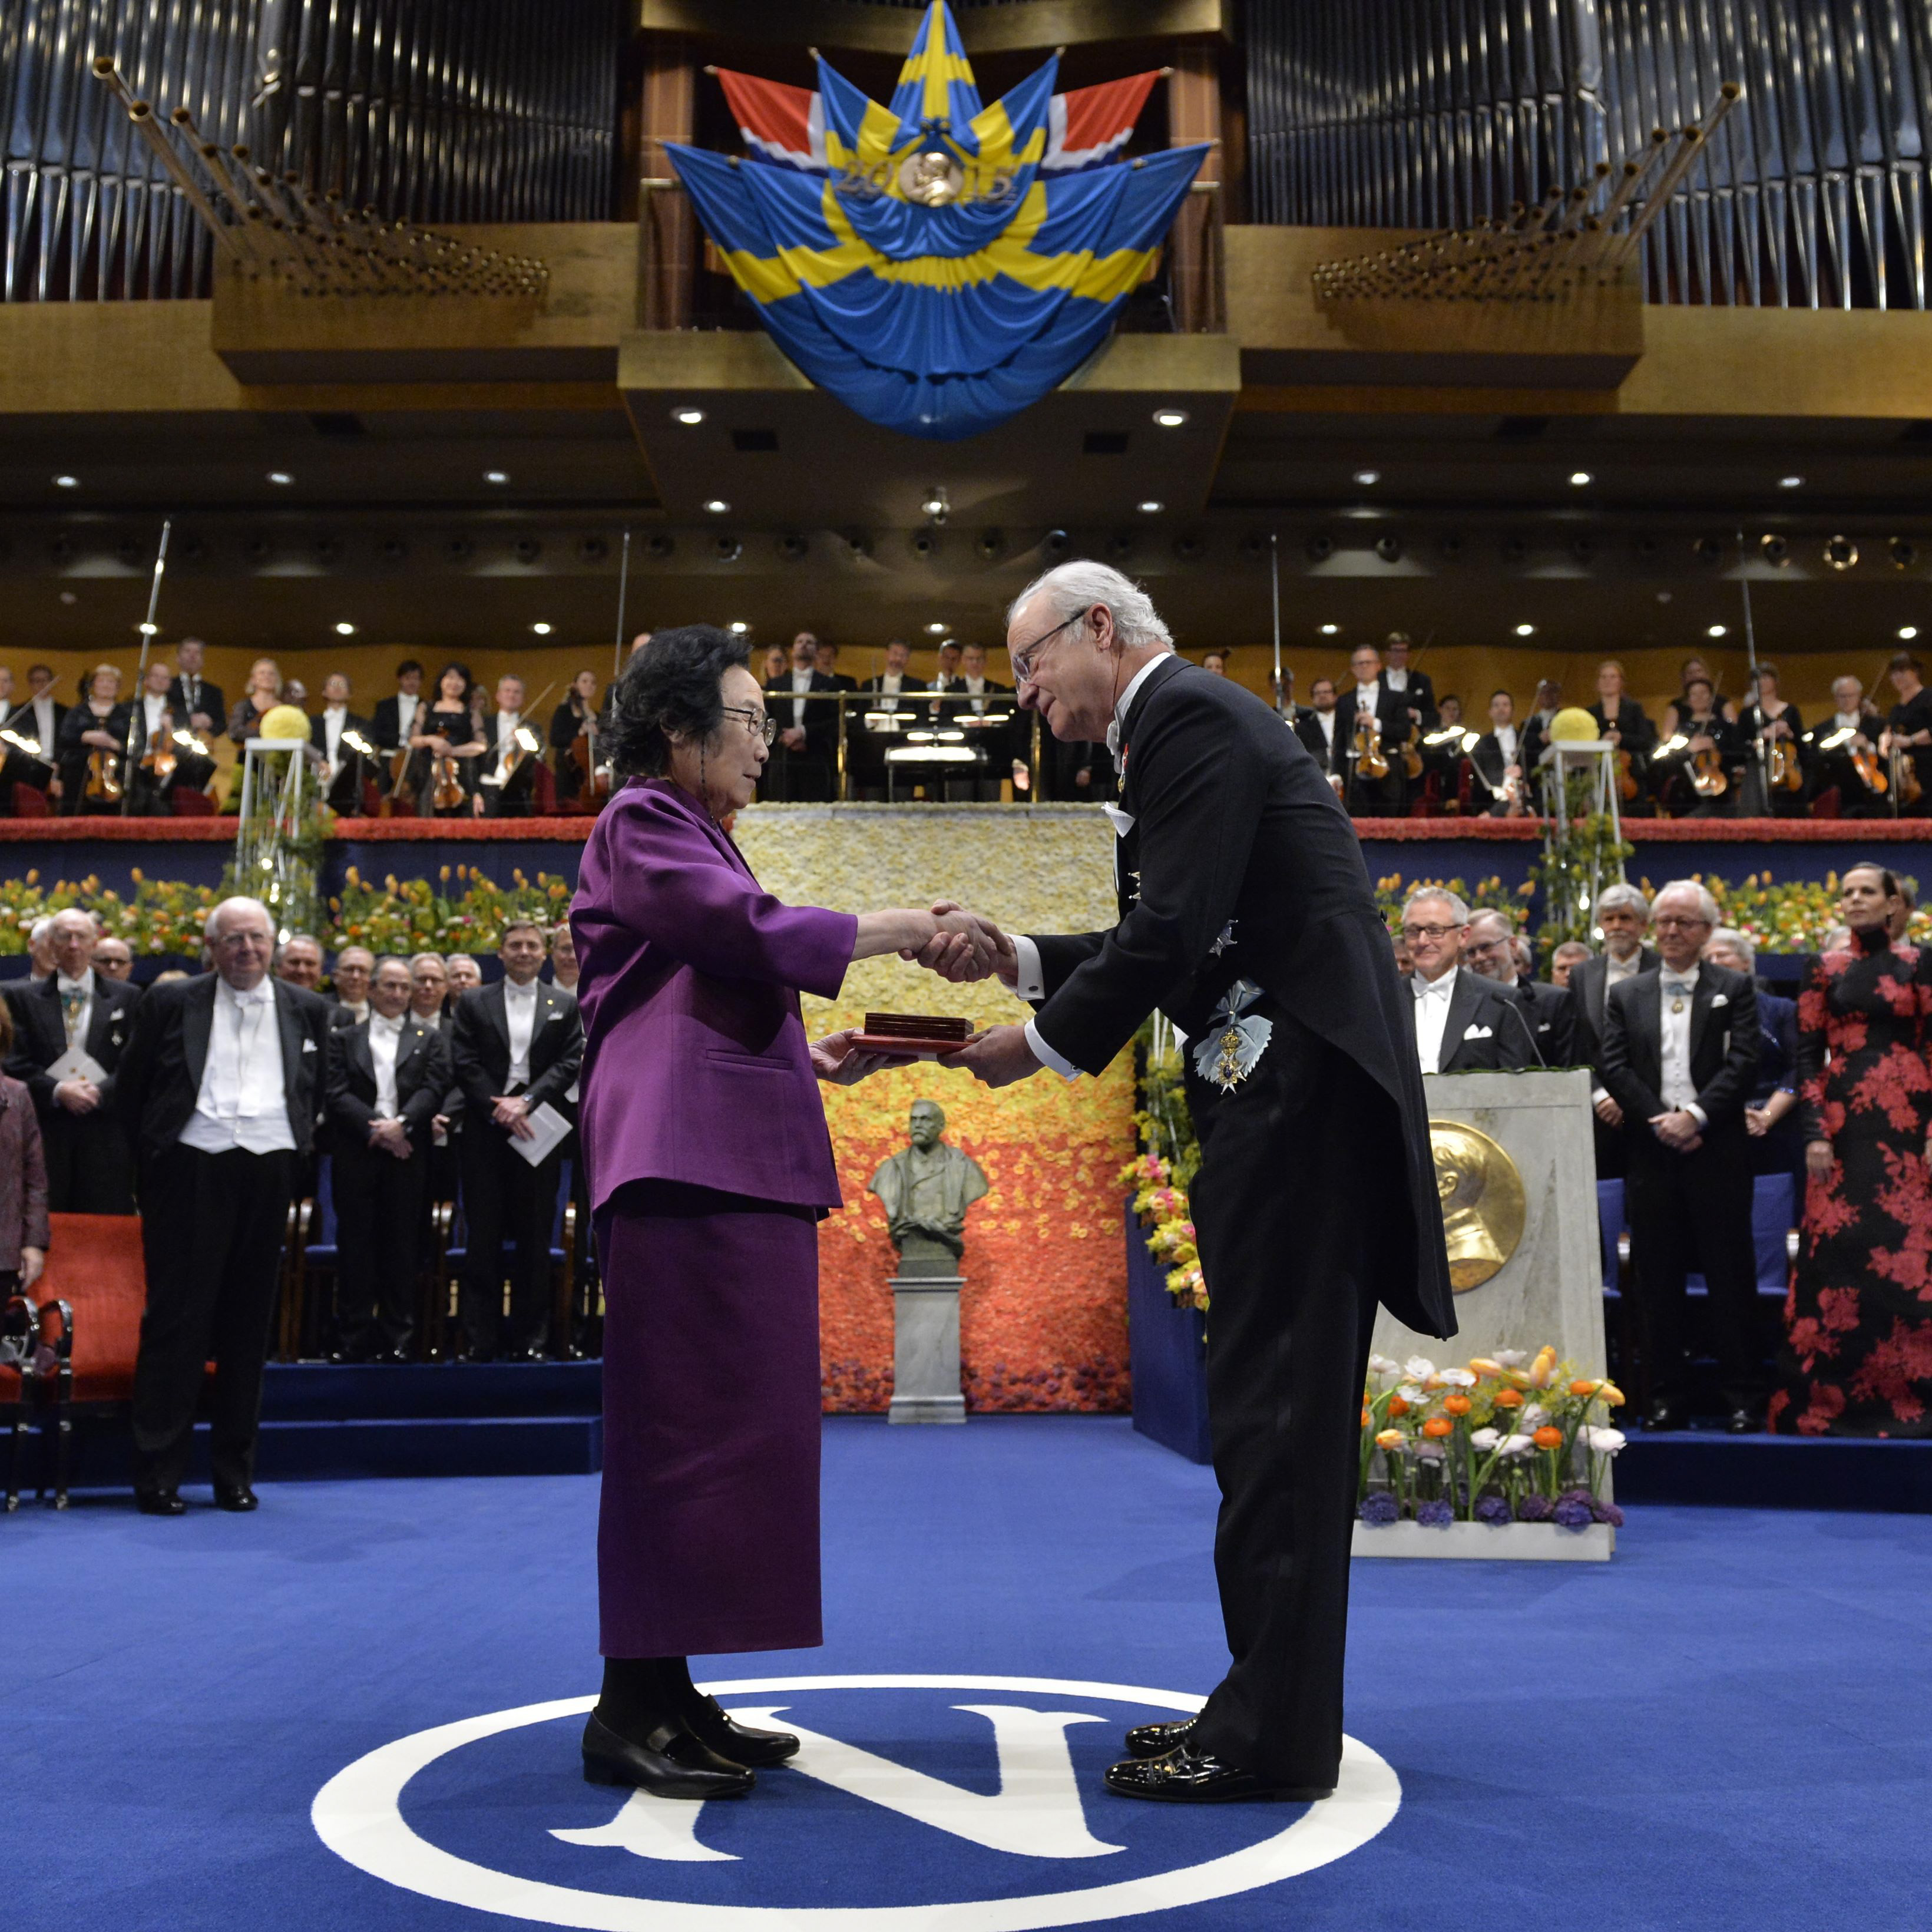
P4: What's Tu Youyou's attitude towards the Nobel Prize?
The honour is not just mine. There is a team behind me, and all the people of my country. This success proves the great value of traditional Chinese medicine. It is indeed an honour for China’s scientific research and Chinese medicine to be spread around the world.
The team effort/cooperation
The wisdom of Chinese people
The rigorous scientific research
The great value of traditional Chinese medicine
The enxtensive and profound Chinese culture
Tu Youyou's committed and patient personalities

Slide 12
Video appreciation：BBC names Tu Youyou as icon of 20th Century

Slide 13
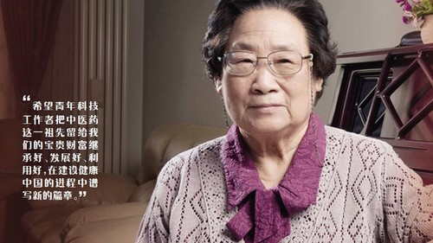
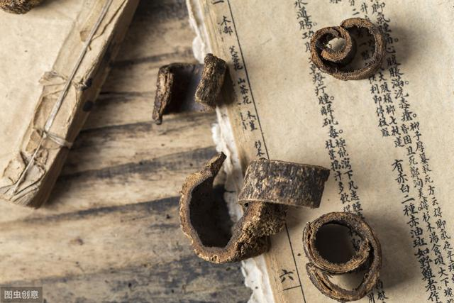
Further thinking: After knowing Tu Youyou's news and story, what impresses you most? State your reasons.
The team effort/cooperation
The wisdom of Chinese people
The rigorous scientific research
The great value of traditional Chinese medicine
The enxtensive and profound Chinese culture
Tu Youyou's committed and patient personalities

Slide 14
Thank you!

