Slide 1
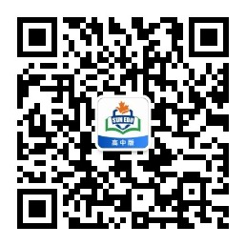
感恩遇见，相互成就，本课件资料仅供您个人参考、教学使用，严禁自行在网络传播，违者依知识产权法追究法律责任。
更多教学资源请关注
公众号：溯恩高中英语
知识产权声明

Slide 2
高中英语应用文写作 询问/咨询信
A Letter of Inquiry
杭州二中 许丽君

Slide 3
Teaching
Goals
After Teaching this lesson, you will
learn about the format and contents of letters;
write the Inquiry completely and clearly;
make your writing more accurate;
know what a good letter of Inquiry is like
master Three Criteria of Inquiry Letters-To be appropriate/concise/To get to the point

Slide 4
Lead in
When do you want to write letters of Inquiry?
Inquiry on advice
Inquiry on appointments
Inquiry on meetings
Inquiry on interviews
Inquiry on personal assistance
Inquiry on contributions
Inquiry on donations

Slide 5
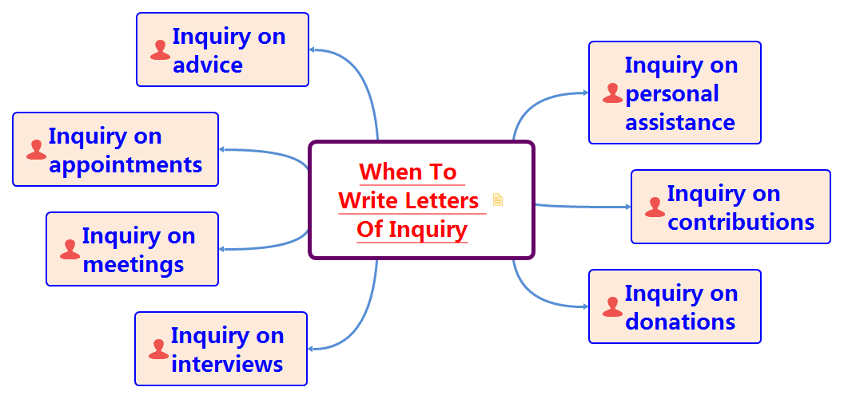


Slide 6
 Address Letters of Inquiry to ➔Who is the recipient（receiver）?
teachers
professors
managers

Slide 7
 询问/咨询信：【写法指导】
询问/咨询信是针对某项活动或相关情况，希望了解详细信息的信件，表明写信人对某方面的信息感兴趣。询问/咨询信，问句较多，写时要避免句式单调，可利用一般疑问句、特殊疑问句、反义疑问句、选择疑问句使句式更丰富，也可用间接引语提问。

Slide 8
What should be included in a letter of Inquiry?
Dear ______,
Beginning --- Purpose of writing the letter【写信意图-说明自己的计划或目的➔询问信息的原因】
➢Why are you writing the letter of Inquiry?
Body Arrangements---【咨询具体信息➔（提出要咨询的几个问题）➔具体例举+变换句式提问】
What information do you want to request?
List the questions you want to inquire?
Ending --- 【期待回复并表示感谢➔表达愿望】
Yours faithfully
***
Layout

Slide 9
Part 1: Purpose of writing the letter【写信意图-说明自己的计划或目的➔询问信息的原因】
【Part 1首段】篇首介绍自己 (收信人非熟人)，说明咨询的主题。
1. I am writing to see if it is possible for you to provide me with information regarding / concerning…
我写信想知道你是否有可能提供我一些关于…的信息。
2. I’d like to acquire all the information relative to…
我想获得与…相关的所有信息。
3. I am writing to ask for more information about the English Contest.
我写信来询问更多关于英语比赛的消息。
4. I am writing for more information about the day tour to London.
我写信为了了解更多有关伦敦一日游的信息。
5. I am Li Hua, attracted by your online advertisement and I am keen to inquire more detailed information concerning...
我是李华，被你们网上广告吸引，我有兴趣了解关于…的具体信息。

Slide 10
Part 2: Body Arrangements 【咨询具体信息（具体列举+变换句式提问）】
【Part 2主体】篇中提出询问的几个问题，具体列举3至4项想要询问的问题，注意变换句式提问
1. As for the money you charge, does it cover the entrance fees for visiting the places listed?
至于你收取的费用，是否已包括参观所列的地方的门票费用呢？
2. It seems unclear to me that (where/how…) …
我似乎不太清楚…….
3. In addition，would you be so kind as to introduce the conditions of board and accommodations to me?
另外，你能向我介绍一下食宿条件吗？
4. There are some pieces of information that I’d like to share with you.
有一些消息我想要和你分享。
5. I want to ask whether the guides will provide accommodation for us.
我想问一下导游是否为我们提供食宿。

Slide 11
Part 3: Ending 【期待回复并表示感谢➔表达愿望】
 【尾段】表达愿望和感谢，并期待对方尽快回复， 注意礼貌。
1. You early reply will be highly appreciated.
你能早日答复， 我将不胜感激。
2. Could you be so kind as to send me some…on the above-mentioned aspects？
你能否寄一些与上述问题相关的资料给我？
3. I am looking forward to your immediate response.
期待你及时的回复。
4. By the way, do you need any other help? Please don’t hesitate to let me know.
顺便问一下，您需要其他的帮助吗？请不要犹豫，随时告知我们。
5. Thanks for your attention and looking forward to a favorable reply.
感谢您的关注，期待一个有益的答复。

Slide 12
Useful words and expressions
appeal
advise
advisable
assistance
audience
consider
contemporary
expertise
favor
furnish
feature
fiction
generous

Slide 13
Writing help: Useful phrases
additional information/time
expect a favorable response
appreciate any information
appreciate your cooperation
appreciate your help
by return mail
hope you are able to
if you can find time in your busy schedule to
I’m writing to ask you
interested in receiving information
interested in learning more about
I would appreciate your assessment of
look forward to hearing from you

Slide 14
Writing help: sentences
♥ 1. Thank you for your time and consideration.
谢谢你腾出时间考虑我的问题。
♥ 2. I am wondering if you have the time to give us a little guidance.
我想知道你是否有时间指导我们。
♥ 3. I have a favor to ask you, but I’m too shy to ask.
我想请你帮个忙，但我不太好意思开口。
♥ 4. Please forward this letter to the appropriate person.
请把这封信转发给合适的人。
♥ 5. Will you please send me a list of sth. you wanted.
你能给我一份你想要的东西的清单吗？

Slide 15
Writing Purpose：
Dear ____, (对象)
Beginning --- Purpose of writing the letter【写信意图-说明自己的计划或目的➔询问信息的原因】
➢Why are you writing the letter of Inquiry?
I’m __________ (自我介绍)．Having read _________(信息来源)， I feel interested and want to join_______（活动）. I am writing to see if it is possible for you to provide me with some specific information concerning ________（要咨询的内容要点）.
Body Arrangements---【咨询具体信息➔（提出要咨询的几个问题）➔具体列举+变换句式提问】
What information do you want to request?
List the questions you want to inquire?
First of all, could you be kind enough to tell me ________ (咨询问题一)？ Besides, I would also like to know ________ (咨询问题二). In addition, I wonder________ (咨询问题三). Also，it seems unclear to me that______________ (用不同的句式提出询问)
Ending --- 【期待回复并表示感谢➔表达愿望】
Thank you for your reading, and your prompt reply to this letter will be highly appreciated.
Yours Sincerely / Faithfully/ Truly,
________________
writing
pattern

Slide 16
Work in groups of four. Each student read the article and others comment on others’ article. Then choose the best one to present in the class. When you are discussing, you can pay attention to the following hints.
Evaluation
Goal | Have you made the purpose clear?
Frame structure | Does the structure conform to the requirements?
Language | Are the sentences concise and accurate? Have you used the proper punctuation, words, sentences and paragraphs to convey yourself?
Main points | Have you included all the points of view?
Proper details | Are the details suitable?
three Criteria of Inquiry | Does the letter meet three Criteria of Inquiry Letters-To be appropriate/concise/To get to the point?

Slide 17
应用文写作— 询问/咨询信
参考范文

Slide 18
【2014全国新课标1卷】假定你是李华，计划暑假期间去英国学习英语，为期六周。下面的广告引起了你的注意，请给该校写封信，询问有关情况（箭头所指内容）。
注意：1．词数80左右；
2．可适当增加细节，以使行文连贯。
3. 参考词汇：住宿——accommodation
咨询信1

Slide 19
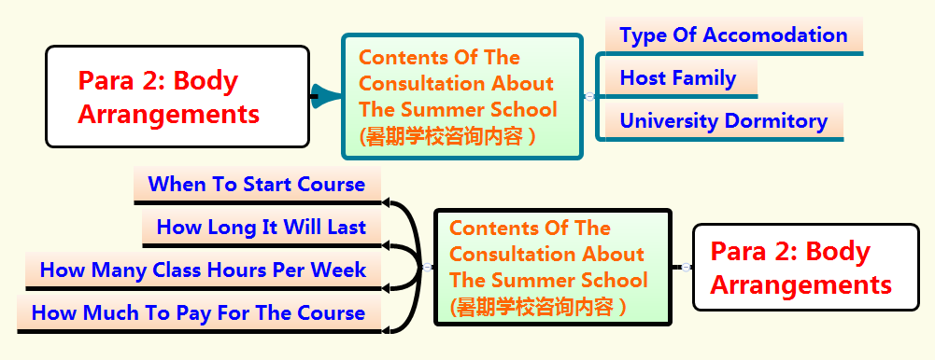
咨询信1

Slide 20
咨询信1
Writing Sample-1
Dear Sir / Madam,
①I am a student in China and I plan to go to Britain to attend a summer school during the vacation. I’ve seen your ad, and I’d like to know something more about your six-week English course. ②First, when will the course start and how many class hours are there per week? Besides, I wish there would not be too many students in a class. I’d also like to know how much I have to pay for the course and whether accommodation is included. ③More importantly，Would there be a host family or university dormitory?
I am looking forward to your early reply.
Yours faithfully
Li Hua

Slide 21
咨询信1
Writing Sample-2
Dear Sir/Madam，
I am a student in China and I plan to go to Britain to attend a summer school during the vacation. I am writing to see if it is possible for you to provide me with information regarding your six-week English course. (点出要询问的内容)
To begin with(引出要询问的问题), could you be so kind as to tell me when the course will start and how many class hours are there per week? Also, what about the class size? I wish there wouldn’t be too many students in a class, in which case students can get more attention. Additionally, I'd also like to know how much I have to pay for the course and whether accommodation is included. Also, I wonder if there would be any host families or university dormitories.
Thank you for your kindness, and your prompt attention to this letter will be highly appreciated.(对阅信人表达感谢)
Yours faithfully,
Li Hua

Slide 22
咨询信1
 Writing Sample-3
Dear Sir/Madam,
①My name is Li Hua and I am a student from China. I saw your advertisement on the Internet and I would like to attend the six-week English course you offer during my summer vacation. I am writing to ask for more information about it.
②First of all, I’d like to know when the classes will start and how many students there will be in a class. what’s more, how many course hours per week will there be? Additionally, how much is the course? Finally, what types of accommodation will you provide? ③Personally, I’d prefer a quiet room where I can sleep alone. Is this possible?
I’m looking forward to hearing from you.
Yours sincerely，
Li Hua

Slide 23
咨询信2
假定你是李华，下周三美国Rossell高中的访问团将来你校参观交 流，作为校学生会主席，请给对方联系人Elizabeth写一封邮件，询问对方相关事宜。内容包括：
1．日程安排；
2．饮食习惯；
3．其他要求。
注意：
1．词数80左右；
2．可以适当增加细节，以使行文连贯。

Slide 24
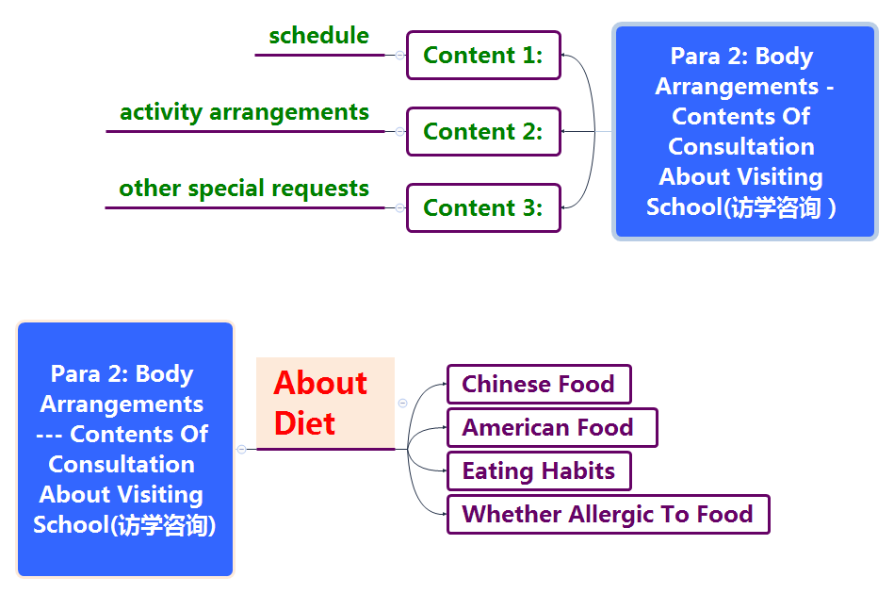
咨询信2

Slide 25
咨询信2
Writing Sample
Dear Elizabeth，
I'm president of the student union of our school. We are more than happy that your group from Rossell High School will come for a visit.
I have some questions to ask you before your arrival so that we could make your visit go smoothly. First and foremost, could you please share your schedule of the visit? So we can get well-prepared for it accordingly in advance. Besides, both Chinese and American food will be offered during your visit. So please let us know whether there is something that any of you are allergic to. Finally, please inform me of other special requests you might have.
Please favor me with an early reply, looking forward to meeting you next Wednesday.
Yours sincerely，
Li Hua

Slide 26
THANKS

