Slide 1
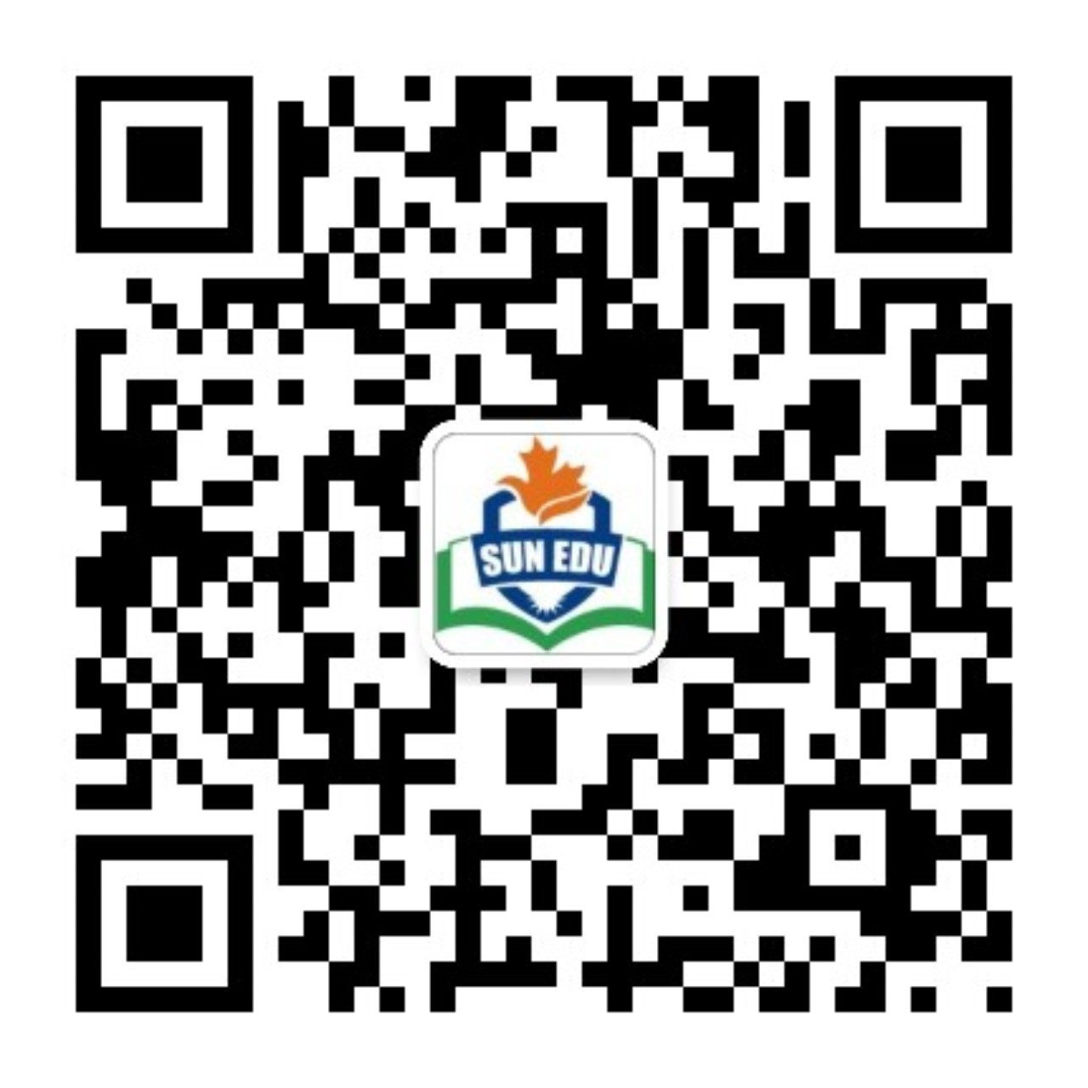
感恩遇见，相互成就，本课件资料仅供您个人参考、教学使用，严禁自行在网络传播，违者依知识产权法追究法律责任。
更多教学资源请关注
公众号：溯恩英语
知识产权声明

Slide 2
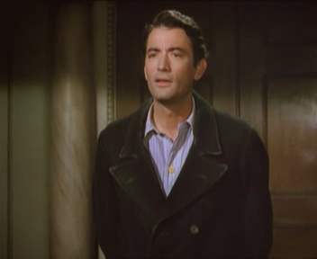
B3U5
Reading and thinking
--- language study
The Million Pound Bank Note

Slide 3
Reading I
Gap-filling

Slide 4
Young man, _____ you step inside a moment, please？
---You mustn’t worry about that. It’s an advantage.---- I’m afraid I don’t quite ___ you, sir.
I worked for a ____ （采矿）company.
___ we ask what you’re doing this country and what your plans are?
As a matter of fact, I ___ (登陆)in Britian by accident.
I found myself ______ (carry) out to sea by a strong wind.
The next morning I was _____ (发现)by a ship.
If___ ___ ____(请原谅), I ought to be on my way.

Slide 5
If ___ ___ ____(请勿介意), may I ask you how much money you have?
Well, to be honest, I have ______.(我没钱）
--- Oliver, give him the letter.
---I ____ ____ ____ go get the letter.(我刚要去取信)
12. Oh, no. I don’t want your _____.（施舍）
13. _____ Mr Adams ____. (领…出去)
14. You’ll soon know. ___ exactly an hour and half. (1.5小时后)
15. It was the ship ___ brought you to England.(也就是这艘船带你来英国的。）
16. I went to the _____ _____(美国领馆） to seek help.

Slide 6
Young man, _____ you step inside a moment, please？
---You mustn’t worry about that. It’s an advantage.---- I’m afraid I don’t quite ___ you, sir.
I worked for a ____ （采矿）company.
___ we ask what you’re doing this country and what your plans are?
As a matter of fact, I ___ (登陆)in Britian by accident.
I found myself ______ (carry) out to sea by a strong wind.
The next morning I was _____ (发现)by a ship.
If___ ___ ____(请原谅), I ought to be on my way.
would
follow
mining
May
landed
carried
spotted
You’ll excuse me

Slide 7
If ___ ___ ____(请勿介意), may I ask you how much money you have?
Well, to be honest, I have ______.(我没钱）
--- Oliver, give him the letter.
---I ____ ____ ____ go get the letter.(我刚正要去取信)
12. Oh, no. I don’t want your _____.（施舍）
13. _____ Mr Adams ____. (领…出去)
14. You’ll soon know. ___ exactly an hour and half. (1.5小时后)
15. It was the ship ___ brought you to England.(也就是这艘船带你来英国的。）
16. I went to the _____ _____(美国领馆） to seek help.
You don’t mind
none
was about to
charity
Show out
In
that
American consulate
For the dictation!

Slide 8
1. Two rich brothers, Roderick and Oliver, have made a bet.
Let’s make a bet ______ the next election.
on
n.
make a bet
win a bet
lose a bet
betting
Mrs. Black spent all her money ________ (bet) on horses.
I bet that they will win the next election
v.
bet on sth.
bet that …
I’m sure that …
---Are you going to the match?
--You bet (I am)!”
“当然（我去）!”
=emphasize a statement or to mean 'certainly'

Slide 9
2. Review of object complement.
waiting for a long time.
I have kept you ______________________
(我已经让你等很久了。）
2. They caught him ________________
(他们当场抓住他在做坏事。）
3. He couldn’t make _______________________.
（他不能让别人相信他。）
4. Her remark left me _______________________.
(他的话让我一直在思考这个事。）
5. I found myself _____________________________.
(我发现我自己被一阵大风刮到了海上。）
6. I found the city __________________.
(我发现这个城市变化很大。）
doing bad deeds.
himself believed by others.
thinking about the matter.
carried out to sea by a strong wind
greatly changed.

Slide 10
3. The next morning I ______________ (spot) by a ship.
was stopped
4. It was the ship _________ brought you to England.
that
It is/was … that…强调句型
He set out at once because the rain stopped.
It was because the rain stopped that that he set out at once.
He didn’t find the key until he opened the drawer.
It was not until he opened the drawer that he found the key.
not …until 句型中，强调状语从句时，主句中的not要放在 until之前。

Slide 11
I went to the American consulate to seek help, but…
v. –sought--sought
1) 请求(帮助);
征求(意见)
2) seek one’s fortune 寻出路
He sought to make fool of others but failed.
3) seek to do=try to do sth.力图;想方设法

Slide 12
Summary of the scene
Ex 5 on P53.

Slide 13
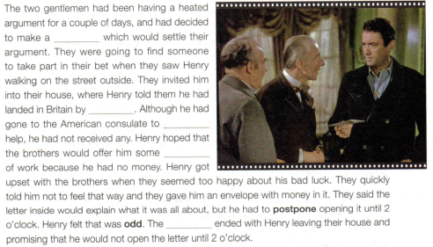
bet
accident
seek
sort
scene

Slide 14
1. postpone v. put off 延迟；延期
They said the letter inside would explain what it was all about, but he had to postpone _________(open) it until 2 o’clock.
opening
postpone sth.
postpone doing sth.
postpone sth. until/to +时间

Slide 15
2. Henry felt that was odd.
adj. strange; unusual
奇怪的；怪异的
It seems odd that nobody noticed anything wrong.
that cannot be divided exactly by the number two 奇数的– opposite: even
1, 3, 5 and 7 are odd numbers.
odd
the odd man/one out
与其他不同的人（或物）
odds and ends
零碎; 小玩意

