Slide 1
感恩遇见，相互成就，本课件资料仅供您个人参考、教学使用，严禁自行在网络传播，违者依知识产权法追究法律责任。
更多教学资源请关注
公众号：溯恩英语
知识产权声明

Slide 2
2024年青岛一模应用文讲评
“五步法”突破高考英语应用文写作
实
践
活
动
课

Slide 3
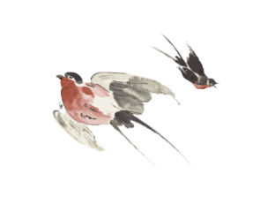
原题再现
行业PPT模板http://www.1ppt.com/hangye/
【2024年3月青岛一模】假定你是李华，你校今年开设了蔬菜栽培、传统工艺(handcraft)等实践课程。请你给外国好友Iohn写一封邮件，内容包括
1.你的参与情况:
2.你的体会。
注意:
1.写作词数应为80左右;
开头和结尾已给出，不计入总词数

Slide 4
行业PPT模板http://www.1ppt.com/hangye/
应用文写作“五步法”
美卷面
细检查
2
定时态
拓细节
4
理头绪
慢审题
5
1
明结构
列要点
3
变句型
换用词

Slide 5
Step I 理头绪 慢审题
邮件—事情告知
【2024年3月青岛一模】假定你是李华，你校今年开设了蔬菜栽培、传统工艺(handcraft)等实践课程。请你给外国好友Iohn写一封邮件，内容包括
1.你的参与情况:
2.你的体会。
注意:
1.写作词数应为80左右;
开头和结尾已给出，不计入总词数
体 裁
李华—学校实践课程参与学生
写作身份
好朋友，可以问候，不用自我介绍
写作对象
外国好友John
介绍自己参与的校实践课
主题语境
人称
第一人称

Slide 6
Step II 明结构 列要点
greeting & writing purpose (share the content of the course)
Para.1
Point 1: course introduction & your participation
Point 2: feelings and inspirations
Para.2
Structure
Para.3
ending (wishes and blessings )

Slide 7
Step III 定时态 拓细节
greeting & writing purpose (share the content of the course)
一般现在时
Para.1
Point 1: course introduction & your participation
Point 2: feelings and inspirations
一般过去时
Para.2
Structure
一般过去时&现在完成时
Para.3
ending (wishes and blessings )
一般现在时

Slide 8
Step III 定时态 拓细节
1. greeting
(1) How is everyting going with you?
(2) I hope this email finds you in good spirits.
(2) How is life treating you?
greeting & writing purpose (share the content of the course)
Para.1
2. writing purpose
1) I’d like to tell you something concerning...
2) I'm excited to share (with you) that our school has introduced/launched practical courses this year, (including ... and ...)
3) I wanted to share something exciting from my school.
Para.2
Structure
Para.3

Slide 9
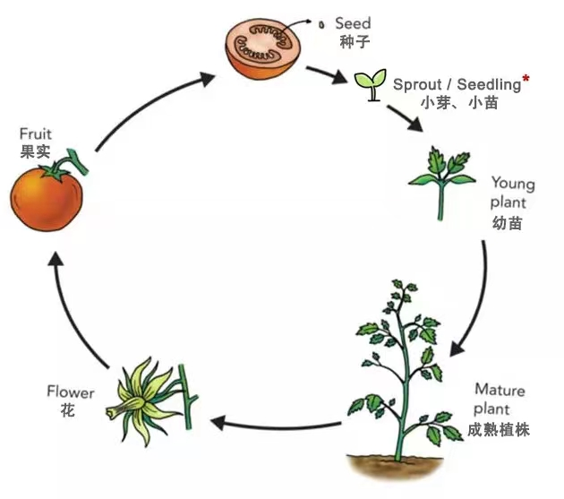
Step III 定时态 拓细节
Course Introduction
1. vegetable planting class
选种子
挖土
把种子放到土里
在种子上盖上一些土
浇水
除草
施肥
收获
Para.1
pick some seeds
scoop some soil
put a few seeds into the soil
Para.2
Structure
place some more soil on the top of seeds
water
Para.3
weed
fertilize
harvest

Slide 10
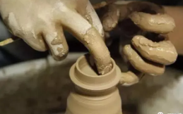
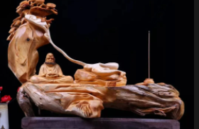
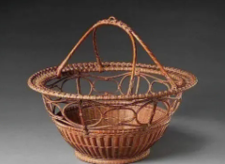
Step III 定时态 拓细节
Course Introduction
2. handcraft class
Para.1
Para.2
Structure
陶瓷
pottery and porcelain
木雕
wood carving
Para.3
竹编
Bamboo Weaving
剪纸
paper-cutting

Slide 11
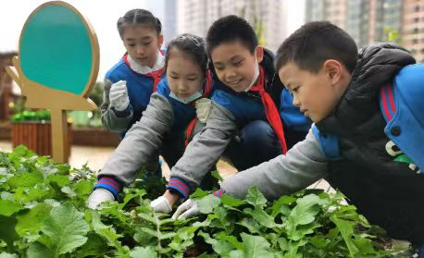
Step III 定时态 拓细节
course content
1) I took ...course and learned ...
2) In the ... course, I learned to ..., understanding the process from ... to .... In the ... class, I've started learning how to ...
3) In the ... class, I've learned how to ..., which has been incredibly rewarding. It's amazing to see ...
On the..., I've been exploring the art of ...
Para.1
Para.2
Structure
Para.3

Slide 12
Step III 定时态 拓细节
inspiration & realization
1. vegetable planting class
Para.1
relieve study stress 减缓活动压力
cultivate a healthy lifestyle 培养健康的生活方式
Para.2
contribute to personal fulfillemt 有助于个人成就感
Structure
promote comprehensive/all-round development 促进综合全面发展
Para.3
have a deeper understanding of the value of labor 对劳动的价值有了更深的认识
enhance physical well-being 增强身体

Slide 13
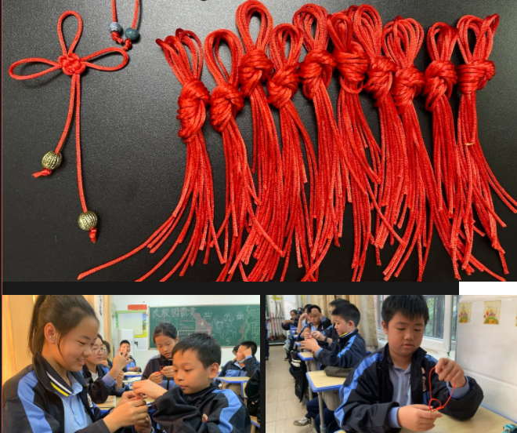
Step III 定时态 拓细节
inspiration & realization
2. handcraft class
Para.1
immerse oneself in the rich cultural heritage
沉浸于丰富的文化遗产中
preserve/safeguard the intangible cultural heritage 将文化遗产传承给后代
Para.2
Structure
contribute to the preservation of cultural treasures
为文化珍宝的保护做出贡献
Para.3
facilitate our understanding of Chinese culture
更好地了解中国文化
lead us into a world of creativity and discovery
带领进入创造和发现的世界

Slide 14
Step III 定时态 拓细节
ending
1. If you are interested in the courses, I will share with you more.
2. It’s been a journey of growth, learning, and discovery, one that I’m eager to share more about with you in the future.
3. I sincerely hope you can come and enjoy the course together.
4. Please drop me a line if you are interested in it. Looking forward to your reply.
Para.1
Para.2
Structure
Para.3

Slide 15
Step IV 变句型 换用词
句式升级 1： 定语从句
1. 我参加了蔬菜种植课，学会了如何种植蔬菜。通过这个课程，我了解了挑选种子，用土壤掩埋种子以及收获果实的过程。
I took the vegetable planting course and learned how to grow vegetables. From the course, I understood the process of picking some seeds, placing some more soil on the top of seeds and harvesting the fruits.
I took the vegetable planting course and learned how to grow vegetables. from which I understood the process of picking some seeds, placing some more soil on the top of seeds and harvesting the fruits.

Slide 16
Step IV 变句型 换用词
句式升级 2： 非谓语
2. 在传统工艺课中，我学会了如何用手制作传统手工艺，比方说木雕，剪纸，陶瓷，竹编等。
In the handcraft class, I learned the process of creating traditional crafts with my own hands, such as wood carving, paper cutting,pottery and porcelain and bamboo weaving.
In the handcraft class, I learned the process of creating traditional crafts with my own hands, ranging from wood carving, paper cutting,pottery to porcelain and bamboo weaving/including wood carving, paper cutting,pottery and porcelain and bamboo weaving.

Slide 17
Step IV 变句型 换用词
句式升级 3： 倒装句式
3. 参加这些实践课程不仅让我加深了对劳动的了解，还让我沉浸在用双手创造手工的喜悦中。
Attending those practical courses not only helped me have a deeper understanding of the value of labor, but also allowed me to experience the joy of creating something with my own hands.
Not only did attending those practical courses help me have a deeper understanding of the value of labor, but also allowed me to experience the joy of creating something with my own hands.

Slide 18
Step IV 变句型 换用词
句式升级 4： 强调句型
4. 这次的体验增强了我的身体， 促进了我的综合全面发展，并带我领进入创造和发现的世界。
This experience enhanced my physical well-being，promoted my comprehensive development and led me into a world of creativity and discovery.
It was this experience that enhanced my physical well-being，promoted my comprehensive development and led me into a world of creativity and discovery.

Slide 19
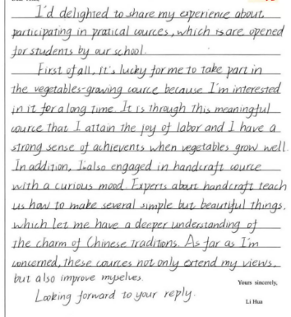
Step V 美卷面 细检查
学生习作 1：
时态错误

Slide 20
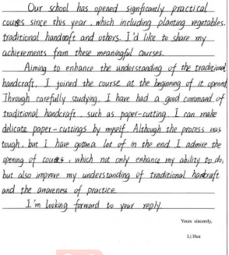
Step V 美卷面 细检查
学生习作 2：
从句谓语错误

Slide 21
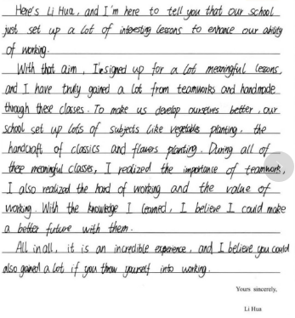
Step V 美卷面 细检查
学生习作 3：
书写不工整

Slide 22
One possible version:
Dear John,
How is everyting going with you? Aiming at relieving our study stress and enriching our school life, our school opened two practical courses this year, including vegetable planitng course and traditional handcrafts course.
In the vegetable planting course, I learned how to grow vegetables, from which I understood the process of picking some seeds, placing some more soil on the top of seeds and harvesting the fruits. Meanwhile, in the handcraft class, I learned the process of creating traditional crafts with my own hands,ranging from wood carving, paper cutting,pottery to porcelain and bamboo weaving.
Not only did attending those practical courses help me have a deeper understanding of the value of labor, but also allowed me to experience the joy of creating something with my own hands.
Please drop me a line if you are interested in it. Looking forward to your reply.

Slide 23
真题强化
行业PPT模板http://www.1ppt.com/hangye/
（2019年新课标全国卷II）假定你是校排球队队长李华。请写封邮件告知你的队友Chris球队近期将参加比赛，内容包括：
1.比赛信息；
2.赛前准备；
3.表达期待。

Slide 24
One possible version:
Dear Chris,
How is everything going? I have good news to tell you. A volleyball match is going to be held in a few weeks and our team will participate.
As for the detailed information of the match, there will be probably dozens of teams which are going to make a revolving competition. Additionally, not only can the top three teams each be awarded a medal but all the other teams taking part in it will get a reward as well. What will be the most attractive is that it will be a great honor for the top three teams to receive special volleyballs that have the name of the most popular volleyball player on them. Therefore, we must do enough preparations before the match, such as training as frequently as we can.
So excited am I that I can’t wait to join in it. How about you? Looking forward to your reply.
Yours,
Li Hua

