Slide 1
感恩遇见，相互成就，本课件资料仅供您个人参考、教学使用，严禁自行在网络传播，违者依知识产权法追究法律责任。
更多教学资源请关注
公众号：溯恩英语
知识产权声明

Slide 2
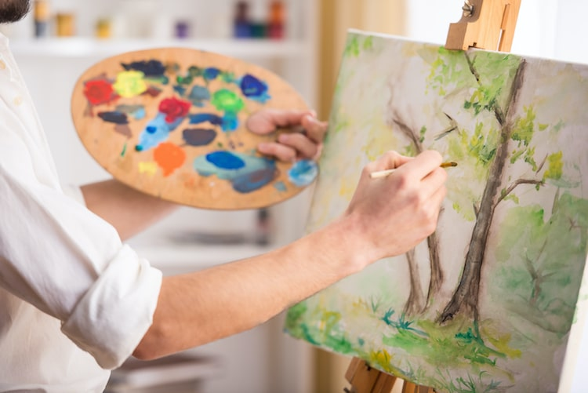

Slide 3
假定你是李华，你们班上周五在公园上了一节美术课，请给英国好友Chris写一封邮件分享你的经历，内容包括：
1. 你的作品内容；
2. 你的感想。
注意：
1. 写作词数应为80左右；
2. 请按如下格式在答题卡的相应位置作答。
文体
时态
对象
关键词
写作目的
邮件（明确格式）
上周五——一般过去时
好友Chris （开头寒暄；语言非正式）
在公园上了一节美术课；作品；感想
分享经历；描述作品；分享感受

Slide 4
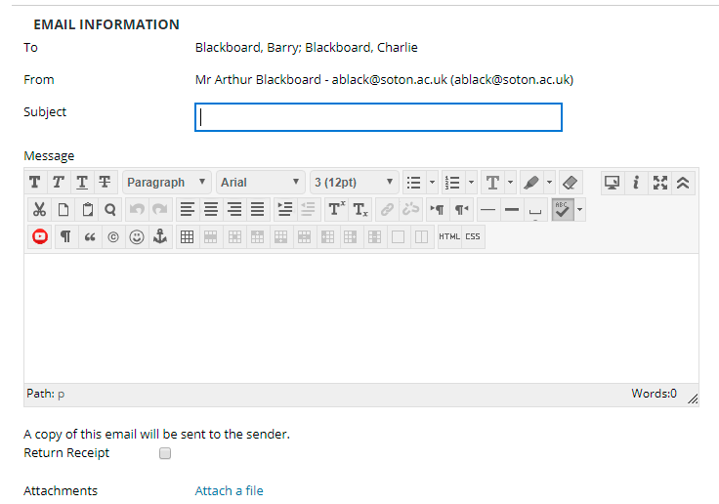
Chris
Li Hua
an art class in the park
Dear Chris,
I’m writing to share with you an art class I had in a park last Friday. All the students were meticulously drawing pictures/ embarking on an artistic journey.
❶ Any similar activities? Hope to hear from you soon!/Looking forward to hearing about your special stories.
(期待分享类似经历)
❷ Keep in touch and I’d like to know special courses in your school.
(期待分享独特课程)
❸ Attached is my painting. Hope it can give you a touch of nature’s serene and revitalizing essence. (分享画作和感受)

Slide 5
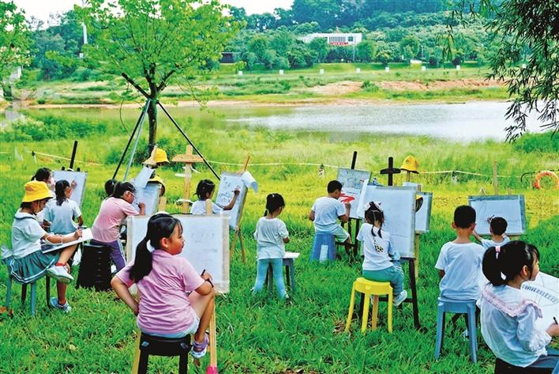
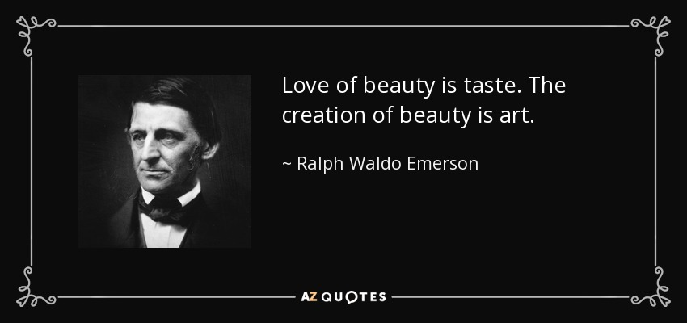
作画过程
你的作品内容；
你的感想。
what/ why/ how
形式/ 画作主题+背景/ 色调/ 风格/ 技巧？
特色？主题？
想要传递的emotion？
接近自然；户外体验；放飞想象力
总分结构
This experience was truly enriching. Being outdoors in nature allowed me to draw inspiration from my surroundings, which is something that I find difficult to replicate (复制) in a classroom setting.
This special art class in the park was a true delight where I not only learnt basic sketching techniques, but also let my imagination run wild/ creative spirit soar by getting closer to nature.
This one-of-a-kind art class has transformed me both on and off the canvas (画布) as I explored authentic self-expression, creativity/ aesthetic inspiration and artistic technique in the park.

Slide 6
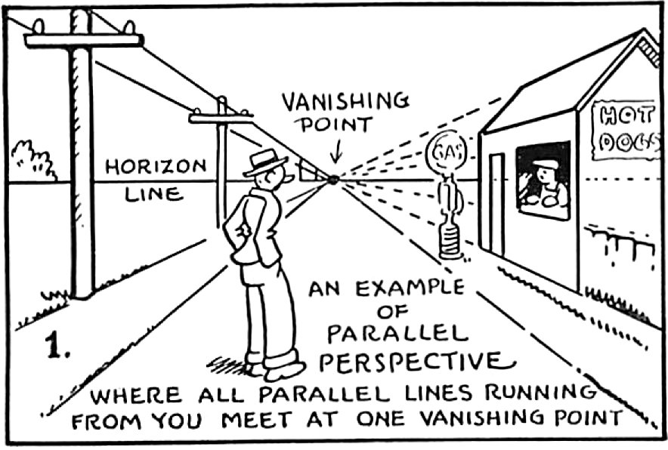
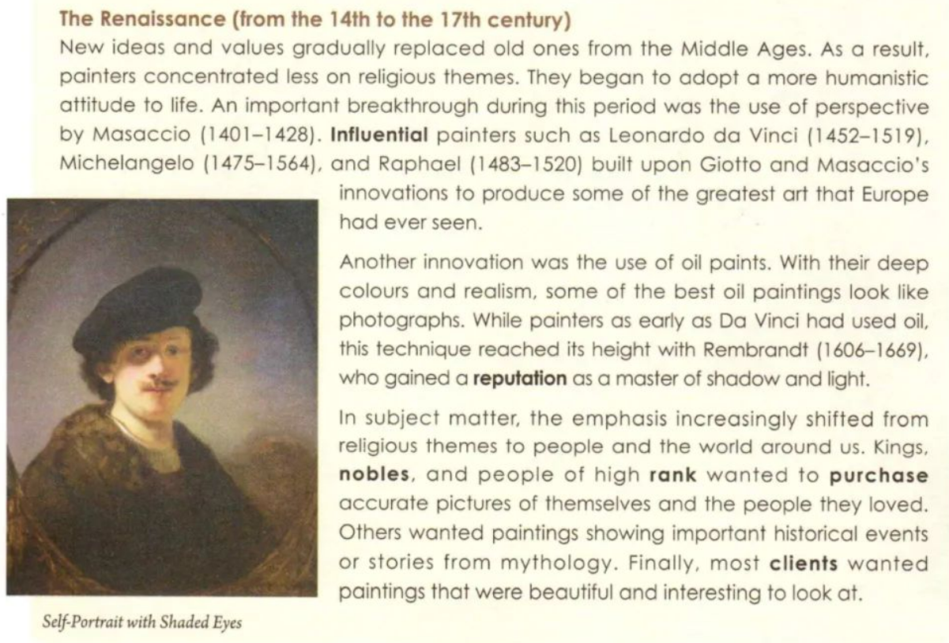
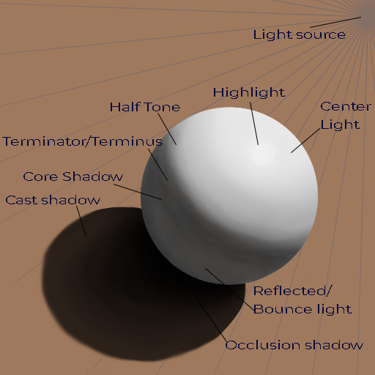
techniques
materials
styles

Slide 7
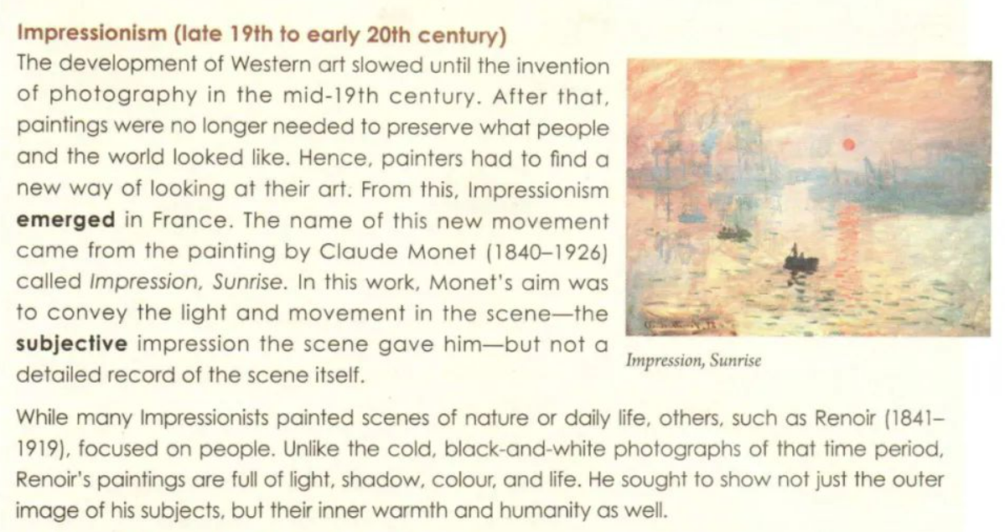
purposes
themes
subjects

Slide 8
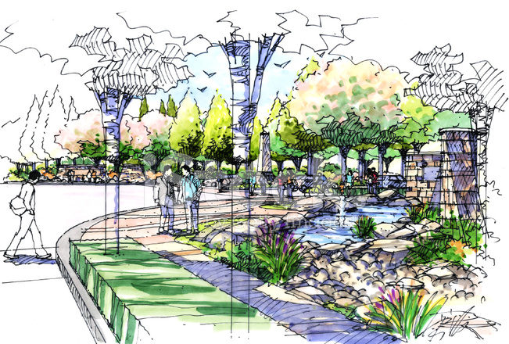
sketch+ watercolor
the use of perspective
modernity and nature
citizens roaming around
an oasis in the city center
Present tense
My watercolor sketch captures a city park oasis (绿洲). Using perspective, the bustling modern skyscrapers recede/ vanish (消失) into the distance, framing the lush greenery. And citizens roam leisurely amidst nature, creating a serene fusion (融合)/ symphony of modernity and tranquility.

Slide 9
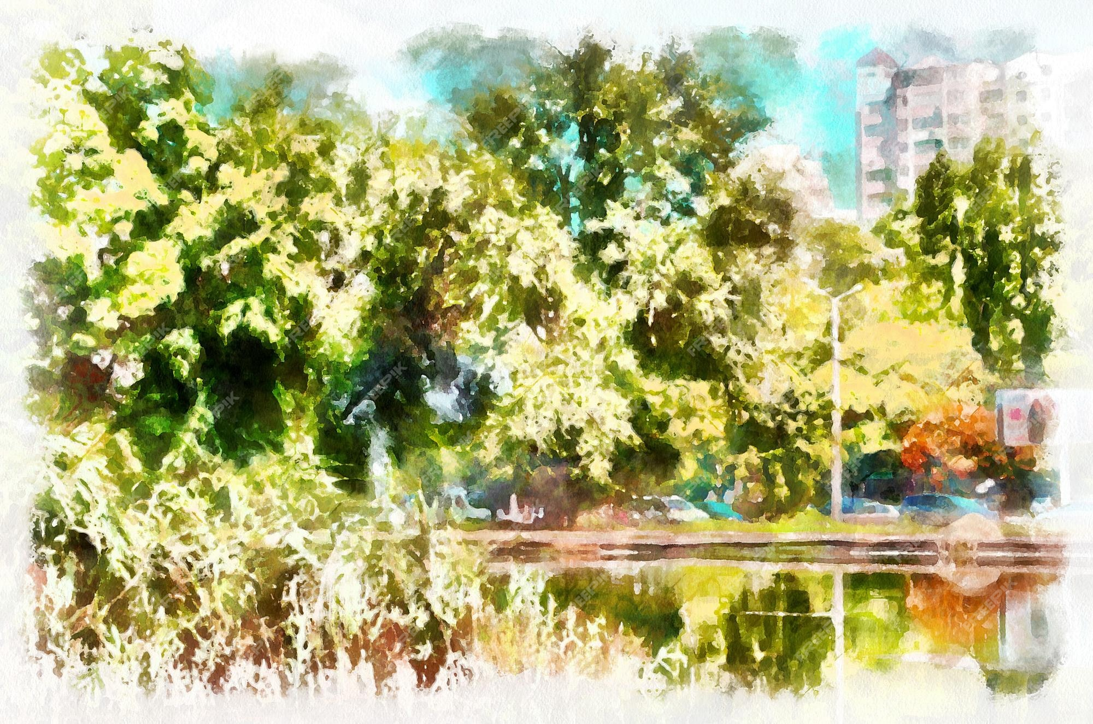
impressionism
watercolor
shadow and light
warm toned (暖色调的)
lush trees and bushes
reflection in the clear water
a tranquil ambiance
My painting is of impressionist style, utilizing watercolors to render (绘制) the play of shadows and light. The scene is dominated by lush trees and bushes, their warm tones reflecting the tranquil ambiance/ vibe (氛围). The clear water mirrors the surroundings, creating reflections that add depth and serenity (宁静).

Slide 10
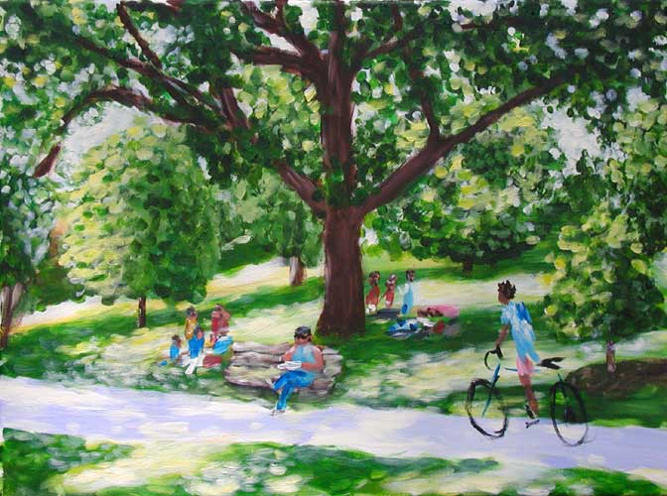
oil painting
a relaxing Sunday morning
some are reading on the bench, some are cycling along the lane, some are having a picnic on the grassland
a getaway/ respite/ an escape
dominant hue--green
recharge and rejuvenate/ revitalize
My oil painting freezes a relaxing Sunday morning in a park. Vibrant greens dominate the canvas, portraying the lush landscape. Benches are dotted with readers, cyclists ride along the shady lane, and families have picnic on the grassland. In my eyes, the park is an escape from the bustle, a place to recharge and rejuvenate the soul (恢复活力).

Slide 11
下水作文：
Dear Chris,
I’m writing to share with you an art class I had in a park last Friday. （背景介绍）
The special outdoor session unfolded with our art teacher encouraging us to draw inspiration from nature and unleash (释放) the artist within us. （活动介绍） As for me, my artwork focuses on capturing the beauty of a blooming cherry blossom tree. The soft pink petals against the lush green leaves make for a striking contrast, which I tried my best to replicate on my canvas. The finished product conveys invigorating warmth, romance and peace. （作品介绍）
The experience was truly transformative. Being immersed in nature allowed me to relax, fuel my inspiration and genuinely express myself in the creative art sanctuary. （个人感受）
Attached is my painting. Hope it can give you a touch of nature’s serene and revitalizing essence. Looking forward to hearing about your similar experience.（结尾）
Yours,
Hua
卷面美+结构美+语言美=分数美

Slide 12
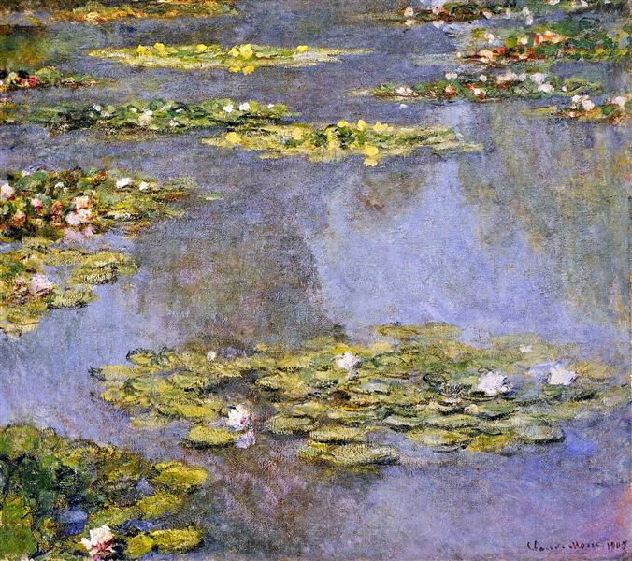
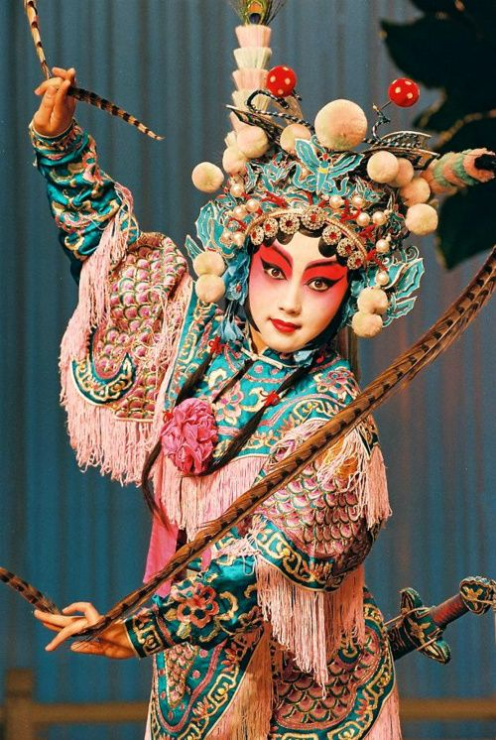
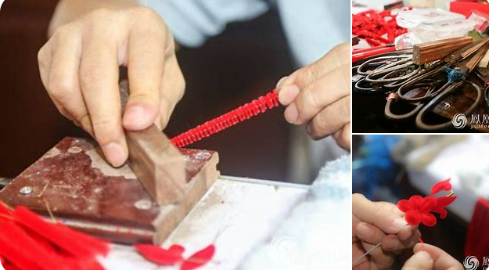
美育，又称美感教育。即通过培养人们认识美、体验美、感受美、欣赏美和创造美的能力，从而使我们具有美的理想、美的情操、美的品格和美的素养。
描述美
from pictures to words
from costumes to words
from procedures to words
…

Slide 13
同话题练习：
（2024.6镇海中学模拟卷）你校英文报社向大家发起了“我最喜欢的校园一角”的征文活动。请就此话题向报社投稿，要点包括：1.介绍校园一角；2.解释原因。
官方范文：
My Favorite Spot on Campus (玫瑰花角)
On our campus, there’s a special place called the Rose Corner. It’s tucked away, covered in lovely rose bushes. Visiting there feels like stepping into a fairy tale. The air is sweet with the scent of roses, and the quiet rustle of leaves adds to the peaceful vibe.
Why do I love this spot so much? It’s not just because of the pretty flowers; it’s because it’s so calm and peaceful. When life gets busy with classes and studying, the Rose Corner is like a haven where I can relax and think. It reminds me to slow down and enjoy the beauty around me. Being there helps me feel refreshed and ready to tackle whatever comes my way. That’s why it’s my favorite place on campus.

