Slide 1
感恩遇见，相互成就，本课件资料仅供您个人参考、教学使用，严禁自行在网络传播，违者依知识产权法追究法律责任。
更多教学资源请关注
公众号：溯恩高中英语
知识产权声明

Slide 2
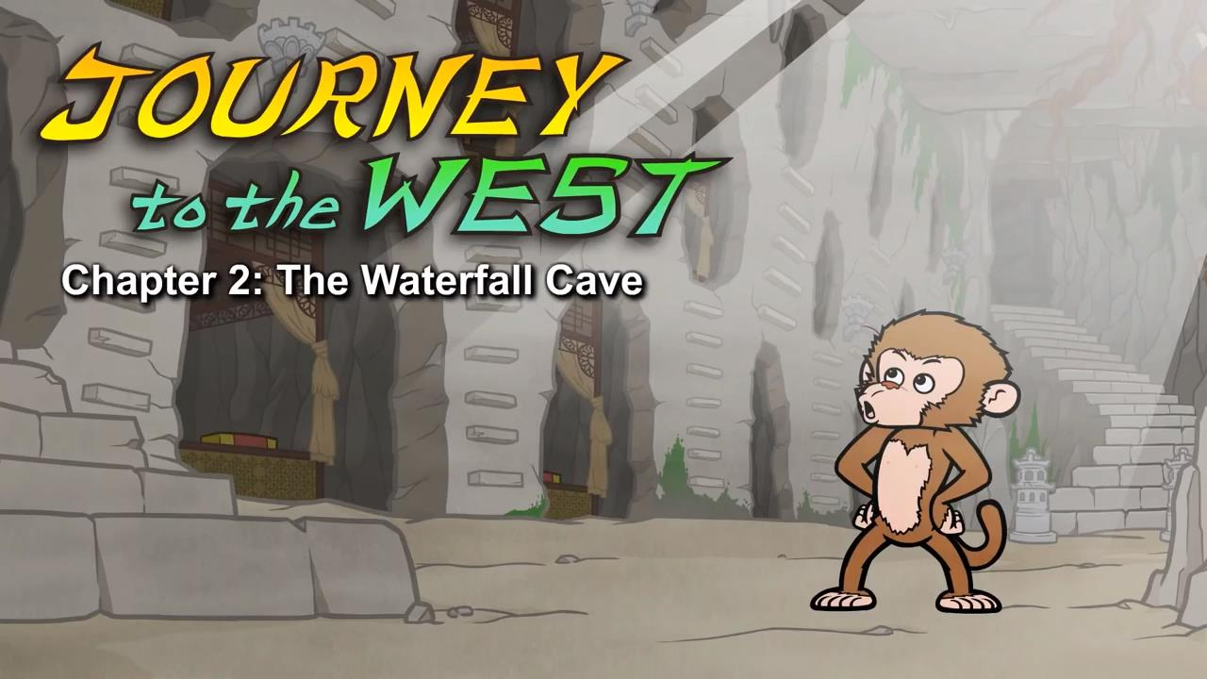
Episode 2: The Waterfall Cave

Slide 3
Part 1 quiz
1.What did Monkey find in the cave?
A.bedrooms B.spiders C.a lake
2.What did the monkeys do in the cave?
A.They argued and fought. B.They played games.
C.They broke everything.
3.Why did everyone bow to Monkey?
A.He gave everyone money. B.He was really big and scary.
C.He found the cave.
4.Why was Monkey sad?
A.He wanted to live forever. B.He didn't get enough food.
C.He wanted more friends.
5.What are sages?
A.very young people B.very wise people C.very rich people
Keys:AACAB

Slide 4
Part 2 vocabulary
1. land [lænd] v. 降落，登陆
Monkey splashed through the waterfall and landed in a large cave.
2. moss [mɒs] n. 苔藓，地⾐ Moss covered the walls.
3. glowing [ˈɡləʊɪŋ] adj. 鲜艳的，鲜明的，炽热的 A stream flowed through the cave, and glowing light and mist filled the air.
4. cozy [ˈkəʊzi] adj.(房间或者家⾥)舒适的，惬意的
Deeper in the cave, Monkey found bedrooms with cozy beds.
5. fold [fəʊld] v.1. 弯曲着，⼸着(脚，⾝体等)，(2. 折叠(纸，布等)) Monkey his friends for a moment and then folded his arms.
6. hail [heɪl] vt. 1. 欢呼，喝采，(2. ⼤声招呼(车辆、⼈等)，3. 雹，冰雹) He bowed to Monkey and said, "All hail the Monkey King."
all hail 万岁！He bowed to Monkey and said, " All hail the Monkey King."

Slide 5
7. feast [fiːst] n. 盛宴，筵席 One night the monkeys and apes had a huge feast.
8. throne [θrəʊn] n. 王位，王座 Monkey sat on his throne and smiled.
9. fade [feɪd] v. 1. 逐渐消失，逐渐变弱，(2. (颜⾊)退⾊，褪去) But then his smile faded.
10. frown [fraʊn] vt.& vi.皱眉 Soon he was frowning.
11. light up (眼神等)发亮，⾯露喜⾊ The gibbon's eyes lit up.
12. sage [seɪdʒ] n. 圣⼈，圣贤 Then you must study with a sage.

Slide 6
Part 3 sentences
1.Monkey splashed through the waterfall and landed in a large cave.
2.His eyes opened wide.
3.A fireplace sat against one wall.
墙边上有个壁炉。
4.Monkey shot out of the waterfall and landed in front of the group.
5.Monkey watched his friends for a moment and then folded his arms.
6.His smile faded. Soon he was frowning.
7.The gibbon's eyes lit up.
8.The gibbon rubbed his chin.

