Slide 1
Global warming
Using language
何建军 浙江金华 第一中学

Slide 2
文本分析
本节课是以Global warming 为主线的阅读和写作课。让学生就WHAT CAN WE DO ABOUT GLOBAL WARMING?进行讨论。欧阳光给关爱地球组织杂志写电子邮件，请求帮助。杂志回信指出，群策群力，问题可解。他们提出了几个具体措施：1、减少电器的使用；2、尽量步行或骑自行车；3、回收玻璃、塑料、报纸等物品；4、劝父母购买节能产品；5、植树；6、宣传有关知识。阅读之后，教师可以让学生就文中提出的建议进行讨论，并可以让学生提出更多的建议。这样，学生就有了充分的材料去完成写的任务：设计类似于高考的应用文，代表学校就如何减缓全球气候变暖的课题，提出你的建议。

Slide 3
教学设计
整篇文章的设计主要分为三部分： 第一部分：课文内容的处理。这一部分通过对地球变暖的现状，原因，结果等图片资料等的展示，要让大众引起对地球变暖危害性的恐惧，从而进一步采取措施来减缓地球变暖的速度，让人类生活的地球更好地为人类服务。 第二部分：链接高考。高考作文中的倡议书、建议信等可以很好地与此文本结合起来。目前学校的老师和学生都有课题的研究和申报，以此为例，可以代表学校向全体学生提出倡议或者是建议，建议学生如何做。 第三部分：语言运用扩展。为了将阅读材料较好地变成写作素材，基本的句子结构，话题词汇，地道的表达需要学习。这一部分就是为此目的而设计的。

Slide 4
教学设计
第一部分 Causes and effects & what can be done
第二部分 Applied to writing
第三部分 Language study

Slide 5
教学过程
第一部分 Causes and effects & what can be done

Slide 6
BACKGROUND背景

Slide 7
Background
Glaciers are melting, sea levels are rising, cloud forests are dying, and wildlife is scrambling(争抢；抢占；争夺) to keep pace. It has become clear that humans have caused most of the past century's warming by releasing heat-trapping gases as we power our modern lives. Called greenhouse gases, their levels are higher now than at any time in the last 800,000 years.
We often call the result global warming, but it is causing a set of changes to the Earth's climate, or long-term weather patterns, that varies from place to place. While many people think of global warming and climate change as synonyms, scientists use “climate change” when describing the complex shifts now affecting our planet's weather and climate systems—in part because some areas actually get cooler in the short term.
Climate change encompasses(包含) not only rising average temperatures but also extreme weather events, shifting wildlife populations and habitats, rising seas, and a range of other impacts. All of those changes are emerging as humans continue to add heat-trapping greenhouse gases to the atmosphere, changing the rhythms of climate that all living things have come to rely on.
What will we do—what can we do—to slow this human-caused warming? How will we cope with the changes we've already set into motion? While we struggle to figure it all out, the fate of the Earth as we know it—coasts, forests, farms, and snow-capped mountains—hangs in the balance.

Slide 8
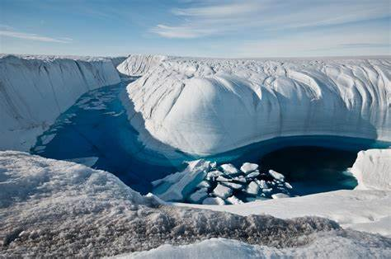
Glaciers are melting！

Slide 9
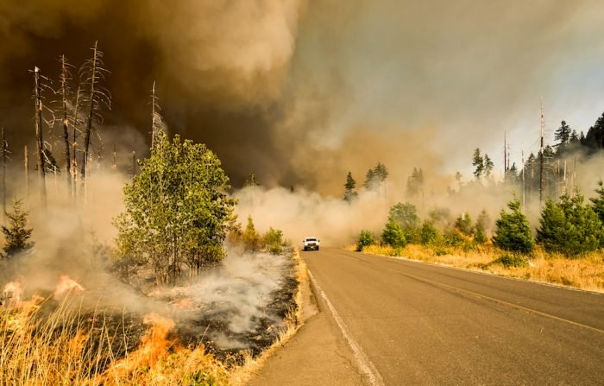
Deforestation森林毁灭

Slide 10
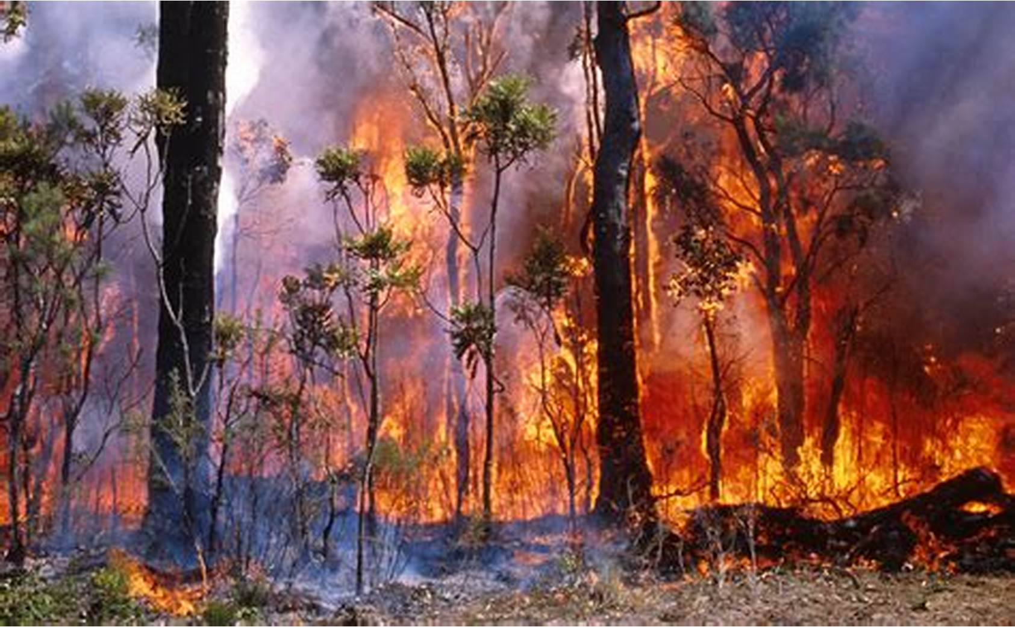
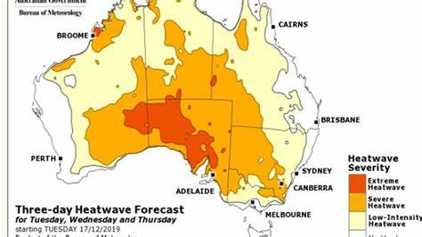
Australian fire in 2019

Slide 11
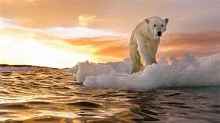
北极熊去哪？

Slide 12
CAUSES AND EFFECTS OF CLIMATE CHANGE

Slide 13
What is Global Warming?
The Earth as an ecosystem is changing, attributable in great part to the effects of globalization and man. More carbon dioxide is now in the atmosphere than has been in the past 650,000 years. This carbon stays in the atmosphere, acts like a warm blanket, and holds in the heat — hence the name ‘global warming.’
The reason we exist on this planet is because the earth naturally traps just enough heat in the atmosphere to keep the temperature within a very narrow range - this creates the conditions that give us breathable air, clean water, and the weather we depend on to survive. Human beings have begun to tip that balance. We've overloaded the atmosphere with heat-trapping gasses from our cars and factories and power plants. If we don't start fixing the problem now, we’re in for devastating changes to our environment. We will experience extreme temperatures, rises in sea levels, and storms of unimaginable destructive fury. Recently, alarming events that are consistent with scientific predictions about the effects of climate change have become more and more commonplace.
地球，作为一个生态系，主要是随着人类的发展和全球化而变化，循环的。此时此刻，大气层里的二氧化碳达到了过去65万年历史的最高点。这些在大气层的二氧化碳就像保暖毯，保持着地球表面的热度－－顾名思义，全球性变暖，也就是温室效应。
我们能够存活于这个星球－地球，是因为它自然地将适量的热气控制在大气层里，以此来保证地球表面温度只在一定范围内波动－－这提供了我们生存的条件，如可呼吸的空气，干净的水源，还有我们生存所必需的天气。我们已经使大气层超负荷地载满了我们车辆，工厂和能源厂排放的保温气体。如果我们不立即开始行动来改善并解决这个问题的话，我们将亲眼目睹环境的摧残性变化。我们将经历更极端的气温，海平线的大幅度上涨，以及更多我们根本无法想象的破坏性风暴的来临。最近，就在科学家们对气候变化带来的各种影响预测下，惊心动魄的灾难连续不断。

Slide 14
Causes and Effects & What can be done
What causes climate change (also known as global warming)? And what are the effects of climate change? Learn the human impact and consequences of climate change for the environment, and our lives.
What can be done?
Addressing（解决） climate change will require many solutions—there's no magic bullet（没有什么灵丹妙药）. Yet nearly all of these solutions exist today, and many of them hinge on（依赖于） humans changing the way we behave, shifting the way we make and consume energy. The required changes span technologies, behaviors, and policies that encourage less waste and smarter use of our resources. For example, improvements to energy efficiency and vehicle fuel economy, increases in wind and solar power, biofuels from organic waste, setting a price on carbon, and protecting forests are all potent（有效的） ways to reduce the amount of carbon dioxide and other gases trapping heat on the planet.

Slide 15
What can be done?
SOLUTIONS
1

Slide 16
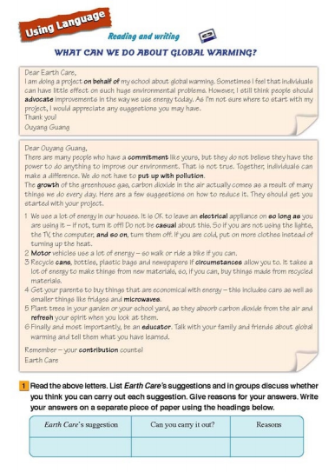
Skimming
Skim the letters, and find out who the writers are and what their purpose of writing the letters is.

Slide 17
Skimming
WHAT CAN WE DO ABOUT GLOBAL WARMING?
Dear Earth Care,
I am doing a project on behalf of my school about global warming. Sometimes I feel that individuals can have little effect on such huge environmental problems. However, 1 still think people should advocate improvements in the way we use energy today. As I'm not sure where to start with my project, I would appreciate any suggestions you may have.
Thank you!
Ouyang Guang
The first letter is written by a student who is asking for suggestions for his project — global warming.

Slide 18
Skimming
Dear Ouyang Guang,
There are many people who have a commitment like yours, but they do not believe they have the power to do anything to improve our environment. That is not true. Together, individuals can make a difference. We do not have to put up with pollution.
The growth of the greenhouse gas, carbon dioxide in the air actually comes as a result of many things we do every day. Here are a few suggestions on how to reduce it. They should get you started with your project.
1 We use a lot of energy in our houses. It is OK to leave an electrical appliance on so long as you are using it - if not, turn it off! Do not be casual about this. So if you are not using the lights, the TV, the computer, and so on, turn them off. If you are cold, put on more clothes instead of turning up the heat.
2 Motor vehicles use a lot of energy- so walk or ride a bike if you can.
3 Recycle cans, bottles, plastic bags and newspapers if circumstances allow you to. It takes a lot of energy to make things from new materials, so, if you can, buy things made from recycled materials.
4 Get your parents to buy things that are economical with energy - this includes cars as well as smaller things like fridges and microwaves.
5 Plant trees in your garden or your school yard, as they absorb carbon dioxide from the air and refresh your spirit when you look at them.
6 Finally and most importantly, be an educator. Talk with your family and friends about global warming and tell them what you have learned.
Remember - your contribution counts!
The second letter is written by an editor of Earth Care magazine. He offers the student some suggestions on what to do about global warming.

Slide 19
Scanning
Read the second email, and answer the question:
Does Earth Care agree with Ouyang Guang’s opinion that
individuals can have no effect?
No, Earth Care does not agree.

Slide 20
Detailed reading
List Earth Care’s suggestions and then in groups, discuss whether you think you can carry out each suggestion.
Earth Care’s suggestions | Can you carry it out? | Reasons
If you are not using electrical appliances, turn them off.
Save
energy
Yes

Slide 21
Detailed reading
If you’re cold, put on more clothes instead of turning up the heat.
Save
energy
Yes
Motor vehicles use a lot of energy, so walk or ride a bike if you can.
Save
energy
Yes
Recycle cans, bottles, plastics and newspapers and buy things made from recycled materials.
Save
energy
Yes

Slide 22
Detailed reading
Get your parents or friends to buy products that are made to save energy.
Yes
Save energy
Plants absorb carbon dioxide from the air.
Plant more trees.
Yes

Slide 23
Detailed reading
Talk with your family and friends about global warming and tell them what you’ve learned.
Together, individuals can make a difference.
Yes

Slide 24
Critical thinking
What do you think is the best solution to slow this human-caused warming?
I think it is education that genuinely counts！

Slide 25
教学过程
第二部分 Applied to writing

Slide 26
What can be done?
Apporach To NMET
2

Slide 27
Read the following letter and write a reply to it.
Dear Earth Care,
I am doing a project on behalf of my school about global warming. Sometimes I feel that individuals can have little effect on such huge environmental problems. However, I still think people should advocate improvements in the way we use energy today. As I'm not sure where to start with my project, I would appreciate any suggestions you may have.
Thank you!
Ouyang Guang

Slide 28
One possible version
Dear Ouyang Guang,
Together, individuals can make a difference to improve our environment. Here are a few suggestions on how to reduce carbon dioxide .
Firstly, turn electrical equipment in houses off if not use . And persuade parents to buy energy-saving equipment. Secondly, walking or riding are great choices to replace Motor vehicles. thirdly, please recycle things more to save materials. Besides, planting trees is beneficial to the air and your spirit. Most importantly, raise the awareness of your family and friends by communicating with them, just like an educator.
Remember - your contribution counts!
Earth Care

Slide 29
Further practice
假定你是李华,你校将做一项减缓全球气候变暖的速度的课题研究，请你代表学校写一封建议书，内容包括:
1.课题名称
2.提出建议
3.提出呼吁
注意:
1.词数80左右;
2.可适当增加细节,以使行文连贯

Slide 30
参考范文
Dear Ouyang Guang,
Doing a project on behalf of my school about global warming, I feel that individuals can have little effect on such huge environmental problems，which should be paid attention to.
To start with,you are supposed to save energy,which is of great significance to reduce carbon dioxide given off.Turn off electrical appliances in time and go green travel as possible help a lot.Meanwhile,it is recommended that you form the habit of recycling,helping bring their energy to the full.Besides,planting trees and flowers in your garden or school yard is a wise choice.
In unity there is strength,so why not try to include your parents and friends in action?I call on everyone to take action and contribute to making our earth a nicer place.
Earth Care

Slide 31
教学过程
第三部分 Language study

Slide 32
What can be done?
Useful expressions
in writing
3

Slide 33
1.I am doing a project on behalf of my school about global warming. 我正代表学校做一项课题研究——关于全球变暖的问题。
on behalf of sb： as the representative of sb or instead of them 代表（或代替）某人
翻译☞
1)我谨代表全系感谢大家。
2)奈特先生不能来，因此由他的夫人代他领奖。
1)On behalf of the department I would like to thank you all.
2)Mr Knight cannot be here, so his wife will accept the prize on his behalf.
on behalf of sb. 表示“代表某人”, 通常在句中作状语, 如：
On behalf of my colleagues and myself I, thank you.我代表我的同事和我本人向你表示感谢。
翻译☞
在此，我代表学校给您讲一讲六月二十六日参观我们学校的有关安排。
On behalf of our school, I'd like to show you the arrangements for our visit to our school on June, 26th.

Slide 34
2.Sometimes I feel that individuals can have little effect on such huge environmental problems. 有时候我觉得，像如此巨大的一个环境问题，个人是起不了什么作用的。
She knows that those five minutes can have an invaluable and powerful ripple effect across our school.
《How can we support the emotional well-being of teachers?》
have effect on sth：to have an influence on sb/sth 对...有影响
1)电视对孩子的行为有影响吗？
2)现代农业耕作方法可能对环境造成负面影响。
翻译☞
1)Does television have an effect on children's behaviour?
2)Modern farming methods can have an adverse effect on the environment.

Slide 35
拓展：修饰词
She found that personality had a major impact on learning.
A has a major impact on B
1）great/huge/large 2）serious 3）direct/indirect 4）negative/positive 5) favorable（=good） 6）profound 7）tremendous/enormous 8）slight 9) substantial
impact前的修饰词
☞

Slide 36
3.However, I still think people should advocate improvements in the way we use energy today. 然而，我仍然认为人们应当提倡改善我们今天能源使用的方式。
advocate 用作动词, 表示“拥护、提倡”时, 后接名词或动名词形式, 如:
He advocates reforming the prison system. 他主张改良监狱制度。
advocate sth. 提倡, 拥护某事
advocate doing sth. 提倡, 拥护做某事
advocate that + 从句 主张, 提倡……
advocate 后接从句时, 从句谓语需用“should do”表示虚拟, should可以省略。

Slide 37
翻译：
1)该团体不支持使用暴力。
2)很多专家主张对小孩的良好表现加以奖励。
3)报告主张所有的建筑物都应安装烟雾报警器。
1)The group does not advocate the use of violence.
2)Many experts advocate rewarding your child for good behaviour.
3)The report advocated that all buildings be fitted with smoke detectors.
Or：The report advocated that all buildings should be fitted with smoke detectors.

Slide 38
3.However, I still think people should advocate improvements in the way we use energy today. 然而，我仍然认为人们应当提倡改善我们今天能源使用的方式。
we use energy today是way的定语从句，在从句中做方式状语，这种情况下，关系代词用in which，或者that，或者省略。
1)The way ______ he explained to us was quite simple.
2) I don't like the way ______ you behave.
规则：
the way 在从句中作主语宾语用 that/which; the way 在从句中作方式状语用 that/in which/省略。
故答案为：1）that/which 2）that/in which/--

Slide 39
4.There are many people who have a commitment like yours, but they do not believe they have the power to do anything to improve our environment. 有许多人跟你有同感，他们不相信自己有能力来影响环境。
特别要注意there be 结构的使用，这个结构实际上由于受到汉语的影响，用错的概率还是比较大的，因此有很多老师好的做法是将结构固定为：
There be +主语+who/which ... or： There be+主语+doing...
1）下周在我们学校501教室将有10名选手同台竞技来参加本次英语演讲比赛。
2）一些孩子坐在教室里积极踊跃地举手参与课堂。
3）每年冬天有许多鸟类前来此地过冬。
翻译☞
1）There is going to be 10 participants competing with each other in the English contest in Room501 of our school next week.
2）There are some pupils sitting in the classroom raising their hands, active in class.
3）There are a great many birds spending the winter here.

Slide 40
5.Together, individuals can make a difference. We do not have to put up with pollution.众人拾柴火焰高。我们不必去忍受污染。
make a, no, some, etc. difference (to/in sb/sth)
=to have an effect/no effect on sb/sth 有（或没有、有些等）作用，关系，影响
1)这场雨对比赛没多大影响。
2)你能否得到这工作应该与你的年龄无关。
3)转学对我的一生有着重大影响。
4)他知不知道有什么关系吗？
5)我认为颜色无关紧要。
6)“我们星期五还是星期六去？” “（我）无所谓。”
翻译☞
1)The rain didn't make much difference to the game.
2)Your age shouldn't make any difference to whether you get the job or not.
3)Changing schools made a big difference to my life.
4)What difference will it make if he knows or not?
5)I don't think it makes a lot of difference what colour it is (= it is not important).
6)'Shall we go on Friday or Saturday?' 'It makes no difference (to me).'

Slide 41
5.Together, individuals can make a difference. We do not have to put up with pollution.众人拾柴火焰高。我们不必去忍受污染。
put up with 忍受; 忍耐; 受苦
That woman, as a housewife, has a lot to put up with. 作为家庭主妇, 那女人得忍受很多烦恼。
put aside 节省(钱、时间); 储蓄;把……放在一边
put away 收拾起来; 储存(钱); 喝掉
put back 放回原处; 拖延
put down 写下; 记下; 控制
put forward 提出(意见、建议); 推荐
put off 延期; 推迟
put on 假装; 增加; 上演(戏剧)
put out 熄灭; 使忧虑; 扑灭; 出版
put up 举起; 张开(伞); 张贴; 为……提供食宿

Slide 42
6.It is OK to leave an electrical appliance on so long as you are using it - if not, turn it off! 在用电器设备时你可以让它开着，如果不用就把它关掉！
As long as there is life, there is hope. 留得生命在, 不怕没希望.
在用as /so long as连接的从句中，当其谓语为be,而主语和主句的主语相同时, 则从句的主语和be可以省略。如:
I'm sure we are safe as long as (we are) in his care. 我深信只要在他的保护下, 我们就会平安无事。
as long as
You can go out on condition that you wear an overcoat. = You can go out _________ you wear
an overcoat.
翻译☞
只要你开心, 你做什么都没关系。
As long as you are happy, it doesn't matter what you do.

Slide 43
7.Get your parents to buy things that are economical with energy - this includes cars as well as smaller things like fridges and microwaves.劝你的父母去买那些节约能源的产品，包括汽车和像冰箱、微波炉之类的小件东西。
economical:providing good service or value in relation to the amount of time or money spent 经济的；实惠的
an economical car to run (= one that does not use too much petrol/gas)节油型汽车
It would be more economical to buy the bigger size.买尺寸大点的更实惠。
using no more of sth than is necessary 节俭的；节约的；简洁的
an economical use of space节约利用空间
an economical prose style (= one that uses no unnecessary words)简练的散文文体
not spending more money than necessary 精打细算的；省钱的
He was economical in all areas of his life.他在生活的各个方面都精打细算。

Slide 44
8.Plant trees in your garden or your school yard, as they absorb carbon dioxide from the air and refresh your spirit when you look at them.在你的花园或校园里栽种树木，它们能吸收空气中的二氧化碳。
refresh [transitive] ~ sb/yourself to make sb feel less tired or less hot 使恢复精力；使凉爽
The long sleep had refreshed her.一场酣睡使她重又精力充沛。
He refreshed himself with a cool shower.他冲了个凉水澡凉快凉快。
[transitive] ~ your/sb's memory to remind yourself/sb of sth, especially with the help of sth that can be seen or heard 提醒；提示；使想起
He had to refresh his memory by looking at his notes.
他不得不靠看笔记来提醒自己。
[transitive, intransitive] ~ (sth) (computing 计算机) to make the most recent information show, for example on an Internet page 刷新（网页等）
Click here to refresh this document.点击此处以刷新文件。

Slide 45
9.Your contribution counts!你的贡献很有价值。
COUNT:MATTER 有重要性
[intransitive] (not used in the progressive tenses 不用于进行时) to be important 重要
Every point in this game counts.这场比赛每一分都很重要。
It's the thought that counts (= used about a small but kind action or gift).贵在心意。
~ for sth
The fact that she had apologized counted for nothing with him.她已道歉，但他认为这没有用。

Slide 46
研究下面句子：
10.众所周知，由于气候变暖，环境污染以及人口的剧增，全球水资源匮乏变得日益严峻。
As we all know, the global water shortage is becoming increasingly severe due to global warming, environmental pollution and the ever-increasing population.

Slide 47
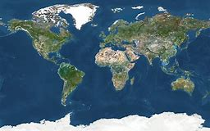
Global warning？
Global warming？
OR
Let's do something！

Slide 48
Thank You!

