Slide 1
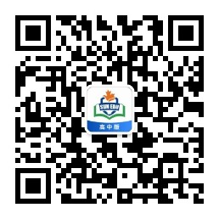
感恩遇见，相互成就，本课件资料仅供您个人参考、教学使用，严禁自行在网络传播，违者依知识产权法追究法律责任。
更多教学资源请关注
公众号：溯恩高中英语
知识产权声明

Slide 2

2023.4
基于课本话题的应用文写作
语料的提取与加工
金华十校 急救演练 通知

Slide 3

通知
类型
时态
人称
语气
要点
假定你是某国际学校的学生会主席李华。你校即将组织急救演练，请你用英文写一则通知。
内容包括：
1. 时间、地点及参与人员；
2. 具体内容；
3. 注意事项。
注意:
1.词数80左右；
2.可适当增加细节，
以使行文连贯。
Announcement for Medical Emergency Drill
The Student Union
一般将来时
审题
第二人称/ 第三人称
formal
？口头通知 vs. 书面通知
Para. 1 时间、地点及参与人员
Para. 2 具体内容
Para. 3 注意事项

Slide 4
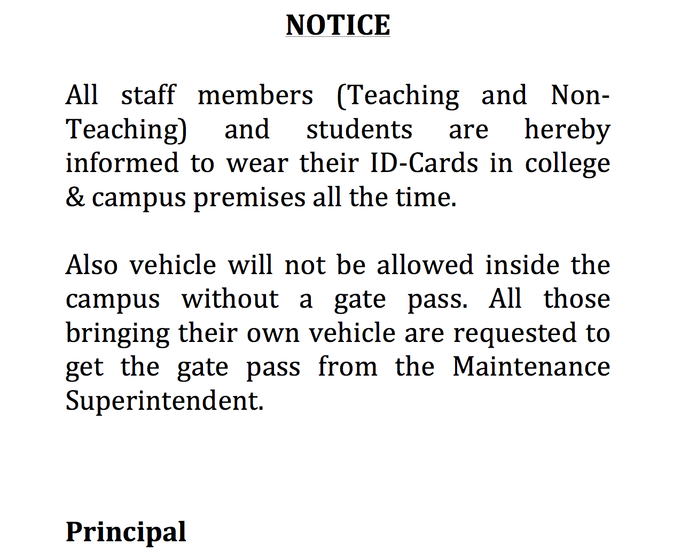
What are the features of a written notice according to its definition?
How to achieve it?
What is a Notice?
It is a common and formal means of communication which aims to give information regarding an event that is about to happen. It is a formal announcement follows a rigid format.
It is important to remember that notices are formally written or printed information or news, thus it follows a formal tone and style as well. It is strictly factual and information are based on released information from the upper management. The language is also simple and formal, it doesn’t need flowery words.
a rigid format
accurate & informative details (time, place, participants)
future tense
formal tone and style
simple and formal language
passive voice
third person
second & (mainly)

Slide 5
notice
oral form & friendly tone
first & second person (depending on the identity of the speaker)
verbal notification
Format
Dear fellow students,
Attention, please!
Thank you for your
attention!
a rigid format
accurate &
informative details
(time, place,
participants)
future tense
simple language
formal tone& language
second & third person (mainly)
Format
Notice
The Student Union

Slide 6
Para. 1 time + place + participants
+ purpose
To/ Aiming to/ in order to/ in a bid to
get better prepared for the emergencies that may arise/ occur in our daily life on and off campus, …
equip students with necessary first-aid knowledge and lifesaving techniques, ...
A two-hour medical emergency drill is to be conducted/ implemented/ initiated on the school playground at 4:00 p.m. next Friday. All the teachers and students are required to participate.
… is scheduled for 4:00 p.m. next Friday on the school playground….
All faculty and students are required to participate in the two-hour medical emergency drill to be carried out by our Student Union in the school auditorium at 4:00 p.m. next Friday.

Slide 7
a practice of what to do in an emergency
Para. 2 specific activities
drill
“演 ”
who will do what
练
a doctor/ nurse/ medical professional/ expert/ specialist
a physician/ surgeon (外科医生)/ general practitioner (全科医生)
volunteers from the local Red Cross
theory
deliver a speech/ lecture
hold a training session
specific enough?
practice
The activity will begin with … delivering a speech.
Then there will follow a training session where…
…will be introduced (in a lecture given by...).
The focus/ highlight will be a training session in which…

Slide 8
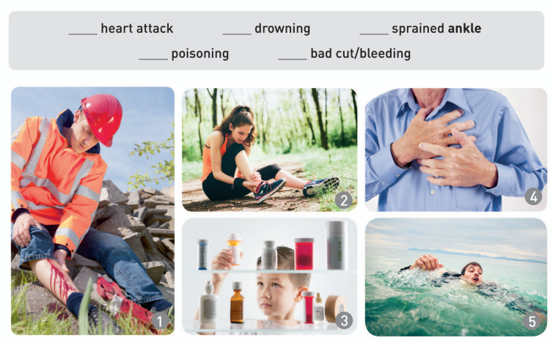
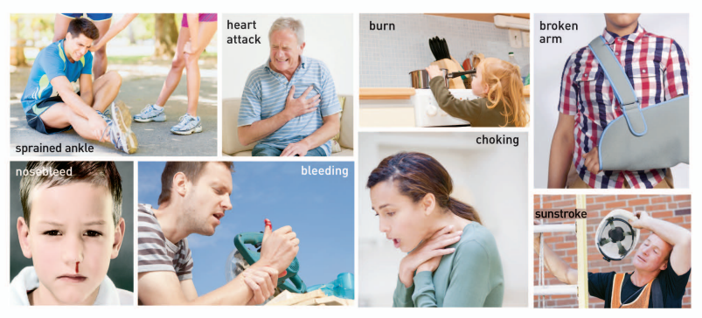
a medical expert will lecture (v.) on/ deliver a speech on how to
identify the symptoms of some medical emergency situations like heart attack and poisoning and thus take immediate first-aid measures.
tackle/ address/ handle/ cope with/ deal with sunstroke, drowning, bleeding and other emergency situations.
take precautions and apply timely first-aid treatment to common emergency situations such as….

Slide 9
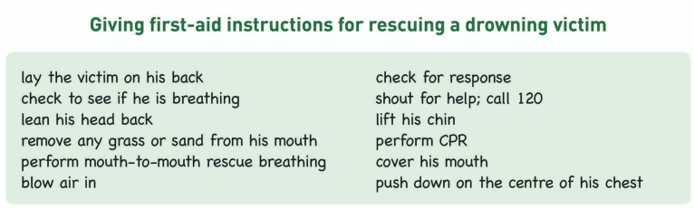
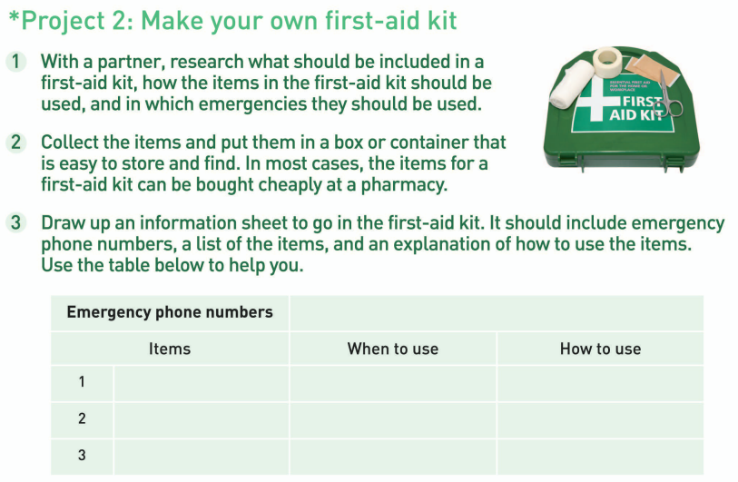
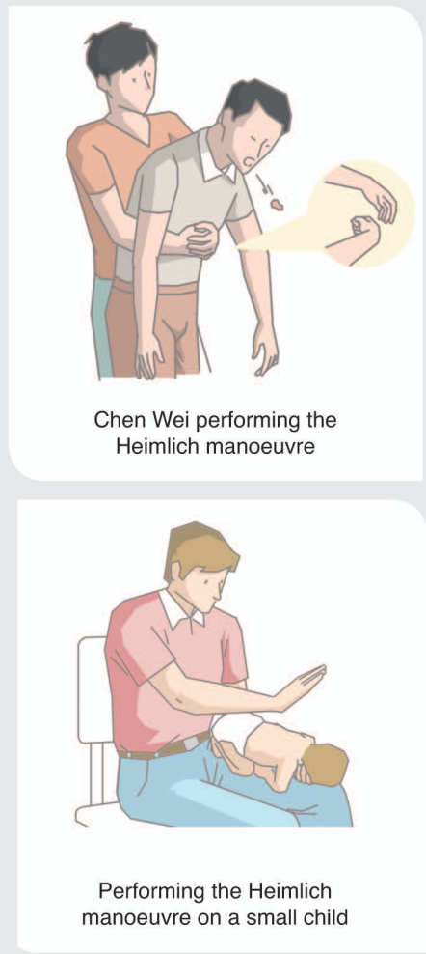
include any benefit?
a training session where
some medical emergencies are stimulated (模拟) and accordingly (相应地) students can have hands-on practices of certain first-aid/ life-saving techniques with the instruction/ guidance of volunteers from the local Red Cross
students can take turns to perform CPR or Heimlich manoeuvre on medical simulation mannequins (医疗假人), prepare their own first-aid kit in groups and role-play (v.) to make emergency calls.

Slide 10
Para. 3 requirements
All those participating
All the participants/ attendees are requested to
arrive at the venue on time/ 5 minutes earlier.
listen attentively and get actively engaged/ involved.
mute phones and keep quiet throughout the drill.
strictly follow the instructions of the emergency personnel.
Food and drinks are forbidden/ not allowed.
Your punctuality (守时) is greatly appreciated.
Thank you for your cooperation/ understanding.

Slide 11
Announcement for Medical Emergency Drill
Aimed at preparing students for medical emergencies that may arise, a medical emergency drill is scheduled to be conducted on the school playground this Friday afternoon from 3 p.m. to 4 p.m. All students and staff members are required to participate.
During the drill, a medical emergency situation will be stimulated, where the participants will be trained on how to provide first aid to victims. The focus will be on providing basic first aid before emergency services arrive, such as CPR and Heimlich maneuver, which can mean the difference between life and death.
Please note that all students must follow the instructions of the emergency personnel. Thank you for your cooperation.
The Student Union
purpose
event
place
time
duration
participants
Activities: list two main steps
requirements

Slide 12
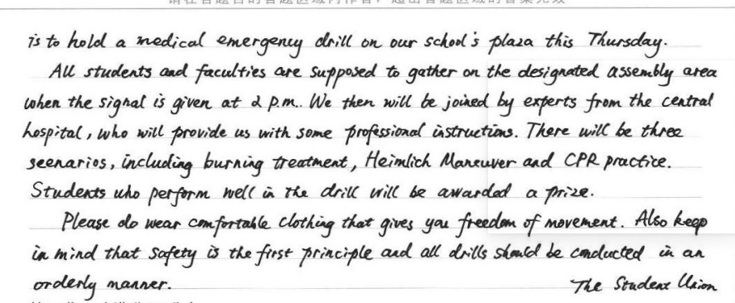
学生优秀习作
anything needs improving?
场景
12分，格式正确，要点完整，语气恰当，逻辑连贯

Slide 13
下水作文
Announcement for Medical Emergency Drill
Aiming to get better prepared for medical emergencies that may occur on and off campus, a two-hour medical emergency drill is to be implemented in the school auditorium at 4:00 p.m. next Friday. All the teachers and students are required to participate.
The activity will begin with a medical specialist delivering a speech on how to take precautions and apply timely first-aid treatment to common emergency situations such as nose bleeding and chocking. Then there will follow a training session where students can stimulate some emergencies and have hands-on practices of certain life-saving techniques like performing CPR and Heimlich manoeuvre, with the guidance of volunteers from the local Red Cross
During the thrill, all those participating are requested to mute phones and keep quiet as well as follow the professionals’ instruction in case of emergency. Thank you for your cooperation.
The Student Union
Activities:
time order

Slide 14

Assignment
假定你是某国际学校的学生会主席李华。你校即将组织急救演练，需在广播讲话中告知学生，请你用英文写一则通知。
内容包括：
1. 时间、地点及参与人员；
2. 具体内容；
3. 注意事项。
注意:
1.词数80左右；
2.可适当增加细节，以使行文连贯。

Slide 15
Dear fellow students,
Attention, please! I have an announcement to make.
Aiming to equip us students with necessary first-aid measures when facing emergencies on and off campus, our school union has decided to carry out a medical emergency drill from 4:00 to 5:00 p.m. this Friday on the school playground. During the drill, we will invite a medical expert to lecture on how to take precautions and identify the symptoms of common medical emergencies. The focus will be some basic first aid practices, such as CPR and Heimlich maneuver. You can have hands-on experience of those techniques. Please arrive 5 minutes earlier and strictly follow the instructions of the emergency personnel.
That’s all. Thanks for your time.
Format
Person
(first + second)
Imperative sentences
(祈使句)

