Slide 1


感恩遇见，相互成就，本课件资料仅供您个人参考、教学使用，严禁自行在网络传播，违者依知识产权法追究法律责任。
更多教学资源请关注
公众号：溯恩英语
知识产权声明

Slide 2
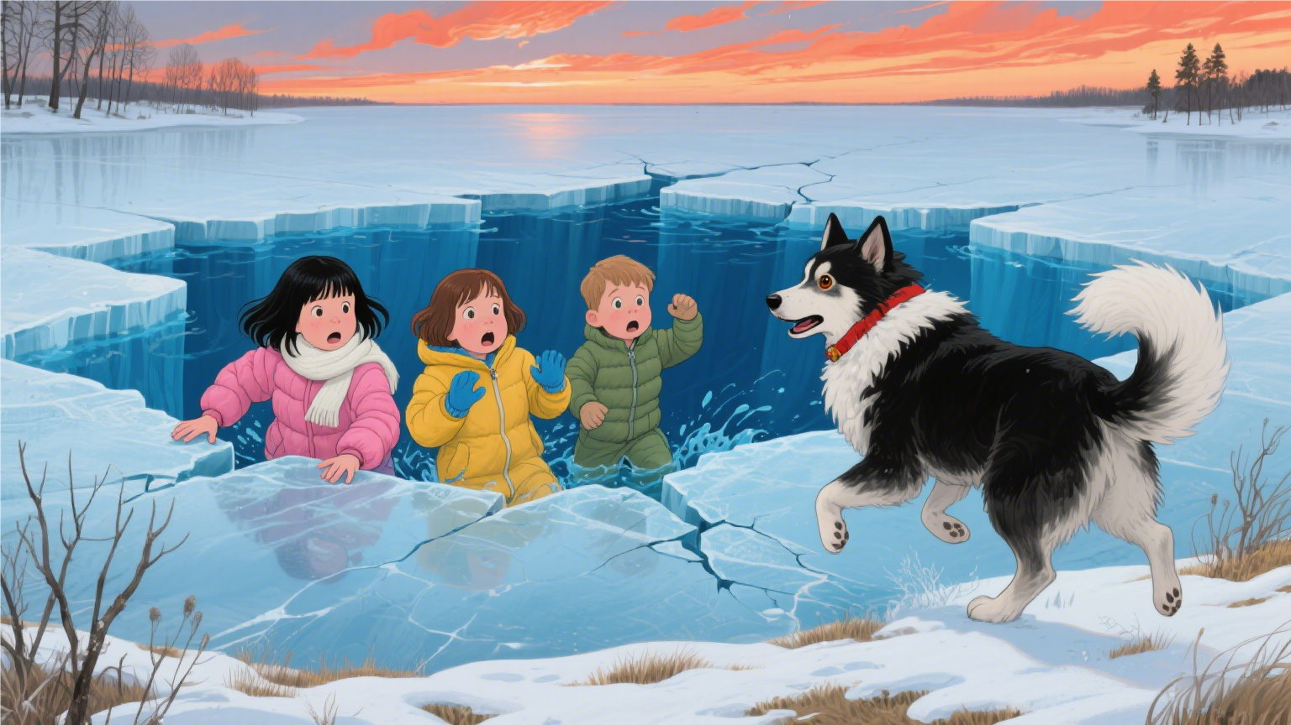
The Rescue Dog
2025年9月浙江省名校协作体读后续写讲评
海亮实验中学 陈虹

Slide 3
阅读下面材料，根据其内容和所给段落开头语续写两段，使之构成一篇完整的短文。
Bear was not a bear. She was a big dog on the Perkinses' family farm,a woolly creature with floppy ears and paws like bedroom slippers. She protected the ducks and chickens from being eaten by foxes and raccoons(浣熊).
She guarded the children as well, watching over them as closely as she did the chickens and ducks. In winter the dog ran alongside the children as they sledded (滑雪橇) down snowy hills. In summer she swam with them in a nearby river.
Bear belonged to a breed(品种) that had long been used by Atlantic fishermen to help with their work, and it had a keen instinct for water rescue. When the children were in the river, the dog would swim in circles around them,barking when she felt they went out too far. She was the perfect farm dog—— companion, guardian, protector.
The dog's favorite among the three children was three-year-old little Mike. They often curled up together.Sometimes Bear would doze while Mike pretended to read to her. Often both were sound asleep, a tangle of dark fur,blond hair, small hands and huge paws. At bedtime, Mike saved his last hug for Bear, his“best friend”.
On a cold winter day, when their parents went out to send a parcel, eight-year-old Martha, seven-year-old Sara and Mike, went to slide on the frozen pond of their farm. Shouting happily, they slid back and forth, their boots gliding easily across the ice. They laughed as they watched Bear's attempts to stop suddenly, which would instead send her skidding beyond them. Then, tired, the three sat down on the ice, with Bear beside them. Suddenly the ice gave way under their combined weight.
As Bear jumped for shore, the three children fell into the freezing cold water. Screaming, Martha and Sarah struggled to find footing on rocks underwater. Branches from a tree nearby provided handholds, and using every bit of their strength, the two girls pulled themselves to shore.
注意：(1)续写词数应为150左右：(2)请按如下格式在答题卡的相应位置作答。
Paragraph 1: Looking back, they saw little Mike holding on to a broken chunk(大块) of ice, unable to crawl onto it.__________________
Paragraph 2: Seeing that, Bear let out a series of woofs and jumped into the water; heading straight for Mike._________________________

Slide 4
读后续写的能力要求
一、记叙文阅读理解能力
二、由读到写的思维能力
三、记叙文书面表达能力

Slide 5
一、记叙文阅读理解能力
浅层的信息定位能力：
what, when, where, who, why, how等
理清故事的发展线索
深层的文本分析能力：
明确文本的主要矛盾
关注故事的语言风格

Slide 6
who
what
where:
Read for basic information

Slide 7
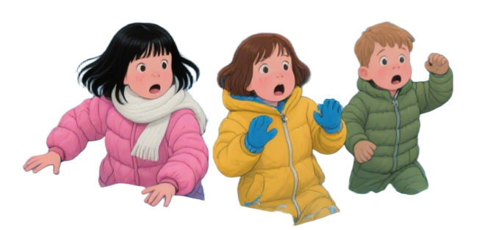
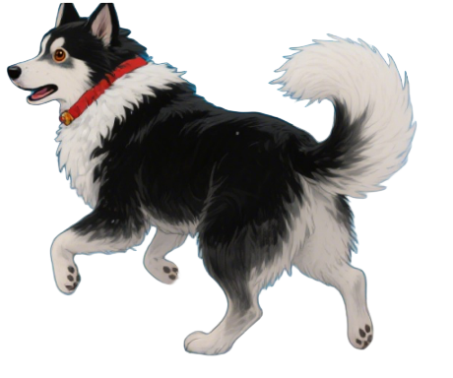
Who?
a breed that ...used ... to help ...work, and it had a keen instinct for water rescue.
three-year-old little Mike
eight-year-old Martha
floppy ears
favourite
paws like bedroom slippers
seven-year-old Sara
The main character
Bear
The Berkinses' children

Slide 8
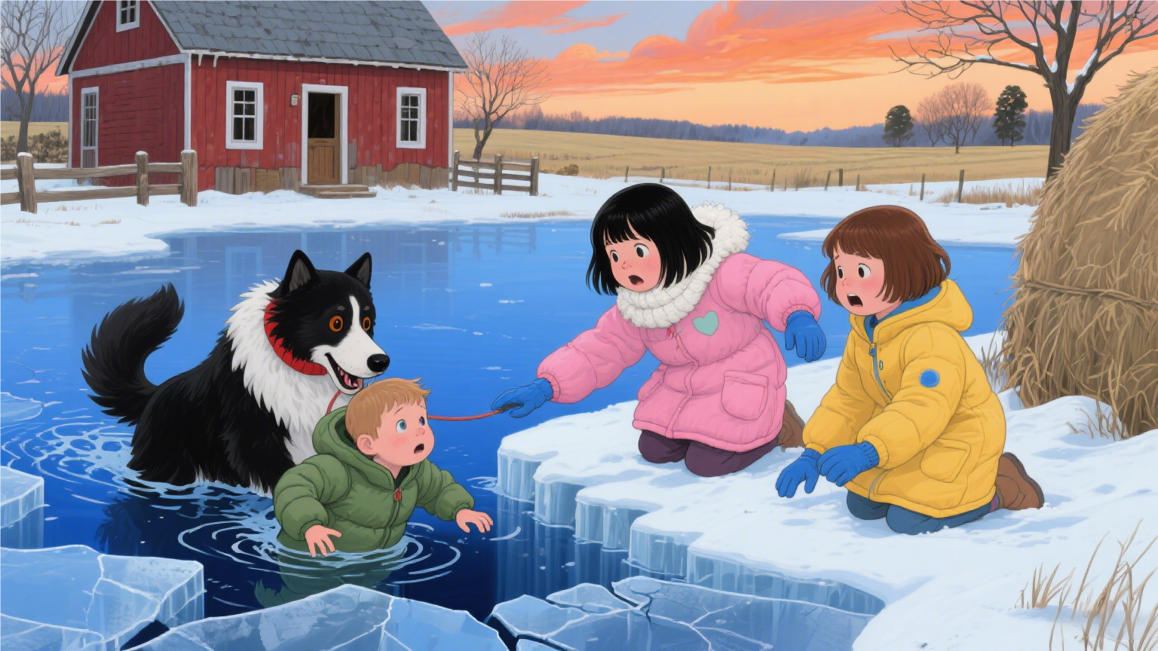
A loyal farm dog named Bear save her best friend, a little boy named Mike, after he falls through the ice on a frozen pond.
What?

Slide 9
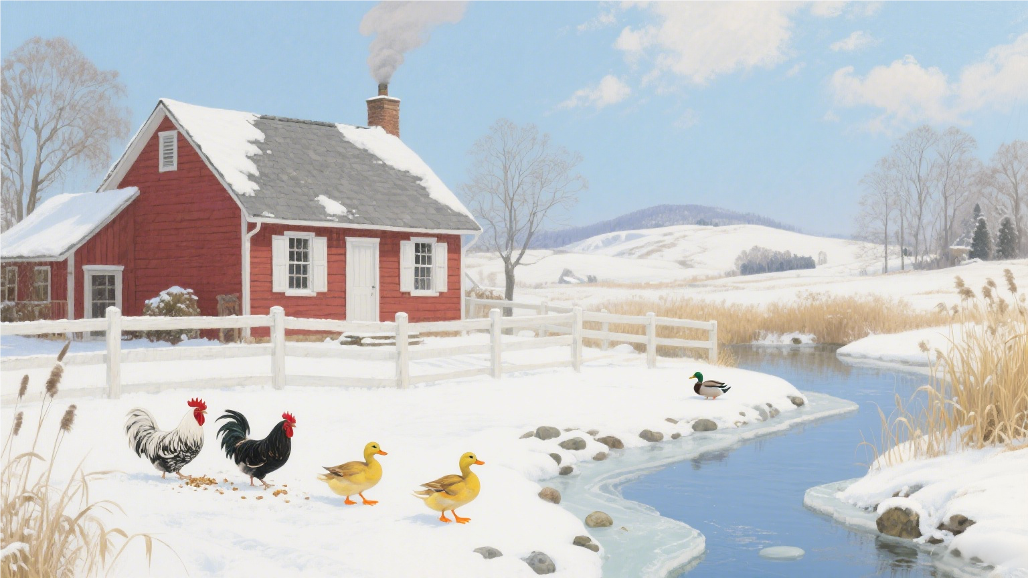
Where?
The Berkinses' family farm
the frozen pond
the key location
where the central conflict of the story erupts
the ducks and chickens

Slide 10
Read for the plot
Background & Setup
(Before the Accident)
Bear was not a bear. She was a big dog on the Perkinses' family farm,a woolly creature with floppy ears and paws like bedroom slippers. She protected the ducks and chickens from being eaten by foxes and raccoons(浣熊).
She guarded the children as well, watching over them as closely as she did the chickens and ducks. In winter the dog ran alongside the children as they sledded (滑雪橇) down snowy hills. In summer she swam with them in a nearby river.
Bear belonged to a breed(品种) that had long been used by Atlantic fishermen to help with their work, and it had a keen instinct for water rescue. When the children were in the river, the dog would swim in circles around them,barking when she felt they went out too far. She was the perfect farm dog—— companion, guardian, protector.
The dog's favorite among the three children was three-year-old little Mike. They often curled up together.Sometimes Bear would doze while Mike pretended to read to her. Often both were sound asleep, a tangle of dark fur,blond hair, small hands and huge paws. At bedtime, Mike saved his last hug for Bear, his“best friend”.
On a cold winter day, when their parents went out to send a parcel, eight-year-old Martha, seven-year-old Sara and Mike, went to slide on the frozen pond of their farm. Shouting happily, they slid back and forth, their boots gliding easily across the ice. They laughed as they watched Bear's attempts to stop suddenly, which would instead send her skidding beyond them. Then, tired, the three sat down on the ice, with Bear beside them. Suddenly the ice gave way under their combined weight.
As Bear jumped for shore, the three children fell into the freezing cold water. Screaming, Martha and Sarah struggled to find footing on rocks underwater. Branches from a tree nearby provided handholds, and using every bit of their strength, the two girls pulled themselves to shore.
Paragraph 1: Looking back, they saw little Mike holding on to a broken chunk(大块) of ice, unable to crawl onto it.__________________
Paragraph 2: Seeing that, Bear let out a series of woofs and jumped into the water; heading straight for Mike._________________________
Bear's role in daily life: perfect guardian dog, companion, and protector.
Her interactions with the children : sledding with them in winter, swimming and guarding them in the river in summer.
Her special, intimate bond with little Mike.
The Main Incident
(The Accident)
Parents’ absence
Happily play together
The breaking of ice
The Climax & Resolution
The two girls’ rescue
Mike was in danger
Bear wanted to rescue Mike

Slide 11
阅读下面材料，根据其内容和所给段落开头语续写两段，使之构成一篇完整的短文。
Bear was not a bear. She was a big dog on the Perkinses' family farm,a woolly creature with floppy ears and paws like bedroom slippers. She protected the ducks and chickens from being eaten by foxes and raccoons(浣熊).
She guarded the children as well, watching over them as closely as she did the chickens and ducks. In winter the dog ran alongside the children as they sledded (滑雪橇) down snowy hills. In summer she swam with them in a nearby river.
Bear belonged to a breed(品种) that had long been used by Atlantic fishermen to help with their work, and it had a keen instinct for water rescue. When the children were in the river, the dog would swim in circles around them,barking when she felt they went out too far. She was the perfect farm dog—— companion, guardian, protector.
The dog's favorite among the three children was three-year-old little Mike. They often curled up together.Sometimes Bear would doze while Mike pretended to read to her. Often both were sound asleep, a tangle of dark fur,blond hair, small hands and huge paws. At bedtime, Mike saved his last hug for Bear, his“best friend”.
On a cold winter day, when their parents went out to send a parcel, eight-year-old Martha, seven-year-old Sara and Mike, went to slide on the frozen pond of their farm. Shouting happily, they slid back and forth, their boots gliding easily across the ice. They laughed as they watched Bear's attempts to stop suddenly, which would instead send her skidding beyond them. Then, tired, the three sat down on the ice, with Bear beside them. Suddenly the ice gave way under their combined weight.
As Bear jumped for shore, the three children fell into the freezing cold water. Screaming, Martha and Sarah struggled to find footing on rocks underwater. Branches from a tree nearby provided handholds, and using every bit of their strength, the two girls pulled themselves to shore.
注意：(1)续写词数应为150左右：(2)请按如下格式在答题卡的相应位置作答。
Paragraph 1: Looking back, they saw little Mike holding on to a broken chunk(大块) of ice, unable to crawl onto it.__________________
Paragraph 2: Seeing that, Bear let out a series of woofs and jumped into the water; heading straight for Mike._________________________
The vivid use of verb:
Bear (protected ...guarded ... ran ...swam...barking...)
Interaction with Mike( curled up...saved)
Play on the ice (... stop suddenly...send her skidding...)
Read for
the language
主动语态充满了主动性和责任感
两者的互动展示亲密的关系
营造笨拙与欢乐的氛围

Slide 12
阅读下面材料，根据其内容和所给段落开头语续写两段，使之构成一篇完整的短文。
Bear was not a bear. She was a big dog on the Perkinses' family farm,a woolly creature with floppy ears and paws like bedroom slippers. She protected the ducks and chickens from being eaten by foxes and raccoons(浣熊).
She guarded the children as well, watching over them as closely as she did the chickens and ducks. In winter the dog ran alongside the children as they sledded (滑雪橇) down snowy hills. In summer she swam with them in a nearby river.
Bear belonged to a breed(品种) that had long been used by Atlantic fishermen to help with their work, and it had a keen instinct for water rescue. When the children were in the river, the dog would swim in circles around them,barking when she felt they went out too far. She was the perfect farm dog—— companion, guardian, protector.
The dog's favorite among the three children was three-year-old little Mike. They often curled up together.Sometimes Bear would doze while Mike pretended to read to her. Often both were sound asleep, a tangle of dark fur,blond hair, small hands and huge paws. At bedtime, Mike saved his last hug for Bear, his“best friend”.
On a cold winter day, when their parents went out to send a parcel, eight-year-old Martha, seven-year-old Sara and Mike, went to slide on the frozen pond of their farm. Shouting happily, they slid back and forth, their boots gliding easily across the ice. They laughed as they watched Bear's attempts to stop suddenly, which would instead send her skidding beyond them. Then, tired, the three sat down on the ice, with Bear beside them. Suddenly the ice gave way under their combined weight.
As Bear jumped for shore, the three children fell into the freezing cold water. Screaming, Martha and Sarah struggled to find footing on rocks underwater. Branches from a tree nearby provided handholds, and using every bit of their strength, the two girls pulled themselves to shore.
注意：(1)续写词数应为150左右：(2)请按如下格式在答题卡的相应位置作答。
Paragraph 1: Looking back, they saw little Mike holding on to a broken chunk(大块) of ice, unable to crawl onto it.__________________
Paragraph 2: Seeing that, Bear let out a series of woofs and jumped into the water; heading straight for Mike._________________________
The description of sensory details:
Tactile sense 触觉 (a woolly creature,paws like bedroom slippers,the freezing cold water)
Auditory sense 听觉 (barking when...Shouting happily,Screaming)
Read for
the language
激活读者的感官来营造氛围

Slide 13
阅读下面材料，根据其内容和所给段落开头语续写两段，使之构成一篇完整的短文。
Bear was not a bear. She was a big dog on the Perkinses' family farm,a woolly creature with floppy ears and paws like bedroom slippers. She protected the ducks and chickens from being eaten by foxes and raccoons(浣熊).
She guarded the children as well, watching over them as closely as she did the chickens and ducks. In winter the dog ran alongside the children as they sledded (滑雪橇) down snowy hills. In summer she swam with them in a nearby river.
Bear belonged to a breed(品种) that had long been used by Atlantic fishermen to help with their work, and it had a keen instinct for water rescue. When the children were in the river, the dog would swim in circles around them,barking when she felt they went out too far. She was the perfect farm dog—— companion, guardian, protector.
The dog's favorite among the three children was three-year-old little Mike. They often curled up together.Sometimes Bear would doze while Mike pretended to read to her. Often both were sound asleep, a tangle of dark fur,blond hair, small hands and huge paws. At bedtime, Mike saved his last hug for Bear, his“best friend”.
On a cold winter day, when their parents went out to send a parcel, eight-year-old Martha, seven-year-old Sara and Mike, went to slide on the frozen pond of their farm. Shouting happily, they slid back and forth, their boots gliding easily across the ice. They laughed as they watched Bear's attempts to stop suddenly, which would instead send her skidding beyond them. Then, tired, the three sat down on the ice, with Bear beside them. Suddenly the ice gave way under their combined weight.
As Bear jumped for shore, the three children fell into the freezing cold water. Screaming, Martha and Sarah struggled to find footing on rocks underwater. Branches from a tree nearby provided handholds, and using every bit of their strength, the two girls pulled themselves to shore.
注意：(1)续写词数应为150左右：(2)请按如下格式在答题卡的相应位置作答。
Paragraph 1: Looking back, they saw little Mike holding on to a broken chunk(大块) of ice, unable to crawl onto it.__________________
Paragraph 2: Seeing that, Bear let out a series of woofs and jumped into the water; heading straight for Mike._________________________
The organization of sentences:
Long Sentences for Calm Narration and Setup
(Bear belonged to a breed that ..., and it had a keen instinct for water rescue.)
Short Sentences to Create Suddenness and Tension:
(Suddenly the ice gave way under their combined weight.
Screaming, Martha and Sarah struggled to find footing on rocks underwater.)
Read for
the language
用句式控制叙事节奏，张弛有度

Slide 14
二、由读到写的思维能力
The girls’ perspective
细读两段续写的开头语，理顺续写段落的逻辑关系；
Para. 1: Looking back, they saw little Mike holding on to a broken chunk(大块) of ice, unable to crawl onto it.
What was the immediate reaction of Martha and Sara?
What was Mike's condition?
What was Bear doing at this exact moment?
What was the overall atmosphere?
Para. 2: Seeing that, Bear let out a series of woofs and jumped into the water; heading straight for Mike.
How did Bear rescue Mike?
How did Mike react to Bear's arrival?
What was the journey back to shore like?
What happened immediately after they reached safety?
Bear’s perspective

Slide 15
三、记叙文书面表达能力
(一) 语言的丰富性
(二) 语篇的连贯性

Slide 16
Para. 1: Looking back, they saw little Mike holding on to a broken
需要回答的问题 | 语言丰富性 (如何写得出彩) | 语篇连贯性 (如何衔接流畅)
1.What was the immediate reaction of Martha and Sara? (Martha和Sara有何即时反应？)
2. What was Mike's condition? (Mike状况如何？)
3. What was Bear doing? (Bear在做什么？) |  | -
使用表状态的短语： frozen in terror（吓呆了）, their hearts pounding in their chests（心狂跳不止）
使用时间副词衔接： At that moment, Instantly, For a second,...
使用生动动词： screamed his name, stretched out their numb hands helplessly（无助地伸出冻僵的手）
逻辑连接： 用But转折她们的无能为力："They screamed his name, but their voices were swallowed by the wind."
感官细节： 描写她们粗重的呼吸(panting heavily)、眼泪(tears streaming down their frozen cheeks)。
精准的形容词： his small fingers were blue and stiff（发紫僵硬）, his blond hair plastered to his pale forehead（金发贴在惨白的额头上）
自然视角过渡： 从女孩们“看”的动作自然引出Mike的状态："Looking back, they saw... Mike's lips were already turning blue."
动态描写： His tiny body was shaking violently against the freezing current.（在寒流中剧烈颤抖）
使用非限制性定语从句补充： ..., his strength fading fast.
声音描写： His cries were weak gasps rather than sobs.（是微弱喘息而非哭泣）
描写动物行为： whined and paced frantically along the edge（在岸边焦急地呜咽、踱步）, barked a series of sharp, alarmed woofs（发出一连串尖锐、警报式的吠叫）
同步进行： 使用Meanwhile,或All the while,等词，将Bear的行为与女孩们的反应、Mike的险境并行描写，增强场景的立体感和紧张感。
拟人化心理： Her instincts screamed at her to act.（她的本能尖叫着要她行动）

Slide 17
Para. 1: Looking back, they saw little Mike holding on to a broken
需要回答的问题 | 语言丰富性 (如何写得出彩) | 语篇连贯性 (如何衔接流畅)
4. What was the overall atmosphere? (整体氛围如何？)
环境渲染： An aura of helpless despair hung over the scene.（无助的绝望笼罩着现场）
总结收束： 本段结尾用一两个句子总结全局氛围，为下一段Bear的行动做足情绪铺垫。例如："It was a hopeless picture, a nightmare from which they couldn't awake."
比喻： The howling wind seemed to mock their panic.（呼啸的风仿佛在嘲笑她们的惊慌）
短句强调： Time stood still. Hope was fading.（时间静止。希望正在消逝。）
Para. 2: Seeing that, Bear let out a series of woofs and jumped into the water; heading straight for Mike.
需要回答的问题 | 语言丰富性 (如何写得出彩) | 语篇连贯性 (如何衔接流畅)
1. How did Bear rescue Mike? (Bear如何救援Mike？)
一连串精准的动词： Lunged into the water, powered through the currents, clamped her jaws gently onto the scruff of his coat, and began to tow him backwards.（猛扑入水，破浪前行，用牙轻轻叼住他衣领，开始将他往回拖）
首句直接响应： 第二段开头句是总起，紧接着必须用细节支撑jumped into the water和heading straight for Mike。
突出艰难： swim against the relentless, freezing current（在与无情寒流的对抗中游泳）
使用顺序副词： First, she... Then, with a mighty effort,... Finally,... 让救援过程清晰有条理。

Slide 18
Para. 2: Seeing that, Bear let out a series of woofs and jumped into the water; heading straight for Mike.
需要回答的问题 | 语言丰富性 (如何写得出彩) | 语篇连贯性 (如何衔接流畅)
2. How did Mike react? (Mike有何反应？)
3. What was the journey back like? (返回岸边的过程如何？)
本能反应： At her touch, a flicker of hope ignited in his eyes.（她的触碰让他眼中闪过一丝希望）
穿插描写： 将Mike的反应穿插在Bear的行动中描写，而不是孤立成段。例如："As she gripped his coat, Mike, who had been nearly limp, suddenly clung to her with what little strength he had left."
微弱动作： His small hand feebly clutched at her fur.（他的手虚弱地抓住她的皮毛）
对比： 与他之前濒临绝望的状态形成对比，显示救援的有效性。
强调缓慢与艰难： It was a slow and agonizing journey.（一段缓慢而痛苦的旅程）
逻辑连接词： 使用However, Despite her strength,来转折过程的艰难。使用With the girls' help,来引入转机，体现合作。
比喻： Each stroke was a battle against the icy depths.（每一次划水都是与冰寒深渊的搏斗）
群体努力： The girls waded in, grabbed hold, and hauled them both to safety.（女孩们涉水相助，抓住他们，把他们拖到安全地带）

Slide 19
Para. 2: Seeing that, Bear let out a series of woofs and jumped into the water; heading straight for Mike.
需要回答的问题 | 语言丰富性 (如何写得出彩) | 语篇连贯性 (如何衔接流畅)
4. What happened immediately after? (脱险后即刻发生了什么？)
触觉与情感结合： Shivering uncontrollably, Mike wrapped his arms around Bear's soaking neck in a fierce hug.（Mike颤抖着，用双臂紧紧抱住Bear湿透的脖子）
自然收尾： 这是故事的结局，要给人以收束感。可以用一个温暖的画面作结，与开头他们相拥而眠的画面首尾呼应，点明“最好的朋友”这一主题。
动作代替言语： Bear collapsed beside him, lickinghis face gently and whining softly.（Bear瘫倒在他身边，轻轻舔他的脸，轻声呜咽）
结局基调： Exhaustion, relief, and unspoken love passed between them.（疲惫、宽慰和无言的爱在彼此间传递
通过这样两个层面的构思，续写出的文章不仅能符合逻辑，更能做到语言生动、细节饱满、语句连贯、结构完整。

Slide 20
Possible Version 1
Paragraph 1:Looking back, they saw little Mike holding on to a broken chunk of ice, unable to crawl onto it. His small fingers were turning blue with cold, and his weak cries were mere gasps against the howling wind. The cruel current was slowly pulling him away from the safety of the bank. Frozen in terror and exhaustion, Martha and Sara could only scream his name, their voices hoarse and desperate. All the while, Bear frantically paced along the icy edge, whining and letting out sharp, alarmed barks that cut through the air. A profound sense of helplessness gripped them all.
Paragraph 2:Seeing that, Bear let out a series of determined woofs and plunged into the water without hesitation, heading straight for Mike. She fought powerfully against the relentless, freezing current, her strong legs driving her forward. When she reached him, she gently but firmly gripped the scruff of his coat with her teeth and began to tow his limp body back towards the shore. With the last ounce of their strength, Martha and Sara waded in, grabbed Mike, and hauled them both onto the bank. Shivering uncontrollably, Mike wrapped his arms around Bear’s soaking neck in a fierce hug. Exhausted, Bear collapsed beside him, licking his face gently as if to whisper, “I’ve got you now, my best friend.”

Slide 21
Possible Version 2
Paragraph 1: Looking back, they saw little Mike holding on to a broken chunk of ice, unable to crawl onto it.Panic slammed into Martha and Sara like a hammer; their breaths came in harsh clouds as the wind howled across the pond. “Mike, keep your arms up—— don't let go!” Martha shouted, her voice cracking with fear she tried to hide.Yet the boy's lips were turning a frightening shade of blue, and water sloshed over his boots each time the ice tilted.The sisters cl ung to a low branch, but the thought of re-entering the frigid hole was unbearable. With no adults in sight and daylight fading, the brittle silence of the farm suddenly felt enormous.
Paragraph 2: Seeing that, Bear let out a series of woofs and jumped into the water, heading straight for Mike.Powerful strokes sliced surface as spray flew from her coat, each kick driving the dog closer to the terrified child.When she reached him, she circled once, nudging his ampli t with her nose until Mike's arms slid over her broad shoulders. Instinct took over. Gripping his jacket between her teeth, she turned toward shore and began towing her passenger. Martha and Sara lay flat on the ice, stretching a long branch. The moment Bear's paws scraped frozen ground, the girls hauled the boy and the dog together, collapsing in a trembling heap of relief.

Slide 22
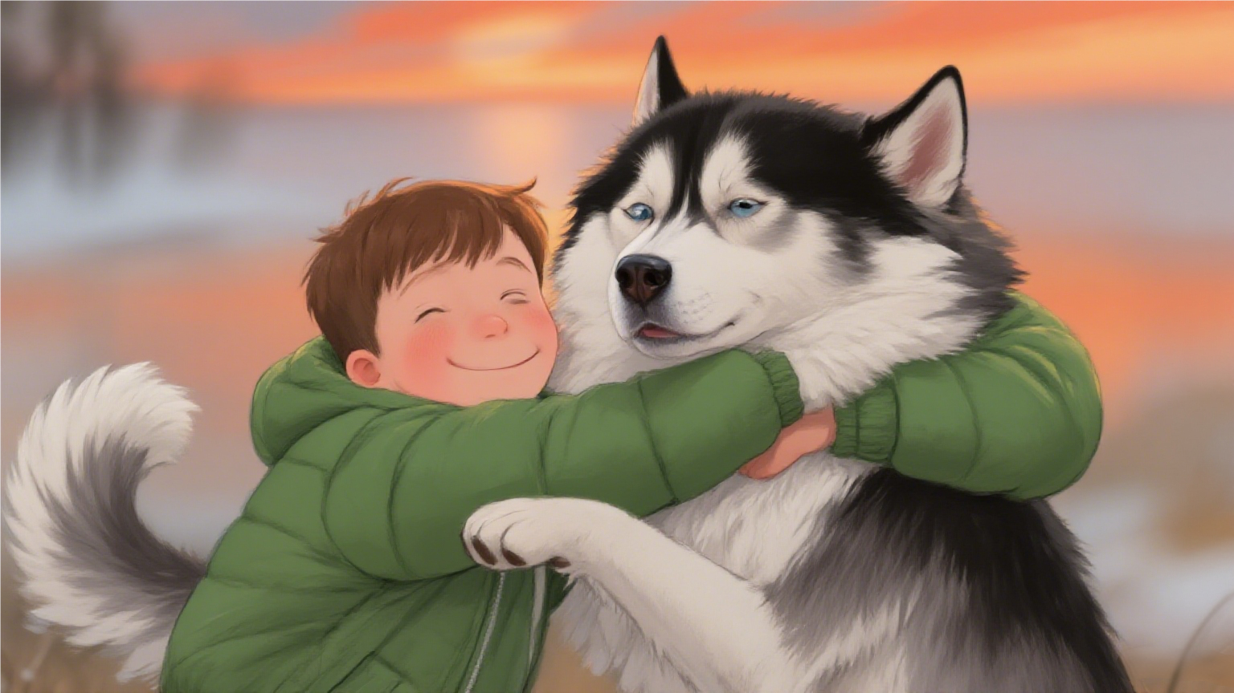
Thank you

