Slide 1

感恩遇见，相互成就，本课件资料仅供您个人参考、教学使用，严禁自行在网络传播，违者依知识产权法追究法律责任。
更多教学资源请关注
公众号：溯恩高中英语
知识产权声明

Slide 2
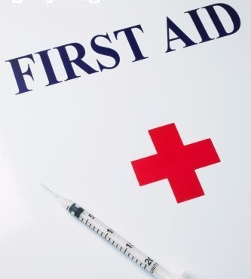
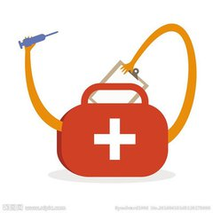
Unit 5
By Lucia

Slide 3
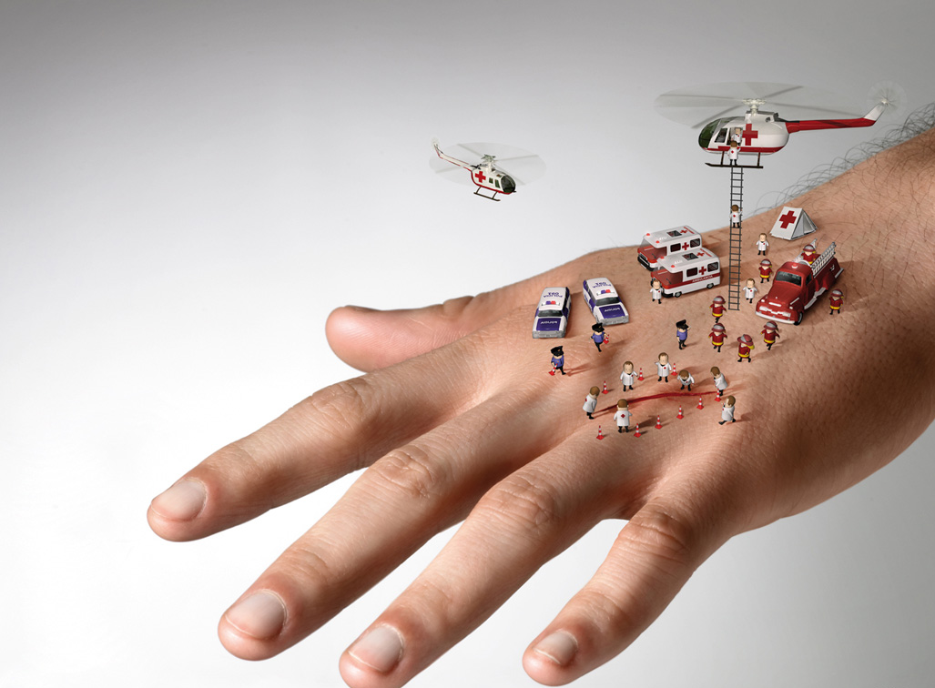
First Aid For Burns
Learning objectives:
At the end of this class, we (students) will be able to
1. grasp reading skills of exposition (especially including subtitles);
2. sort out the information on types and characteristics of burns as well as first aid treatment;
3. judge type of burns and give proper treatment with some key words, such as layer, barrier, mild, tissue, swell, char, be stuck to, in place;
4. develop respect for life and quality of helping others.

Slide 4
Pre-reading
While-reading
Post-reading
Assignment
Stage I
PRE-READING
First Aid For Burns

Slide 5
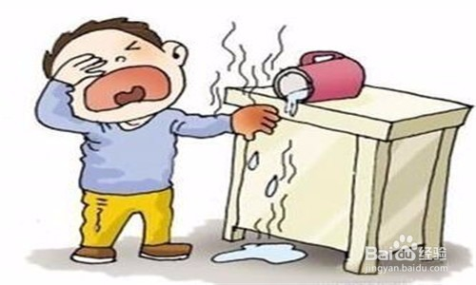
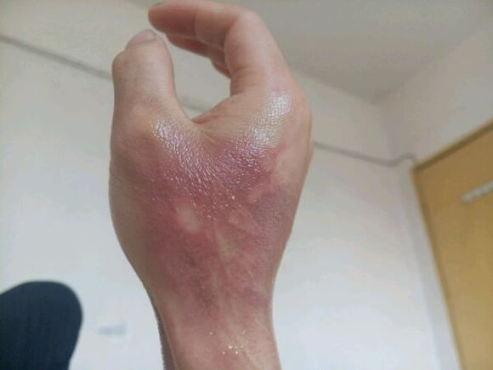
Pre-reading
While-reading
Post-reading
Assignment
Activity 1: Situation
I got hurt.

Slide 6

Pre-reading
While-reading
Post-reading
Assignment
Activity 1: Situation
Can you help me?

Slide 7
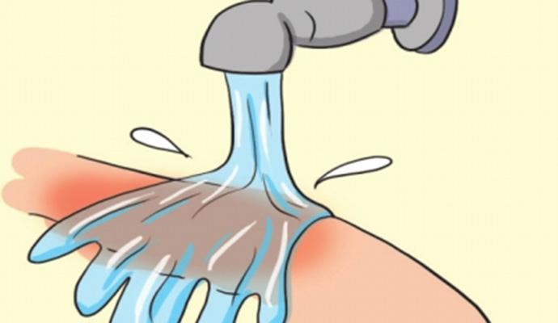

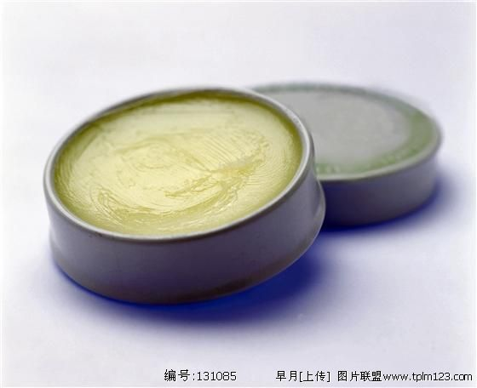
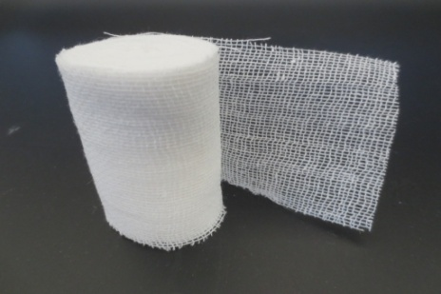
Pre-reading
While-reading
Post-reading
Assignment
Activity 1: Situation

Slide 8
Pre-reading
While-reading
Post-reading
Assignment
Stage II
WHILE-READING
First Aid For Burns

Slide 9

Pre-reading
While-reading
Post-reading
Assignment
Activity 2: Fast-reading
￭ Read fast and answer the two questions (1 min)
(1) What is the text type of this passage?
A. Narration
B. Argumentation
C. Exposition
Tip1: Narration is the process of telling a story or the description of events.
Exposition is usually a full explanation of a theory, plan, thing,etc.

Slide 10
Pre-reading
While-reading
Post-reading
Assignment
Tip2: The title and the picture(s) in the text will always be helpful when we try to get the main idea.
Activity 2: Fast-reading
(2) What is this passage mainly about?
Title
Subtitles
First aid for burns
Causes of burns
Types of burns
Characteristics of burns
First aid treatment

Slide 11
Pre-reading
While-reading
Post-reading
Assignment
Activity 3: careful-reading
Tip3: Table is an effective way for readers to grasp and sort out the details of a text.
1. Types | 2. Characteristics
Mildly
First degree burns | Affect the top______ of the skin | Dry, red and mildly _________ | _______ painful | Turn white when pressed
Second degree burns | Affect both the top & the second layers | ________, red and swollen | Extremely painful. | ________ watery surface
Third degree burns | Affect_____ ________ layers of the skin | Swollen; ______ can be seen | ______ or ____ pain | Black and white and _______
layer
swollen
Rough
Blisters
all
three
Little
no
tissue
charred

Slide 12
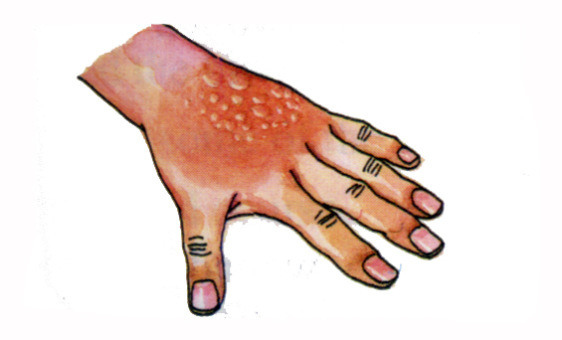
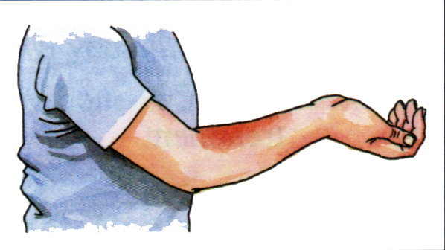
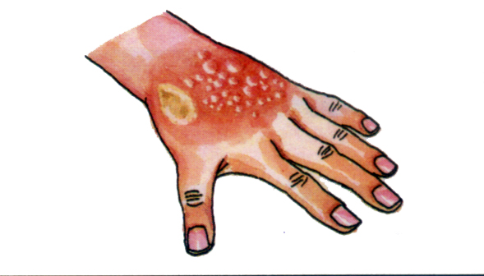
Pre-reading
While-reading
Post-reading
Assignment
Activity 3: careful-reading
Tip4: Self test
According to the description of the text, label(标记) these pictures with first degree burns, second degree burns and third degree burns.(pay attention to these details)
first degree burns
second degree burns
third degree burns

Slide 13


.
Pre-reading
While-reading
Post-reading
Assignment
Tip5: Pay attention to synonym(同义词), antonym and negative(否定词) in understanding details.
Activity 3: careful-reading
Right or Wrong?
First aid treatment
Take off clothing and jewelry near the burns.
Put butter, oil, ointment on burns
Cover the burned area with a dry clean bandage.
Remove the clothing that is stuck to the burns.
Keep the burned area higher than the heart, if
possible.
Cool the burns with cool but not icy water.

Slide 14
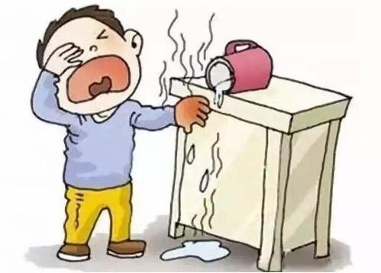
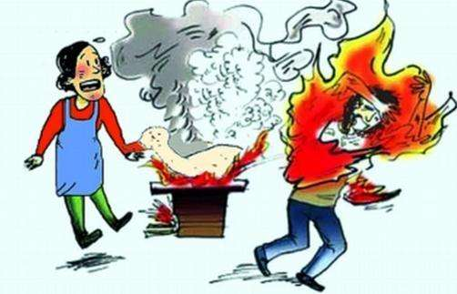

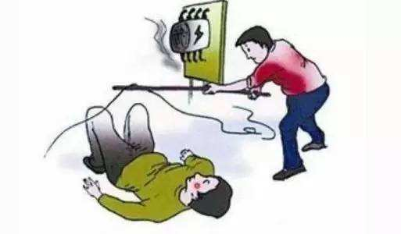
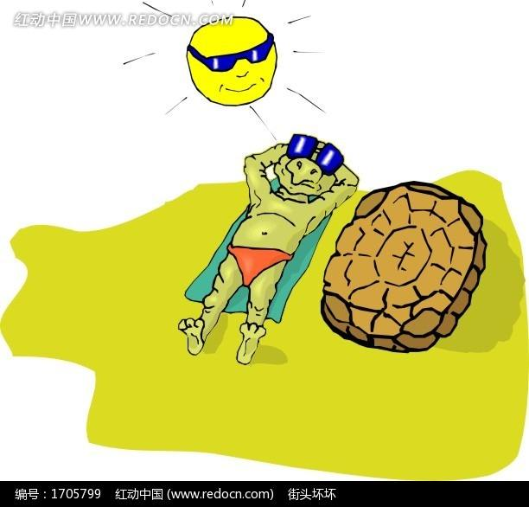
Pre-reading
While-reading
Post-reading
Assignment
Activity 3: careful-reading
What else causes burns?
hot liquid/steam
fire/radiation
chemicals
sun
electricity

Slide 15
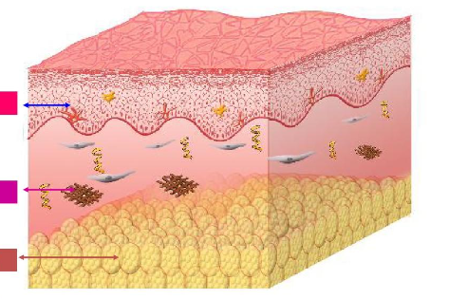
Pre-reading
While-reading
Post-reading
Assignment
Activity 3: careful-reading
What adjectives are used to describe the function of skin?
largest organ
essential
The top layer
barrier
The second layer
complex
The third layer
keep
prevent
give

Slide 16
Pre-reading
While-reading
Post-reading
Assignment
Stage III
POST-READING
First Aid For Burns

Slide 17

Pre-reading
While-reading
Post-reading
Assignment
Activity 4: Presentation
1. Enjoy & think: when you come across the accident like this, what will you do?

Slide 18
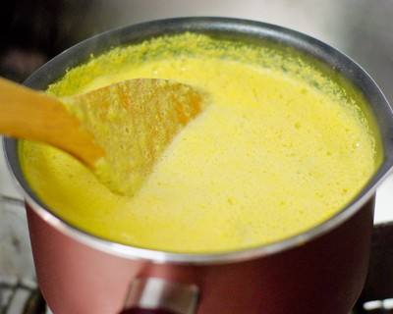
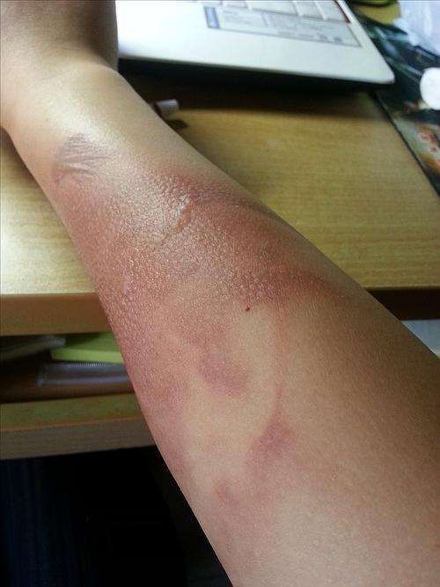

Pre-reading
While-reading
Post-reading
Assignment
3 minutes
Activity 4: Presentation
2. Prepare
Judge which degree of burns it belongs to.
Take measures to treat it.
Show it.
Description: 1 person —— Performance: 2 persons
Boiling liquid

Slide 19

Pre-reading
While-reading
Post-reading
Assignment
Activity 4: Presentation

Slide 20
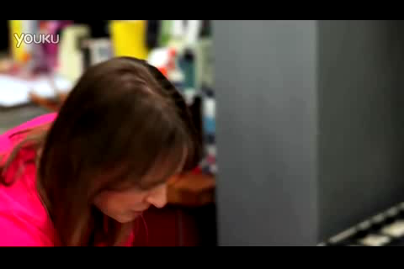
Pre-reading
While-reading
Post-reading
Assignment
Activity 4: Presentation
3. Learn: when we come across the accident,
we can do it like this.

Slide 21
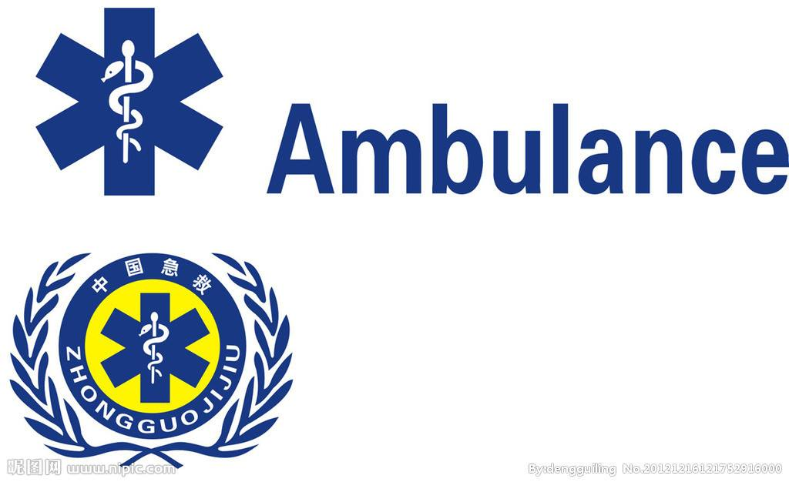
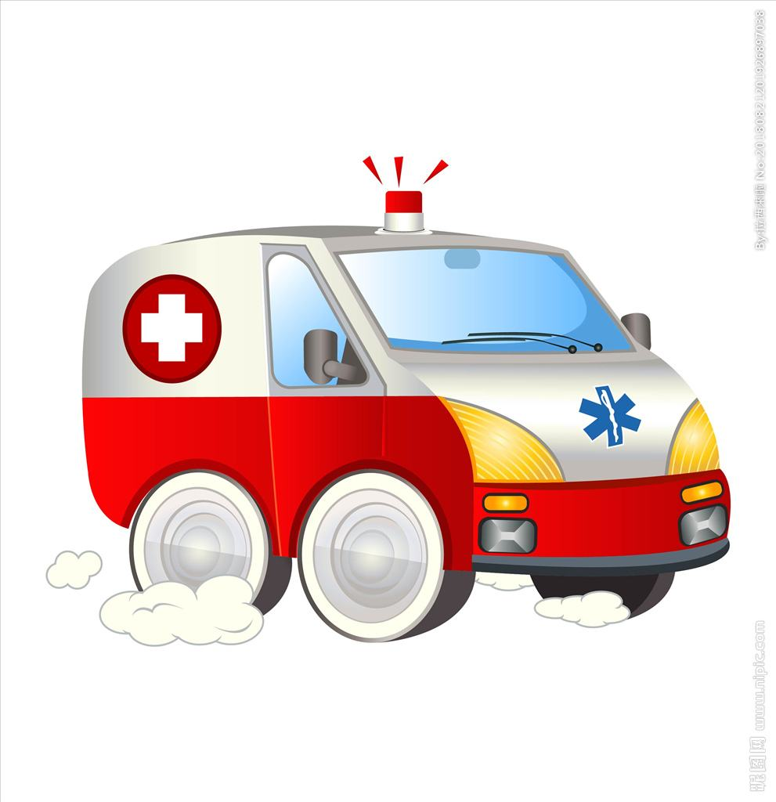
Pre-reading
While-reading
Post-reading
Assignment
Activity 4: Presentation
Life is precious while it is also weak.
It is necessary to master some first aid knowledge.

Slide 22
Pre-reading
While-reading
Post-reading
Assignment
▌迁移创新类活动
Tip8: Reflecting on your attitude and performance in class will help you to improve your learning efficiency.
Activity 5: Reflection
课堂学习反思评价表 (tick √)
Items For Reflection | Agree | Partly Agree | Disagree
Have I known the text type?
Have I grasped the words and phrases about first aid for burns in the text?
Can I introduce types of burns and first aid treatment in English now?
Was I active in group work?
What do I still need to practice in the future? _________________________________________________________________

Slide 23
Pre-reading
While-reading
Post-reading
Assignment
Stage IV
ASSIGNMENT
First Aid For Burns

Slide 24
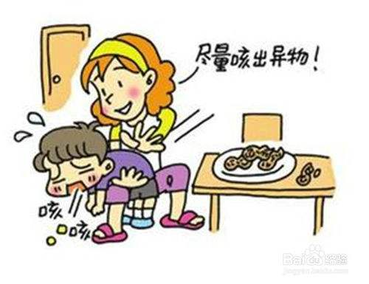
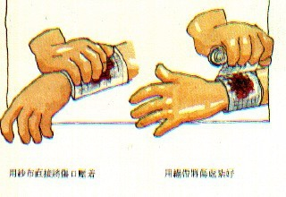
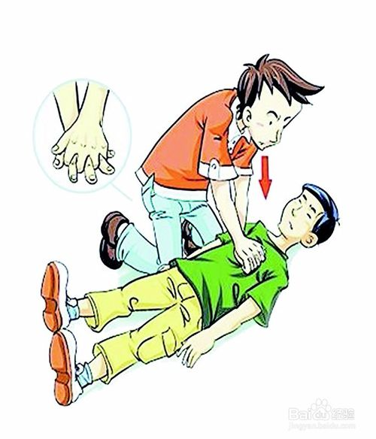
Pre-reading
While-reading
Post-reading
Assignment
Assignment
In our daily life, nobody knows which comes first, tomorrow or accident?
Imitate (模仿) what you have learned in this class and imagine: When you come across the accident like this, what will you do?
choking
bleeding
heart attack

Slide 25
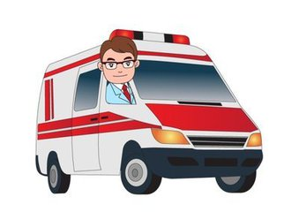
Thanks for listening!
王丹妮 重庆市为明学校

