Slide 1


感恩遇见，相互成就，本课件资料仅供您个人参考、教学使用，严禁自行在网络传播，违者依知识产权法追究法律责任。
更多教学资源请关注
公众号：溯恩英语
知识产权声明

Slide 2
2024年6月8号全国一卷听力精听课件
瑞安新纪元高中
焦海滨老师制作

Slide 3


影响听力的因素
心理因素学生在进行听力练习或考试时往往表现为听音时感到紧张、焦虑因而导致无法正常听音。
壹
缺乏背景知识由于没有语言环境，学生很少了解听力材料中的背景知识，无法做出正确的判断、推理、猜测。
贰
叁
学生缺乏听力解题技巧研究发现，很多情况下由于听者未能掌握相关的听力技巧，因而不能很好地理解听力材料。
肆
词汇储备不足一个学生的听、说、读、写要达到一定的水平，必须拥有相应数量的必备词汇。

Slide 4

语音知识对听力的影响
在听力理解的过程中，语音是第一位的，听者首先接受的是语音信息，大脑接受了因素，音节，中音等因素构成的单词，短语和句子后使他们在自己的语言图式中“对号入座”，根据已有的知识结构( 图式 ),开始对该信息进行建构，以理解其意义。

Slide 5
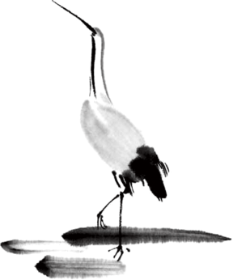
语速的加快主要有一下三种原因
壹
贰
叁
连读
（ 以下用红色标记 )
省音
（ 以下用蓝色标记 ）
音变
（以下用黄色标记 ）

Slide 6


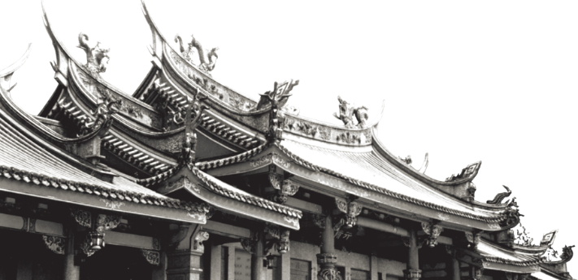
一，连读 （ 以下用红色标记 )
1，“辅音+元音”型连读（异性相吸）
如：I’d like another bowl of rice.
2、“辅音+半元音”型连读英语语音中的/j/和/w/是半元音，如果前一个词是以辅音结尾，后一个词是以半元音，特别是/j/开头，此时也要连读。Thank you .

Slide 7

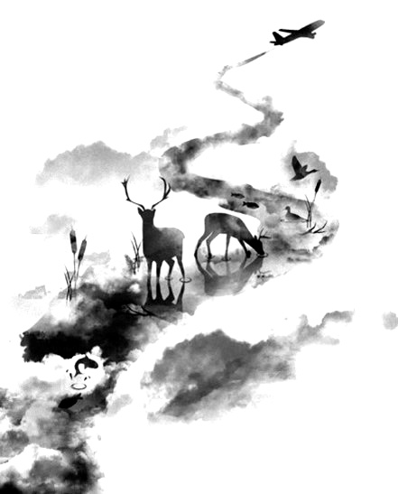

二，省音 （以下用蓝色标记）
01
壹
一、爆破音/b/ /p/ /d/ /t/ /g/ /k/
1.以上任何一个爆破音后面如果紧接着是一个辅音或者半元音，那么这个爆破音将不再发音，仅空半拍就行。如：Good morning!可以发为/gu_'mɔ:niŋ/。
2.以上任何一个爆破音在句尾时，这个爆破音不再发音。如：Good night!最后的/t/音便不再发，整句话可读作/gu_nai_/。

Slide 8
省音 （以下用蓝色标记）
01
二、不完全爆破
① 爆破音中的任何两个爆破音相邻时，前一爆破音失去爆破。如：a big car等。
② 爆破音中的任何一个后接摩擦音f,h,x,sh,s,r时，前面的爆破音失去爆破。
如：I didn't say so.
③ 爆破音后接/t/， /d/， /tr/， /dr /时，前面的爆破音失去爆破。如：a great change等。
④ 爆破音后接/m/, /n/, /l/, /s/时，前面的爆破音失去爆破。如：a bit more expensive等。

Slide 9
省音 （以下用蓝色标记）
01
三、/s/-/z/ /ts/-/dz/ /∫/-/ ʒ / /t∫/-/ dʒ / /θ/-/ ð / ds发/dz以上任何两个音相遇，只读后面的那个音，而前面的音则省略不发。
如：Who is Stone?可把前面一个/z/省掉，只读作/hu i stəun /。

Slide 10
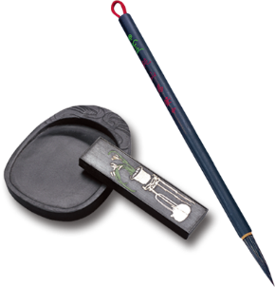
音的变化也是一种连读现象，两个词之间非常平滑的
过渡，导致一个音受临音影响而变化。
主要是以下两种方式：
1、 辅音[d]与[j]相邻时，被同化为[dʒ]：
Would you....?
2、 辅音[t]与[j]相邻时，被同化为[t∫]：
Can’t you？
三，音变
（以下用黄色标记 ）

Slide 11
听力试音材料
M:Hello ! International Friends Club , can I help you ?
W: Oh , hello ! I read about your club in the paper today . And I thought I’d phone to find out a bit more .
M:Yes , certainly . well , we’re a sort of social club for people from different countries . It’s quite a new club .we have about 50 members at the moment but we’re growing all the time .

Slide 12
听力试音材料
W: That sounds interesting .I’m British actually ,and I came to Washington about three months ago ,I’m looking for ways to meet people . . Er ,what kinds of events do you organize ?
M: well , we have social get-togethers ,and sports events ,and we also have language evenings
W: Could you tell me something about the language evenings ?

Slide 13
听力试音材料
M: Yes , every day except Thursday , we have a language evening. People can come and practice their languages .you know , over a drink or something .we have different languages on different evenings . Monday -Spanish; Tuesday- Italian ;Wednesday- German and Friday- French .On Thursday we usually have a meal in a restaurant for everyone who wants to come .

Slide 14
听力试音材料
W:well,that sounds Great , I really need to practice my French .
M: Ok , well if you can just give me your name and address I’ll send you the form and some more information .If you join now ,you can have first month free .

Slide 15


例题
M:Excuse me ,can you tell me how much the shirt is ?
W：Yes, it’s nine-fifteen.
例：How much is the shirt?
A. ￡19.15. B. ￡9.18. C. ￡9.15.

Slide 16


Text 1 机场送行
A: Thanks for the wonderful weekend, Kate.
B: That’s OK. Bob and I are glad you came to see us.
A: Oh, I have to go in, my_____ will _______ soon. Do contact me when you’re in Sydney.
B: Sure, we will.
1.What is Kate doing?
A.Boarding a flight. B.Arranging a trip C.Seeing a friend off.

Slide 17

Text 1 机场送行
A: Thanks for the wonderful weekend, Kate.
B: That’s OK. Bob and I are glad you came to see us.
A: Oh, I have to go in, my flight will take off soon. Do contact me when you’re in Sydney.
B: Sure, we will.
1.What is Kate doing?
A.Boarding a flight. B.Arranging a trip C.Seeing a friend off.

Slide 18
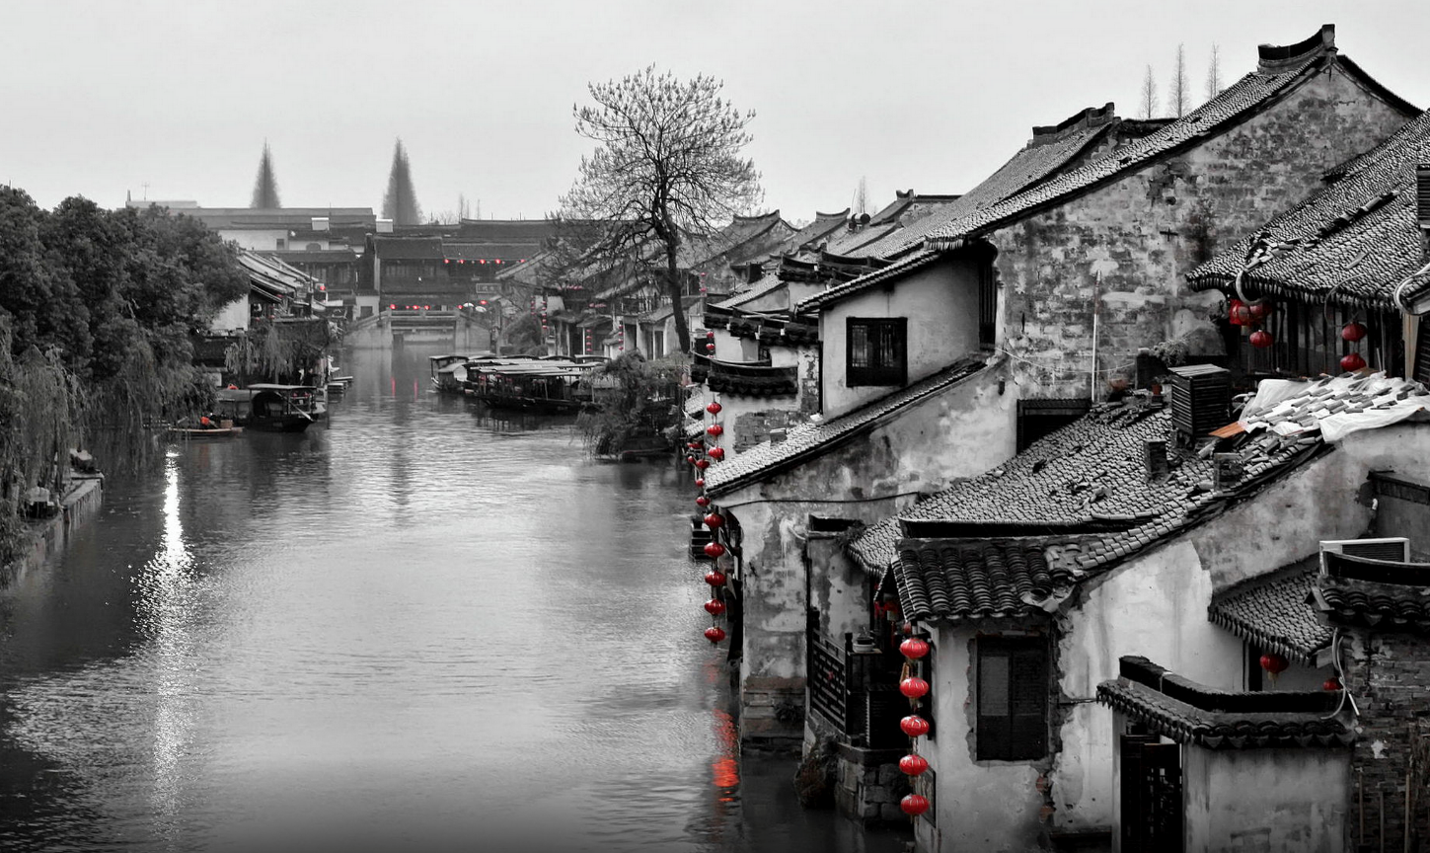
Text 2 回忆婚礼时的场景
——————————
A: Paul, Listen to the radio. It’s You’ve Stolen My Heart-___ of the _____ _______ at our wedding.
B: Yeah, how beautiful! ____ been ______ for almost 2 ________.
2.What are the speakers talking about?
A.A pop star. B.An old song C.A radio program

Slide 19
Text 2 回忆婚礼时的场景
——————————
A: Paul, Listen to the radio. It’s You’ve Stolen My Heart-one of the songs played at our wedding.
B: Yeah, how beautiful! It’s been popular for almost 2 decades.
2.What are the speakers talking about?
A.A pop star. B.An old song C.A radio program

Slide 20
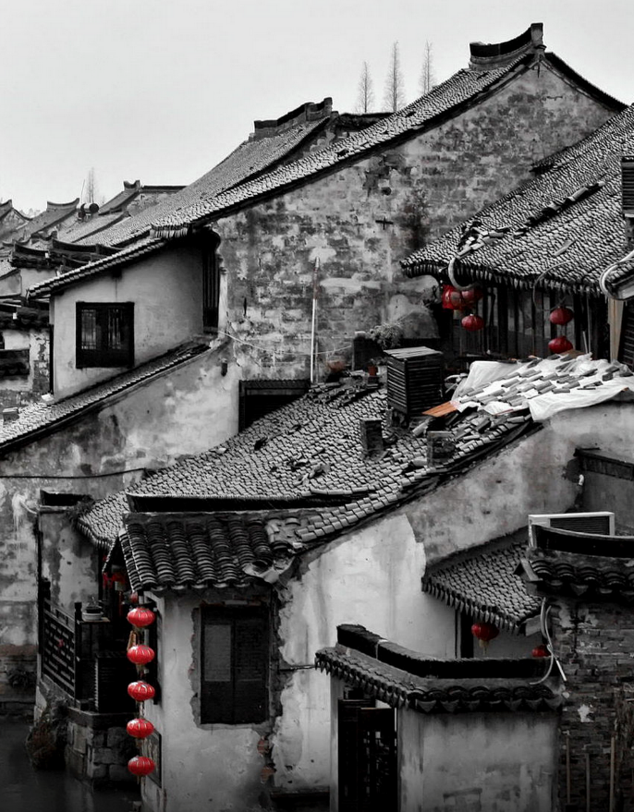
Text 3 计划被取消的失望
A: David, Forget about Mark. His aunt is in town. So, he ____ go with us ____.
B: Oh, What a pity. It's the ____ ____ of the ____ _____.
3.What will the speakers do today?
A.Go to an art show. B.Meet the man's aunt. C.Eat out with Mark
天人合一
天 下 皆 知 美 之 为 美 ， 斯 恶 已
皆 知 善 之 为 善 ， 斯 不 善 已
有 无 相 生 ， 难 易 相 成 ， 长 短 相 形
高 下 相 盈 ， 音 声 相 和 ， 前 后 相 随
恒 也

Slide 21
Text 3 计划被取消的失望
A: David, Forget about Mark. His aunt is in town. So, he can't go with us today.
B: Oh, What a pity. It's the last day of the art show.
3.What will the speakers do today?
A.Go to an art show. B.Meet the man's aunt. C.Eat out with Mark
天人合一
天 下 皆 知 美 之 为 美 ， 斯 恶 已
皆 知 善 之 为 善 ， 斯 不 善 已
有 无 相 生 ， 难 易 相 成 ， 长 短 相 形
高 下 相 盈 ， 音 声 相 和 ， 前 后 相 随
恒 也

Slide 22

T Text 4 37词 购物送货日期的问题
A: How may I help you?
B: I bought a desk and asked for it ______________ to my house this ______.
A: Yes, what’s the problem?
B: I need to ______ it __________ this _________.
4.What does the man want to do?
A.Cancel an order. B.Ask for a receipt. C.Reschedule a delivery.

Slide 23
T Text 4 37词 购物送货日期的问题
A: How may I help you?
B: I bought a desk and asked for it to be delivered to my house this Friday.
A: Yes, what’s the problem?
B: I need to have it delivered this Saturday.
4.What does the man want to do?
A.Cancel an order. B.Ask for a receipt. C.Reschedule a delivery.

Slide 24
Text 5 解决火车错过及改趟问题
A: Next please.
B: Oh, hi! I missed my 9 o’clock train to Bedford. Do I have to buy another ticket?
A: No, the ____ ______ leaves at _________ at platform 11.
B: Thank you.
5.When will the next train to Bedford leave?
A.At 9:45. B.At 10:15 C.At 11:00.

Slide 25
Text 5 解决火车错过及改趟问题
A: Next please.
B: Oh, hi! I missed my 9 o’clock train to Bedford. Do I have to buy another ticket?
A: No, the next train leaves at 9:45 at platform eleven.
B: Thank you.
5.When will the next train to Bedford leave?
A.At 9:45. B.At 10:15 C.At 11:00.

Slide 26
Text 6 谈论天气及面对极端天气问题
A: Honey, have you checked today’s _______ forecast?
B: Yes, it’s ____ and _____. there is a _______ for ______ wind up to 100 km/h.
A: What are we going to do then?
B: Nothing much, just stay indoors. There is a _____, _____ trees and power lines,
A: Right.
B: And _____temperatures could bring______ to the forest area.
A: I hope it’s over quickly.
M: Well, it won't get better until late Wednesday. Anyway, I have to ______________away from the trees.
W: Yeah, you cannot be too careful.
6.What will the weather be like today?
A.Stormy B.Sunny C.Foggy
7.What is the man going to do?
A.Plant a tree. B.Move his car C.Check the map

Slide 27
Text 6 谈论天气及面对极端天气问题
A: Honey, have you checked today’s weather forecast?
B: Yes, it’s cold and wet. there is a warning for strong winds up to 100 km/h.
A: What are we going to do then?
B: Nothing much, just stay indoors. There is a risk, falling trees and power lines,
A: Right.
B: And low temperatures could bring snow to the forest area.
A: I hope it’s over quickly.
M: Well, it won't get better until late Wednesday. Anyway, I have to move the car away from the trees.
W: Yeah, you cannot be too careful.
6.What will the weather be like today?
A.Stormy B.Sunny C.Foggy
7.What is the man going to do?
A.Plant a tree. B.Move his car C.Check the map

Slide 28
Text 7 朋友之间的嘘寒问暖
A: Hello Dave, this is Kathy from Sunny California.
B: Hi, Kathy. you finally called. How was the______? All _____ ______?
A: Sorry I hadn’t called sooner, but it’s been a busy month or slowly getting things set up in our new home.
A: Yeah, I understand. How are _____ and the_______?
B: _____ doing well with his new job, _____ has made many new friends here and has a lot to do._____ is fine. Oh, she misses her grandma. By the way _____ you for _______________ my mother from time to time. I ____ her every week, but it isn’t the same as ______ her.
A: No problem. Betty and I are friends now. how is the weather there?
B: It’s nice and warm and we are able to spend some time every week on the beach with the children.
A: that’s great.

Slide 29
Text 7 朋友之间的嘘寒问暖
A: Hello Dave, this is Kathy from Sunny California.
B: Hi, Kathy. you finally called. How was the move? All settled in?
A: Sorry I hadn’t called sooner, but it’s been a busy month or slowly getting things set up in our new home.
A: Yeah, I understand. How are Jeff and the children?
B: Jeff doing well with his new job, Tom has made many new friends here and has a lot to do. Fiona is fine. Oh, she misses her grandma. By the way thank you for looking in on my mother from time to time. I call her every week, but it isn’t the same as seeing her.
A: No problem. Betty and I are friends now. how is the weather there?
B: It’s nice and warm and we are able to spend some time every week on the beach with the children.
A: that’s great.

Slide 30
8.Why is Kathy in California now? A.She is on vacation there.
B.She has just moved there.
C.She is doing business there. 9.What is the relationship between Tom and Fiona? A.Husband and wife.
B.Brother and sister.
C.Father and daughter. 10.What does Kathy thank Dave for?( 同义转述） A.Finding her a new job.
B.Sending her a present.
C.Calling on her mother.

Slide 31
Text 8 上学方式的变化及其影响
A: Jack, how did you get to school when you were in primary school?
B: I lived _____ to my school so I ______ every day. Why?
A: Well, I remember that when we were kids, we often walked ,rode a bike or caught the bus to school. Few of us were dropped off at the school gate by our parents.
B: I see what you mean, these days you can see traffic jams around schools that drop off and pick-up times, but it’s hard to blame the parents. They have good _____ for driving their kids to school mostly to do with ______ and _________.
A: You have a _____ there, but it also means children are missing out on much needed exercise and other life skills. Some _____ are just being __________ with their children learning nothing but living in fear of everything. Studies have found the children who spend more time outside tend to be healthier, better adjusted and better at dealing with stress.

Slide 32
Text 8 上学方式的变化及其影响
A: Jack, how did you get to school when you were in primary school?
B: I lived close to my school so I walked every day. Why?
A: Well, I remember that when we were kids, we often walked ,rode a bike or caught the bus to school. Few of us were dropped off at the school gate by our parents.
B: I see what you mean, these days you can see traffic jams around schools that drop off and pick-up times, but it’s hard to blame the parents. They have good reasons for driving their kids to school mostly to do with safety and convenience.
A: You have a point there, but it also means children are missing out on much needed exercise and other life skills. Some parents are just being overprotective with their children learning nothing but living in fear of everything. Studies have found the children who spend more time outside tend to be healthier, better adjusted and better at dealing with stress.

Slide 33


11.How did Jack go to school when he was a child?
A.By bike.
B.On foot.
C.By bus.
12.What is Jack's attitude toward parents driving their kids to school?
A.Disapproving.
B.Encouraging
C.Understanding.
13.What is the problem with some parents according to the woman? A.Overprotecting their children.
B.Pushing their children too hard.
C.Having no time for their children.

Slide 34
Text 9 厨房园艺爱好者如何通过社交媒体记录种植进展
A: So, Marie your kitchen garden looks excellent. What made you turn to __________ to _______ your vegetable_______?
B: Initially, I used the _______ platform as a _______, something to look back on, giving me a sense of achievements and keeping me motivated and moving forward. As time went by, other gardeners and like-minded people began to follow my progress, too.
A: I know you grow lots of fruit on your land. _______ would you__________ to beginners as the best to grow?
B: Strawberries would be______________. They _______ a lot of _______ in their first season.
A: That's cool. Well, do you have plans to try new or any particular crops next year?
B: Next season I will be adding some pear trees to the fruit area. I will be adding more herbs which I can use in the kitchen. After a couple of years of _______, I will try growing ______ again.
A: What advice would you offer someone thinking of doing kitchen gardening?
B: Have a plan of what you want your kitchen garden to look like. ______ be too _________ if things don't go according to plan. Learn from your mistakes and move on. There's always next season.

Slide 35
Text 9 厨房园艺爱好者如何通过社交媒体记录种植进展
A: So Marie ,your kitchen garden looks excellent. What made you turn to social media to record your vegetable growing?
B: Initially, I used the online platform as a diary, something to look back on, giving me a sense of achievements and keeping me motivated and moving forward. As time went by, other gardeners and like-minded people began to follow my progress, too.
A: I know you grow lots of fruit on your land. Which would you recommend to beginners as the best to grow?
B: Strawberries would be a good choice. They produce a lot of fruit in their first season.
A: That's cool. Well, do you have plans to try new or any particular crops next year?
B: Next season I will be adding some pear trees to the fruit area. I will be adding more herbs which I can use in the kitchen and after a couple of years of failure, I will try growing carrots again.
A: What advice would you offer someone thinking of doing kitchen gardening?
B: Have a plan of what you want your kitchen garden to look like. Don't be too discouraged if things don't go according to plan. Learn from your mistakes and move on. There's always next season.

Slide 36
14.Why did Marie post her kitchen gardening online at first?
A.To keep records of her progress.
B.To sell home-grown vegetables.
C.To motivate her fellow gardeners.
15.Why does Marie recommend beginners to grow strawberries?
A.They need no special care.
B.They can be used in cooking.
C.They bear a lot of fruit soon.
16.What is difficult for Marie to grow?
A.Herbs. B.Carrots. C.Pears.
17.What is Marie's advice to those interested in kitchen gardening?
A.Aim high.
B.Keep focused.
C.Stay optimistic

Slide 37
Text 10 著名体育作家Jacob Johnson的访谈介绍
Welcome to Meet the Author. Well, many readers of Sports Times _______ the _______ of their magazine first in order to read Jacob Johnson's weekly article under the title Life of Johnson, the______ along with his ______ and ______ collections have _____ Johnson the ________ as one of the ______ humans on the planet. Johnson began writing about sports as a second-year student at the University of Colorado, covering high school volleyball games for his hometown newspaper. After graduating in _______, he moved on to work at the Denver Weekly for_____years and the Los Angeles Post for ____________ before ______ at Sports Times. He has been voted national sports writer of the year 11 times. So now let's welcome the funny man with serious tone, Jacob Johnson.

Slide 38
Text 10 著名体育作家Jacob Johnson的访谈介绍
Welcome to Meet the Author. Well, many readers of Sports Times turn to the last page of their magazine first in order to read Jacob Johnson's weekly article under the title Life of Johnson, the articles along with his novels and essay collections have earned Johnson the reputation as one of the funniest humans on the planet. Johnson began writing about sports as a second-year student at the University of Colorado, covering high school volleyball games for his hometown newspaper. After graduating in 1981, he moved on to work at the Denver Weekly for 2 years and the Los Angeles Post for two more years before landing at Sports Times. He has been voted national sports writer of the year 11 times. So now let's welcome the funny man with serious tone, Jacob Johnson.

Slide 39
18.What is“Life of Johnson”?
A.A magazine column.
B.A TV series.
C.A historical novel.
19.What is Johnson famous for?
A.His acting talent
B.His humorous writing.
C.His long sports career.
20.When did Johnson join Sports Times?
A.In 1981.
B.In 1983.
C.In 1985.

Slide 40
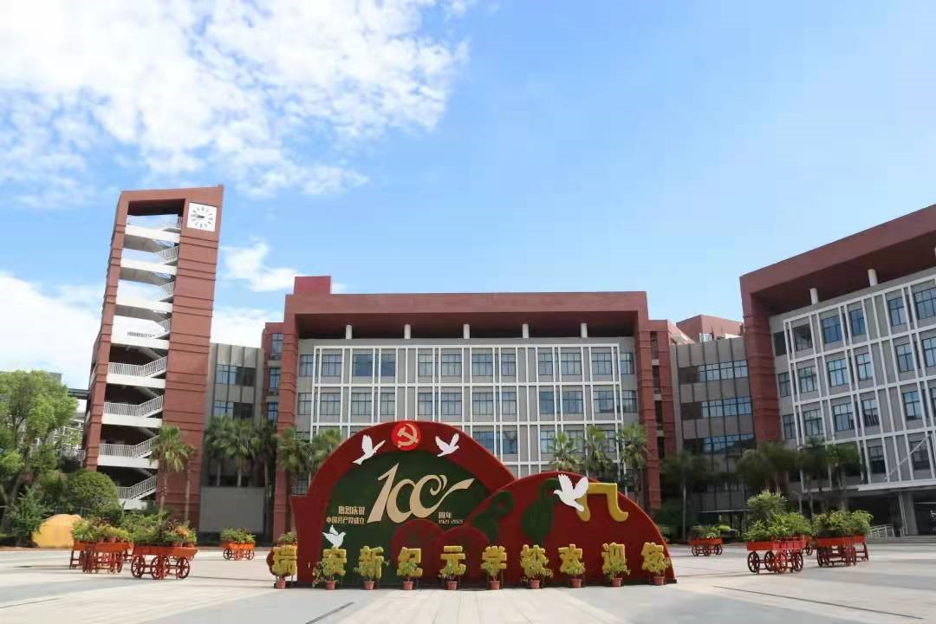
祝各位考生金榜题名！
欢迎指导

