Slide 1


感恩遇见，相互成就，本课件资料仅供您个人参考、教学使用，严禁自行在网络传播，违者依知识产权法追究法律责任。
更多教学资源请关注
公众号：溯恩英语
知识产权声明

Slide 2


从语篇结构突破新闻报道类高考真题
华南师范大学附属惠阳学校 梁晓林

Slide 3

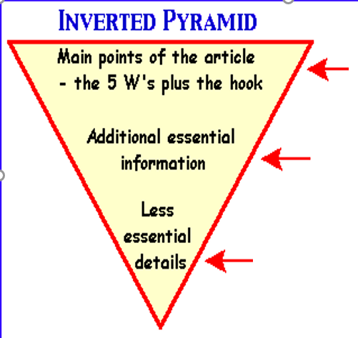
一
1.Event (who /what/why):
2. Details：
3. Background information and significance
倒金字塔结构一般用于新闻报道，是按照新闻价值的大小，即新闻事实的重要程度、新鲜程度，以及读者感兴趣的程度等，依次将新闻事实写出的一种结构形式。由于这种结构格局前边重、后边轻，上头大、下头小，所以称之为“倒金字塔”或“倒三角”结构。

Slide 4
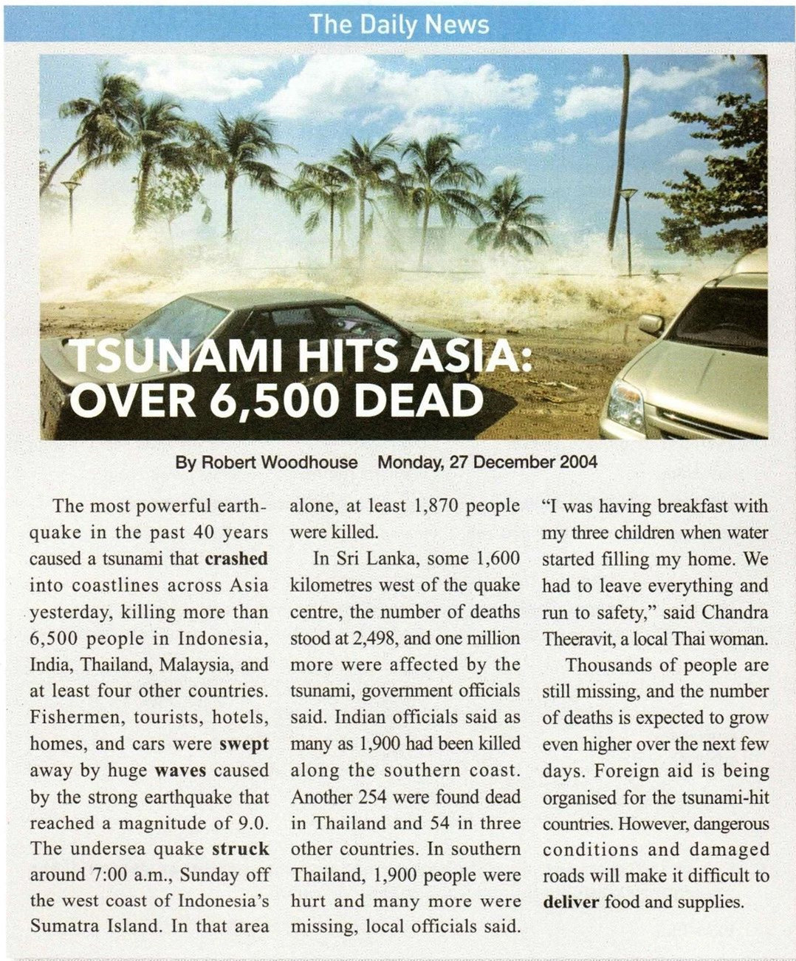
二
文本结构复习与回顾
What’s the genre of the text?
News report.

Slide 5
Understand the structure of the news
A NEWS REPORT
Title
01
02
Reporter
03
Time
04
Lead
Body
05
06
End

Slide 6

Analyse the content of the news
The most powerful earthquake in the past 40 years caused a tsunami that crashed into coastlines across Asia yesterday, killing more than 6,500 people in Indonesia, India, Thailand, Malaysia, and at least four other countries.
Lead
01
Event:
tsunami
02
Cause:
earthquake
03
Place:
coastlines across Asia
04
Efffect:
Main points of the news, usually including the event, cause, time, place, and effect.

Slide 7
Analyse the content of the news
Indian officials said as many as 1,900 had been killed along the southern coast. Another 254 were found dead in Thailand and 54 in three other countries. In southern Thailand, 1,900 people were hurt and many more were missing, local officials said. “I was having breakfast with my three children when water started filling my home. We had to leave everything and run to safety,” said Chandra Theeravit, a local Thai woman.
Body
01
India
02
Thailand
03
Southern Thailand
04
Specific examples
Details of the event and its effects

Slide 8
Analyse the content of the news
Thousands of people are still missing, and the number of deaths is expected to grow even higher over the next few days. Foreign aid is being organised for the tsunami-hit countries. However, dangerous conditions and damaged roads will make it difficult to deliver food and supplies.
End
01
Missing
02
Deaths
03
Foreign aid
04
Difficulties
Possible effects and other imformation about the event, or a conclusion

Slide 9
三
“倒金字塔”语篇结构高考真题总结
年份 | 试卷 | 主题语境 | 主题内容 | 主题意义 | 语篇类型
2024年 | 全国甲卷C篇 | 人与社会 | 俄罗斯政府开展医疗援助 | 培养学生的理想信念和社会责任感 | 说明类新闻报道
2023年 | 全国新高考II卷B篇 | 人与自我 | 校园菜园项目 | 增强学生劳动意识和劳动观念 | 记叙类新闻报道
2022年 | 全国新高考I卷C篇 | 人与社会 | 养老院老人养鸡 | 引导学生关爱老年人，热心公益事业 | 记叙类新闻报道
2021年 | 全国甲卷B篇 | 人与自然 | 保护黑犀牛所实施的繁殖计划 | 保护野生动物，人与自然和谐相处 | 说明类新闻报道
2021年 | 全国新高考II卷C篇 | 人与社会 | 一位英国女教师让艺术家走进课堂，引发课堂变革 | 重视艺术教育，提高中和文化素养 | 议论类新闻报道
2021年 | 全国乙卷C篇 | 人与自然 | 艺术家将塑料做成引人深思的雕塑 | 保护生态环境，关注并参与人类命运共同体的构建 | 说明类新闻报道

Slide 10
四．
梳理高考真题新闻报道类语篇结构，助力阅读理解
1.2023.6新高考II卷B篇
①Turning soil, pulling weeds, and harvesting cabbage sound like tough work for middle and high school kids. And at first it is, says Abby Jaramillo, who with another teacher started Urban Sprouts, a school garden program at four low-income schools. The program aims to help students develop science skills, environmental awareness, and healthy lifestyles.
②Jaramillo’s students live in neighborhoods where fresh food and green space are not easy to find and fast food restaurants outnumber grocery stores. “The kids literally come to school with bags of snacks and large bottles of soft drinks,” she says. “They come to us thinking vegetables are awful, dirt is awful, insects are awful.” Though some are initially scared of the insects and turned off by the dirt, most are eager to try something new.
③Urban Sprouts’ classes, at two middle schools and two high schools, include hands-on experiments such as soil testing, flower-and-seed dissection, tastings of fresh or dried produce, and work in the garden. Several times a year, students cook the vegetables they grow, and they occasionally make salads for their entire schools.
④Program evaluations show that kids eat more vegetables as a result of the classes. “We have students who say they went home and talked to their parents and now they’re eating differently,” Jaramillo says.
⑤She adds that the program’s benefits go beyond nutrition. Some students get so interested in gardening that they bring home seeds to start their own vegetable gardens. Besides, working in the garden seems to have a calming effect on Jaramillo’s special education students, many of whom have emotional control issues. “They get outside,” she says, “and they feel successful.
What (event)+ who+purpose
background information
Implementation
evaluation/significance 1
significance 2

Slide 11
4. What do we know about Abby Jaramillo?
A. She used to be a health worker.
B. She grew up in a low-income family.
C. She owns a fast food restaurant.
D. She is an initiator of Urban Sprouts.
5. What was a problem facing Jaramillo at the start of the program?
A. The kids’ parents distrusted her.
B. Students had little time for her classes.
C. Some kids disliked garden work.
D. There was no space for school gardens.
6. Which of the following best describes the impact of the program?
A. Far-reaching. B. Predictable.
C. Short-lived. D. Unidentifiable.
7. What can be a suitable title for the text?
A. Rescuing School Gardens
B. Experiencing Country Life
C. Growing Vegetable Lovers
D. Changing Local Landscape
What (event)+ who+purpose
background information
implementation
evaluation/significance 1
significance 2

Slide 12
4. What do we know about Abby Jaramillo?
A. She used to be a health worker.
B. She grew up in a low-income family.
C. She owns a fast food restaurant.
D. She is an initiator of Urban Sprouts.
5. What was a problem facing Jaramillo at the start of the program?
A. The kids’ parents distrusted her.
B. Students had little time for her classes.
C. Some kids disliked garden work.
D. There was no space for school gardens.
6. Which of the following best describes the impact of the program?
A. Far-reaching. B. Predictable.
C. Short-lived. D. Unidentifiable.
7. What can be a suitable title for the text?
A. Rescuing School Gardens
B. Experiencing Country Life
C. Growing Vegetable Lovers
D. Changing Local Landscape

Slide 13
2. 2022.6新高考1卷C篇
What (event)+ who+purpose
①The elderly residents (居民) in care homes in London are being given hens to look after to stop them feeling lonely.
②The project was dreamed up by a local charity (慈善组织) to reduce loneliness and improve elderly people’s wellbeing. It is also being used to help patients suffering dementia, a serious illness of the mind. Staff in care homes have reported a reduction in the use of medicine where hens are in use.
③Among those taking part in the project is 80-year-old Ruth Xavier. She said: “I used to keep hens when I was younger and had to prepare their breakfast each morning before I went to school.
④“I like the project a lot. I am down there in my wheelchair in the morning letting the hens out and down there again at night to see they’ve gone to bed.
⑤“It’s good to have a different focus. People have been bringing their children in to see the hens and residents come and sit outside to watch them. I’m enjoying the creative activities, and it feels great to have done something useful.”
⑥There are now 700 elderly people looking after hens in 20 care homes in the North East, and the charity has been given financial support to roll it out countrywide.
⑦Wendy Wilson, extra care manager at 60 Penfold Street, one of the first to embark on the project, said: “Residents really welcome the idea of the project and the creative sessions. We are looking forward to the benefits and fun the project can bring to people here.”
⑧Lynn Lewis, director of Notting Hill Pathways, said: “We are happy to be taking part in the project. It will really help connect our residents through a shared interest and creative activities.”
who+purpose
implementation
evaluation

Slide 14
28.What is the purpose of the project?
A. To ensure harmony in care homes.
B. To provide part-time jobs for the aged.
C. To raise money for medical research.
D. To promote the elderly people’s welfare.
purpose Para 2
②The project was dreamed up by a local charity (慈善组织) to reduce loneliness and improve elderly people’s wellbeing. It is also being used to help patients suffering dementia, a serious illness of the mind. Staff in care homes have reported a reduction in the use of medicine where hens are in use.

Slide 15
implementation
Para 5
29.How has the project affected Ruth Xavier?
A. She has learned new life skills.
B. She has gained a sense of achievement.
C. She has recovered her memory.
D. She has developed a strong personality.
⑤“It’s good to have a different focus. People have been bringing their children in to see the hens and residents come and sit outside to watch them. I’m enjoying the creative activities, and it feels great to have done something useful.”

Slide 16
30.What do the underlined words “embark on” mean in paragraph 7?
A. Improve.
B. Oppose.
C. Begin.
D. Evaluate.
evaluation
Para 7
⑦Wendy Wilson, extra care manager at 60 Penfold Street, one of the first to embark on the project, said: “Residents really welcome the idea of the project and the creative sessions. We are looking forward to the benefits and fun the project can bring to people here.”

Slide 17
31.What can we learn about the project from the last two paragraphs?
A. It is well received. B. It needs to be more creative.
C. It is highly profitable. D. It takes ages to see the results.
evaluation
Para 7-8
⑦Wendy Wilson, extra care manager at 60 Penfold Street, one of the first to embark on the project, said: “Residents really welcome the idea of the project and the creative sessions. We are looking forward to the benefits and fun the project can bring to people here.”
⑧Lynn Lewis, director of Notting Hill Pathways, said: “We are happy to be taking part in the project. It will really help connect our residents through a shared interest and creative activities.”

Slide 18
3.2021.6全国乙卷C篇
①You’ve heard that plastic is polluting the oceans—between 4.8 and 12.7 million tonnes enter ocean ecosystems every year. But does one plastic straw or cup really make a difference? Artist Benjamin Von Wong wants you to know that it does. He builds massive sculptures out of plastic garbage, forcing viewers to re-examine their relationship to single-use plastic products.
②At the beginning of the year, the artist built a piece called “Strawpocalypse,” a pair of 10-foot-tall plastic waves, frozen mid-crash. Made of 168,000 plastic straws collected from several volunteer beach cleanups, the sculpture made its first appearance at the Estella Place shopping center in Ho Chi Minh City, Vietnam.
③Just 9% of global plastic waste is recycled. Plastic straws are by no means the biggest source (来源)of plastic pollution, but they’ve recently come under fire because most people don’t need them to drink with and, because of their small size and weight, they cannot be recycled. Every straw that' s part of Von Wong's artwork likely came from a drink that someone used for only a few minutes. Once the drink is gone, the straw will take centuries to disappear.
④In a piece from 2018, Von Wong wanted to illustrate (说明) a specific statistic: Every 60 seconds, a truckload's worth of plastic enters the ocean. For this work, titled “Truckload of Plastic,” Von Wong and a group of volunteers collected more than 10,000 pieces of plastic, which were then tied together to look like they’d been dumped(倾倒)from a truck all at once.
⑤Von Wong hopes that his work will also help pressure big companies to reduce their plastic footprint.
What (event)+ who+purpose
implementation
(sculpture +
collecting plastic waste)
evaluation

Slide 19
28. What are Von Wong’s artworks intended for?
A. Beautifying the city he lives in.
B. Introducing eco-friendly products.
C. Drawing public attention to plastic waste.
D. Reducing garbage on the beach.
purpose
Para1
①You’ve heard that plastic is polluting the oceans—between 4.8 and 12.7 million tonnes enter ocean ecosystems every year. But does one plastic straw or cup really make a difference? Artist Benjamin Von Wong wants you to know that it does. He builds massive sculptures out of plastic garbage, forcing viewers to re-examine their relationship to single-use plastic products.

Slide 20
29. Why does the author discuss plastic straws in paragraph 3?
A. To show the difficulty of their recycling.
B. To explain why they are useful.
C. To voice his views on modern art.
D. To find a substitute for them.
implementation
Para3
③Just 9% of global plastic waste is recycled. Plastic straws are by no means the biggest source (来源)of plastic pollution, but they’ve recently come under fire because most people don’t need them to drink with and, because of their small size and weight, they cannot be recycled. Every straw that' s part of Von Wong's artwork likely came from a drink that someone used for only a few minutes. Once the drink is gone, the straw will take centuries to disappear.

Slide 21
30. What effect would "Truckload of Plastic" have on viewers?
A. Calming. B. Disturbing C Refreshing D. Challenging.
implementation
Para4
④In a piece from 2018, Von Wong wanted to illustrate (说明) a specific statistic: Every 60 seconds, a truckload's worth of plastic enters the ocean. For this work, titled “Truckload of Plastic,” Von Wong and a group of volunteers collected more than 10,000 pieces of plastic, which were then tied together to look like they’d been dumped(倾倒)from a truck all at once.

Slide 22
31. Which of the following can be the best title for the text?
A. Artists' Opinions on Plastic Safety
B. Media Interest in Contemporary Art
C. Responsibility Demanded of Big Companies
D. Ocean Plastics Transformed into Sculptures
What (event)+ who+purpose
Para1
①You’ve heard that plastic is polluting the oceans—between 4.8 and 12.7 million tonnes enter ocean ecosystems every year. But does one plastic straw or cup really make a difference? Artist Benjamin Von Wong wants you to know that it does. He builds massive sculptures out of plastic garbage, forcing viewers to re-examine their relationship to single-use plastic products.

Slide 23
4.2021.全国甲卷B篇
①Port Lympne Reserve, which runs a breeding(繁育) programme, has welcomed the arrival of a rare black rhino calf(犀牛幼崽）. When the tiny creature arrived on January 31, she became the 40th black rhino to be born at the reserve. And officials at Port Lympne were delighted with the new arrival, especially as black rhinos are known for being difficult to breed in captivity(圈养).
②Paul Beer, head of rhino section at Port Lympne, said:“Obviously we're all absolutely delighted to welcome another calf to our black rhino family. She's healthy, strong and already eager to play and explore. Her mother, Solio, is a first-time mum and she is doing a fantastic job. It's still a little too cold for them to go out into the open, but as soon as the weather warms up, I have no doubt that the little one will be out and about exploring and playing every day.”
③The adorable female calf is the second black rhino born this year at the reserve, but it is too early to tell if the calves will make good candidates to be returned to protected areas of the wild. The first rhino to be born at Port Lympne arrived on January 5 to first-time mother Kisima and weighed about 32kg. His mother, grandmother and great grandmother were all born at the reserve and still live there.
④According to the World Wildlife Fund, the global black rhino population has dropped as low as 5500, giving the rhinos a “critically endangered” status.
What (event)+ who+when
Details: the health condition new calf and her mother
background information

Slide 24
4.Which of the following best describes the breeding programme?
A.Costly. B.Controversial. C.Ambitious. D.Successful.
What (event)+ who+when
Para1
①Port Lympne Reserve, which runs a breeding(繁育) programme, has welcomed the arrival of a rare black rhino calf(犀牛幼崽）. When the tiny creature arrived on January 31, she became the 40th black rhino to be born at the reserve. And officials at Port Lympne were delighted with the new arrival, especially as black rhinos are known for being difficult to breed in captivity(圈养).

Slide 25
5.What does Paul Beer say about the new-born rhino?
A.She loves staying with her mother. B.She dislikes outdoor activities.
C.She is in good condition. D. She is sensitive to heat.
Details: the health condition new calf and her mother
Para 2
②Paul Beer, head of rhino section at Port Lympne, said:“Obviously we're all absolutely delighted to welcome another calf to our black rhino family. She's healthy, strong and already eager to play and explore. Her mother, Solio, is a first-time mum and she is doing a fantastic job. It's still a little too cold for them to go out into the open, but as soon as the weather warms up, I have no doubt that the little one will be out and about exploring and playing every day.”

Slide 26
6. What similar experience do Solio and Kisima have?
A.They had their first born in January.
B. They enjoyed exploring new places.
C.They lived with their grandmothers.
D.They were brought to the reserve young.
Details+background information
Para2+3
②Paul Beer, head of rhino section at Port Lympne, said:“Obviously we're all absolutely delighted to welcome another calf to our black rhino family. She's healthy, strong and already eager to play and explore. Her mother, Solio, is a first-time mum and she is doing a fantastic job. It's still a little too cold for them to go out into the open, but as soon as the weather warms up, I have no doubt that the little one will be out and about exploring and playing every day.”
③The adorable female calf is the second black rhino born this year at the reserve, but it is too early to tell if the calves will make good candidates to be returned to protected areas of the wild. The first rhino to be born at Port Lympne arrived on January 5 to first-time mother Kisima and weighed about 32kg. His mother, grandmother and great grandmother were all born at the reserve and still live there.

Slide 27
7. What can be inferred about Port Lympne Reserve?
A.The rhino section will be open to the public.
B.It aims to control the number of the animals.
C.It will continue to work with the World Wildlife Fund.
D.Some of its rhinos may be sent to the protected wild areas.
background information
Para3
③The adorable female calf is the second black rhino born this year at the reserve, but it is too early to tell if the calves will make good candidates to be returned to protected areas of the wild. The first rhino to be born at Port Lympne arrived on January 5 to first-time mother Kisima and weighed about 32kg. His mother, grandmother and great grandmother were all born at the reserve and still live there.

Slide 28
5.2024.全国甲卷C篇
①The Saint Lukas train doesn’t accept passengers — it accepts only the sick. The Saint Lukas is one of five government-sponsored medical trains that travel to remote towns in central and eastern Russia. Each stop lasts an average of two days, and during that time the doctors and nurses on board provide rural (乡村) populations with basic medical care, X-ray scans and prescriptions.
②“People started queuing to make an appointment early in the morning,” says Emile Ducke, a German photographer who traveled with the staff of the Saint Lukas for a two-week trip in November through the vast regions (区域) of Krasnoyarsk and Khakassia.
③Russia’s public health care service has been in serious need of modernization. The government has struggled to come up with measures to address the problem, particularly in the poorer, rural areas east of the Volga River, including arranging doctor’s appointments by video chat and expanding financial aid programs to motivate doctors to practice medicine in remote parts of the country like Krasnoyarsk.
④The annual arrival of the Saint Lukas is another attempt to improve the situation. For 10 months every year, the train stops at about eight stations over two weeks, before returning to the regional capital to refuel and restock (补给). Then it starts all over again the next month. Most stations wait about a year between visits.
⑤Doctors see up to 150 patients every day. The train’s equipment allows for basic checkups. “I was very impressed by the doctors and their assistants working and living in such little space but still staying focused and very concerned,” says Ducke. “They were the best chance for many rural people to get the treatment they want. ”
What (event)+ where
background information
implementation
evaluation

Slide 29
8. How is the Saint Lukas different from other trains?
A. It runs across countries. B. It reserves seats for the seniors.
C. It functions as a hospital. D. It travels along a river.
event (what )Para1
①The Saint Lukas train doesn’t accept passengers — it accepts only the sick. The Saint Lukas is one of five government-sponsored medical trains that travel to remote towns in central and eastern Russia. Each stop lasts an average of two days, and during that time the doctors and nurses on board provide rural (乡村) populations with basic medical care, X-ray scans and prescriptions.

Slide 30
9. What can we infer from paragraph 3 about Krasnoyarsk?
A. It is heavily populated. B. It offers training for doctors.
C. It is a modern city. D. It needs medical aid.
background information Para3
③Russia’s public health care service has been in serious need of modernization. The government has struggled to come up with measures to address the problem, particularly in the poorer, rural areas east of the Volga River, including arranging doctor’s appointments by video chat and expanding financial aid programs to motivate doctors to practice medicine in remote parts of the country like Krasnoyarsk.

Slide 31
10. How long can the Saint Lukas work with one supply?
A. About a year. B. About ten months.
C. About two months. D. About two weeks.
implementation Para4
④The annual arrival of the Saint Lukas is another attempt to improve the situation. For 10 months every year, the train stops at about eight stations over two weeks, before returning to the regional capital to refuel and restock (补给). Then it starts all over again the next month. Most stations wait about a year between visits.每年有10个月，火车在两周内停靠大约八个车站，然后返回地区首府进行补给和重新装货。) ”可知，圣卢卡斯号一份补给可以工作大约两周，

Slide 32
10. How long can the Saint Lukas work with one supply?
A. About a year. B. About ten months.
C. About two months. D. About two weeks.
implementation Para4
④The annual arrival of the Saint Lukas is another attempt to improve the situation. For 10 months every year, the train stops at about eight stations over two weeks, before returning to the regional capital to refuel and restock (补给). Then it starts all over again the next month. Most stations wait about a year between visits.每年有10个月，火车在两周内停靠大约八个车站，然后返回地区首府进行补给和重新装货。) ”可知，圣卢卡斯号一份补给可以工作大约两周，

Slide 33
11. What is Ducke’s attitude toward the Saint Lukas’ services?
A. Appreciative. B. Doubtful C. Ambiguous. D. Cautious.
evaluation Para5
⑤Doctors see up to 150 patients every day. The train’s equipment allows for basic checkups. “I was very impressed by the doctors and their assistants working and living in such little space but still staying focused and very concerned,” says Ducke. “They were the best chance for many rural people to get the treatment they want. ”

Slide 34
6.2021新高考2卷C篇
①A British woman who won a＄1 million prize after she was named the World's Best Teacher will use the cash to bring inspirational figures into UK schools.
②Andria Zafirakou, a north London secondary school teacher, said she wanted to bring about a classroom revolution （变革）. “We are going to make a change，＂she said.＂I’ve started a project to promote the teaching of the arts in our schools."
③The project results from the difficulties many schools have in getting artists of any sort - whether an up-and-coming local musician or a major movie star - into schools to work with and inspire children.
④Zafirakou began the project at Alperton Community School, her place of work for the past twelve years. “I've seen those magic moments when children are talking to someone they are inspired by - their eyes are shining and their faces light up,” she said. “We need artists more than ever in our schools."
⑤Artist Michael Craig-Martin said: “Andria's brilliant project to bring artists from all fields into direct contact with children is particularly welcome at a time when the arts are being downgraded in schools." It was a mistake to see the arts as unnecessary, he added.
⑥Historian Sir Simon Schama is also a supporter of the project. He said that arts education in schools was not just an add-on. “It is absolutely necessary. The future depends on creativity and creativity depends on the young. What will remain of us when artificial intelligence takes over will be our creativity, and it is our creative spirit, our visionary sense of freshness,that has been our strength for centuries."
What (event)+ who+where+purpose
Why(reason)
background information
evaluation 1
evaluation 2

Slide 35
28.What will Zafirakou do with her prize money?
A. Make a movie. B.Build new schools.
C.Run a project. D. Help local musicians.
What (event)+ who+where+purpose Para1-2
①A British woman who won a＄1 million prize after she was named the World's Best Teacher will use the cash to bring inspirational figures into UK schools.
②Andria Zafirakou, a north London secondary school teacher, said she wanted to bring about a classroom revolution （变革）. “We are going to make a change,＂she said.＂I’ve started a project to promote the teaching of the arts in our schools."

Slide 36
29.What does Craig-Martin think of the teaching of the arts in UK schools?
A. It is particularly difficult. B. It increases artists' income.
C. It opens children's mind. D.It deserves greater attention.
evaluation Para5
⑤Artist Michael Craig-Martin said: “Andria's brilliant project to bring artists from all fields into direct contact with children is particularly welcome at a time when the arts are being downgraded in schools." It was a mistake to see the arts as unnecessary, he added.

Slide 37
30.What should be stressed in school education according to Schama?
A. Moral principles. B. Interpersonal skills.
C.Creative abilities. D.Positive worldviews.
evaluation 2 Para6
⑥Historian Sir Simon Schama is also a supporter of the project. He said that arts education in schools was not just an add-on. “It is absolutely necessary. The future depends on creativity and creativity depends on the young. What will remain of us when artificial intelligence takes over will be our creativity, and it is our creative spirit, our visionary sense of freshness,that has been our strength for centuries."

Slide 38
31.Which of the following is a suitable title for the text?
A.Bring Artists to Schools B.When Historians Meet Artists
C.Arts Education in Britain D.The World's Best Arts Teacher
What (event)+ who+where+purpose Para1-2
①A British woman who won a＄1 million prize after she was named the World's Best Teacher will use the cash to bring inspirational figures into UK schools.
②Andria Zafirakou, a north London secondary school teacher, said she wanted to bring about a classroom revolution （变革）. “We are going to make a change,＂she said.＂I’ve started a project to promote the teaching of the arts in our schools."

Slide 39
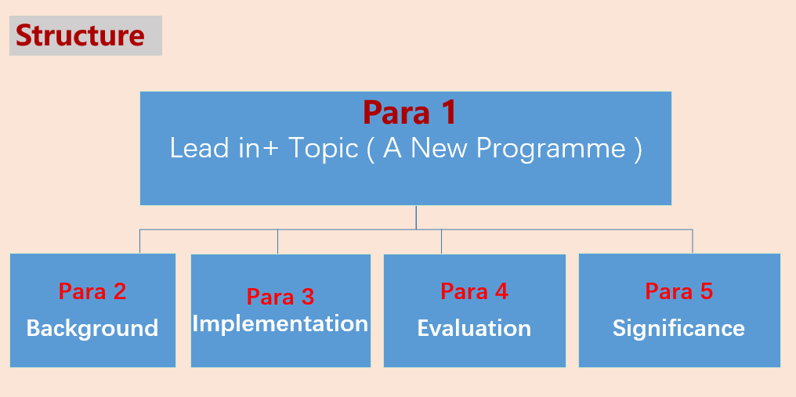
Lead in+ Topic ( A New Programme )
From crystal-blue lakes to snow-capped mountains and thousand-year-old trees, Canada’s nature is admired around the world. Now it might also be just what the doctor ordered. An ambitious new programme allows doctors to write prescriptions (处方) for free annual passes to Canada’s national parks, encouraging their patients to improve their health — both mental ad physical — by taking a stroll in nature.
The prescriptions are provided by PaRX, in partnership with Parks Canada. The first passes were handed out last month, giving holders access to more than 80 national parks, historic sites and nature reserves. PaRX, a health initiative (倡议) launched in 2019 by the British Columbia Parks Foundation, notes on its website that spending time in nature can lead to longer lives, increased energy, reduced stress and anxiety, improved heart health, less pain and better mood. Vitamin D from the sun’s rays has proven health benefits. The organization also hopes that the prescriptions will boost investment in conservation in Canada.
The initial provision covers four Canadian provinces: British Columbia, Saskatchewan, Ontario and Manitoba. Participating doctors have only 100 annual passes to hand out for now, but PaRX hopes that the programme will be expanded.
“Medical research now clearly shows the positive health benefits of connecting with nature,” Steven Guilbeault, the environment minister, said. “I am confident this programme will quickly show its enormous value to the well-being of patients as it continues to expand throughout the country.”
Canada’s physicians are already in the habit of prescribing “nature therapy” as a treatment for anxiety, depression, high blood pressure, immune function and insomnia (失眠). Previously, though, they would write more general prescriptions, such as spending time in nature twice a week, for at least 20 minutes at a time. This is the first time that they have been able to equip their patients with tickets.
Background
Implementation
Evaluation
Significance

Slide 40
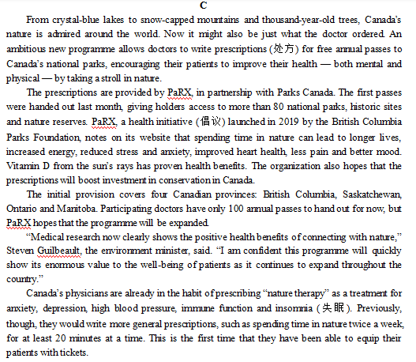
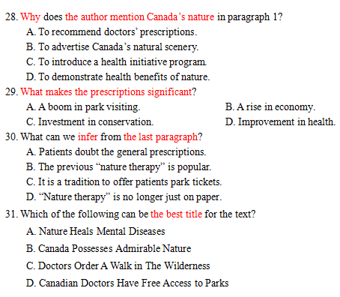
Lead in+ Topic/event
Background
Implementation
Evaluation
Significance

Slide 41
（Para 1) From crystal-blue lakes to snow-capped mountains and thousand-year-old trees, Canada’s nature is admired around the world. Now it might also be just what the doctor ordered. An ambitious new programme allows doctors to write prescriptions (处方) for free annual passes to Canada’s national parks, encouraging their patients to improve their health — both mental and physical — by taking a stroll in nature.
topic/event
28. Why does the author mention Canada’s nature in paragraph 1?
To recommend doctors’ prescriptions.
B. To advertise Canada’s natural scenery.
C. To introduce a health initiative program.
D. To demonstrate health benefits of nature.
考查写作意图

Slide 42
（Para 1) From...... An ambitious new programme allows doctors to write prescriptions (处方) for free annual passes to Canada’s national parks, encouraging their patients to improve their health — both mental and physical — by taking a stroll in nature.
（Para 2) The prescriptions are provided by ...... PaRX, a health initiative (倡议) launched in 2019 by the British Columbia Parks Foundation, notes on its website that spending time in nature can lead to longer lives, increased energy, reduced stress and anxiety, improved heart health, less pain and better mood. Vitamin D from the sun’s rays has proven health benefits. The organization also hopes that the prescriptions will boost investment in conservation in Canada.
topic/event
background--data
投身大自然能促进长寿、更充沛的精力、更少的压力和焦虑感、提高心脏健康、更少的痛感和更佳的心情 。已经证明日光中的维生素D 对健康大有裨益。
29. What makes the prescriptions significant?
A. A boom in park visiting. B. A rise in economy.
C. Investment in conservation. D. Improvement in health.
n. 激增，繁荣
环保方面的投资

Slide 43
（Para 5) Canada’s physicians are already in the habit of prescribing “nature therapy” as a treatment for anxiety, depression, high blood pressure, immune function and insomnia (失眠). Previously, though, they would write more general prescriptions, such as spending time in nature twice a week, for at least 20 minutes at a time. This is the first time that they have been able to equip their patients with tickets.
30. What can we infer from the last paragraph?
A. Patients doubt the general prescriptions.
B. The previous “nature therapy” is popular.
C. It is a tradition to offer patients park tickets.
D. “Nature therapy” is no longer just on paper.
病人质疑普通处方。
先前的自然疗法很受欢迎。
自然疗法不再是纸上谈兵。

Slide 44
（Para 1) From crystal-blue lakes to snow-capped mountains and thousand-year-old trees, Canada’s nature is admired around the world. Now it might also be just what the doctor ordered. An ambitious new programme allows doctors to write prescriptions (处方) for free annual passes to Canada’s national parks, encouraging their patients to improve their health — both mental and physical — by taking a stroll in nature.
topic/event
31. Which of the following can be the best title for the text?
A. Nature Heals Mental Diseases
B. Canada Possesses Admirable Nature
C. Doctors Order A Walk in The Wilderness
D. Canadian Doctors Have Free Access to Parks
医生要求（病人）去户外散步
加拿大的医生拥有免费参观公园的权利。强干扰项

Slide 45
Thank you

