Slide 1


感恩遇见，相互成就，本课件资料仅供您个人参考、教学使用，严禁自行在网络传播，违者依知识产权法追究法律责任。
更多教学资源请关注
公众号：溯恩英语
知识产权声明

Slide 2


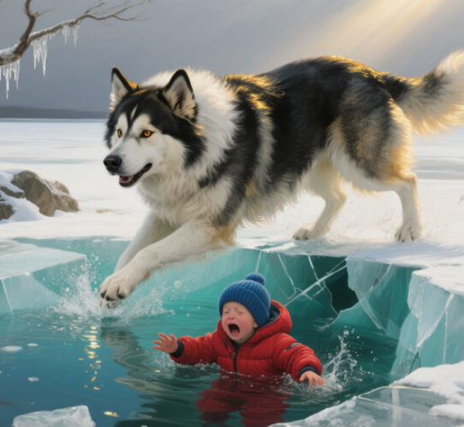
读后续写“思维第一”
2025
高三名校协作体读后续写
， 救命犬 Bear
突破续写词汇瓶颈的思维：
五感+动作链+修辞+前文取材+情感交织
刘艳

Slide 3
Bear was not a bear. She was a big dog on the Perkinses' family farm, a woolly creature with floppy ears and
paws like bedroom slippers. She protected the ducks and chickens from being eaten by foxes and raccoons（浣熊）.
She guarded the children as well, watching over them as closely as she did the chickens and ducks. In winter the dog ran alongside the children as they sledded (滑雪橇) down snowy hills. In summer she swam with them in a nearby river.
Bear belonged to a breed (品种) that had long been used by Atlantic fishermen to help with their work, and it had a keen instinct for water rescue. When the children were in the river, the dog would swim in circles around them, barking when she felt they went out too far. She was the perfect farm dog companion, guardian, protector.
The dog's favorite among the three children was three-year-old little Mike. They often curled up together.Sometimes Bear would doze while Mike pretended to read to her. Often both were sound asleep, a tangle of dark fur, blond hair, small hands and huge paws. At bedtime, Mike saved his last hug for Bear, his "best friend".
On a cold winter day, when their parents went out to send a parcel, eight-year-old Martha, seven-year-old Sara and Mike, went to slide on the frozen pond of their farm. Shouting happily, they slid back and forth, their boots gliding easily across the ice. They laughed as they watched Bear's attempts to stop suddenly, which would instead send her skidding beyond them. Then, tired, the three sat down on the ice, with Bear beside them. Suddenly the ice gave way under their combined weight.
As Bear jumped for shore, the three children fell into the freezing cold water. Screaming, Martha and Sarah struggled to find footing on rocks underwater. Branches from a tree nearby provided handholds, and using every bit of their strength, the two girls pulled themselves to shore.
Paragraph 1: Looking back, they saw little Mike holding on to a broken chunk(大块) of ice, unable to crawl onto it.
Paragraph 2: Seeing that, Bear let out a series of woofs and jumped into the water, heading straight for Mike.

Slide 4
记叙文要素
Categories | Details (in English)
Characters | - Bear: A big, woolly farm dog with floppy ears, belonging to a breed skilled in water rescue; acts as a companion, guardian, and protector. - Mike: A 3-year-old child, Bear's favorite, called Bear his "best friend". - Martha: 8-year-old child, Mike's sister. - Sara: 7-year-old child, Mike's sister. - Perkinses' parents: Briefly mentioned as going out to send a parcel.
Time | A cold winter day (when the parents went out to send a parcel).
Setting | Perkinses' family farm, specifically the frozen pond on the farm.
Conflict | The three children fell into the freezing water when the ice of the frozen pond gave way under their combined weight. Martha and Sara managed to pull themselves to shore, but little Mike was left holding on to a broken chunk of ice, unable to crawl onto it, facing danger.
Theme | Loyalty and guardianship of animals; the bond between humans and animals; courage and rescue in crisis.

Slide 5
读原文
Bear was not a bear. She was a big dog on the Perkinses' family farm, a woolly creature with floppy ears and
paws like bedroom slippers. She protected the ducks and chickens from being eaten by foxes and raccoons（浣熊）.
She guarded the children as well, watching over them as closely as she did the chickens and ducks. In winter the dog ran alongside the children as they sledded (滑雪橇) down snowy hills. In summer she swam with them in a nearby river.
Bear belonged to a breed (品种) that had long been used by Atlantic fishermen to help with their work, and it had a keen instinct for water rescue. When the children were in the river, the dog would swim in circles around them, barking when she felt they went out too far. She was the perfect farm dog companion, guardian, protector.
The dog's favorite among the three children was three-year-old little Mike. They often curled up together. Sometimes Bear would doze while Mike pretended to read to her. Often both were sound asleep, a tangle of dark fur, blond hair, small hands and huge paws. At bedtime, Mike saved his last hug for Bear, his "best friend".
On a cold winter day, when their parents went out to send a parcel, eight-year-old Martha, seven-year-old Sara and Mike, went to slide on the frozen pond of their farm. Shouting happily, they slid back and forth, their boots gliding easily across the ice. They laughed as they watched Bear's attempts to stop suddenly, which would instead send her skidding beyond them. Then, tired, the three sat down on the ice, with Bear beside them. Suddenly the ice gave way under their combined weight.
As Bear jumped for shore, the three children fell into the freezing cold water. Screaming, Martha and Sarah struggled to find footing on rocks underwater. Branches from a tree nearby provided handholds, and using every bit of their strength, the two girls pulled themselves to shore.
Paragraph 1: Looking back, they saw little Mike holding on to a broken chunk(大块) of ice, unable to crawl onto it.
Paragraph 2: Seeing that, Bear let out a series of woofs and jumped into the water, heading straight for Mike.
找出前文伏笔
1动词短语
2名词短语
3情节搭建的主要行为动作句式

Slide 6
Paragraph 1: Looking back, they saw little Mike holding on to a broken chunk(大块) of ice, unable to crawl onto it.
情节搭建
- What emotions did Martha and Sarah feel when they saw Mike clinging to the broken ice, unable to climb up?
- What desperate attempts did they make to reach him from the shore?
- How did Mike struggle to pull himself onto the ice?
瓶颈：危机场景描写？
Paragraph 2: Seeing that, Bear let out a series of woofs and jumped into the water, heading straight for Mike.

Slide 7
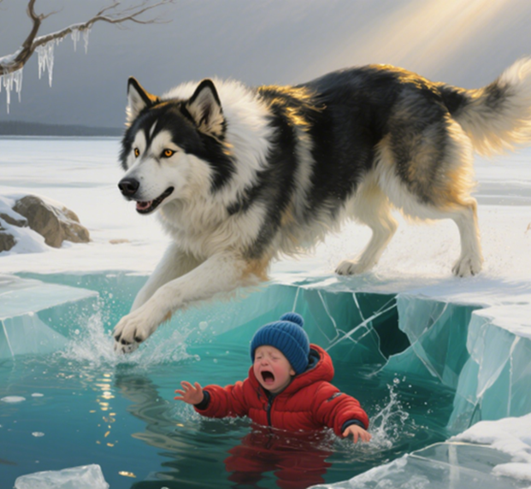
Paragraph 2: Seeing that, Bear let out a series of woofs and jumped into the water, heading straight for Mike.
How did Bear get close to Mike?
How did Bear save Mike?
After Mike was rescued, what reactions did his siblings, the dog Bear, and Mike have?
重点：救援过程
瓶颈：救援过程细节和画面感？

Slide 8
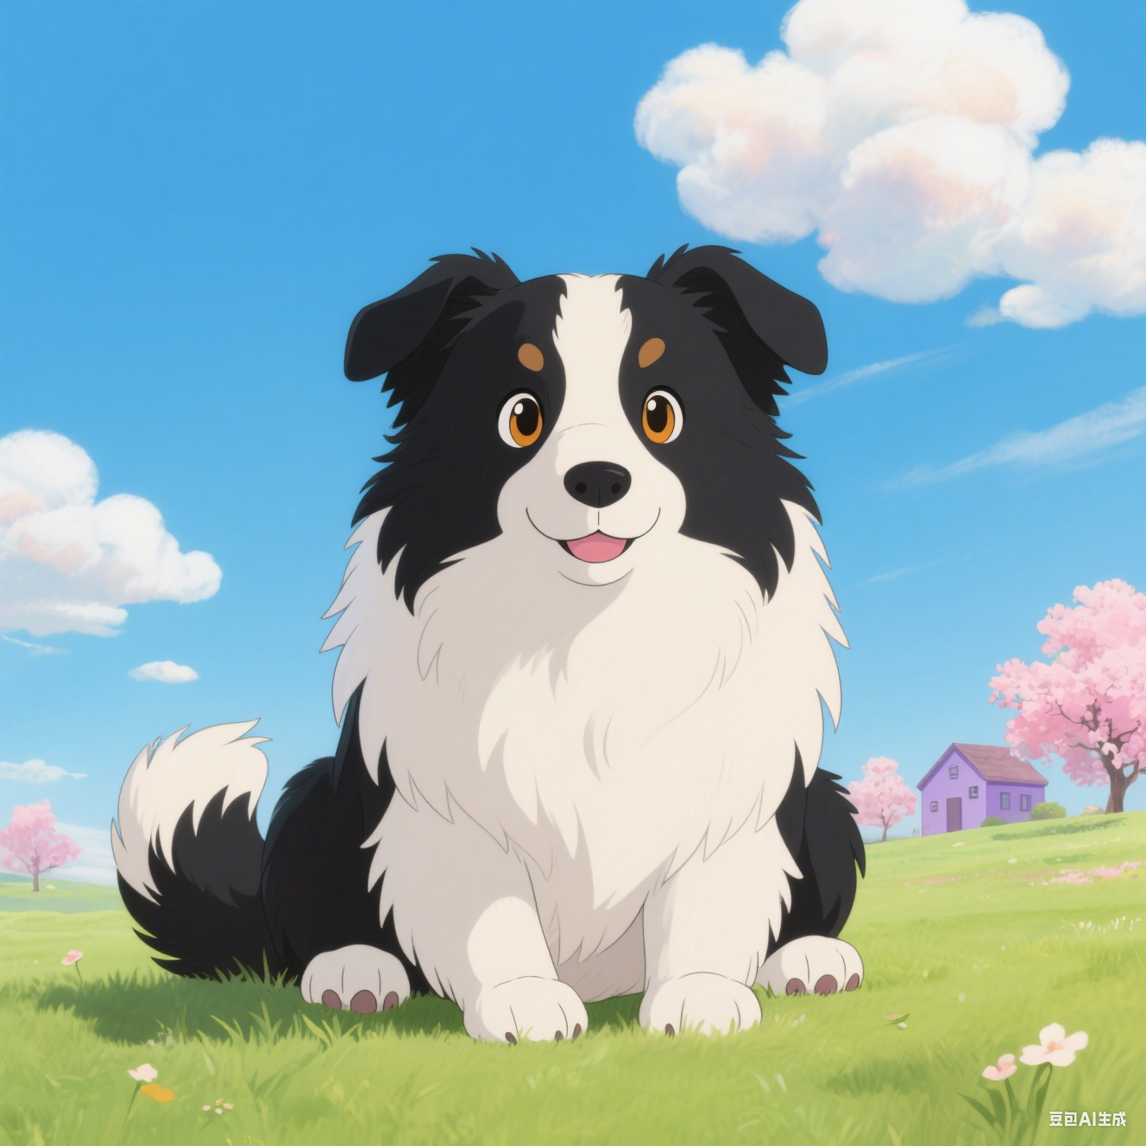
Paragraph 2: Seeing that, Bear let out a series of woofs and jumped into the water, heading straight for Mike.
方法
感官联动法
动作链拆解
修辞强化法
情感交织法
重点：救援过程
瓶颈：救援过程细节和画面感？

Slide 9
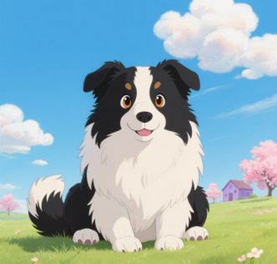
Paragraph 1: Looking back, they saw little Mike holding on to a broken chunk(大块) of ice, unable to crawl onto it.
瓶颈：危机场景描写？
（五感描述场景）
Martha 和 Sarah 回头一看，心一下子沉了下去。Mike 小小的身子趴在一块断裂的冰上，冻得发紫的手指死死抠着冰面，每回试着往上爬，都会带起几片碎冰，在阳光下闪着刺眼的光（视觉）
Martha and Sarah looked back, their hearts sinking. Little Mike lay on a broken piece of ice, his purple fingers gripping the ice tightly. Every time he tried to climb up, some ice pieces would fall off, shining sharply in the sun (sight).

Slide 10

Paragraph 1: Looking back, they saw little Mike holding on to a broken chunk(大块) of ice, unable to crawl onto it.
瓶颈：危机场景描写？
（五感描述场景）
冰面 “咔嚓” 一声又裂了道缝，Mike “哇” 地哭了出来，哭声混着呼啸的寒风，像小针扎在姐妹俩心上（听觉+修辞）。
The ice cracked again with a "crunch." Mike burst into tears, and his cries mixed with the whistling wind, pricking the sisters' hearts like small needles (sound).

Slide 11
Paragraph 1: Looking back, they saw little Mike holding on to a broken chunk(大块) of ice, unable to crawl onto it.
瓶颈：危机场景描写？
（五感描述场景）
Sarah 想冲过去，却被 Martha 一把拽住 —— 脚下的冰还在微微晃，透着刺骨的冷（触觉）
Sarah tried to rush over but was pulled back by Martha—the ice under their feet shook a little, sending a bitter cold (touch).

Slide 12
Paragraph 1: Looking back, they saw little Mike holding on to a broken chunk(大块) of ice, unable to crawl onto it.
瓶颈：危机场景描写？
（五感描述场景）
水面飘来水草的腥气，混着冷风灌进喉咙，又凉又呛（嗅觉）。Mike 的嘴唇冻得发乌，眼泪刚流出就结了层薄冰，他望着姐姐们，小脸上满是慌和怕。（视觉+眼神）
A fishy smell from water plants came up, mixing with the cold wind and filling their throats, cold and choking (smell). Mike's lips were dark from the cold. His tears froze into a thin layer as soon as they came out. He looked at his sisters, his small face full of fear.

Slide 13
Paragraph 2: Seeing that, Bear let out a series of woofs and jumped into the water, heading straight for Mike.
方法
感官联动法
动作链拆解
修辞强化法
情感交织法
重点：救援过程
瓶颈：救援过程细节和画面感？

Slide 14
瓶颈：救援过程细节和画面感？
方法 | 核心技巧 | 具体应用示例（结合文本情境）
感官联动法 | 融合视觉、听觉、触觉、嗅觉、体感，让场景立体 | 视觉：frostbitten fingers turning purple；听觉：ice cracking like shattered glass；触觉：water biting into skin like needles
动作链拆解 | 将营救拆解为 “入水→接近→接触→拖拽→上岸”，每个环节细化 2-3 个关键动作 | 入水：plunge into the icy torrent, paws churning；接近：slice through waves, nose nuzzling Mike’s shoulder；拖拽：clamp onto his coat collar, heave upward
修辞强化法 | 用比喻、拟人、夸张增强画面感，弥补词汇不足 | 比喻：Bear’s body cut through water like a sleek torpedo；拟人：her eyes burned with a mother’s urgency；夸张：waves roared as if hungry to swallow the child
情感交织法 | 同步描写 Mike 的恐惧与 Bear 的决心，通过互动展现信任 | Mike：choked sobs mixing with gasps；Bear：nuzzling his cheek to calm him, tail thumping reassuringly

Slide 15
Paragraph 2: Seeing that, Bear let out a series of woofs and jumped into the water, heading straight for Mike.
Bear 朝着 Mike 奋力游去，毛茸茸的前爪在水里用力划动，每一次划水都带着一股劲儿，把冰冷的水劈出一道道波纹，像小船的桨叶在使劲儿（动作链分解;比喻修辞；呼应前文 ）
Bear swam hard toward Mike, its woolly front paws paddling strongly in the water. Each stroke cut through the cold water, sending out ripples like the oars of a small boat working hard

Slide 16

Paragraph 2: Seeing that, Bear let out a series of woofs and jumped into the water, heading straight for Mike.
它那厚实的皮毛被水浸得沉甸甸的，却一点儿也没放慢速度，身体在水里一沉一浮，像一颗被线牵引着的毛球，直冲向目标（视觉描写；比喻修辞）。
Its thick fur, heavy with water, didn’t slow it down at all. Its body bobbed up and down in the water, like a fuzzy ball pulled by a string, heading straight for its target.

Slide 17
Paragraph 2: Seeing that, Bear let out a series of woofs and jumped into the water, heading straight for Mike.
Mike 看见 Bear 过来，冻得发紫的小手在水里胡乱扑腾，嘴里发出 “呜呜” 的哭声，那哭声又细又弱，混着冰块碰撞的 “咔啦” 声，听得人心都揪紧了（听觉描写；情感交织）
When Mike saw Bear coming, his little purple hands flailed wildly in the water, and weak, thin whimpers escaped his mouth. The whimpers, mixed with the "crack" of colliding ice, made one’s heart ache.

Slide 18
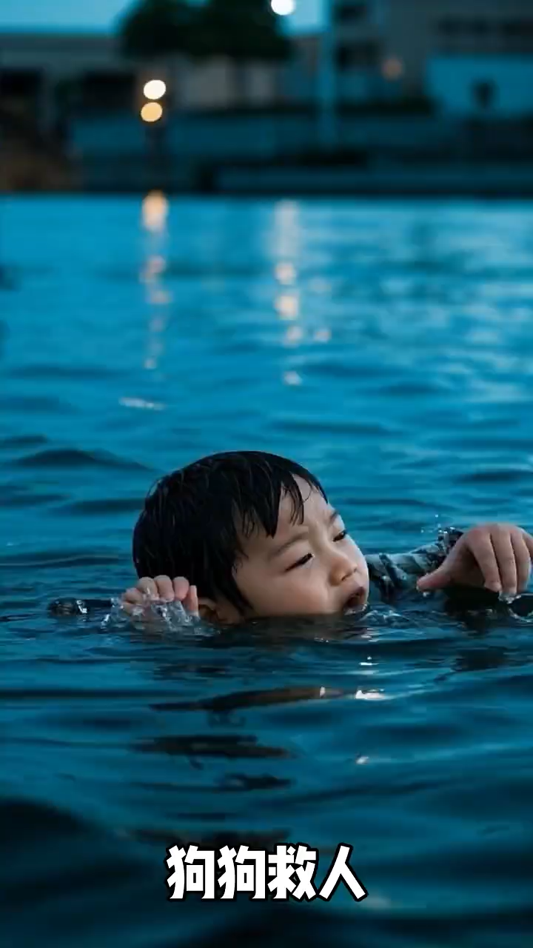
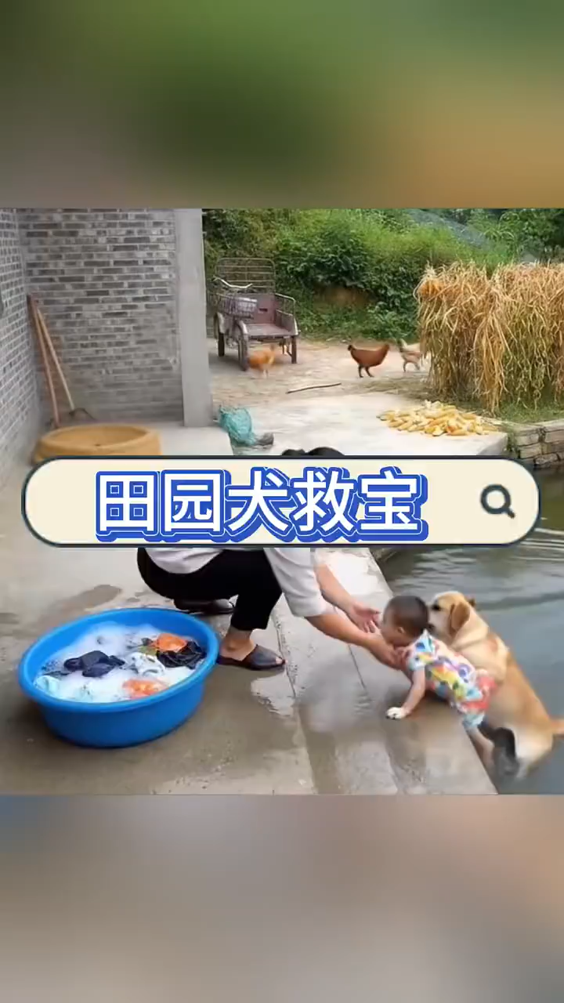
狗狗具体救人方式
The dog grabs the child's clothes with its mouth and pulls the child ashore.
The dog acts as a stepping stone, using its body to push the child up to safety.

Slide 19
Paragraph 2: Seeing that, Bear let out a series of woofs and jumped into the water, heading straight for Mike.
Bear 游到 Mike 身边，立刻低下头，用嘴巴轻轻咬住他湿透的外套后领，像叼着易碎的宝贝一样稳住力道（动作链拆解：低头→咬衣→调整力度；比喻修辞，体现小心谨慎；呼应前文 “protector” 的守护特质）。
Bear swam up to Mike, immediately lowered its head, and gently bit the collar of his wet coat with its mouth, holding the force steady as if carrying a fragile treasure.

Slide 20
Paragraph 2: Seeing that, Bear let out a series of woofs and jumped into the water, heading straight for Mike.
岸边的 Martha 和 Sarah 早已趴在冰沿，伸出冻红的手，等到 Bear 靠近，她们死死抓住 Mike 的胳膊，Bear 则在水下用鼻子一顶，三人合力将 Mike 拉上了岸（动作链拆解：托举→靠近→接力救援；多角色互动增强画面感）。
Martha and Sarah on the shore had already lain down on the ice edge, stretching out their red, frozen hands. When Bear got close, they grabbed Mike’s arms tightly. Bear then pushed upward with its nose underwater, and together, the three pulled Mike onto the shore.

Slide 21
Paragraph 2: Seeing that, Bear let out a series of woofs and jumped into the water, heading straight for Mike.
那个冬天的冰窟成了全家人心照不宣的印记 ——Bear 不只是农场的守护者，更是这个家的一份子。(呼应前文，升华)
The winter ice hole became an unspoken memory for the family—Bear was not just the farm’s guardian, but a member of the family.

Slide 22
Judy 下水作文
P1：Martha and Sarah looked back, their hearts sinking. Little Mike lay on a broken piece of ice, his purple fingers gripping the ice tightly. Every time he tried to climb up, some ice pieces would fall off, shining sharply in the sun. The ice cracked again with a “crunch.” Mike burst into tears, and his cries mixed with the whistling wind, pricking the sisters‘ hearts like small needles. Sarah tried to rush over but was pulled back by Martha—the ice under their feet shook a little, sending a bitter cold . A fishy smell from water plants came up, mixing with the cold wind and filling their throats, cold and choking. Mike's lips were dark from the cold. His tears froze into a thin layer as soon as they came out. He looked at his sisters, his small face full of fear.
P2：Bear swam hard toward Mike, its woolly front paws paddling strongly in the water. Each stroke cut through the cold water, sending out ripples like the oars of a small boat working hard. Its thick fur, heavy with water, didn’t slow it down at all. Its body bobbed up and down in the water, like a fuzzy ball pulled by a string, heading straight for its target. When Mike saw Bear coming, his little purple hands flailed wildly in the water, and weak, thin whimpers escaped his mouth. The whimpers, mixed with the "crack" of colliding ice, made one’s heart ache. Bear swam up to Mike, immediately lowered its head, and gently bit the collar of his wet coat with its mouth, holding the force steady as if carrying a fragile treasure. Martha and Sarah on the shore had already lain down on the ice edge, stretching out their red, frozen hands. When Bear got close, they grabbed Mike’s arms tightly. Bear then pushed upward with its nose underwater, and together, the three pulled Mike onto the shore. The winter ice hole became an unspoken memory for the family—Bear was not just the farm’s guardian, but a member of the family.

Slide 23
官方范文
P1:Looking back, they saw little Mike holding on to a broken chunk of ice, unable to crawl onto it. Panic slammed into Martha and Sara like a hammer; their breaths came in harsh clouds as the wind howled across the pond. "Mike, keep your arms up — don't let go!" Martha shouted, her voice cracking with fear she tried to hide. Yet the boy's lips were turning a frightening shade of blue, and water sloshed over his boots each time the ice tilted(倾斜). The sisters clung to(紧握) a low branch, but the thought of re-entering the frigid(寒冷的)hole was unbearable. With no adults in sight and daylight fading, the brittle silence(死寂) of the farm suddenly felt enormous.
P2:Seeing that, Bear let out a series of woofs and jumped into the water, heading straight for Mike. Powerful strokes sliced surface as spray flew from her coat, each kick driving the dog closer to the terrified child. When she reached him, she circled once, nudging his armpit(轻推他的腋下) with her nose until Mike's arms slid over her broad shoulders. Instinct took over. Gripping his jacket between her teeth, she turned toward shore and began towing her passenger. Martha and Sara lay flat on the ice, stretching a long branch. The moment Bear's paws scraped(摩擦) frozen ground, the girls hauled(用力拖拉) the boy and the dog together, collapsing in a trembling heap of relief(如释重负瘫倒在地).

Slide 24
适配场景的核心词汇补充（结合文档情境）
类别 | 高级表达
狗的动作细节 | nuzzle（用鼻蹭）、clench（咬紧）、heave（奋力托起）、thrash（挣扎划水）
环境动态 | crackle（冰裂声）、surge（暗流涌动）、glisten（冰面反光）
人与动物接触 | clutch at（紧抓）、press against（紧贴）、tug（拖拽）
情感化声音 | whimper（呜咽）、yip（短促吠叫）、gasp（孩子抽气声）

Slide 25
感谢聆听

