Slide 1
感恩遇见，相互成就，本课件资料仅供您个人参考、教学使用，严禁自行在网络传播，违者依知识产权法追究法律责任。
更多教学资源请关注
公众号：溯恩高中英语
知识产权声明

Slide 2
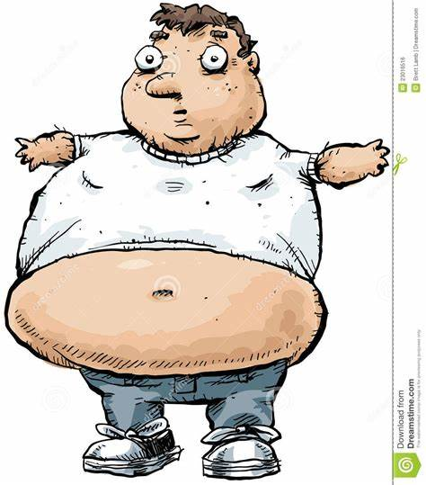
2020年杭州地区（含周边地区）高一上
期中考试应用文 建议信
浙江省衢州第一中学 徐荣仙

Slide 3
假定你是李华，你的笔友Amy最近写了一封e-mail给你，表达了因体重过重带来的烦恼。请你安慰Amy，并给她建议，内容包括：
表达安慰；
给出建议；
你的祝福。
注意：
词数80左右；
可以适当增加细节，以使行文连贯。

Slide 4
三 审 题 干
假定你是李华，你的笔友Amy最近写了一封e-mail给你，表达了因体重过重带来的烦恼。请你安慰Amy，并给她建议，内容包括：
表达安慰；
给出建议；
你的祝福。
注意：
词数80左右；
可以适当增加细节，以使行文连贯。
安慰信+建议信
who
why
How to comfort
How to give reasonable suggestions
Wishes
suggestion1
suggestion2
…

Slide 5
How to offer comfort:TRY THIS
I know how difficult things have gotten.
I'm here for you, in whatever way that helps you.
“I know this is very difficult for you. How have you been doing?
You’re my friend and I want you to feel supported and loved.
“For future reference, I never get tired of giving out hugs, okay?

Slide 6
How to offer comfort: AVOID
“I'm going to pray for a miracle.”
You can still silently pray for your friend, but your caring presence will make the most difference
“Have you tried juicing? I hear it can really turn things around.”
In some instances, your friend might like your help researching alternative healing and holistic treatments, but it's best to follow their lead in this type of discussion.
“Actually, you needn't worry about your weight. It's quite normal for everyone to be obese.”
Clearly, it's impossible for everyone to be overweight. So, this kind of comfort can't really ease your friends' worry. Instead, it will make your friend think you are unreliable.

Slide 7
How to Make Polite, Indirect Suggestions
1. Turn your suggestion into a question
You might sound like a know-it-all if you make direct suggestions before knowing all the facts. This is why it's often better to offer your suggestion in the form of the question.
•Have you thought about…?
• Have you considered…?
• What if you/we…?
• Could you/we…?
• Would you/we be able to…?

Slide 8
How to Make Polite, Indirect Suggestions
2. Use tentative language
Native speakers subconsciously use words like perhaps, maybe, might, may, and could to “soften” a suggestion. Simply adding the word maybe before saying “you should” can make a world of difference in terms of politeness.
• You might want to think about…
• You might want to consider…
• Perhaps you/we could…
• Maybe you/we could…
• It may be a good idea to…
• It might be a good idea to…

Slide 9
How to Make Polite, Indirect Suggestions
3. Use past tenses
With suggestions, we often use the past progressive and simple past. Using these tenses makes the suggestion less direct, and therefore more polite.
• I was thinking we could…
• I thought we could…
• If I were you, I would...

Slide 10
How to Make Polite, Indirect Suggestions
4. Use the word we whenever possible
We sounds collaborative. You can sound accusatory. If you have a suggestion for a group to which you belong, use we.
• I believe we could ...
• If we..., things would ...

Slide 11
Other forms of giving polite and indirect suggestions
You should/ ought to do...
Why don't you do...?
How about doing...?
You'd better do...
It's advisable for sb. to do...
It's better for sb. to do...
It's beneficial for sb. to do...

Slide 12
How to naturally lose weight fast
Avoid sugary drinks and fruit juice.
Tracking your diet and exercise
Eating mindfully
Mindful eating is a practice where people pay attention to how and where they eat food. This practice can enable people to enjoy the food they eat and maintain a healthy weight.
Cutting back on sugar and refined carbohydrates
Getting a good night's sleep
Numerous studies have shown that getting less than 5–6 hours of sleep per night is associated with increased incidence of obesity. There are several reasons behind this.
Managing your stress levels

Slide 13
How to End a Letter to Make a Lasting Impression
Professional closings
Casual closings
These closings are appropriate for new contacts, managers or other important stakeholders you don’t speak with often.
These closing phrases are appropriate for friends, close colleagues or stakeholders you communicate with on a regular basis.
Thank you,
Regards,
Respectfully,
Cordially,
With gratitude,
Best regards,
In sympathy,
Best,
All the best,
Thanks,
Best wishes,
Warmly,
Have a good day/evening/weekend,

Slide 14
Best wishes in this suggestion letter
All the best, I hope these suggestions helpful/ practical/ constructive.
Warmly, I wish you greater improvements in this regard.
Best wishes! For future reference, I never get tired of giving out hugs.

Slide 15
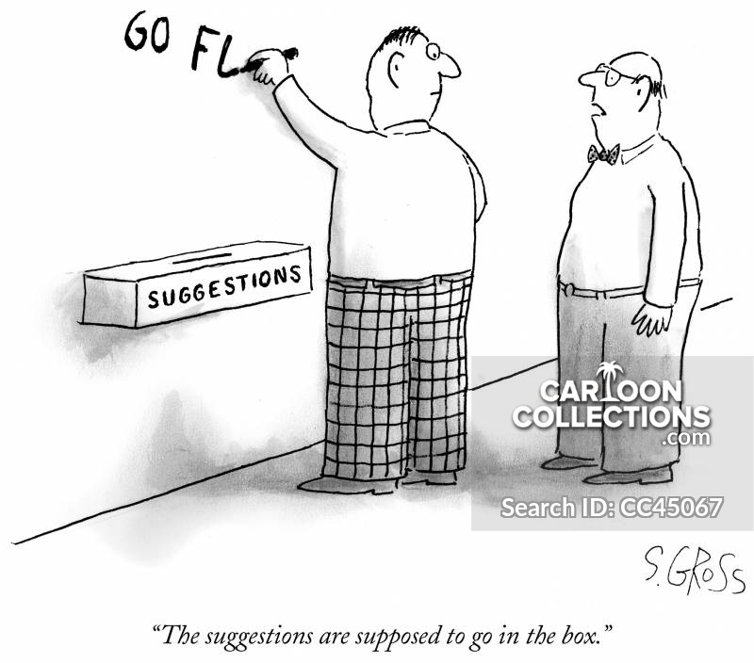
A possible sample

Slide 16
Dear Amy,
Knowing that you are worried about your weight, I quite understand how upset and anxious you feel. Actually, things would improve if we followed the suggestions below.
Firstly, a balanced diet and regular exercise make a difference, which not only helps you watch your figure but also contributes to a healthy life. Besides, have you thought about avoiding sugary drinks and fruit juice? Sugar is the first cause of gaining weight. Frankly speaking, if I were you, I would focus more on fitness rather than weight. A good healthy body is worth more a crown in gold.
All the best, I hope these suggestions beneficial!
Yours,
Li Hua

Slide 17
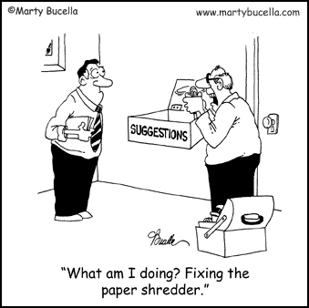
Samples from students

Slide 18
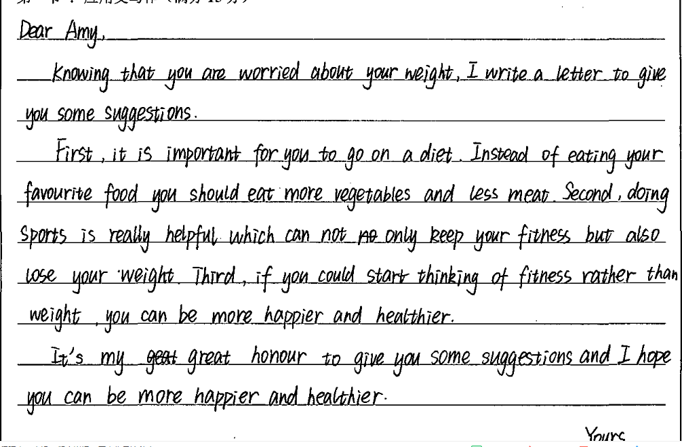
学生习作点评：
该篇建议信能写明绝大部分要点，但是语言有少量错误；第二段的过渡词first,second,third有点生硬，如果可以替换一下会更好，如：First, Besides, Meanwhile/ Plus/By the way。最后一段的It's my great honor to give you some suggestions, 这个客气程度过了点，要注意对方的角色，Amy和Li Hua 是朋友，所以语气不必如此正式，可以稍微随意一点。
you fit
help lose your weight
much
much

Slide 19
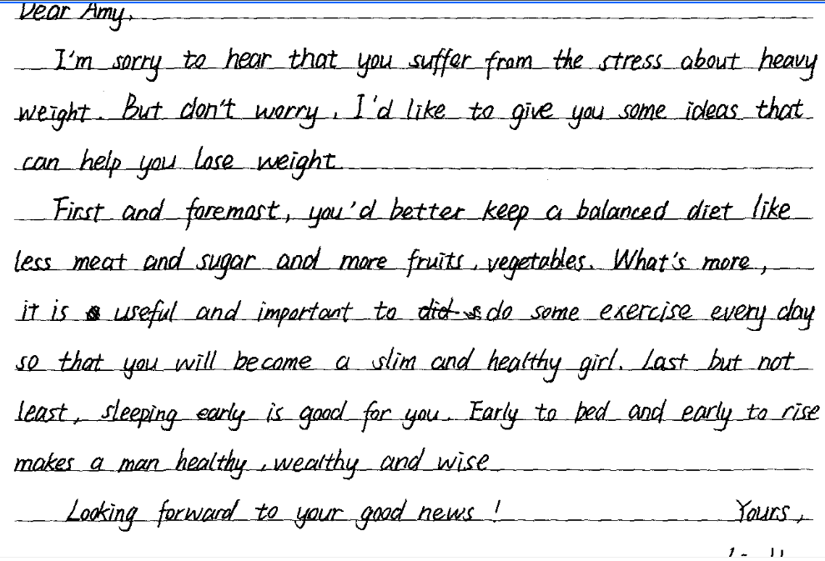
学生习作点评：
该篇建议信卷面清晰，要点齐全，建议合理，句型丰富，语气也符合朋友身份。作为高一上的学生来说，算是一篇佳作了。如果第一段的give you some ideas改成offer you some suggestions或许会更妥当一点。

