Slide 1

感恩遇见，相互成就，本课件资料仅供您个人参考、教学使用，严禁自行在网络传播，违者依知识产权法追究法律责任。
更多教学资源请关注
公众号：溯恩高中英语
知识产权声明

Slide 2
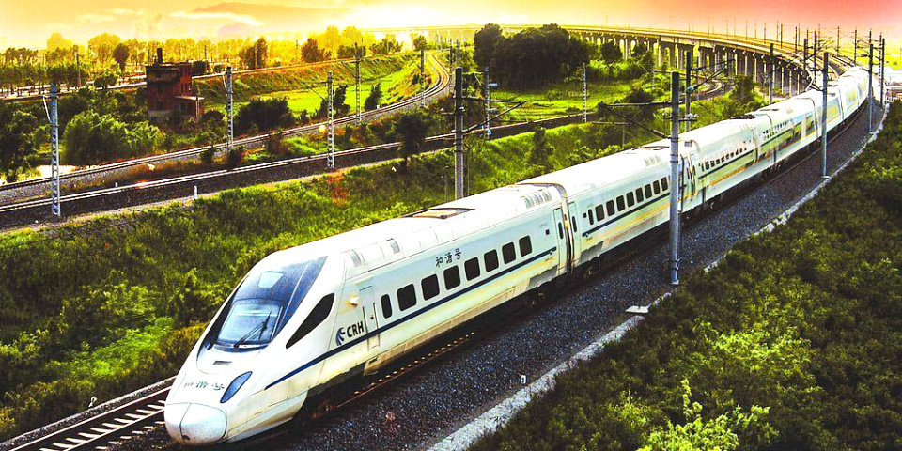
2021学年第二学期期中杭州地区（含周边）
重点中学高二年级联考
A Letter of Recommendation
临安中学
余智良

Slide 3
题目：
假如你是李华，你的南非朋友Stephan今年暑假来中国旅游，最近中国开通了一条从上海到新疆的高铁专线，你向他推荐这趟专列。内容如下：
1. 选择高铁的优势；
2. 沿途的经历（领略自然风光等）；
3. 你的祝愿
参考词汇：高铁 high-speed rail line

Slide 4
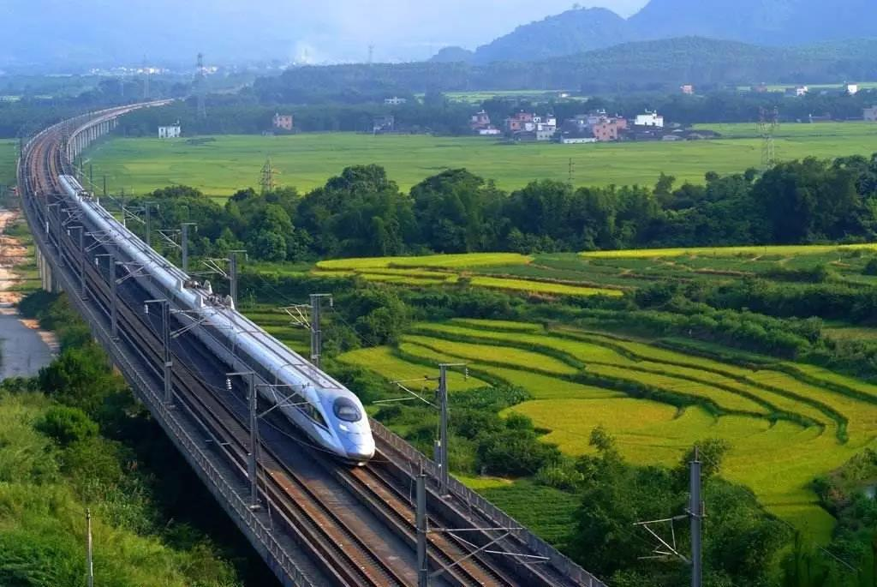
审题
体裁:
对象：
人称:
时态:
要点与结构:
A Letter of recommendation
(means of transport)
Friend(friendly, casual, informal)
The second and third person
Simple present tense
Purpose of writing
advantages+ experiences
best wishes

Slide 5
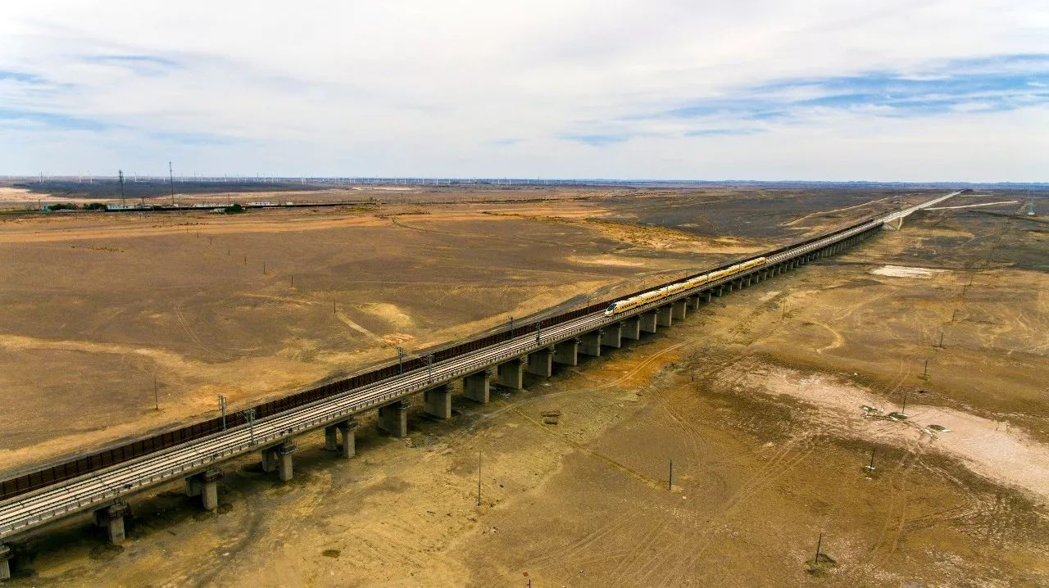
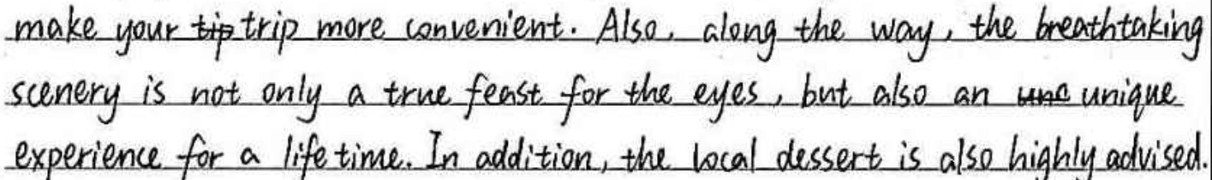
Thinking：
Which point should be the main point of Para 2, the advantages or the experiences of traveling by rail?
How will you state the experiences, generally or in detail?
What experiences?
The experiences of traveling
Too general
Enjoy the breathtaking views outside
Have a taste of the local food
Interact with other passengers

Slide 6
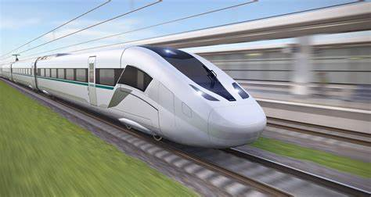
Brainstorm:
Advantages/benefits of taking a high-speed rail/train
save time because it runs at a high speed
convenient due to the highly developed railway network
offer comfortable seats and excellent local food
have a cozy environment
be equipped with customer-friendly facilities
cheaper ticket price compared to air tickets
contribute to the protection of the environment and the sustainable development
These advantages come along with the development of the high-speed rail technology.

Slide 7
Expression:
How to state the advantages briefly?
Make a sentence by using the structures above
Not only---but also---
Range from---to---/vary from---to---
Like, such as, including
The line can not only guarantee you a safe and comfortable journey, but also help you contribute to the protection of the environment.

Slide 8
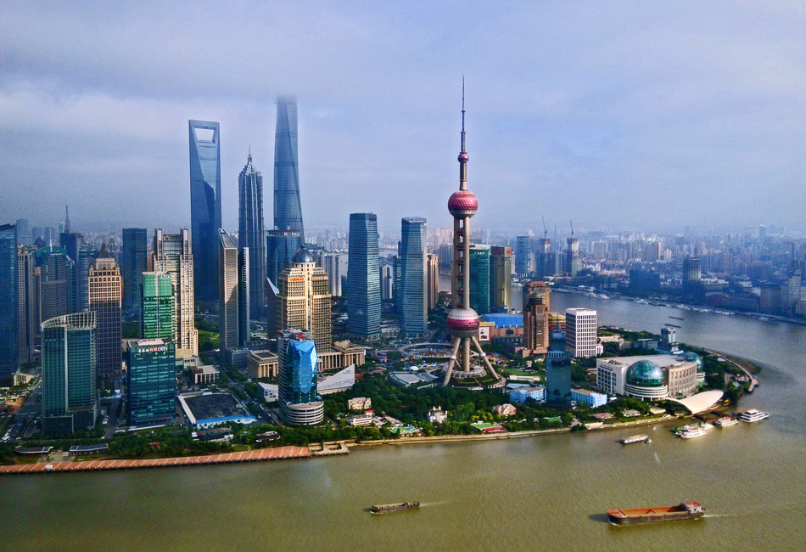
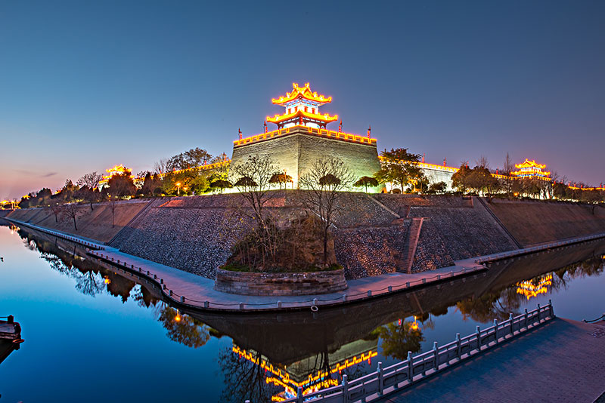

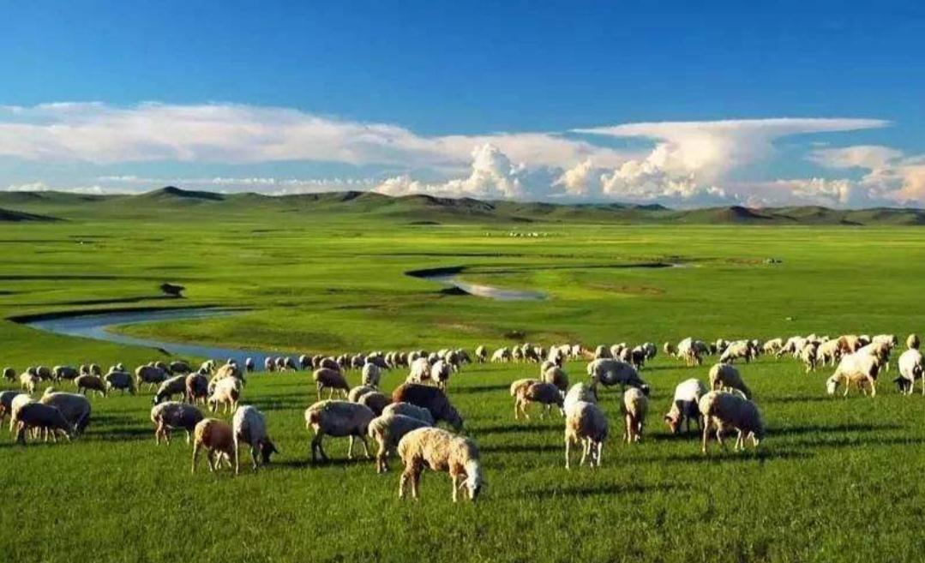
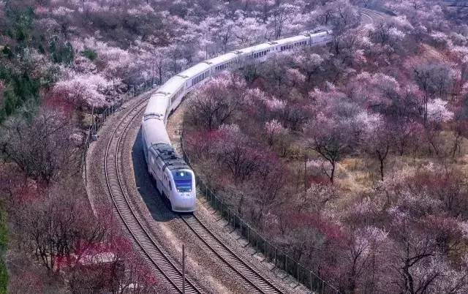
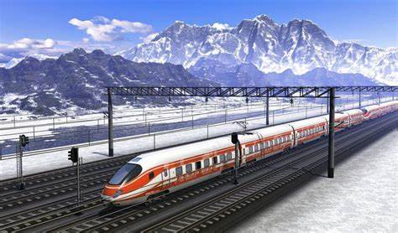
Brainstorm:
What experiences will Stephan gain from this route?
(From Shanghai to Xinjiang)

Slide 9
Brainstorm:
What experiences will Stephan gain from this route?
(From Shanghai to Xinjiang)
modern city/ high skyscrapers of Shanghai
historical buildings of Xi’an
vast desert dotted with the well-known Yue Ya Spring
Large flocks of sheep and cattle wandering on the plain in Xinjiang
Snow-capped/rolling mountains
Taste the authentic local food served on the trains
Interact with other passengers
breathtaking views
authentic food
friendly local people

Slide 10
Expression:
3. How to state the possible experiences in detail?
4. Write two or three sentences to show the possible experiences.
from at least two different angles,
use specific information
The journey will provide you with a feast for your eyes, ranging from the historical buildings in Xi’an to the vast plains dotted with sheep and cattle in Xinjiang. Besides, you will be exposed to the local food served on the train.

Slide 11
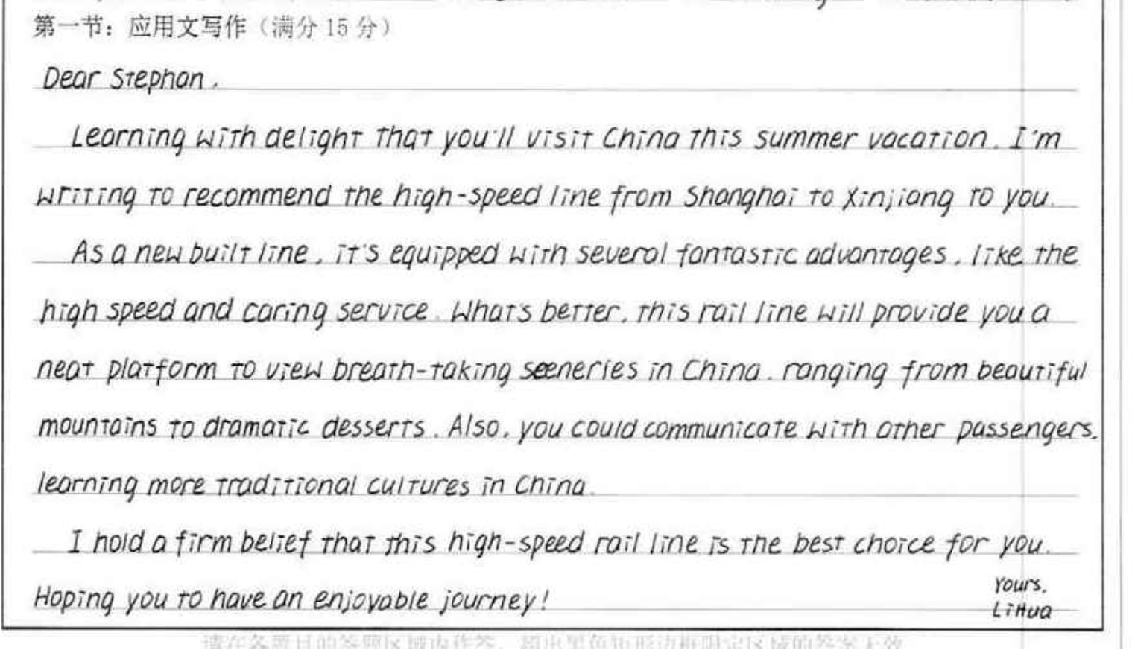
Para1: 简洁、明了、点出背景和写信目的
Para2: 内容完整、主次分明、并且具体地列出了沿路的景观
本文词汇、句式丰富、表达准确流畅，属于12-15档作文。

Slide 12
下水作文：
Dear Stephan，
Glad to know that you will pay a visit to China in this coming summer vacation. I strongly recommend that you take the newly opened high-speed rail line from Shanghai to Xinjiang. 32
Specially designed for this route, the line can not only guarantee/ensure you a safe and comfortable journey, but also provide you with a feast for your eyes, ranging from the historical buildings in Xi’an to the vast plains dotted with sheep and cattle in Xinjiang. Besides, you will be exposed to the local food served on the train. These fantastic experiences will surely be engraved in your memory. 68
Wish you a pleasant journey in China! 7
Yours, Li Hua

Slide 13
Tips:
审题时充分理解题目中的关键词汇，如本文中的：旅游---专线，依据关键词汇，可以判断本文的重点；
第二段一定要详略得当；
重点内容需要从不同维度写具体，如不同的景色可以写上海的skycrapers, 西安的historical buildings, 敦煌的 Mogao Caves, deserts; 或者新疆的plains or cattle；正宗的地方美食等等，具体的内容会让推荐的理由更加充分；

Slide 14
Sample:
Dear Stephan,
I am more than excited to hear that you will visit China this Summer vacation. I recommend you board the newly opened high-speed rail line to travel from Shanghai to Xinjiang.
Many benefits include short travel time, improved safety and comfort, support for environmentally sustainable development, as well as tourism. There are many great things along the way to feast your eyes on. You can feel the prosperity of China, experience the history and culture in Xi’an and enjoy spectacular natural scenery in Qinghai, to name a few.
Wish you a pleasant journey and a relaxing vacation here in China! Yours, Li Hua

