Slide 1


感恩遇见，相互成就，本课件资料仅供您个人参考、教学使用，严禁自行在网络传播，违者依知识产权法追究法律责任。
更多教学资源请关注
公众号：溯恩高中英语
知识产权声明

Slide 2

Reading for Writing
M1U4 Natural Disasters
溯恩英语

Slide 3
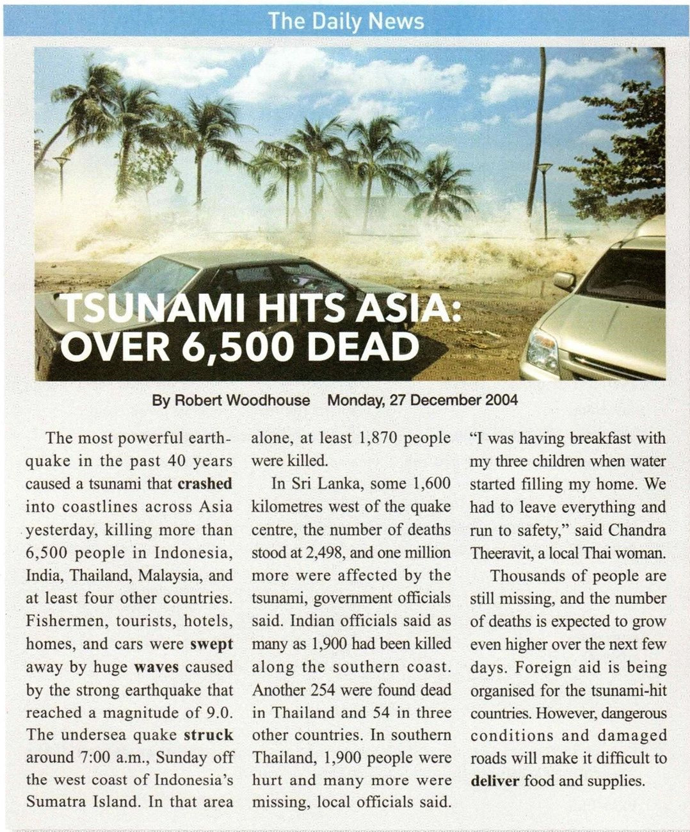
A NEWS REPORT
Title
01
Reporter
02
Time
03
Lead
04
Body
05
End
06

Slide 4

The most powerful earthquake in the past 40 years caused a tsunami that crashed into coastlines across Asia yesterday, killing more than 6,500 people in Indonesia, India, Thailand, Malaysia, and at least four other countries.
Lead
01
Event:
tsunami
02
Cause:
earthquake
03
Place:
coastlines across Asia
04
killing more than 6,500 people
Efffect:
Main points of the news, usually including the event, cause, time, place, and effect.

Slide 5
Indian officials said as many as 1,900 had been killed along the southern coast. Another 254 were found dead in Thailand and 54 in three other countries. In southern Thailand, 1,900 people were hurt and many more were missing, local officials said. “I was having breakfast with my three children when water started filling my home. We had to leave everything and run to safety,” said Chandra Theeravit, a local Thai woman.
Body
01
India
02
Thailand
03
Southern Thailand
04
Specific examples
Details of the event and its effects

Slide 6
End
Thousands of people are still missing, and the number of deaths is expected to grow even higher over the next few days. Foreign aid is being organised for the tsunami-hit countries. However, dangerous conditions and damaged roads will make it difficult to deliver food and supplies.
01
Missing
02
Deaths
03
Foreign aid
04
Difficulties
Possible effects and other imformation about the event, or a conclusion

Slide 7
01
When did the tsunami happen?
It happened on December 2004.

Slide 8
02
What caused the tsunami?
The most powerful earthquake in the past 40 years.

Slide 9


Read the summary of the news report.
Check the main points it includes.
Summary: On 26 December 2004, a tsunami killed more than 6,500 tourists, fishermen, and other locals in Southeast Asia. Thousands of people are missing and the number of deaths is expected to grow. The damage caused by the tsunami is making it difficult for rescue workers to help the survivors.
date
time
place
event
A summary is a short statement of main points. A summary paragraph tells the main ideas and the most important information of a longer passage.
cause
effect
following events

Slide 10

一篇好的概要所具备的特点
What is a summary?
a short retelling of the main idea of a text or a topic.
Examples:
a news report
a description of a movie
a blurb on the back of a book
…
What makes a good summary?
A good summary should include:
a.
b.
c.
1. the main ideas
2. important details
A good summary is short, true and fair.
(客观、准确、公正；不渲染、不加入自己的主观评价或观点）
A good summary is written in your own words and
in a clear order that the original text is presented in.

Slide 11
Read the text on page 50 and write a list of the main details of it.
___________ happened in ____________ before the __________.
01
Strange things
the countryside
the earthquake
An earthquake hit _____________on___________.
02
Tangshan,China
28 July 1976
________________ people were killed or injured in the earthquake.
03
More than 400,000
04
Nearly everything
_______________ in the city was destroyed.
_______ soldiers and ______________ doctors and nurses and many workers were sent to do ruscue work.
150,000
more than 10,000
05
With _______from the government and ______ of the city's people, a new Tangshan was built upon the ruins.
06
support
efforts
Notes:
_

Slide 12
List the main points above according to the time line.
More than 400,000 people were killed or injured in the earthquake.Nearly everything in the city was destroyed.
before the quake
in the quake
after the quake
150,000 soldiers and more than 10,000 doctors and nurses and many workers were sent to do ruscue work.With support from the government and efforts of the city's people, a new Tangshan was built upon the ruins.
Strange things happened in the countryside.

Slide 13




Organize the main points above and draft your summary. Pay attention to the following:
01
A summary should be around 60-70 words.
05
02
Write down the key supporting points for the topic.
03
Do not include unimportant details or examples

Slide 14

Check your draft
Does the summary give you a clear idea of what the test is about?
Does the summary include only the most important information of the text?
Is the summary the proper length?
Are there any spelling or punctuation errors?
Does the writer use correct tenses?

Slide 15
Summary
An earthquake hit Tangshan, China on 28 July 1976. Before the earthquake, strange things happened in the countryside. More than 400,000 people were killed or injured in the earthquake.Nearly everything in the city was destroyed. After the quake,150,000 soldiers and more than 10,000 doctors and nurses and many workers were sent to do ruscue work.With support from the government and efforts of the city's people, a new Tangshan was built upon the ruins.

