Slide 1


感恩遇见，相互成就，本课件资料仅供您个人参考、教学使用，严禁自行在网络传播，违者依知识产权法追究法律责任。
更多教学资源请关注
公众号：溯恩高中英语
知识产权声明

Slide 2
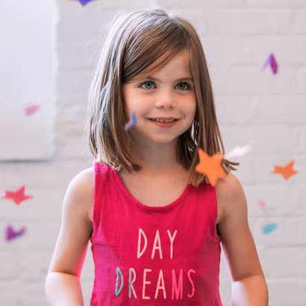
How to introduce yourself

Slide 3
Three parts of a
self-introduction
life
hobby
dream

Slide 4
Three aspects of part 1
who
name
where
hometown /
native country
life
what
character &
personality

Slide 5
Three aspects of part 1
who:
Susan
where:
America
an active &
out-going girl
what:

Slide 6
The combination of part 1
Hello, my name is Susan and I'm from America. I'm an active and out-going girl.

Slide 7
Three aspects of part 2
what
hobby
why
the main reason
for choosing it
hobby
when
when to do it

Slide 8
Three aspects of part 2
what:
playing the piano
why:
I love classical music.
when:
every evening after school

Slide 9
The combination of part 2
My hobby is playing the piano, because I love classical music. I usually play the piano every evening after school.

Slide 10
Three aspects of part 3
What my dream is
When I plan to achieve it
Why I choose it
what
dream
why
when

Slide 11
Three aspects of part 3
what:
to travel around the world
when:
when I grow up
why:
I'd like to see more sights and learn about new cultures.

Slide 12
The combination of part 3
My dream is to travel around the world. I plan to do it when I grow up. I'd like to see more sights and learn about new cultures.

Slide 13
The combination of all three parts
life
hobby
dream

Slide 14
The final version
Hello, my name is Susan and I'm from America. I'm an active and out-going girl.
My hobby is playing the piano because I love classical music. I usually play the piano every evening after school.
My dream is to travel around the world. I plan to do it when I grow up. I'd like to see more sights and learn about new cultures.

Slide 15
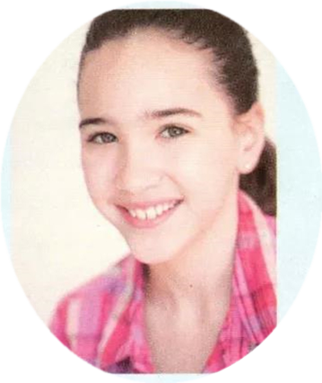
Ann, 15
Lakeside High School
USA
My name is Ann Wells and I’m a Grade 10 student at Lakeside High School. I’m an active person and I love sports. I’m curious about everything. I often ask questions, but I learn best by doing.
life
hobby
My favourite subject is physics. Dancing and skating are my hobbies, and I also like to read short stories.
dream
I plan to become an engineer in the future.

Slide 16
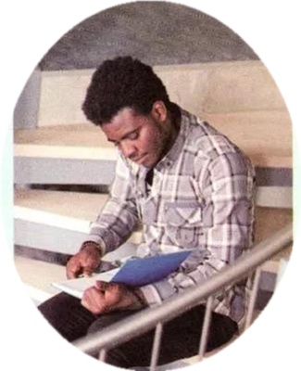
Thando, 16
South Hill High School
South Africa
I’m Thando Gowon. I’m 16 this year. I come from South Africa. I’m a Grade 10 student at South Hill High School.I look good, think fast, and play hard. You’ll never see me without a book or a pen.
life
hobby
If I’m not in class, I’m either in the library or in the computer lab. At the weekends, I play computer games if I’m not busy studying.
dream
My dream is to start my own IT company!

Slide 17

Try to introduce yourself
who: My name is...
where: I'm from...
life
what: I am a...person and I ...
what: My hobbies are...
why: I like...because...
hobby
when: I often...after school/at weekends.
what: I want to .../My dream is...
dream
when: in the future/after graduation
why: because...

Slide 18
Wish your dream come true.

