Slide 1
感恩遇见，相互成就，本课件资料仅供您个人参考、教学使用，严禁自行在网络传播，违者依知识产权法追究法律责任。
更多教学资源请关注
公众号：溯恩英语
知识产权声明

Slide 2
2025届T8联盟12月
第一次联考应用文讲评
WINNER
Showcase the Cultural Charm of Your Nation

Slide 3
01
审题分析
02
语料搭建
03
范文赏析
04
迁移延伸

Slide 4
审题分析
01

Slide 5
原题呈现
Theme
假定你是李华，在英国一所中学做交换生，你在该校举办的“Showcase the Cultural Charm of Your Nation”艺术创作大赛上获得了一等奖。请你写一篇获奖感言，内容包括：
1.介绍你的作品；
2.自己的感想。
注意：
1.写作词数应为80个左右；
2.请按如下格式在答题卡的相应位置作答。
Dear teachers and friends,
_____________________________________________________________________
Purpose+Genre

Slide 6
总结—破解题目信息
文体体裁 | 发言稿——获奖感言
写作人 | 获奖学生
目标听众 | 交换学校的全校师生
写作背景 &目的 | As an exchange student, I participated in a cultural art competition at my UK school and won the first prize. The aim was to showcase China's cultural charm, foster mutual understanding, and express gratitude for the opportunity to share my heritage.
人称时态 | 第一人称 | 一般过去时 | 一般现在时

Slide 7
语料搭建
02

Slide 8
【Opening】开篇
At the very beginning, we should write something like “Thank you all for this incredible honor” because it immediately conveys gratitude and acknowledges the significance of the award.
Thank you all for this incredible honor. I am truly humbled to be standing here today.
Ladies and gentlemen, I am deeply honored to receive this award.
Good evening, everyone. It is with immense gratitude that I accept this award.
I am overwhelmed with joy and gratitude for this recognition.
To be recognized with this award is a dream come true, and I am truly blessed.
They set a respectful and thankful tone,
acknowledging the award's significance and the support from others.

Slide 9
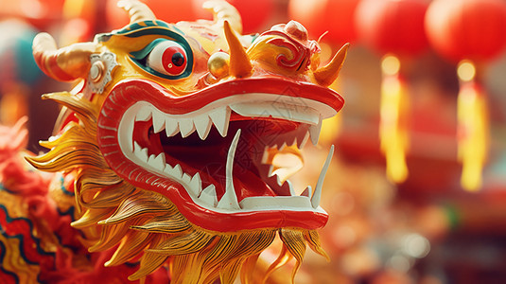
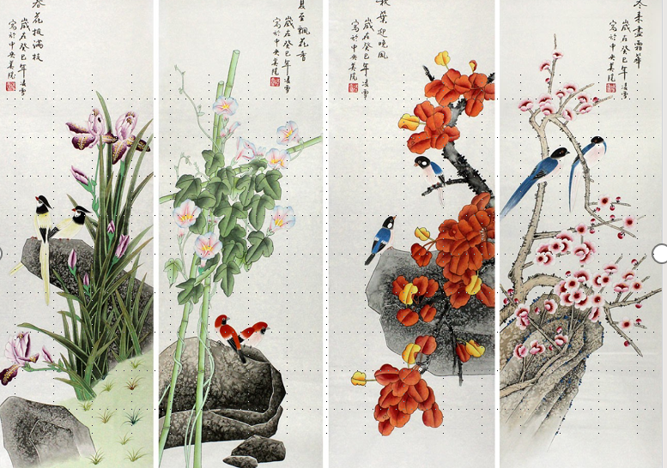
【Main Point Ⅰ】
必写角度1: What is your artwork? What are its major characteristics?
In this part, you need to give a name to your artwork, related to Chinese culture. Then you are expected to list some characteristics about the artwork.
Successful Examples From Students:
My artwork, “Dragon Dance Harmony”, is inspired by traditional Chinese dragon dances. It features dynamic brush strokes, vibrant red and gold colors, and intricate patterns that capture the movement and energy of the dragon.
My artwork is a traditional Chinese ink painting titled “Harmony of the Seasons” It features delicate brush strokes, vibrant colors, and intricate patterns that depict the changing seasons in a serene landscape.

Slide 10
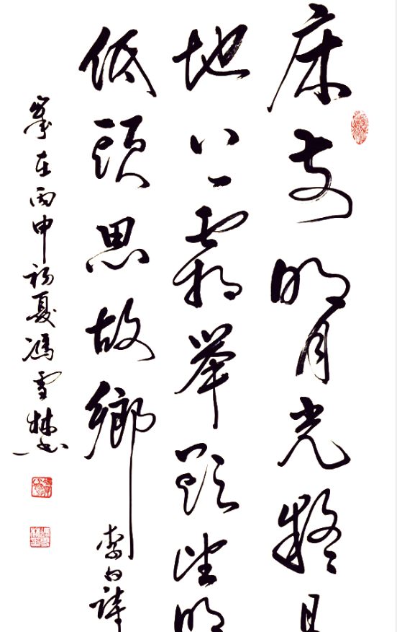
Other Options
The art creation could also be a traditional Chinese calligraphy piece or a paper-cutting artwork. etc.
For many of us, painting is relatively easy to write about because it visually represents cultural scenes and symbols vividly, making it easily understandable and impactful for a diverse audience.
Task：如果你的作品是一幅书法作品，你该如何介绍？（结合前面讲授的启示）
My piece is a traditional Chinese calligraphy, showcasing the profound beauty of Chinese characters. It features the poem “Jingyesi” by Li Bai, written in elegant Seal Script. This art form embodies the essence of Chinese culture, blending history, literature, and aesthetics seamlessly.

Slide 11
【Main Point Ⅰ】
必写角度2: What does it represent? (Why did you choose this theme?)
Successful Examples From Students:
The painting symbolizes the balance and harmony inherent in Chinese culture, reflecting the cyclical nature of life and nature.
I chose this theme to showcase the beauty and continuity of Chinese traditions through the depiction of seasonal changes.
It represents the unity and strength found in Chinese cultural traditions. I chose this theme to showcase the significance of the dragon as a symbol of power and good fortune in Chinese heritage.

Slide 12
【Main Point Ⅰ】
*选择性角度: How did you create the artwork? (techniques used)
抽象与现实元素结合：I combined both abstract and realistic elements to convey a sense of celebration and cultural richness.
传统和现代艺术手法结合：I created the artwork using a combination of traditional Chinese ink painting techniques and modern digital enhancement.
拓展：“艺术”方面的语块语料
artistic expression 艺术表达 be inspired by nature 受自然启发
textural contrasts 质感对比 dynamic composition 动态构图
bold strokes 大胆的笔触 exquisite details 精细细节
harmonious blending 和谐融合 vibrant hues 鲜艳色调
impressionistic style 印象派风格 realistic portrayal 现实描绘
expressive lines 表现力的线条

Slide 13
Extension: Some Perspectives On How to Describe a Painting
You can try some other things instead. Here are some adjectives you can use to explain the color palette of the painting:
bright, vibrant, vivid;
natural, artificial, earthy, rich, intense;
deep, flat, weak, pale, muted;
complementary, quiet, contrasting;
dark, light, monochromatic.
You can use these expressions and words to describe art composition:
asymmetrical, symmetrical, centered;
urban landscape, suburban landscape, rural landscape;
a historic site, domestic setting;
horizontal, vertical, circular, triangular.
VS
不对称的

Slide 14
【Major Point Ⅱ】
如何理解“感想”？和感受的最大区别是什么？
“感想”可以解构为“感受”和“想法”，含义是接触外界事物引起的思想活动。所以可以从获奖的心情感受出发，再写获奖后或者创作中个人的体会和领悟。
Gratitude:
I am grateful（感情中心词） for the opportunity to participate in this competition and to have my work recognized. It has been a wonderful experience to engage with such a diverse and talented group of individuals, and I have learned so much from all of you.（想法）

Slide 15
【Major Point Ⅱ】
Inspiration and Motivation:
Winning this award inspires me to continue exploring and celebrating my cultural roots. This achievement motivates me to be a bridge between different cultures, fostering mutual respect and appreciation.
Connection and Community:
I feel more connected to my peers and the school community through this shared celebration of our diverse backgrounds. It’s heartwarming to see how art can bring us together, transcending linguistic and cultural barriers.
【结合场合和背景（留学生身份），还可以这样写】
Being an exchange student here in the UK, I wanted to share a piece of my homeland and bridge our cultures through art. Winning this award not only validates my efforts but also inspires me to continue exploring and sharing the beauty of Chinese culture with others. I would like to thank my teachers, fellow students, and everyone who supported me throughout this process.

Slide 16
范文赏析
03

Slide 17
官方范文
Dear teachers and friends,
I am honored to receive first prize in this competition.
My artwork, Whispers of Bamboo, is a traditional Chinese ink wash painting that features bamboo, symbolizing resilience and strength in Chinese culture. Through delicate brushstrokes and shades of green and black, I aimed to capture bamboo’s beauty and vitality in a natural setting, with light and shadow adding a sense of serenity.
Winning this award means a lot to me, as it reflects not only my art but also the support from my teachers and classmates. I am grateful for the chance to share my culture and learn from you all. Thank you!
这篇文章内容充实，结构清晰。开头表达荣幸，中间介绍作品及寓意，结尾表达感激，层次分明，情感真挚，很好地达到了感言的目的。主体段中有很多和“艺术”主题相关的主题词汇和语料，体现了丰沛的语料库意识。

Slide 18
下水范文
Dear teachers and friends,
I am truly honored to receive the first prize in the competition.
My artwork is titled “Harmony of Traditions”, and it represents the rich history of Chinese culture through a blend of traditional ink painting and modern digital techniques. I incorporated elements like the graceful movements of the dragon dance, vibrant colors of traditional festivals, and symbolic motifs that reflect our heritage and values.
Being an exchange student here in the UK, I wanted to share a piece of my homeland and bridge our cultures through art. Winning this award not only validates my efforts but also inspires me to continue exploring and sharing the beauty of Chinese culture with others. I would like to thank my teachers, fellow students, and everyone who supported me throughout this process. Thank you, again!

Slide 19
迁移延伸
04

Slide 20
类似任务：天域名校协作体2024届10月联考
假定你是李华，在新西兰的一所高中做交换生。你们小组为世界海洋日(World Oceans Day)设计的海报获一等奖，请代表你们组做经验分享，内容包括：
1.海报主题及制作过程；
2.活动感受。

Slide 21
Dear fellow students,
It’s my privilege to share with you our experience in creating the poster. Themed on sea pollution, our poster intends to advance ocean conservation and education.
Surfing the Internet for inspiring stories about the sea was the first step we took. Then we selected the top concern as the theme and a short, catchy title was chosen to promote the theme. Using the Internet and our school library, we collected information and brainstormed ideas for the design of our poster and what to include. Finally, an appealing picture was added to arouse people’s empathy.
With joint efforts, our project turned out to be a huge success. Through the practice, our team spirits as well as individual competence have been improved. Thank you!

Slide 22
Thanks For Watching!
Congratulation
AWARD CEREMONY

