Slide 1

感恩遇见，相互成就，本课件资料仅供您个人参考、教学使用，严禁自行在网络传播，违者依知识产权法追究法律责任。
更多教学资源请关注
公众号：溯恩高中英语
知识产权声明

Slide 2
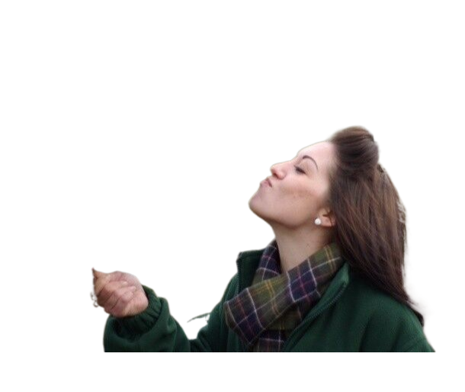
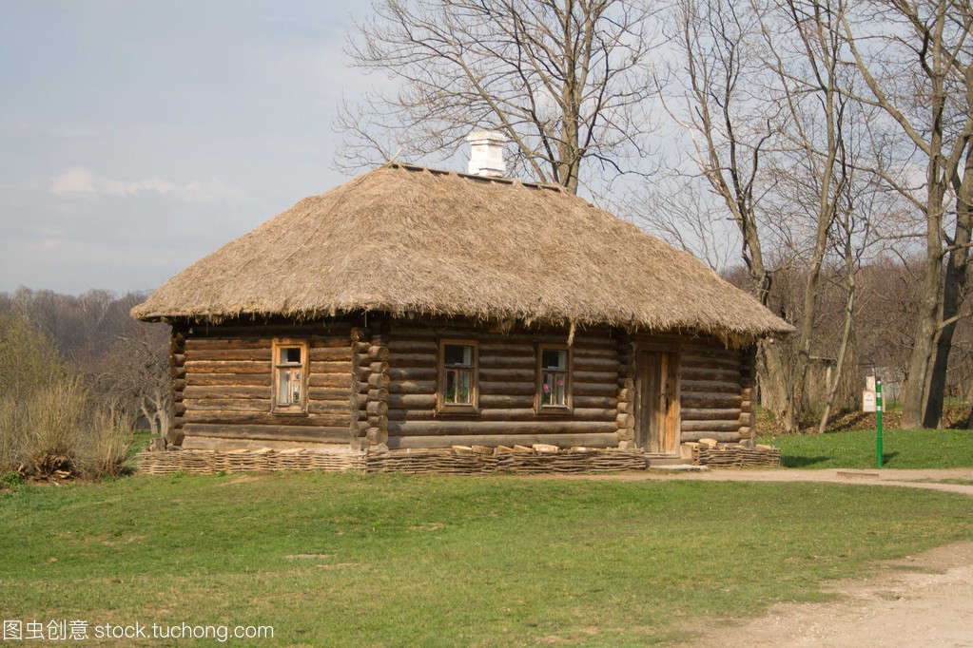
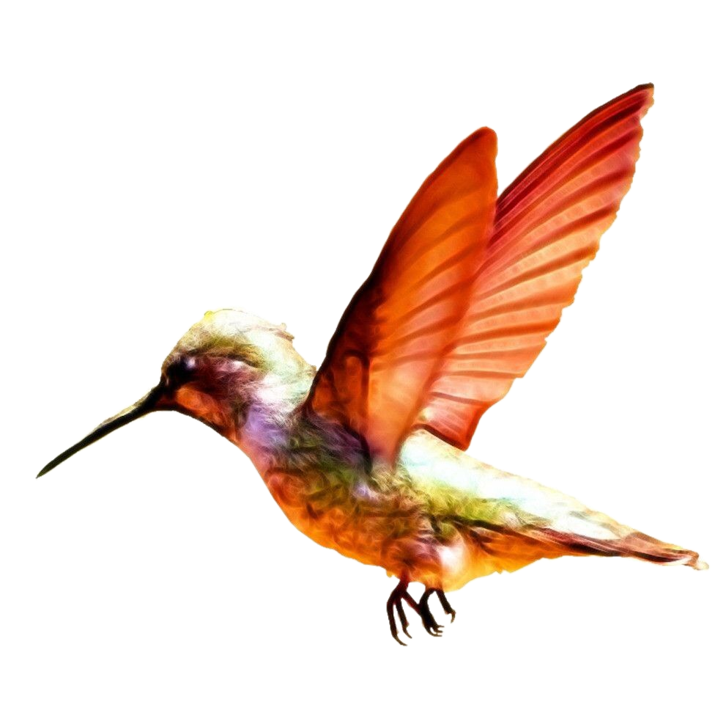
2023年浙江首考读后续写真题：
人鸟情未了
杭州二中树兰高级中学 郭合英

Slide 3
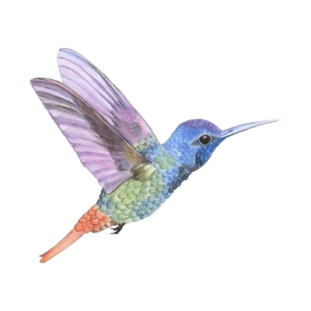
According to the characters to guess what it is?
1.It is the smallest bird in the world.
2. It has bright coloures and is found in North,
Central and South America.
3. It has a long thin beak and powerful
narrow wings that can move very fast.
4. It can hover(悬停) in the sky like a
helicopter and fly left and right.
5. It is the only birds that can fly backwards.
hummingbird
6. Its eyes are like two shiny black spots.

Slide 4
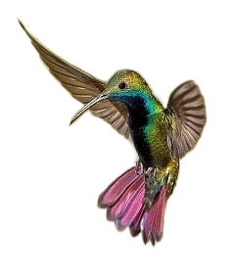

01
Understand the story and define the theme
读懂故事，确定主题
02
Analyze the traits of the leading character and the hummingbird 分析主人公和蜂鸟的性格特点
03
According to the given sentences to infer the story
根据首句推断故事
CONTENTS
04
Language accumulation
语言积累
05
Excellent sample essay
优秀范文

Slide 5
2023年浙江首考读后续写：人鸟情未了
解决生词
n. 野外聚餐
n. 挤奶房
I was invited to a on an old friend’s farm in western Washington. I parked my car outside the farm and walked past which had apparently not been used in many years. A noise at a window caught my attention, so I entered it. It was a hummingbird (蜂鸟), desperately trying to escape. She was covered in spider-webs (蛛网) and was barely able to move her wings. She her struggle I picked her up. With the bird in my cupped hand, I looked around to see how she had gotten in. The broken window glass was the likely answer. I a piece of cloth into the hole and took her outside, closing the door securely behind me. When I opened my hand, the bird did not fly away; she sat looking at me with her bright eyes. I removed the spider-webs that covered her head and wings. Still, she made no attempt to fly, Perhaps she had been struggling against the window too long and was too tired? Or too thirsty?
cookout
a milking house
v. 停止、停下
conj. 一……就
ceased
the instant
vt. 把……塞满；
stuffed
adj. 可粘贴的;
sticky

Slide 6
As I carried her up the blackberry-lined path toward my car where I kept a water bottle, she began to move. I stopped, and she soon took wing but did not immediately fly away.
Hovering (悬停), she approached within six inches of my face. For a very long moment, this tiny creature looked into my eyes, turning her head from side to side. Then she flew quickly out of sight.
During the cookout, I told my hosts about the hummingbird incident. They promised to fix the window, As I was departing, my friends walked me to my car. I was standing by the car when a hummingbird flew to the center of our group and began hovering. She turned from person to person until she came to me. She again looked directly into my eyes, then let out a call and was gone. For a moment, all were speechless. Then someone said, “She must have come to say good-bye.”
Paragraph1: A few weeks later, I went to the farm again.
Paragraph2: I was just about to leave when the hummingbird appeared
adj. (发出)尖锐声的;
squeaking

Slide 7
1. 文本解读
语法填空
An old friend invited me to visit his farm for the cookout. I parked my car outside the farm and walked past a milking house that had apparently not 1 (use) for many years. When a noise in the house caught my attention. Curiously, I entered it, finding
a hummingbird covered in spider-webs. The broken window is 2 (possible) the reason why she was here. I aided her 3__ (move) the sticky spider-webs that covered her head and wings, but the bird did not fly away, maybe she was too tired or too thirsty due 4 her long struggle. I took her to my car, taking out a bottle of water for her. 5___ (Hover) for a while, she looked into 6 (I) eyes over again, flying away quickly. 7 the cookout, I told my friends about 8 hummingbird incident and they promised to fix the window. When I was departing, my friends accompanied me to my car. When a hummingbird flew around our group, she hovered before me, 9 (look) directly into my eyes, let out a squeaking call and was gone. My friends said she must 10 (come) to say good-bye to me.
been used
possibly
to move
to
Hovering
my
During
the
looked
have come

Slide 8
2. 理清故事（5W1H）
I, my friends,
a hummingbird
A noise in the milking house caught my attention, so I entered it, saving a hummingbird.
who
what
a milking house , outside near my friend’s farm
story
The broken window glass was the likely reason why the hummingbird was here.
where
why
When I was invited to visit the farm for cookout
Paragraph1: A few weeks later, I went to the farm again. ……
Paragraph2: I was just about to leave when the hummingbird appeared. ……
when
how

Slide 9
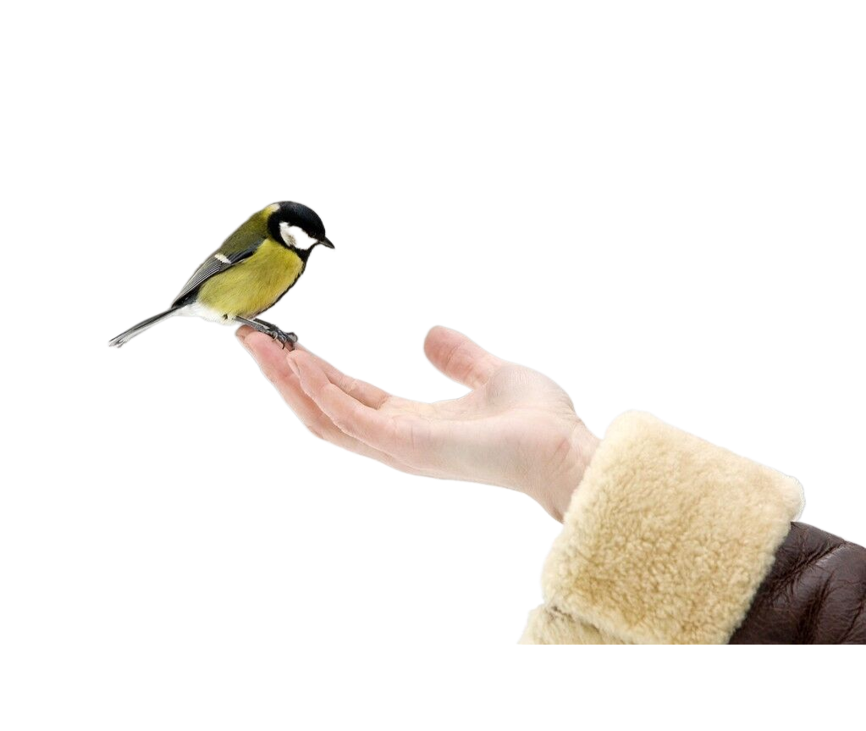
people-person（人缘好的）
3. “我”的性格分析
I was invited to a cookout on an old friend’s farm in western Washington. I parked my car outside the farm and walked past a milking house which had apparently not been used in many years. A noise at a window caught my attention, so I entered it. It was a hummingbird (蜂鸟), desperately trying to escape. She was covered in spider-webs (蛛网) and was barely able to move her wings. She ceased her struggle the instant I picked her up. With the bird in my cupped hand, I looked around to see how she had gotten in. The broken window glass was the likely answer. I stuffed a piece of cloth into the hole and took her outside, closing the door securely behind me. When I opened my hand, the bird did not fly away; she sat looking at me with her bright eyes. I removed the sticky spider-webs that covered her head and wings. Still, she made no attempt to fly, Perhaps she had been struggling against the window too long and was too tired? Or too thirsty?
As I carried her up the blackberry-lined path toward my car where I kept a water bottle, she began to move. I stopped, and she soon took wing but did not immediately fly away.
Hovering (悬停), she approached within six inches of my face. For a very long moment, this tiny creature looked into my eyes, turning her head from side to side. Then she flew quickly out of sight.
During the cookout, I told my hosts about the hummingbird incident. They promised to fix the window, As I was departing, my friends walked me to my car. I was standing by the car when a hummingbird flew to the center of our group and began hovering. She turned from person to person until she came to me. She again looked directly into my eyes, then let out a squeaking call and was gone. For a moment, all were speechless. Then someone said, “She must have come to say good-bye.”
作用：
通过人物性格的分析，暗示了续写第一段首句“A few weeks later, I went to the farm again. ” 中主人公为什么再次来到农场：
attentive（细心的）
benevolent （有爱心的）
因为主人公对蜂鸟的牵挂，他/她想知道蜂鸟的现状。

Slide 10
3. 蜂鸟的心理活动分析
a strong survival instinct （强烈的求生欲）
I was invited to a cookout on an old friend’s farm in western Washington. I parked my car outside the farm and walked past a milking house which had apparently not been used in many years. A noise at a window caught my attention, so I entered it. It was a hummingbird (蜂鸟), desperately trying to escape. She was covered in spider-webs (蛛网) and was barely able to move her wings. She ceased her struggle the instant I picked her up. With the bird in my cupped hand, I looked around to see how she had gotten in. The broken window glass was the likely answer. I stuffed a piece of cloth into the hole and took her outside, closing the door securely behind me. When I opened my hand, the bird did not fly away; she sat looking at me with her bright eyes. I removed the sticky spider-webs that covered her head and wings. Still, she made no attempt to fly, Perhaps she had been struggling against the window too long and was too tired? Or too thirsty?
As I carried her up the blackberry-lined path toward my car where I kept a water bottle, she began to move. I stopped, and she soon took wing but did not immediately fly away.
Hovering (悬停), she approached within six inches of my face. For a very long moment, this tiny creature looked into my eyes, turning her head from side to side. Then she flew quickly out of sight.
During the cookout, I told my hosts about the hummingbird incident. They promised to fix the window, As I was departing, my friends walked me to my car. I was standing by the car when a hummingbird flew to the center of our group and began hovering. She turned from person to person until she came to me. She again looked directly into my eyes, then let out a squeaking call and was gone. For a moment, all were speechless. Then someone said, “She must have come to say good-bye.”
作用：
通过分析蜂鸟的心理活动，暗示故事后续发展的第二段
“I was just about to leave when the hummingbird appeared.”
蜂鸟为什么会再次出现，她来这儿的目的是什么？她又做了什么，为什么要这样做？
at a loss（茫然不知所措）
Keep the benefactor in mind
（将恩人牢记于心）
因为蜂鸟想用自己的方式报答和感谢救命恩人。
She was reluctant to part with his benefactor.
（对救命恩人恋恋不舍）

Slide 11
4. 推断故事情节
Paragraph1: A few weeks later, I went to the farm again.
Paragraph2: I was just about to leave when the hummingbird appeared.
1. Why did I go to th farm again? My mood?
2. What did I do on the farm?
3. What were my feelings when the hummingbird was absent?
1. Why did the hummingbird appear?
2. What did the hummingbird do ?
3. What did I do ? What were my feelings?
4. What does the story tell us?

Slide 12
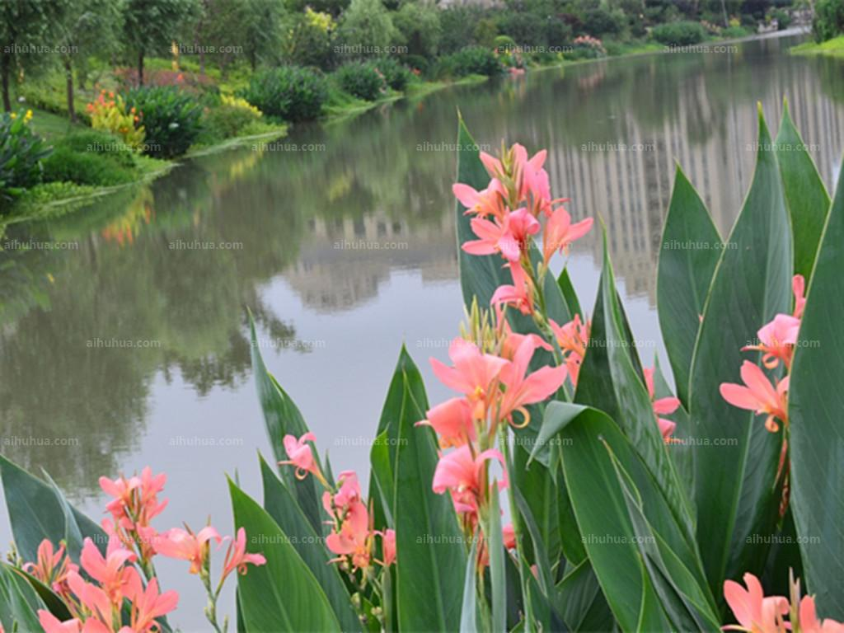
5. 丰富语言（Show, Don’t tell）
利用五感描写农场的环境
（视觉、听觉、嗅觉、味觉、触觉）
翻译：1. 当我再次来到农场时，农场看上去和我上次来时一样：相同的山、相同的水，相同的风景
When I went to the farm again, the farm looked the same as I came last time : the same mountain, the same water, the same scenery.
视觉
翻译：2.河岸两边有各种各样的花，鲜花的香味沁人心脾，同时引来了很多蝴蝶，围着他们转来转去。
With a variety of flowers on both sides of the river, the fragrant flowers delighted the heart, and attracted lots of butterflies, lingering around them .
嗅觉

Slide 13
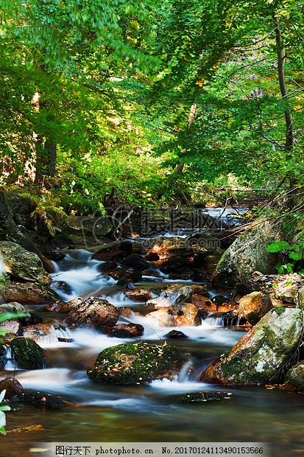
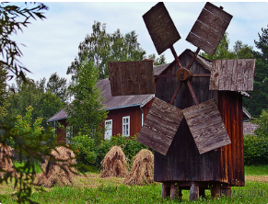
5. 丰富语言（Show, Don’t tell）
利用五感描写农场的环境
（视觉、听觉、嗅觉、味觉、触觉）
翻译：3. 潺潺的流水声让我很放松。
The gurgling/burbling stream soothed me.
听觉
翻译4：我沉浸在小鸟悦耳的歌声中。
听觉
The melodious song of birds made me spellbound.
翻译：5. 古老的风叶像张开的翅膀，迎风转动，不仅与绿草、野花构成了独特的风景，更为这童话般的世界增添了神奇的色彩！
Ancient windmill's leaves opened like the birds’ wings, rotating against the wind. The windmill, the green grass and the wild flower not only constituted the unique view, but also added mysterious color to the fairy-tale world !
视觉

Slide 14
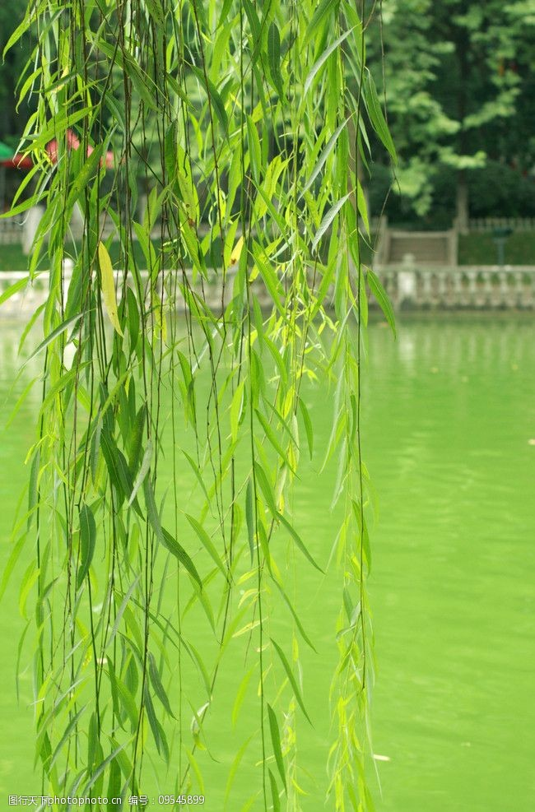
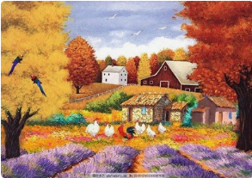
5. 丰富语言（Show, Don’t tell）
利用五感描写农场的环境
（视觉、听觉、嗅觉、味觉、触觉）
翻译：6.岸边的柳树很诱人，我轻触长长的垂柳真像是柳树姑娘的辫子，它看上去鲜嫩、摸上去柔滑。
The willows on the bank were very attractive. I lightly touched the long willow twigs really like the willow girl's braid, and they looked fresh and tender and felt silky.
触觉+视觉
翻译：7. 沐浴在暖阳下，呼吸着清新的空气，欣赏着优美的风景，感受着农场的惬意, 我仿佛正在享受大自然赋予我的人间“美味”。
味觉
Bathed in the warm sun, breathing the fresh air, enjoying the beautiful scenery and feeling the comfortable farm, I seemed to be enjoying the “delicious food” endowed by nature.

Slide 15
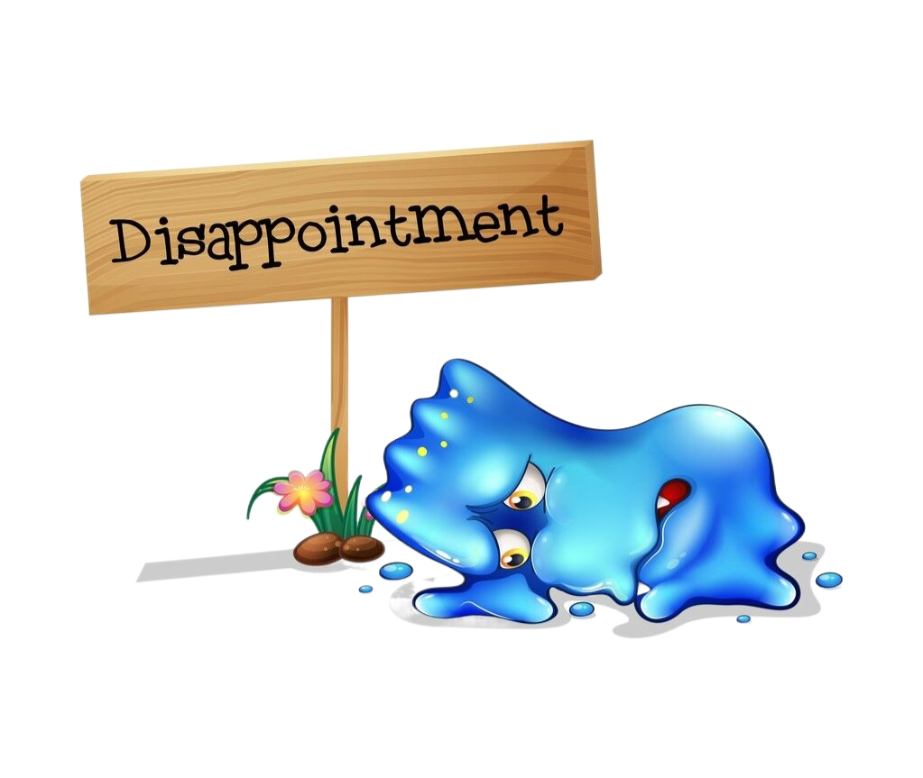
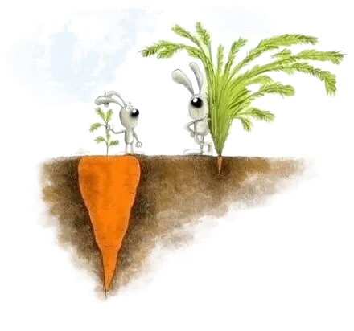
5. 丰富语言（Show, Don’t tell）
没看到蜂鸟时的失望
1. I broke down emotionally.
2. Disappointment overwhelmed my heart.
3. My heart was drizzling, heart wet.
我的心下着淅淅沥沥的小雨，心里湿漉漉的。
4. I was more than gutted, tears streaming down my cheeks.
5. I couldn't resist crying bitterly, burying my face in my hands.
6. My heart sank, just like a stone falling heavily to the ground.
7.Not seeing the hummingbird, I felt no end (非常) disappointed .

Slide 16


5. 丰富语言（Show, Don’t tell）
看到蜂鸟时的欣喜/开心
1. I was at the top of the world.
2. she cheered and jumped with joy.
3. I was in high spirits as if floating on the air.
4. I grin from ear to ear as if the world were my own.
5. Seeing the hummingbird, my eyes twinkled with excitement.
6. I was like a dog with two tails when seeing the hummingbird.
7. Exhilaration took possession of me upon seeing the hummingbird.
8. The hummingbird in sight, my eyes danced with joy and sweetness.

Slide 17
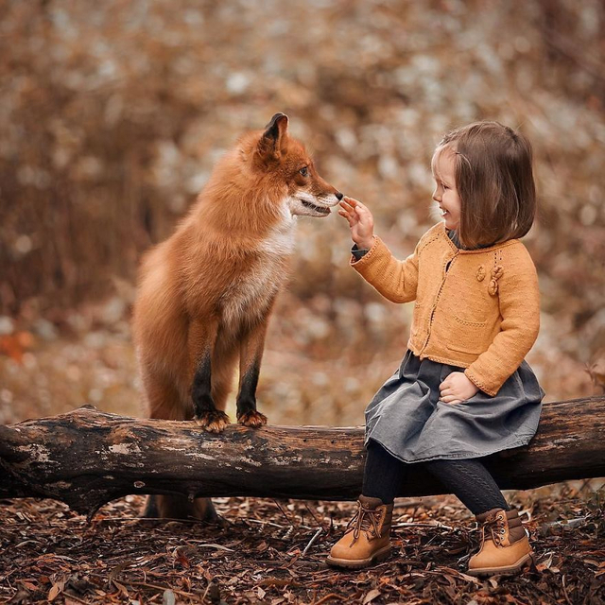
6. 人和动物和谐的主题升华
1. The relationship between human and animals is gradually causing
people’s attention. 人与动物的关系正在逐渐引起人们的注意。
2. It is a reminder that we need to care about the world we live in and that
we should learn to respect life and nature.
它提醒我们要关心我们生活的世界，我们应该学会尊重生命和大自然。
3. It is time for every one of us to start to
do what we can to protect the animals
that are beneficial to man.
它是时候对我们每个人开始做我们能
做的事情去保护有益于人类的动物了。

Slide 18
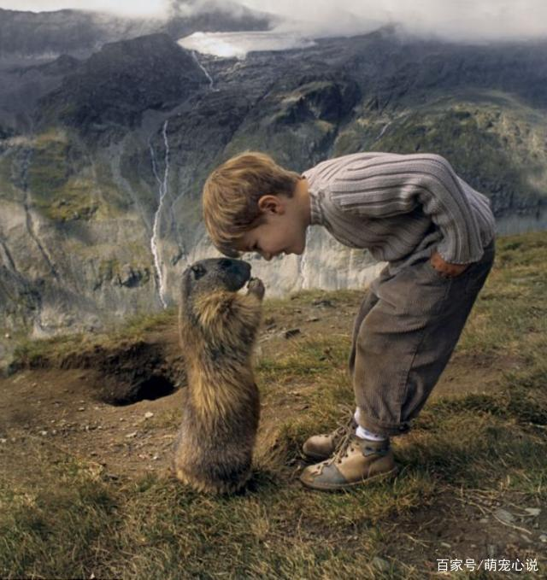
4. In order to live better, we should learn to treat animals better so that they
will look after us better in the future.
为了更好地生活，我们要学会善待动物，将来动物也会关照我们。
5. The reason why we have to protect animals is that they are man's friends
for ever. 我们保护动物的理由是他们是人类永远的朋友。
6. How important a thing it is to protect animals! Animals are to us what friends are to us.
保护动物是多么重要的一件事情！动物对于我们来说就好像朋友对我们一样的重要。

Slide 19
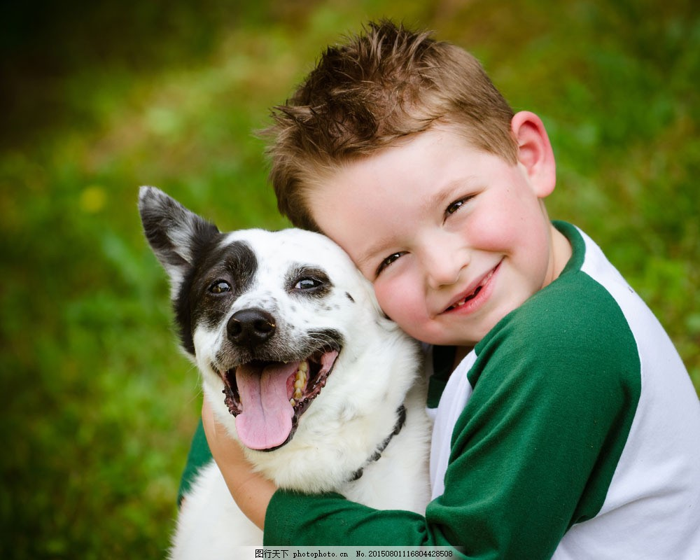
7. Without animals, the world wouldn’t a complete one; without animals, we would upset the ecological balance ; without animals, we would live a boring life without the sound of birds singing.
8. We should attach importance to animals protection.
9. There’s no denying the fact that animals are man’s friends.
10. It is universally acknowledged that animals are significant to us.
11. Last but not least, we should have s strong sense of responsibility for ecological balance and spare no efforts to protect birds and other animals.

Slide 20
7. 优秀范文
契诃夫法则，呼应原文： During the cookout, I told my hosts about
the hummingbird incident. They promised to fix the window
比喻修辞写出了我希望看到蜂鸟的急切心情
夸张修辞表达了蜂鸟无数次回来寻找救命恩人，同时也表达了蜂鸟回报恩人的决心。
无灵表达写出了我没看到蜂鸟的失望
A few weeks later, I went to the farm again. I rushed to the house like an arrow leaving the bow to see whether the hummingbird was there. Disappointment visited me when not seeing the hummingbird. But to my relief, the window was fixed. I gave the farmer a call. He told me about the hummingbird, saying the hummingbird had flied back for 101 times as if to wait for me. Hearing this, My heart melted, tears streaming down my cheeks. Bathed in the warm sun, breathing the fresh air, I had no mood in enjoying the beautiful scenery. Scanning around, I tried to look for the hummingbird's shadow. With the time ticking by, the hummingbird didn’t still come into my sight. My heart sank, like a stone falling heavily to the ground.
I was just about to leave when the hummingbird appeared. I cheered with joy with eyes dancing with sweetness. The hummingbird hovered before me, looking directly into my eyes. She let out a squeaking call the instant she recognized me, jumped onto my outstretched left hand and kissed it desparately, which made my heart melt again. I stretched out another hand, gently stroking her head as if she were my own child. The soft breeze and the amber-like sunshine witnessed the great friendship between us. It dawned on me that birds are to our human what friends are to us. Therefore, we should protect birds so as to make them become our friends for ever.
景物反衬法：景物虽好，却没心情欣赏，写出了
主人公没看到蜂鸟的失望。
被蜂鸟的行为所感动
虽心有不甘，可终究还是失望了。此句既写出了
主人公的失望，又呼应了下文的给出句：I was just about
to leave when the hummingbird appeared.
原文词汇产出,尤其是“looking directly into my eyes”，
在原文中被三次提到。
这是人与鸟儿和谐相处的温馨瞬间，微风与阳光见证了这一
切。此句既渲染了主题，又为升华主题做了铺垫。
看到蜂鸟时的欣喜
与续写第一段相呼应
升华主题，突出人与自然和谐的重要性

Slide 21


