Slide 1


感恩遇见，相互成就，本课件资料仅供您个人参考、教学使用，严禁自行在网络传播，违者依知识产权法追究法律责任。
更多教学资源请关注
公众号：溯恩高中英语
知识产权声明

Slide 2



Slide 3
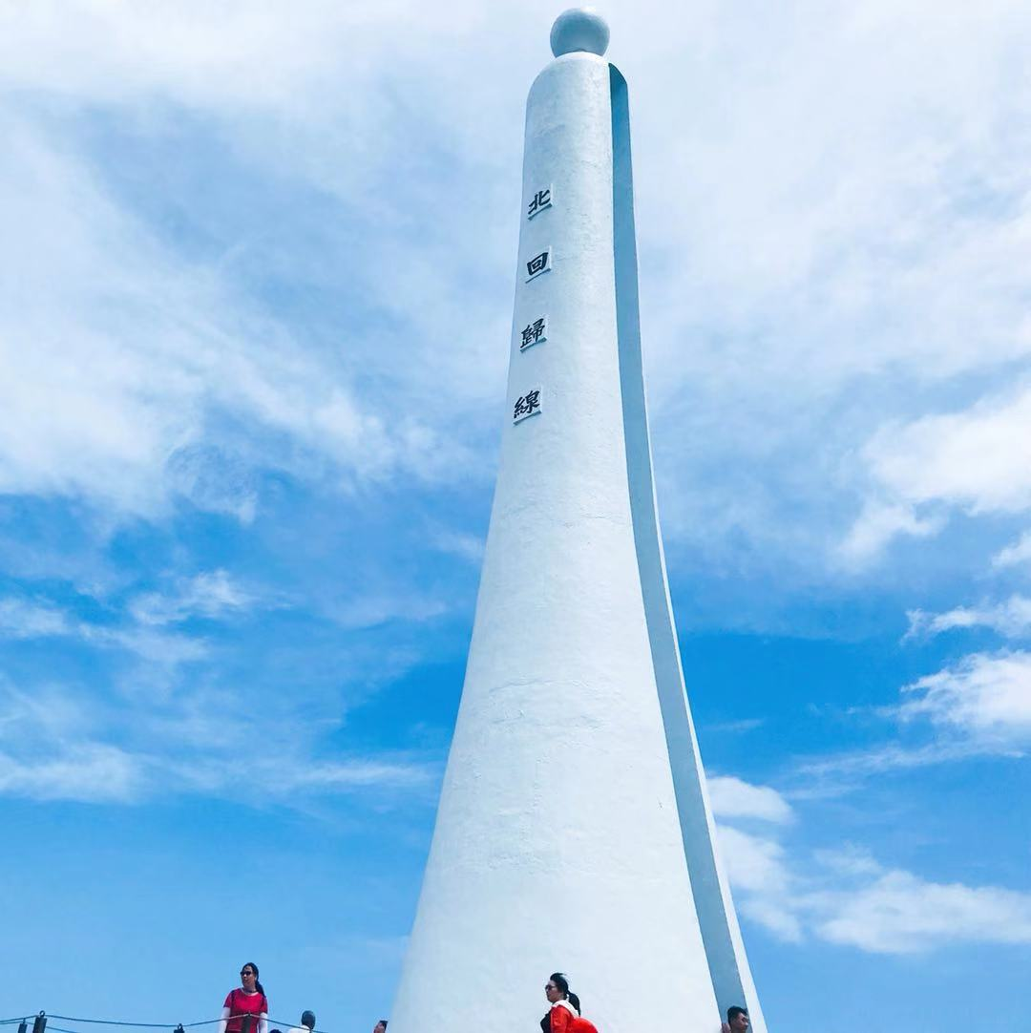
Lead in
A trip to Taiwan
The guide told us that
earthquakes happen so frequently that locals know how to protect themselves.
stay calm
drop down onto...
cover the head with...
stay away from...
Hide under…, hold on to...
go to an open space...
...

Slide 4
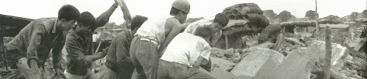
Prediction
Look at the title and photo below and guess what the text is about.
THE NIGHT THE EARTH DIDN'T SLEEP

Slide 5
Skimming
THE NIGHT THE EARTH DIDN'T SLEEP
when
where
what
before
Para. 1
____ the earthquake
____ the earthquake
____ the earthquake
time or space
during
Para. 2-3
It is a literary journalism(报告文学).
The text is developed in order of ____
time
An text using a descriptive language and rhetorical devices(修辞手法)to present facts.
after
Para. 4-5

Slide 6
Scanning
Para.1 before the earthquake
What were the strange things?
topic sentence
warning signs
______________ before the earthquake
Strange things were happening in the countryside of northeastern Hebei. For several days, the water in the village wells rose and fell, rose and fell. There were deep cracks that appeared in the well walls. At least one well had some smelly gas coming out of it. Chickens and even pigs were too nervous to eat, and dogs refused to go inside buildings. Mice ran out of the fields looking for places to hide, and fish jumped out of the water. At about 3:00 a.m., on 28 July 1976, bright lights were seen in the sky outside the city of Tangshan and loud noises were heard. But the city's one million people were asleep as usual that night.
repetition
To impress readers deeply

Slide 7
Scanning
Para.1 before the earthquake
What were people doing that night?
warning signs before the earthquake
People were asleep as usual
thought little of
extreme damage

Slide 8
Scanning
Para.2-3 extreme damage during the earthquake
To make the information convincing
one of the most deadly earthquakes of the 20th century
described by data
1/3
of the nation felt the earthquake.
A huge crack, ____ kilometers long and _____ meters wide, cut across houses, roads and waterways.
In less than _____ minute, a large city lay in ruins.
_______ of the people who lived there were dead or injured.
The number of people who were killed or badly injured in quake was more than __________.
About ______ of the city's factories and buildings, ______ of its homes, and all of its hospital were gone.
8
30
1
2/3
400,000
75%
90%

Slide 9
Sentences to appreciate
To present vivid pictures
1. Hard hills of rock became _____________.
2. Bricks covered the ground _____________________, but no wind could blow them away.
rivers of dirt
methaphor
like red autumn leaves
simile
anxious
shocked
helpless
scared/terrified
desperate/hopeless
…
People began to wonder how long the disaster would last.
People felt ____________

Slide 10

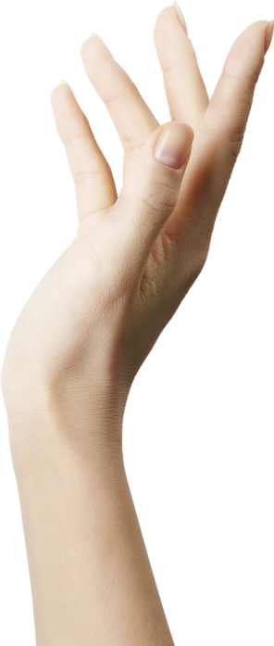
Scanning
Para.4 _________ after the earthquake
rescue
But hope was not lost.
The army sent 150,000 soldiers to…
various help
________
from all over the country
Most than 10,000 doctors and nurses came to...
Workers built shelters for…
Water and food were brougt into …
Slowly, the city began to breathe again.
revive
To give people hope
personification

Slide 11
Scanning
Para.5 ________ after the earthquake
revival
topic sentence
Tangshan started to revive itself and get back up on its feet.
With strong support from the government and the tireless efforts of the city's people, a new Tangshan was built upon the earthquake ruins. The new city has become a home to more than seven million people, with great improvements in transportation, industry, and environment. Tangshan city
has proved to China and the rest of the world that in times of disaster, people must unify and show the wisdom to stay positive and rebuild for a brighter future.
reasons
results
conclusion

Slide 12
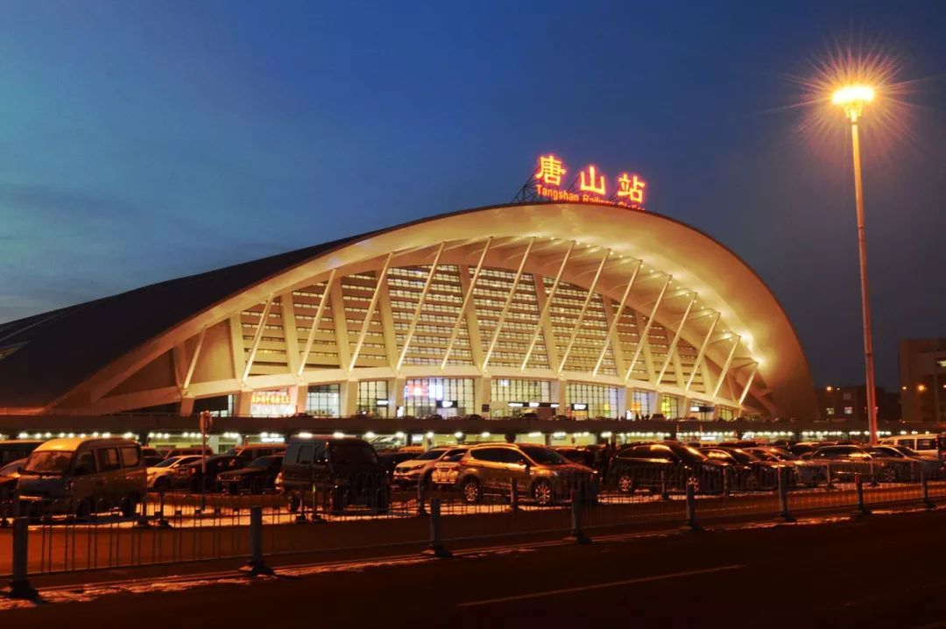
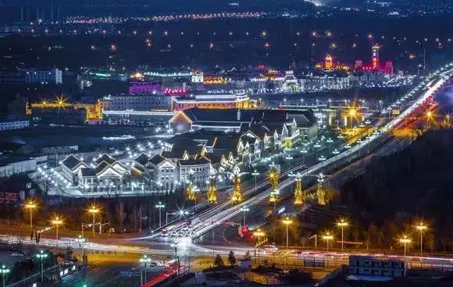
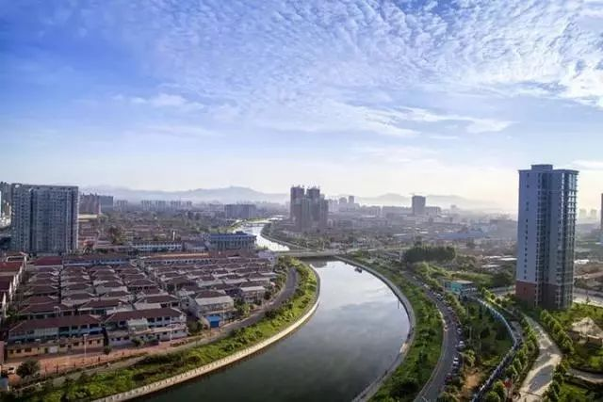
Further-thingking
What makes Tangshan develop so fast?

Slide 13
Further-thingking
What makes Tangshan develop so fast?
strong support from the government
unify
tirelss efforts of the city's people
various help from the whole nation

Slide 14
Pair work
Suppose you were a survivor of the Tangshan earthquake in 1976, would you please share your experience with us? Please discuss with your partner.
Supportive words and expressions:
I remembered there were… before the quake, but…
It was terrible when…
I felt shocked/frightened/hopeless/desperate…, because…
It seemed as if …
Luckily, …

Slide 15
Further-thinking
Why do you think the earthquake caused such great damage to the city and its people?
It was a 7.8 magnitude earthquake, which was very destructive.
It happened in the early morning, when people were enjoying a sound sleep.
An unexpectedbig aftershock struck Tangshan afterwards.
People paid little attention to the warning signs.
...

Slide 16
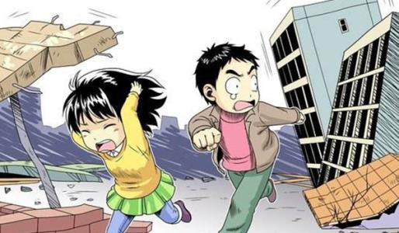
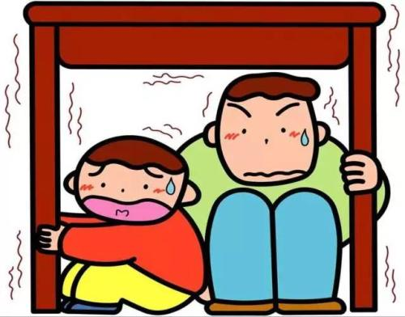
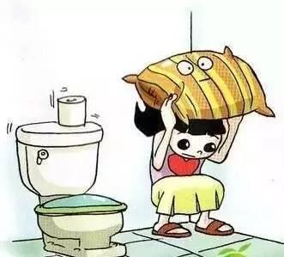
Discussion
If one day we come across an earthquake, what should we do to protect ourselves?
stay calm
drop down onto...
cover the head with...
stay away from...
hide under…
hold on to...
move to...
call... if possible
...

Slide 17
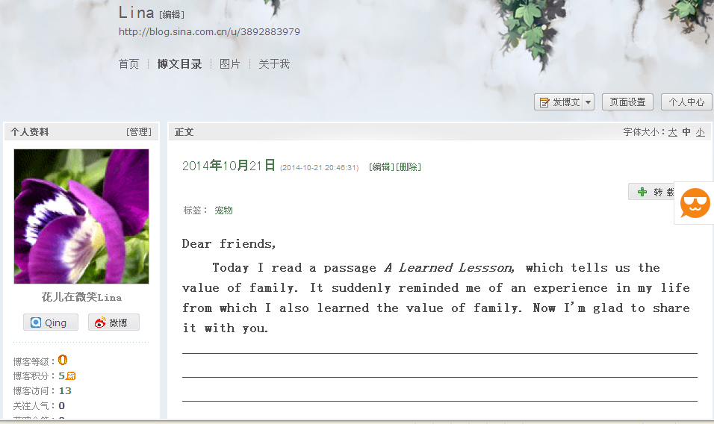
Homework
Write your story and advice down, and share them with
your friends on the blog. Try to use what we’ve learnt in class.
It is a terrible experience for me. I remembered there were some strange signs before the quake. For example, ... but...
If one day you come across an earthquake, first of all you should...

Slide 18



