Slide 1

B2U1 In Search of the Amber Room
Reading

Slide 2
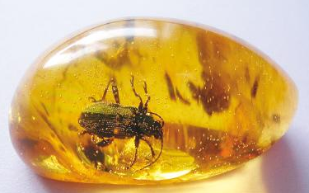
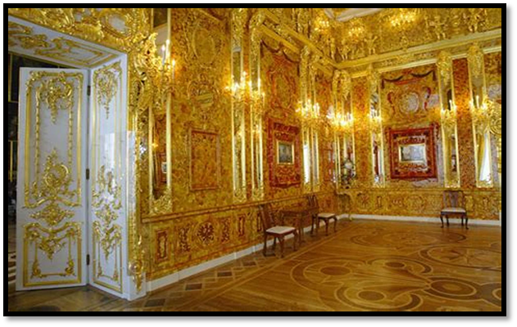
Is amber economically valueless or priceless?
1. What do you know about the amber? (color/usage/formation)
  yellowish brown clear
  for decoration, necklaces and other ornaments
  Amber is the fossilized resin from ancient forests.
  It was formed tens of millions of years ago.
2. What words would you use to describe the Amber Room?
fancy; extraordinary; rare…

Slide 3
In Search of the Amber Room
Frederick William I, the king of Prussia, could never have imagined that his greatest gift to the Russian people would have such an amazing history.
What do you want to know about the title and the first sentence? (Raise questions)
1. What was the amber room like?
2. Who made the amber room? Why?
3. Who is in search of the amber room? And how?
4. What was the result of the search?
5. What was the amazing history?
6. Why did the amber room have such an amazing history?
7. Why was the amber room the greatest gift?

Slide 4
1. Skim the passage and relate the raised questions to paragraphs.
Para. 1
Para. 2
Para. 2-5
What we want to know
√
1. What was the amber room like?
2. Who made the amber room? Why?
3. Who is in search of the amber room? And how?
4. What was the result of the search?
5. What was the amazing history?
6. Why did the amber room have such an amazing history?
7. Why was the amber room the greatest gift?
√
√
factual questions
√
√
√
probing questions
2. Collect evidence for the above questions and share.

Slide 5
1. What was the amber room like?
2. Who made the amber room? Why?
Para. 1&2
What words would you like to describe the amber room? (Evidence)
Frederick William Ⅰ, the King of Prussia , could never have imagined that his greatest gift to the Russian people would have such an amazing history . This gift was the Amber Room, which was given this name because several tons of amber were used to make it. The amber which was selected had a beautiful yellow-brown colour like honey. The design of the room was in the fancy style popular in those days. It was also a treasure decorated with gold and jewels, which took the country's best artists about ten years to make.
Frederick William Ⅰ, the King of Prussia , could never have imagined that his greatest gift to the Russian people would have such an amazing history . This gift was the Amber Room, which was given this name because several tons of amber were used to make it. The amber which was selected had a beautiful yellow-brown colour like honey. The design of the room was in the fancy style popular in those days. It was also a treasure decorated with gold and jewels, which took the country's best artists about ten years to make.
The amber room was an a___________ treasure with considerable s___________ materials, a f______ design and the b____ artists’ unremitting efforts for years.
amazing
selected
fancy
best

Slide 6
4. What was the result of the search?
5. What was the amazing history?
Para. 2-5
not a gift, the palace
trade…with…
part of the winter palace
serve as…
be at war;
secretly steal…
Frederick I
Frederick WilliamⅠ
Peter the Great (the Czar)
CatherineⅡ
The Nazis
The Russians and Germans
belong to; not to keep it; give it to
move…
add more details(improve)…
rebuild;
look like…
What words would you like to describe the amber room?
The amber room was an a___________ treasure with an a____________ history.
amazing
amazing

Slide 7
As an eyewitness, what did Amber Room see over the centuries?
Germany-
Russia
relationship
Frederick W. I
&Peter the Great
Around 2000
good
1980s
bad
worst
World War II
18th C
19th C
20th C
21st C

Slide 8
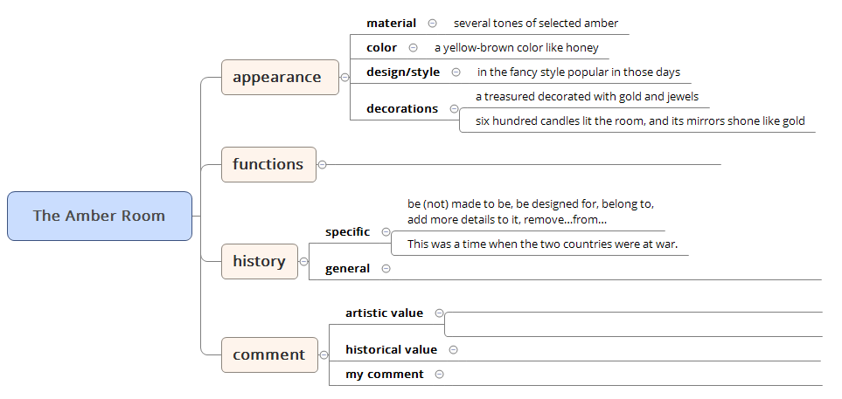
6. Why did the amber room have such an amazing history?
7. Why was the amber room the greatest gift?
Our idea
An Eyewitness
the luxurious life of kings and queens
serve as a small reception hall, become part of…
the Nazi Crime
such an amazing history; remain a mystery
rare, valuable
the friend-foe-friend relationship change between Germany and Russia
be considered(as) one of the wonders of the world
survive, witness a special period of history, reminder
There is no doubt that… be (not) worth protecting

Slide 9

Make a report
1. How many versions of Amber Room are mentioned?
2. What are the differences? (makers/style/purpose)
3. What decides the fate of the Amber Room?
There are two. They are the lost Amber Room and the new Amber Room. The former, in the fancy style popular in those days, was made by the Prussian and Russian best artists years to complete. It is an eyewitness to the luxurious life of kings and queens, and an eyewitness to the Nazi crime during WWII. However, they rebuilt the latter one , a replica (复制品), in 2003 to celebrate the 300th birthday of their cities. It is an eyewitness to the friend-foe-friend relationship change between Germany and Russia. Personally, it is humans’ wisdom and weaknesses that decides the fate of the amber room.

Slide 10
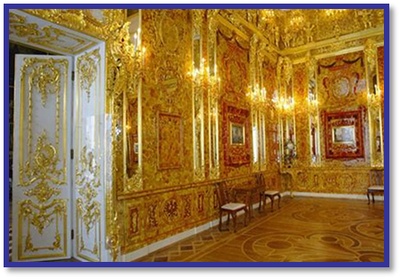
Think further
1. What words would you use to describe the amber room?
  fancy; extraordinary; rare…
  an amazing treasure with an amazing history
  eyewitness, reminder…
2. Why would you describe it in this way?
  the economical value
  the historical value
  the cultural value

Slide 11
Question the title
Which title do you prefer? Why?
A. In Search of the Amber Room
B. The Amazing History of the Amber Room
C. The Value of the Amber Room
D. The Amber Room, an Eyewitness of the Amazing history
…
In search of something means looking for something. The title In Search of the Amber Room provides readers with an opportunity to make their own judgement, including the amazing history, the economical, historical and cultural value of the Amber Room.

Slide 12
Assignment
Chose an important object with historical significance at home or abroad. Make a claim for its importance and give the specific dimensions to support your claim.

