Slide 1

感恩遇见，相互成就，本课件资料仅供您个人参考、教学使用，严禁自行在网络传播，违者依知识产权法追究法律责任。
更多教学资源请关注
公众号：溯恩高中英语
知识产权声明

Slide 2

2022年6月高考 考前惊鸿一瞥：

Slide 3








语篇衔接的三个“一定”
1
2
句式高级的四种“表达”
目录
3
词汇丰富的五类“词性”
4
备考精准的六篇“热文”

Slide 4

认识寿春，从此我是寿春人
1
语篇衔接的
三个“一定”

Slide 5
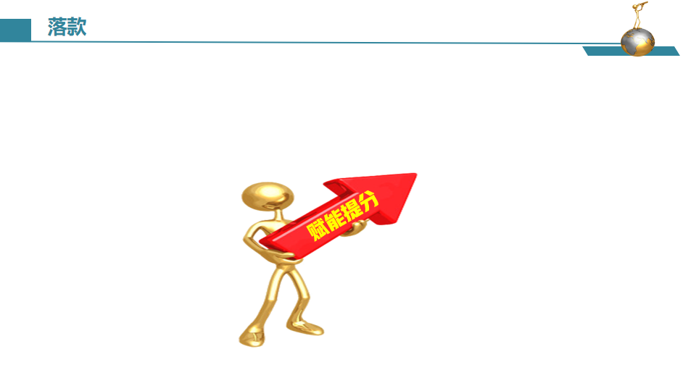


语篇衔接的三个“一定”
根据衔接连贯理论，通过词汇的有效衔接（词汇同现或词汇复现）实现语义连贯和逻辑衔接。
第一段结尾
①一定要有与第二段段首句中的同词或同义词。
②实现无缝衔接
第一、二段开头
①一定要把段首句的名词或动词（尤其是后半句），用在写作开头，实现语义连贯。
②力争高分开头
第二段结尾
①一定要有原文中体现主题或伏笔的关键词。
②实现主题升华

Slide 6
语篇衔接的三个“一定”_{(以2022年1月浙江高考读后续写“与学霸做项目”为例)}
原文（第一段） | When Dr. Henderson was assigning(指定) project mates for his psychology class, I secretly hoped he would pair me with my best friend or at least a classmate I could have some fun with.
第一段 | We started to meet regularly to draw up plans. At first it seemed that he dominated our discussion for he was familiar with the topic, but I was the opposite. ..... .... We parted the day before analysis discussion with confidence for our project but when I returned the next morning, he was nowhere to be found. That fact struck me feeling desperate. He didn’t come either in the following days.
第二段 | One day I got word that he was admitted to hospital for a serious disease. It was the day before deadline and I drowned myself doing analysis and preparing for the presentation. Hearing the word, I dashed to the hospital and found him, my dear teammate. ... .... My seemingly single-minded and cold teammate and I, together, achieved something satisfying, and had fun but more than fun.

Slide 7
语篇衔接的三个“一定”_{(以2021年6月浙江高考读后续写“我的假日薪水”为例)}
原文（第一段 第二段） | My dad, George, only had an eighth grade education. A quiet man, he didn’t understand my world of school activities. From age 14, he worked. And his dad, Albert, took the money my dad earned and used it to pay family expenses. I didn’t really understand his world either： He was a livestock trucker, and I thought that I would surpass_{（超过）}anything he had accomplished by the time I walked across the stage at high school graduation.
第一段 | When I brought my paycheck home — it was $119 — my dad wanted to talk to me. “Good for you, breadwinner!” He said, an absolute gaiety spreading across his face. ..... .... Then, he gripped my wrist, with his eyes full of love. “Now that you have grown up, and I'm sure you will manage your money successfully!”
第二段 | I was surprised that my dad allowed me to use the money as I wished. I jumped a mile. my mouth wide open in amazement. After a pregnant pause, we began to laugh together, ideas of buying new shoes, a football and a basketball flooded into my mind. ... ....At exactly that moment, I understood why my father let me have the money—it was his expectation for my future, his encouragement and quiet love. And that was something I never surpass.

Slide 8
认识寿春，从此我是寿春人
2
句式高级的
四种“表达”

Slide 9

省略if对过去的虚拟句：突显“①后悔、遗憾; ②生气、愤怒; ③成功的感激”的心理活动和归因
If +主语+ had +过去分词，主语 + would/could/might/should+ have + 过去分词
升级句式，高级表达 →（省略if, 部分倒装）
Had +主语 +过去分词，主语 + would/could/might/should + have + 过去分词
1. 突显“后悔、遗憾”的心理活动和归因
“如果我没有做.../去了...，我就不会陷入如此窘迫的境地”，Jane充满了后悔与焦虑，渐渐地眼泪湿了眼眶。_{（2016年10月浙江“夫妻吵架而迷路”）}
“Hadn’t done sth/gone to the+地方, I wouldn't have been trapped in the awful situation now!" Jane said with anxiety and regret, and gradually her tears welled up in her eyes.
很长一段时间，她很懊恼悔恨地呆在原地。“如果不是我那么固执/粗心，我不会把它们都弄死了”
✍For a long while, she was rooted in the spot, regretfully. “Hadn’t I been so stubborn/ careless, I would not have killed them all.”_{(倒装+虚拟, 表示“后悔”的心理活动描写)}

Slide 10
省略if对过去的虚拟句：突显“①后悔、遗憾; ②生气、愤怒; ③成功的感激”的心理活动和归因
If +主语+ had +过去分词，主语 + would/could/might/should+ have + 过去分词
升级句式，高级表达 →（省略if, 部分倒装）
Had +主语 +过去分词，主语 + would/could/might/should + have + 过去分词
2.突显“生气、愤怒”的心理活动和归因
如果你能耐心/小心..., 事情也不会那么糟糕，我不能抑制我的愤怒并大声对他喊叫。
Had you been more patient/careful..., the thing would not have been so terrible. I couldn't contain(抑制）my anger and shouted at him.
“他活该!”阿萨德愤怒地想。“要不是他嘲笑我，我一定马上还给他。”
✍At first, Asad wanted to keep it a secret and punished Fahad. “He deserves the punishment!” Asad thought to herself with rage. “Had he not laughed at me, I would certainly return it to him right away.”_{(错综时间虚拟句+倒装，表示“生气”的缘由和纠结)}

Slide 11
省略if对过去的虚拟句：突显“①后悔、遗憾; ②生气、愤怒; ③成功的感激”的心理活动和归因
If +主语+ had +过去分词，主语 + would/could/might/should+ have + 过去分词
升级句式，高级表达 →（省略if, 部分倒装）
Had +主语 +过去分词，主语 + would/could/might/should + have + 过去分词
3.突显“成功的感激”的心理活动和归因
如果不是因为她对......的坚持，她不可能得到........, 更重要的是塑造了一个......的形象。
✍Had it not been for her sticking to..., she wouldn't have earned herself ... and more importantly build up an image of..._{(表品格的名词）}
要不是比尔我不可能完成两公里的绕湖赛并且找到我的勇气的。(虚拟语气)
✍
Hadn’t it been for Bill/But for Bill, I wouldn’t have made the two-mile race around the lake and found my confidence.

Slide 12
叠加多个动词_{带给读者动态的画面感}，活用伴随状语_{使动作更富有立体感}
名词动词是续写语言之基，善用doing/done、形容词、副词、介词短语，做伴随状语，在关键处驻足，避免流水账，细化动作延缓过程，立体动感show出鲜活。
done状态或被动
doing同时主动发生
主语
谓语+谓语
宾语
With复合结构
或独立主格结构
形容词或副词作状语

Slide 13
叠加多个动词_{带给读者动态的画面感}，活用伴随状语_{使动作更富有立体感}
1.从设定假设，到做调查问卷，再到联系学校申请实验许可，一切都如预期般顺利，但不好的事情却在等待着我 。_{（2022年1月浙江卷续写，“与学霸做项目”）}
Everything went on smoothly as expected, ranging from setting hypothesis, making a questionnaire to contacting a school for permission to conducting experiments, but something bad was in store for me.
2.让我沮丧的是，爸爸妈妈低声说着，轻声笑着，咯咯笑着，最后哈哈大笑起来。_{（2021年1月浙江卷续写，“南瓜卡头”）}
Much to my dismay, my dad and mom whispered, chuckled, giggled and finally burst into laughter.
连续相接的动词叠加能够使读者身临其境，如关于“合作式项目”进展顺利的描写用setting，making，contacting，conducting，环环相扣，一气呵成。
四连动，由轻渐重，层层递升，所抒发的感情层层推进，增强语言的说服力和感染力。

Slide 14
叠加多个动词_{带给读者动态的画面感}，活用伴随状语_{使动作更富有立体感}
1.我深吸一口气，大喊一声，往前冲去。(三连动)
I ______ ________, _______ ______ and ____ ___________.
2.沃尔夫女士优雅地走向钢琴，坐到座位上，然后开始弹奏。她的手指在琴键上翩翩起舞。她时而摇摆, 时而点头, 乌黑发亮的马尾辫跟着起伏摆动。她的双脚在踏板间来回穿梭。
took a deep breath let out a shout sprinted forward
made her graceful way
took her seat
Ms. Wolff to the piano, and then began to . Her fingers across the keys. She and ,
and her shiny black ponytail . Back and forth she 。
her feet among the pedals.
play
danced
swayed
nodded
bobbed
raced

Slide 15
叠加多个动词_{带给读者动态的画面感}，活用伴随状语_{使动作更富有立体感}
1.烈日烤着我的脸，汗珠模糊了我的视线，我几乎窒息，但仍在继续努力。
The scorching sun ________ _ my face, and beads of sweats _________ _ my vision, I was nearly __________ _____, yet on.
2. 伊丽莎白手里拿着玫瑰花，紧张地慢慢走向沃尔夫，舞台灯光灼热，汗珠顺着伊丽莎白的脸上滴下来。
the roses, Elizabeth nervously towards Ms. Wolff，the stage lights hot and beads of perspiration down Elizabeth's face.
baking_{独立主格结构}
blurring_{独立主格结构}
suffocated_{谓语动词}
ploughing_{伴随状语}
Clutching_{伴随状语}
edged_{谓语动词}
blazing_{独立主格结构}
trickling_{独立主格结构}
准确使用非谓语动词做伴随状语，两个独立主格结构做状语，能让写作句子更简洁，段落更紧凑，层次更分明，更富有立体感。

Slide 16
熟练掌握一两种部分倒装句 _{以2016年10月浙江“夫妻吵架，森林迷路”为例}
1.Jane在之前的人生中从未体会过如此强烈的后悔之情。
☞Never before in Jane’s life had she been so overcome by regret.
2.Jane太累了，以至于她一躺下就很快睡着了。
☞So tired was Jane that she fell fast asleep the moment she lay down.
=Hardly had Jane laid down when she fell fast asleep because of exhaustion.
=No sooner had Jane laid down than she fell fast asleep because of exhaustion.
3.她太疲倦了，眼睑开始往下垂，打起了呵欠，昏昏欲睡起来。
✍ So exhausted was she that her eyelids were beginning to droop, yawning and drowsing.
4.Jane不仅又累又饿，而且对自己的无理行为深感后悔。
☞Not only was Jane exhausted and hungry, but she was also deeply regretful for her unreasonable behaviors.
5.只有当简处于如此无助的境地时，她才意识到汤姆对她是多么重要。
☞Only when Jane was in such helpless situation was she aware that her beloved Tom meant so much to her.

Slide 17
善于利用when句型，推动时间、地点和动作的发展
1.“一 … 就 … ”高级表达, 动作连贯，一气呵成
No sooner had sb done … than sb did... / Hardly had sb done... when sb did...
父亲刚一离开家，我们就冲到阳台上。
No sooner had our father left home than we rushed towards the balcony.
Hardly had our father left home when we rushed towards the balcony.
=We rushed towards the balcony the second/moment/instant our father left home.
_{名词充当连词}
=We rushed towards the balcony instantly/immediately our father left home.
_{副词充当连词}
2.“when ”表示突然，突发动作，制造紧张感
be about to do ... when... 正要去做...，突然 ...
be doing_{(进行时)}... when... do/did_{（一般时）} ... 正在做...,突然...
had done .... when... 刚做完..., 突然 ...
我们正想踮着脚尖走到阳台上，突然传来一个尖利的声音。
We were on the point of tiptoeing to the balcony when a sharp voice came/spread.

Slide 18
认识寿春，从此我是寿春人
3
词汇丰富的
五类“词性”

Slide 19
巧记活用悟透五种“词性”的新课标词汇，保证词汇的丰富性
名词 / 动词 |  | 形容词 | 副词 | 转化
a string of | dread | furious | furiously | 活用派生词： picturesque problematic rusty cocky businesslike
hush | miracle | miraculous | miraculously
hook | brim | brimful | spontaneously
surge | droop | radiant | reluctantly
sweat | stamp/stomp | gloomy | simultaneously
tick | slip | weathered | intoxicatingly | 名词活用动词： 动物名词 地点名词 自然现象名词 身体部位名词
plough | make one’s way | hysterical | absolutely
roar | melt | blurry | literally
soar | pound | awkward | resolutely
murmur | blurt | irresistible | affectionately
spring | mingle | desperate | motionlessly

Slide 20
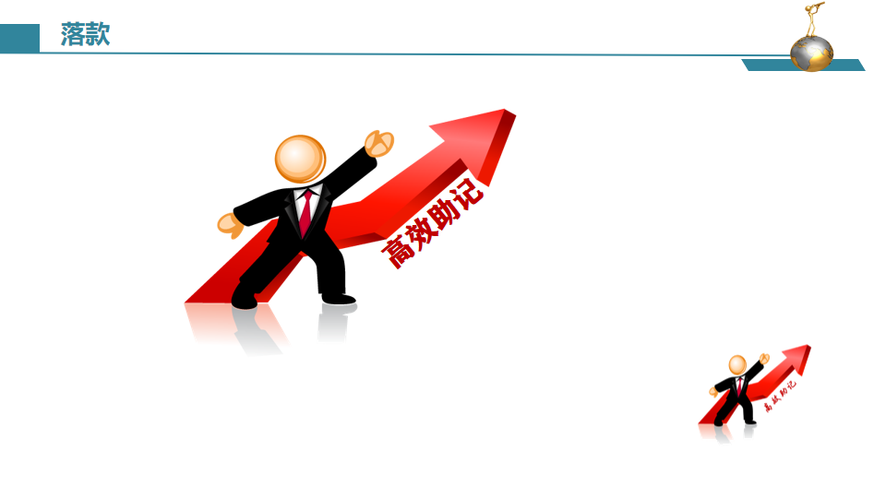


furious /ˈfjʊəriəs/adj. 狂怒的，暴怒的；狂暴的，猛烈的；喧闹的，热烈兴奋的
以音想义--“佛郁而死”：佛大怒，抑郁而死
1.风暴骤起，大海咆哮不断。
A furious storm rose and stirred up the seas.
2.他因妻子所受到的对待方式而狂怒不已。
He was absolutely furious at the way his wife had been treated. _{be furious at 对……大发雷霆/怒不可遏}
3.小狗很惊讶，疯狂地摇着尾巴，高兴地叫着。_{（2020年1月浙江“为狗找伴”）}
Puppy was amazed, wagging furiously and barking with joy.
4.他过去经常取笑我，直到我气得又跺脚又尖叫，感觉非常无助。
Often he teased me till my temper went and I stamped and screamed, feeling furiously helpless.

Slide 21
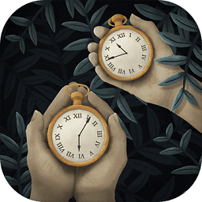
tick _{/tɪk/ vt. 给……标记号；发出滴答声}
tick 是拟声词，滴答声
tick作为听觉的感官词(sensory words) 在叙述和描写中的运用能给人以极大地感染力
时间一分一秒地过去了，母亲还没回家，这使我很担心她。_{（2017年10月浙江卷续写，“健忘妈妈旅行记”）}
✍Time ticking away_{(独立主格结构)}, Mother hadn't been home yet, making me worry about her.
ticktock /ˈtɪkˌtɒk/
n. 滴答声 vi. 发出滴答声

Slide 22

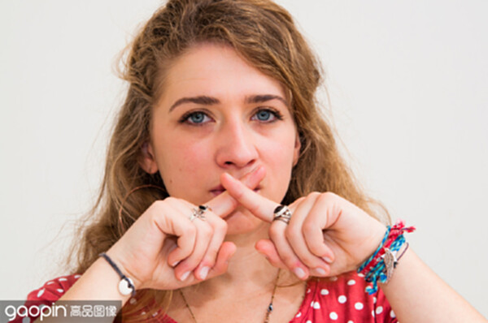
hush _{/hʌʃ/ v. 安静；停止说话 n. 寂静，安静}
hush是拟声词，“嘘，不要出声，保持安静”
1.空气中充满了焦急和期待的寂静。_{（2020年7月浙江“和北极熊面对面”）}
✍1.The air was heavy with the hush of suspense and expectancy.
suspense /səˈspens/ n. （对即将发生的事等的）担心；焦虑
2.房间变得/弥漫着死一般的沉寂。
✍2.A deathly hush fell over / pervaded
the room as he walked in.
_{pervade/pəˈveɪd/ vt. 遍及；弥漫（续）}

Slide 23

droop /dru:p/ vi. (因疲倦或沮丧等而)下垂；萎靡
drop“落下”，加一个字母“o”，巧记表示“情绪的低落”。
1.她太疲倦了，眼睑开始往下垂，打起了呵欠，昏昏欲睡起来。
✍1.So exhausted was she that her eyelids were beginning to droop, yawning
and drowsing.drowse /draʊz/ v. /n.打瞌睡；昏昏沉沉地消磨（时光）----drowsy /ˈdraʊzi/ adj. 昏昏欲睡的
2.詹姆斯低头捂脸，十分内疚。
✍2.James hid his face in his hands and drooped his head, feeling guilty.
3.听到这坏消息，我们情绪低落下来/精神委靡不振。
✍3.Our spirits drooped when we heard the bad news.
4.经过无数次无果而终的尝试，我们都精疲力竭，垂头丧气。
✍4.After countless fruitless attempts, we were all worn out, with heads drooping.
5.“对不起，我应该接受你的建议。”我喃喃地说，低着头。乔如释重负地轻笑着说:“你安全了。这就够了。”
✍5.“I’m sorry, and I should have taken your advice,” I murmured, head drooping. Joe chuckled in relief, “You are safe. That’s enough.” _{chuckle /ˈtʃʌkl/ v. 咯咯的笑}

Slide 24

dread /dred/ v. /n.非常害怕；极为担心(+doing )
dead“死”，加一个字母“r”，dread巧记表示“怕得要死”。
1. 这是我们一直最担心的时刻。_{（2020年7月浙江“和北极熊面对面”）}
✍1.This was the moment we had been dreading.
2. 害怕他发现秘密，我们终日惶恐不安。
✍2.We lived in dread of him discovering our secret.
3.我莫名其妙地害怕学校。_{（2022年1月浙江“与学霸做项目”）}
✍3.I have an irrational dread of school.
_{/ɪˈræʃənl/ adj. 不合理的；无理性的；荒谬的}
4.很大的错误/坏消息/讨厌的天气/可怕的孤独
✍4.dreadful mistake/news /weather /loneliness
5.咄咄逼人的冷风像一只无家可归的狗渴望着美味的骨头一样呼啸。_{bully /ˈbʊli/ v. 欺负；威吓}
✍5.The bullying wind was howling dreadfully like a homeless dog hungry for a delicious bone.

Slide 25
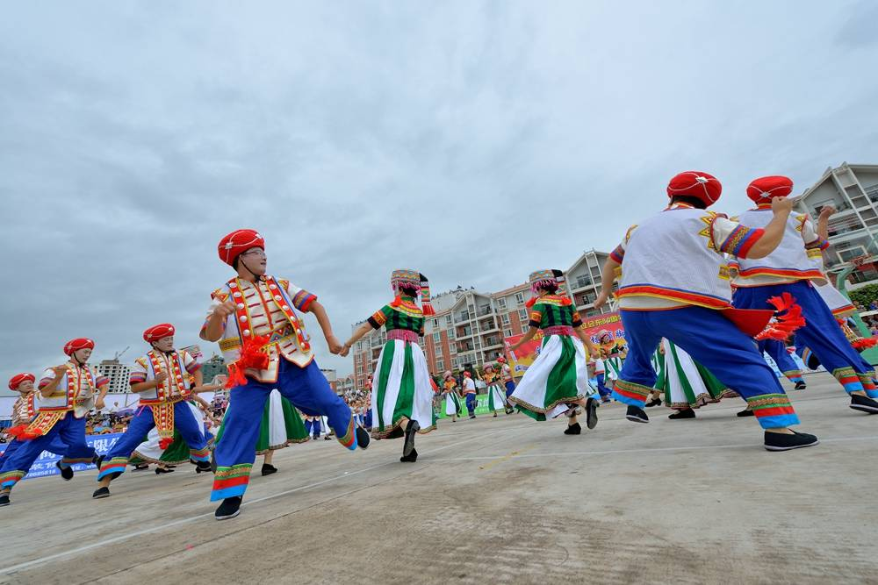
stamp _{/stæmp/n./v. 邮票；印记；标志；跺脚}
stomp /stɒmp/ v. /n. 跺脚，重踩；(常指因生气而) 迈着重重的脚步走
stamp“邮票”，想象盖邮戳时“用力跺脚”，意思就记牢了。
stomp比stamp发音更沉闷，就有“因生气而迈着重重的脚步走”的意思
1.我妻子绝望地/沮丧地跺着脚。//我妻子跺着她冰冷的脚
✍ My wife stamped her feet in despair/ in frustration. // My wife stamped her cold feet._{（2020年7月浙江“和北极熊面对面”）}
2.他过去经常取笑我直到我生气，又跺脚又尖叫，感觉非常无助。
✍ Often he teased me till my temper went and I stamped and screamed, feeling furiously helpless.
3.“我要在情况变得更糟前离开！”他叫嚷着顿足走出了卧室，砰地关上门。
✍ "I'm going before things get any worse!" he screamed at the top of his lung as he stomped out of the bedroom, slamming the door.

Slide 26
miracle _{/ˈmɪrəkl/n. 奇迹；} miraculous_{/mɪˈrækjələs/ adj. 奇迹般的；}miraculously_{adv.}
“秘约克”，去创造“奇迹”。
1.奇迹般地，狡猾的风又把她吹回了小岛。
Miraculously, shifting winds carried her back to the island.
2.这匹马奇迹般地缓过劲来，最终以微弱的差距获得了第三名。
The horse made a miraculous recovery to finish a close third.
3.但一想到能给我的队友一个完美的共享分数，我就坚定了创造奇迹的决心。_{（2022年1月浙江“与学霸做项目”）}
But the thought of getting a perfect shared grade for my teammate strengthened my resolution to achieve a miracle.

Slide 27
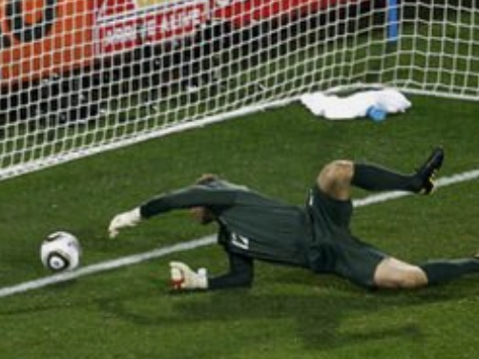
slip /slɪp/ slipped - slipped- slipping --slippery adj. 滑的 v. 滑倒; 溜走; 迅速放置（某物）
slip的引申义 “溜”“错过_{（机会）}”“陷入_{（困难或不愉快的处境）”}值得回味。
1.滑倒；滑跤
他在结冰的人行道上滑倒了。
✍He had slipped on an icy pavement.
2.悄悄地溜走；滑落；滑离；摆脱；挣脱
他一把没抓牢，让那孩子跑掉了。
✍The child slipped from his grasp and ran off.
她溜下床，踮起脚尖走向窗户。
✍She slipped out of bed and tiptoed to the window.
透过玻璃，我发现他平静地躺在床上，脸色苍白如粉笔。我溜进房间，坐在他身边。他睁开眼睛，“我现在不能去上学了。但我相信你能很好地展示我们的发现。他用微弱的声音说。_{（2022年1月浙江“与学霸做项目”）}
✍Peering through the glass, I found him lying peacefully on the bed, his face pale as chalk. I slipped into the room and sat beside him. He opened his eyes,"I can't go to school now. But I believe you can well present our findings. " he said in a weak voice.

Slide 28
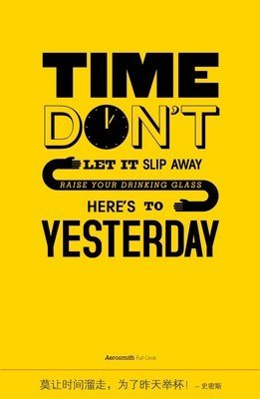
slip /slɪp/ slipped - slipped- slipping --slippery adj. 滑的 v. 滑倒; 溜走; 迅速放置（某物）
slip的引申义 “溜”“错过_{（机会）}”“陷入_{（困难或不愉快的处境）”}值得回味。
4.下降；退步；陷入（困难或不愉快的处境）
近来他已不如过去那样受欢迎。
✍His popularity has slipped recently.
病人陷入昏迷状态。
✍ The patient had slipped into a coma _{/'kəʊmə/.}
5.（迅速且容易地）穿上，脱下
但当我穿上马甲，站在捐款箱旁，我的感觉简直糟透了。
✍But I could not have felt worse as I slipped on the vest and took my spot beside the donation box.
6.let sth ˈslip (through your fingers) 错过（机会）
这个出国工作的机会你可不要错过。
✍Don't let the chance to work abroad slip through your fingers.

Slide 29
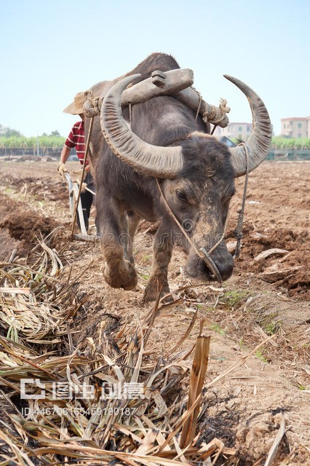
plough /plaʊ/v. 耕，犁；破浪前进；奋力前进；苦撑；埋头苦干；（不顾困难）继续坚持
plough 本义为“犁地，耕地”，联想汉语中“笔耕不缀”“辛勤耕耘”，其引申义“奋力前进；（不顾困难或要求停止的警告而）继续坚持；埋头苦干”就轻松掌握了。
1.烈日烤着我的脸，汗珠模糊了我的视线，我几乎窒息，但仍在继续努力。
The scorching sun baking my face, and beads of sweats blurring my vision, I was nearly suffocated, yet ploughing on.
2.为了完善我们的心理学研究，我不得不熬过几十个下午。在此期间，他的严肃逐渐让位于兴奋。
I had to plough through dozens of afternoons to perfect our psychological study during which his seriousness gave way to exhilaration _{/ɪɡˌzɪləˈreɪʃn/} inch by inch. _{（2022年1月浙江卷续写，“与学霸做项目”）}

Slide 30
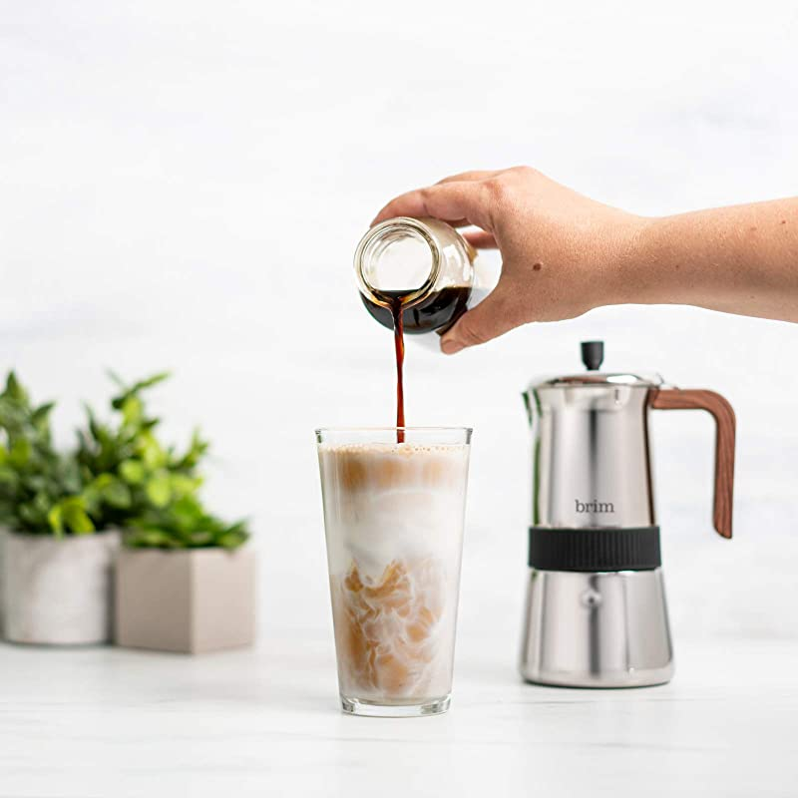
brim _{/brɪm/ n. 边；边缘；帽檐v. 满溢；溢出} brimful _{/ˈbrɪmfʊl/ adj. 盈满的；满到边际的}
brim 与“盈”的音相似，联想记忆“满溢边缘；溢出边沿”。
1.她精力充沛，热情洋溢。
✍She was brimful of energy and enthusiasm.
2.这个消息立刻使我目瞪口呆，我坐在无助的边缘。_{（2022年1月浙江卷续写，“与学霸做项目”）}
✍The news instantly found me dumbfounded, perching myself on the brim of helplessness.
3.我的队友虽然脸色依然苍白，但还是对我微微一笑。 “谢谢。 过了一会儿他说。 “我曾经认为我一个人可以做得更好。 但现在我知道和朋友在一起的感觉有多棒了。” 我点了点头，眼里噙满了泪水 。
✍My teammate, though still pale, gave me a faint smile. “Thank you.” he said after a while. “I used to think I could do everything better alone. But now I know how great it feels to be with a friend.” I nodded, eyes brimming with tears/ with eyes brimful of tears.

Slide 31

businesslike _{adj. 有效率的；认真的；有条理的}
派生词不仅保留词根的意思，更能抓住事物的特征而彰显新意和变化性，在续写中给人耳目一新之感。
如：picturesque /ˌpɪktʃəˈresk/ 风景如画的；（语言）生动的；（服饰和外貌）引人注意的
problematic /ˌprɒbləˈmætɪk/ adj. 成问题的，有困难的；
rusty_{/ˈrʌsti/ （技术、知识等）荒废的，生疏的；}
cocky_{/ˈkɒki/ adj. 自大的；骄傲的；过于自信的}
1.他回答时显出一副公事公办/一本正经的样子。_{（2022年浙江“与学霸做项目”）}
He answered in a businesslike manner.
2.我们非常想摆脱这种问题重重的局面。
We are deeply concerned to get out of this problematic situation.
3.我很久没有弹钢琴，可能会有点生疏。
I haven't played the piano for ages—I may be a little rusty.
4.别一有成绩就翘尾巴。
5.对海上生活生动的描述
Don't get cocky when you've achieved something.
a picturesque description of life at sea

Slide 32
名词的动词化：dog；parrot；peacock；wolf；pig；corner；house
名词的动词化，指的是名词没有任何形态变化而直接用作动词。这种转化使得语言的表达更加简洁、形象、生动、有文采。对于基础薄弱的同学，这种方法值得在续写中努力尝试。
1.动物名词可以转化为表示具有该动物习性特点的行为动
①她突然发现有人跟随着她。
②约翰鹦鹉学舌地重复他父亲说的话。
③他妹妹总是在她的同学们面前夸耀她的新衣服。
His sister always peacocks_{孔雀} her new clothes before her classmates.
④那些男孩狼吞虎咽地把三明治吃完了，接着又开始吃蛋糕。
The boys wolfed down / pigged out the sandwiches down and then started on cakes.
2.某些表地点、处所的名词可以转化为与其功能有关的动词。
①警察把逃犯逼入角落，再次把他抓获。
The police cornered the escaped criminal and caught him again.
②我们怎么给所有这些人提供住房呢？
She suddenly found that someone was dogging her.
John parroted what his father had said.
How can we house all the people?

Slide 33
名词的动词化：_{fog；ice；snow；storm；thunder}
名词的动词化，指的是名词没有任何形态变化而直接用作动词。这种转化使得语言的表达更加简洁、形象、生动、有文采。对于基础薄弱的同学，这种方法值得在续写中努力尝试。
3.某些表自然现象的名词可以转化为以其性质为特征的动词。
①蒸汽使我的眼镜模糊不清。
The steam fogged my glasses.
②他的拒绝浇灭了我的热情。_{（2022年浙江“与学霸做项目”）}
His refusal iced my enthusiasm.
③她过生日那天，礼物和信件铺天盖地而来。
Gifts and messages snowed in on her birthday.
④我把衣服一披，就向事故现场冲去。
I jumped into my clothes and stormed over to the scene of the accident.
⑤我耳边响起了雷鸣般的说话声。_{（2021年1月浙江“南瓜卡头”）}
A voice thundered in my ear.

Slide 34
名词的动词化：_{eye；thumb；tiptoe；mouth}
名词的动词化，指的是名词没有任何形态变化而直接用作动词。这种转化使得语言的表达更加简洁、形象、生动、有文采。对于基础薄弱的同学，这种方法值得在续写中努力尝试。
4.某些身体部位名词，可以转化为表示与该身体部位有关的动作或功能的动词。
①站在街角处的一个警察用怀疑的目光盯视着他。
A policeman on a street corner eyed him suspiciously.
②他用拇指翻阅词典查找那个词。
He thumbed the dictionary for the word.
③ 她溜下床，踮起脚尖蹑手蹑脚地走向窗户。
She slipped out of bed and tiptoed to the window.
④我只张嘴不出声地说了个再见就赶紧跟在妈妈身后进去了。
I mouthed a goodbye and hurried in behind Momma.
⑤我们转身朝家走去。
We turned and headed for home.

Slide 35
make/fight / nudge / feel / wind / crack / inch one’s way
由词组“make one’s way 克服困难艰难地或想方设法去某地”所延展的“fight / nudge / feel / wind / crack / inch one's way”都是非常生动形象，想象丰富的描述性语言，尤其是crack one's way含隐喻表达，生动耐读； inch one's way中“inch”作动词，准确明了，画面感和代入感很强。
1.尽管发生了大洪水，但救援队仍然艰难地向灾区进发。
✍There being a big flood_{独立主格结构}, the rescue team still made their way to the disaster area.
2.简慢慢地爬过矮树丛。
✍ Jane wormed her way through the under-growth.
3.一列货车沿着山坡蜿蜒而行。
✍A wagon train was snaking its way along the slope.
4.努力辟出一条路挤进；推进；摸索着前进； 蜿蜒而行；艰难地进入； 慢慢前行
✍fight / nudge _{[nʌdʒ]vt.(用肘)轻推} / feel / wind / crack / inch_{夸张} one's way

Slide 36
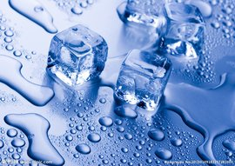

melt /melt/ （melted; melted, molten） vi.融化；溶化；软化
melt本义为“固态物质熔化溶化为液态物质”，引申为“内心软化”含隐喻意义“坚硬冰冷的气氛或内心缓和变软”，形象生动。
1.屋里的紧张气氛开始缓和。
✍1.The tension in the room began to melt.
2.她那信任的微笑使他的心变软了。
✍2.Her trusting smile melted his heart.
3.听到这些话，我觉得内心的疑虑/焦虑消失了。
✍3.When hearing these words, I felt my inner doubts/anxiety melt away. _{（2022年浙江“与学霸做项目”）}
4.年轻人们散开了，消失在夜色中。
✍4.The youths broke up and melted into the darkness.
5.我能感觉到他冰冷的外壳逐渐融化。_{（2022年浙江“与学霸做项目”）}
✍5.I could feel his icy shell gradually melting away.

Slide 37
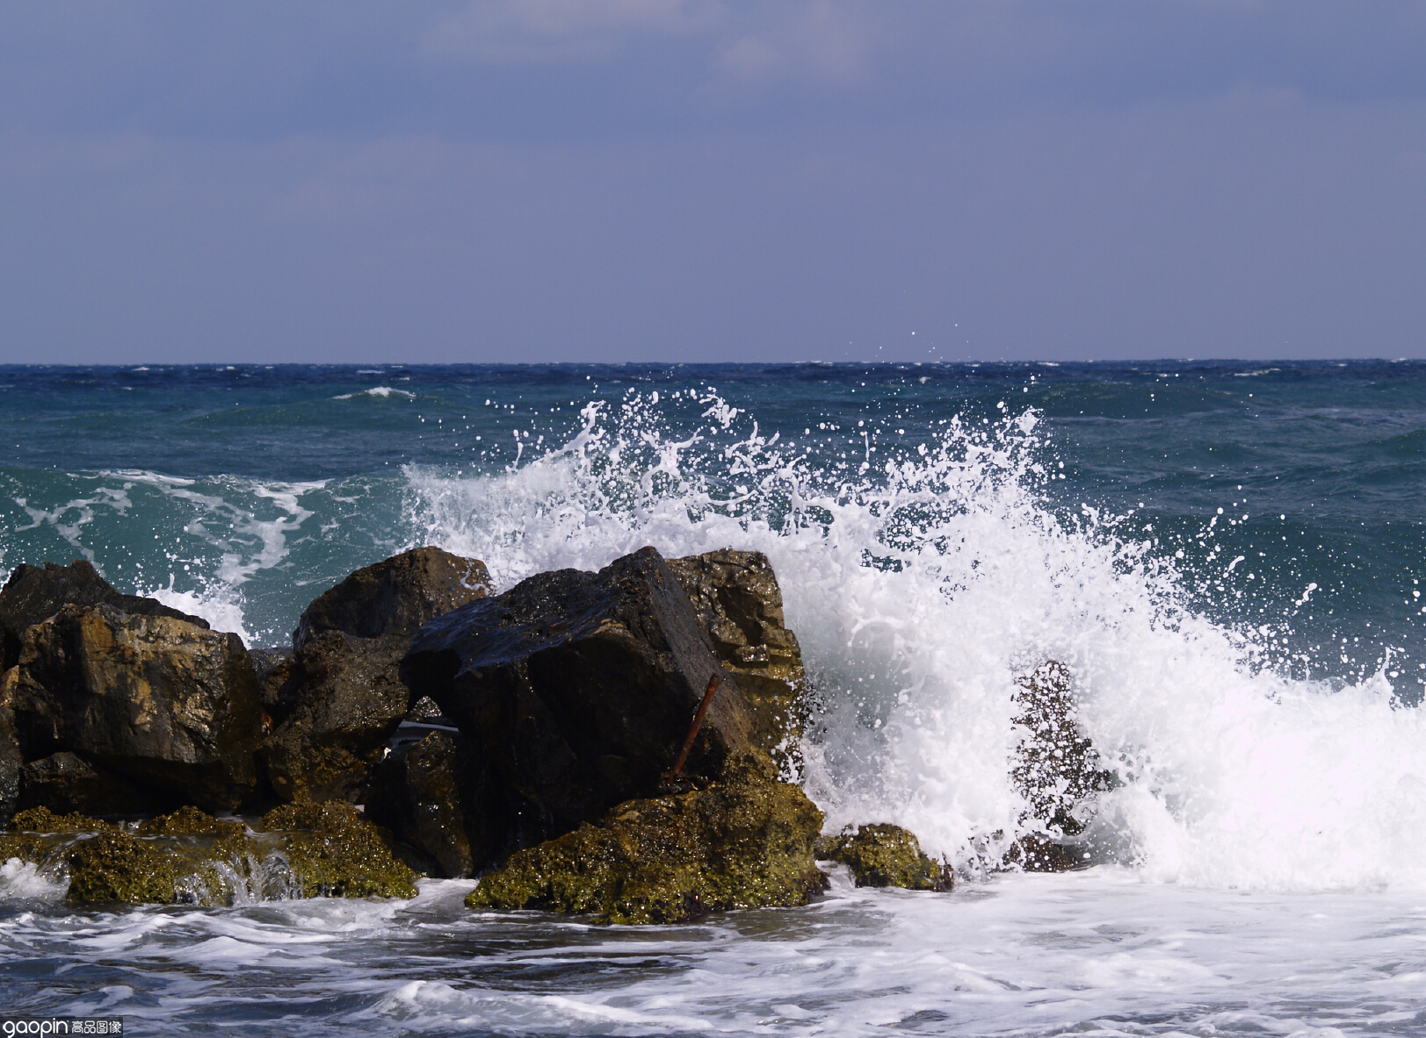
surge /sɜːdʒ/ n. 汹涌澎湃 v. 汹涌；起大浪，蜂拥而来；upsurge_{急剧上升}
由读音“瑟瑟激动联想“情绪波动”，瞬间秒记。
1.她顿觉宽慰。
✍ Relief surged through her.
2.一阵喜悦/ 悲伤/ 兴奋/ 爱/ 快乐/ 愤怒/ 痛苦席卷了我，我……
✍ An upsurge of delight / sorrow/ excitement/ love/ happiness /rage/ pain sweeping over me_{（独立主格结构）}, I …
3.一阵如释重负的感觉席卷了全身，我对埃利喊道:“我们现在安全了!”
✍A sudden surge of relief sweeping over me, I exclaimed at Elli, “We're safe now!”exclaim /ɪkˈskleɪm/ v. （由于强烈的情感或痛苦而）惊叫，呼喊

Slide 38

sweat _{[swet] n. 汗 vi. 出汗}
“出汗”的描写既可是第一人称视角，也可是第三人称视角，容易与读者产生共鸣。运动、情绪激动、天气炎热或者是进食辛辣刺激的食物时都有可能生理性出汗。功能性出汗受情绪或环境影响，如紧张、恐惧、兴奋等。
1.满头大汗; 汗流浃背
2.他的手汗津津的。
3.汗湿的头发粘在前额和脖子上 _{soak/səʊk/ v. 浸泡；渗透}
✍3.sweat-soaked hair sticking to one's forehead and neck
✍1.sweating profuselyprofusely/prəˈfjuːsli/ adv. 丰富地; 大量地 --bleeding profusely 血流如注
✍2.His hand was slippery with sweat.
4.烈日烤着我的脸，汗珠模糊了我的视线，我几乎窒息，但仍在继续努力。
The scorching sun baking my face, and beads of sweats blurring my vision, I was nearly suffocated, yet ploughing on.

Slide 39
pound/paʊnd/n. 磅；英镑重击，重击声v. 连续重击；（心脏）剧烈地跳动；脚步声沉重地走（跑）；连续轰炸，猛烈袭击；捣碎，击碎
pound拟声词“怦怦”“，砰砰”，所以很轻松记住“重击；（心脏）剧烈地跳动；脚步声沉重地走（跑）”
1.心砰砰直跳，手心冒汗，我小心翼翼地把鸡蛋放进篮子里。
Heart pounding and palms sweating, I put the egg cautiously into the basket.
2.他用他强壮的爪子疯狂地敲打着铁丝网，一次又一次，他锋利的牙齿在近处显得更可怕。 时间怎么过得这么慢! 一想到栅栏很快就会倒塌，我和埃利的脊背都打了个寒颤。 _{（2020年7月浙江卷 “和北极熊面对面”）}
He pounded the wire fence madly with his strong paws again and again, his sharp teeth appearing more scary at close ranged . How could time drag so slowly! The thought of the fence collapsing in no time sent shiver down both Elli's and my spines.

Slide 40
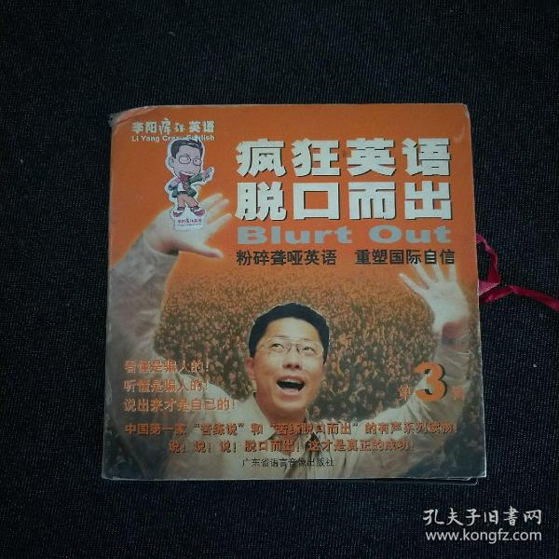
blurt _{/blɜːt/ 未加思索地冲口说出；脱口而出}
blurt读音助记：剥落脱-“脱口而出”
drawl （助记：draw拉+l长）_{/drɔːl/ v. （拉长调子）慢吞吞地说； 有气无力的说}
1.部分是由于紧张，他才脱口而出这个问题。
It was partly nervousness that had made him blurt out the question.
2.突然，一声吼叫从高高的草丛中传来。 “美洲狮! 她脱口而出，立刻蹲了下来，一股寒意爬上了她的脊背，脸上的血色也消失了。
Suddenly, a roar came from tall grass. “A cougar!” she blurted out and immediately squatted down, a chill creeping up on her spine and all the color draining from her face.
  3.“喂，你好！”她拖着长腔懒洋洋地说。
  “Hi there!”she drawled lazily.
  4.她带着南方的拖腔慢条斯理地讲话。
  She spoke in a slow southern drawl.

Slide 41


mingle _{/ˈmɪŋɡl/ v.（使）混合}
两种声音，色彩或情绪（尤其是矛盾的情感）的交织，表现力极强
1.笑声和歌声交织在夜空中。
The sounds of laughter and singing mingled in the evening air.
2.她的泪水和脸上的血混在了一起。
Her tears mingled with the blood on her face.
3.我站在那里，一言不发，一动不动。 一股夹杂着悔恨的悲伤突然涌上心头，泪水模糊了我的视线。
I stood there, silent and motionless. … A sudden surge of sorrow mingled with regret enveloped me, tears blurring my vision.
4.兴奋夹杂着紧张，他迅速地把钱包放进口袋里，生怕有人看见。
Excitement mingled with nervousness, he put the wallet into his pocket swiftly for the fear that someone might see it.

Slide 42

roar/rɔː/ n./v. 吼叫，咆哮；（人群）用欢呼声激励，为......喝彩，为加油；哄笑；（尤指车辆）轰鸣着疾驶，呼啸而过；熊熊燃烧
象声词 “发动机的轰鸣声”, 故很容易记住 “咆哮，轰鸣，”
“Stand back,” he roared.
1.“靠后站。”他吼道。
2.他的笑语使满座哄堂大笑。
3.校园里一片哗然
The campus was in an uproar_{一片喧腾；一片哗然}.
His jokes set the table in a roar.
3.然而，司机们要么对我们疯狂挥舞的手视而不见，要么从我们身边疾驰而过，在震耳欲聋的引擎轰鸣中淹没了我们的希望。
Yet the drivers either turned a blind eyeto our frantically-waving hand or sped past us, drowning our hope in the deafening roar of engines.
4.所以我慢慢走近这位不速之客，隔着栅栏朝他脸上喷了一枪。 随着一声愤怒的咆哮，熊跑到湖边去洗眼睛。
So I approached our uninvited guest slowly and, through the fence, sprayed him in the face. With an angry roar，the bear ran to the lake to wash his eyes.

Slide 43

soar（数量、价值、水平、规模等）急升猛涨；高飞翱翔；（精神或希望）高涨；(树木、建筑等）高耸
象声词 “嗖soar _{/sɔː/} ，飞上天！”, 故 很容易记住 “急升，高飞，高涨”
1.拥抱梦想可以给你飞翔的勇气。
Embracing a dream can give you courage to soar.
2.有了明确的目标，小Ben的成债突飞 猛进。
With a specific and explicit goal now, young Ben soared from the bottom of his class toward the top.
3.我们想起农舍附近也有一条河。意识到这条河流可能是一个回家的向导，我们精神高涨，开始沿着河流轻快地小跑。
It occurred to us that there was also a river nearby the farm house. Realizing the river may be a guide back, our spirits soared and we began to trot briskly along the river.

Slide 44
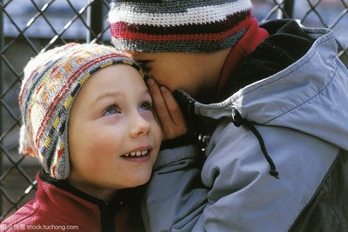
murmur /ˈmɜːmə/ vi. 低声说；私下抱怨；连续发出低沉的声音 n. 低语；潺潺声
murmur：拟声词，发出轻柔持续的声音。
stammer ：（助记：失态没）_{/'stæmə/ 结结巴巴地说}
utter（助记：啊出声音） _{/ˈʌtə/ vt. 说；发出}
chatter： chat “聊天 ” 的比较级 _{/ˈtʃætə/ v. 唠叨；喋喋不休；}
_{（动物等）吱吱叫；（人的牙齿）打战}
1.她低声表示同意。
2.小河流水淙淙，轻轻流过。
The river murmurs and flows softly. _{(河水等) 轻微连续的声音}
3.她抚摸他的头发，喃喃地说：“别担心。你会没事的。”
She stroked his hair and murmured, "Don’t worry. You’ll be all right." _{stroke 中风；轻抚}
4.“为什么不……?玛丽亚神秘地小声对我说，她的眼睛像可爱的珍珠一样闪闪发光。“爸爸说我们不能……”我犹犹豫豫地低声说。
“Why not….?” Maria whispered to me mysteriously with her eyes shining like lovely diamonds_{动词+副词+with复合结构（状语）}. “Dad said we can’t …_{长短结合，详略得当(省略号)} ” I murmured hesitantly.
She murmured her agreement.

Slide 45
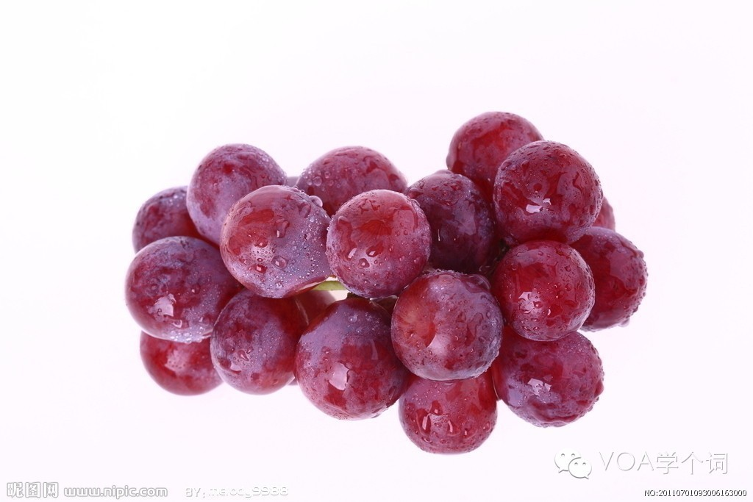
a string of 一连串（类似事件）；一系列，
string “线，细绳”，a string of 是一种含比喻意义的形象表达。
1.接二连三的成功/代价高昂的错误
a string of hits/ costly mistakes
2.那条杜宾犬发出一连串的吼叫声。
The Doberman let out a string of roaring barks.
3.她冲着法官高声骂了一连串的脏话。
She screamed a string of abuse at the judge.
4.我们对他说了一连串的感谢，立即开始购买，然后前往哈林区。
Showering him in a string of thanks, we immediately set out to purchase and then headed for Harlem.
5.妈妈说，哪怕只打乱一天的日程安排，我们的日程就会像多米诺骨牌一样倒下，遭受一系列糟糕的事情—— 预定会被取消，目的地会改变。
According to Mom, messing up our agenda even by one day would send our schedule toppling like dominoes, suffering a string of awful things — reservations would need to be canceled, destinations would be changed.

Slide 46
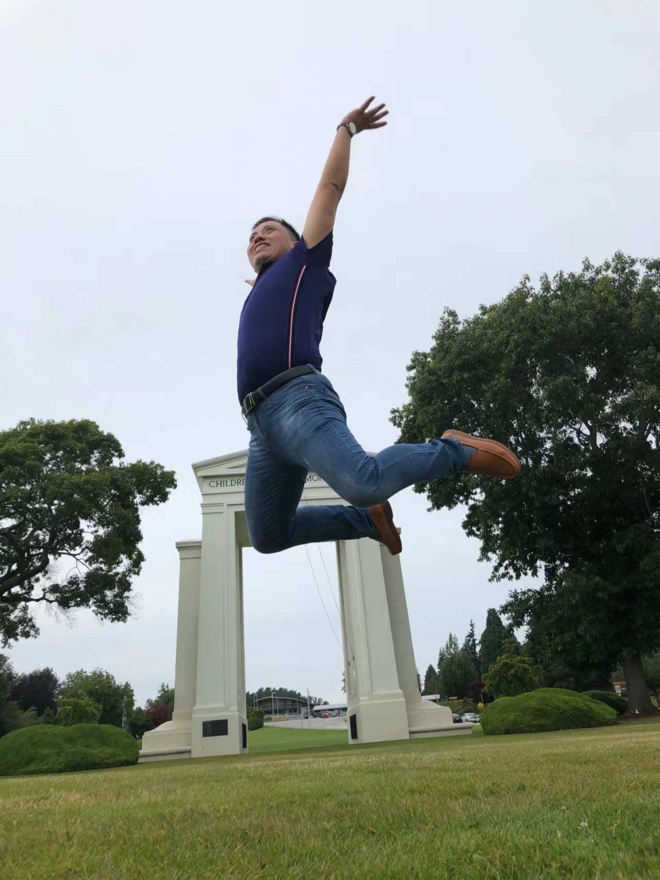
springn. 春天；泉水；根源；弹簧；弹性；跳跃；活力 v. 跳跃；突然弹开；突然出现，涌现
熟词多义：由“春天”；很容易联想到“泉水；弹簧”；续写中很形象地表达 “跳跃；突然弹开；突然出现，涌现” 等动作。
1.眼前的废墟反而让他投入行动。
The sight of rubble and ruin only made him spring into action.
2.他跳了起来，从咖啡桌上抓起他的钥匙。
He sprang to his feet, grabbing his keys off the coffee table.
3. 狮子吼了一声，跳了起来。
The lion roared once and sprang.
4.她眼里一下子涌出了泪水。
Tears sprang to her eyes.
5.我的思绪涌出，我的笔开始舞动。
My thoughts sprang up and my pen began to dance.
6.我施加压力，捕兽器就弹开，狼挣脱了。
I applied pressure, the trap sprang open, and the wolf pulled free.
(三个动词描写， 生动简洁、 apply“施加,用力压/跺”）

Slide 47
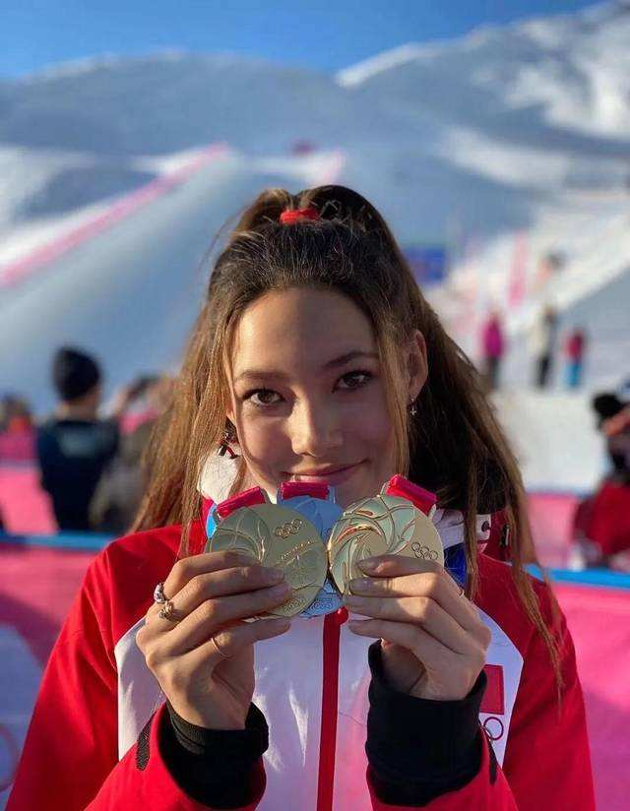
hook _{/hʊk/} n. 钩；勾拳；吸引人的东西 v. 钩住；箍住；钓鱼；弯成钩状；吸引
本义为“钩子”，可引申为“吸引，动力”；hooked形象表达“（对某事）着迷”；off the hook “脱离困境，如释重负”
1.这就是我参加滑雪运动的源动力。
That is actually the hook that initially got me into skiing.
2. 她一只手紧紧抓住他的胳膊，另一只胳膊抱住一棵树。
She hung on to his arm, hooking her other arm around a tree.
（尤指用腿、胳膊、手指等）钩住，箍住
3.我们完全被这片如画的风景迷住了。
We have been totally hooked on this picturesque landscape.
4.会议已经取消了，所以我现在如释重负了。
The meeting has got cancelled, so I'm off the hook now.

Slide 48
认识寿春，从此我是寿春人
4
备考精准的
六篇“热文”

Slide 49
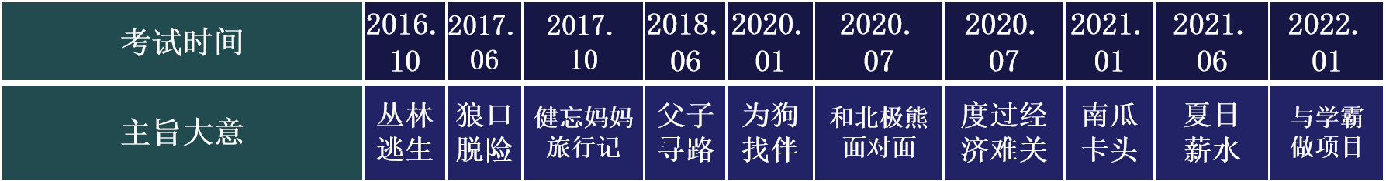
高考续写语篇风向标
通过分析，我们发现浙江每年两次的续写都有类似点，以保持两次高考作文语篇类型对同届考生的公平性。如：
2017届：人与自然，主题词 “逃生”，“户外”
2018届：人与自然/社会，主题词 “旅行”，“母子/父子”，“”
2019届：人与自然/社会，主题词“动物”，“关爱动物”，“夫妻/父母与孩子”
2020届：人与社会/自我，主题词“家庭生活”，“自我成长”，“父母与孩子”
2021届：人与社会/自我，主题词 “校园生活”，“自我成长”，“同学之间”
所以，2022年6月的高考，我们重点关注“校园生活”话题，体现“自我成长”过程和经历，处理“同学同伴队友”人际关系。

Slide 50
1
^{2020.12 山水联盟考试} 诚实不会让你失望 —— 学校同学交往篇：诚实做人
Honesty Won’t Let You Down
Asad was a 13-year-old boy who was very honest and hardworking. Recently, he had entered a new school so he had no friends yet, On Monday morning, he was nearly late for school. The night before, his family attended his cousin’s wedding and reached home late, which was why he couldn’t get up on time as usual.
At school, Asad could not pay attention to anything and wanted the bell to ring so that he could buy something to eat. After a few hours, when the bell rang, Asad quickly opened his schoolbag to find his money, but just then he remembered that he had left for school in a hurry in the morning and forgotten to take money, He looked under his books, hoping to find some money but there was nothing.
Not knowing what to do, he walked out of the classroom and sat on a bench in front of the canteen. He saw a few of his classmates there, among them was Fahad. He was one of the richest kids in his class but he was a very arrogant ( /ˈærəɡənt/ adj. 自大的，傲慢的) boy who thought everyone else was a loser. But as Asad was new, he didn’t know much about Fahad.
When he went towards Fahad and asked if he could borrow some money for his lunch, Fahad laughed a lot and said, “I knew you were a loser, maybe a beggar? "Fahad laughed out so loud that other kids also heard and made fun of the situation. He didn’t answer Fahad, and slowly walked back towards an empty bench.
When he reached the bench, he noticed something lying near it. It was a wallet. He picked it up and recognized it as Fahad's, as he remembered Fahad showing it to his friends and telling that his uncle bought it for him from the UK. There was quite a lot of money inside for a kid.
Para 1: At first, Asad wanted to Keep it a secret and punished Fahad. _________ ________
Para 2: Then Fahad said, “Why are you giving it back?”____________ __________________

Slide 51
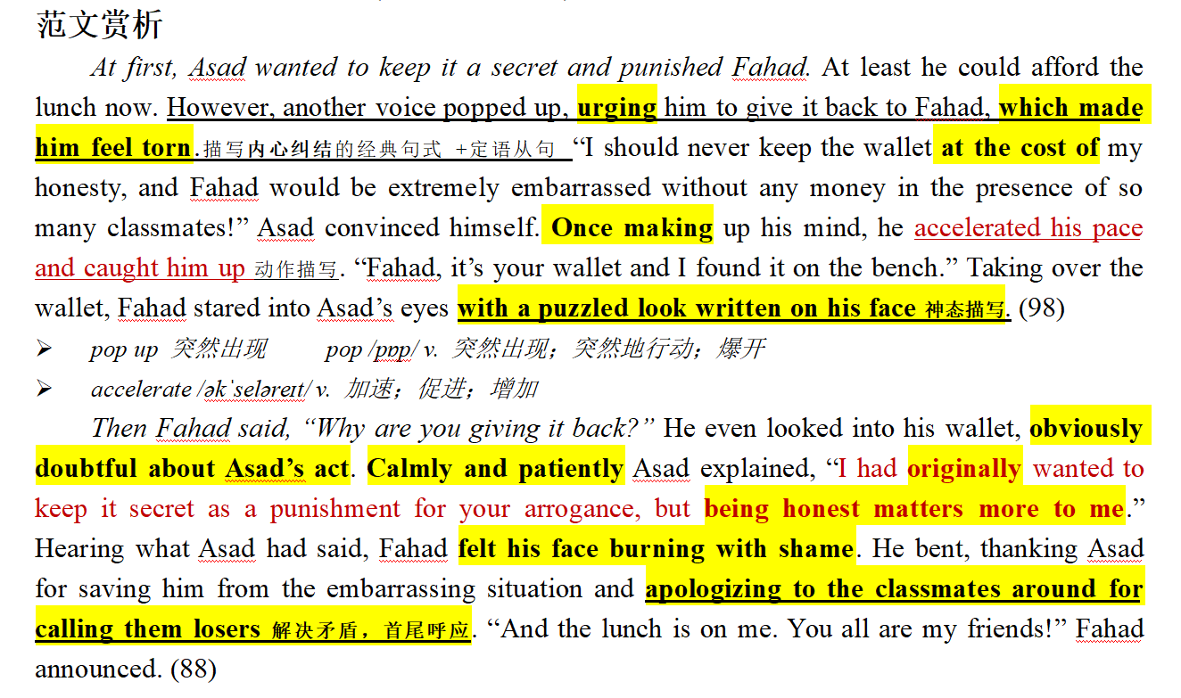
1
^{2020.12 山水联盟考试} 诚实不会让你失望 —— 学校同学交往篇：诚实做人

Slide 52
2
^{2021年9月山水联盟} 我的第一次登台表演 —— 学校文艺篇：战胜自我
I looked out at the smiling faces packed into the school hall. Flashes from cameras lit up in all directions. The applause filled my ears. I had done it. I had really done it.
Just a few months earlier, I would never have pictured myself acting in a play in front of two hundred people. But when the time came, I got up on stage and faced one of my greatest fears-and proved I could do more than I ever gave myself credit for. I found a new person inside me, a much more daring, outgoing person who had been hidden all along, just waiting for the opportunity to appear.
If not for my teacher, Mrs. Sather, I might never have found that opportunity.
In the first and second grade, I was extremely shy. I had friends, but it just wasn't in my personality to be very outgoing, even when I knew someone well. I was afraid I would do or say something wrong, so usually I just smiled and listened to other people's conversations. I did well in school and I loved to write. However, I would escape into my writing, where I could be myself and never had to worry about what other people thought of me. In my stories, I was never shy.
My teacher, Mrs. Sather, always encouraged me to write more. She told our class to chase after our dreams and dig in with both hands. I think she was one of the first people to see my inner strength. One day, she announced that our class was going to perform a play she had written." I'll begin to cast (分配角色)everyone tomorrow" she said." I need someone who is not afraid to be on stage in front of the public to play the lead part of Dorothy. Anybody want to try?" A few excited hands shot up---mine, of course, was not one of them---and Mrs. Sather smiled." We'll talk more about it tomorrow," she said. Then the bell rang and my classmates slowly left the classroom.
Paragraph 1: When I was loading up my backpack, Mrs. Sather asked me to go to her.
Paragraph 2: Fast-forward through five months of practicing, we were ready.

Slide 53
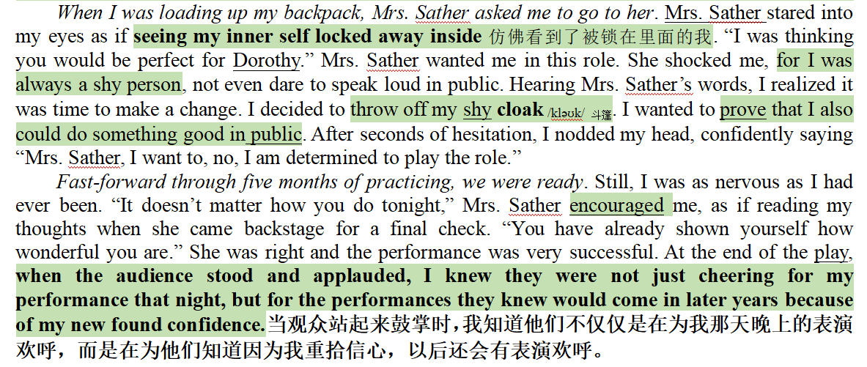
2
^{2021年9月山水联盟} 我的第一次登台表演 —— 学校文艺篇：战胜自我

Slide 54
3
^{2021年9月名校协作体}“环湖赛跑” —— 体育活动篇：教练和同伴鼓励，战胜自我
1. For me, it was normal to feel lost at the inter-camp track. Four camps of kids were ready to lead their teams to a blue ribbon and win the day. Not me. I was too little to be the leader and too skinny to be an athlete. I knew this by the time I was twelve, because my camp counselors（辅导员）and the other kids reminded me of it every chance they got. So when our camp needed a fourth runner in the two-mile race around the lake, I knew I was no one’s first choice. 2. I hid in the shade of a maple tree as they called the names of the runners, my body tensed as I heard a counselor call, “Fred! Where is Fred! He is in this race!” It was Barry. He spotted me under the tree. “Fred! We need a 12-year-old who hasn’t been in other events to run the two-mile!” 3. He gave me a push towards the starting line. Having no confidence and trying to save myself from the shame of taking the last place as four camps watched, I pleaded with him. 4. “But I don’t know the way around the lake!” 5. “You’re in. Just follow Bill!” Barry smiled. 6. Bill was my friend and the fastest runner in our camp. And then Barry said, “When you make it to the last stretch（最后一程）on the field, just throw your head back and run.” 7.At the starting line, I stood next to Bill and trembled. 8. “On your mark… Get set...” The gun cracked and sixteen of us took off. I stayed close on Bill’s heels, a little too close for Bill, I guess. He shouted at me, “Back off!” 9. I did. Two guys passed me, but I kept my eyes on Bill. 10. It was tiring. The distance was widening between Bill and me. We made the turn from the dusty road onto the muddy, wooded trail that would go around the lake back to the field. Through the trees, I saw Bill trip over a tree root and fall. A runner from another camp passed him. Paragraph 1 In a moment, Bill was up again and running. ____________________________________________ Paragraph 2I didn’t know when I crossed the finish line. _____________________________________________

Slide 55
3
^{2021年9月名校协作体}“环湖赛跑” —— 体育活动篇：教练和同伴鼓励，战胜自我
In a moment, he was up again and running. He yelled to me, “Watch the roots!” Struggling to keep my legs moving, I looked down and saw the tree root. I puffed over it. Two hundred metres later, I scrambled up the hill, ready to see the rest of the pack crossing the finish line when I saw not the fifteen guys, but three. The crowd was roaring, but I could hear Barry over the rest of them, yelling “Run!” I threw my head back and told my legs to go and I knew I was winning.
I didn't know when I crossed the finish line. Barry caught me and I collapsed. “You flew! You flew, man! Second! You passed two guys!” There was a crowd of kids around me, patting me on the back, giving me high fives. I had come in second. Bill had finished first. With that and all the high fives and the cheers of the day, the best prize that I walked away with (轻易赢得)was my confidence. That year I discovered I could do a lot of things if I put my energy into them.

Slide 56
4
^{2021年11月9+1联盟}“ 鸡蛋降落挑战” —— 学校活动篇：合作共赢，完成项目
“OK, everybody. It’s that time of year,” said my science teacher, Mr. Beal. “This Friday we’ll have the annual Egg Drop Challenge. Bring your best containers to class. You can work alone or work together.”
Mr. Beal’s fifth-grade Egg Drop Challenge was an institution at my school. The goal of the Challenge was simple—you had to build a protective container to keep an egg from breaking when dropped over the stadium wall.
My best friend, Cassie, and I grinned at each other. We always worked on projects together. She’s brainy; I’m creative. We’re the perfect combination_{伏笔,} like peanut butter and marshmallow cream (棉花糖霜). which happens to be my favorite kind of sandwich. I made my favorite sandwich that afternoon while waiting for Cassie to come over and work on the container. Spreading the fluffy marshmallow cream gave me an idea.
“I have a brilliant design for our egg container!” I said when Cassie arrived. She looked at me eagerly. “We can cushion it with some marshmallow cream. You know, to absorb the shock of the impact,” I explained. “You’ve got to be kidding, Laura.” Cassie exclaimed. “You have a better idea?” Cassie pointed to a sketch(草图) in her notebook. “Actually, I do. We put the egg in a basket with parachute (降落伞) attached. It will simply float to safety.” “It’s too easy for something to go wrong. It will never work!” I said. Cassie rolled her eyes, “The parachute is better than that stupid idea.”
I couldn’t believe it. Of course we’d had our little fights in the past, but this was different. She’d never called any of my ideas “stupid” before. “Then I’ll build mine and you build yours, and we’ll just see whose is better.” “Fine!” Cassie threw her notebook into her backpack and stormed out. And just like that, our friendship was broken. Like an egg dropped from the top of a stadium without marshmallow cream to protect it._{伏笔}
Para 1: When Friday finally came, I had to admit that Cassie’s Egg Force One looked pretty good.
Para 2: By the fourth round, only Cassie and I were left.

Slide 57
4
^{2021年11月9+1联盟}“ 鸡蛋降落挑战” —— 学校活动篇：合作共赢，完成项目
When Friday finally rolled around, I had to admit that Cassie’s Egg Force One looked pretty good. She had used a handkerchief to create a small parachute. It was tied to a basket that held soft packing peanuts and, in the center of it all, her egg. Cassie cast a queer look at me as if to declare war. The competition was on. My classmates carried their egg containers up three stadium steps and dropped them over the side wall. One by one. The egg broke, the owner out. Sighs and yells echoed. Soon the side walk was already dotted with egg shells from failed drops.
By the fourth launch, only Cassie and I were left. Taking a deep breath, I let go of my box. Then I raced down and got to the bottom before Cassie did. When I saw yolk and egg white seeping from the container, my heart sank. Then I saw Cassie’s basket lying beside mine, empty. “My egg bounced out,” she explained, pointing to a broken shell in the grass. “I guess the pilot had an egg-jector seat,” I offered. Cassie looked at me, and her glare softened. I grinned. She giggled. “A tie,” Mr. Beal announced. But we knew we'd won something more important than the Egg Drop Challenge.

Slide 58
5
^{2022年3月三钉试卷-3}“放下手机游戏，走进大自然” —— 同伴活动篇
This fall break, I took my son Nels, aged 15, for our long-planned vacation in a national park. We had a rented cottage at the foot of the mountain by a lake. And my niece Susan, aged 12, also joined us.
On the first day, abundant items kept everyone occupied: picnicking, canoeing, shooting. When night fell, we sat around the campfire singing and dancing with other vacationers, all having a great day.
Nevertheless, on the second day, I noticed Susan constantly checking her screen, busily texting.
That day, she stayed indoors glued to her phone, playing Axe Climber (一款登山游戏). Then, I had an idea, announcing, “Tomorrow, we’ll hike to the top of the Stone Mountains.” Hearing this, Susan shrugged, as if to say, “Why? ”
Eyes fixed on Susan, I continued, “Put your phone aside and climb a real mountain, ok? ”
“Well,” Susan responded reluctantly, “The Axe Climber is moving up to the final level, so I’ll not be available tomorrow. ”
“Susan, that’s not the actual wilderness experience. I hiked a lot. It’s greater fun.” Nels said persuasively.
“Sounds more like punishment,” she mumbled. “I hate sweating.”
“Never have you been on a mountaintop. Susan, have a go this time, and you are sure to love the feeling and pleasure it brings.” She finally nodded unwillingly, “Fine, I’ll give it a try.”
I smiled. Anyway, she agreed. The next morning, we awakened to the sound of birds singing. It was a nice day with the sun shining mildly and clouds floating leisurely. “A perfect day for hiking,” I said. “I will go, Uncle,” Susan replied mechanically.
Packing bread, bottled water and camera into the backpack, we set out for our destination. Against the blue sky, a rough trail wound its way to the top of the mountain.
“I still don’t think it’s a good idea,” Susan complained, frowning.
“No pains, no gains! Come on!” I encouraged.
Paragraph l: Thus, Susan began hiking up. ______________________________________________
Paragraph 2: Finally, we made it to the top. “How awesome!” Susan yelled excitedly. ___________

Slide 59
5
^{2022年3月三钉试卷-3}“放下手机游戏，走进大自然” —— 同伴活动篇
Thus, Susan began hiking up. At first, she went up at a brisk pace. However, the higher we climbed, the steeper the trail became. It was not long before we began sweating. “I can’t walk any further!” Susan complained breathlessly. She was thirsty, sweaty and exhausted. Handing her a bottle, I suggested taking a break. Minutes later, we continued our way. Susan followed, falling further and further behind. “ Hold on! We’re almost to the top!” “ Susan, you’re a real climber!” Both Nels and I cheered for her. Gasping, Susan took every step with great effort, progressing slowly but firmly. I was proud she didn’t quit.
Finally, we made it to the top. “How awesome!” Susan yelled excitedly. Falling leaves, red, yellow and orange, danced gracefully in the air. Below us, miles of fields and hills stretched out as far as we could see. “We’re on the top of the world! It feels so good!” Susan was enchanted, immersed in the pleasure never experienced. Resting on the rocks, we felt the refreshing breeze brushing our cheeks. “Anyone still miss her phone?” I joked. Susan rolled her eyes, laughing out loud, “Remember to call me next time you go hiking!” I felt relieved and rewarded. This hiking was worth all the pains.

Slide 60
6
^{2022年4月稽阳联考}“可以不一样” —— 师生交往篇：尊重个性发展
The paper on my desk was yellow, with straight blue lines stretching across it. The lines repeated themselves all the way down the page. I counted them. Twenty-six straight lines ran across the paper. The yellow color reminded me of sunshine. In summer the sun is bright yellow like that, and the sky is blue like those lines. I loved blue — blue is for getting lost in...
“You haven’t written a word yet, have you?” Miss Perry had found me out. I hung my head, as in past years, and gave her the lines I’d given previous teachers.
“I don’t feel like it.”
The truth was that I wanted to write about something different. “Write about Your Best Friend,” demanded the assignment on the board. I didn’t have a best friend. I had a few friends, but I didn’t want to claim any of them as my “best” because I was afraid they might pick someone else. What if I picked a “best” friend and then someone different, who thought I was their best friend, heard my paragraph read aloud and then never spoke to me again? It was a stupid topic. I was disappointed in Miss Perry for choosing it.
I knew Miss Perry must have heard about me from my other teachers. I had already prepared myself for another year of listening to teachers scold me. I was only nine years old, but my ears had been dull to the voices of my elders. My teachers, my parents, and the school principal had all given me the “What are we supposed to do with you?” speech. That was probably what Miss Perry was about to say, too.
However, there was something different about Miss Perry. ____________________________
I bet I was touched. ___________________________________________________________

Slide 61
6
^{2022年4月稽阳联考}“可以不一样” —— 师生交往篇：尊重个性发展
However, there was something different about Miss Perry. “What do you want to do, then?” she smiled, tenderly staring at me with deep blue watery eyes. What? My previous teachers would scold me or send me to the principal’s office. Miss Perry, however, stood in front of my desk and kept her soft gaze on my face. Without a word, I lowered my head to avoid her eyes. “You just think what it is that you want to write about? Then, come to share with me, and we’ll make some arrangements that you can live with. Fair enough?” She patted me on the back. No teacher had touched me before.
I bet I was touched. Automatically, I raised my head and caught sight of her walking back to her desk. Wondering what to make of her, I received another glance. A sense of something different attacked. I looked out of the window. The trees, the rain, everything was in sight. Inspired, I rose from the seat. “I want to study the weather outside.” “You really like that? But promise to write down what you learn on that blank paper. Deal?” “Deal!” All that afternoon I studied clouds, winds and the rain. Amazingly, a rainbow hung above like an upside-down smile. For the first time in years, I was really concentrating on my school work.

Slide 62
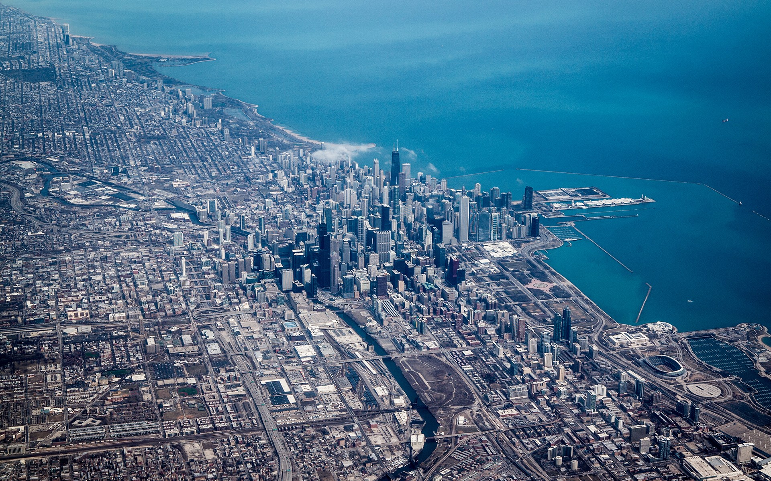
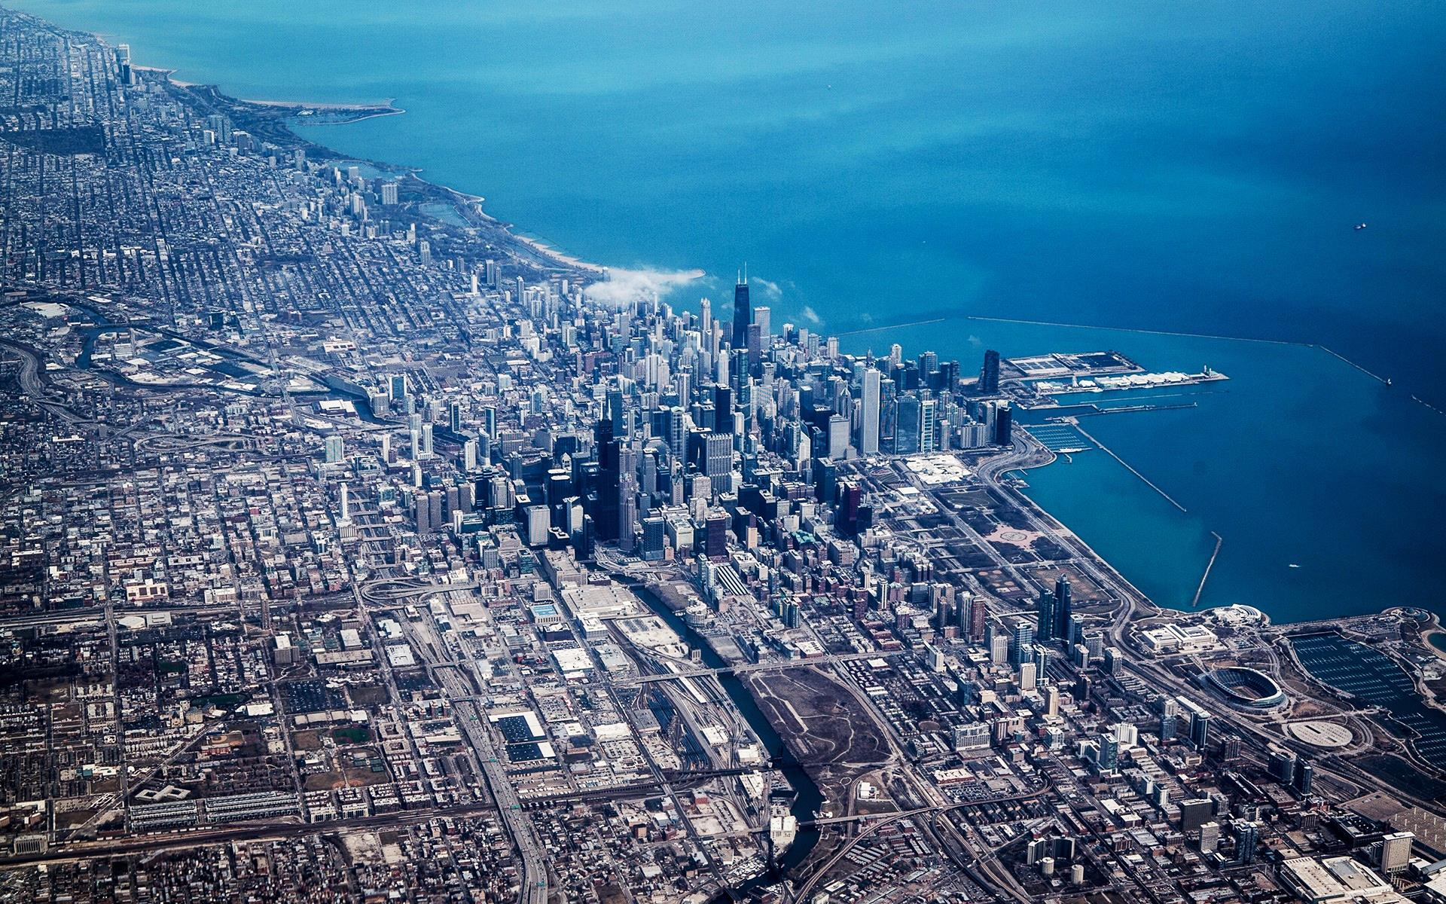
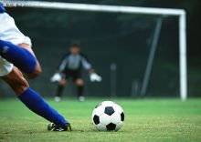


奇迹总在拼搏之后；
成功蕴于进取之中。
——“溯恩高中英语”寄语高三考生

