Slide 1

2022年6月全国Ⅰ卷 & 浙江卷
听力精听课件
瑞安新纪元高中
焦海滨老师制作

Slide 2

感恩遇见，相互成就，本课件资料仅供您个人参考、教学使用，严禁自行在网络传播，违者依知识产权法追究法律责任。
更多教学资源请关注
公众号：溯恩高中英语
知识产权声明

Slide 3
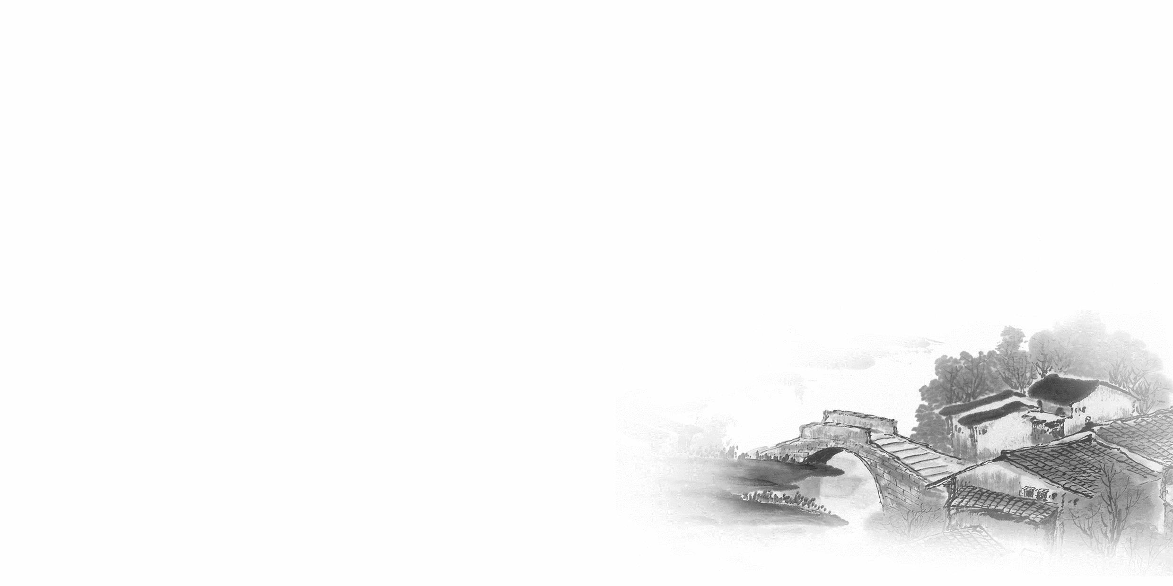

影响听力的因素
心理因素学生在进行听力练习或考试时往往表现为听音时感到紧张、焦虑因而导致无法正常听音。
壹
缺乏背景知识由于没有语言环境，学生很少了解听力材料中的背景知识，无法做出正确的判断、推理、猜测。
贰
叁
学生缺乏听力解题技巧研究发现，很多情况下由于听者未能掌握相关的听力技巧，因而不能很好地理解听力材料。
肆
词汇储备不足一个学生的听、说、读、写要达到一定的水平，必须拥有相应数量的必备词汇。

Slide 4

语音知识对听力的影响
在听力理解的过程中，语音是第一位的，听者首先接受的是语音信息，大脑接受了因素，音节，中音等因素构成的单词，短语和句子后使他们在自己的语言图式中“对号入座”，根据已有的知识结构( 图式 ),开始对该信息进行建构，以理解其意义。

Slide 5
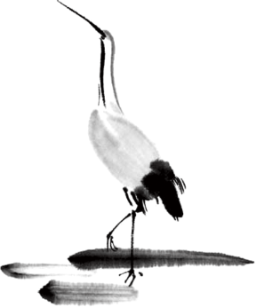
语速的加快主要有一下三种原因
壹
贰
叁
连读
（ 以下用红色标记 )
省音
（ 以下用蓝色标记 ）
音变
（以下用黄色标记 ）

Slide 6


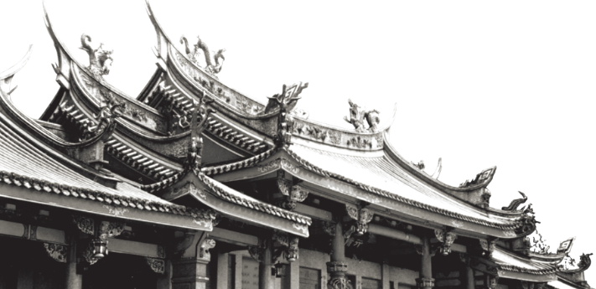
一，连读 （ 以下用红色标记 )
1，“辅音+元音”型连读（异性相吸）
如：I’d like another bowl of rice.
2、“辅音+半元音”型连读英语语音中的/j/和/w/是半元音，如果前一个词是以辅音结尾，后一个词是以半元音，特别是/j/开头，此时也要连读。Thank you .

Slide 7

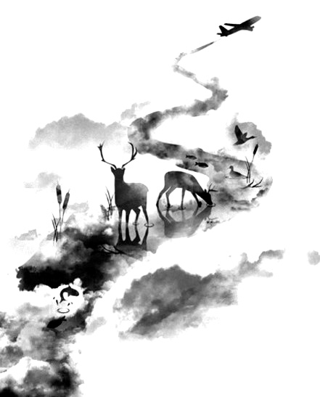

二，省音 （以下用蓝色标记）
01
壹
一、爆破音/b/ /p/ /d/ /t/ /g/ /k/
1.以上任何一个爆破音后面如果紧接着是一个辅音或者半元音，那么这个爆破音将不再发音，仅空半拍就行。如：Good morning!可以发为/gu_'mɔ:niŋ/。
2.以上任何一个爆破音在句尾时，这个爆破音不再发音。如：Good night!最后的/t/音便不再发，整句话可读作/gu_nai_/。

Slide 8
省音 （以下用蓝色标记）
01
二、不完全爆破
① 爆破音中的任何两个爆破音相邻时，前一爆破音失去爆破。如：a big car等。
② 爆破音中的任何一个后接摩擦音f,h,x,sh,s,r时，前面的爆破音失去爆破。
如：I didn't say so.
③ 爆破音后接/t/， /d/， /tr/， /dr /时，前面的爆破音失去爆破。如：a great change等。
④ 爆破音后接/m/, /n/, /l/, /s/时，前面的爆破音失去爆破。如：a bit more expensive等。

Slide 9
省音 （以下用蓝色标记）
01
三、/s/-/z/ /ts/-/dz/ /∫/-/ ʒ / /t∫/-/ dʒ / /θ/-/ ð / ds发/dz以上任何两个音相遇，只读后面的那个音，而前面的音则省略不发。
如：Who is Stone?可把前面一个/z/省掉，只读作/hu i stəun /。

Slide 10
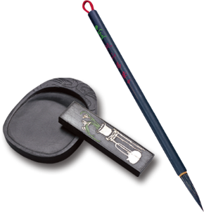
音的变化也是一种连读现象，两个词之间非常平滑的
过渡，导致一个音受临音影响而变化。
主要是以下两种方式：
1、 辅音[d]与[j]相邻时，被同化为[dʒ]：
Would you....?
2、 辅音[t]与[j]相邻时，被同化为[t∫]：
Can’t you？
三，音变
（以下用黄色标记 ）

Slide 11
听力试音材料
M:Hello ! International Friends Club , can I help you ?
W: Oh , hello ! I read about your club in the paper today . And I thought I’d phone to find out a bit more .
M:Yes , certainly . well , we’re a sort of social club for people from different countries . It’s quite a new club .we have about 50 members at the moment but we’re growing all the time .

Slide 12
听力试音材料
W: That sounds interesting .I’m British actually ,and I came to Washington about three months ago ,I’m looking for ways to meet people . . Er ,what kinds of events do you organize ?
M: well , we have social get-togethers ,and sports events ,and we also have language evenings
W: Could you tell me something about the language evenings ?

Slide 13
听力试音材料
M: Yes , every day except Thursday , we have a language evening. People can come and practice their languages .you know , over a drink or something .we have different languages on different evenings . Monday -Spanish; Tuesday- Italian ;Wednesday- German and Friday- French .On Thursday we usually have a meal in a restaurant for everyone who wants to come .

Slide 14
听力试音材料
W:well,that sounds Great , I really need to practice my French .
M: Ok , well if you can just give me your name and address I’ll send you the form and some more information .If you join now ,you can have first month free .

Slide 15
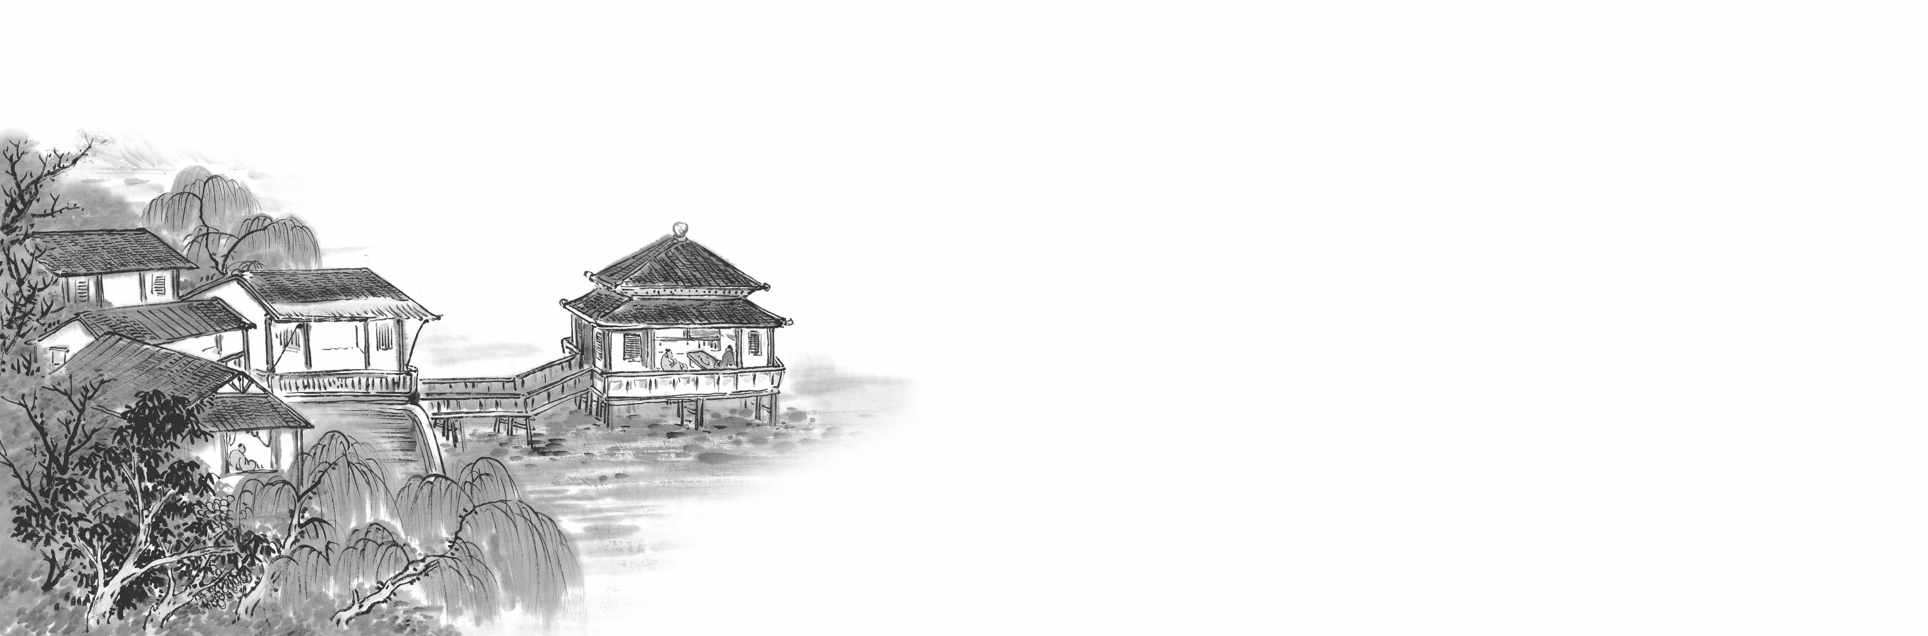

例题
M:Excuse me ,can you tell me how much the shirt is ?
W：Yes, it’s nine-fifteen.
例：How much is the shirt?
A. ￡19.15. B. ￡9.18. C. ￡9.15.

Slide 16


Text1 找车位
M:We have to find ___________.Let's drive around the block one more time.
Did you say the restaurant has no off-street parking at all?
W:None，I checked it.Look，___________________.
1.What will the speakers do next?
A.Check the map. B.Leave the restaurant C.Park the car.

Slide 17

Text1 找车位
M:We have to find a parking space.Let's drive around the block one more time.
Did you say the restaurant has no off-street parking at all?
W:None，I checked it.Look，there is a space.
1.What will the speakers do next?
A.Check the map. B.Leave the restaurant C.Park the car.
重点词汇：
off-street adj，非主干街区的：不靠街面的 block .n. 街区

Slide 18
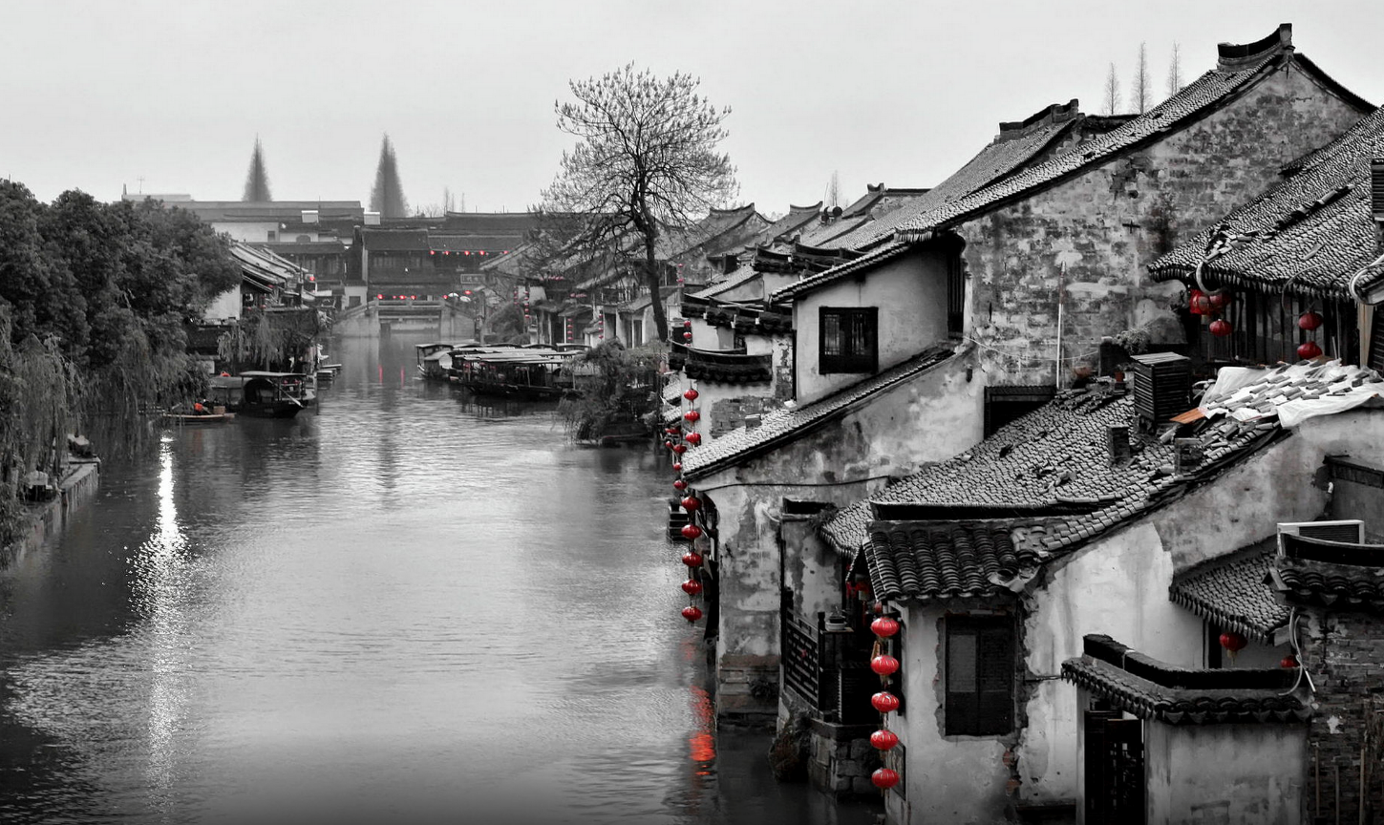
Text2 赶飞机
M:____________,Judy,or you'll miss your flight.It's an hour's drive to the airport.
W:I'm leaving._________________.Just a minute,where is my ticket,Dad?
2.Where are the speakers?
A.At a bus stop. B.At home. C.At the airport.
——————————

Slide 19
Text 2 赶飞机
M:You have to go now,Judy,or you'll miss your flight.It's an hour's drive to the airport.
W:I'm leaving.Don't forget to water my flowers.Just a minute,where is my ticket,Dad?
2.Where are the speakers?
A.At a bus stop. B.At home. C.At the airport.
——————————

Slide 20
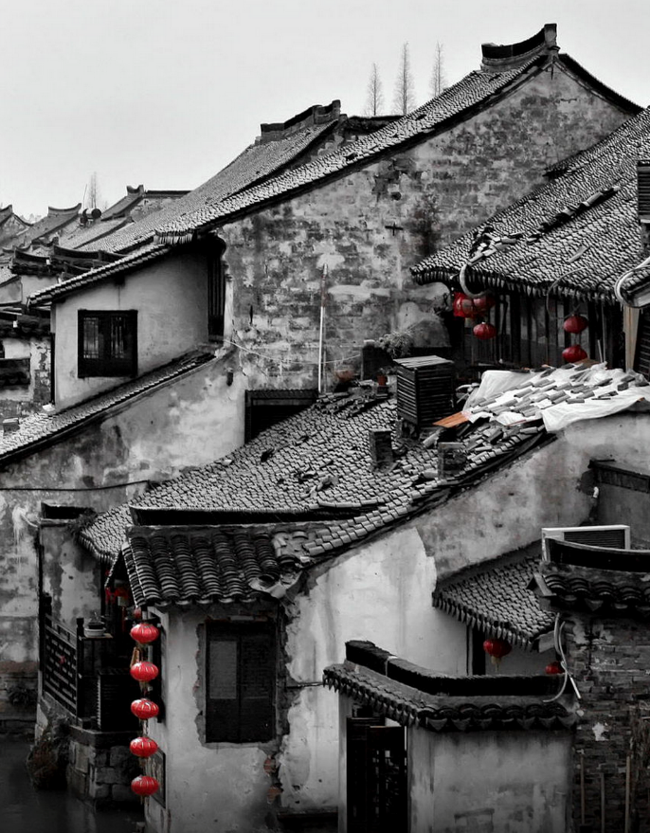
Text3 感谢信
M:Laura,what's in the mailbox?
W:It's a thank-you note from our neighbor.They thank us for ________last week when ___________.They also invite us to have dinner next Friday.
M:Are they back home now?
W:Should be.
3.What did the speakers do last week?
A.They had a celebration dinner.
B.They went to see a newborn baby.
C.They sent a mail to their neighbors.
天人合一
天 下 皆 知 美 之 为 美 ， 斯 恶 已
皆 知 善 之 为 善 ， 斯 不 善 已
有 无 相 生 ， 难 易 相 成 ， 长 短 相 形
高 下 相 盈 ， 音 声 相 和 ， 前 后 相 随
恒 也

Slide 21
Text3 感谢信
M:Laura,what's in the mailbox?
W:It's a thank-you note from our neighbor.They thank us for visiting them last week when the baby was born.They also invite us to have dinner next Friday.
M:Are they back home now?
W:Should be.
3.What did the speakers do last week?
A.They had a celebration dinner.
B.They went to see a newborn baby.
C.They sent a mail to their neighbors.
天人合一
天 下 皆 知 美 之 为 美 ， 斯 恶 已
皆 知 善 之 为 善 ， 斯 不 善 已
有 无 相 生 ， 难 易 相 成 ， 长 短 相 形
高 下 相 盈 ， 音 声 相 和 ， 前 后 相 随
恒 也

Slide 22

T Text4 开馆时间
W:Good afternoon,Paper Museum.
M:Hello,____________________________?
W:Yeah,we're open from 10:00 in the morning to 5:00 in the afternoon.
M:Thanks.
4.Why does the man make the phone call?
A.To cancel a weekend trip
B.To make an appointment.
C.To get some information.

Slide 23
T Text4 开馆时间
W:Good afternoon,Paper Museum
M:Hello,could you tell me your opening hours for Saturday?
W:Yeah,we're open from 10:00 in the morning to 5:00 in the afternoon.
M:Thanks.
4.Why does the man make the phone call?
A.To cancel a weekend trip 取消周末旅行
B.To make an appointment. 预约
C.To get some information. 获取信息

Slide 24
Text5 寻找酒店健身馆
M:Excuse me.______________________?
W:It's on the top floor.You can take the lift over there.
M:Do I have to pay extra?
W:No，sir.You just need to take your room key with you.
5.What does the man probably want to do?
A.Do some exercise
B.Get an extra key.
C. Order room service.

Slide 25
Text5 寻找酒店健身馆
M:Excuse me.Where is the hotel gym,please?
W:It's on the top floor.You can take the lift over there.
M:Do I have to pay extra?
W:No，sir.You just need to take your room key with you.
5.What does the man probably want to do?( 开门见山 ）
A.Do some exercise 做运动
B.Get an extra key. 多拿一把钥匙
C. Order room service.叫客房服务
重点词汇：
take the lift 坐电梯 pay extra 额外付钱

Slide 26
Text6 计划参观历史博物馆
W:Mr.Wilson,students from Class Two want to visit the history museum.___________________________________________?
M:How about their revision test?Are they through with it?
W:Yes,they are.
M:In that case,you can go ahead._____________________so that the students still ____________________________.
W:All right,I'll manage.

Slide 27
Text6 计划参观历史博物馆
W:Mr.Wilson,students from Class Two want to visit the history museum.Will it be all right if I take them there this weekend?
M:How about their revision test?Are they through with it?
W:Yes,they are.
M:In that case,you can go ahead.(7)Try to finish it within one day so that the students still have a whole day to rest on Sunday.
W:All right,I'll manage.
重点词汇：
revision test 复习测试
be through with sth 完成；通过
Will it be all right if...... 可以吗

Slide 28


6.Why does the woman come to the man?
A.To ask for permission. 请求允许
B.To extend an invitation. 发出邀请
C.To express thanks.
7.When are the students going to the museum?
A.On Friday.
B.On Saturday
C.On Sunday.

Slide 29
Text 7
Text7 孩子的生日礼物
M:Hi,Linda.Fancy seeing you here.How long have you been shopping?
W:Almost an hour.I have a lot to buy.My _________ Melissa's ________ is coming.I'm trying to get her
__________,but I don't know ____________.She seems to have everything she loves.
M:Yeah,______________.We've already had bags of toys she's no longer playing with.So this year,we didn't buy her
material things.We gave her an experience gift.
W:What's that?
M:A city pass,with which she can visit 12 different attractions,including theNational History Museum,the Science
Museum,the zoo and more.
W:How much is it?
M:__________________ for a year-long pass.I bought _______for the whole family.
W:So you can have a different outing every month for the entire year.What a great idea!

Slide 30
Text 7
Text7 孩子的生日礼物
M:Hi,Linda.Fancy seeing you here.How long have you been shopping?
W:Almost an hour.I have a lot to buy.(9)My daughter Melissa's birthday is coming.I'm trying to get her a good
gift,but I don't know what to choose.She seems to have everything she loves.
M:Yeah,the same as Clara.We've already had bags of toys she's no longer playing with.So this year,we didn't buy her
material things.We gave her an experience gift.
W:What's that?
M:A city pass,with which she can visit 12 different attractions,including the National History Museum,the Science
Museum,the zoo and more.
W:How much is it?
M:(10)50 dollars per person for a year-long pass.I bought 3 for the whole family.
W:So you can have a different outing every month for the entire year.What a great idea!
重点词汇：fancy doing (用以表示惊奇)想不到 （两套卷同时考到） pass＜熟词生义＞n.通行证

Slide 31
8.What are the speakers talking about?
A.Buying groceries. B.Choosing gifts. C.Seeing friends.
9.Who is Clara?
A.The man's wife B.The man's sister. C.The man's daughter.
10.How much did the man spend on the city passes?
A.$36. B.$50. C.$150
天人合一
天 下 皆 知 美 之 为 美 ， 斯 恶 已
皆 知 善 之 为 善 ， 斯 不 善 已
有 无 相 生 ， 难 易 相 成 ， 长 短 相 形
高 下 相 盈 ， 音 声 相 和 ， 前 后 相 随
恒 也

Slide 32
Text 8 陪护狗帮助孩子建立信心
M:Helen,busy doing anything?
W:Oh,Kevin.I'm preparing a presentation for the city library.It's about a girl named Tracy Woods
M:What's special about her?
W:It was an amazing story.She brought specially _________to special education schools and _____ children to ________.She believes that dogs can help children in ways we can't.Dogs don't judge and they don't care who you are or what you look like.
M:But putting dogs into a school?Aren't they going to ___________________?
W:Don't worry.All the dogs are assessed and trained properly.There are now forty dogs working with children aged from six to eighteen.
M:I hope the children love them.
W:Of course they do.I've got some pictures.I'll show them ______________ tomorrow morning.

Slide 33
Text 8 陪护狗帮助孩子建立信心
M:Helen,busy doing anything?
W:Oh,Kevin.I'm preparing a presentation for the city library.It's about a girl named Tracy Woods
M:What's special about her?
W:It was an amazing story.She brought specially trained dogs to special education schools and helped children to build confidence.She believes that dogs can help children in ways we can't.Dogs don't judge and they don't care who you are or what you look like.
M:But putting dogs into a school?Aren't they going to mess up the school?
W:Don't worry.All the dogs are assessed and trained properly.There are now forty dogs working with children aged from six to eighteen.
M:I hope the children love them.
W:Of course they do.I've got some pictures.I'll show them at my presentation tomorrow morning.
重点词汇：mess up the school 搞乱学校
assess v. 评价，评定

Slide 34


11.Why did Tracy bring dogs to the children?( 同义转述 ）
A.To teach them to love animals
B.To help them gain confidence
C.To protect them from dangers.
12.What is Kevin's concern about the dogs?( 同义转述 ）
A.They may misbehave. 行为不端，举止失礼
B.They may get hurt. 受伤
C.They may carry diseases.传播疾病
13.What will Helen do tomorrow morning?( 同义转述 ）
A.Give a talk.
B.Meet the children
C.Take some photos

Slide 35
Text 9 采访演员
M:Emily,thank you for ________ out of your busy ________ to _______a few _________.
W:It's my pleasure.
M:People say you're doing unpaid work in the new season of My Fair Lady.Is this what the show business has become?
W:No,not really.All of my acting in the new season is _______,but the crew is paid.This is to _________ for the _____________ of the show.
M:I notice you've___________________________:film,TV,and even theater.
W:Yeah,that's_____________________.I work on anything that excites me.
M:Tell us about the six months you recently spent at the workshop of the film centre.
W:It was an ________ experience-teaching young actors and actresses and working with some great acting artists.It was also ______to work in various labs,such as directors,writers and so on.It's very______for making you ______________ and ____________ of the film and television industry.
M:Thank you very much，Emily.We look forward to your new season.

Slide 36
Text 9 采访演员
M:Emily,thank you for taking time out of your busy schedule to answer a few questions.
W:It's my pleasure.
M:People say you're doing unpaid work in the new season of My Fair Lady.Is this what the show business has become?
W:No,not really.All of my acting in the new season is unpaid,but the crew is paid.This is to raise money for the post production of the show.
M:I notice you've tried many different kinds of things:film,TV,and even theater.
W:Yeah,that's how I was trained at university.I work on anything that excites me.
M:Tell us about the six months you recently spent at the workshop of the film centre.
W:It was an unbelievable experience-teaching young actors and actresses and working with some great acting artists.It was also great to work in various labs,such as directors,writers and so on.It's very helpful for making you a really well-rounded and active member of the film and television industry.
M:Thank you very much，Emily.We look forward to your new season.
重点词汇：
Post production n.后期制作 well-rounded adj 全面发展的

Slide 37
14.What is the man doing?
A.Attending a lecture. 听讲座
B.Hosting a workshop. 举办研讨会
C.Conducting an interview.进行采访
15.Why is Emily doing unpaid work in the new season of the show?
A.To follow the latest trend .紧跟最新潮流
B.To help raise the crew's pay. 提高员工的工资
C.To support the post-production.支持后期制作
16.What enables Emily to try different things in her field?
A.Her college education.
B.Her teaching experience.
C.Her family tradition.
17.What does Emily think of her work at the Film Centre?
A.Boring. 乏味的，无趣的
B.Rewarding. 值得的，有意义的
C.Demanding 费时费力的；苛刻的

Slide 38
Text 10 邀请健康专家演讲
W:Hi,everyone.This is the ___________ of ________.We've been fortunate to have got good advice from some famous athletes on how to improve our skills and build up our body.Today,we'll hear something different.We're honored to have Emma Wilson here.Emma is a health expert and lecturer from UBC,the University of British Columbia.Emma worked for a football team in Manchester,then for a very successful ______team in_______,and finally ended up working here in Vancouver.Emma says it's _________ to be __________,because people can be easily _________ by ___________ that _________________.Also,people aren't willing to change their views about food and nutrition as there is so much confusing information online.It's really important to hear what experts say and that's why we've invited Emma here.She isn't going to tell us about everything we should eat,but she will teach us to make better choices.Let's welcome Emma Wilson.

Slide 39
Text 10 邀请健康专家演讲
W:Hi,everyone.This is the monthly meeting of our club.We've been fortunate to have got good advice from some famous athletes on how to improve our skills and build up our body.Today,we'll hear something different.We're honored to have Emma Wilson here.Emma is a health expert and lecturer from UBC,the University of British Columbia.Emma worked for a football team in Manchester,then for a very successful rugby team in Dublin,and finally ended up working here in Vancouver.Emma says it's challenging to be a health expert,because people can be easily influenced by advertisements that lack scientific support.Also,people aren't willing to change their views about food and nutrition as there is so much confusing information online.It's really important to hear what experts say and that's why we've invited Emma here.She isn't going to tell us about everything we should eat,but she will teach us to make better choices.Let's welcome Emma Wilson.
重点词汇：rugby[ˈrʌɡbi]n.英式橄榄球 Dublin[ˈdʌblɪn]n.都柏林（爱尔兰共和国的首都）lack v.缺乏
背景知识：UBC (University of British Columbia) 哥伦比亚大学

Slide 40
18.Who is the speaker talking to?
A.Sports club members.
B.International tourists.
C.University students.
19.Where did Emma work for a rugby team?
A.In Manchester.
B.In Dublin.
C.In Vancouver.
20.What can be a challenge to Emma's work?
A.Competition in the health care industry.
医疗保健行业的竞争
B.Discrimination against female scientists.
对女性科学家的歧视
C.Influence of misinformation on the public
错误信息对公众的影响

Slide 41
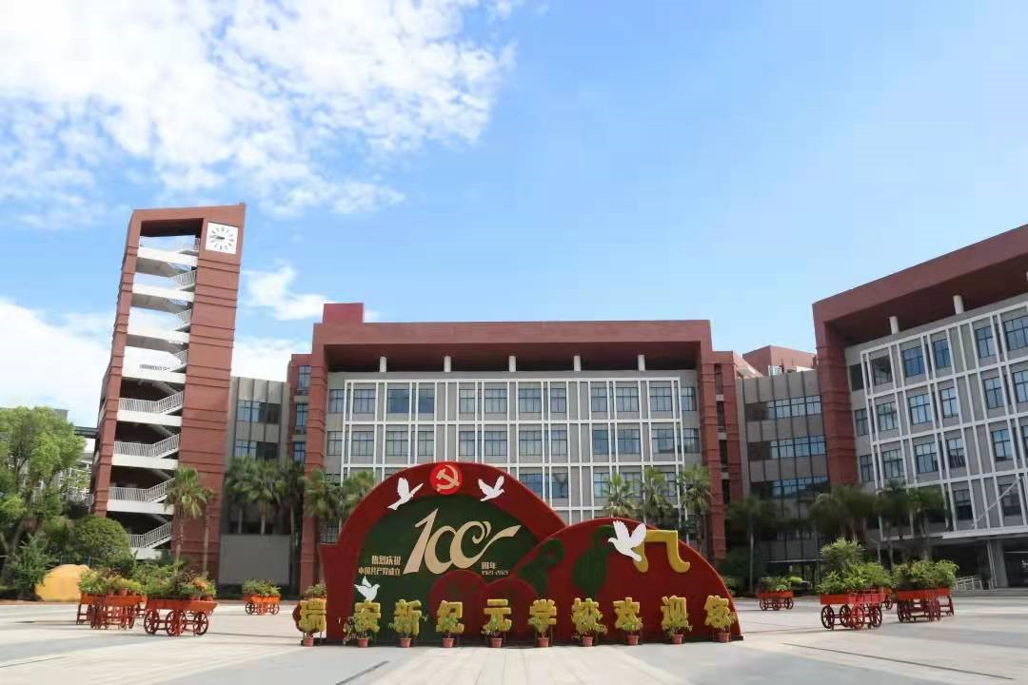
欢迎指导

