Slide 1
感恩遇见，相互成就，本课件资料仅供您个人参考、教学使用，严禁自行在网络传播，违者依知识产权法追究法律责任。
更多教学资源请关注
公众号：溯恩高中英语
知识产权声明

Slide 2
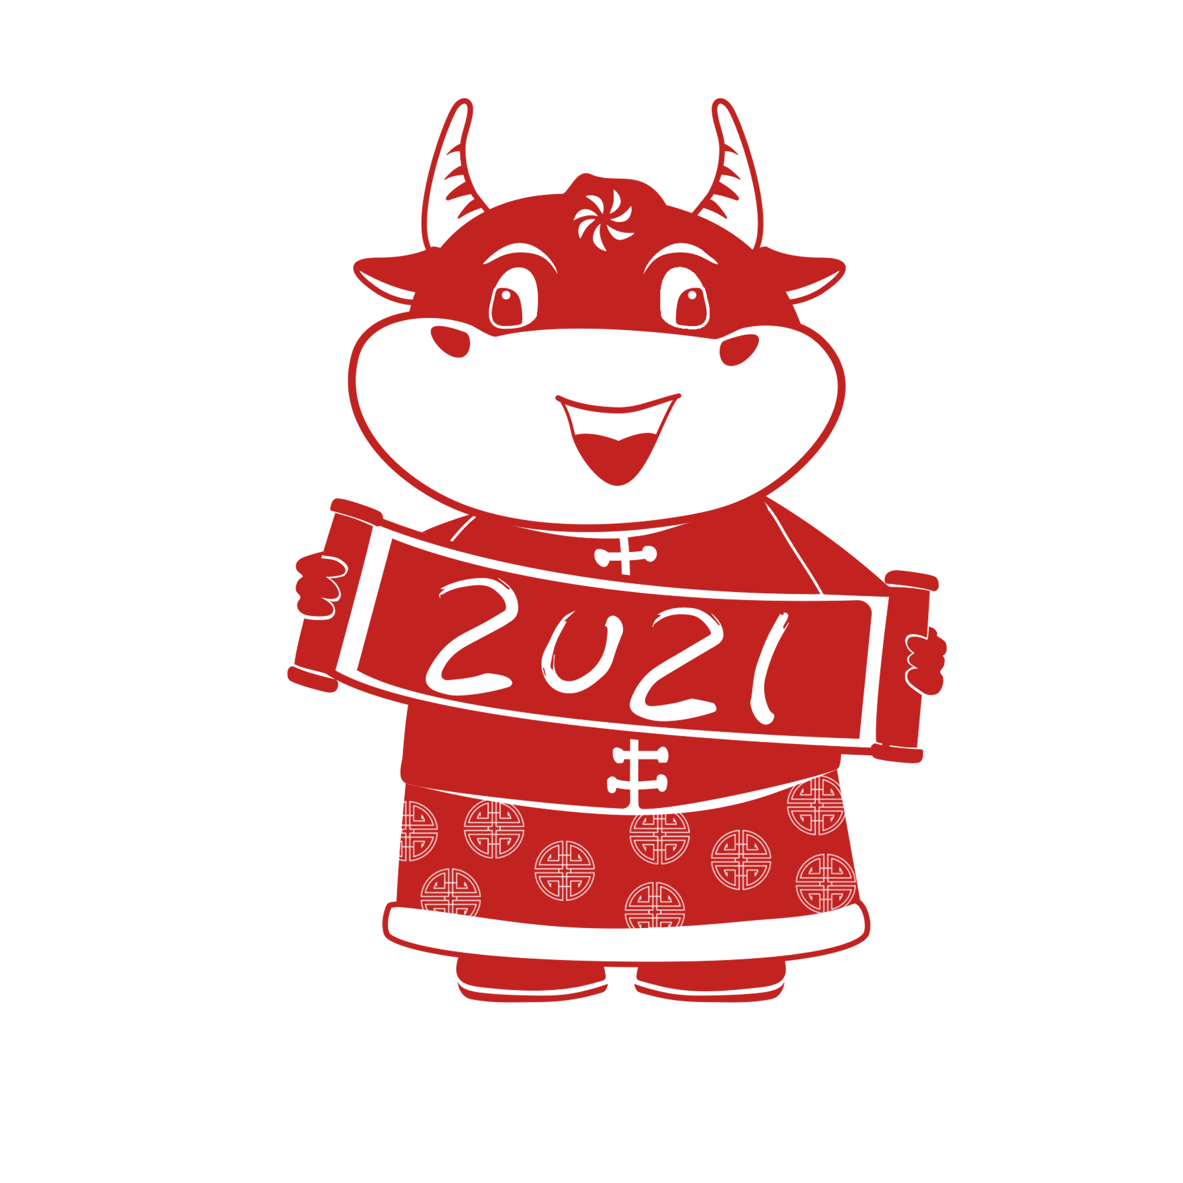
May everyone be extremely fortunate
in the year of the Ox
Spring Festival
高考题型开发
余杭区杭州二中树兰高级中学 郭合英

Slide 3
The origin of the Spring Festival
The legend of the Spring Festival
Learning
objectives
Historical development
The customs of Spring Festival
Appreciation of poetry
Blessings

Slide 5
The origin of the Spring Festival
The Spring Festival, is the first lunar month, also called the lunar year, commonly known as “Spring Festival”. This is our country folk ceremonious, the most lively a traditional festival. The history of the Spring Festival is very long, and it originated in the period of Yinshang the sacrifices of the tail and head of the ancestor worship of god. Usually, its celebrations last 15 days.
Preparations tend to begin a month from the date of the Chinese New Year when people start buying presents, decoration materials, food and clothing.
A huge clean-up gets underway days before the Spring Festival, when Chinese houses are cleaned from top to bottom, to sweep away any traces of bad luck, and doors and windowpanes are given a new coat of paint, usually red. The doors and windows are then decorated with paper cuts and couplets with themes such as happiness, wealth and longevity printed on them.

Slide 6
The eve of the New Year is perhaps the most exciting part of the event, as anticipation creeps in. Here, traditions and rituals are very carefully observed in everything from food to clothing.
Dinner is usually a feast of seafood and dumplings, signifying different good wishes. Delicacies include prawns（对虾）, for liveliness and happiness, dried oysters (牡蛎), for all things good, raw fish salad or yu sheng to bring good luck and prosperity, Fai-hai (Angel Hair), an edible(可食用的) hair-like seaweed to bring prosperity, and dumplings boiled in water signifying a long-lost good wish for a family.
It’s usual to wear something red as this colour is meant to ward off evil spirits， but black and white are out, as these are associated with mourning. After dinner, the family sit up for the night playing cards, board games or watching TV programmes dedicated to the occasion. At midnight, the sky is lit up by fireworks.

Slide 7
On the day itself, an ancient custom called Hong Bao, meaning Red Packet, takes place. This involves married couples giving children and unmarried adults money in red envelopes. Then the family begins to say greetings from door to door, first to their relatives and then their neighbours. Like the Western saying “let bygones be bygones,” at Chinese New Year, grudges (怨恨，积怨)are very easily cast aside. The end of the New Year is marked by the Festival of Lanterns, which is a celebration with singing, dancing and lantern shows.
Although celebrations of the Chinese New Year vary, the underlying message is one of peace and happiness for family members and friends.
高考题型开发：阅读理解
How many years can we infer about the origin of the Spring Festival?
A. about 2000 years. B. about 200 years.
C. about 4000 years. D. about 5000 years.

Slide 8
2. What does the underlined word “observed” in Paragraph 4 probably mean?
A. watch B. celebrate C. obey D. comment
3. Who usually gives children Hong Bao?
A. The man B. Only the old.
C. The married woman D. The married men or women
4. Why do people eat an edible hair-like seaweed in the feast ?
A. Because it represents well-being.
B. Because it stands for boom.
C. Because it signifies a good wish.
D. Because it is a sign of good luck.
5. Which of the following statements is true according to the passage?
A. A huge clean-up is finished within a day before the Spring Festival.
B. Say greetings from door to door begins from neighbors to relatives.
C. The doors and windows are painted only in red.
D. Wearing something red in Spring Festival is aimed at scaring the evil spirits off.

Slide 9
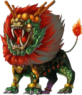
The legend of the Spring Festival
高考题型开发：语篇填空
called
Long time ago, in China, there was a big scary nasty beast 1 ( call) “Nian”, whose name means “year”. He had razor-sharp teeth, giant claws, and a 2 (reality) mean growl. Most of time , he lived in the wildness, but on every New Year’s Eve, he would sneak into the village and swallow the humans and 3 (animal).
People dreaded the New Year’s Eve for many years 4 a wise man taught them the three things 5 Nian was afraid of: loud noise, fire and the color red.
The next time Nian came, the villagers fought back. They hit their drums as loud as they could, 6 (light) every firecrackers they had and wore the color red from head 7 toe. Nian ran far away and never came back.
After that, people started celebrating the New Year’s Eve instead of 8 (fear) it. The custom of putting on new clothes, pasting red couplets and 9 (set) off fireworks remains. That celebration became 10 fifteen-day festival of family food and good fortune called Chinese New Year.
really
animals
until
that
lit
to
fearing
setting
a

Slide 10
Another version of the legend
高考题型开发：语篇填空
Once upon a time, there was a monster called "Xi", which came out every
year 1 (hurt) people. Even the Kitchen King 2 protected the people could not do anything with it. So the Kitchen King invited a prodigy(天才)
3 (name) "Nian" to the heavens.
The prodigy had high mana （超自然力量）power, 4 (destroy) the Evening Beast with red silk and bamboo poles which 5 (burn) in the fire. This day is the last day of December. In order to thank and commemorate the last day of the year, the people call the last day of the lunar calendar "New Year's Eve" 6 the first day of the New Year "New Year's Eve".
People hope that 7 (they) families have red silk and 8 (firecracker) in their hands. So the red silk and bamboo poles burned in the fire gradually evolve into red couplets and red whips 9 every family has during the New Year. This legend about the year can be said to be clear and 10 (order).
to hurt
who
named
destroying
were burned
and
their
firecrackers
that
orderly

Slide 11
Historical development
高考题型开发：七选五
Spring Festival is our ancient traditional festival. It is not in the twelfth lunar month on the 29th or on the 30th, 1 Southern and Northern Dynasties later, the “Wax Festival” to the end of the year. To the Republican era, the switch to Gregorian (根据格列高里历法的) calendar was only then that the lunar year is called “Spring Festival”.
Spring Festival is China’s biggest and most exciting festival of an ancient tradition. According to China’s Lunar New Year, the first month in ancient times was known Yuan Chen, Yuan zheng, Yuan Shuo, New Year’s Day and so on, 2 .
Spring is the beginning of a new round of sowing and harvesting season. 3__ .
Thus, before the Spring Festival red paper pasted on the door face, yellow-word New Year’s Message.
C
F
B

Slide 12
A
4 “Year” is a kind of bad luck for people’s imagination in animals. When “Year” came, it damaged humans and animals. You need to use fireworks to make
“Year” away, so have the custom of burning firecrackers. In 1993, the Beijing Municipal People’s Government promulgated a law to ban fireworks, so that this continuity throughout the ages for centuries the custom of the past.
Spring Festival is a family reunion holiday 5 . Real the night before Chinese New year is called “New Year’s Eve”. From the traditional New Year’s Eve celebrations continued until the fifteenth day Lantern Festival. Holiday movies before Jizao, worship of ancestors, to eliminate contamination. To be posted on the 30th Door God, couplets, flag, eating dumplings, fireworks, New Year’s Eve, “Shou Sui” and other ceremonies; younger generation asked their elders to pay the first month, and then to the New Year with relatives and friend.
December 23, 1949, the PRC Central People’s Government provides for an annual Lunar New Year holiday 3 days. In China the public holiday is the most solemn, the most lively of an ancient traditional festivals.
E

Slide 13
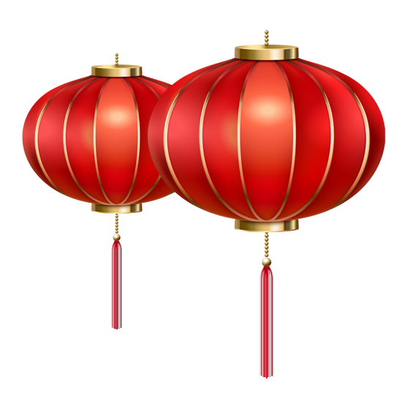
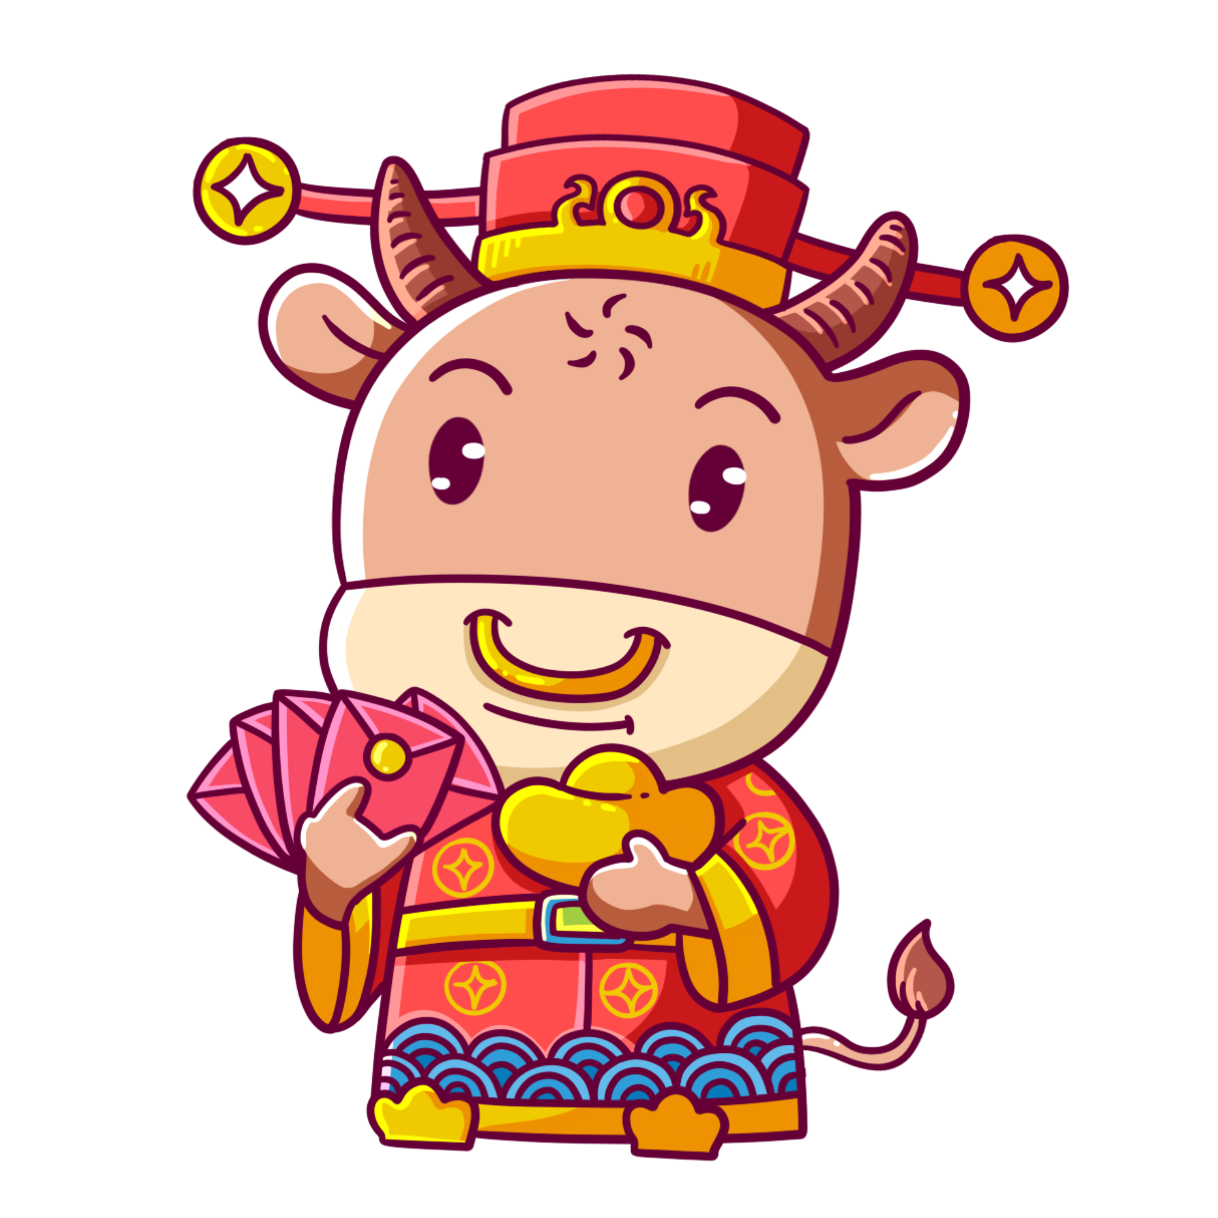
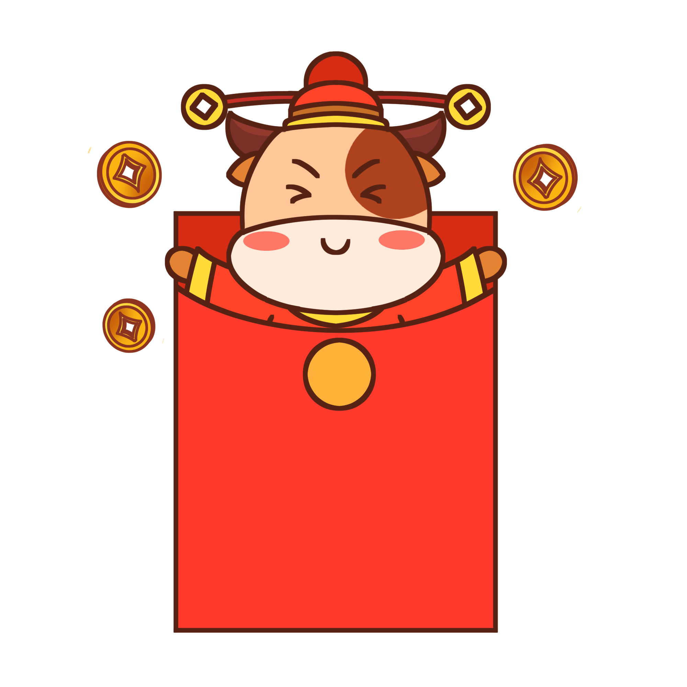
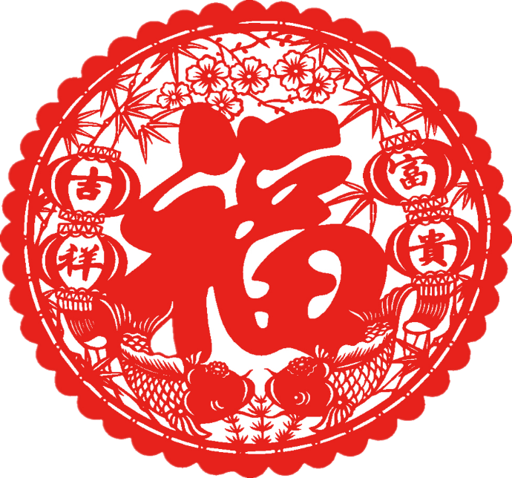
A. Another name is called “Guo nian”.
B. People danced and sang to welcome its coming.
C. but in the “wax on”, that later, “Laba.”
D. It is a festival that symbolizes reunion, prosperity for the future.
E. when the children away from home returned to their parents at home
F. which means the first month is the year, month, day three start.
G. There are many versions about the origin of the Spring Festival.

Slide 14
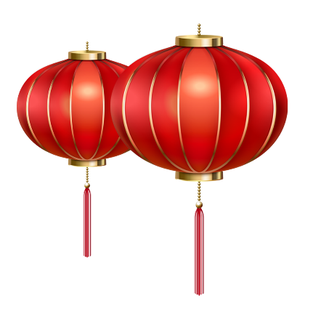
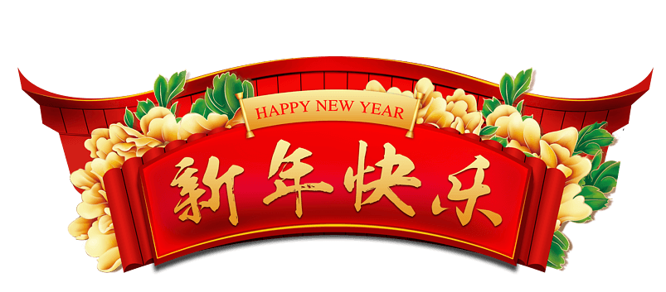
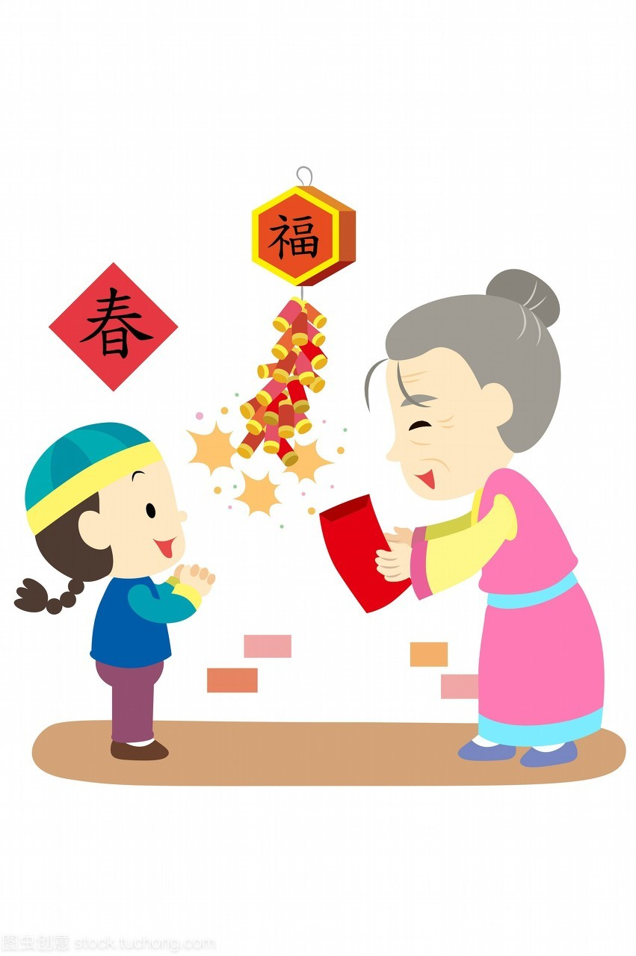
The customs of Spring Festival
题型开发：补全句子。
Luck money
(celebrate) new year spring festival, the elders would prepare some lucky money to younger generation, it is said the new year’s money can bring good luck. The junior always spend lucky money books , clothes and toys.
To celebrate
that
on

Slide 15
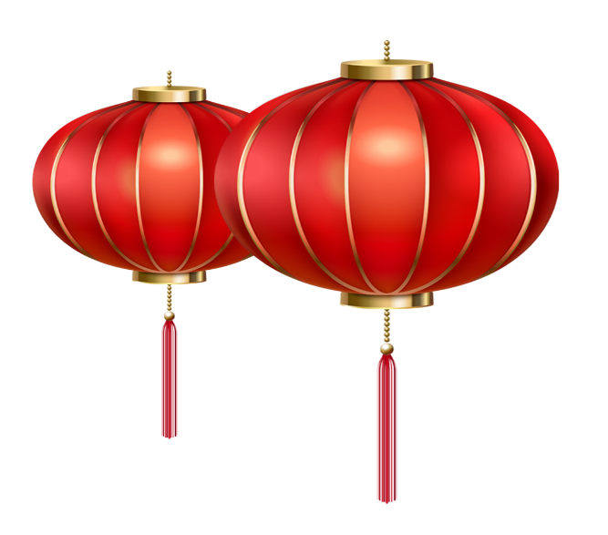
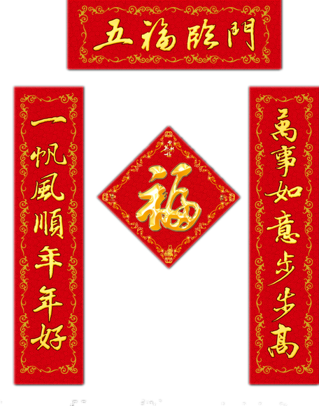
Spring Festival couplets
Every Chinese New Year, no matter the city or the country, every family choose a pair of bright red couplets ( stick) on the door, to create festival atmosphere, and to express good (wish).
to stick
wishes

Slide 16
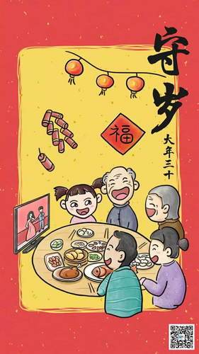
ShouSui
The New Year’s eve ShouSui is the most important in one of the common
(activity). New Year`s eve , the family reunion together , people have the reunion dinner, (sit) together, chatting and watching the Spring Festival Gala on TV. People stay up all night
(welcome) the new year.
activities
sitting
to welcome

Slide 17
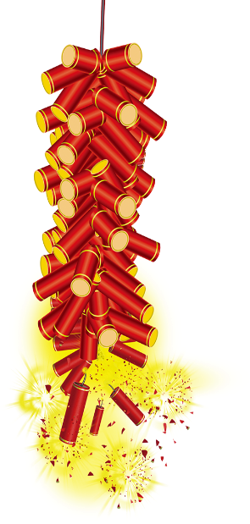
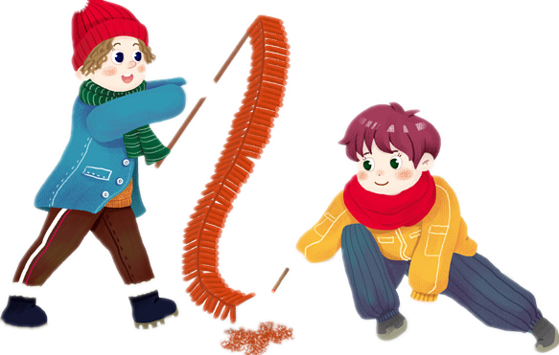
Firecrackers
When new year comes, every family opens the door , the first thing (do) is to set off firecrackers. Firecrackers can create the festival atmosphere , (bring) joy.
The four traditional customs about the spring festival (last) for many years in China, and later will always continue. They are our Chinese people’s treasure. They are Chinese history.
to do
bringing
are lasted

Slide 18
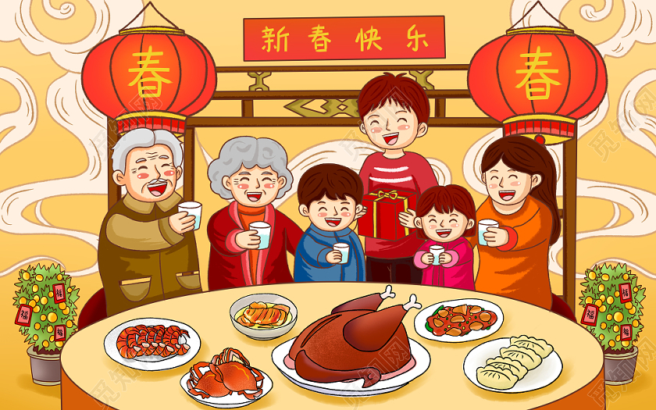
Appreciation of poetry
《元日》
王安石
爆竹声中一岁除，春风送暖入屠苏。
千门万户曈曈日，总把新桃换旧符。
New Year's Day Wang Anshi Amid the boom of firecrackers a year has come to an end, And the spring wind has wafted warm breath to the wine. While the rising sun shines over each and every household, People would put up new peachwood charm for the old.
《元日》是北宋政治家王安石创作的一首七言绝句。这首诗描写新年元日热闹、欢乐和万象更新的动人景象，抒发了作者革新政治的思想感情，充满欢快及积极向上的奋发精神。

Slide 19
Appreciation of poetry
《除夜作》
高适
旅馆寒灯独不眠，
客心何事转凄然？故乡今夜思千里，霜鬓明朝又一年。
Composed on New Year’s Eve
Gao Shi
Alone in an inn by a cold lamp I stay awake;
One might wonder what is troubling this traveller’s heart of mine.
A thousand li away my people must be thinking of me;
Grey-haired already, I shall be a year older overnight.
高适素以边塞诗人著称，诗风浑厚雄放，这首《除夜作》却诗风平易自然，全诗没有一句生僻字句和华丽词藻，也没有塞外风景和异城奇观，都是浅近的口语，表达除夕夜的平常感受；却将他乡游子真实的感受写得淋漓尽致，感人肺腑。

Slide 20
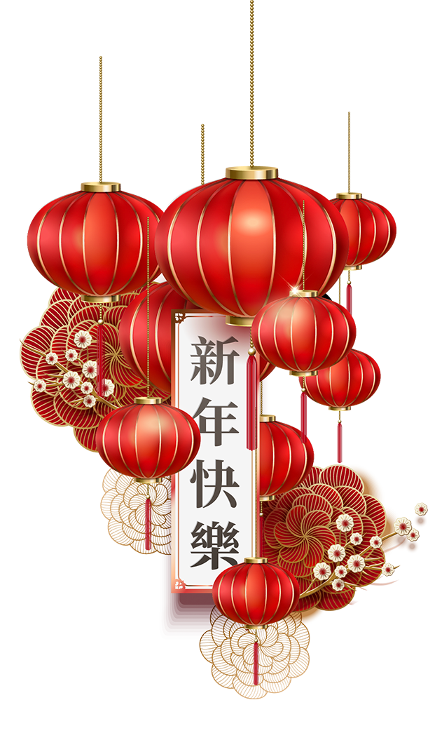
Blessings
Good health! 身体健康 ！
Hope everything goes your way！ 心想事成！
May you come into a good fortune！ 恭喜发财 ！
Everything goes well！吉祥如意 ！
A good start in the New Year ！ 新春大吉！
Good luck in the year ahead! 祝吉星高照！
Good health, good luck and much happiness throughout the year.
恭祝健康、幸运，新年快乐。
Best of luck in the year to come.
愿你在未来的一年里，吉星高照。
New Year Eve, I wish you family reunion.
除夕佳节，祝你合家团圆。
I hope you find your pot of gold. 祝你招财进宝。

Slide 21
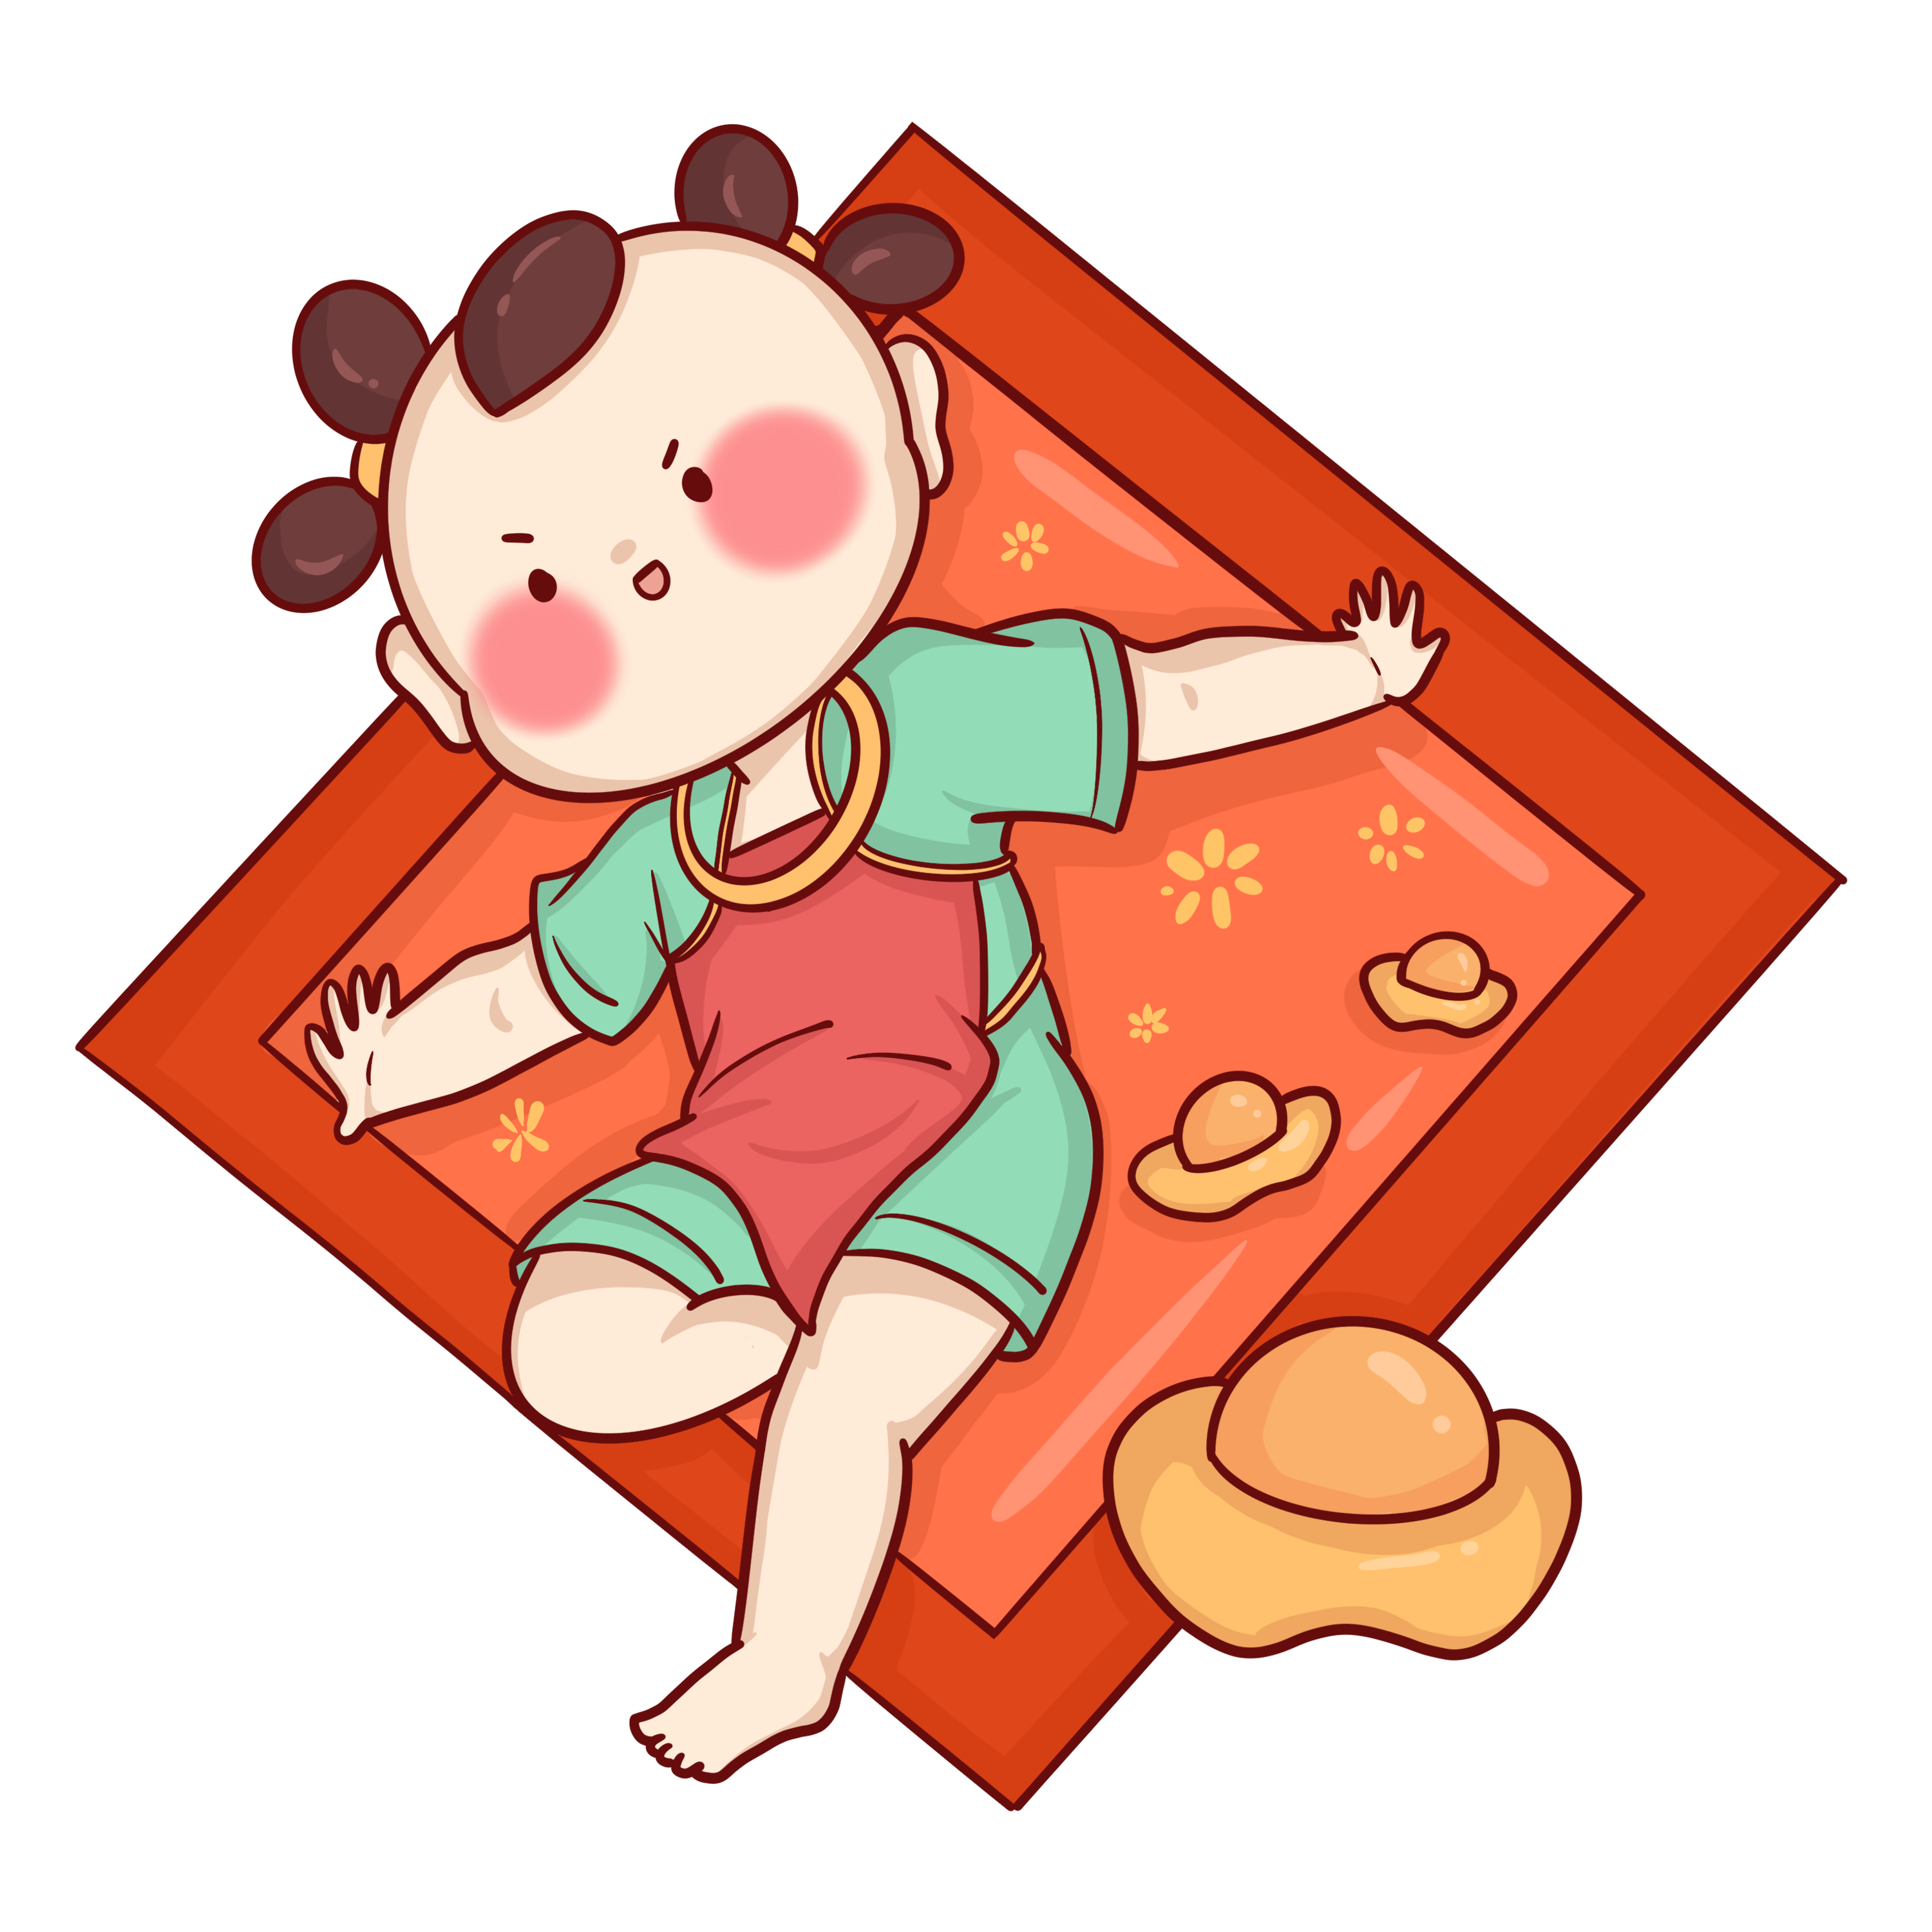
May the joy of New Year be with you throughout the year.
愿新年的快乐一年四季常在。
May the New Year be a time of laughter and real enjoyment for you. Best wishes.
愿新年不仅是你欢笑的时刻，更是你欢喜的日子。祝福你。
New Year time is here. I hope you have a wonderful New Year. May every day hold happy hours for you.
新年来临，祝新年快乐，愿你时时刻刻幸福欢乐!
May the beauty and joy of New Year remain with you throughout the new year!
愿新春美景与欢乐常伴随你新年新年!
Best wishes for a wonderful new year.
献上最诚挚的祝福，祝您新年愉快。
May happiness follow you wherever you go!
愿您幸福快乐，直到永远永远。
I hope you have a most happy and prosperous New Year.
谨祝新年快乐幸福，大吉大利。

Slide 22
Homework
题型开发：阅读理解（根据要求完成题目）
Chinese New Year (also called the Spring Festival) is the oldest traditional festival in China, but what is the origin behind the festival? It could be traced back to a popular story of the Monster Nian, which helps to explain why and how the festival is celebrated. According to the Chinese ancient legend, there was a violent and ugly monster named “Nian” with sharp teeth and horns. Living in the dark sea for a long time, the beast would climb up the shore by the end of the lunar year, hunting people and farm animals of a village. Therefore, every time before the New Year's Eve, all the villagers would lock their doors before sunset and escape to remote mountains to avoid Nian's attack. One New Near's Eve, a beggar came to the village and changed the bad situation. The old man asked to stay one night in a granny's house. He promised he would expel （驱逐） away the frightening beast in reward. The granny agreed and escaped to the mountain alone.
At midnight, the monster broke into the village, but it sensed the change of

Slide 23
the atmosphere. Approaching the house slowly, it found all the doors and windows pasted with red papers and many candles lit inside the house. The beast trembled and howled, glaring at all strange things. At that moment, loud cracking sound burst in the courtyard, daunting（使胆怯） Nian not to dare come closer. The front door was opened in a flash, and the old man came out in red clothes, roaring with laughter （放 声 大 笑). The monster was badly frightened, running away through the dark night. After that, villagers were enlightened by the truth that the bamboo burning cracking, red color and bright light were magic keys to scare away the monster. Since then, on every New Year‘s Eve, villagers would celebrate the triumph over the monster. People always pasted red spring couplets （贴对联）, hung lanterns and set off fireworks. They dressed in new and visited neighbors to share the joy. Everyone was immersed （沉浸） in happiness. The traditions are passed on from one generation to another till today. According to the story, Chinese New Year’s Day is also called “Guo Nian”, which means “surviving the Nian”. The red also becomes the most popular color for festival celebration.

Slide 24
I. Choose the best answer.
1.When did the Monster Nian appear to hunt people and farm animals?
A. After New Year's Eve. B. The first day of a month.
C. The end of the lunar year. D. The beginning of the lunar year.
2.What can be inferred about Nian according to the text？
A. It was a kind of evil beasts. B. It usually appeared at dawn.
C. It was afraid of shiny couplets. D. It became a friendly beast in the end.
II. Complete the sentences based on the text.
1. (approach) the house slowly, it found all the doors and windows
pasted with red papers and many candles （light）inside the house.
2.Soon, villagers were enlightened by the truth the bamboo burning
cracking, red color and bright light were magic keys to scare away the monster.
Approaching
lit
that

Slide 25
Vocabulary in the text
1.tremble v.发抖；战栗；摇晃 n. 颤抖；战栗；哆嗦
2.triumph n.伟大胜利；重大成就
3.trace back to... 追溯到……
4.New Year's Eve 除夕
5.in reward 作为回报；作为报酬
6.set off 出发；动身；引发；使爆炸
Ⅲ. Complete the following sentences in correct forms with the vocabulary given above.
1.The dangerous situation increases her heart rate, making her hands .
2.The origin of the Silk Road can be the history of Zhang Qian's visit to
the Western Region.
3.I brought him a book for his help.
tremble
tracked back to
in reward

Slide 26
composition
应用文（15分）
假如你叫李华，得知外教Mr. Hall因新型冠状病毒疫情形式严峻寒假不回国，你想邀请他到你家过春节。请你给他写一封信，内容包括：
时间；
一同过节的家人；
活动安排。
注意：
80词左右；
可以适当增加细节，以使行文连贯。

Slide 27
Dear Mr. Hall,
Informed that you don’t return to your own hometown due to the severe novel coronavirus, I'm writing to invite you to come over for Spring Festival on February 12.
Spring Festival is traditionally a time for family reunion, so my parents and my brother will all be there. We’ll make dumplings together and have a big dinner. If you came here, you would have a taste of our Chinese food and customs, I’m convinced that you you‘ll like them. After that we’ll play card games, waiting to watch CCTV Spring Festival Gala on TV at 8pm. on time, from which you will have an eye for Chinese traditions and art culture. What’s more, you may even get lucky money from my parents. If it is convenient for you to come, I’ ll go and pick you up at your place.
Your presence will surely add color to our activity. Your prompt reply will be highly appreciated.
Best,
Li Hua

