Slide 1


感恩遇见，相互成就，本课件资料仅供您个人参考、教学使用，严禁自行在网络传播，违者依知识产权法追究法律责任。
更多教学资源请关注
公众号：溯恩高中英语
知识产权声明

Slide 2

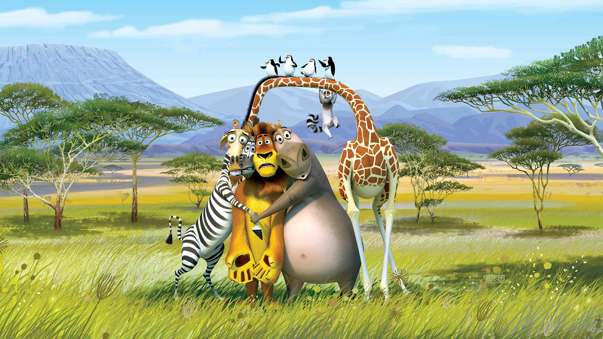
What are they scared of?
-- Yu Yue, Shengzhou Senior High School

Slide 3

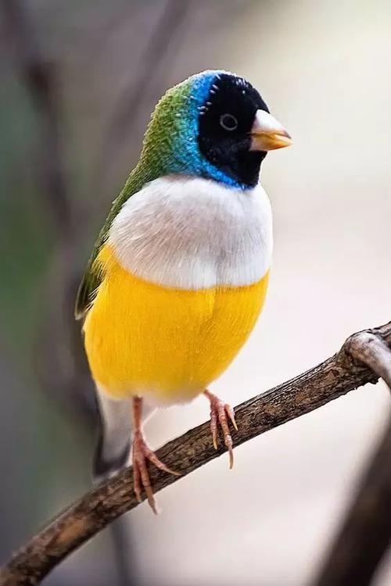
M2U2 Wildlife Protection
Wildlife
wild plants
｛
wild animals
Listening and Speaking

Slide 4



What's the present living condition of wild animals?
or

Slide 5
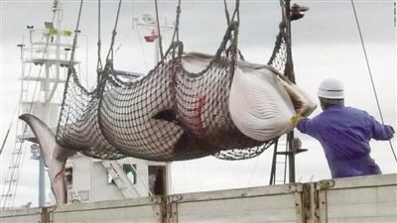
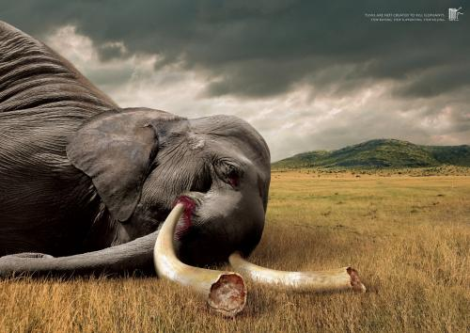
illegal hunting
Elephants are hunted for ivories!
Whales are hunted for food!

Slide 6
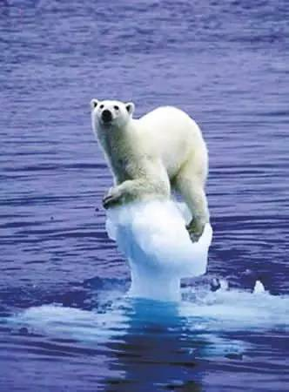
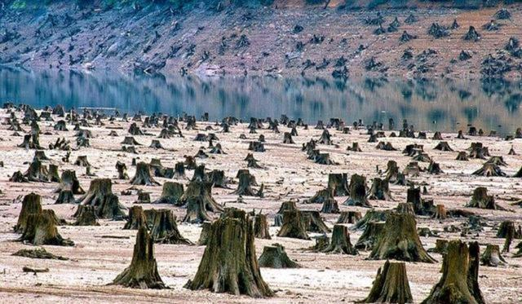
habitat loss
Global warming melt glaciers， so that polar bears are losing their homes.
People cut trees for various reasons so that natural habitats are fewer and fewer.

Slide 7
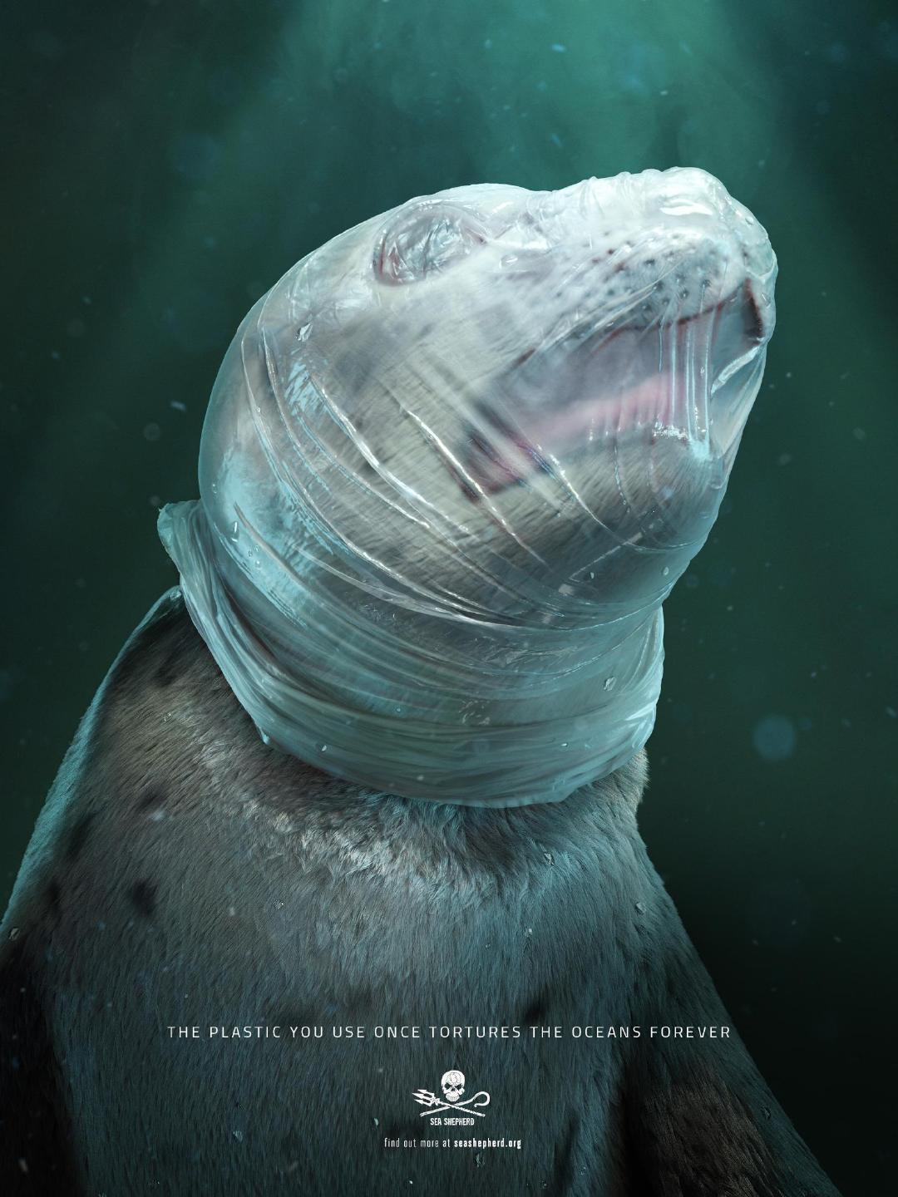
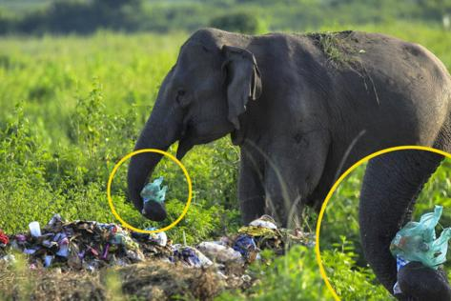
white pollution
habitat pollution
People throw away plastic bags there and here, which pollutes wild animals’ habitat.

Slide 8

illegal hunting
An increasing number of wild animals are dying out.
habitat loss
The mass extinction is caused.
habitat
pollution
lack of food

Slide 9
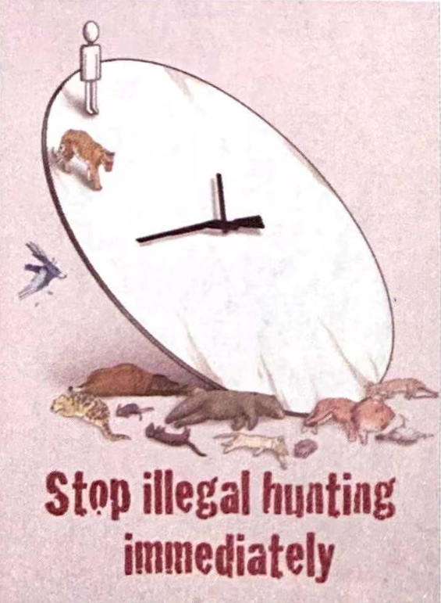
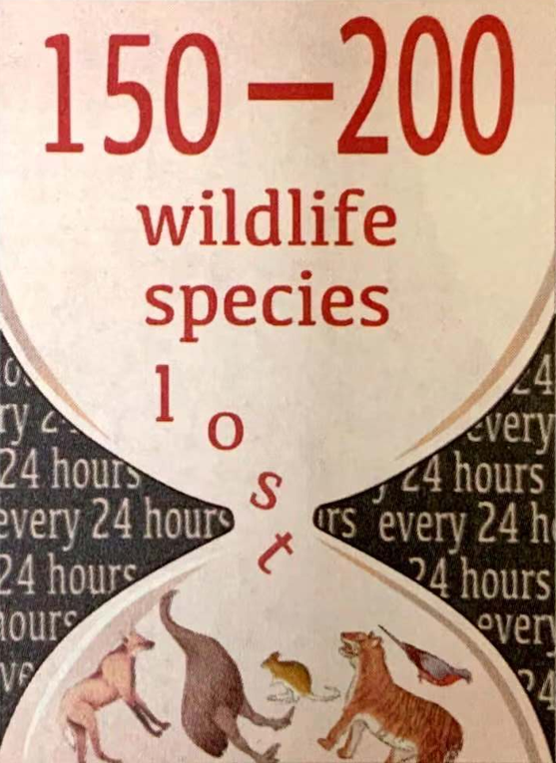
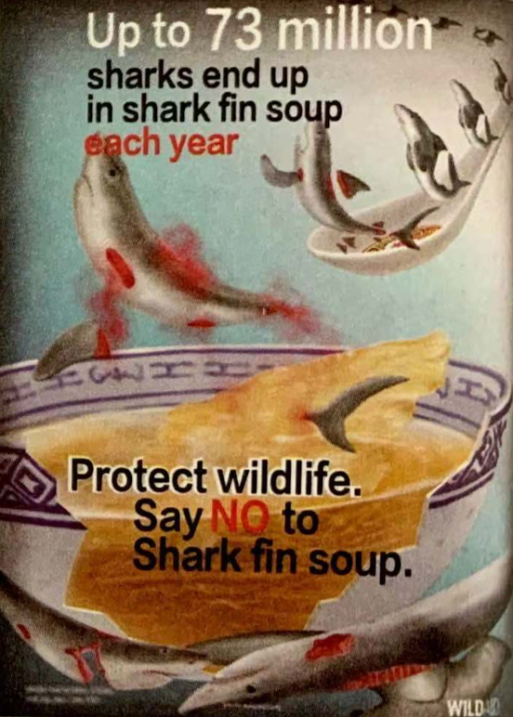
poster
What message do these posters share?
Wild animals are in danger!

Slide 10

listening part1:
What on Earth Are We Doing to Our Planet?
Our planet’s ________ is dying out at an alarming rate. Between 150-200 species are becoming extinct every day. This mass extinction is caused by hunting, habitat ______, and pollution. We must make people aware of the problem and help _______ the endangered wildlife before it’s too late!
wildlife
loss
protect

Slide 11
listening part2:
54
How many elephants are killed on average every day?____
What did Prince William say about China?
A. China has made a lot of progress.
B. China can become a global leader in wildlife protection.
C. China preserves its natural habitats well.
What does the speaker tell us at the ending of the speech?
_________________________________________
B
Change begins with you!
If we want things to change, we must change ourselves first and not wait for others to change first. We must be the change we want to see in the world.

Slide 12

speak up for endangered animals
Someone has to1.____________________________. Some famous people, such as Chinese superstar Yao Ming and Britain’s Prince William, work hard to help. In October 2015, Prince William 2._________________ on CCTV: “In the 33 years since I was born, 3.______________________
of Africa’s elephant population. Of those that are left, 20000 are killed every year. That is 54 elephants killed every single day.” That means 4.____
_________________________________________
In his speech, Prince William also praised China’s efforts to protect wildlife: “ 5._____________________ that China can become 6.________
________ in the protection of wildlife.” You don’t have to be Prince William or Yao Ming to speak up and do something 7.________________. ________. You can 8.______________________________ in your area. Remember: Change begins with you!
gave a moving speech
we’ve lost around 70 percent
there
are elephants which are being killed right now!
I am absolutely convinced
a global
leader
about endangered
animals
be the voice of wildlife protection

Slide 13

In face of the massive extinction of endangered animals, what can we do to preserve them from dying out ?

Slide 14

What can we do to preserve them from dying out ?
If a problem seems too difficult for a single nation, the global community can sometimes provide a solution.
Laws should be passed to stop people from killing or hunting them.
Nature preserves/reserves are set up so that wild animals can live in peace with no hunting.
People are educated to be aware of the importance of wildlife protection.
People organized international organizations to preserve wildlife together.

Slide 15
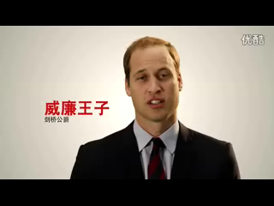
public service advertising

Slide 16
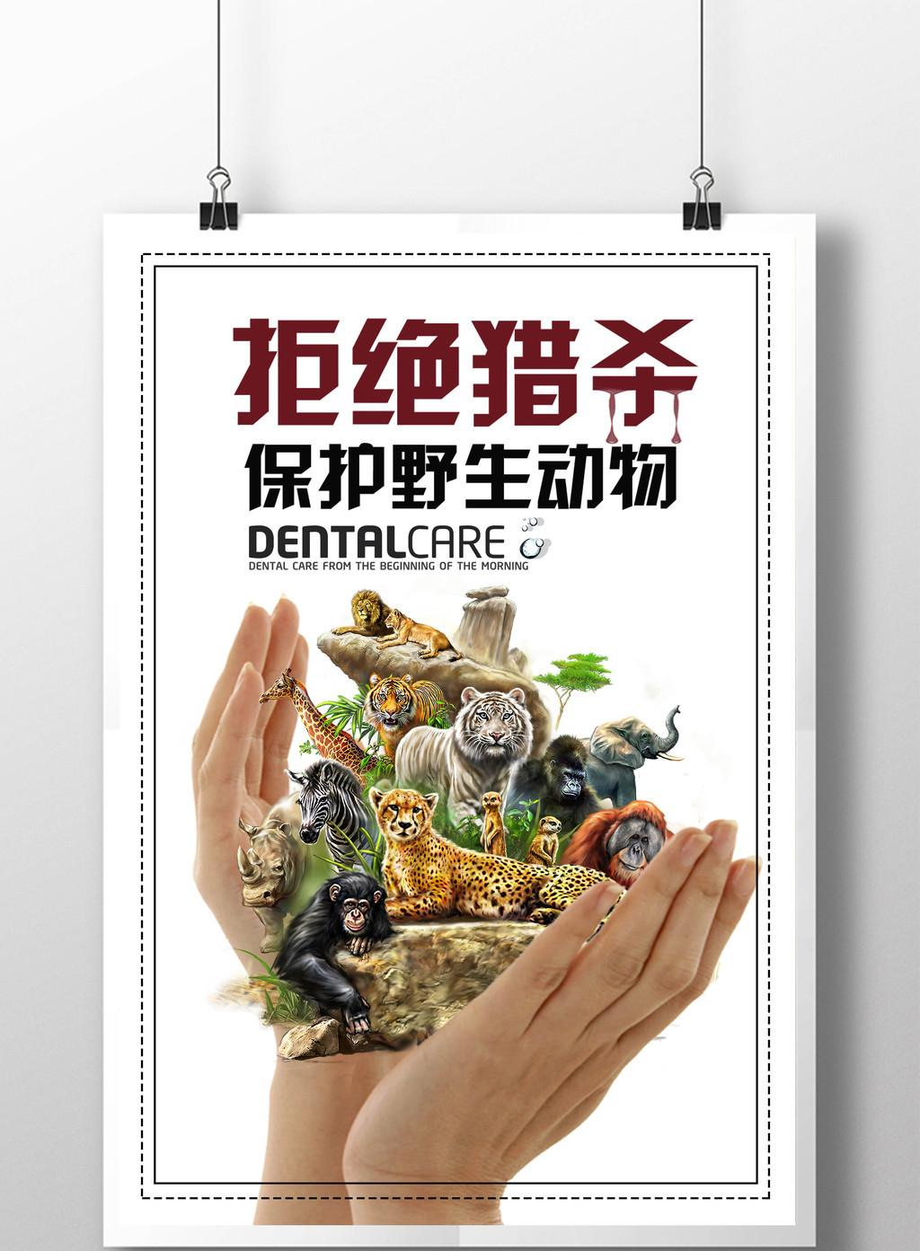
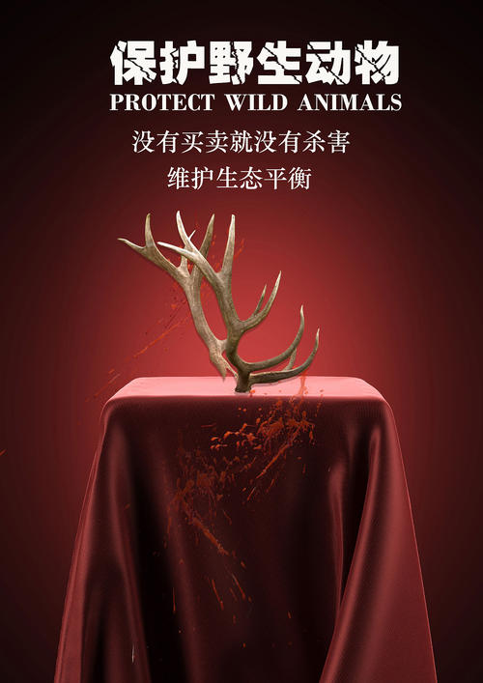
poster
When the buying stops, the killing can too.

Slide 17
The protection of wild animals and plants is essentially to protect the ecological environment on which human beings live, and is to protect the homeland of human beings.
-- Xi Jinping

Slide 18
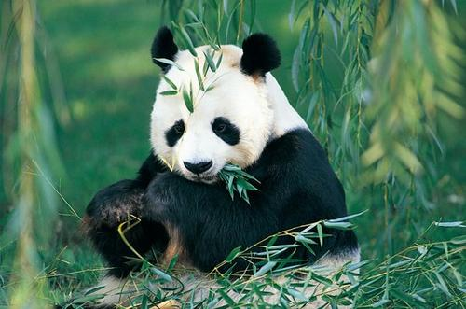
Thank you!

