Slide 1
感恩遇见，相互成就，本课件资料仅供您个人参考、教学使用，严禁自行在网络传播，违者依知识产权法追究法律责任。
更多教学资源请关注
公众号：溯恩高中英语
知识产权声明

Slide 2
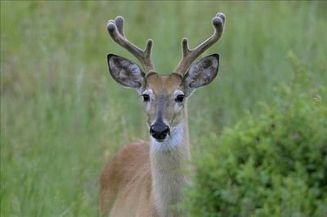
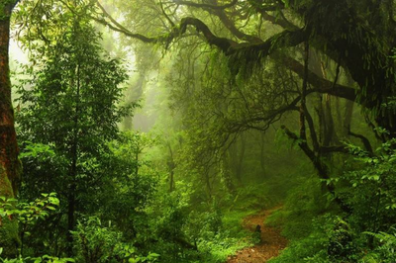
基于“捕捉和照应原文伏笔”模式的读后续写讲评
2022年4月浙江省高一9+1联盟考试
浙江省衢州第二中学 徐飞

Slide 3
试题呈现：
It was when I was 13 years old. My cousin and I would drive to a national forest to hunt for whitetail deer. We would have to return to finish much housework before 5 p.m., when my father came back from work.
On one such hunt we went down a track and split up. He went down one ridge (山脊) while I went down a nearby ridge. We were both quietly following deer rather than setting up in deer stands. Shortly after leaving one another, I came across a well-used deer track that had fresh tracks on it leading a particular direction. It was there that I had my direction of travel and headed out cross-country to track and find these deer.
After about an hour of following through the woods, I could faintly make some deer out about 100 yards in front of me in some large trees. I continued to follow and make my way to them. It was early and these deer were on their way to a bedding site and were constantly on the move. This required some great following skills on my part. I was slowly, but surely, closing the time and distance gap between them and myself. When I got within forty yards of them, I knew I was getting close enough to them that I was going to get a good shot on one. They turned around the end of a ridgeline and went out of sight due to a large rock.

Slide 4
This gave me the opportunity to close the gap quickly as I could move without alerting (使警觉) them as long as I stayed quiet. That was exactly what I did. When I came around the rock the deer were well within range and I pulled up to take a shot, but was surprised by a deer much closer that I had not seen. That deer alerted the others and took off running, which caused the other deer to do the same.
Paragraph 1：
When the deer had disappeared, I realized I had housework to do before my dad returned home. ______________________________________________________________________________
Paragraph 2：
After what felt like a lifetime of running and many falls on the ground, I fell down nearly exhausted.
______________________________________________________________________________

Slide 5
读后续写时，学生在阅读原文时没有关注作者在原文中所设置的伏笔，从而续写部分的文章容易脱离原文主线。本课件试图从捕捉原文伏笔的角度帮助学生设置续写部分的情节。从而让学生的习作能够在语言，内容，逻辑上更符合原文的基调，即与原文有更高更自然的融合度。
伏笔1：We would have to return to finish much housework before 5 p.m., when my father came back from work. 这句话中作者用了have to do这个语法结构，说明狩猎之后回家做家务是我们必须要做的事情。
因此原文始终应该围绕赶回家做家务这件事展开。作者的劳累应该也是因为着急赶路回家造成的。
照应方式：学生根据第一段首句可以设置问题：How did I feel when I realized I had housework to do before my dad returned home? 第二段中可以设置问题：Exhausted as I was, did I give up? If not, what happened then? Did I succeed in reaching home on time? If not, what was my father’s reaction?
伏笔2：On one such hunt we went down a track and split up. He went down one ridge (山脊) while I went down a nearby ridge. We were both quietly following deer rather than setting up in deer stands.
照应方式：根据第一段和第二段首句以及原文的最后一段，“我”应该是赶路回家，而我和我的堂哥分开寻鹿，因此在回家的路上“我”遇到了困难，例如迷路了。这时候可以设置问题Did I look my cousin?或者What difficulties did I meet? How did I solve the difficulties? How did I feel？

Slide 6
Language accumulation：
1.分开
2.沿着一个山脊往下
3.不久之后
4.偶尔遇见
5.通往一个特定的方向
6.隐约地看清一些鹿
7.前往......
8.射中一只
9. 在我这方
10.立刻跑走
1.split up
2.go down one ridge
3.Shortly after
4. come across
5.lead a particular direction
6.faintly make some deer out
7.make my way to
8.get a good shot on one
9.on my part
10. take off running

Slide 7
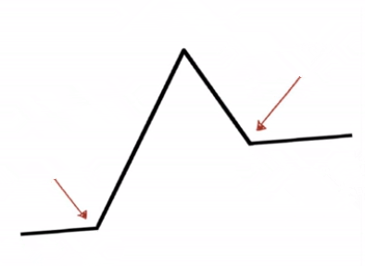
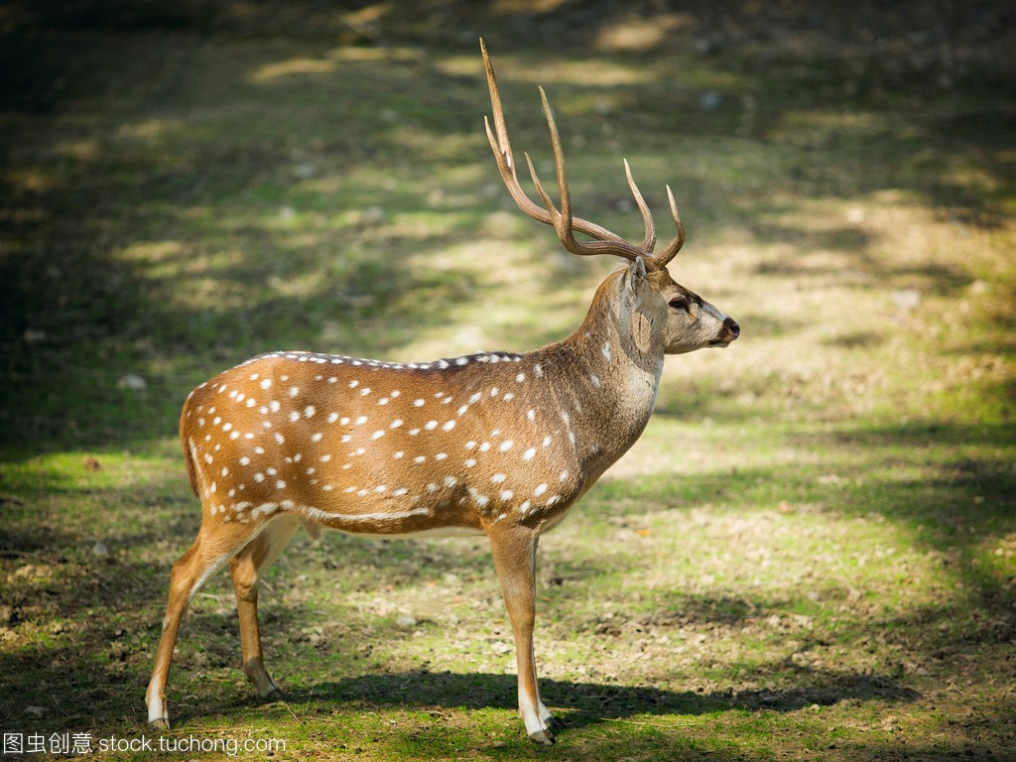
Read for the plot & emotional change
The deer alerted and ran away.
surprised
I got close to the deer and ready to get a good shot on one.
I had to go home to do housework.
excited
?
Rising action
?
I split up with my cousin and headed out farther to find these deer.
Ending
hopeful
I fell down nearly exhausted.
development
expectant
beginning/setting
My cousin and I drove to hunt for dear and we had to return to finish housework.

Slide 8
Design the plot
Paragraph 1: When the deer had disappeared, I realized I had housework to do before my dad returned home. _______
Q1:How did I feel when I realized I had housework to do before my dad returned home?
Q2: Did I look for my cousin?
Q3: What difficulties did I meet? How did I feel?

Slide 9
Design the plot
Paragraph 2: After what felt like a lifetime of running and many falls on the ground, I fell down nearly exhausted _______.
Q1:When I was exhausted, did I give up? What happened then?
Q2: How did I succeed in reaching home?
Q3: What was my father’s reaction if I didn’t reach home on time?

Slide 10
Design the plot
Paragraph 1: When the deer had disappeared, I realized I had housework to do. before my dad returned home. _______
Q1:How did I feel when I realized I had housework to do before my dad returned home?
Aware of the mission, I made up my mind to return and get the work done in case of my father’s punishment.
I turned around to look for the path I came along. But it looked totally unfamiliar to me as leaves had covered the tracks, leaving me at a loss in the woods.
“What if I can’t finish the housework?” I murmured, a surge of anxiety sweeping through my body.
So anxious and fearful was I that I hurriedly shouted for help, hoping my shouts could be heard by my cousin, but in vain.
Stomach knotting, mind in a turmoil, I felt my mounting fear stretching my nerves to the breaking point of outburst.

Slide 11
Design the plot
Paragraph 1: When the deer had disappeared, I realized I had housework to do. before my dad returned home. _______
Q1:How did I feel when I realized I had housework to do before my dad returned home?
Turning around, I realized that I got lost! Surrounded by big trees, I could’t make out the direction.
Seized by a flood of despair, I was at a loss how to cope with the situation.
Looking around the woods, I surprisedly realized the fact that I was lost. A surge of nervousness rose inside my heart. I made every attempt to recall the way but fruitless.
Disappointed, I glanced around to find a way back. After a long time of attempt, I was rooted to the spot, wondering where I was.

Slide 12
Design the plot
Paragraph 1: When the deer had disappeared, I realized I had housework to do before my dad returned home. _______
Q2: Did I look for my cousin?
After a moment’s reflection, I decided to find my cousin who had split up with me.I shouted with all my strength, but in vain. All I could get was my loud scream echoing in the valleys.
As it was getting darker, I had no way but to cry on the top of lung, hoping my scream could be heard by my cousin. However, nobdoy came into sight.
I was at a loss, not knowing what exactly to do. Suddenly, it occurred to me that if I could find my cousin, I would be safe.

Slide 13
Design the plot
Paragraph 1: When the deer had disappeared, I realized I had housework to do before my dad returned home. _______
Q3: What difficulties did I meet? How did I feel?
Consumed with panic, I made every effort to calm down. Then it suddenly struck me that I could follow the tracks the deer had left. However, it was not an easy job.Everywhere I looked around, nothing could give me any clue to where I was. All the trees and ridges were the same. Silence ruled the forest, broken by scattered noises of deer. I became increasingly frightened. I began to run without knowing the exact direction leading to my home.
I suddenly felt as if I had been in another brand-new world surrounded by scenery alien to me. “Where is it?” “How should I get out of here?” A stream of puzzles buzzed around in my mind, making me dizzy.

Slide 14
Design the plot
Paragraph 1: When the deer had disappeared, I realized I had housework to do before my dad returned home. _______
Q3: What difficulties did I meet? How did I feel?
But soon I found that my troubles had only begun; I could not find my way; I was lost! I could not tell exactly where I was, but wandered about here and there, crying and calling, expecting my cousin could hear me. However, no sound came to ears but the melancholy moaning of the wind as it swept through the thick branches of the forest.
I had no clue about my surroundings as I had never been there before. I cried for my cousin loudly, but all was in vain; there was no reply, and the whole place was silent. An upsurge of paralyzing fear washed over me: I was lost.
I walked around the forest, trying to find a way back to my car. It felt like I has been walking forever, my legs felt like jelly and I had no energy left. I was exhausted.

Slide 15
Design the plot
Paragraph 1: When the deer had disappeared, I realized I had housework to do before my dad returned home. _______
Q3: What difficulties did I meet? How did I feel?
I kept running for the way back, shouting for my cousin at the top of my lungs, but no response. My throat ached and my eyes stung with sweat. Each breath was like inhaling fire, and my lips were salty with tears trickling down my face.
But my stomach was fluttering with fear. I couldn’t help thinking of the ferocious animals in the wild, tigers, lions and serpents.
My fingers were curled into a fist, nails digging into my palm. I can’t hear my rapid breathing, but I can feel the oxygen flooding in and out of my lungs. Fear tortured my guts, churning my stomach in tense cramps.

Slide 16
Design the plot
Paragraph 2: After what felt like a lifetime of running and many falls on the ground, I fell down nearly exhausted _______.
Q1:When I was exhausted, did I give up? What happened then?
“Oops!” I fell down over my belly, fully stained with mud, only to find a round rock lurking to trip me over. Without a second thought, I rose to my feet, dusted some ash from my jeans, and sped up forward along the possible “homeward” track.
“Ouch!” I toppled over and hit my knees, leaving a mass of bruises on them. Trying to hold back tears welling up in eyes, I struggled to my feet and stumbling around in the darkening woods.
It was starting to get dark. I decided to climb to the top of the nearest hill. Here I could better saw what was around me. I was nearly up to the top of the nearest hill when I stumbled across a well-developed logging road.

Slide 17
Design the plot
Paragraph 2: After what felt like a lifetime of running and many falls on the ground, I fell down nearly exhausted _______.
Q1:When I was exhausted, did I give up? What happened then?
I gasped for air and collapsed onto a big stone. “Will I die?” Some horrible thoughts then secretly crowded into my mind. I was about to give up when a familiar voice and comforting voice came into my ears. Looking up instantly, I found it was my cousin telling me he had been looking for me since we went our separate way. Despite my efforts to blink back tears, I rushed to his warm hug.
“I will never make it out of the woods,” the helpless thought rippled through my heart. Staggering to my feet, I spotted a track, fresh and clean, out of other tracks covered by leaves. I gazed into the distance, stepping forward regardless of danger or hope ahead.

Slide 18
Design the plot
Paragraph 2: After what felt like a lifetime of running and many falls on the ground, I fell down nearly exhausted _______.
Q2: How did I succeed in reaching home?
He told me he had left some marks along the road in case some emergency happeded. Hearing this, I breathed a sigh of relief. With the assitance of my cousin’s clever way, we two both reached home safe and sound.
By chance, I picked the right direction to travel and made my way to the main road. I then hiked my way to where my cousin was with the vehicle. I was glad thay though I was panicked at the beginning, I made a right direction.
Suddenly, the ridge! The familiar ridge extending down the moutain was glistening dyed by the orange sun. Nearly there! Ecstasy overwhelmed me as I noticed my cousin searching for me wiith binoculars in his hands. With tears of joy and relief in our eyes, we jumped into the car headed for home.

Slide 19
Design the plot
Paragraph 2: After what felt like a lifetime of running and many falls on the ground, I fell down nearly exhausted _______.
Q3: What was my father’s reaction if I didn’t reach home on time?
My father had already finished the housework and inviting scent of dished were floating throughout the house. We explained our adventure to him prepared for his punishment. To our astonishment, my father laughed, saying every moment was meant for us. Relieved, we all laughed. What an unforgettable memory.
Letting out a sigh in relief, I embraced him tightly, tears blurring my eyes.Dad patted me on the shoulder and comforted me in a loving way.

Slide 20
参考范文：
When the deer had disappeared, I realized I had housework to do before my dad returned home. I then turned around and headed back to the ridge. The same ridge that I had come down and started the following. When I got there I realized it wasn’t the ridge I thought it was. I was lost! I kept telling myself if I just went to that ridge over there I could find myself. So I did exactly that and kept finding myself, farther and deeper in the woods. It was already past noon. I started to panic knowing that I was not going to get home in time to get my work done and would therefore upset my dad. That was not a good position to be in. This caused me to start running through the woods.
After what felt like a lifetime of running and many falls on the ground, I fell down nearly exhausted. It was starting to get dark. I decided to climb to the top of the nearest hill. Here I better saw what was around me. I was nearly up to the top of the hill when I stumbled across a well-developed logging road. By chance, I picked the right direction to travel and made my way to the main road. I then hiked my way to where my cousin was with the vehicle. I was glad that though I panicked at the beginning, I made a right decision. In the wild, it could mean life or death.
点评：
内容上：
本文围绕“回家做家务”这一主题展开，与原文在内容上有合理的衔接和连贯。
语言上：整体的语言风格比较简洁，符合作者当时忐忑不安的心情。语言灵活丰富，用词地道，读来有种身临其境的感觉。本文还合理运用了代词：it, this, that等。总之本文真正做到了用学生熟悉的词汇进行遣词造句。语言上的用词和原文有很高的融合度。
但是本文用了大量的I did sth的句式，读来稍显枯燥。可以适当地运用一些无灵主语句。

Slide 21
高分作文：
When the deer had disappeared, I realized I had housework to do before my dad returned home. I turned around to look for the path I came along. But it looked totally unfamiliar to me as leaves had covered the tracks, leaving me at a loss in the woods. As time ticked by, rosy sunshine shone through the woods, leaving long shadows on the ground. “Why did I split up with my cousin?” I moaned in regret. Then I sprinted for a direction, while screaming at the top of my lungs, hoping to find my cousin. But no reply came. Unfortunately I stumbled over the roots of trees stretching into the ground, and fell down. I struggled to my feet and kept running, not even minding the cuts and bruises on my face and arms and blood oozing out of my skin.
After what felt like a lifetime of running and many falls on the ground, I fell down nearly exhausted. “I’ll never make it out of the woods,” the helpless thought rippled through my heart.
Staggering to my feet, I spotted a track, fresh and clean, out of other tracks covered by rotten leaves. I gazed into the distance, stepping forward regardless of danger or hope ahead. Suddenly, the ridge! The familiar ridge extending down the mountain was glistening dyed by the orange sun. Nearly there! Ecstasy overwhelmed me as I noticed my cousin searching for me with binoculars in his hands. “Hey, I am here!” Waving wildly my hands, I instantly dashed to him and gave him a bear hug. With tears of joy and relief in our eyes, we jumped into the car and headed for home. On the road, We were enveloped by the sunset showering down, the woods far behind us.

Slide 22
下水作文：
When the deer disappeared, I realized I had housework to do before my dad returned home. “What if I can’t finish the housework?” I murmured to myself, a surge of anxiety sweeping through my body. After a moment’s reflection, I decided to find my cousin who had slip up with me. I shouted with all my strength, but it was in vain. All I could get was my loud scream echoing in the valleys. “Perhaps he has left here.” I thought to myself. Consumed with panic, I made every effort to effort to calm down. Then it suddenly struck me that I could follow the tracks the deer had left. However, it was not an easy job. Everywhere I looked around, nothing could give me any clue to where I was. All the trees and ridges were the same. Silence ruled the forest, broken by scattered noises of deer. I became increasingly frightened. I began to run without knowing the exact direction leading to my home.

Slide 23
下水作文：
After what felt like a lifetime of running and many falls on the ground, I fell down nearly exhausted. I gasped for fresh air and collapsed onto a big stone.“Will I die?” Some horrible thoughts then secretly crowded into my mind. I was about to give up when a familar voice and comforting voice came into my ears. Looking up instantly, I found it was my cousin telling me he had been looking for me since we went our separate way. Despite my efforts to blink back tears, I rushed to his warm hug. He told me he had left some marks along the road. Hearing this, I breathed a sigh of relief. With the assistance of my cousin’s clever way, we two both reached home safe and sound, but it was late. My father had already finished the housework and inviting scent of dished were floating throughout the house. We explained our adventure to him prepared for his punishment. To our astonishment, my father laughed, saying every moment was meant for us. Relieved, we all laughed. What an unforgettable memory.

