Slide 1
独立主格 Absolute Construction

Slide 2
Ⅰ. Learning Objectives
At the end of the lesson, we are expected to
1. know the form and function of absolute construction;
2. rewrite sentences with absolute construction;
3. complete sentences with absolute construction;
4. describe photos with absolute construction.

Slide 3
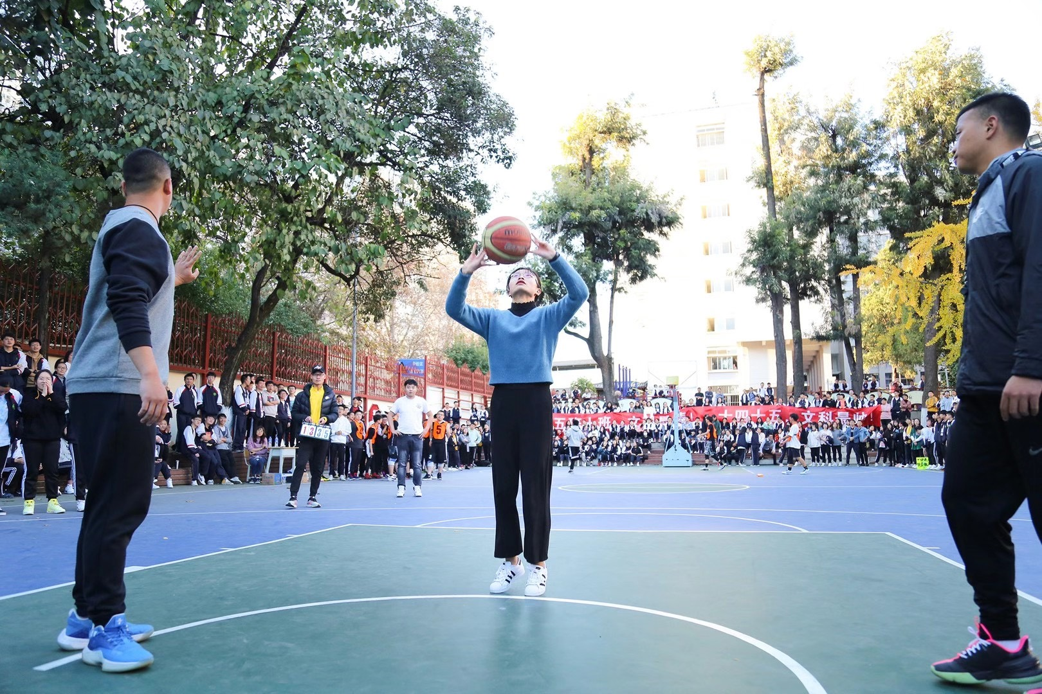
Ⅱ. Presentation
Activity 1 Rewrite sentences.
I looked up at the basket and I aimed the basketball at it.
Looking up at the basket, I aimed the basketball at it.

Slide 4
Ⅱ. Presentation
Activity 1 Rewrite sentences.
I aimed the basketball at the basket and the students stared at me.
I aimed the basketball at the basket, the students staring at me.

Slide 5
Ⅱ. Presentation
I aimed the basketball at the basket, the students staring at me.
Looking up at the basket, I aimed the basketball at it.
Looking up at the basket, I aimed the basketball at it.
The students staring at me, I aimed the basketball at the basket.
Activity 2 Compare and summarize.
逻辑主语
非谓语
主语
谓语
独立主格

Slide 6
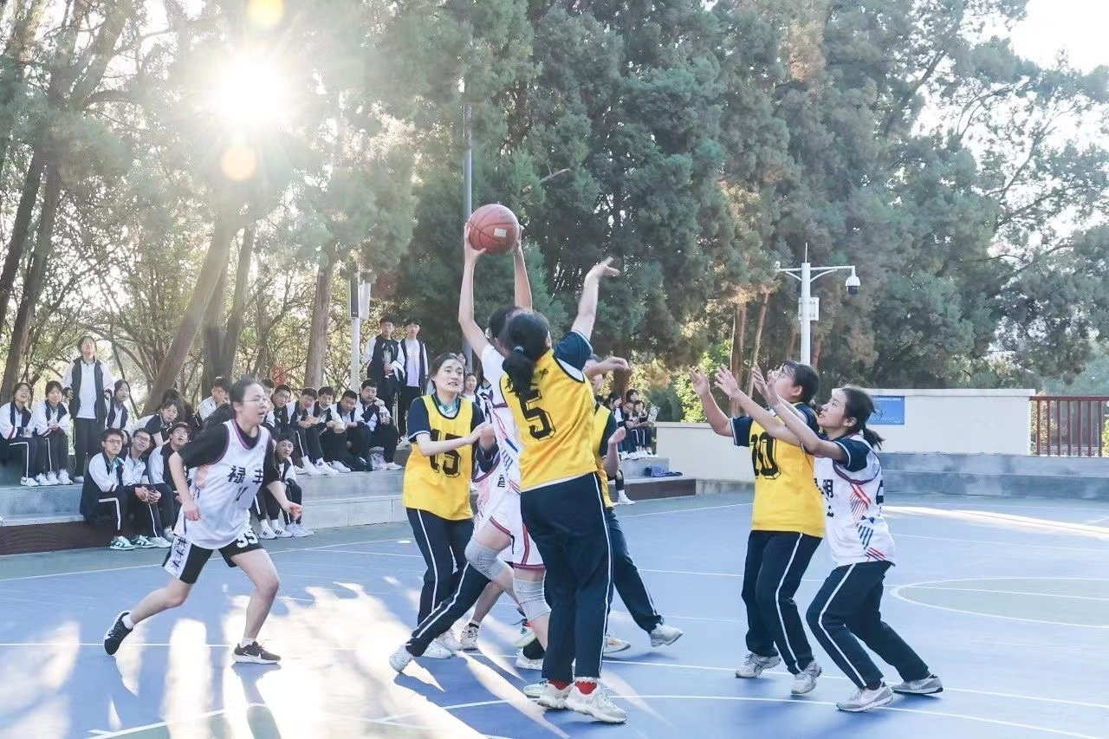
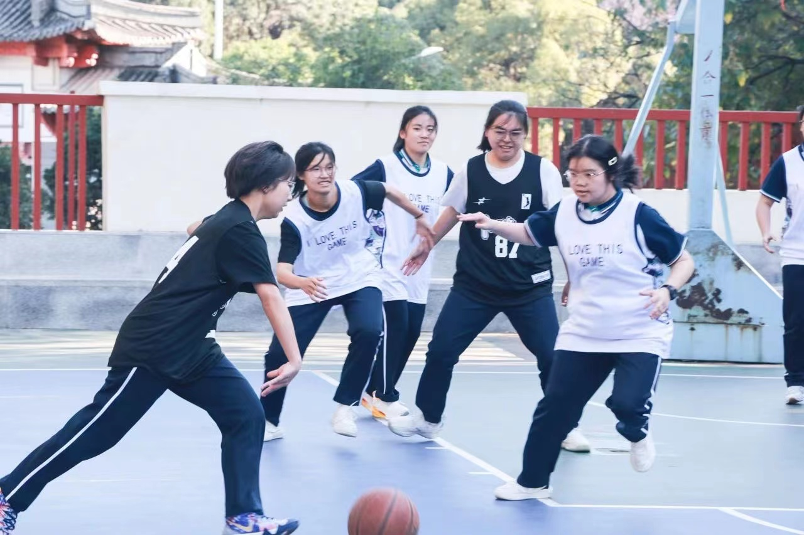
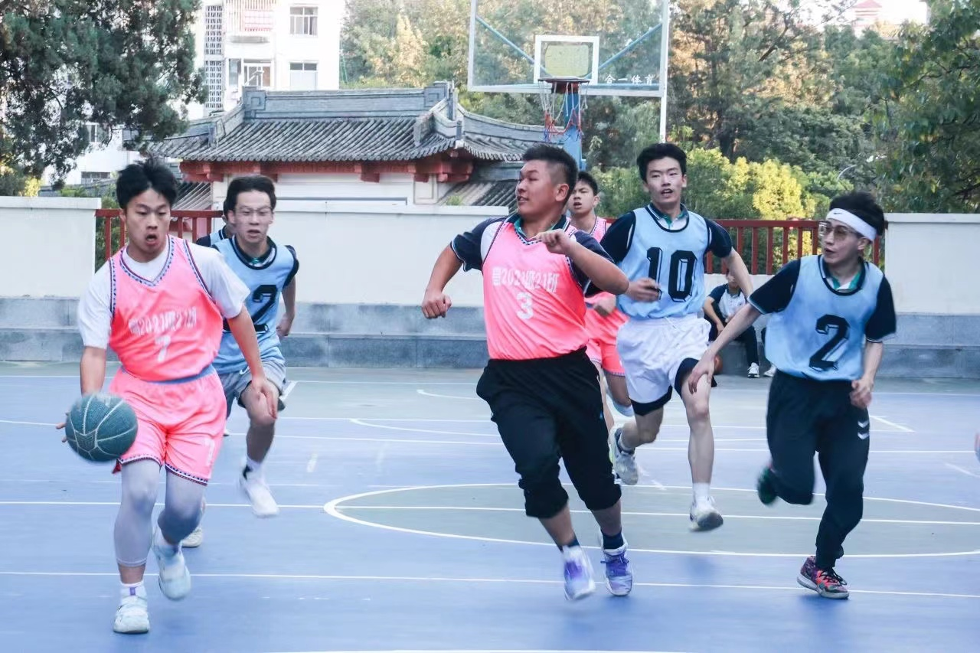
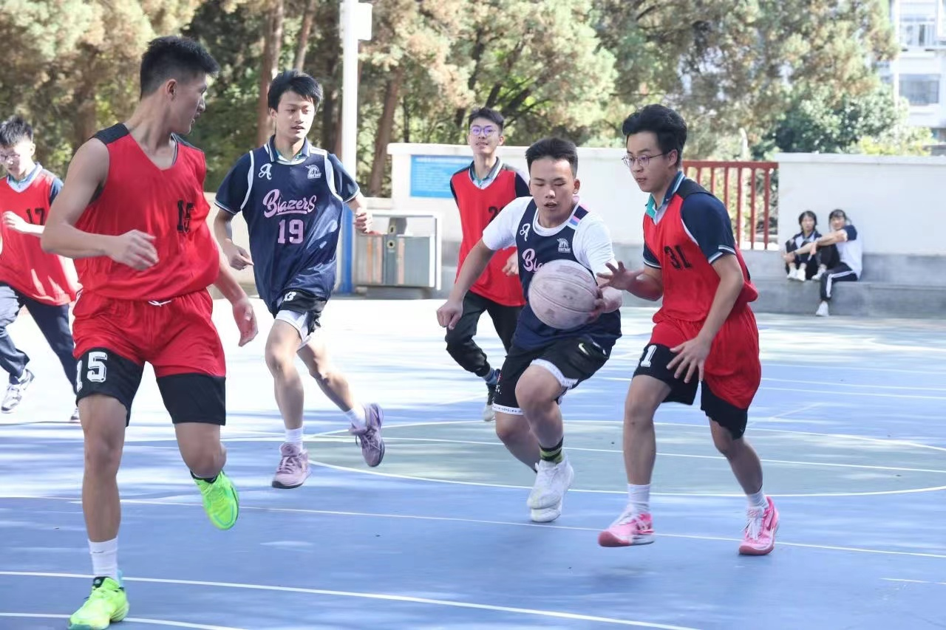
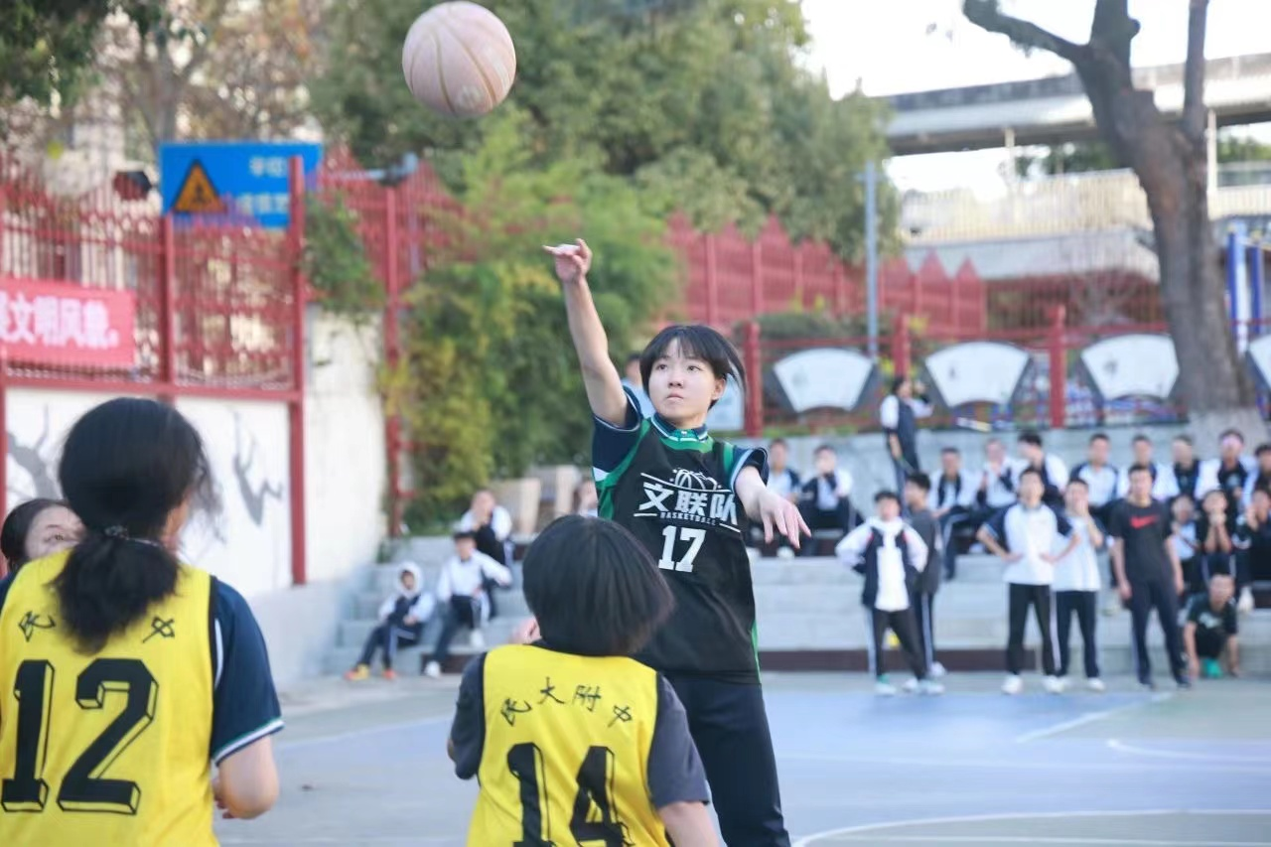
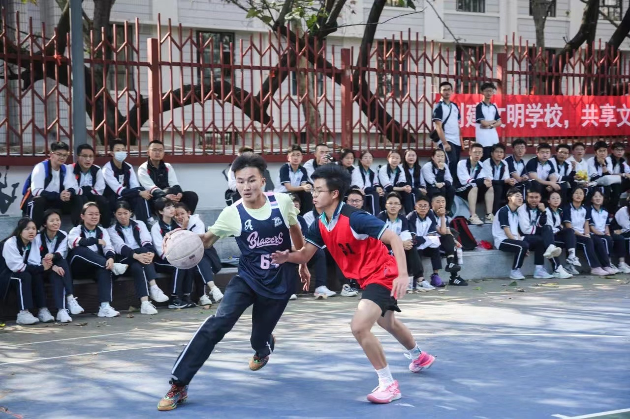
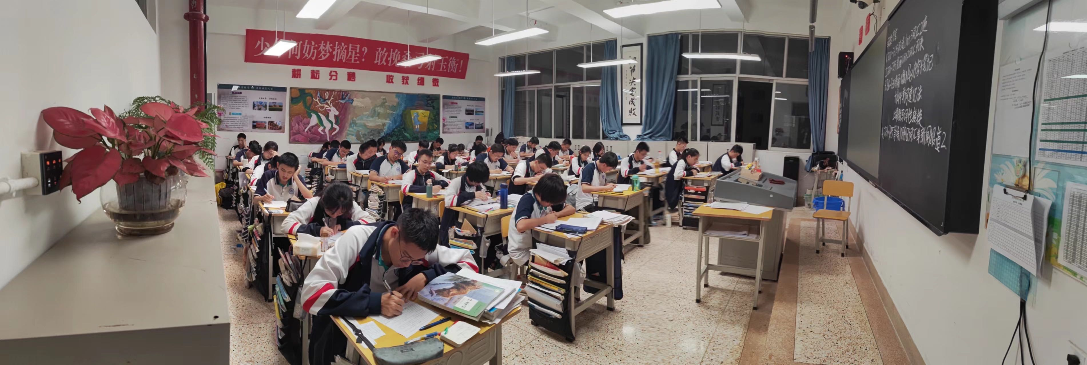
Ⅱ. Presentation
Activity 3 Observe and summarize the form and function of absolute construction.
The players ran on the court, beads of sweat on their faces.
The girl made the basket, the opponents wide-eyed.
The basketball game over, we settled down to studying.
独立主格 = 名词 / 代词 + 非谓语 / 副词 / 形容词 / 介词短语
名词+介词短语
名词+形容词
名词+副词
What function does it have?
Act as an adverbial(状语).

Slide 7
Ⅲ. Practice
Activity 1 Judge whether the sentences use absolute construction.
1. One boy was having a rest, one of his legs injured.
2. A basketball in his hands, the player was racing towards the basket.
3. The headteacher gathered them all around, providing strategies for them.
4. The students were seated around the ground, their eyes fixed on the players.
5. The game was going on fiercely, some reporters taking photos of the memorable scenes.
6. A grand basketball game was being held, the sun casting sparkling light everywhere.
7. The moment the headteacher announced there would be a basketball game, the students leaped to their feet with wild joy.
8. The player shot the basket and scored three points. A storm of thunderous applause burst on the playground.
名词+形容词
名词+介词短语
名词+非谓语
名词+非谓语
名词+非谓语

Slide 8
Ⅲ. Practice
Activity 2 Rewrite the sentences under the guidance of the teacher.
7. The moment the headteacher announced there would be a basketball game, the students leaped to their feet with wild joy.
The headteacher announced there would be a basketball game, the students leaping to their feet with wild joy.
8. The player shot the basket and scored three points. A storm of thunderous applause burst on the playground.
The player shot the basket and scored three points, a storm of thunderous applause bursting on the playground.

Slide 9
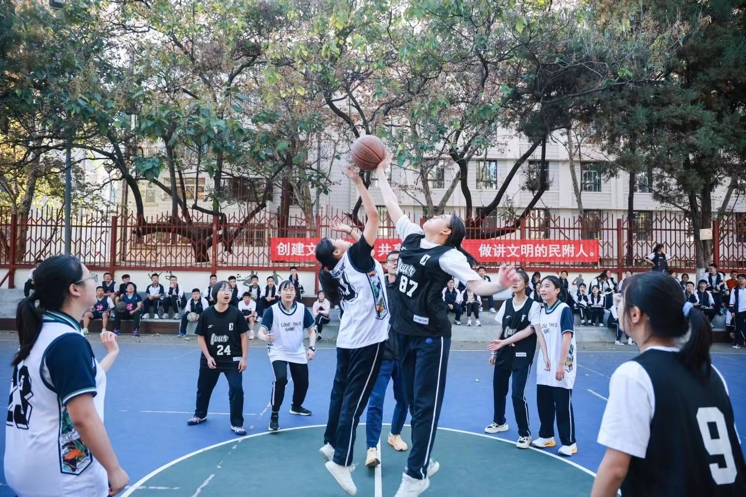
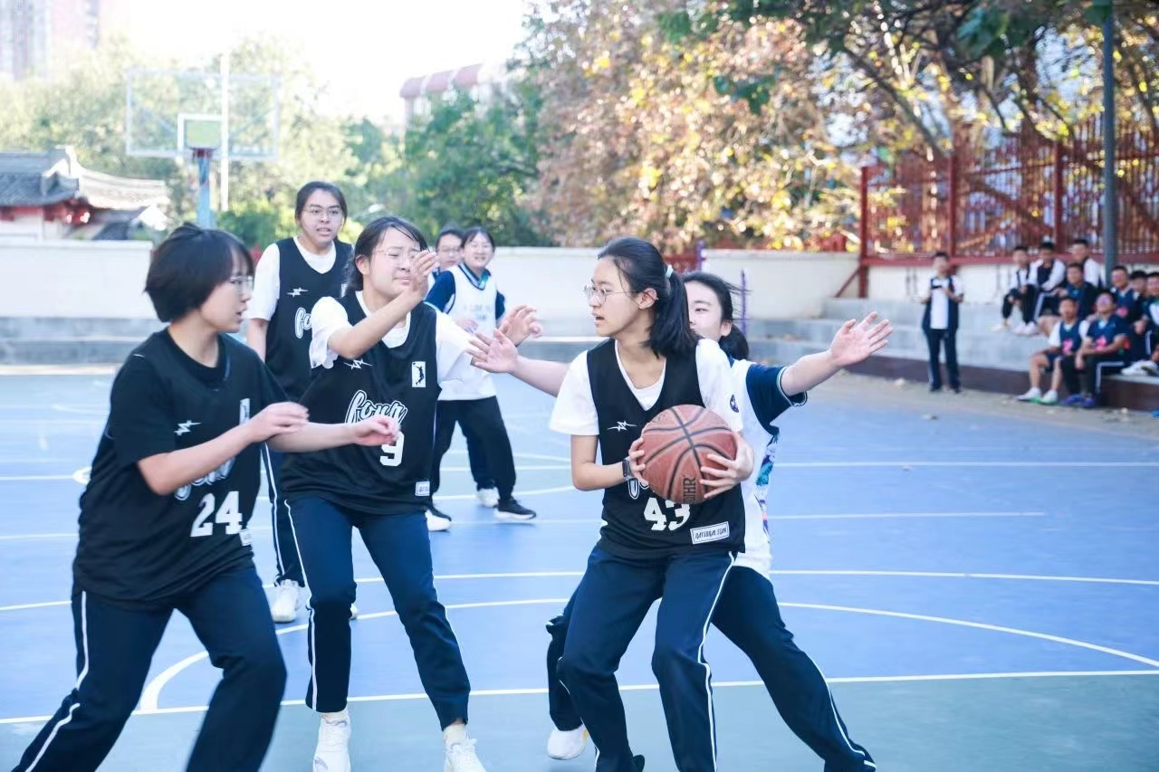
Ⅲ. Practice
Activity 3 Rewrite the sentences in groups.
1. All the players were worn-out. Their faces turned pale.
2. She stood on the ground and a frightened expression was on her face.
3. While the two girls were trying for the ball, their teammates gaped at them.
4. The girl was surrounded by the opponent. Her teammate tried to catch the ball.
5. All the students cheered for the player. He gathered all the strength to dribble the ball.
6. After the final round of the game was over, the champion team was awarded a medal.
7. The class won the first place, so the headteacher praised them for their team spirit.
8. If time permits, we shall have another basketball game next year.

Slide 10
Ⅲ. Practice
Activity 3 Rewrite the sentences in pairs.
1. All the players were worn-out. Their faces turned pale.
→ All the players were worn-out, their faces (turning) pale.
→ All the players (being) worn-out, their faced turned pale.
2. She stood on the ground and a frightened expression was on her face.
→ She stood on the ground, a frightened expression (being) on her face.
3. While the two girls were trying for the ball, their teammates gaped at them.
→ The two girls were trying for the ball, their teammates gaping at them.
4. The girl was surrounded by the opponent. Her teammate tried to catch the ball.
→ The girl was surrounded by the opponent, her teammate trying to catch the ball.
→ The girl surrounded by the opponent, her teammate tried to catch the ball.

Slide 11
Ⅲ. Practice
Activity 3 Rewrite the sentences in pairs.
5. All the students cheered for the player. He gathered all the strength to dribble the ball.
→ All the students cheering for the player, he gathered all the strength to dribble the ball.
→ All the students cheered for the player, he gathering all the strength to dribble the ball.
6. After the final round of the game was over, the champion team was awarded a medal.
→ The final round of the game (being) over, the champion team was awarded a medal.
7. The class won the first place, so the headteacher praised them for their team spirit.
→ The class winning the first place, the headteacher praised them for their team spirit.
8. If time permits, we shall have another basketball game next year.
→ Time permitting, we shall have another basketball game next year.

Slide 12
Ⅲ. Practice
Activity 4 Complete the sentences with absolute construction.
1.【2023年宁波联考续写】I woke up, _______________________________________(我周围的地板上有个坏掉的梯子).
2.【2023年温州二模续写】___________________________(疲劳席卷了我的身体), I felt my lungs were bursting.
3.【2023新高考I卷续写】_________________________________________(雷鸣般的掌声在礼堂回荡), I could hardly wait to share the honor with my teacher, who assisted me in discovering my potential and passion.
4.【2023新高考I卷续写】I went to my teacher’ office after the award presentation. As I entered, he looked up from his desk, __________________________________(脸上洋溢着灿烂的笑容), and said, “Congratulations! Your diligence and perseverance paid off.”
a broken ladder lying around me on the floor
Fatigue sweeping over my body
Thunderous applause echoing in the auditorium
a bright smile spreading across his face

Slide 13
Ⅲ. Practice
Activity 4 Complete the sentences with absolute construction.
5.【2022年1月浙江省高考续写】When I opened the door, he was staring at me peacefully. ___________________(恢复了镇定), I slightly approached him and sat by the bed.
6.【2018年6月浙江省高考续写】________________________________________________
________(我的心疯狂地跳动，我的血液在我的血管里涌动), I pulled back the reins(缰绳), distracted the horse and tried every means to stop the horse but in vain.
7.【2017年11月浙江省高考续写】Thinking of the tent, Mom suggested that we go camping in the next village, __________________________(她的眼里闪着兴奋得光芒).
8.【2016年10月浙江省高考续写】She thought of Tom, ____________________(回忆涌起) as she closed her eyes and recalled the kindness of him.
Composure regained
My heart pumping wildly and my blood pulsing through
my veins
eyes glittering with excitement
memories flooding out

Slide 14
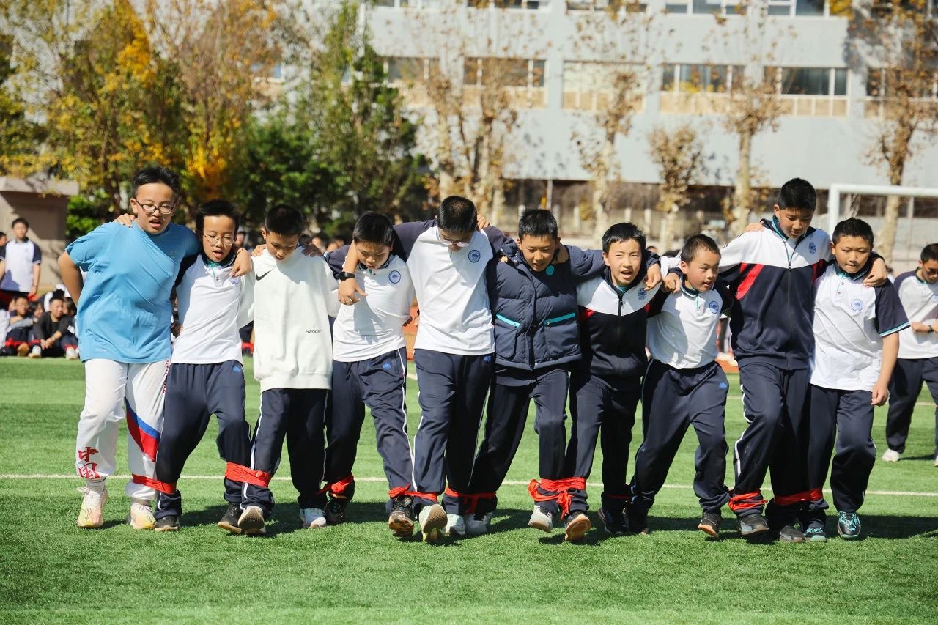
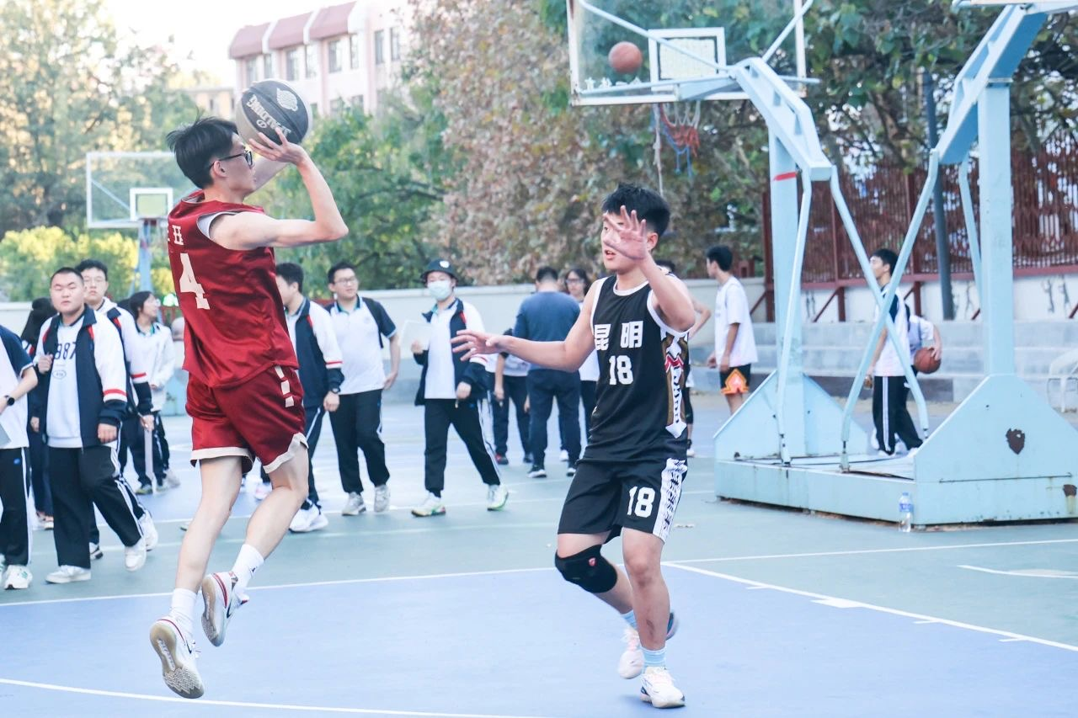
Ⅳ. Production
Describe one of the photos using at least one absolute construction. (No less than 30 words.)

Slide 15
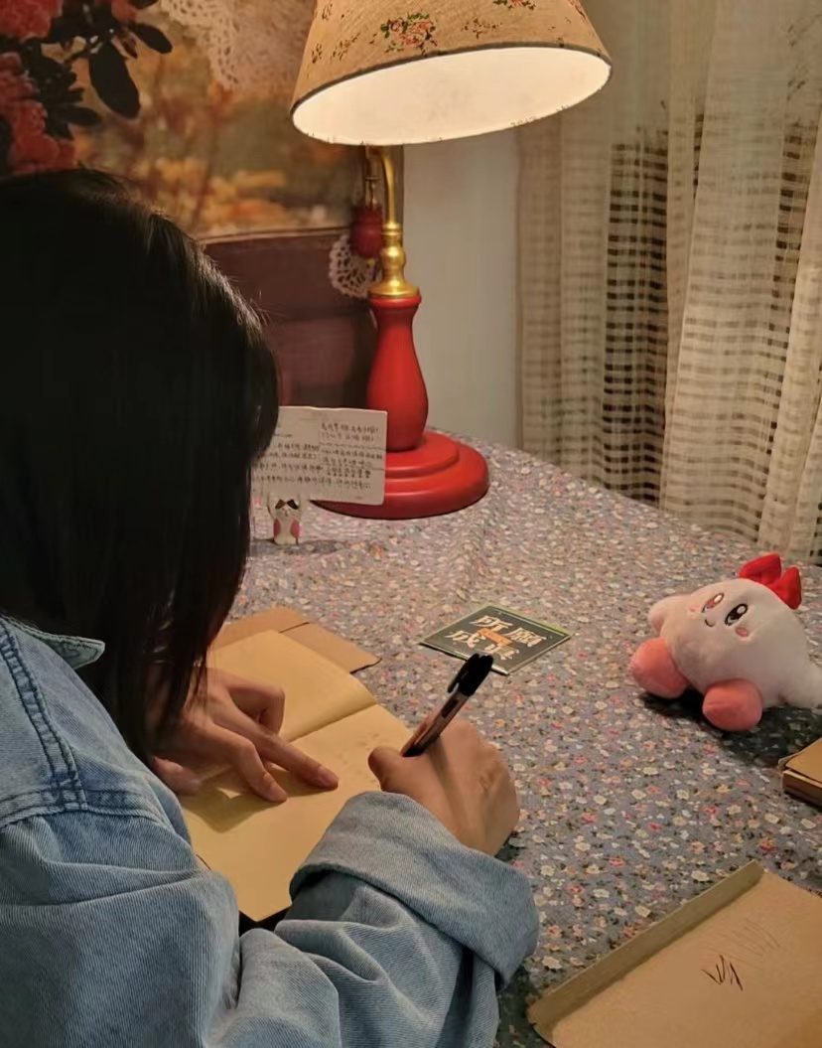
Sample
Describe the photo using at least one absolute construction.
She sat down at the desk with a pen and paper, the soft light of a lamp casting a warm glow over the room. She carefully crafted each word, her thoughts and emotions flowing onto the page. She sealed the envelope with a sense of satisfaction and hope, knowing that her message would soon reach its intended recipient.

Slide 16
Ⅳ. Production
Describe one of the photos using at least one absolute construction. (No less than 30 words.)
Use the following questions to evaluate the creation.
1. Is there at least one absolute construction? 2. Does the description make sense?
3. Is there any spelling or grammar mistake? 4. Is the handwriting clear?

Slide 17
Their feet tied tight and hands on their shoulders, the players were doing their best to drag themselves to the finish line, shouting slogans aloud together to help maintain balance. In the meantime, a crowd of audience, cheering the players on, were sitting on the grassland, their eyes fixed on the dedicated players.
The sun shining brightly and casting a warm glow over the students, the basketball game was being held on the playground. In front of the basket was a player who was trying to shoot the basket, feet off the ground. His opponent was sparing no effort to defend him, hands waving in the air. The boys passing by were attracted by the fierce scene, their eyes fixed on the two handsome players.

Slide 18
Ⅴ. Self-Assessment
Have you achieved the following objectives?
1. Know the form and function of absolute construction;
2. Rewrite sentences with absolute construction;
3. Complete sentences with absolute construction;
4. Describe photos with absolute construction.

Slide 19
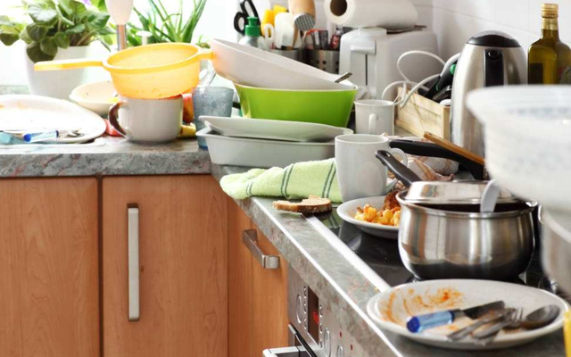
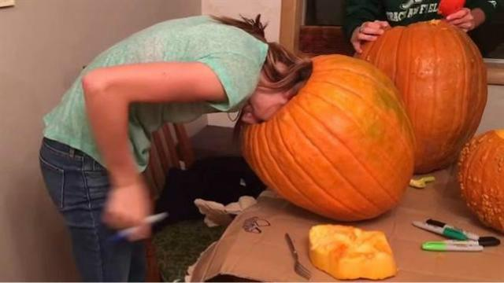
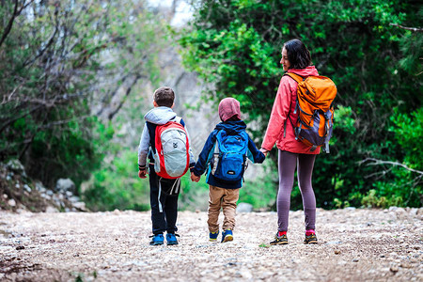
Ⅵ. After-Class Assignment
Describe one of the scenes with absolute construction. (场景改编自高考真题)
You prepare a gift for your mother on Mother’s Day and make a mess in the kitchen. Then, your father comes in.
Your head is stuck in the pumpkin at Halloween and it’s quite hard to get out.
You go to travel with your mother and cannot find a hotel. Your mother suggests putting up a tent.
Imagine what would happen to you in the scenes. Choose one to describe.
Use at least 80 words.
Use at least 3 sentences with absolute construction.
Describe actions, feelings, conversations, or settings.

