Slide 1
感恩遇见，相互成就，本课件资料仅供您个人参考、教学使用，严禁自行在网络传播，违者依知识产权法追究法律责任。
更多教学资源请关注
公众号：溯恩高中英语
知识产权声明

Slide 2
人教版 选择性必修三
Unit 2 Healthy Lifestyle
Period 5 using language 2
write a letter to the editor about your lifestyle

Slide 3
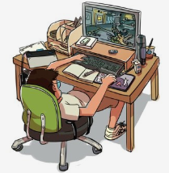
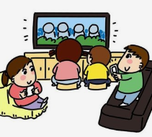
Lead in
What problems do you think you have about your lifestyle?
Aspects
？
Suppose you intend to write a letter to the editor about your lifestyle，what contents should be included and in what way？
logic

Slide 4
Thinking
What should be the contents and logic of your letter?
1. What was the problem?
Problem
2. How did you decide to change that bad habit?
Decision
3. What did you do to change that?
Action
4. What is the result?
Result

Slide 5
Two letters from students to the editor, who attended the summer camp organized by the magazine Healthy Life
Reading for writing
Activity 1:Reading for the main idea
What are the main ideas of the two letters?
The two letters mainly talk about _________________ of the two students.
the healthy lifestyles

Slide 6
Activity 2:Reading for the structure
Read and analyze the organization of the letter and label the paragraphs using the letters below.
A: considering what to do
B: the results
C: identifying problems.
D: what he/she has done to change

Slide 7
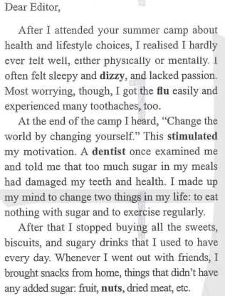
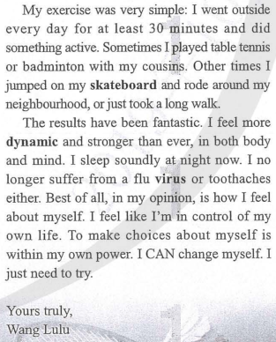
Analyse the organisation of the letters. Label the paragraphs using the letters below. Some paragraphs may cover more than one topic.
A identifying problem(s) B considering what to do
C what he/she has done to change D the results
C
D
A
B

Slide 8
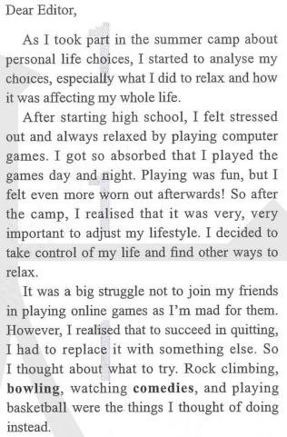
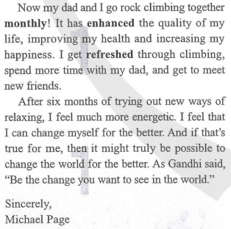
A identifying problem(s) B considering what to do
C what he/she has done to change D the results
C
D
B
A

Slide 9
Summary

Slide 10
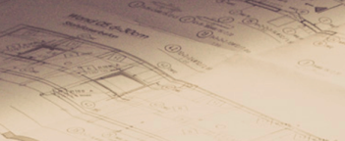
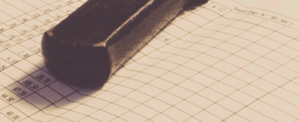
Reading
Activity 3:Reading for the details
Student 1
Wang Lu
did not feel well physically or mentally
felt sleepy and dizzy and lacked passion
got the flu easily and experienced many toothaches
Problem
Decision
to eat nothing with sugar
to exercise regularly
Action
stopped buying all the sweets, biscuits and sugary drinks
exercises every day for at least 30 minutes
Result
more dynamic and stronger in body and mind
sleeps soundly at night
no longer suffers from a flu virus or toothaches
feels like she is in control of her life

Slide 11
Activity 3:Reading for the details
Reading
Student 2
George Fielding
felt stressed out after starting high school
felt even more worn out after playing computer games
Problem
Decision
to take control of his life and find other ways to relax
Action
goes rock climbing with his father every month
Result
feels much more energetic
feels he can change himself for the better

Slide 12
Filling in the blanks and feel the tenses in the passage
Wang Lu and George Fielding attended the summer camp 1 ____________（organize） by the magazine Healthy Life. At the end of the camp，what Wang Lu heard stimulated her 2____________（motivate）. She made up her mind 3_________ （eat） nothing with sugar and to exercise regularly. Now she sleeps soundly at night and feels 4__________________（dynamic） than ever.
In the meanwhile，George Fielding has changed himself 5_________the better. He used to get so absorbed 6_________he played the games day and night. However，after the camp，he 7_________（take） control of his life though it was 8_________ big struggle not to play online games. Now he and his dad go rock climbing together 9 _________（month）. It has enhanced the quality of his life，10___________ （improve） his health and increasing his happiness.
organized
motivation
to eat
more dynamic
for
that
took
a
monthly
improving

Slide 13
Activity 4:Reading for tenses
Reading
What is the result?
Present tense
What did the author do to change that?
(action)
Past tense
How did the author decide to change that?
Past tense
What was the problem?
Past tense

Slide 14
Writing
Writing task
The magazine Healthy Life is organising this year's summer camp. They invite interested teenagers to write to the editor about how they plan to change their bad habits. The campers will be chosen accordingly.
Past tense+Present tense+ future tense

Slide 15
Activity 5:Writing
1. Brainstorm with your partner.
What lifestyle habit you would like to change
Why you want to change
How you can change
What result you hope to see
2. Draft your letter to the editor. Use the organisation of the letters above to help you.

Slide 16
Exchange drafts with a partner. Use this checklist to give feedback on your partner’s draft.
 Does the letter say what the writer’s problem is?
 Does the letter explain the decisions the writer made to solve the problem?
 Does the letter show the ways to change?
 Are the results included in the letter?
 Can you see the writer’s attitude and determination in the letter?
 Is the letter clear and complete?
Get your draft back and revise it. Then share your letter with the rest of the class.

Slide 17
Sample writing:
Dear editor,
I was walking past a shop window the other day when I saw my reflection. At first, I didn’t realise it was me. When I saw it was me, I felt sad as I am overweight. I didn’t realise how I looked, and I really want to change. I really like eating, but I realise I eat too much, and I don’t eat good things.
I want to change because I want to be able to look at myself and feel happy with how I look. I also want to be healthy.
My plan is to change my diet and exercise routine. I will stop eating sugar, and only eat at mealtimes rather than eating snacks during the day. I will focus on healthy foods. Then I will exercise every day. I will walk to school and back, and on the weekend, I will go swimming. I have only been doing my plan for a week, but I’m already starting to feel better. I haven’t lost a lot of weight yet, but to do anything makes me feel positive. I feel confident I will reach my goal!
Yours sincerely,
A . Smith

Slide 18
假如你是某校高一学生李华，请根据以下要点写一篇英文短文投稿。
1.一年前，吃垃圾食品，很少锻炼，上楼困难；
2.做出改变：平衡膳食，加强锻炼。3. 改变后结果。
Homework
One year ago, I got into a habit of eating a lot of junk food and snacks. Besides, I spent a lot of time on sofa, watching TV, and did little exercise. As a result, I put on so much weight that I found it difficult to climb the stairs.
So I decided to change the unhealthy lifestyle. Not only did I begin to have a balanced diet, but I also took an active part in various sports activities such as swimming, skating, running and playing basketball. Months later, I became as fit as before. I will keep on exercising and have a healthy lifestyle.
A healthy diet and regular exercise may help to prevent obesity among children. Take action now and start to change your lifestyle and yourself.

