Slide 1
感恩遇见，相互成就，本课件资料仅供您个人参考、教学使用，严禁自行在网络传播，违者依知识产权法追究法律责任。
更多教学资源请关注
公众号：溯恩高中英语
知识产权声明

Slide 2
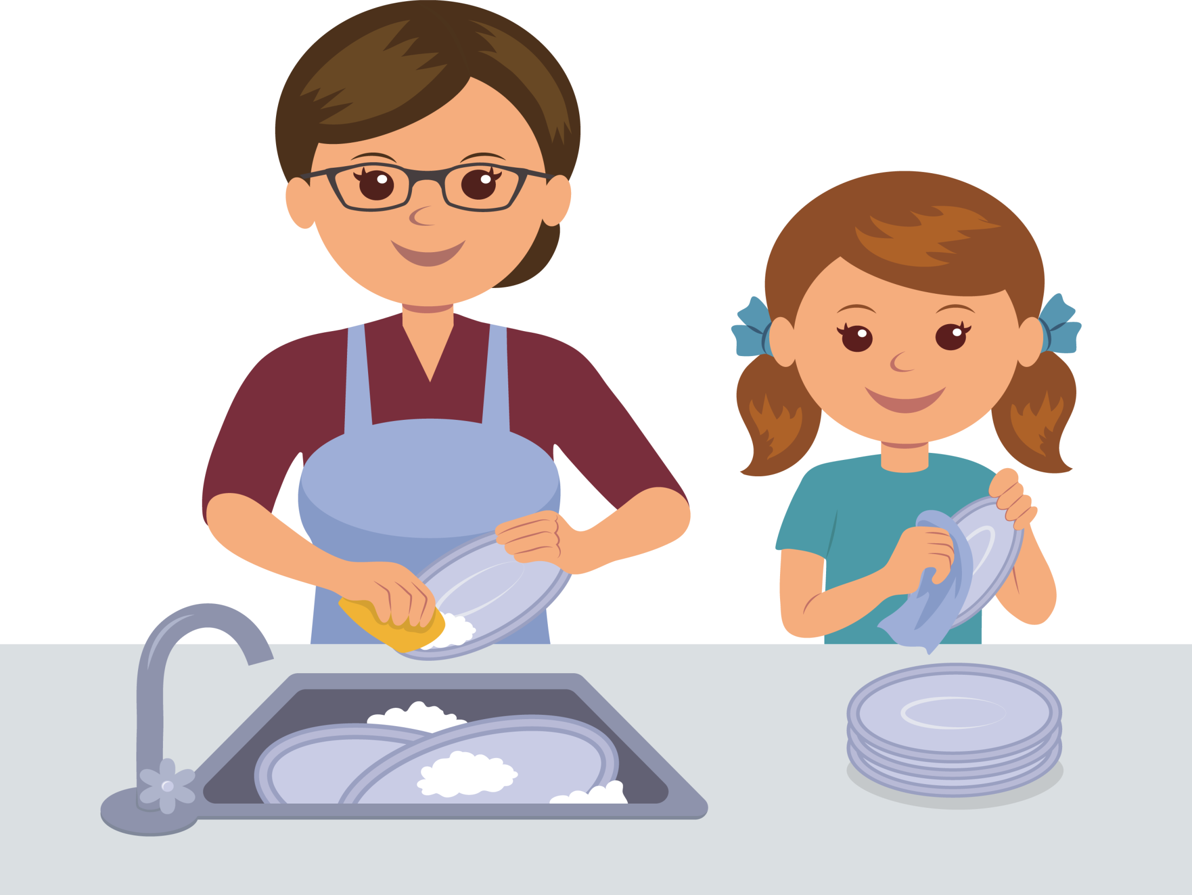
⁴¹Thomas pushed up his sleeves and plunged the plug into the sink. "I'll wash, Sam. You dry."
The Crystals 萨曼萨的晶体实验
Jacqueline Crompton Ottaway
(New Zealand)
Act 9 Talk after dinner I

Slide 3
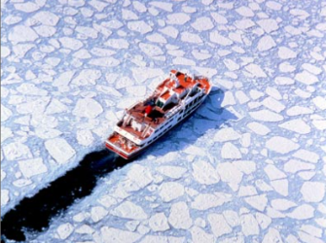
△Did Thomas chat in the same way as Samantha and Mum?
△情境造句。参照蓝色字体句子，进行类似描述：
小明诧异的眨了眨眼。他的同桌会抱怨他的不耐心。而小亮总是表扬他所做出的进步。
9________________________________
⁴³“What‘s the matter?” queried质问 Thomas.
⁴⁴“Nothing.”
⁴⁵Thomas started singing.“ Yesterday, all my troubles seemed so far away..."
⁴⁶Samantha had an overwhelming压倒一切的 urge冲动 to shove 推挤 the dish towel into his mouth. That'd shut him up! Better not. Mum wouldn't like it. She'd give her another two-hour lecture about accepting Thomas into the family and how it wasn't easy for any of them, learning to live together.
⁴⁷“Is that how you feel?”
⁴⁸“What?” Samantha was still plotting密谋 how she could outwit以智取胜 Thomas without Mum finding out about it.
⁴⁹"Before I married your mother, you seemed a lot happier.”
⁵⁰Samantha rolled her eyes upwards把眼珠转向上方. “I was used to just the two of us living together. That's all."
⁵¹Thomas placed the casserole dish有盖炖菜锅 in the dish drainer. "Everything changes, you know. We're a family now -- you, me, Jodie, Jon and your mum." He turned to her.
⁵²"Do you miss your dad?”
⁵³“No.” said Samantha, absorbed in专注于 drying the dish without breaking it. It was Mum's favourite. "He was worse than you," she added, without thinking.
⁵⁴Thomas looked surprised. “Well, Sam, don't hold back隐瞒. Maybe we'll make an extrovert out of you yet!”
⁵⁵Samantha blinked at眨眼 him in amazement. Her own father would have ranted and raved大声叫嚷 about her impertinence鲁莽的言行. Here was Thomas almost praising her for speaking her mind直抒己见.
〇After the talk, did Samantha still think so ill of Thomas? Can you find any expression to prove your opinion?
The talk after dinner I
Her attitude towards Thomas changed.

Slide 4
¹⁶"Have a good day?” Samantha called over her shoulder as she filled the kettle with water and then plugged it in. …
⁴³“What‘s the matter?” queried质问 Thomas.
⁴⁴“Nothing.”
⁴⁵Thomas started singing.“ Yesterday, all my troubles seemed so far away..."
⁴⁶Samantha had an overwhelming压倒一切的 urge冲动 to shove 推挤 the dish towel into his mouth. That'd shut him up! Better not. Mum wouldn't like it. She'd give her another two-hour lecture about accepting Thomas into the family and how it wasn't easy for any of them, learning to live together.
⁴⁷“Is that how you feel?”
⁴⁸“What?” Samantha was still plotting密谋 how she could outwit以智取胜 Thomas without Mum finding out about it.
⁴⁹"Before I married your mother, you seemed a lot happier.”
⁵⁰Samantha rolled her eyes upwards把眼珠转向上方. “I was used to just the two of us living together. That's all."
⁵¹Thomas placed the casserole dish有盖炖菜锅 in the dish drainer. "Everything changes, you know. We're a family now -- you, me, Jodie, Jon and your mum." He turned to her.
⁵²"Do you miss your dad?”
⁵³“No.” said Samantha, absorbed in专注于 drying the dish without breaking it. It was Mum's favourite. "He was worse than you," she added, without thinking.
⁵⁴Thomas looked surprised. “Well, Sam, don't hold back隐瞒. Maybe we'll make an extrovert out of you yet!”
⁵⁵Samantha blinked at眨眼 him in amazement. Her own father would have ranted and raved大声叫嚷 about her impertinence鲁莽的言行. Here was Thomas almost praising her for speaking her mind直抒己见.
△情境造句。参照蓝色字体句子，进行类似描述：
小明诧异的眨了眨眼。他的同桌会抱怨他的不耐心。而小亮总是表扬他所做出的进步。
△From the description of Thomas here, can you tell if Thomas chat in the same way as Samantha and Mum?
Xiaoming blinked at him in amazement. His deskmate would have complained about his impatience. Here was Xiaoliang almost praising him for making progress.
No. he acted in a much straightfoward way

Slide 5
The talk after dinner II

Slide 6
The talk after dinner II
10 _______________________
⁵⁶“What went wrong with those crystals, Sam?” asked Thomas, nodding towards the blue solution glinting闪闪发光 on the windowsill. “Don‘t know. I followed遵循 the book. It should have worked.”
⁵⁷She looked at Thomas out of the corner of her eyes斜着眼睛偷看. "My name's Samantha -- not Sam.”
⁵⁸“Well, Samantha, shall we try making another batch(一)批 of crystals?"
⁵⁹“It's too late. Got to hand them in on Monday."
⁶⁰“We could make a saturated饱和的 solution and stick放置 them in the fridge. Then we‘ll get a supersaturated过饱和的 solution that will make crystals. Simple, huh?” Thomas beamed微笑 with satisfaction.
⁶¹Samantha looked doubtful不确定的. What would Thomas dream up next? Now he wasn‘t just a fitness expert, but a science wizard男巫 as well. Still, if he was prepared to call her Samantha, perhaps she could humour迁就 him for the evening. It might take his mind off使某人不去想 her introverted personality个性.
⁶²“How?” she asked. “It doesn't say anything about a supersaturated solution in the book, or about putting them in the fridge.“
〇Was Samantha interested in what Thomas said?
Do you know these “look”s? Can you find more here? What do these expressions suggest?
²Samantha …and stared glumly at the piece of bald blue thread.
³⁴“Didn't work.” Samantha concentrated on her chicken pieces. Thomas had better …, she thought, glaring hard at her plate.
⁵⁰Samantha rolled her eyes upwards, “…”
Yes, because here she asked him “how?”. And this was the first time she asked.

Slide 7
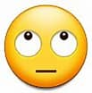
⁵⁶“What went wrong with those crystals, Sam?” asked Thomas, nodding towards the blue solution glinting闪闪发光 on the windowsill. “Don‘t know. I followed遵循 the book. It should have worked.”
⁵⁷She looked at Thomas out of the corner of her eyes斜着眼睛偷看. "My name's Samantha -- not Sam.”
⁵⁸“Well, Samantha, shall we try making another batch(一)批 of crystals?"
⁵⁹“It's too late. Got to hand them in on Monday."
⁶⁰“We could make a saturated饱和的 solution and stick放置 them in the fridge. Then we‘ll get a supersaturated过饱和的 solution that will make crystals. Simple, huh?” Thomas beamed微笑 with satisfaction.
⁶¹Samantha looked doubtful不确定的. What would Thomas dream up next? Now he wasn‘t just a fitness expert, but a science wizard男巫 as well. Still, if he was prepared to call her Samantha, perhaps she could humour迁就 him for the evening. It might take his mind off使某人不去想 her introverted personality个性.
⁶²“How?” she asked. “It doesn't say anything about a supersaturated solution in the book, or about putting them in the fridge.“
Do you know these “look”s? Can you find more here?
²Samantha …and stared glumly at the piece of bald blue thread.
³⁴“Didn't work.” Samantha concentrated on her chicken pieces. Thomas had better …, she thought, glaring hard at her plate.
I only saw the accident __________________________. I don't know who is at fault.
_______________________ _____________________________
He can't ____________________ his work when he is tired.
They stood there, ______________ each other hatefully.
He had so much anxiety that he would wake up in the middle of night and _________ the ceiling.
⁵⁰Samantha rolled her eyes upwards, “…”
out of the corner of my eye
roll one’s eyes upwards
roll one’s eyes upwards to the left
concentrate on
glaring at
stare at

Slide 8
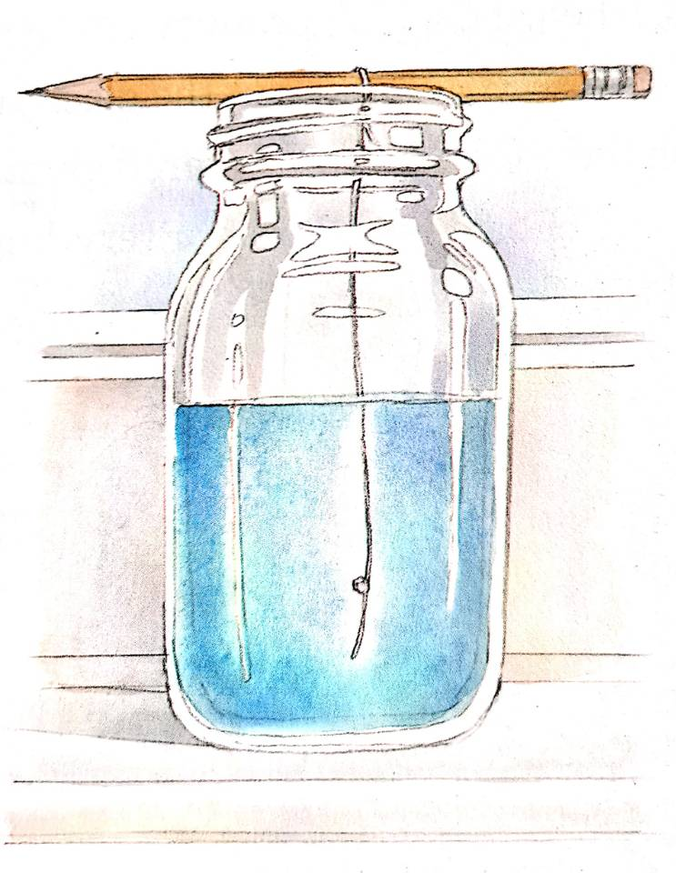
?
Could their way work?
Would Samantha change?
Illustrated by Gary Undercuffler

