Slide 1
感恩遇见，相互成就，本课件资料仅供您个人参考、教学使用，严禁自行在网络传播，违者依知识产权法追究法律责任。
更多教学资源请关注
公众号：溯恩高中英语
知识产权声明

Slide 2
2023年12月
浙江Z20联盟高三第二次联考
读后续写解读与讲评
父子关系修复

Slide 3
CONTENTS
01
Text analysis and Appreciation
02
Plot weaving and Continuation
03
Sample writing and Assessment
04
Further thinking and Expansion

Slide 4
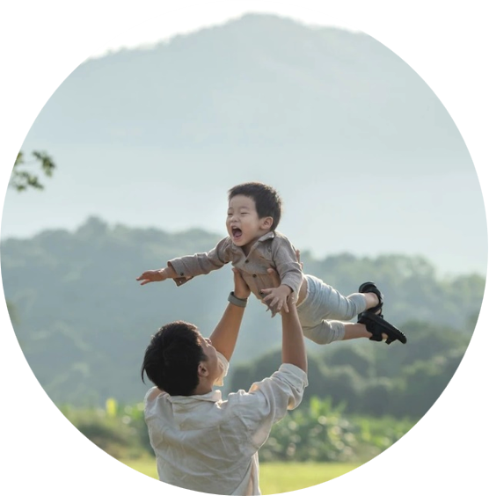
PART 1
Text analysis & Appreciation
文本分析与鉴赏

Slide 5
第二节 读后续写（满分25分） 阅读下面材料，根据所给情节进行续写，使之构成一篇完整的故事。 Jeff and I had many conversations during the year, but I will always remember the time he told me about his family. His father, a successful physician, was cold and strict in Jeff’s words. His father had even paved the way for Jeff to attend the same college from which he had graduated.
Jeff was twenty-seven and a successful business planner at a company—without a degree. His passion was skiing. When he graduated from high school, he decided to decline his father’s offer and, instead, to work with a ski patrol (滑雪巡逻队). With pain in his eyes, Jeff told me he still remembered the day when he told his father he was going to give up college and take a job at a ski resort. Hearing Jeff’s decision, his father looked off into the distance. Then came the words that still echoed in Jeff’s mind: “You lazy kid. No son of mine is going to work with a ski patrol and does not attend college. I should have known you’d never amount to anything!” The two had not spoken since that conversation.
Later, he was back in the area near where he grew up and he certainly did not want his father to know he was attending college. He was doing this for himself, not for his father. He said it over and over again. Jeff’s sister had always remained supportive of Jeff’s decisions. She stayed in contact with their father, but Jeff had made her promise that she would not share any information about his life with him. The day when the graduation ceremony came, I walked around talking to people before it started. I noticed a man with a confused expression.
“Excuse me,” he said as he politely approached me. “What is happening here today?”
“It’s graduation day,” I replied, smiling. “Well, that’s odd,” he said, “my daughter asked me to meet her at this address.” His eyes sparkled and he smiled. “Maybe she completed her associate’s degree and wanted to surprise me!” I helped him find a seat. 注意：1．续写词数应为150个左右； 2．请按如下格式在答题卡的相应位置作答。
Paragraph 1: As I left him, he said, “Thank you. By the way, my name’s Dr. Holstrom.” Paragraph 2: Jeff was the last person to cross the stage.

Slide 6
Step1: 文本伏笔与协同要素分析
Jeff and I had many conversations during the year, but I will always remember the time he told me about his family. His father, a successful physician, was cold and strict in Jeff’s words. His father had even paved the way for Jeff to attend the same college from which he had graduated.
From the first sentence, what basic information can we learn？
Jeff’s family situation (particularly about his father) has left a deep impression on me.
The narrative perspective of the article is the first-person perspective/view.
From the first paragraph, what can be inferred about Jeff’s father？
His behavior might reflect a sense of discipline and high expectations. Especially, the act of arranging a predetermined path for Jeff denies his son’s own aspirations, which was confirmed in their quarrel in the following paragraphs.

Slide 7
Step1: 文本伏笔与协同要素分析
Jeff’s sister had always remained supportive of Jeff’s decisions. She stayed in contact with their father, but Jeff had made her promise that she would not share any information about his life with him.
“It’s graduation day,” I replied, smiling. “Well, that’s odd,” he said, “my daughter asked me to meet her at this address.” His eyes sparkled and he smiled. “Maybe she completed her associate’s degree and wanted to surprise me!” I helped him find a seat.
From these paragraphs, what can be guessed about the man？
He was actually Jeff’s father. His daughter, namely Jeff’s sister took advantage of this elaborately-designed encounter to repair their relationship.

Slide 8
Step2: 中心人物动态分析
Jeff
Which sentence can showcase?
stick to his enthusiasm
When he graduated from high school, he decided to decline his father’s offer and, instead, to work with a ski patrol .
Which sentence can showcase?
become more mature
Later, he was back in the area near where he grew up and he certainly did not want his father to know he was attending college. He was doing this for himself, not for his father. He said it over and over again.

Slide 9
Step3: 语料积累与语言风格
His father had even paved the way for Jeff to attend the same college from which he had graduated.
With pain in his eyes, Jeff told me he still remembered the day when he told his father he was going to give up college and take a job at a ski resort.
Then came the words that still echoed in Jeff’s mind.
广东外语外贸大学教授、“续论”创始人王初明教授曾指出，读后续写要遵循“语言要模仿、内容要创新”的原则。
I noticed a man with a confused expression.
“Excuse me,” he said as he politely approached me.
His eyes sparkled and he smiled.
本文统观之，语言上清新晓畅，有第一人称叙述的亲临亲历之感，没有用词上的晦涩感，但语言不乏传情达意上的微妙性，直接引语与间接引语都有出现。续写中要延续这种连贯的用语风格。

Slide 10
PART 2
Plot weaving & Continuation
情节构思与续写

Slide 11
Step1: 提示句入手——情节阶梯模型
Driven by the chain of questions and answers
Jeff was the last person to cross the stage.
How to connect the two scenes?
The ceremony started and many graduates showed up on the stage in turns.
Would I speak out the truth to the man?
What would I do, think or feel?
Probably not.
What is my reaction when hearing the name?
I would probably sit by the man and awaited the ceremony.
so that I could witness the content of continuation para 2
Suspicious—Astonished— Convinced
As I left him, he said, “Thank you. By the way, my name’s Dr. Holstrom.”

Slide 12
Step1: 提示句入手——情节阶梯模型
Driven by the chain of questions and answers
So what’s the theme of the article?
A happy ending showcasing the theme of the article.
Would Jeff recognize his father?
Yes. To make the ending good and highlight reunion and mutual understanding.
How would his father react to the scene that his son was on stage?
What would Jeff do on stage?
Expressions about utter surprise.
He received his diploma and bowed to audience, feeling a sense of achievement and joy.
Jeff was the last person to cross the stage.

Slide 13
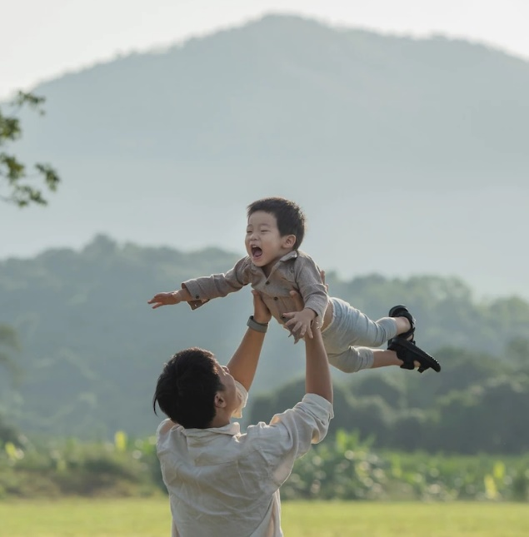
Step2: 主题协同
Figure out the theme of the article
The love between Jeff and his father
Inner growth of Jeff and his father
The melting of the ice between Jeff and his father
Mutual understanding and care
Discussion

Slide 14
Step3: 微场景刻画
How to depict Mini Scenes using vivid language
As I left him, he said, “Thank you. By the way, my name’s Dr. Holstrom.”
方法1：丰富的内心独白
The name ringing in my mind, I froze on the spot. Jeff Holstrom!
Could this be the cold, stern father who demanded his son attend college or never enter his home again?
描写
妙处
Jeff Holstrom! 短促有力，一言胜过千言。
Could this be……? 以一种震惊的语调写出内心的惊讶，cold and stern则协同呼应了原文第一段父亲的印象。

Slide 15
Expansion: Expressions for describing someone’s astonishment
Hearing his words, my jaw dropped in disbelief, my eyes widening in shock.
My mind was in a whirlwind of utter astonishment , like a storm raging within.
Hearing the unexpected news, Mary was numb with shock, as if rooted to the ground.
When I was having my oral exam, I got so tongue-tied that it was a miracle that I could utter a complete sentence, utterly dumbfounded.

Slide 16
Step3: 微场景刻画
How to depict Mini Scenes using vivid language
As I left him, he said, “Thank you. By the way, my name’s Dr. Holstrom.”
方法2：激越的氛围营造
Speeches given, the dean began to read the names of the graduates.With each graduate walking onto the stage, the auditorium broke into waves of thunderous applause, which seemed to brim out of the place. (personification)
表达
异构
Cheers and chatter filled the air like a cheerful melody.
笑语交错,活泼的气氛如同欢快的乐曲般弥漫空中。

Slide 17
Step3: 微场景刻画
How to depict Mini Scenes using vivid language
Jeff was the last person to cross the stage.
方法3：情感赋能画面
Suddenly, a lone figure popped into his eyes—Dr. Holstrom.I didn’t know how their eyes met. I could feel a flood of memories must be rushing through their hearts, binding father and son in an unspoken embrace. The room seemed to hold its breath, as if time itself had paused to witness the reunion. The years apart melted away as their eyes met, and a fragrance of family love permeated in the air.
亮点
品鉴
本段有哪些地方值得学习？
The use of personification and the moving language style.

Slide 18
Step3: 微场景刻画
How to depict Mini Scenes using vivid language
Jeff was the last person to cross the stage.
方法4：主题升华深刻
In the end, he realized that family love and bond could break through the icy fortress, allowing love to seep back into each other's hearts.
In their reunion, a tapestry of love, forgiveness, and acceptance unfolded, weaving a bond that time and distance could no longer unravel.
反思
提升
主题升华是多元的，正向的，符合价值观的

Slide 19
PART 3
Sample writing & Assessment
例文阅读与评价

Slide 20
Sample Writing 1
As I left him, he said, “Thank you. By the way, my name’s Dr. Holstrom.”The name ringing in my mind, I froze on the spot. Jeff Holstrom! Could this be the cold, stern father who demanded his son attend college or never enter his home again? Curiosity and doubt bubbling up, I turned around to get a glimpse of Dr. Holstrom, attempting to find some facial resemblances. Beaming and scanning, Dr. Holstrom seemed to be looking for his daughter. Speeches given, the dean began to read the names of the graduates, inviting them onto the stage one by one to receive their diplomas.
Jeff was the last person to cross the stage. Having received his diploma, he turned toward the audience, radiant with joy. Suddenly, a lone figure popped into his eyes—Dr. Holstrom. I was not sure how Jeff spotted him in the crowd, but I could tell their eyes met. Dr. Holstrom, gazing at Jeff thoughtfully for a few seconds, opened his arms as if to embrace the air around him. For a moment time seemed to stand still. Jeff came down, smiling with tears in eyes. “My father is here,” he whispered to me, “I think I’m going home.”
反思
提升
Your assessment: _________________
Why? _____________________________________________

Slide 21
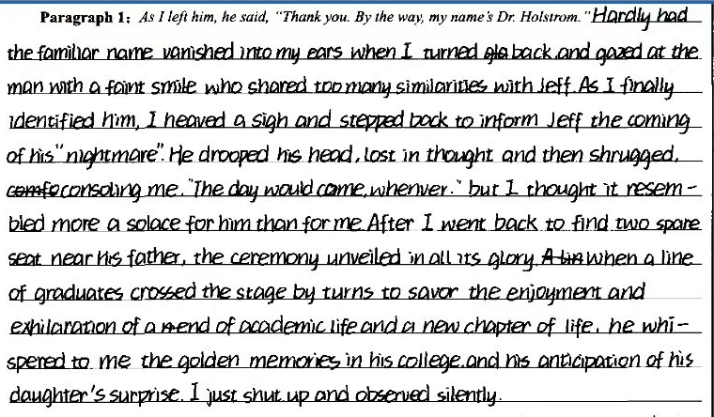
Sample Writing 2
1. 首句用倒装结构，但整句有点冗长，读之不够自然
2.关于我告诉Jeff他的父亲到来，并称之为“nightmare”的情节构思略有不妥
3.Jeff 父亲与“我”分享，“shut up”此词略有不妥
4.本段写作总体方向正确，部分略有细节上的偏差，考生有较强的语言水平，能使行文连贯性保持。
反思
提升

Slide 22
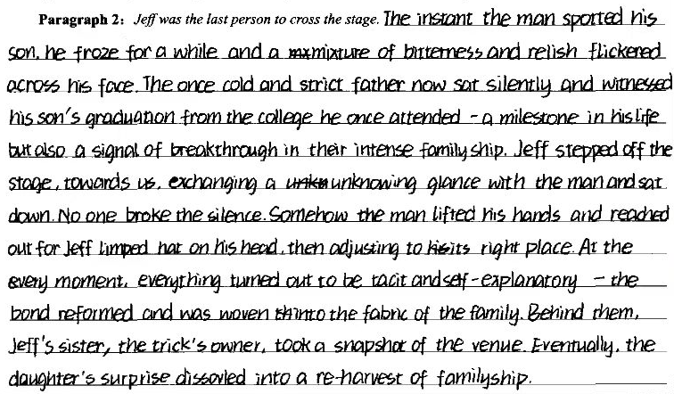
Sample Writing 2
1. 首句描绘父亲见到儿子时的情态颇有可取之处。
2.once 建议可改成previous
3.breakthrough in their intense familyship 表述不妥，更应该是家庭关系的修复，而非突破。
4.文章整体用词风格有点与原文不甚协同，建议考虑自然化语言风格。
反思
提升
本文有部分晦涩用语，但综合来看，还是可以打在第四、第五档。

Slide 23
Revise and Polish your own continuation
内容：内容的丰富性、故事发展的合理性，续写的完整性
01
02
2）词汇语法：使用语言的多样性、准确性和恰当性；（语言为交际服务，不可一味使用所谓“高级”语言，要与原文语言特点保持一致。）
03
3）篇章结构：上下文的衔接（包括续写段落之间的衔接）连贯性；
4）写作规范：
① 词数少于130的，扣2分；
② 拼写和标点符号错误多将分数降低一个档次；
③ 如书写较差，以至影响交际，将分数降低一个档次；
04

Slide 24
PART 4
Further thinking & Expansion
深入思考与延伸

Slide 25
When you read the whole passage ,what is the deep-rooted reason for the separation between Jeff and his father？
The deep-rooted reason for the separation between Jeff and his father seems to stem from a significant clash in their beliefs and values regarding education and career choices.
Jeff's father, a successful physician with firm convictions about the necessity of college education, had set expectations for Jeff to follow a similar path. However, Jeff's passion for skiing led him to decline his father's offer and pursue a different career path, one that didn't align with his father's aspirations for him.
This conflict of values and divergent perspectives on what constitutes success and a fulfilling life caused a rift between them. Jeff's decision to prioritize his passion over his father's expectations and the father’s conformity to his view resulted in their separation.

Slide 26
同类型话题篇章迁移
At home, his son, my father, could be quiet and withdrawn. I wouldn’t want to make him sound humorless. He wasn’t. Silly things would amuse him. He had phrases that he liked to use, “It’s immaterial to me” being one of them. “I don’t mind” would have done just as well but he liked the word “immaterial.” I realize that, deep down, he was probably disappointed that he hadn’t made more of his life. He left school without qualifications and became apprenticed to a plumber. Plumbing was not something he was passionate about. It was just what he did. He was never particularly ambitious, though there was a moment when he and Mum thought of emigrating to Canada, but it came to nothing. Where he came into his own was around the house. He had an “eye for the job.” Be it bookshelves or a cupboard—what he could achieve was astonishing.
Of the three options, moors, woods or river—the river was the one that usually got my vote. On a stretch of the river I was allowed to disappear with my imagination into another world, an ideal world defined by myself. With a fishing net over my shoulder I could set off in sandals that were last year’s model, with the fronts cut out to accommodate toes that were now right to the end. I’d walk along the river bank looking for a suitable spot where I could take off the painful sandals and leave them with my picnic while I ventured out, tentatively, peering through the water for any fish that I could scoop up with the net and take home.

Slide 27
同类型主题篇章迁移
I wanted to leave school as soon as possible but that seemed an unlikely prospect until one day my father announced, “They’ve got a vacancy for an apprentice gardener in the Parks Department. I thought you might be interested.” In one brief moment Dad had gone against his better judgment. He might still have preferred it if I became a carpenter. But I like to feel that somewhere inside him was a feeling that things might just turn out for the best. Maybe I’m deceiving myself, but I prefer to believe that in his heart, although he hated gardening himself, he’d watched me doing it for long enough and noticed my unfailing passion for all things that grew and flowered and fruited.
What is the message the writer want to convey?
A. Living without a motive is equal to sailing without a compass.
B. Despite other’s mockeries, fragrant flowers are on the up way.
C. Passion, if not deserted, equips you with chance to pay off eventually.
D. Reflection and interaction serve as treatments for bridging the gap.
√

Slide 28
同类型话题篇章训练-人与社会之家庭关系
As a country music song goes, "She's a wild one with an angel's face." That is my younger sister, lulu. When I think of er, I think of trying to tame a wild horse.
It is hard to find words to describe my relationship with Lulu. "All-out nuclear warfare" could not interpret it quite exactly. The irony is that we are very much alike: we share the hot-tempered and fast-forgiving personality.
Speaking of personalities, the Chinese Zodiac (属相) describes Lulu and me perfectly. People born in the Pig Year are "stubborn" and "tough" and often "fly into anger," although they "never harbour a grudge (记仇)" as they are honest and warm-hearted. That is Lulu and I exactly, with an age gap of twelve years.
I had my first face-off with Lulu when she was about five. It was a freezing winter afternoon in New Haven, Connecticut. Mum and Dad were at work. Babysitting Lulu at home, I decided that it would be the perfect time to introduce Lulu to the piano as I was in the learning process myself. Excited about working together - with her brown curls, round eyes, and China doll face, Lulu was desperately cute - I put her on the piano bench, on top of some comfortable pillows. I then demonstrated how to play a single note with a single finger, and asked her to do the same. A small request, but Lulu refused, preferring instead to smash at many notes at the same time with two open palms. When I asked her to stop, she smashed harder and faster. When I tried to pull her away from the piano, she began yelling, crying, and kicking angrily.
Fifteen minutes later, she was still yelling, crying, and kicking, and I had had it! Avoiding her blows, I dragged the screaming demon (恶魔) to our back door, and threw it open. The wind chill was six degrees below zero, and my own face hurt from just a few seconds' exposure to the icy air.
注意:
1. 所续写短文的词数应为 150 左右;
2. 续写部分分为两段, 每段的开头语已为你写好;
Paragraph 1:
But I was determined to teach the little wild one a lesson.
Paragraph 2:
Lulu's teeth were clicking repeatedly together because of cold, but she shook her head again.

Slide 29
Sample Writing
But I was determined to teach the little wild one a lesson."You can't stay in the house if you don't listen to me." I said sternly. Instead of being obedient, Lulu stepped outside, facing me in a challenging way. A dull dread began seeping through my body - the little one was wearing only her sweater and tights."Okay, you've decided to behave," I said quickly."Come in now." However,Lulu shook her head with a stubborn look in her eyes.”Don't be silly, Lulu." I was panicking."It's freezing. You're going to get sick. Come in now."
Lulu's teeth were clicking repeatedly together because of cold, but she shook her head again. It suddenly dawned on me that I had underestimated Lulu. She would rather freeze to death than give in. My mind racing. I changed tactics immediately, begging and bribing Lulu to come back into the house. When Mum and Dad arrived home, they found Lulu contentedly soaking in a hot bath, dipping a biscuit in a steaming cup of hot chocolate, desperately cute. Anyway, I love Lulu, a similar wild one with an angel's face.

Slide 30
Thank you !

