Slide 1


感恩遇见，相互成就，本课件资料仅供您个人参考、教学使用，严禁自行在网络传播，违者依知识产权法追究法律责任。
更多教学资源请关注
公众号：溯恩英语
知识产权声明

Slide 2
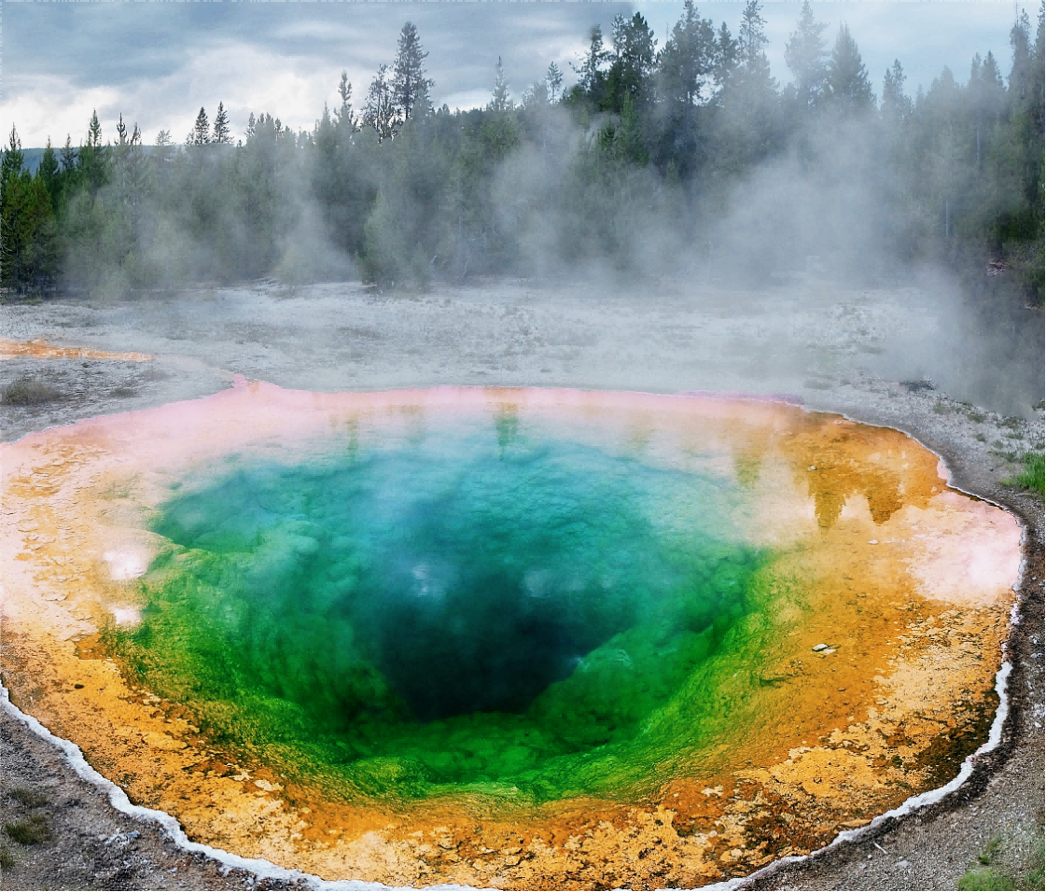
Fascinating Parks
Unit 3
Sarek National Park
---Europe’s Hidden National Treasure
A national park is not a playground. It's a sanctuary for nature and for humans who will accept nature on nature's own terms.
——Michael Frome

Slide 3

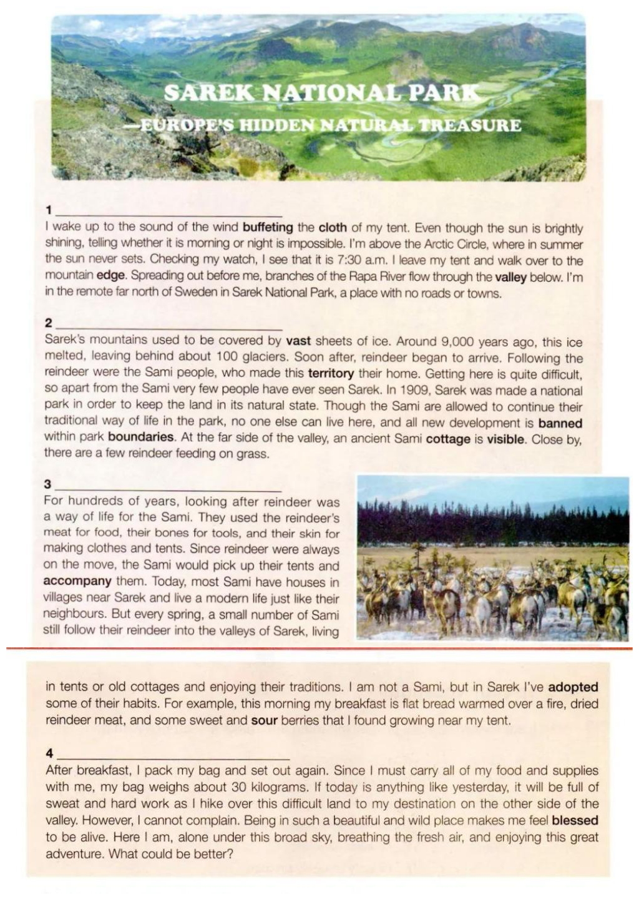
Reading and Predicting
1. Reading the title and answer the following questions:
(1) What is the function of a dash(---)?
Sarek National Park
---Europe’s National
Hidden
Treasure
A dash is used to explain and illustrate the items.
A Land of Mountains and Ice
Man at Peace with Nature
A Land of Adventure
A Summer Where the Sun Never Sleeps

Slide 4
Reading and Predicting
Sarek National Park
---Europe’s Hidden National Treasure
A Land of Mountains and Ice
Man at Peace with Nature
A Land of Adventure
A Summer Where the Sun Never Sleeps
(2). What are subtitles for?
(3). What do you expect to read in the text?

Slide 5
Reading and Thinking
Skim the text and answer the following questions:
(1) Match the subtitles with each paragraph.
(2)Where would you most likely to read this text?
Sarek National Park
---Europe’s Hidden National Treasure
A Land of Mountains and Ice
Man at Peace with Nature
A Land of Adventure
A Summer Where the Sun Never Sleeps

Slide 6
Reading and Thinking
Skim the text and answer the following questions:
(1) Match the subtitles with each paragraph.
(2)Where would you most likely to read this text?
Sarek National Park
---Europe’s Hidden National Treasure
A Summer Where the Sun Never Sleeps
A Land of Mountains and Ice
Man at Peace with Nature
In a travel magazine or travel journal
A Land of Adventure

Slide 7
A Summer Where the Sun Never Sleeps
I wake up to the sound of the wind buffeting the cloth of my tent. Even though the sun is brightly shining, telling whether it is morning or night is impossible. I’m above the Arctic Circle, where in summer the sun never sets. Checking my watch, I see that it is 7:30. I leave my tent and walk over to the mountain edge. Spreading out before me, branches of the Rapa River flow through the valley below. I’m in the remote far north of Sweden in Sarek National Park, a place with no roads or towns.
Arctic Circle
the remote far north of Sweden
the sun
1. Where is the Sarek National Park exactly?
Sight
2. What did the author see and hear ?
the Rapa River
Sound
the wind

Slide 8
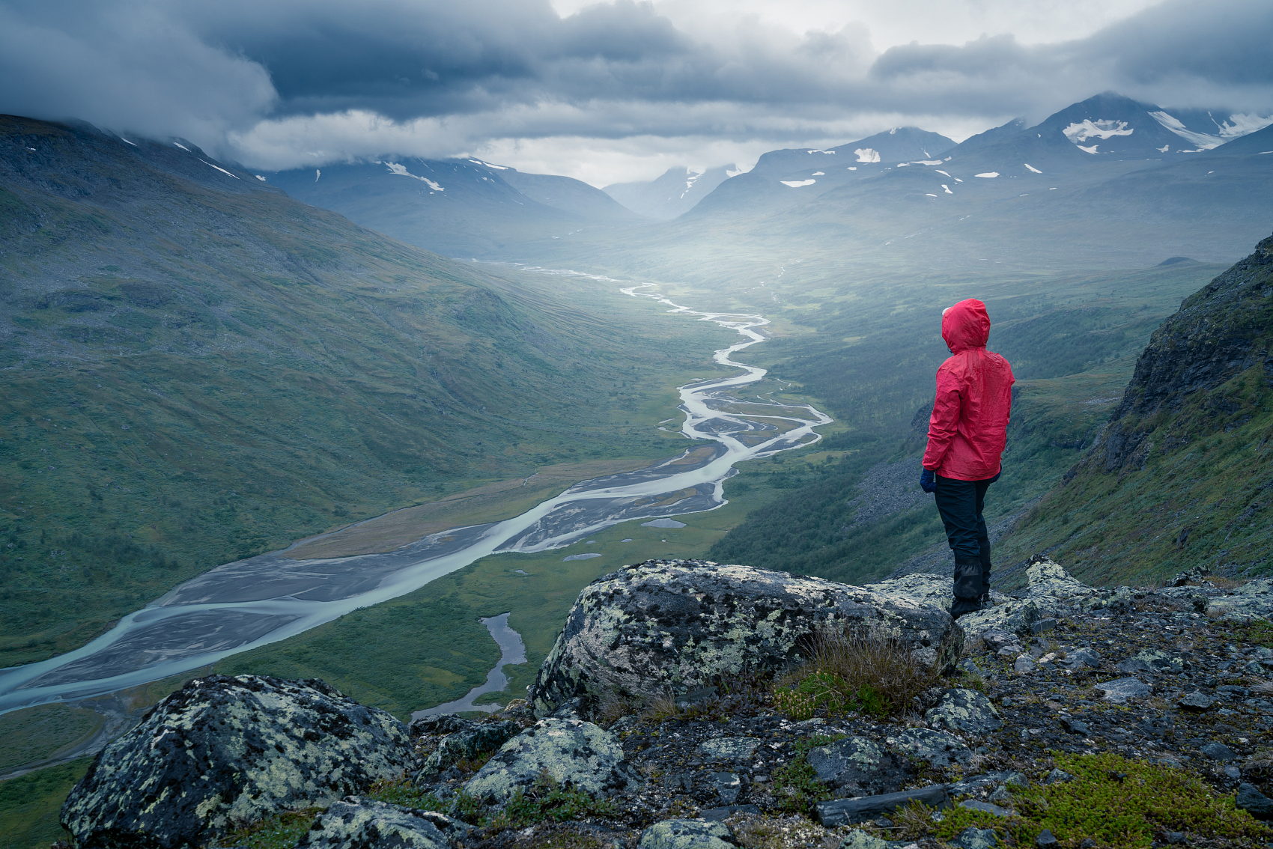
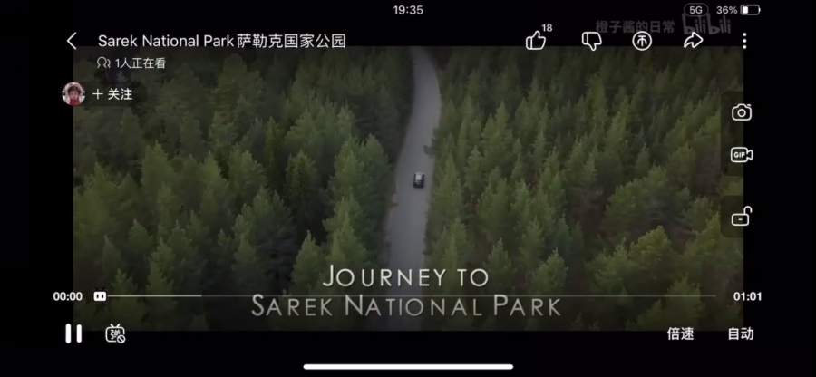

Slide 9
A Summer Where the Sun Never Sleeps
I wake up to the sound of the wind buffeting the cloth of my tent. Even though the sun is brightly shining, telling whether it is morning or night is impossible. I’m above the Arctic Circle, where in summer the sun never sets. Checking my watch, I see that it is 7:30. I leave my tent and walk over to the mountain edge. Spreading out before me, branches of the Rapa River flow through the valley below. I’m in the remote far north of Sweden in Sarek National Park, a place with no roads or towns.
Arctic Circle
the remote far north of Sweden
1. Where is the Sarek National Park exactly?
2. What did the author see and hear ?
3. From this paragraph, how would you describe Sarek National park?
remote
fascinating

Slide 10
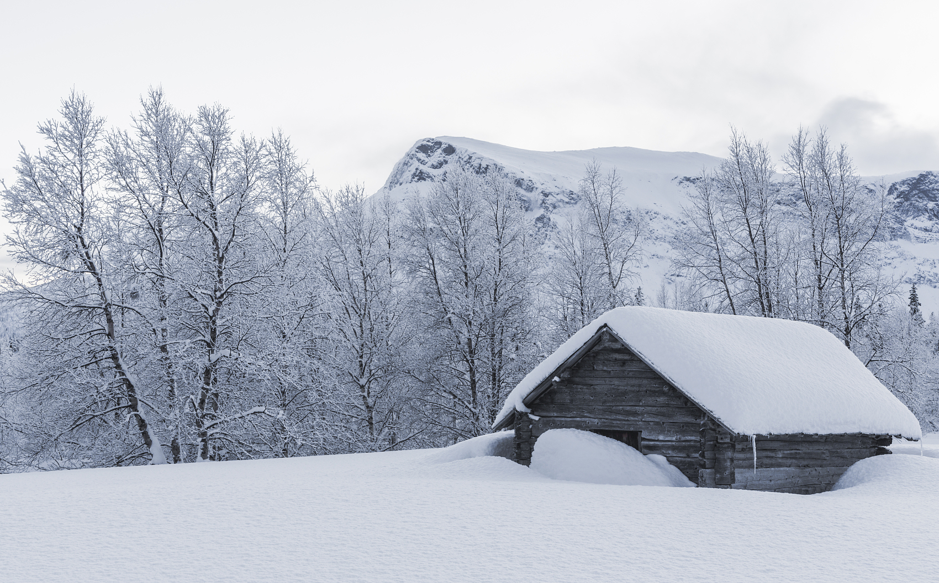
A Land of Mountains and Ice
Sarek mountains used to be covered by vast sheets of ice. Around 9,000 years ago, this ice melted, leaving behind about 100 glaciers. Soon after, reindeer began to arrive. Following the reindeer were the Sami people, who made this territory their home. Getting here is quite difficult, so apart from the Sami very few people have ever seen Sarek. In 1909, Sarek was made a national park in order to keep the land in its natural state. Though the Sami are allowed to continue their traditional way of life in the park, no one else can live here, and all new development is banned within park boundaries. At the far side of the valley, an ancient Sami cottage is visible. Close by, there are a few reindeer feeding on grass.
no one else can live here
1. How did the Sarek National Park develope?
2. Why does the author add “no one else can live here”?
3. From this paragraph, how would you describe Sarek National park?
natural
original

Slide 11
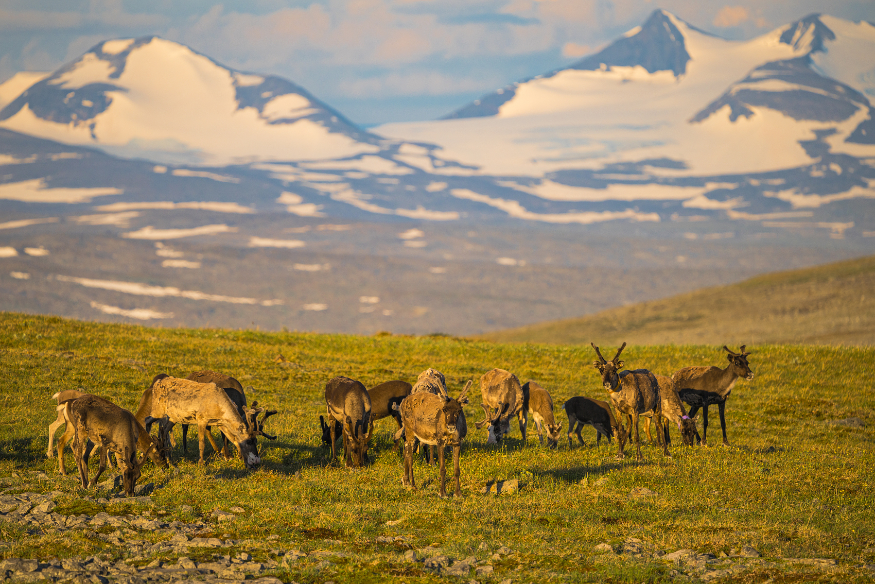
Man at Peace with Nature
For hundreds of years, looking after reindeer was a way of life for the Sami. They used the reindeer's meat for food, their bones for tools, and their skin for making clothes and tents. Today, most Sami have houses in villages near Sarek and live a modern life just like their neighbors. But every spring, a small number of Sami still follow their reindeer into the valleys of Sarek, living in tents or old cottages and enjoying their traditions. I am not a Sami, but I’ve adopted some of their habits. For example, this morning my breakfast is flat bread warmed over a fire, dried reindeer meat and some sweet and sour berries that I found growing near my tent.
bread
Taste
meat
berries
For hundreds of years, looking after reindeer ...
Today, most Sami have houses in villages .... live a modern life.
But every spring, a small number of Sami still ...
Structure:
Content:
Language: rhetorical device
1.How does the writer show the peace between man and nature?
contrast
I am not a Sami, but I’ve adopted some of their habits.
examples
They used the reindeer's meat for food, their bones for tools, and their skin for making clothes and tents.
repetition

Slide 12
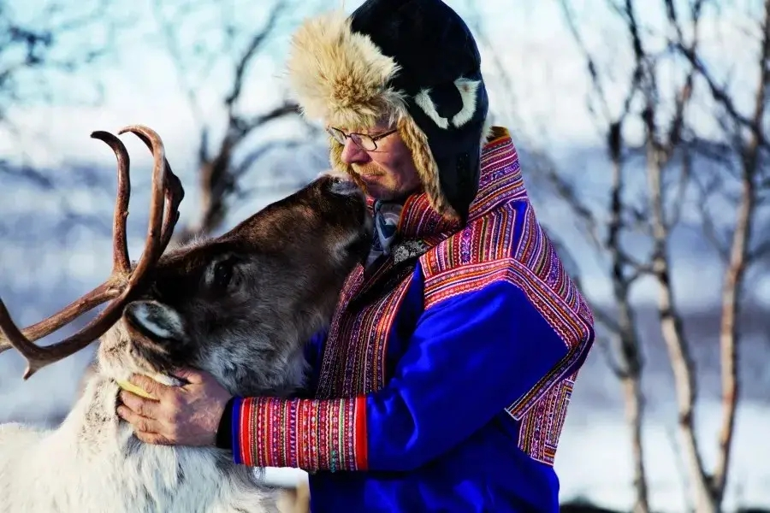
Man at Peace with Nature
For hundreds of years, looking after reindeer was a way of life for the Sami. They used the reindeer's meat for food, their bones for tools, and their skin for making clothes and tents. Today, most Sami have houses in villages near Sarek and live a modern life just like their neighbors. But every spring, a small number of Sami still follow their reindeer into the valleys of Sarek, living in tents or old cottages and enjoying their traditions. I am not a Sami, but I’ve adopted some of their habits. For example, this morning my breakfast is flat bread warmed over a fire, dried reindeer meat and some sweet and sour berries that I found growing near my tent.
1.How does the writer show the peace between man and nature?
2. From this paragraph, how would you describe
Sarek National park?
traditional
harmonious

Slide 13
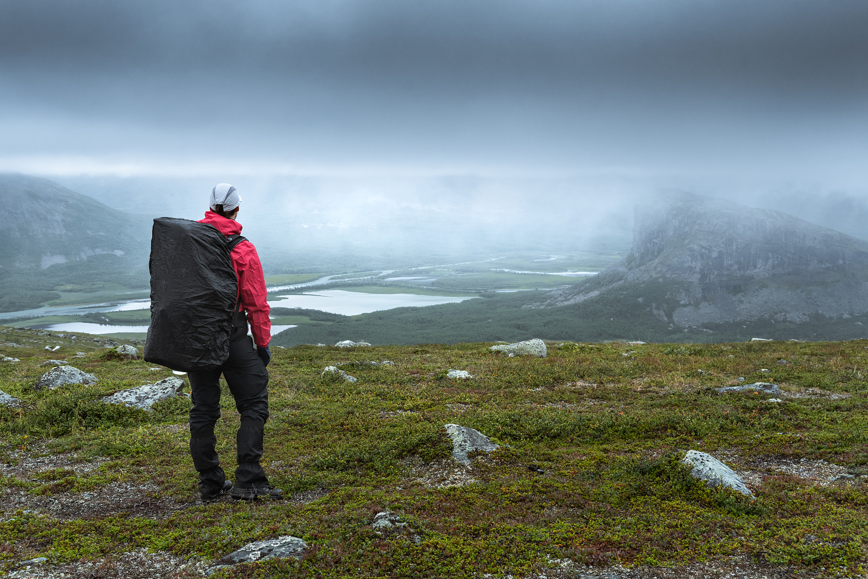
A Land of Adventure
After breakfast, I pack my bag and set out again. Since I must carry all of my food and supplies with me, my bag weighs about 30 kilograms. If today is anything like yesterday, it will be full of sweat and hard work as I hike this difficult land to my deestination on the other side of the valley. However, I cannot complain. Being in such a beautiful wild place makes me feel blessed to be alive. Here I am, alone under this broad sky,breathing the flesh air, and enjoying the great adventure. What could be better?
1. What does the author think of this journey?
the bag
Touch
Smell
fresh air
sweat

Slide 14
Sarek National Park
---Europe’s Hidden National Treasure
the sun
Sight
Rapa River
cottage
reindeer
Sound
the wind
worthy
blessed
bread
Taste
meat
To vividly express his feelings the journey.
Why does the author use these five senses to describe his journey? in the journey.
berries
To describe the journey in a more all-round way.
Smell
fresh air
the bag
Challenging
tough
Touch
sweat

Slide 15
Sarek National Park
---Europe’s Hidden National Treasure
remote
fascinating
natural
original
w
traditional
harmonious
challenging
tough
worthy
blessed

Slide 16
Sarek National Park
---Europe’s Hidden National Treasure
remote
fascinating
original
natural
w
traditional
harmonious
a treasure land yet to be explored by yourself
challenging
worthy
tough
blessed

Slide 17

Discussing and Sharing
Is it worth making a place like Sarek National Park? State your reasons.
Pro:
appreciate the fascinating scenery
keep nature in its natural way
pursue the peace between man and nature
promote ecological protection
experience the traditional way of life
...
Con:
waste a large amount of money and resources
leave the local residents like Samis moving out their original homes
full of inconvenience because of lack of advanced technology
...

Slide 18
To protect nature is to protect ourselves!
Humans

Slide 19
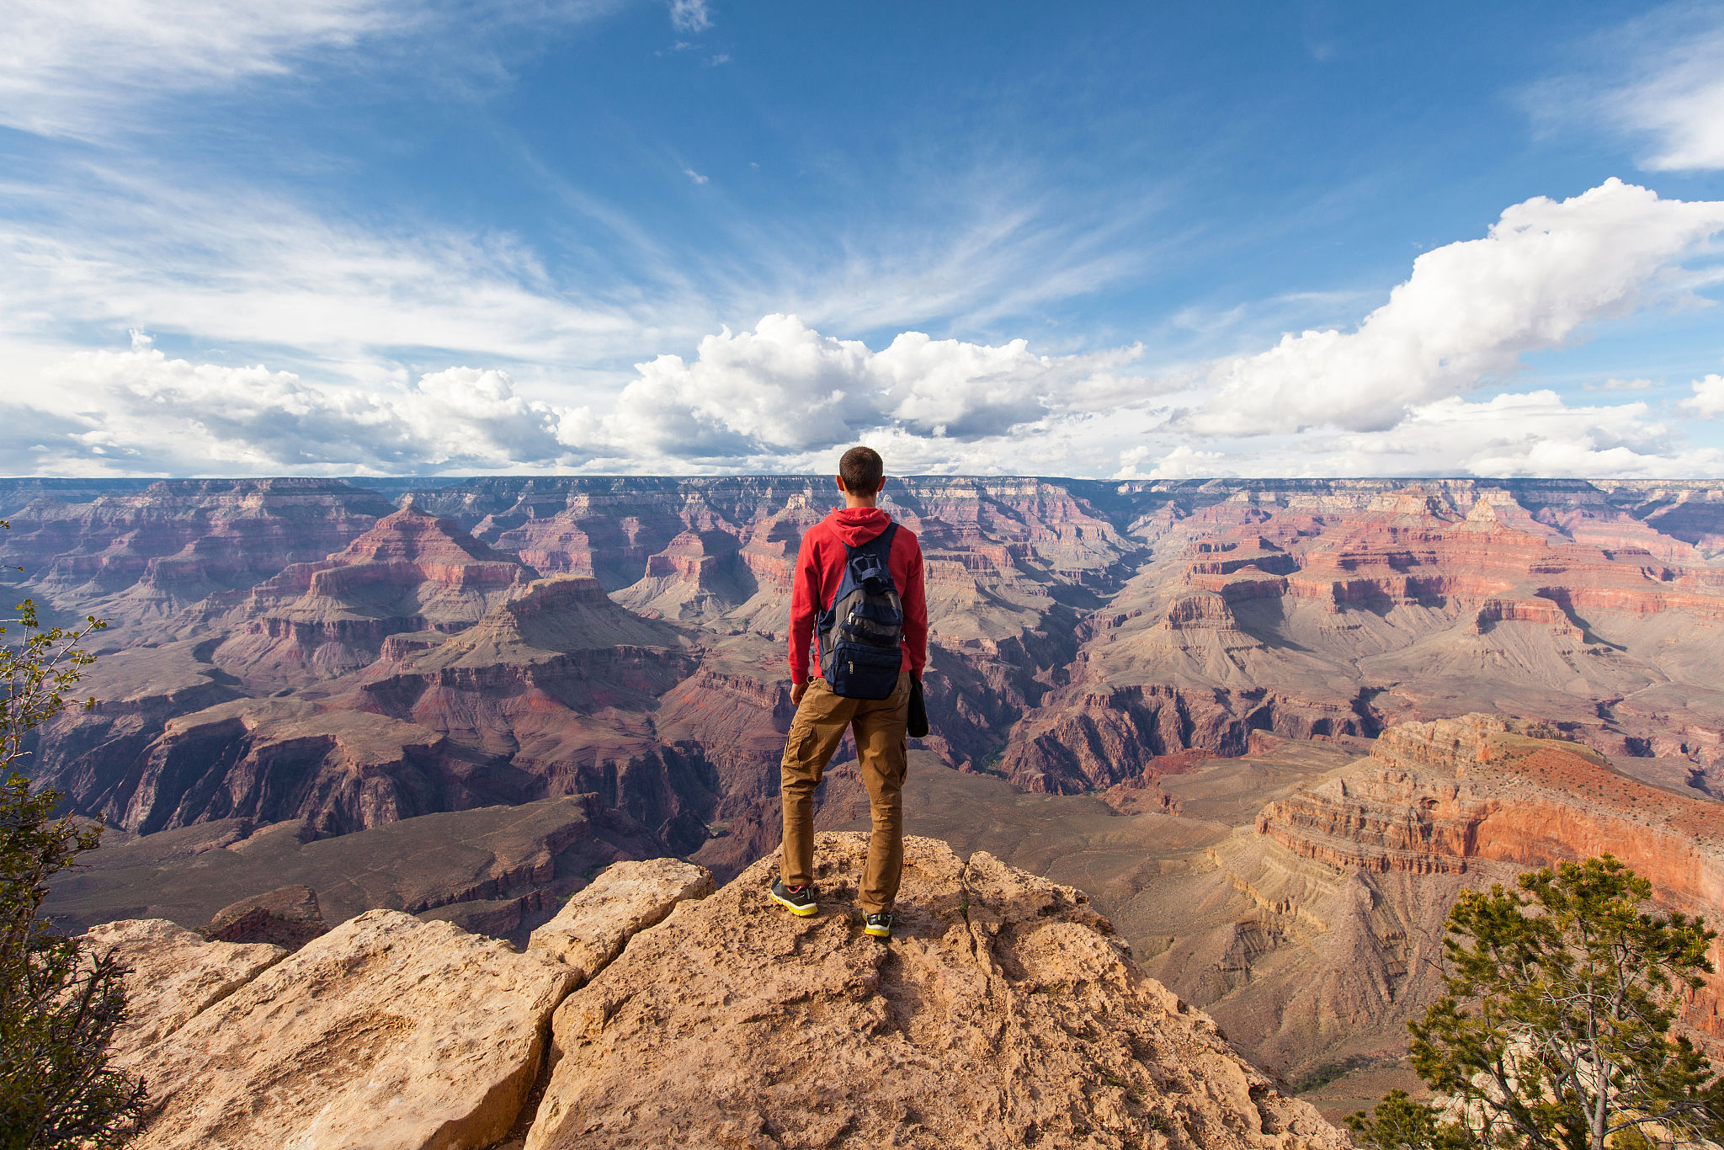
Set off and explore your treasure!

