Slide 1
感恩遇见，相互成就，本课件资料仅供您个人参考、教学使用，严禁自行在网络传播，违者依知识产权法追究法律责任。
更多教学资源请关注
公众号：溯恩高中英语
知识产权声明

Slide 2
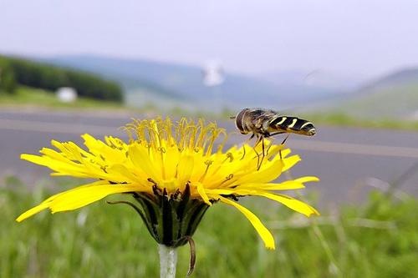
让人物语言在你的笔端鲜活
语言描写

Slide 3
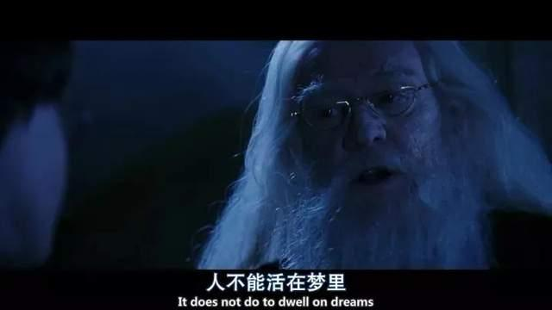
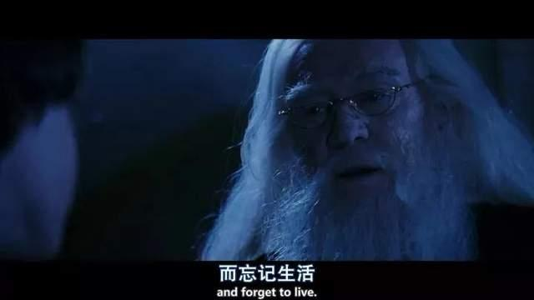
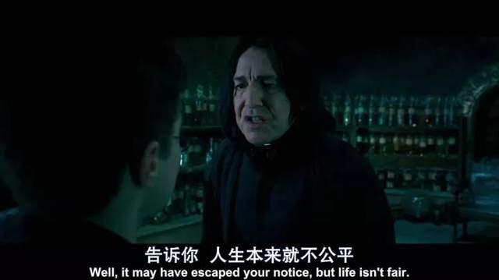
语言描写
“言为心声”。语言描写是塑造人物形象的重要手段。成功的语言描写不仅能展示人物的性格和思想感情，还能深刻地反映人物的内心世界。

Slide 4
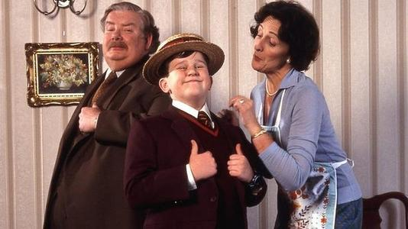
取胜第一招：语言描写体现人物个性
素材摘录1：“Get the mail, Dudley,” said Uncle Vernon from behind his paper.
“Make Harry get it.”
“Get the mail, Harry.”
“Make Dudley get it.”
“Poke him with your Smelting stick, Dudley.”
“达力，去拿信。” 弗农姨父在报纸后说。 “让哈利去拿。”
“哈利，去拿信。”
“让达力去拿。”
“达力，用你的棍子戳他。”
poke(v.)捅;戳
bad parenting
and the
Sorcerer’s Stone

Slide 5
素材背景：When the letters arrive in the morning, Uncle Vernon asks his son Dudley to get the mail. When Dudley refuses to do so, he asks Harry to get the mail. When Harry refuses to do so, he asks Dudley to poke Harry with a stick.
素材解读：From what Uncle Vernon says, the readers can see he is a rude man and sets bad example for his child. While Harry is brave enough to stand up for himself and say no, though he knows he will be bullied.
Tips：The writer should choose proper words for the characters to use to show his/ her most distinguishing personality.

Slide 6
素材摘录2： His aunt was back outside the door.
"Are you up yet?" she demanded.
"Nearly," said Harry.
"Well, get a move on, I want you to look after the bacon. And don't you dare let it burn. I want everything perfect on Duddy's birthday.”
“你起来了吗？”她问。
“ 差不多了。” 哈利说。
“快一点, 我要你去看着烤肉，如果它要是糊了我可要你好看。今天是达德里的生日，我希望一切都是最好的。”
and the
Sorcerer’s Stone
Notes:
llo

Slide 7
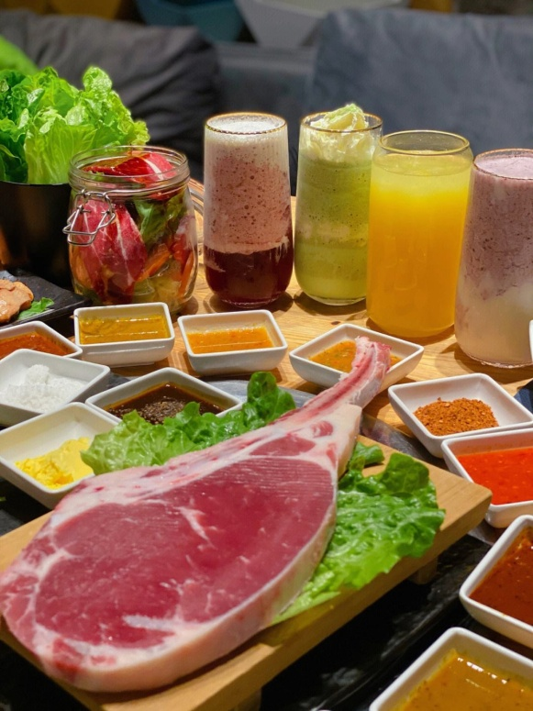
素材背景：Early in the morning, Aunt Petunia screeches outside Harry’s cupboard to get him up just to look after the bacon because it is Dudley’s birthday and she wants it to be perfect.
素材解读：First, Aunt Petunia demands Harry to get up fast. Then she warns him not to burn the bacon. From what she says, the writer portraits a selfish and mean woman, who spoils her son.

Slide 8
取胜第二招：语言描写体现人物特点
素材摘录1：Dudley thought for a moment. It looked like hard work. Finally he said slowly, "So I'll have thirty ... thirty..."
"Thirty-nine, sweetums," said Aunt Petunia.
达力想了一会儿。似乎这是一件很难的工作。最后他总算慢慢吞吞地说: “那我就有三十……三十……”
“三十九件，我的心肝宝贝。”佩妮姨妈说。
and the
Sorcerer’s Stone

Slide 9
素材背景：It is Dudley’s birthday. He is unhappy because he gets thirty seven presents this year while he got thirty eight last year. His parents promise him to buy two more when they are out later. Dudley is calculating exactly how many total presents he will get.
素材解读：Dudley has difficulty in adding thirty seven and two, which implies he is not so smart.
Tips：A character’s oral language will show his/ her most distinguishing characteristic or identity.

Slide 10
素材摘录2： "Call me Hagrid," he said, "everyone does. An' like I told yeh, I'm Keeper of Keys at Hogwarts -- yeh'll know all about Hogwarts, o' course.
就叫我海格吧，”他说，“大伙都这么叫我。我刚才对你说过，我是霍格沃茨的钥匙保管员——当然，霍格沃茨你总该知道吧？”
素材背景：Hagrid keeps on following Harry until he succeeds. Here he introduces himself to Harry.
素材解读：Hagrid speaks modern English with west country accent. The author emphasizes his accent, to show a rural, kind, and somewhat rough image of a hunting ground guard with a low level of education.
and the
Sorcerer’s Stone

Slide 11
取胜第三招：语言描写体现人物情感、态度
素材摘录1： "I really don't think they should let the other sort in, do you? They're just not the same, they've never been brought up to know our ways. Some of them have never even heard of Hogwarts until they get the letter, imagine. I think they should keep it in the old wizarding families.”
我真的认为他们不应该让其他的种类进入学校学习，你呢？他们就是与我们不一样。成长的环境不一样，所以他们不会理解我们生活的方式的。可能他们其中的一些从没听说霍格沃茨，直到有一天他们收到了一封信。我想他们应该把这仅限于古老的魔法师家族才对。
and the
Sorcerer’s Stone

Slide 12
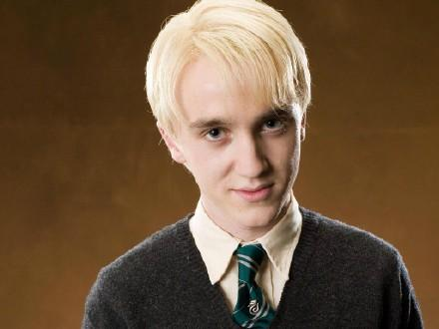
素材背景：When Harry goes into Madam Malkin’s shop to get his school uniform, he comes across Malfoy. They have an interesting conversation.
素材解读：From what Malfoy says, the readers easily get a conclusion that Malfoy is arrogant and looks down upon all non-pure blood wizards, Muggles.
Tips：The dialogue should reflect a character’s emotions and attitudes. Sometimes, the same character may express different emotions as the plot progresses.

Slide 13
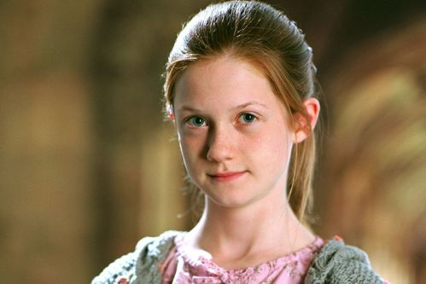
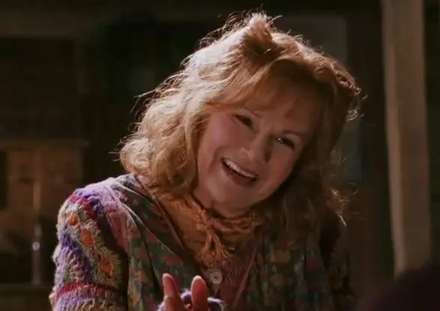
素材摘录2： "Oh, Mom, can I go on the train and see him, Mom, eh please...."
"You've already seen him, Ginny, and the poor boy isn't something you goggle at in a zoo.".
goggle /ˈɡɒɡl/ v. 瞪大眼睛看
“哦, 妈, 我能上车去看看他吗？妈，求求你……”
“你不是已经见过他了吗, 金妮。那可怜的孩子可不是动物园里让你看的动物呀。”
and the
Sorcerer’s Stone

Slide 14
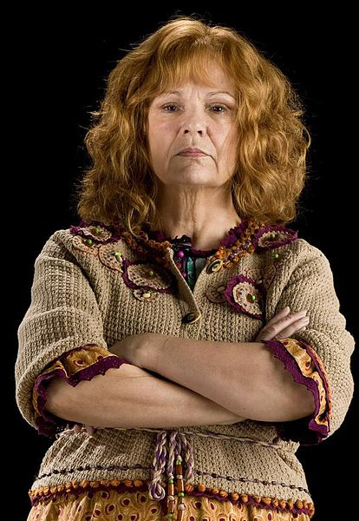
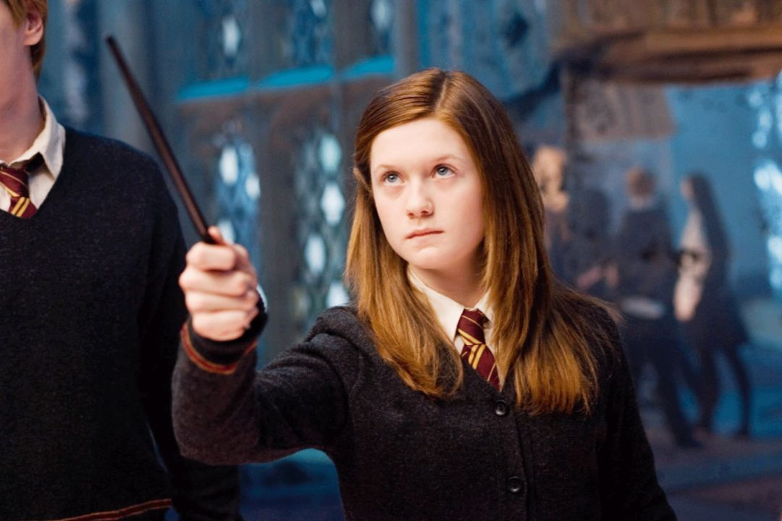
素材背景：Harry meets the Weasley twins on the train to Hogwarts. When their sister Ginny, who is seeing them off, is told the boy she met a moment ago is Harry, the legend, she is eager to see him again. But her mother, Molly Weasley refuses her request.
素材解读：Ginny talks to her mother in a pettishly charming manner, showing she usually is a obedient girl but this time, curiosity wins.
From Ms. Weasley’s reply, the
readers can see she is kind and
considerate. She respects Harry
and she is trying her best to
protect him.
and the
Sorcerer’s Stone

Slide 15
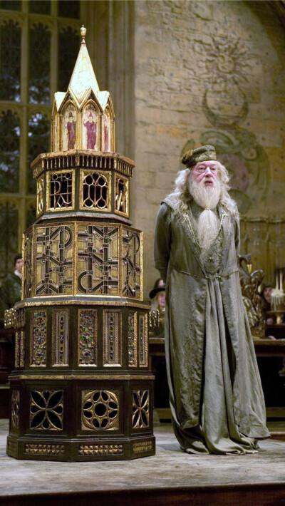
取胜第四招：语言描写要有节奏
素材摘录1："Everyone pick their favorite tune," said Dumbledore, "and off we go!"
tune /tjuːn/ n. 曲调;曲子
“每个人都选自己喜欢的调子唱,”邓布利多说, “预备, 唱!”
素材背景：Before the students go to bed, Dumbledore asks them to sing the school song together.
素材解读：As the principal of Hogwarts, he gives the students simple and direct requirement. So the writer uses the short sentences.
The way of singing school songs is indeed rare. The principal allows everyone to choose their favorite tune to sing. "Everyone sang it in a scattered manner, while the Weasley twins sang it slowly with funeral melodies. Finally, after singing, Dumbledore applauded them loudly. "

Slide 16
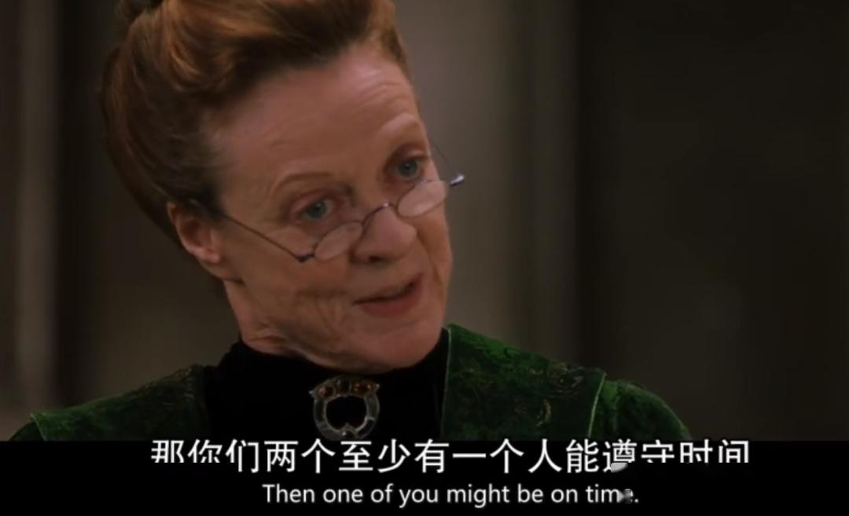
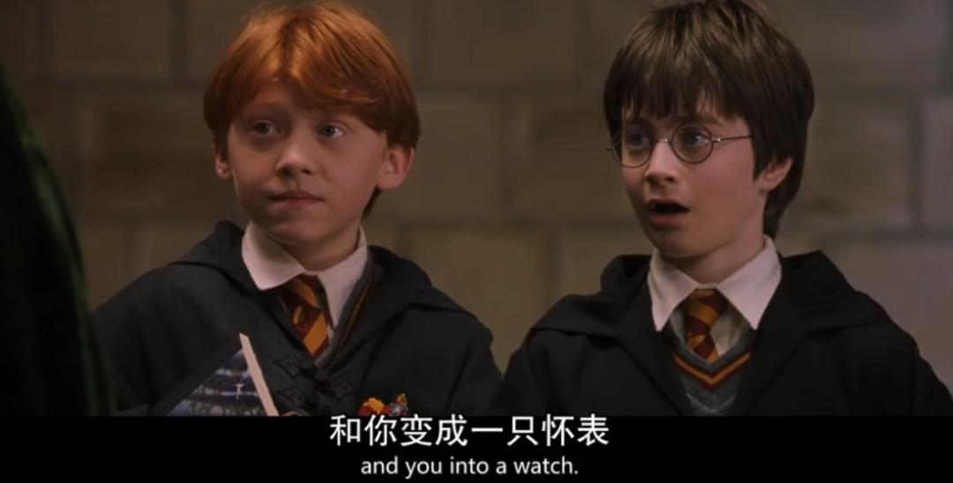
素材摘录2："Transfiguration is some of the most complex and dangerous magic you will learn at Hogwarts," she said. "Anyone messing around in my class will leave and not come back. You have been warned."
她说: “变形术是你在霍格沃茨学到的最复杂、最危险的魔法之一。任何在我班上捣乱的人都会离开，不再回来。我已经警告过你们了。”
transfiguration 变形
complex /ˈkɒmpleks/ adj.复杂的
and the
Sorcerer’s Stone

Slide 17
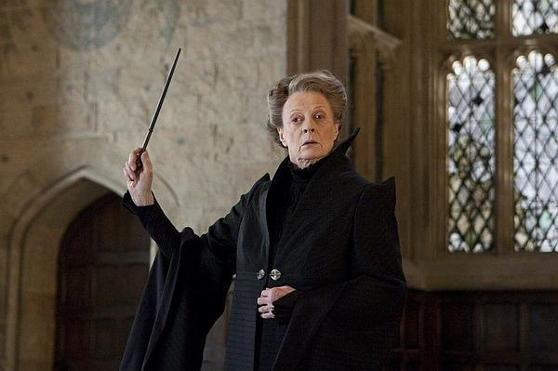
素材背景：Professor McGonagall is strict and clever. She gives the first years a talking-to the moment they sit down in her first class. So they think she isn't a teacher to cross.
素材解读：It’s McGonagall’s first class, so she needs to make it clear what can be done in her class and what cannot. The writer uses long sentences to make the class rules clear to the students. Yet the last one is a conclusion, so a short sentence is used.
Tips：Different oral language rhythm should be used in different situations. Sometimes it is simple and short, sometimes it is long and detailed.

Slide 18
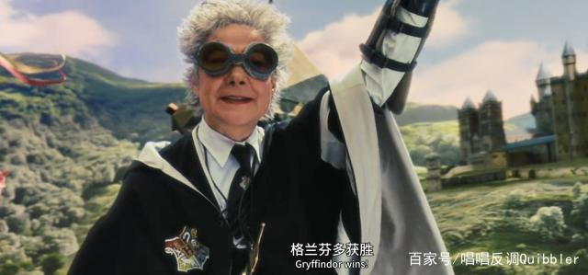
取胜第五招：语言描写推动故事发展
素材摘录： "Well, what are you all waiting for?" she barked. "Everyone stand by a broomstick. Come on, hurry up."
bark /bɑːk/ v. 厉声质问; (狗)吠叫
broomstick /ˈbruːmstɪk/ n. 扫帚柄(传说中巫婆用以飞行)
“好了，你们大家还等什么?” 她厉声说道, “每个人都站到飞天扫帚旁边。来吧, 快点。”
素材背景：Madam Hooch is the teacher of flying lessons. It’s their first class.
Tips：Oral language can be used to foreshadow or move the story along.

Slide 19
取胜第六招：语言描写交代故事来龙去脉
素材摘录： "No, no, no. I tried to kill you. Your friend Miss Granger accidentally knocked me over as she rushed to set fire to Snape at that Quidditch match. She broke my eye contact with you. Another few seconds and I'd have got you off that broom. I'd have managed it before then if Snape hadn't been muttering a countercurse, trying to save you."
counter前缀，“相反的”
“不, 不, 不, 想害死你的是我。那次魁地奇比赛的时候, 你的朋友格兰杰小姐冲过来给斯内普施咒, 无意中把我撞倒了。她打断了我对你的盯视。只要再坚持几秒钟, 我就能把你从飞天扫帚上摔下来了。如果不是斯内普一直在旁边念一个反咒, 想保住你的性命, 我早就把你摔死了。”
and the
Sorcerer’s Stone

Slide 20
素材背景：When Harry goes into the last chamber where he thinks the sorcerer‘s stone is, he finds Quirrell not Professor Snape. Quirrell tells Harry the truth that it is he not Snape tries several times to kill him.
素材解读：From what Quirrell says, the readers know the whole story from soup to nuts.
Tips： Oral language can be used to tell the readers the ins and outs of the story.

Slide 21
Have a practice 1
Fill in the blanks, using the proper words to finish the conversation and pay attention to what characteristics each speaker shows from the dialogue.
After the Voldemort was defeated at the beginning of the story. Everywhere everyone was celebrating. Professor McGonagall thought they should be more careful.
“ ____________________(你不能责怪他们)," said Dumbledore gently. "We've had precious little to celebrate for eleven years."
“I know that,” said Professor McGonagall irritably. “But that’s _______________________ (不是我们昏头的理由). People are being _________ (十足的) careless, out on the streets _______________ (光天化下), not even dressed in Muggle clothes, swapping rumors.”
You can't blame them
no reason to lose our heads
downright
in broad daylight

Slide 22
Have a practice 2
Fill in the blanks, using the proper words to finish the conversation and pay attention to what characteristics, emotion and background you can get from the dialogue.
Hagrid brought Harry in a buddle to the Dursleys' house where McGonagall and Dumbledore were waiting. When it was time to say goodbye, Hagrid let out a howl like a wounded dog.
“Shhh!” hissed Professor McGonagall, “ ___________ (你会吵醒) the Muggles!”
“S-s-sorry,” sobbed Hagrid, taking out a large, spotted handkerchief and burying his face in it. “But I c-c-can’t ________ (忍受) -- Lily an' James dead -- an' poor little Harry off ter (have to) live with Muggles -"
you'll wake
stand it

Slide 23
Have a practice 3
Fill in the blanks, using the proper words to finish the conversation and pay attention to what characteristics each speaker shows.
Harry and Ron met on the train to Hogwarts for the first time. When Harry was comforting Ron, Ron was shocked Harry mentioned Voldemort.
“_________________________________ (我并不是为了显示勇敢什么的), saying the name,” said Harry, “I just never knew you shouldn’t. See what I mean? _____________________ (我有很多东西要学) .... I bet,” he added, voicing for the first time something that had been worrying him a lot lately, “I bet __________________ _________(我是班上最差的).”
“_____________ (你不会的). There’s loads of people who come from Muggle families and they learn quick enough.”
I'm not trying to be brave or anything
I’ve got loads to learn
I’m the worst in
the class
You won’t be

Slide 24
Many thanks!
Goodbye!

