Slide 1
感恩遇见，相互成就，本课件资料仅供您个人参考、教学使用，严禁自行在网络传播，违者依知识产权法追究法律责任。
更多教学资源请关注
公众号：溯恩英语
知识产权声明

Slide 2
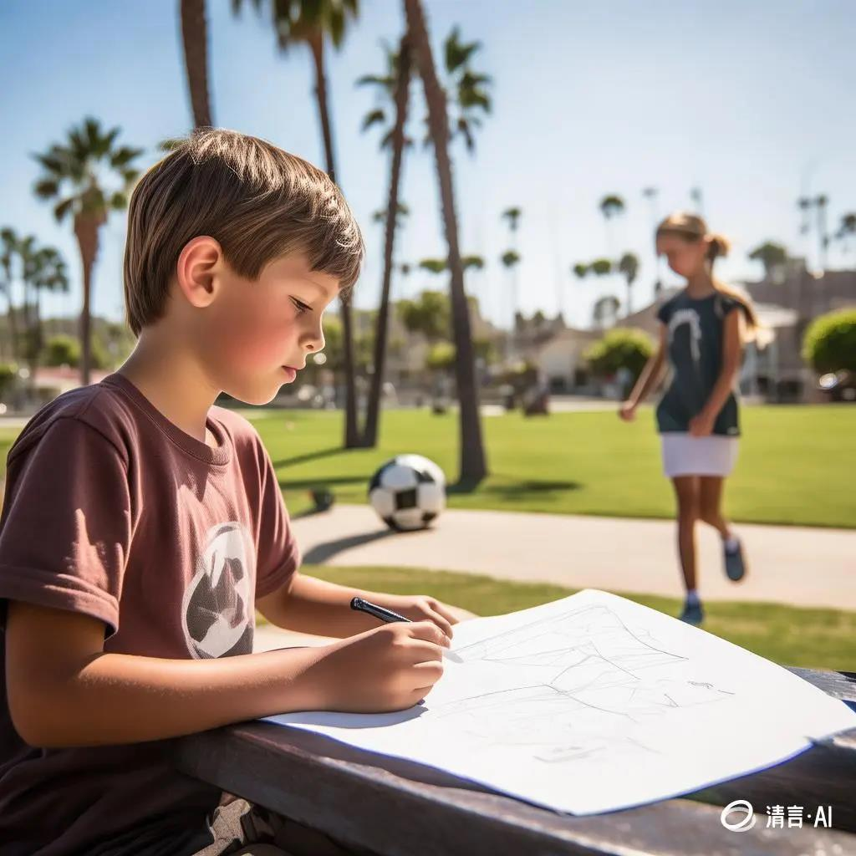
Ice- breaking Drawing ---2024-11 金华十校
人与社会之友谊篇
郑素红

Slide 3
读原文:
Knock-knock-knock. “Hello? ” I called timidly through my cousin Anita’ s bedroom door. No answer. There's no way she forgot I was moving in today, right? I thought. “Anita? It's me, Norah! ” I called again.
I had only met my cousin once a couple of years ago when Anita and Aunt Sonam had flown to California to visit. Mom had hoped Anita and I would be friends. But all Anita wanted to talk about was soccer, which was practically a foreign language to me. Secretly, I had felt relieved when the visit was over.
Now, I was standing in my aunt's tiny apartment in New York City, and there was still no answer from Anita. I knocked again, a little louder this time. Finally, Anita opened the door. She apologized, saying she had been listening to music. But instead of inviting me in, Anita frowned at my massive suitcase.

Slide 4
Behind her, I could see a blue beanbag chair crowded next to a bunk bed（上下铺）. In my old room in California, I'd had a double bed all to myself, and my original artwork had covered all the walls. Anita's walls, on the other hand, were covered with posters of the U. S. women's soccer team. I didn't see any free space to hang anything else.
“C-can I come in? ” I asked, blushing. Anita nodded, but she barely moved. I had no choice but to squeeze by her into the room. I put my stuff against the wall and Anita started bouncing the soccer ball from her foot to her knee and back again. Suddenly, her foot kicked the ball at an odd angle, and it accidentally flew toward me. “Whoops! ” Anita called. “Think fast! ”
But I was still taking in the surroundings, so the ball caught me off guard and bounced off my shoulder. Forcing a smile, I pretended it didn't bother me. Unsure of what to do, I took out my sketchbook（素描本） and colored pencils and sat down. Just holding my sketchbook made me feel more at ease. I started sketching aimlessly while Anita went back to bounce her ball.
Para1: Suddenly, it dawned on me that I could draw Anita in action.
Para2: Anita studied the drawing carefully.

Slide 5
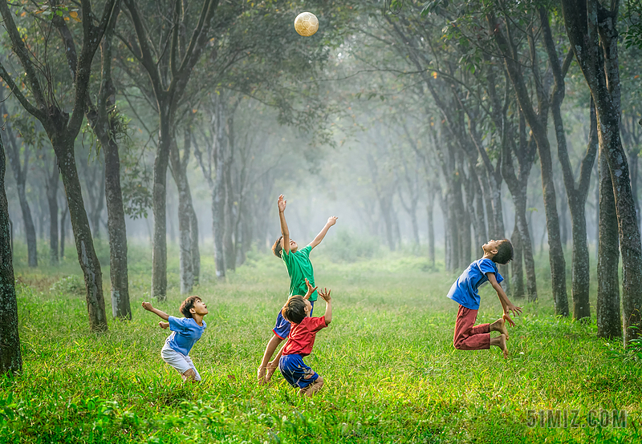
Read for elements
Major roles: Anita & I
Minor roles : Mother ; Aunt Sonam （几乎可以不写）
2. narrative perspective: first-person ( I )
3. time： a couple of years ago & now
place： a tiny apartment in New York City
event: I moved into Anita’s room.
6. Analyze
conflicts
Conflict : Anita and I had different hobbies.
Solution: Anita and I were bonded by art and football.

Slide 6
5.
story
line
Read for elements
Climax
Feeling uneasy, I took out my sketchbook and started sketching aimlessly while Anita focused on her soccer.
Para1: Suddenly, it dawned on me that I could draw Anita in action.
Anita seemed not to show a warm welcome to me and bounced her football in her room.
Now I moved into Aunt Sonam’s tiny apartment in New York City.
Para2: Anita studied the drawing carefully.
A couple years ago, Anita visited my family, but due to our different hobbies, we didn’t get along well.
background
Ending
Beginning

Slide 7
Read for elements
Read for clues and echoes
hidden clues | echoes
I had only met my cousin once a couple of years ago when Anita and Aunt Sonam had flown to California to visit. Mom had hoped Anita and I would be friends. But all Anita wanted to talk about was soccer, which was practically a foreign language to me. Secretly, I had felt relieved when the visit was over. | 1. Never in my wildest dream had I imagined that Anita maintained her enthusiasm for soccer for so long.

Slide 8
Read for elements
Read for clues and echoes
hidden clues | echoes
Now, I was standing in my aunt's tiny apartment in New York City, and there was still no answer from Anita. I knocked again, a little louder this time. Finally, Anita opened the door. She apologized, saying she had been listening to music. But instead of inviting me in, Anita frowned at my massive suitcase. | 2. As her eyes scanned the drawing, her face cracked into a radiant smile.

Slide 9
Read for elements
Read for clues and echoes
hidden clues | echoes
Behind her, I could see a blue beanbag chair crowded next to a bunk bed（上下铺）. In my old room in California, I'd had a double bed all to myself, and my original artwork had covered all the walls. Anita's walls, on the other hand, were covered with posters of the U. S. women's soccer team. I didn't see any free space to hang anything else. | 3. Casting an appreciative glance at me, she asked me if she could have it and put it on the posters. Wearing a proud smile on my face, I nodded readily, offering to help her to paste it onto the wall. 4. Staring at the newly-added drawing, Anita declared confidently and enthusiastically, “I hope to join the US women's soccer team in future! Thank you for bringing my dream closer!”

Slide 10
Read for elements
Read for clues and echoes
hidden clues | echoes
“C-can I come in? ” I asked, blushing. Anita nodded, but she barely moved. I had no choice but to squeeze by her into the room. I put my stuff against the wall and Anita started bouncing the soccer ball from her foot to her knee and back again. Suddenly, her foot kicked the ball at an odd angle, and it accidentally flew toward me. “Whoops! ” Anita called. “Think fast! ” | 5. Listening to the ear-catching rhythm of Anita’s hitting the football, I intently observed Anita bouncing her ball from her foot to her knee and back repeatedly. She was completely immersed in her soccer with her eyes locked onto the ball all the time.

Slide 11
Read for elements
Read for clues and echoes
hidden clues | echoes
But I was still taking in the surroundings, so the ball caught me off guard and bounced off my shoulder. Forcing a smile, I pretended it didn't bother me. Unsure of what to do, I took out my sketchbook（素描本） and colored pencils and sat down. Just holding my sketchbook made me feel more at ease. I started sketching aimlessly while Anita went back to bounce her ball. | 7. Colored pencils dancing happily on the page, an overwhelming sense of admiration for Anita welled up inside me. As I was occupied in capturing every detail of her dynamic movements, my initial embarrassment and awkwardness gave way to calmness and ease.

Slide 12
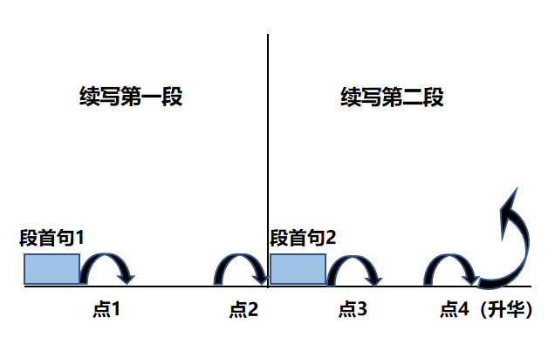
Plot Continuation
点1：位于续写第一段段首，流畅衔接前面的故事（常与原文最后一段呼应）和第一段段首语；
点2：位于续写第一段段尾，流畅衔接第二段段首句；
点3：位于续写第二段段首，续写衔接第二段段首语；
点4：文章结尾升华，给予读者正能量，揭示和强调主题。

Slide 13
Plot the continuation story
Para1: Suddenly, it dawned on me that I could draw Anita in action.
Para2: Anita studied the drawing carefully.
Link1: How did I feel?
Body: What did I do then? What did Anita show me ?
Link2: What happened to my drawing?
Link3: How did she feel?
Body: What did Anita do with the drawing? How did I feel? What did I do?
Ending: What was the ending of the adventure?

Slide 14
心理描写
神态描写
动作描写
外貌描写
环境描写
对话描写
语言
无灵主语
动作链
分词作状语
With 复合结构
独立主格
从句
倒装句
虚拟语气
强调句
长短句结合
考生构思情节的同时，要考虑合适的语言句式以及修辞

Slide 15
Design link1
Para1: Suddenly, it dawned on me that I could draw Anita in action.
Link1A: (呼应原文最后一段holding my sketchbook made me feel more at ease 以及所给句 draw Anita in action ） A faint smile appearing at the corner of my mouth, I quickly flipped to a blank page. Listening to the ear-catching rhythm of Anita’s hitting the football, I intently observed Anita bouncing her ball from her foot to her knee and back repeatedly.
Link1B: （呼应所给首句： draw Anita in action） I watched her closely as she continued to bounce the soccer ball with skill and concentration.

Slide 16
Design link2
Para1: Suddenly, it dawned on me that I could draw Anita in action.
Para2： Anita studied the drawing carefully.
Link2 A: (呼应第二段所给句 首句，暗示drawing 已经跃然纸上且引起她的关注) Time fleeting, a vivid drawing took shape/ formed on the paper, which attracted Anita’s attention.
Link2 B: (呼应第二段所给句 首句，暗示drawing 已经画好，我主动把画给Anita欣赏) No sooner had I accomplished my art creation than I showed/ demonstrated it to Anita.

Slide 17
Design link3
Para2: Anita studied the drawing carefully.
Link3A: (认真看画的Anita会有表情显现） As her eyes scanned the drawing, her face cracked into a radiant smile.
Link3B: (认真看画的Anita会有情感流露） Overwhelmed by a wave of surprise, Anita almost jumped at the drawing, saying, “ It’s just incredible! You are a genius!”

Slide 18
Design ending
Para2: Anita studied the drawing carefully.
Ending A: (我俩虽然爱好迥异，但是素描让我们的关系破冰) Thanks to the drawing, I found a subtle way to bridge the gap between us. Meanwhile, a seed of a beautiful friend was sown in our hearts despite our distinct differences in hobbies.
Ending B: (我俩各自的爱好都很投入，展望未来 并回扣两个妈妈希望我们成为朋友的美好愿望)
Knowing the ice between us began to melt, I breathed a sigh of relief,
convinced that my devotion to art and her dedication to soccer would make us befriend each other.

Slide 19
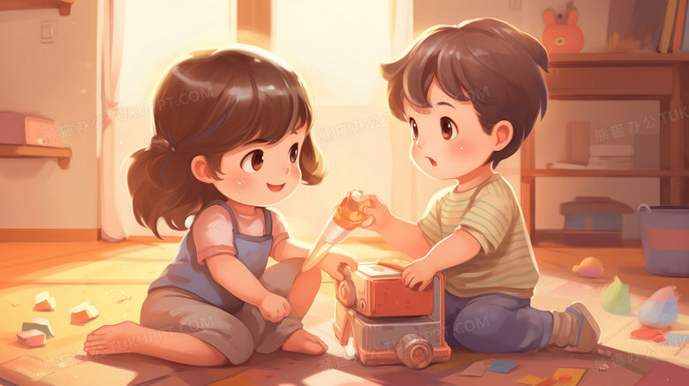
习作
Para1: Suddenly, it dawned on me that I could draw Anita in action.
A faint smile appearing at the corner of my mouth, I quickly flipped to a blank page. Listening to the ear-catching rhythm of Anita’s hitting the football, I intently observed Anita bouncing her ball from her foot to her knee and back repeatedly. She was completely immersed in her soccer with her eyes locked onto the ball all the time. Never in my wildest dream had I imagined that Anita maintained her enthusiasm for soccer for so long. Colored pencils dancing happily on the page, an overwhelming sense of admiration for Anita welled up inside me. As I was occupied in capturing every detail of her dynamic movements, my initial embarrassment and awkwardness gave way to calmness and ease. Time fleeting, a vivid drawing took shape, which attracted Anita’s attention. (130)

Slide 20
Para2: Anita studied the drawing carefully.
As her eyes scanned the drawing, her face cracked into a radiant smile. Eyes sparkling with excitement mingled with joy, Anita exclaimed, “It's amazing, Norah! You make me look like a super football star!” Casting an appreciative glance at me, she asked me if she could have it and put it on the posters. Wearing a proud smile on my face, I nodded readily, offering to help her to paste it onto the wall. Staring at the newly-added drawing, Anita declared confidently and enthusiastically, “I hope to join the US women's soccer team in future! Thank you for bringing my dream closer!” Thanks to the drawing, I found a subtle way to bridge the gap between us. Meanwhile, a seed of a beautiful friend was sown in our hearts despite our distinct differences in hobbies. (135)

Slide 21
社会关系类
该故事模型涉及人际交往、社区服务、团队合作、家庭关系、友情维护、职场竞争等方面，是目前高考出现最频繁的话题之一。这类读后续写题隶属于“人与自我”“人与社会”两大主题语境，内容丰富多样。 “人与自我，人与社会”在读后续写文本中又会交错在一起，在社会中成就个人成长。

Slide 22
友情 同学情 师生情 邻里情 陌生人 之间的 情谊 | 共同 经历 | 帮助与陪伴；照顾生病的人；给予关怀；社区服务；慈善活动等； 合作与竞争：学校或社区的合作项目；共同完成表演；个体间竞争； 应对困难：野外受困；学习遇困；成长的烦恼（心理；学习；比赛）
 | 人际关系 | 适应新环境；结识新朋友； 产生危机：缺乏沟通产生误会；关系疏远； 关系修复：道歉反思（老师调解、家人点拨，同学安慰）；采取行动（消除误会，融入集体）感谢感恩（合作的力量，善待与包容，感谢感恩，沟通的重要性；社会责任感等）

Slide 23
社会关系类真题 ：
1.2024年6月新高考I卷 维也纳之约 （ 陌生人之间诚信互助）
2.2022年6月浙江卷 我的志愿者经历 （友善互助，让世界更美好）
3.2020年6月新高考I卷 帮穷人家的孩子挣钱 （友善互助，让世界更美好）
4.2022年1月浙江卷 学渣与学霸合作 （学校生活，互相学习，成就成长）
5.2021年6月新高考I卷 双胞胎为母亲做惊喜早餐 （家庭生活，亲情与爱）
6.2021年6月浙江卷 我打工赚钱补贴家用 （家庭生活，亲情与爱）
7.2021年1月浙江卷 万圣节趣事之南瓜卡头 （ 家庭生活趣事，喜悦美好）
8.2017年11月 浙江卷 和健忘妈妈一起旅行的经历 （家庭生活趣事，善良）

Slide 24
对话描写 –小贴士
续写对话描写不宜过多，对话描写一般要控制在一个或者两个对话即可。一般对话描写适合与人物之间两两互动，往往为了推动情节。
如本文Anita 看了我的素描后，应该会说点什么，根据原文 In my old room in California, I‘d had a double bed all to myself, and my original artwork had covered all the walls. 可见我的画画水平还可以，由此可以推断Anita 会赞叹：
As her eyes scanned the drawing, Anita exclaimed, “Norah, it’s amazing! You are a genius/ talent !”
结合原文Anita‘s walls, on the other hand, were covered with posters of the U. S. women’s soccer team. I didn‘t see any free space to hang anything else. 可以再设计一个对话，表明Anita的志向；
2. Staring at the newly-added drawing, Anita declared confidently and enthusiastically, “I hope to join the US women's soccer team in future! Thank you for bringing my dream closer!”

