Slide 1
感恩遇见，相互成就，本课件资料仅供您个人参考、教学使用，严禁自行在网络传播，违者依知识产权法追究法律责任。
更多教学资源请关注
公众号：溯恩英语
知识产权声明

Slide 2
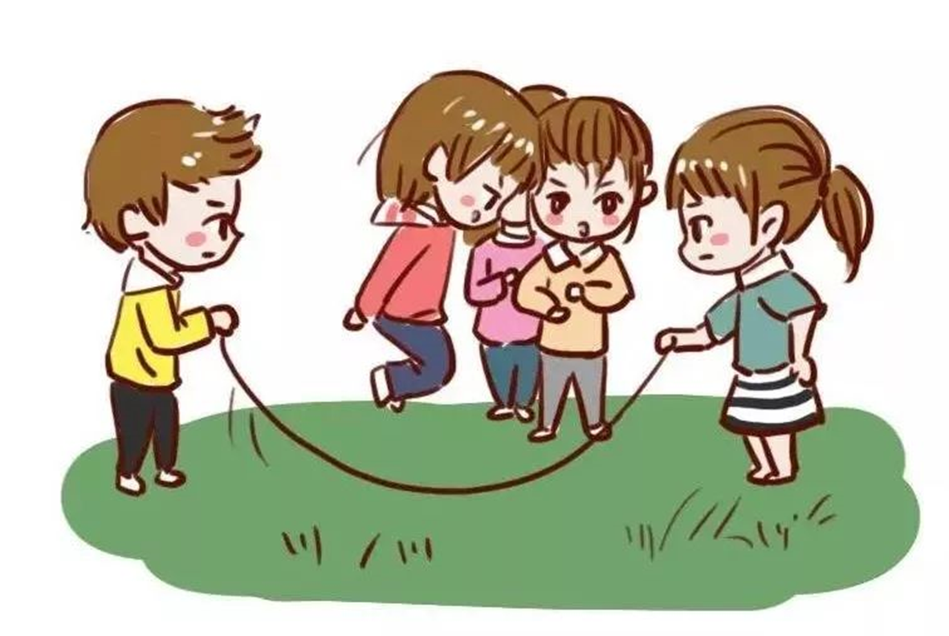
2024年11月稽阳联谊学校
高三联考英语
应用文：跳长绳活动
北师大嘉兴附中 吴晨华

Slide 3
审题与谋篇布局
假如你是李华，运动会临近，你想邀请外教Mr. Smith参加你们班的集体活动跳长绳（Long Rope Jumping）请你写一封邮件给他，内容包括：
1.介绍该运动；2.准备事宜。
邀请信
体裁：
时态：
人称：
结构：
一般将来时+一般现在时
第一、二人称
Para.1 background+ writing purpose
问候+提出邀请
Para.2 introduction and preparations
活动形式、特点、意义+准备事项
Para.3 hope
再次邀请+愿意提供帮助
注意：
须凸显吸引力

Slide 4
Para.1
background+ writing purpose
问候+提出邀请
假如你是李华，运动会临近，你想邀请外教Mr. Smith参加你们班的集体活动跳长绳（Long Rope Jumping）请你写一封邮件给他，内容包括：
1.介绍该运动；2.准备事宜。
运动会临近，我写信来邀请你参加我们班的集体活动——跳长绳。
Hope this email finds you well
the much-anticipated sports meet
根据题目
转写第一段
As the school sports meet draws near/ approaches, I’m writing to invite you to participate in a collective activity with our class –long rope jumping.
a thrilling and engaging activity
I can hardly restrain my eagerness to extend a genuine invitation to you
, which may intrigue enthusiasts just like you/ undoubtedly deserves a joyful memory in your mind.

Slide 5
Para.1
background+ writing purpose
问候+提出邀请
Possible versions:
Hope this email finds you well. As the much-anticipated sports meet approaches, I can hardly restrain my eagerness to extend a genuine invitation to you to participate in a thrilling and engaging activity with our class –long rope jumping, which may intrigue enthusiasts just like you.
Hoppe this email finds you well. The much-anticipated sports meet is all set to take place. Here, I’m exceedingly delighted to invite you to join our class’s activity –long rope jumping, which undoubtedly deserves a joyful memory in your mind.

Slide 6
Para.2
introduction and preparations
活动形式、特点、意义+准备事项
1. 活动形式、特点
时间、地点
特点
形式（方式）
Nov. 10th at the school’s sports field
fantastic/ dynamic/ exhilarating/ team-oriented/ time-honored
简略版：two people swing a long rope rhythmically while others jump over it
详细版：Participants will be divided into teams, 12 members for each team, 2 of whom turn the rope and the rest jump over the rope one after another on end. The winner will be determined by the number of successful jumps within 3 minutes.
2. 活动意义
combine personal skills and collaborative efforts
a blend of teamwork spirit and physical exercise
foster teamwork and create moments of shared laughter
意义：
常用句式：
What…, which…（主语从句+定语从句/非谓语）
Not only… but also （倒装句）

Slide 7
Para.2
introduction and preparations
活动形式、特点、意义+准备事项
该活动定于11月10日在学校运动场举行。这是一项极好的活动，两个人有节奏地摆动一根长绳，另一个人跳过去。这是一项令人高兴的活动，不仅能培养团队合作精神，还能创造共同欢笑的时刻。
the activity, featuring collaborative efforts and skillful coordination, involves …,
Scheduled for Nov.10th at the school’s sports field,
The event is scheduled for Nov. 10th at the school’s sports field. It’s a fantastic activity where two people swing a long rope rhythmically while others jump over it. It’s an exhilarating activity which not only fosters teamwork, but also creates moments of shared laughter.
, which not only… but also…
Possible version:
Scheduled for Nov.10th at the school’s sports field, the activity, featuring collaborative efforts and skillful coordination, involves two students rhythmically swinging a long rope for others to jump over, which not only creates moments of shared laughter, but also fosters teamwork spirit.
化短为长

Slide 8
Para.2
introduction and preparations
活动形式、特点、意义+准备事项
advice + reasons
3. 准备事项
轻便的衣服和鞋子
一双舒适合脚的鞋子
做热身运动
积极乐观的心态
light clothes and shoes
a pair of comfortable and suitable sneakers
do some warm-up shoes
keep a positive mindset
to avoid unnecessary injuries;
to move flexibly and conveniently;
to ensure you a wonderful experience.
When it comes to preparations,
Possible version:
To ensure a smooth participation in the long rope jumping event, comfortable and suitable sneakers are highly recommended, and never forget to do warm-ups before the game, which can avoid unnecessary injuries and prepare your body for the game. Since we have practiced it diligently, you can come only with a positive mindset.

Slide 9
Para.2
introduction and preparations
活动形式、特点、意义+准备事项
Possible versions:
Scheduled for Nov.10th at the school’s sports field, the activity, featuring collaborative efforts and skillful coordination, involves two students rhythmically swinging a long rope for others to jump over, which not only creates moments of shared laughter, but also fosters teamwork spirit. To ensure a smooth participation in the long rope jumping event, comfortable and suitable sneakers are highly recommended, and never forget to do warm-ups before the game, which can avoid unnecessary injuries and prepare your body for the game. Since we have practiced it diligently, you can come only with a positive mindset.

Slide 10
Para.3
hope
再次邀请+愿意提供帮助
再次邀请：
1. “想见到你的到来”
We’re looking forward to seeing you jump with us soon!
We’re excited to see you there and share this unforgettable moment with you!
We would be absolutely thrilled if you could join us!
2. “你的到来很重要”
Your presence would mean a lot to us, adding even more enthusiasm and energy to our team.
We’re eagerly looking forward to your presence at our dynamic event, which is bound to be an experience filled with joy and fun.
3. “想要你的肯定回复”
Hopefully, I could receive your favorable response at your earliest convenience.
愿意提供帮助：
Should you have any questions or need assistance, feel free to reach out.
吸引力再现

Slide 11
Possible version1:
Dear Mr. Smith,
As the much-anticipated sports meet approaches, I can hardly restrain my eagerness to invite to you to participate in an engaging activity with our class –long rope jumping, which may intrigue enthusiasts just like you.
Scheduled for Nov.10th at the school’s sports field, the activity, featuring collaborative efforts and skillful coordination, involves two students rhythmically swinging a long rope for others to jump over, which not only creates moments of shared laughter, but also fosters teamwork spirit. To ensure a smooth participation in the event, comfortable and suitable sneakers are highly recommended, and never forget to do warm-ups before the game, which can avoid unnecessary injuries and prepare your body for the game.
Your presence would mean a lot to us, adding even more enthusiasm and energy to our team. Should you have any questions or need assistance, feel free to reach out.
Yours,
Li Hua

Slide 12
Possible version2:
Dear Mr. Smith,
I hope this email finds you well. As the school sports meet draws near, I am writing to cordially invite you to participate in a thrilling and engaging activity with our class –long rope jumping.
The event is scheduled for Nov. 10th at the school’s sports field. It’s a fantastic activity where two people swing a long rope rhythmically while others jump over it. As it requires our perfect collaboration, a practice session is to be arranged to familiarize you with the basic rules and techniques. Please let me know a convenient time for you this week. Do wear comfortable shoes suitable for jumping.
Thank you considering. We’re looking forward to seeing you jump with us soon!
Yours,
Li Hua

Slide 13
同类拓展
2024.9嘉兴基础测试：
假定你是李华，你校承办的国际夏令营计划开展体育嘉年华活动(Sports Carnival) 现向学生征集趣味运动项目。请你给负责人 David写一封邮件，内容包括: 1．提议一个项目; 2、阐述实施方案。

Slide 14
Dear David,
Yours,
Li Hua
Thrilled to know that you’re looking for fun activities for the Sports Carnival, I highly propose Jump Rope Relay, which not only is entertaining to attend and convenient to organize but also helps foster team work and friendly competition.
To carry it out, participants will be divided into teams, 12 members for each team, 2 of whom turn the rope and the rest jump over the rope one after another on end. The winner will be determined/ crowned by the number of successful jumps within 3 minutes. Also of primary note is the rope should be sturdy and long enough. Besides, the school play ground can be the venue.
It will definitely add excitement and bring a lot of laughter to our carnival. I’d appreciate it if my proposal could be adopted. Wish a complete success.

Slide 15
同类拓展
2024.1浙江首考：
请你写一篇短文向校英文报“Sports and Health”栏目投稿，向同学们推荐一项适合课间开展的运动，内容包括：1.介绍这项运动；2. 说明推荐理由。

Slide 16
Stand up and Exercise, Everybody!
In order to take advantage of the breaks and improve our well-being, I highly recommend Jump Rope, which is a simple relaxation exercise.
To carry it out, it doesn’t require any special equipment or facilities but a skipping rope and some space. And it involves swinging a rope over one’s head while jumping over it. You could total the successful jumps with the designated time and have a competition with others. It not only can be done individually or in groups, making it a social and interactive exercise, but also suitable for students of all ages and fitness levels. As a great way to keep fit, rope skipping can also help students relieve our academic pressure.
In conclusion, skipping rope, literally beneficial for our physical and mental well-being, is a good choice during a short break. So stand up and exercise, every body!

Slide 17
Stand up and Exercise, Everybody!
Sports in the school breaks are essential for maintaining our good health and boosting overall well-being. Therefore, I would like to recommend a great exercise that is not only enjoyable but also beneficial for students.
Jump rope, a simple yet effective form of exercise, has gained popularity worldwide for its numerous health benefits and convenience. Known as skipping, it involves swinging a rope over one's head while jumping over it. It can be done individually or in groups, making it a versatile(多功能的)and inclusive(包容广阔的) activity for students of all ages and fitness levels. Regular participation in this exercise can help students enhance concentration, improve mood, and alleviate anxiety, thereby positively impacting students' academic performance.
Remember, staying active is key to a healthy body and mind. Let's take a leap towards a fitter and happier life with jump rope!

Slide 18
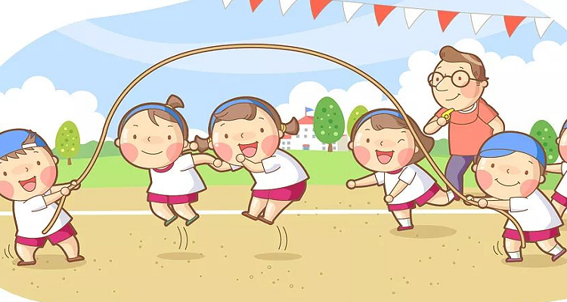
Thanks for your attention

