Slide 1
感恩遇见，相互成就，本课件资料仅供您个人参考、教学使用，严禁自行在网络传播，违者依知识产权法追究法律责任。
更多教学资源请关注
公众号：溯恩高中英语
知识产权声明

Slide 2
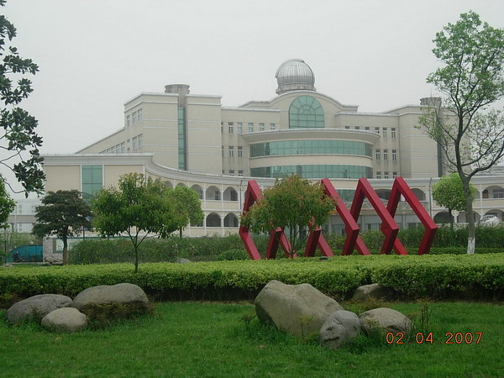
Changxing Senior High School, Zhengjiang Province
Mr. Young
Born on the morning of National Day
杨国晨

Slide 3
Mr. Young is a(n) ______ English teacher.
outstanding excellent
marvelous
terrific
superb
extraordinary
brilliant
remarkable
tremendous
fabulous
…
With your flattery (奉承), I feel more and more as if
I were on top of the world.

Slide 4
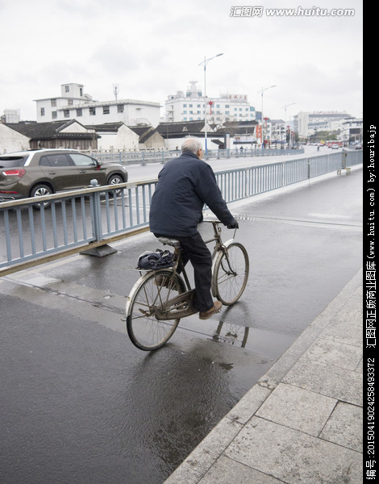
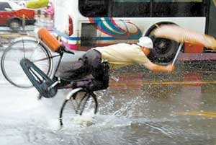
day-dreaming
The other day I rode slowly on my way to work, ____________
about being the best English teacher in the world.
I was so busy dreaming about all the praises I would get
that I ______________ everything else around me…
was unaware of

Slide 5
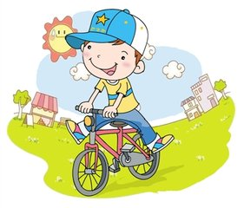
Paragraph 1
thinking about
Andy
day-dreaming
Andy rode slowly on his way to school, ____________ about the fishing trip that his father had promised him. He was so busy dreaming about all the fish he would catch that he ______________ everything else around him.
was unaware of

Slide 6
Paragraph 2
He rode along ____ a strange sound drew him to the present.
until
Mr. Young day-dreamed about all the praises he would get
until an extremely loud thunder drew him to the present.
draw sb./ oneself to the present
eg: After what seemed like a century, he drew himself to
the present.

Slide 7
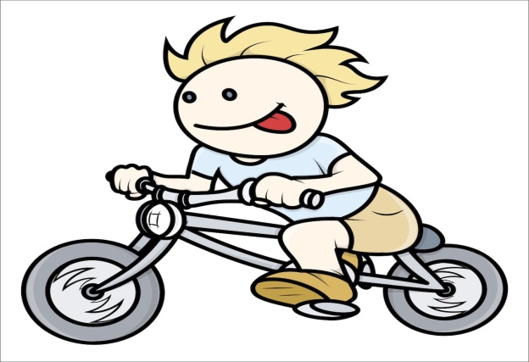
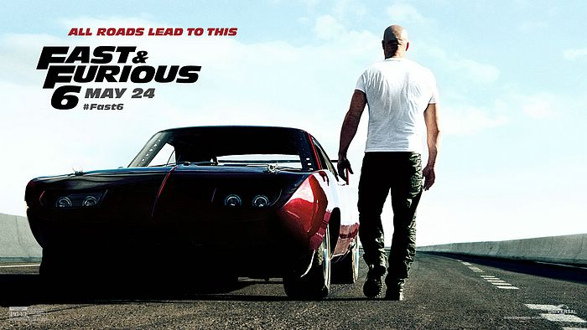
Paragraph 3
ran away quickly
With no time to waste, Andy sped off in the opposite direction, riding furiously.
with great energy, speed, or anger
They worked furiously all weekend in an attempt to get it finished on time.

Slide 8
Paragraph 3
With a rapidly beating heart and his legs pumping furiously, he sped down the rough road.
With his heart beating rapidly and his legs pumping furiously, he sped down the rough road.
As the bees came closer, his panic increased.
Suddenly, his father’s words came to him. “When you are in a tight situation, don’t panic. Use your brain and think your way out of it.”

Slide 9
Paragraph 5
1. Suddenly, out of the corner of his eyes, he spotted a small dam used by Mr. Nelson to irrigate his vegetable garden.
Out of the corner of sb.’s eyes, sb. spotted…
eg: Out of the corner his eyes, Mr. Young spotted a car racing
rapidly toward him from behind.
2. Dragging himself out of the dam, he struggled up the hilly
slope and rang the doorbell.
Dragging himself out of the dam, he struggled up the hilly
slope, ringing the doorbell.

Slide 10
Paragraph 5
3. Off his bike he got and into the cool water he dived, disappearing below the surface and away from the savage insects.
Full inversion (完全倒装）
用在表示方向、地点的副词或某些介词词组开头的句子里。如 there, here, out, in, up, down, away, in front of 等，以示强调。
On top of the mountain stands a temple.
注意：当主语是人称代词时，主语与谓语的语序不变
In he comes.

Slide 11
Full inversion (完全倒装）
1. The door opened and Mr. Smith came in.
The door opened and in came Mr. Smith.
2. A tiny spot came into my sight and it grew bigger and bigger. (倒装；定语从句)
Into my sight came a tiny spot, which grew bigger
and bigger.
3. The child tiptoed quietly to the bird. It flew away into
the forest when he was about to catch it.
The child tiptoed quietly to the bird. Away it flew into the forest when he was about to catch it.

Slide 12
Sentence bank
1. Andy rode slowly on his way to school, day-dreaming about... He was so… that he was unaware of…
2. He rode along until a strange sound drew him to the present.
3. With no time to waste, Andy sped off in the opposite direction, riding furiously.
4. With his heart beating rapidly and his legs pumping furiously, he sped down the rough road.
5. As the bees came closer, his panic increased.
6. Suddenly, his father’s words came to him. “…don’t panic.”
7. Suddenly, out of the corner of his eyes, he spotted…
8. Dragging himself out of the dam, he struggled up the hilly
slope, ringing the doorbell.
9. Off his bike he got and into the cool water he dived, disappearing below the surface and away from the savage insects.
…

Slide 13
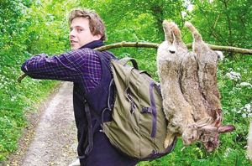
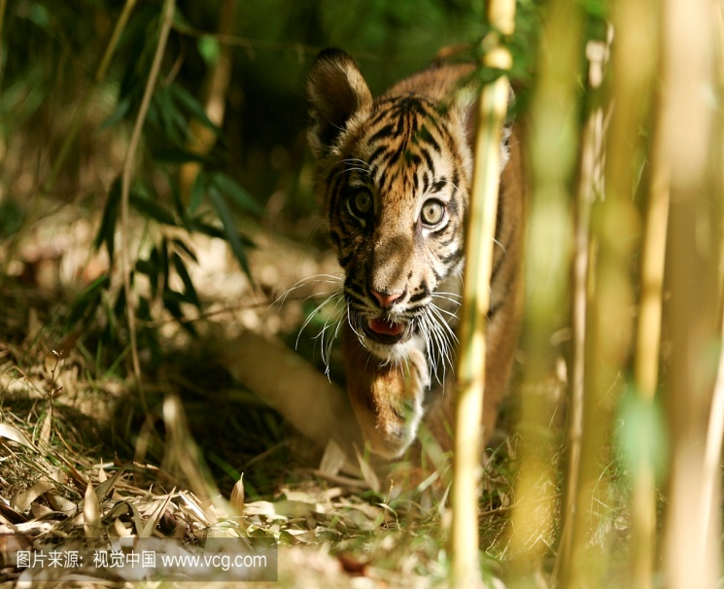
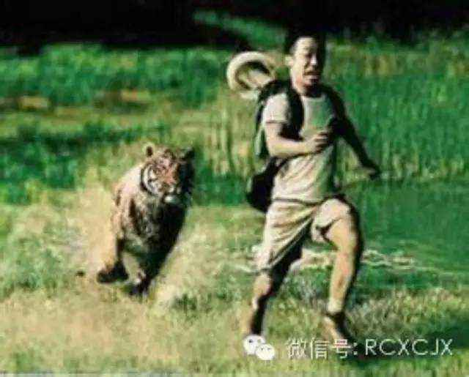
Using language
Tom walked slowly in the forest,
_________________ the big meal he
was to make with the prey.
day-dreaming about
He was so busy dreaming about the
feast that he was unaware of…
Tom the hunter
prey
Write a paragraph about Tom’s narrow escape (100 words)

