Slide 1
感恩遇见，相互成就，本课件资料仅供您个人参考、教学使用，严禁自行在网络传播，违者依知识产权法追究法律责任。
更多教学资源请关注
公众号：溯恩高中英语
知识产权声明

Slide 2
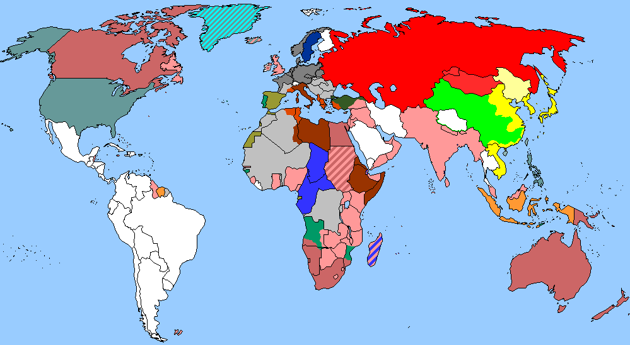
The World
July 16th-31st, 2022

Slide 3
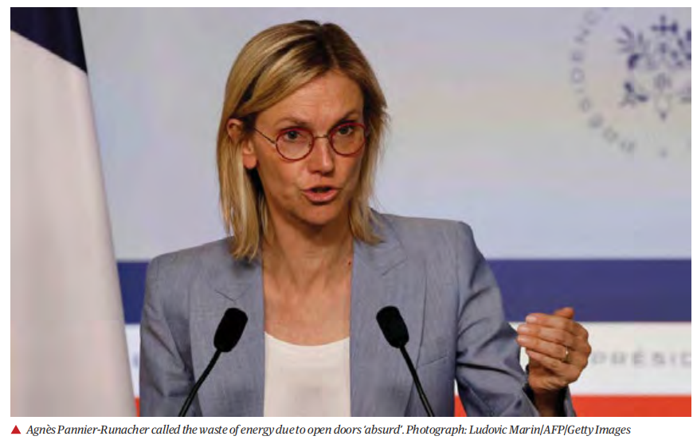
1. France orders air-conditioned shops to save energy by shutting doors 法国下令有空调商店营业时须关门

Slide 4
语篇填空
（《卫报》美国版 2022年7月26日 37页）
Air-conditioned shops throughout France will have to keep their doors shut ___ risk a fine of €750 (£635), a French minister has announced, after the ______ (mayor) of several major cities unveiled a similar rule during the country’s heatwave last week.
Agnès Pannier-Runacher, the minister for ecological transition, said leaving doors open _____ air conditioning on led to “20% more energy consumption and … is absurd”. A decree __________ (confirm) the decision will be issued in the coming days.
French electricity is cheap because of the country’s use of nuclear power, which produces about 70% of its needs, ____ the Russian gas crisis has prompted the president, Emmanuel Macron, to demand ___ energy “sobriety programme”.
Retail ______ (outlet) including major supermarkets have already agreed a plan under ______ they will switch off illuminated signs “as soon as the store closes” and “systematically reduce lighting intensity” by reducing shop-floor lighting levels.
Public premises will also be required _____ (set) thermostats higher in summer and lower in winter, while the public will __________ (expect) to turn off their wifi router and TV when they are away and switch off lights in rooms they are not using.
or
mayors
with
confirming
but
an
outlets
which
to set
be expected

Slide 5
词汇讲解
1. prompt: to make sb decide to do sth; to cause sth to happen
促使；导致；激起
The need for villagers to control their own destinies has prompted a new plan.
村民们想要掌握自己的命运，这促成了一项新的计划。
2. illuminate: to shine light on sth 照明；照亮；照射
Floodlights illuminated the stadium. 泛光灯照亮了体育馆。
The earth is illuminated by the sun. 太阳照亮地球。
翻译句子
他的讲话激起了人群中一男子的愤怒。
His speech prompted an angry outburst from a man in the crowd.
翻译句子
闪电照亮了黑沉沉的天空。
The black sky was illuminated by lightning.

Slide 6
句子翻译
Air-conditioned shops throughout France will have to keep their doors shut or risk a fine of €750 (£635), a French minister has announced, after the mayors of several major cities unveiled a similar rule during the country’s heatwave last week.
法国一位部长宣布，法国各地的空调商店必须保持关门，否则将面临750欧元（合635英镑）的罚款。此前，几个主要城市的市长在上周的热浪中公布了一项类似的规定。
翻译
Public premises will also be required to set thermostats higher in summer and lower in winter, while the public will be expected to turn off their wifi router and TV when they are away and switch off lights in rooms they are not using.
公共场所也将被要求在夏季调高和在冬季调低恒温器，而人们需要在离开房间时关闭无线路由器和电视，并关闭不使用房间的灯。
翻译

Slide 7
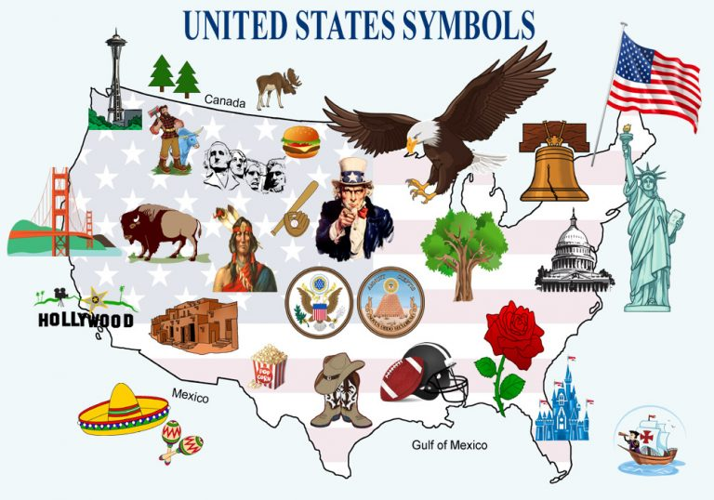
2. Official Symbols
美国官方标志

Slide 8
语篇填空1
（《鹅卵石》 2022年7月刊 13页）
In red-and-white-striped pants, a top hat, and a blue coat, illustrations of Uncle Sam have become a familiar symbol of the United States. The first “Uncle Sam” traces his roots to a real person. Samuel Wilson was __ honest, patriotic man in the meatpacking business in Troy, New York. During the War of 1812 (1812-1815), he provided barrels of meat ___ the U.S.Army. The barrels were marked with “U.S.” for United States, but his workers joked that the initials really stood for “Uncle Sam” Wilson.
In time, “Uncle Sam” ___________ (adopt) as a personification of the U.S. govemnment. Famous political cartoonist Thomas Nast was the first _______ (draw) Uncle Sam with whiskers in 1869. But _____ (use) his own face for a model artist J.M. Flagg gave Uncle Sam his now-familiar tall, thin, and serious look. Flagg’s famous World War I (1914-1918) enlistment poster shows Uncle Sam pointing a finger and saying, “I Want You for U.S.Army.”
an
for
was adopted
to draw
using

Slide 9
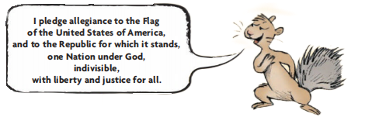
语篇填空2
（《鹅卵石》 2022年7月刊 14页）
has gone
The Pledge of Allegiance ________ (go) through a few changes since it was introduced in September 1892. Minister and author Francis Bellamy wrote the _______ (origin) 23-word version. It appeared in The Youth’s Companion, a popular children’s _________ (publish). Bellamy hoped to get young people feeling patriotic and involved in the upcoming World’s Columbian Exposition in Chicago. President Benjamin Harrison approved the pledge’s recitation in public schools during dedication __________ (ceremony) for that international fair on October 12,1892.The pledge has been revised by the addition of words over the years. Bellamy’s draft did not include “the United States of America” or “under God”. It also has been contested by some people for violating First Amendment rights. It was ________ (official) recognized as the nation’s oath on June 22, 1942, during World War Il (1939-1945).
original
publication
ceremonies
officially

Slide 10
词汇讲解
1. patriotic:having or expressing a great love of your country 爱国的
Patriotic songs have long been a feature of Kuwaiti life. 爱国歌曲长期以来一直是科威特人生活的一个特点。
2. violate: to go against or refuse to obey a law, an agreement, etc. 违反，违犯，违背（法律、协议等）
Thirty-four protesters were arrested for violating criminal law. 34名抗议者因违反刑法被逮捕。
翻译句子
投票是你爱国义务的一部分。
Voting is part of your patriotic duty.
翻译句子
他们因犯法而入狱。
They went to prison because they violated the law.

Slide 11
句子翻译
In red-and-white-striped pants, a top hat, and a blue coat, illustrations of Uncle Sam have become a familiar symbol of the United States. The first “Uncle Sam” traces his roots to a real person.
穿着红白条纹裤子，戴着礼帽，穿着蓝色外套的山姆大叔的插图已经成为人们熟悉的美国的象征。第一个“山姆大叔”的根源可以追溯到一个真实的人。
翻译
Minister and author Francis Bellamy wrote the original 23-word version. It appeared in The Youth’s Companion, a popular children’s publication. Bellamy hoped to get young people feeling patriotic and involved in the upcoming World’s Columbian Exposition in Chicago.
牧师兼作家弗朗西斯·贝拉米撰写了最初的23字版本。它发表在一本很受欢迎的名为《青年伙伴》儿童刊物上。贝拉米希望唤起年轻人的爱国情怀，并参与即将在芝加哥举行的世界哥伦比亚博览会。
翻译

Slide 12
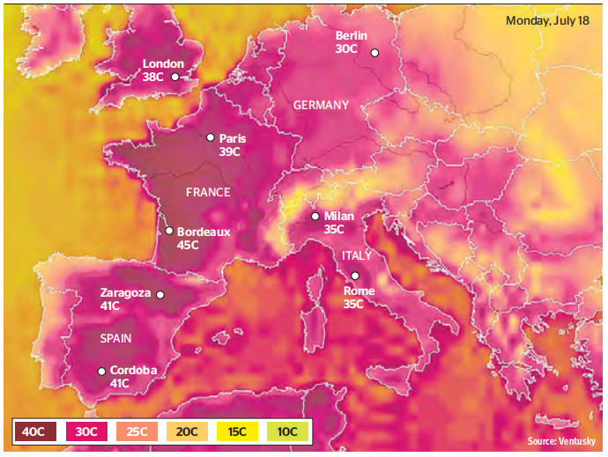
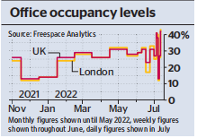
3. Workers flock back to their offices for the air conditioning
酷暑难耐，居家上班族逃往办公室蹭空调

Slide 13
语篇填空
（《泰晤士报》 2022年7月16日 19页）
______ Jacob Rees-Mogg failed, the British weather appears to have succeeded. Home workers hot under the collar from the heatwave have been returning to ____ (they) desks in droves as they seek out the cooling effect of office air conditioning.
Average office occupancy across the country reached 42 percent on Tuesday, making __ an equal record for the busiest Tuesday of ___ year so far. Occupancy on the usually quieter day of Monday reached 27 percent, making that an equal record for the busiest Monday this year.
Office occupancy was even ______ (high) in London at 43 percent on Tuesday, which is unusual because occupancy has been lower in London than the rest of the country for much of the year. The statistics, which ___________ (supply) by Freespace, a technology company that has workplace ________ (monitor) at 140,000 desks across the country, found that average office occupancy over the past five days has been 32 percent _________ (compare) with 28.5 percent in June. __________ (previous), good weather has meant workers are more likely ______ (stay) at home in the sunshine. On Monday and Tuesday temperatures across the country soared well into the 30s.
Where
their
it
the
higher
are supplied
monitors
compared
Previously
to stay

Slide 14
词汇讲解
1. drove: [usually pl.] a large number of people or animals, often moving or doing sth as a group （移动的）人群，畜群
People were leaving the countryside in droves to look for work in the cities. 一批一批的人离开农村到城里找工作。
2. occupancy: the act of living in or using a building, room, piece of land, etc. （房屋、土地等的）占用，使用，居住
Prices are based on full occupancy of an apartment. 公寓租金按全部住满为基础计算。
翻译句子
科学家们正成群地离开这个国家。
Scientists are leaving the country in droves.
翻译句子
酒店入住率已低至40%。
Hotel occupancy has been as low as 40%.

Slide 15
句子翻译
Home workers hot under the collar from the heatwave have been returning to their desks in droves as they seek out the cooling effect of office air conditioning.
翻译
热浪袭人，居家上班族纷纷回到办公桌前，寻求办公室空调的降温效果。
The statistics, which are supplied by Freespace, a technology company that has workplace monitors at 140,000 desks across the country, found that average office occupancy over the past five days has been 32 percent compared with 28.5 percent in June.
翻译
由科技公司Freespace提供的统计数据显示，过去五天的平均每个办公室使用率为32%，而6月份为28.5%。该公司在全美14万张办公桌上安装了办公监视器。

Slide 16
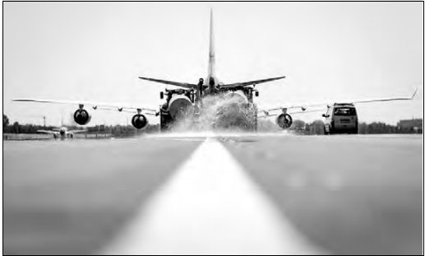
4. Extreme heat wreaks havoc on roads, railways.
Experts say we need to adapt.
极端高温破坏了公路和铁路。专家表示，我们需要适应

Slide 17
语篇填空
（《华盛顿邮报》 2022年7月26日 E4版面）
Roads and airport runways buckling. Train tracks warping. These are just some of the damaging effects extreme heat has had ____ critical infrastructure in recent years, ____ heat waves have become more frequent and intense — a stark reminder, experts say, of the need to adjust quickly to a__________ (warm) planet.
“Most of our physical infrastructure was built using the temperature ________ (record) of the mid-20th century,” Costa Samaras, a principal assistant director for energy， wrote in an email. “That is not the climate we have now.”
Samaras added: “Melting roads and runways are no longer a hypothetical — and we know with increased emissions it’s only going to get ______ (hot).”
The latest scramble to adapt came last week as heat waves smothered parts of the United States and Europe, sending temperatures in many ____________ (history) temperate areas skyrocketing. In London, for instance, parts of a Victorian-era bridge ____________(wrap) in silver insulation foil to protect the metal from cracking. Meanwhile, airport runways were damaged by the heat, ________(cause) widespread travel disruptions.
But experts stressed that solutions shouldn’t focus solely on improving infrastructure. “___ bottom line is: we are not going to only build our way out of this,” Samaras said. “We must decarbonize our energy uses _____learn how to remove carbon we’ve already added to the atmosphere.”
on
as
warming
records
hotter
historically
were wrapped
causing
The
and

Slide 18
词汇讲解
1. stark: very different to sth in a way that is easy to see
明显的，鲜明的
The good weather was in stark contrast to the storms of previous weeks.
这时的好天气和前几个星期的暴风雨形成鲜明的对比。
2. decarbonize: to remove carbon from (an engine) 除去碳素；脱去…的碳
As the gas price rises, it pays to decarbonize, and the climate will benefit. 随着油价上涨就有利于减少二氧化碳气体的排放，将有助气候的改善。
翻译句子
城市里各社会阶层有明确的分野。
Social divisions in the city are stark.
翻译句子
如果我们相信我们有保险政策，那么脱碳的动机可能会消失。
The motivation to decarbonize might disappear if we believed we had an insurance policy.

Slide 19
句子翻译
These are just some of the damaging effects extreme heat has had on critical infras-tructure in recent years, as heat waves have become more frequent and intense — a stark reminder, experts say, of the need to adjust quickly to a warming planet.
这些只是近年来极端高温对关键基础设施造成的一些破坏性影响，因为热浪变得越来越频繁和强烈——专家说，这是一个严峻的提醒，需要迅速适应全球变暖。
翻译
“The bottom line is: we are not going to only build our way out of this,” Samaras said. “We must decarbonize our energy uses and learn how to remove carbon we’ve already added to the atmosphere.”
萨马拉斯说:“底线是:我们不会只靠建设来解决问题。”“我们必须使能源使用脱碳，并学会如何清除我们已经向大气中添加的碳。”
翻译

Slide 20
5. BBC新闻听写填空 07/22/22

Slide 21
听力填空
The embattled Italian Prime Minister Mario Draghi has won a __________ motion in the senate but three parties from his coalition boycotted the vote, which the BBC Rome correspondent says means he will be forced to ______ probably on Thursday.
Prosecutors in Mexico city have announced that eight _______________________ will face trial for their role in the collapse of a metro overpass last year in which 26 people died. The elevated track collapsed under ________________________ near the Oliver station.
President Biden has unveiled new executive steps to ___________________ which he described as an existential threat to the nation and the world. 2.3 billion dollars will go to the expanding of ___________ and helping low-income families pay for ________________ costs. There’s also support for the offshore wind industry.
The director of the CIA William Burns says Russian gains in Ukraine have come ____________. He said US Intelligence estimates about 15,000 Russian troops have been killed over the past five months with three times more ________with Ukrainian losses ___________.
confidence
resign
former government officials
the weight of a passing train
address climate change
flood control
heating and cooling
at a great cost
wounded
a little lower

Slide 22
词汇讲解
1. boycott: to refuse to buy, use or take part in sth as a way of protesting
拒绝购买（或使用、参加）；抵制
The main opposition parties are boycotting the elections.
主要反对党都抵制此次选举。
2. unveil: to show or introduce a new plan, product, etc. to the public for the first time （首次）展示，介绍，推出；将……公之于众
The will be unveiling their new models at the Motor Show.
他们将在汽车大展上首次推出自己的新型汽车。
翻译句子
我们正呼吁大家抵制雇佣童工的公司的产品。
We are asking people to boycott goods from companies that use child labour.
翻译句子
全欧洲的公司都来到这里展示其最新款产品。
Companies from across Europe are here to unveil their latest models.

Slide 23
句子翻译
Prosecutors in Mexico city have announced that eight former government officials will face trial for their role in the collapse of a metro overpass last year in which 26 people died.
翻译
墨西哥城检察官宣布，8名前政府官员将因在去年导致26人死亡的地铁立交桥坍塌事故中负有的责任而面临审判。
President Biden has unveiled new executive steps to address climate change which he described as an existential threat to the nation and the world.
翻译
拜登总统公布了应对气候变化的新行政措施，他称气候变化是对国家和世界的生存威胁。

