Slide 1

感恩遇见，相互成就，本课件资料仅供您个人参考、教学使用，严禁自行在网络传播，违者依知识产权法追究法律责任。
更多教学资源请关注
公众号：溯恩高中英语
知识产权声明

Slide 2
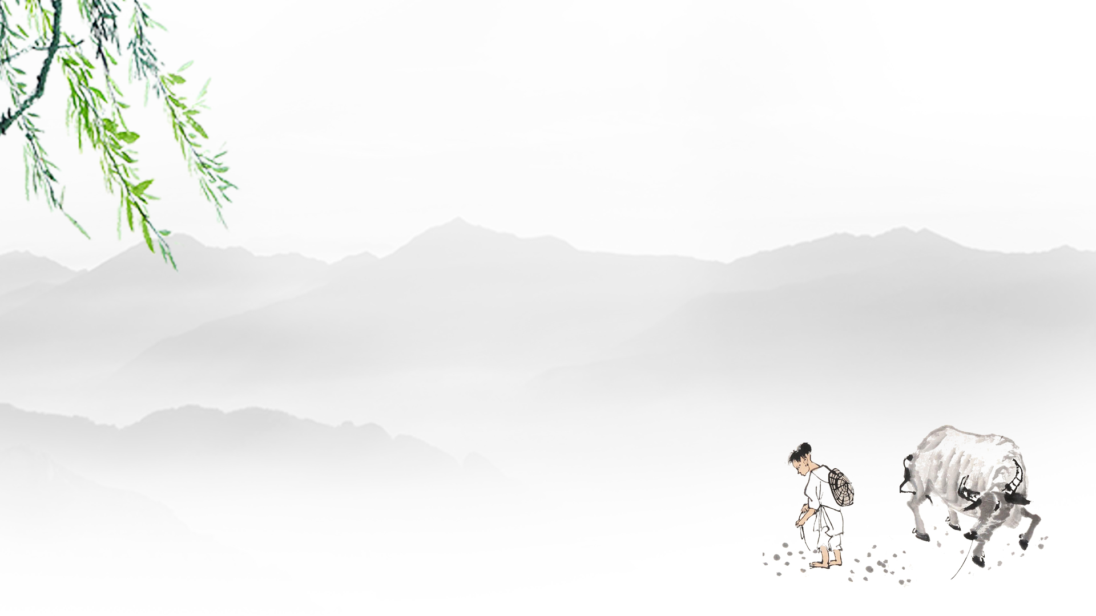
M4U2
Working the Land
Language Points
---- Miss Miao

Slide 3


Let’s explore the knowledge bravely to get close to Dr.Yuan. Surprises are waiting for us.
学习闯关之旅
④
③
Consolidation
in writing
①
②
Words & Phrases
Application
Lead-in: activate the knowledge

Slide 4
Let’s explore the knowledge bravely to get close to Dr.Yuan. Surprises are waiting for us.
学习闯关之旅
④
③
①
②
Lead-in: activate the knowledge

Slide 5
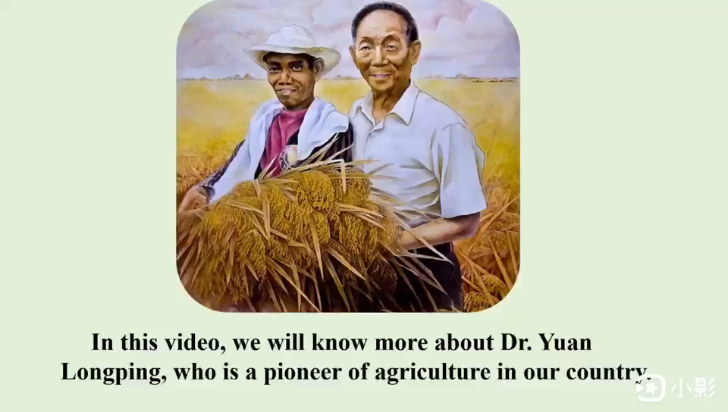
Activate the knowledge
Dr.Yuan
Listen to a video clip and underline the key words &expressions based on Book4 Unit2.
（划出本单元的重点单词与词组）

Slide 6
……Working the land for the past six decades, Dr. Yuan has struggled for growing what is called super hybrid rice. This special strain of rice makes it possible to produce harvests twice as large as before. No matter how tough the situation is, Dr.Yuan takes up the challenges constantly. How time flies. Now he is 90 years old. Because of his arduous efforts, Dr. Yuan was awarded the medal of Republic by President Xi. To our amazement, on the same day, Dr. Yuan went back Hunan after the ceremony, working the land again.
When the reporter asked him “Have you ever regretted devoting all your life to studying the rice?” Dr. Yuan replied it firmly. “That’s impossible”. “In 1960s, it was due to hunger that many people starved to death. I won’t let it happen again！Besides working, Dr. Yuan is strict with himself in daily life. For example, he would rather keep swimming and play volleyball to build up his body rather than just sit around. In his view, lack of exercise will lead to Alzheimer's disease. (老人痴呆症) Thus, he will not retire unless he cannot move.
1.
2.
3.
4.
5.
6.
7.
8.
Lead-in: Activate the knowledge

Slide 7
Let’s explore the knowledge bravely to get close to Dr.Yuan. Surprises are waiting for us.
学习闯关之旅
④
③
①
②
Words & Phrases Application

Slide 8
The exercises in cloze&reading&writing.
Paraphrase(释义) : express the
same meaning in different words.
Cloze(完型) & Reading：
Writing：
Put what we have learned into practice &
Polish(润色) the normal expressions.
Key Words&Phrases Application

Slide 9
Read and choose the correct answer .
① Dr.Yuan Longping’s pioneering research has struggled to transform China from food deficiency(缺乏) to food security with three decades. His accomplishments and clear vision helped create a more abundant food supply and, through food security, a more stable world.
:make great efforts to do sth. when it is very difficult.
1.What can we learn about Dr.Yuan’s research?
A. It was easy for him to create an abundant food supply.
B. Efforts were made before he can change the situation of food deficiency.
C. Little time was enough to conduct his research.
D. His research came to an end finally due to its difficulties.
Key Words&Phrases Application

Slide 10
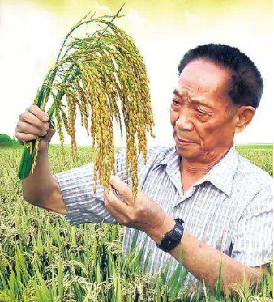
struggle:make efforts to do sth when it is very difficult.
vi. 奋斗，努力；挣扎 n. 努力，奋斗
(阅读文段) ① Dr.Yuan Longping’s pioneering research has struggled to transform China from food deficiency(缺乏) to food security with three decades.
(将struggle运用到写作:)外国笔友Peter最近想了解你最钦佩的伟人，请你写信简述该伟人的事迹及对你的启发。
②Born in 1930, Dr. Yuan is now 90 years old, __________________
_________________, which motivates me to conquer the difficulties in study constantly.
struggle to do.挣扎;奋斗做某事
(Vi.): struggle for sth.为…奋斗
still struggling for the
high output of rice
Key Words&Phrases Application

Slide 11
2. build up vt.增强…体质;
① (将build up运用到写作)最近外国笔友Peter因为学习太劳
累而生病了。得知此消息，你写信表达关心和提建议。
Knowing that you have a cold recently, I am writing to show my concern. First of all, I sincerely hope that you should make it a rule _______________________________________, learning to balance between your study and health.
to spend much time building up your body
Key Words&Phrases Application

Slide 12
Brainstorm: Given Chinese expression, speak out the English one.
clear up
bring up
show up
抚养，教养
出现，来到
take up
编造，弥补，化妆
pick up
拿起，占据，开始从事
清理，整理，放晴
出现，露面
挂起来；挂电话
捡起，搭载，接收
make up
turn up
hang up

Slide 13
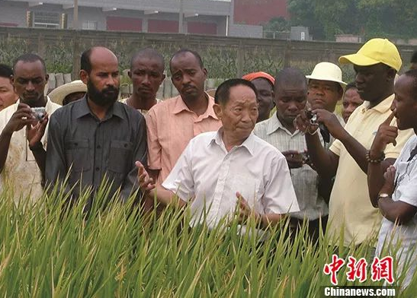
2. build up vt.
Cloze:
②At present, Yuan's has 22.________ and trained the teams throughout Asia and to Africa and the Americas, which are expected to achieve commercial seed production in the following 3 or 4 years and hope to 23.apply technology into the research of sea rice.(海水稻)
22.A. picked up B. hanged up C. built up D. cleared up
建立
Paraphrase(释义):
found; set up; establish
Key Words&Phrases Application

Slide 14
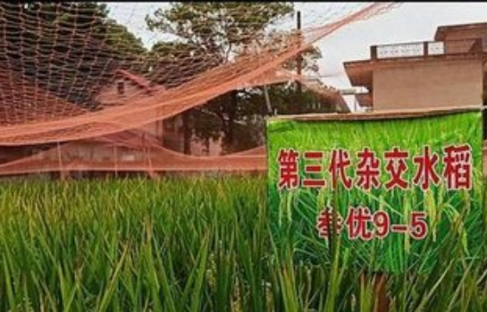
3. make it possible to do.有可能做某事
it: 作形式宾语；真正的宾语是: to do
Cloze:
①However, under the same planting conditions and environment, the yield(产量) of the third-generations hybrid rice could make 25.______ possible to reach 800 kg per mu. China now feeds around 20% of the world's population with less than 9% of the world's arable(可耕种的)land.
25. A. that B. its C. it D. this
Key Words&Phrases Application

Slide 15
3. make it possible to do.有可能做某事…
it作形式宾语；真正的宾语是to do
easy
difficult
feel
important
feel
think
necessary
think
a rule
make + it +possible+(for sb)+to do
make + it +n.+(for sb)+to do
Vt.
adj.
Vt.
an honor
find
indispensable
find
one's duty
……
consider
……
consider
inevitable
impossible
regular
……
Key Words&Phrases Application

Slide 16
3. Vt.+ it +adj./n.+ to do.
it: 形式宾语；真正宾语是to do
②用“Vt.+ it +adj./n.+ to do.”美化作文句子：
As for the ways of strengthening your willpower, you had better do sports everyday to build up your body and entertain yourself like Dr.Yuan.
As for the ways of strengthening your willpower, you had better _____________________________ your body and entertain yourself like Dr.Yuan.
make it regular/a rule to build up
Key Words&Phrases Application

Slide 17
4. lead to vt.
引起；导致；通往(to是介词)
Reading:
Dr.Yuan's distinguished life's work has led to many to call him the “Father of Hybrid Rice”, while his continuing research offers even more promise for world food security and adequate nutrition for the world's poor.
Paraphrase:
导致: cause; result in; contribute to
①.What caused many people to call Dr.Yuan “Father of Hybrid Rice?
A. because he is the father of Hybrid Rice.
B. because of his outstanding life' work to study and research rice.
C. because of his transforming China from food deficiency to food security.
D. because his son also worked in studying and researching rice.
Key Words&Phrases Application

Slide 18
Let’s explore the knowledge bravely to get close to Dr.Yuan. Surprises are waiting for us.
学习闯关之旅
④
③
Consolidation
in writing
①
②

Slide 19
Writing.
Q1: What inspirations can you obtain from Dr.Yuan’s deeds and spirits?
Q2: Based on Dr.Yuan’s deeds and spirits, how can you put them into your study life to conquer the difficulties?
Consolidation in Writing

Slide 20
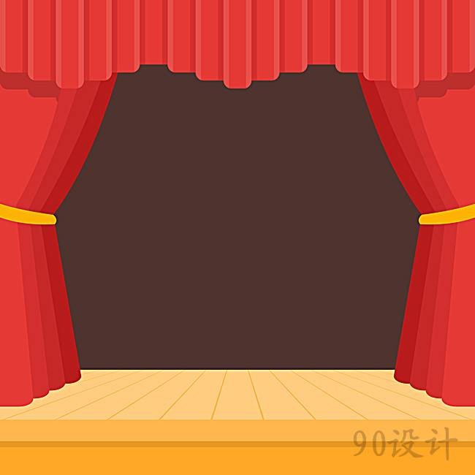

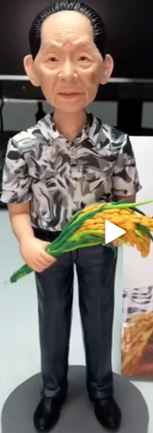

Writing.
Speech Time (Ode赞美 to Dr.Yuan)
假定你是李华。为弘扬袁院士的精神, 近期你校以“Father of Hybrid Rice”为题举行英语演讲比赛，请你写一篇演讲稿, 内容包括：
1.简介袁隆平；
2.描述其对你影响最大的事迹以及启发（至少2点）
注意
1.将struggle, build up, V+it+adj./n.+to do; lead to运用到写作中；
2.开头、主题句已给出，小组合作完成支撑句；
3.不得抄袭。
Consolidation in Writing

Slide 21
评判标准: 1.handwriting(2); 2.grammar & spelling & coherence(3)
3.content:specific(5); 4.application:key expressions(5)
Ode to Dr.Yuan Longping
Good morning, everyone！I am extremely honoured to deliver a speech to share the person I adore and respect most with you. Undoubtedly, the person is Dr. Yuan Longping, who has a great impact on me.
When it comes to Dr. Yuan Longping, a sense of pride hovers over me. ________________
___________________________________________________________________________
As for his great deeds, the following two aspects inspire me most. First and foremost, ____
______________________________________________________________________________
________________________________________________. In addition, ___________________
________________________________________________________________________________________________________________.
It is not easy to enter a dream university. _______________________________________
______________________________________________________________________________________________________________________. Thank you for your listening.
小组互评:G1—G2; G3—G4; G5—G6;G7—G8 (根据标准进行互评)
（简介袁隆平：2点）:G1，G2
（影响我的第1点事迹+启发）:G3,G4
（影响我的第2点事迹+启发）:G5,G6
（表决心）:G7, G8
0
90s
30s
Consolidation in Writing
60s

Slide 22
Good morning, everyone! I am extremely honoured to deliver a speech to share the person I adore and respect most with you. Undoubtedly, the person is Dr. Yuan Longping, who has a great impact on me.
When it comes to Dr. Yuan Longping, a sense of pride hovers over me. Born in September, 1930, he is now 90 years old, still struggling for the high output of rice. Known as China's “father of hybrid rice and for the devotion he made, Dr.Yuan was awarded the medal of Republic by president Xi.
As for his great deeds, the following two aspects inspire me most. First and foremost, Dr. Yuan initially found it hard to study the new rice under such a tough condition, but he didn't regret devoting his youth and energy to it. Therefore, his perseverance can constantly stimulate me to keep moving, regardless of how many exams I failed. In addition, no matter how busy he is, he makes it a rule to spend much time building up his body, such as keeping swimming and playing volleyball, which reminds me of learning how to keep balance between study and health from Dr. Yuan.
It is not easy to enter a dream university. With the spirit of Dr. Yuan, days of arduous practice and continual learning, I am firmly convinced that I will definitely enter my dream university, leading to the wonderful life I desire. Therefore, like Dr. Yuan, one day, my dream can be fulfilled with industrious work to pave the way. Thank you for your listening.
Handwriting: 2
Grammar, spelling, coherence: 3
Connect with your life: specific evidences: 5
Put what we’ve learned into writing; polish the expressions:5
Consolidation in Writing

Slide 23
Practice makes perfect.
Words & Phrases：
Writing：
Learn them by heart & feel their connections
with cloze(完型)&reading.
1.Finish the writing independently & Top 5 will
make a speech sent to the school website;
2.Search the Internet to know more about Dr.Yuan
Homework

