Slide 1
扫码关注
回复：hello sun
获取课件制作、录课等实用工具包
知识产权声明
感恩遇见，相互成就，本课件资料仅供您个人参考、教学使用，严禁自行在网络传播，违者依知识产权法追究法律责任。
更多教学资源请关注
订阅号：溯恩英语

Slide 2
外刊阅读初探
Reading Of
印
魏庆菊

Slide 3
Admit slip
 | News
 | 300
 | 200
 | 100
Play a Jeopardy game.

Slide 4
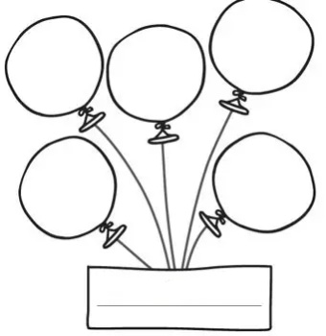
body
正文
title
标题
lead
导语
back-
ground
背景
ending
结尾
Composition

Slide 5
Do you remember?

Slide 6
Basic structure of news:
Inverted pyramid
Pyramid

Slide 7
“There’s simply no doubt about the athletic aspects of the discipline,” a French break dancer said. （caption图片说明）

Slide 8
Read for structure
Para.1-para___
Lead
2
Para.___-para____
3
3
Background
4
ending
Para.__-________
Body

Slide 9
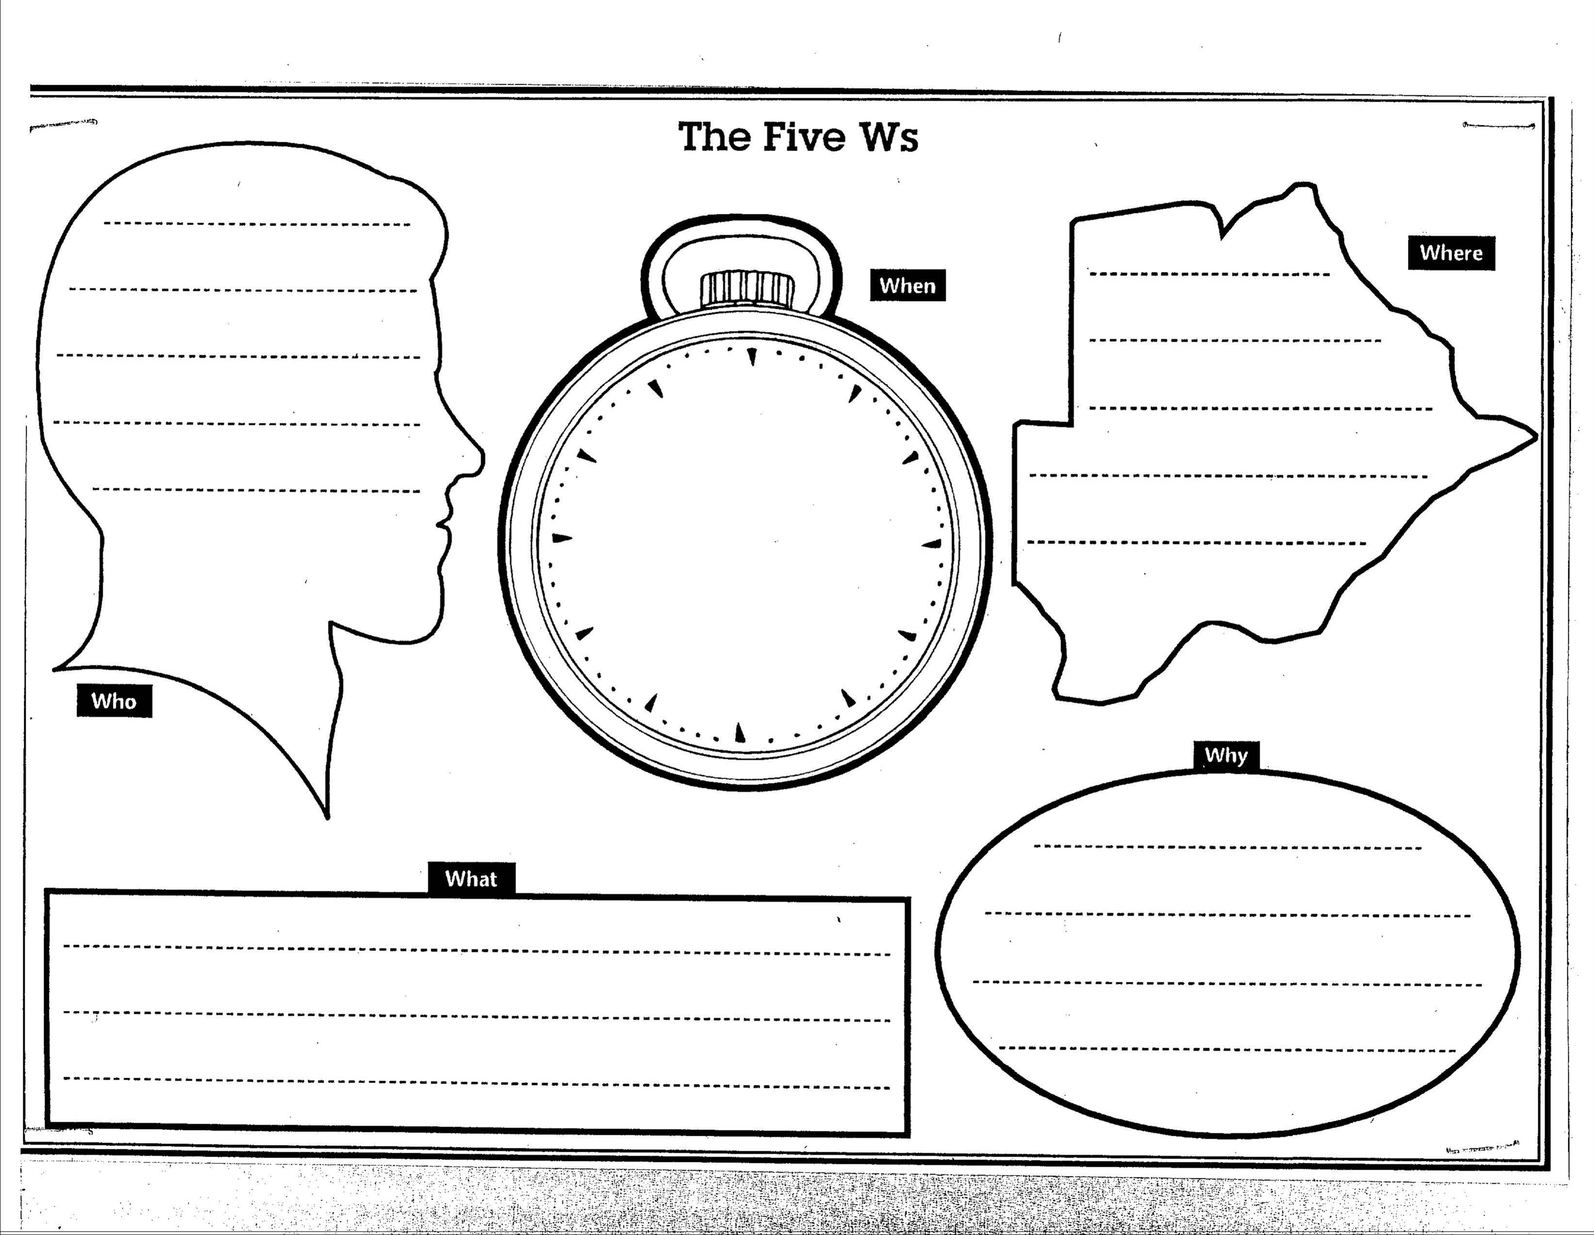
5WS
Read for information
Break
dancing
and other
three events
Where
When
Lead
导语
Paris
2024
Who
How
Approved
by IOC
What
proposed for
the Olympics
Notes:
9

Slide 10
Read for information
What’s the best title according to the lead paragraphs?
________________________
Headline
标题
Break dancing among new events
proposed for 2024 Olympics

Slide 11
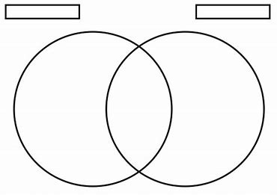
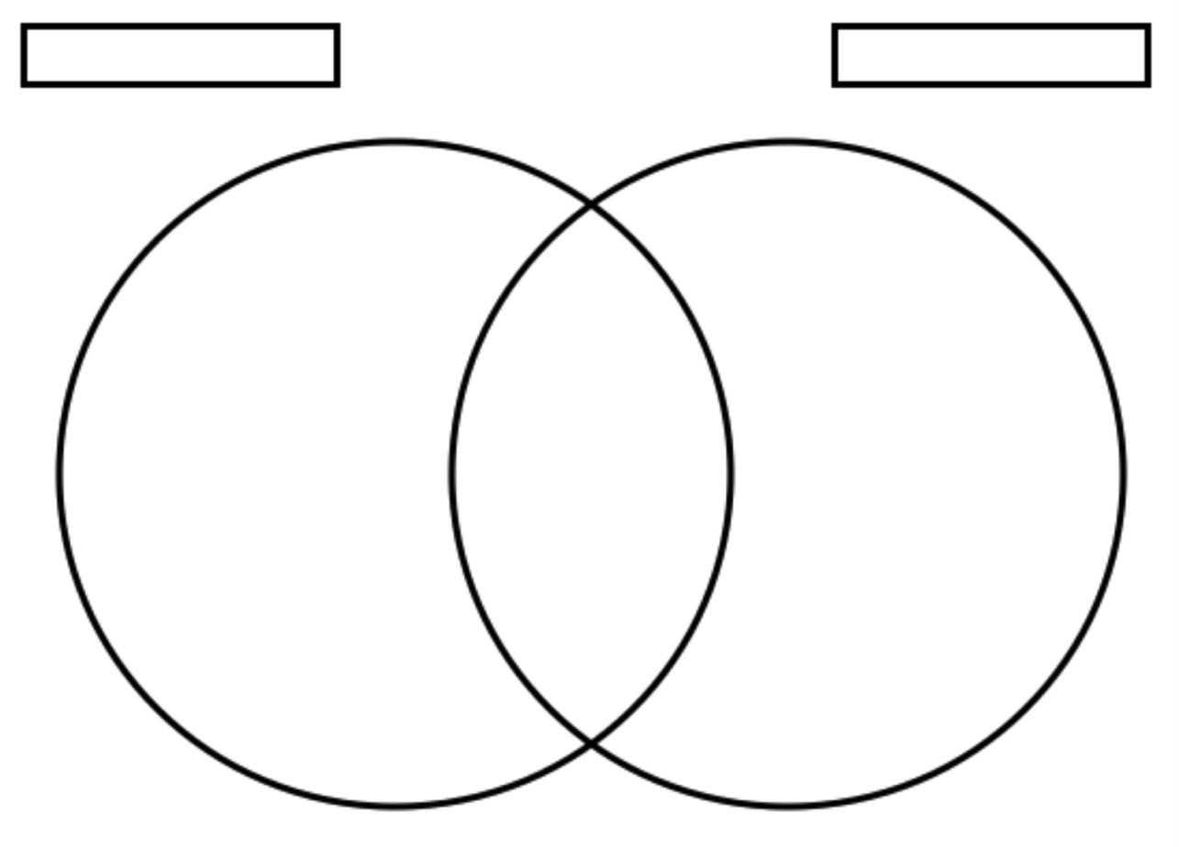
Background
背景
Read for information
current
French
origin
American
Japan
Russia
Ballroom
dancing
hip-hop
Breaking
gold
medal
Ram
Bumblebee

Slide 12
扫码关注
回复：hello sun
获取课件制作、录课等实用工具包
知识产权声明
感恩遇见，相互成就，本课件资料仅供您个人参考、教学使用，严禁自行在网络传播，违者依知识产权法追究法律责任。
更多教学资源请关注
订阅号：溯恩英语

Slide 13
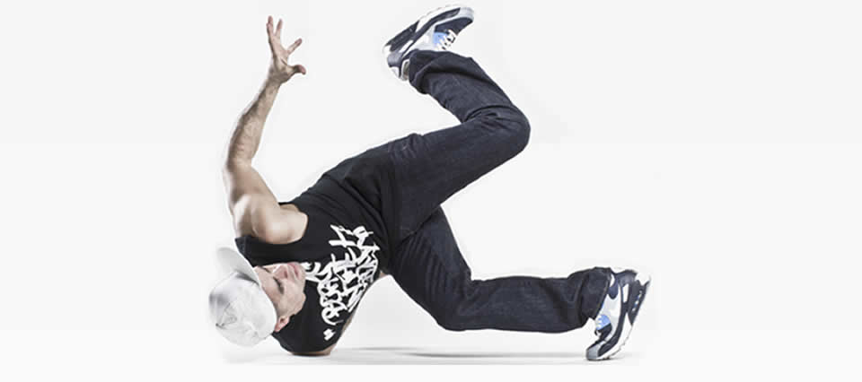
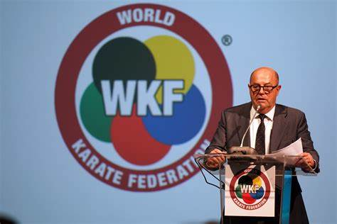
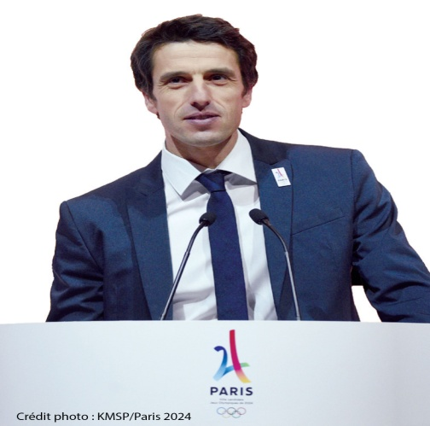
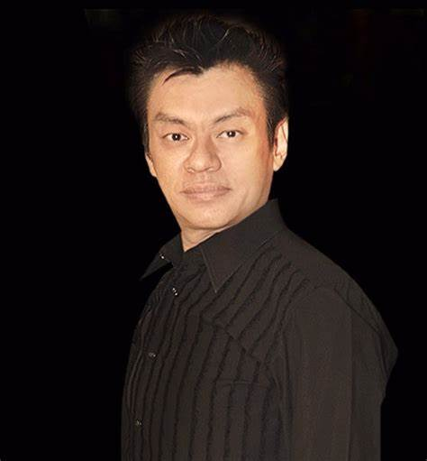
Read for information
Body
正文
break
dancingng

Slide 14
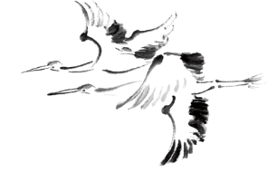
Body
正文
Read for ideas
Two different ways to quote others’ opinions：
direct speech
indirect speech
Why does the author use
direct speech?
Why does the author suddenly use indirect speech in para.9?
A. To show the author’s
objective attitude
B. To make the news more convincing
C. To keep its original characteristics
To express his own opinion through others' mouth.

Slide 15
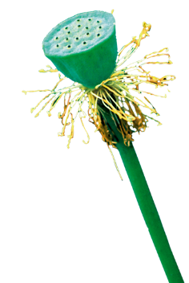
Read for ideas
What is theme that the author wants to convey(传递）?

Slide 16
Read for ideas
“It’s a victory for us,” Biba said. “Even if it goes no further, we’ll still have won.”
①Where should this sentence be placed?______.
②Why ?
③What can you learn from this sentence?
③

Slide 17
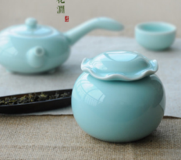
Oral presentation
Question:
What’s your opinion on the breaking’s being proposed for the 2024 Olympic Games?
表达个人观点句型：
①I suppose/ guess/ believe/ reckon/presume....
②I am firmly convinced that...
③To my mind/ From where I stand,/ As far as I am concerned
单击此处编辑您要的内容，建议您在展示时采用微软雅黑字体，本模版所有图形线条及其相应素材均可自由编辑、改色、替换。更多使用说明和作品请详阅模版最末的使用手册。
添加标题
添加标题
添加标题
添加标题

Slide 18
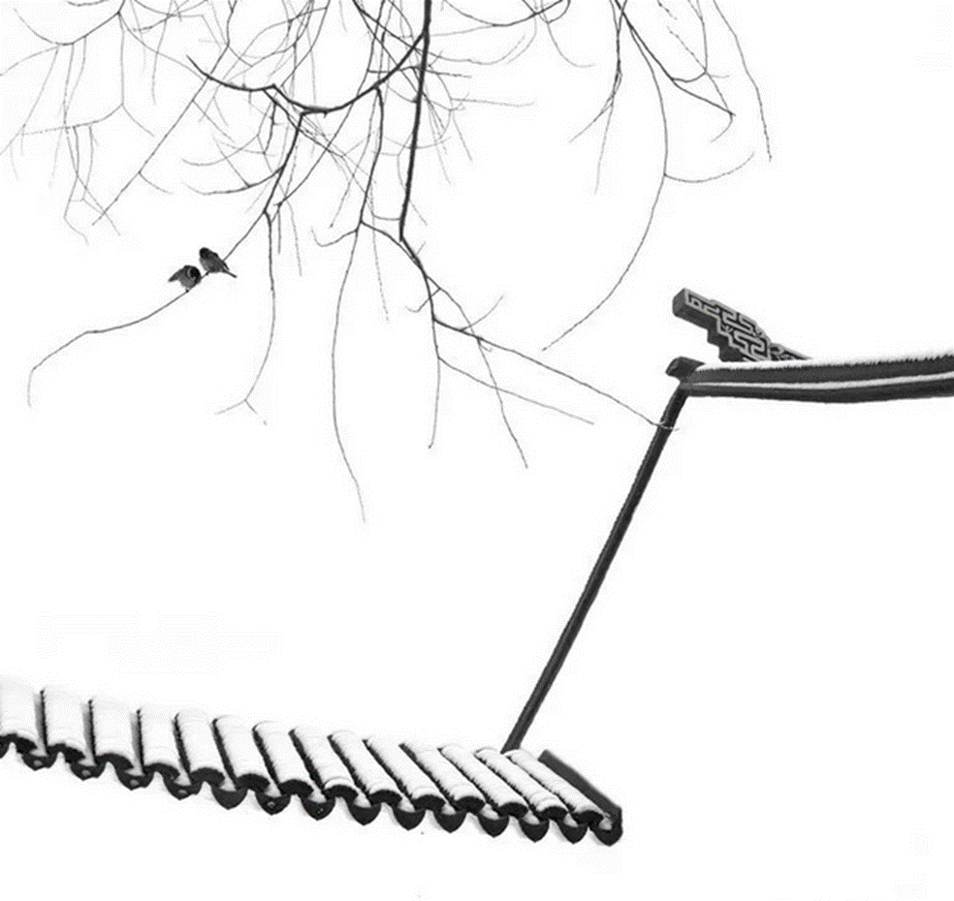
Exit slip
After reading
What I have learnt
What I still want to know

Slide 19
Homework
1. Work in groups and prepare a convincing speech on breaking’s inclusion for 2024 Olympics.
2. Preview Project of Unit2 and learn something about the exclusion and inclusion of the Olympics’ events.

Slide 20
扫码关注
回复：hello sun
获取课件制作、录课等实用工具包
知识产权声明
感恩遇见，相互成就，本课件资料仅供您个人参考、教学使用，严禁自行在网络传播，违者依知识产权法追究法律责任。
更多教学资源请关注
订阅号：溯恩英语

Slide 21
Thank
You!!!
印

