Slide 1

感恩遇见，相互成就，本课件资料仅供您个人参考、教学使用，严禁自行在网络传播，违者依知识产权法追究法律责任。
更多教学资源请关注
公众号：溯恩高中英语
知识产权声明

Slide 2
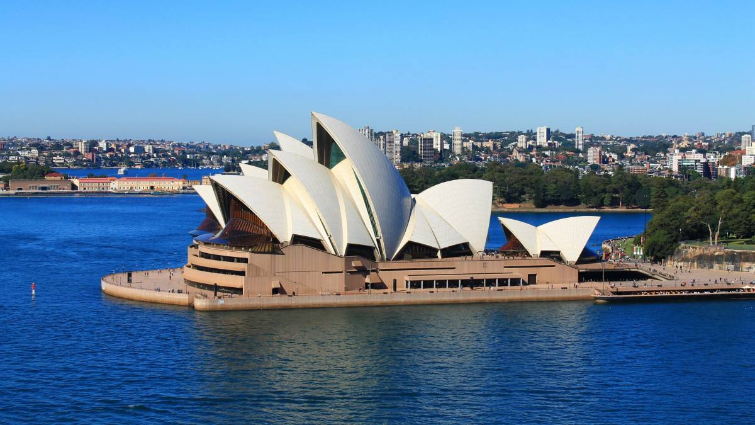

as a sign or symbol of someplace.
Unit 2 Iconic Attractions
Whatever makes an impression on the heart seems lovely in the eye.
— Saadi
任何给心灵留下深刻印象的东西，在人们眼里似乎都是可爱的。
——萨迪（波斯诗人）

Slide 3

Lead-in
1. What do you know about the place in the photo?
It is the Sydney Opera House in Australia, and that it is one of the world’s most famous buildings.
2. What are your impressions of Australia based on your personal experience/ what you have seen in the media?

Slide 4
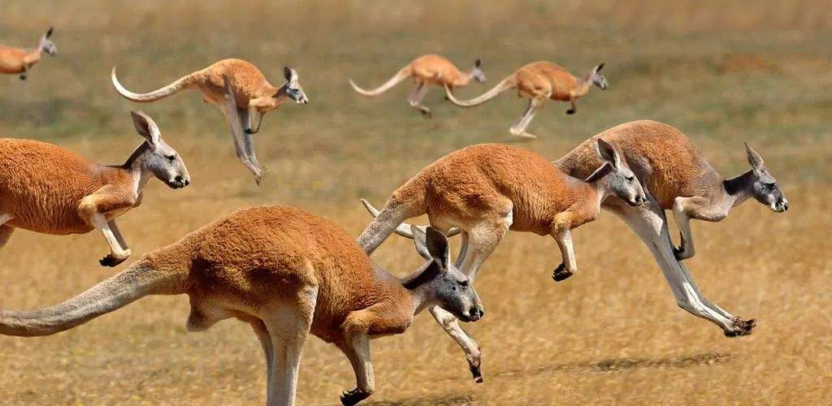
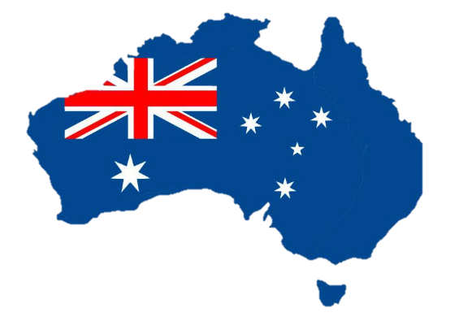
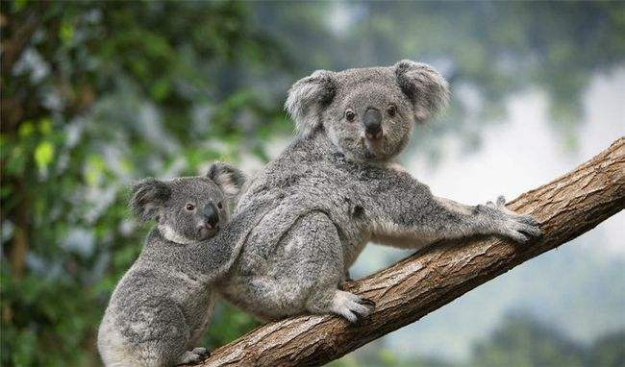
Lead-in
2. What are your impressions of Australia based on your personal experience/ what you have seen in the media?
Kangaroos
Koalas
It is the smallest continent but a very big country

Slide 5
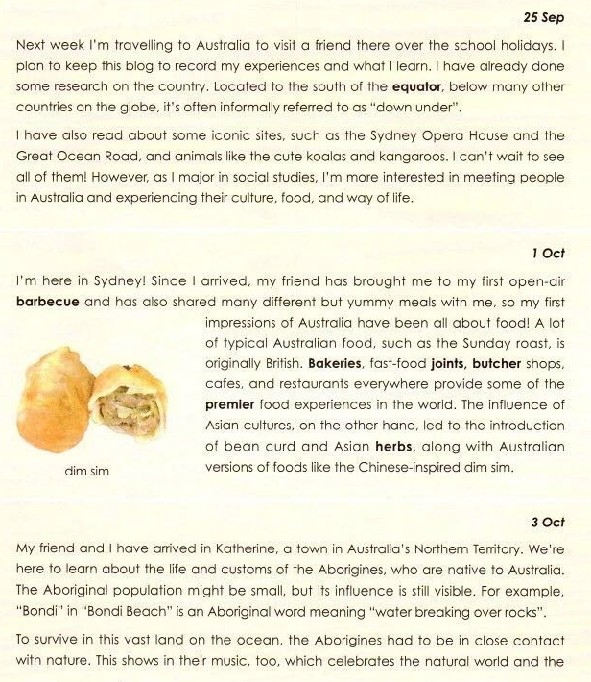
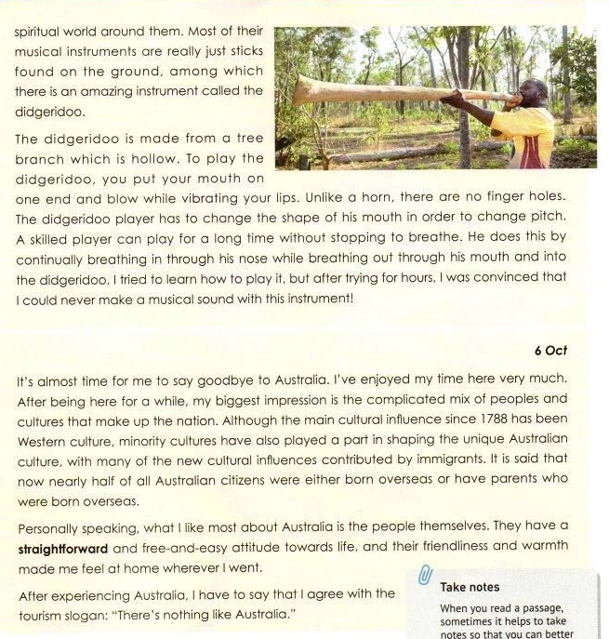
2. What iconic features of Australia do you think the writer has experienced?
Prediction
1. What type of text is it? How can you make your judgement?
a blog
with four entries

Slide 6
Skim the text. And match the blog and subheadings.
1: Preparing to travel
（before traveling）
3: Aborigines and the didgeridoo
(while traveling)
2: First impressions
(while traveling)
4: Reflections on multiculturalism
(post traveling)

Slide 7
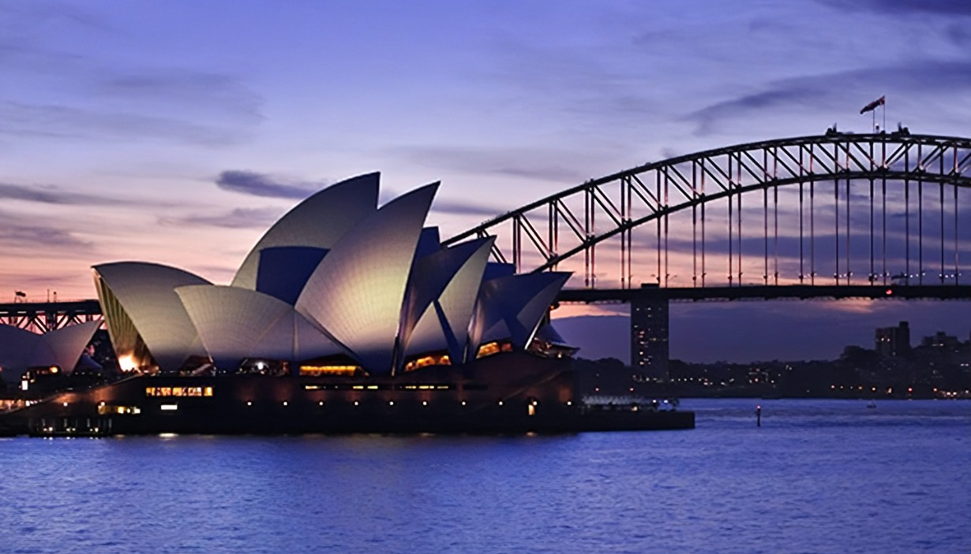
Careful-reading
Blog 1：
Preparing to travel
By preparing to travel to Australia, what information has the writer got?
What is the writer interested in and why?
Location, iconic sites, animals.
She was more interested in meeting people in Australia and experiencing their culture, food and way of life. Because she majored in social studies.
Please take notes while reading, using key words and keeping your notes short .

Slide 8
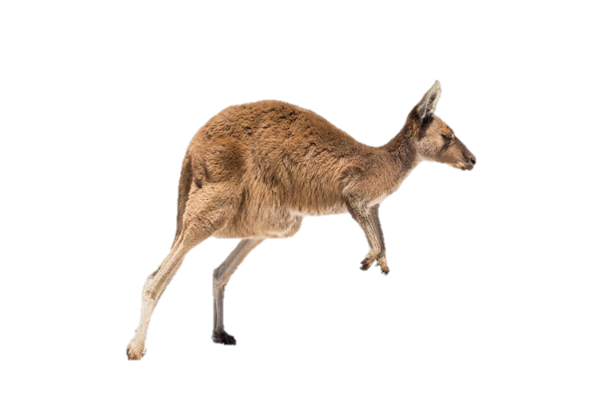
Careful Reading
Located south equator, below many countries
referred to …“down under”.
N
Location of Aus
many countries
equator
AU = down under
S
SOH (Sydney Opera House)
iconic sites & animals
GOR (Great Ocean Road)
koalas &kangaroos

Slide 9
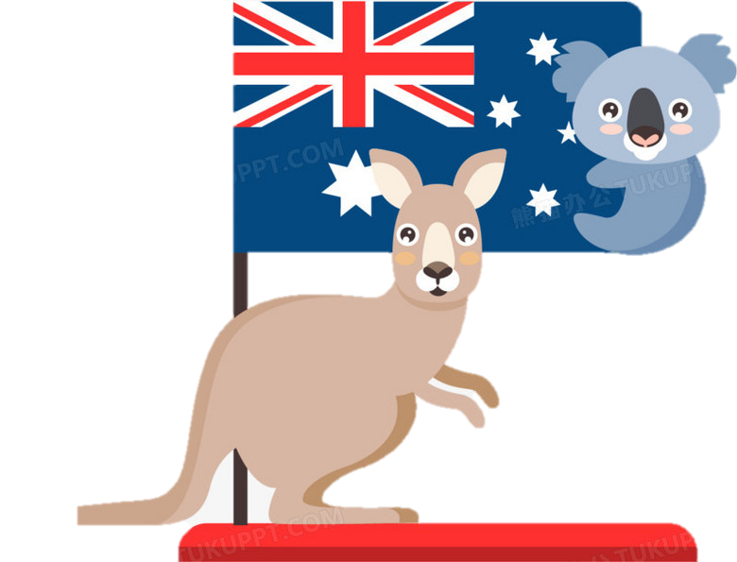
Careful-reading
meeting people
Interest ²
experiencing culture, food & way of life
∴major in social studies

Slide 10
Organize the notes well.
N
many countries
1. Location of Aus
equator
AU = down under
do research
S
SOH
Blog 1：Preparing to travel
read about
2. iconic sites & animals
GOR
koalas &kangaroos
meeting people
3. Interest ²
experiencing culture, food & way of life
∴major in social studies

Slide 11

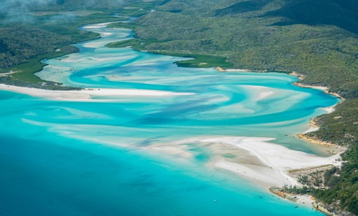
Careful Reading
1.When you read a passage, sometimes it helps to take notes so that you can better remember and understand what you have learnt.
How to take notes?
3. You can also use abbreviations, such as “Aus” for “Australia” and “N” for “north”, and use symbols such as “&” for “and”.
2. When you take notes, it is good to write down the important facts just using key words and ignore many of the small words.

Slide 12
Careful Reading
Abbreviation
cf. | compare
c. | about / approximately
imp. | important / importance
tho | though
e.g. | example
info | information
Symbol
∴ | therefore
∵ | because
≠ | differs from, is the opposite of
= | is/are/have/has/ equals
∧ | but
& | and

Slide 13
Careful Reading
Cornel Note Taking
Cue Column
Note-taking Column
-Key ideas
-Key words
-Important dates, people, places
-Diagrams and pictures
-Key questions
-Formulas
-Repeated (stressed) information

Slide 14
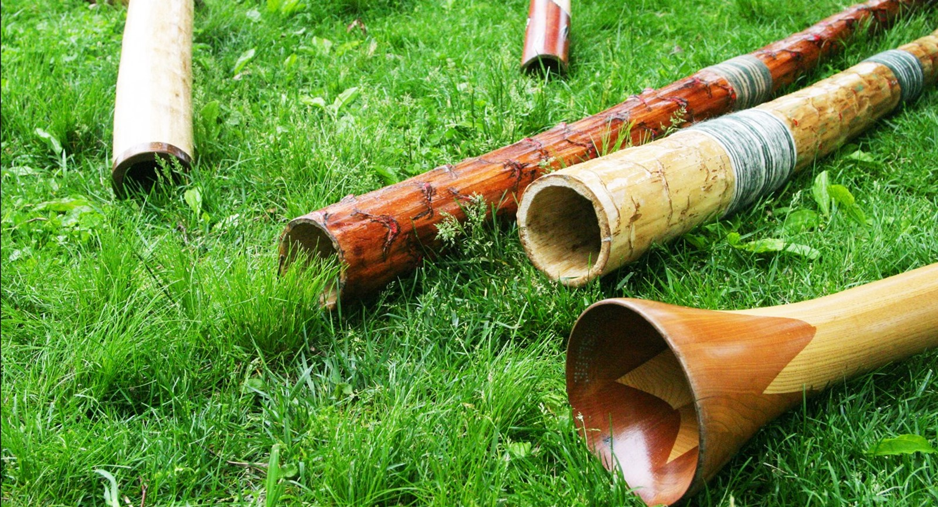
Careful Reading
Guiding questions for the following entries:
Blog 2：First impressions
Blog 3: Aborigines and the didgeridoo
Blog 4: Reflections on multiculturalism
Who did the writer meet and what did the writer experience?
What did she learn about the people and the culture, food and way of life?
Take notes while reading carefully. Keep your notes short, using abbreviations and symbols creatively. Then, summarize your notes with your own words.

Slide 15
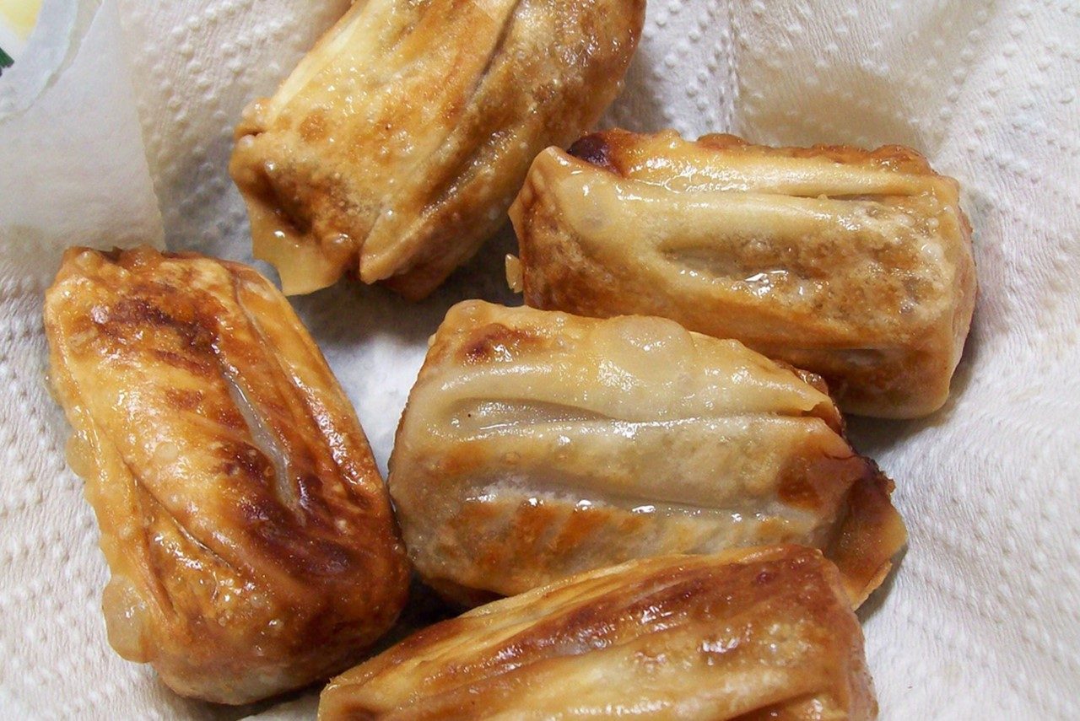
Careful Reading
Experiences
1st open-air BBQ
1
Blog 2：First impressions
dif ∧ yummy meals
2
1st impressions
(Sydney)
Food
typical Au food ← Bri
e.g. Sunday roast
3
4
premier food expces
Learn
5
Asian cultures →
bean curd & herbs
Au version dim sim

Slide 16
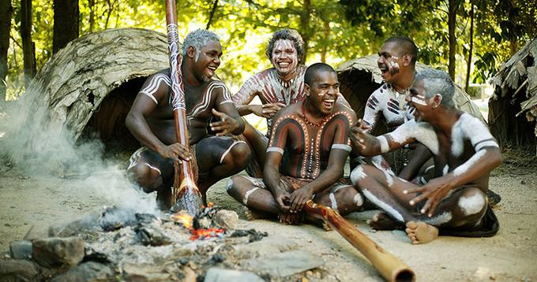
Careful Reading
1. small population
visible influence
Blog 3：Aborigines and the didgeridoo
Aborigines
2. history: hard
survive, close contact with nature
(Katherine, N. Territory)
theme: celebrate natural &spiritual world
music
instru: sticks
Name
the didgerigoo: hollow branch
Usage
put, blow…vibrating…, hole→change mouth shape →pitch, breathe in …nose, out…mouth

Slide 17
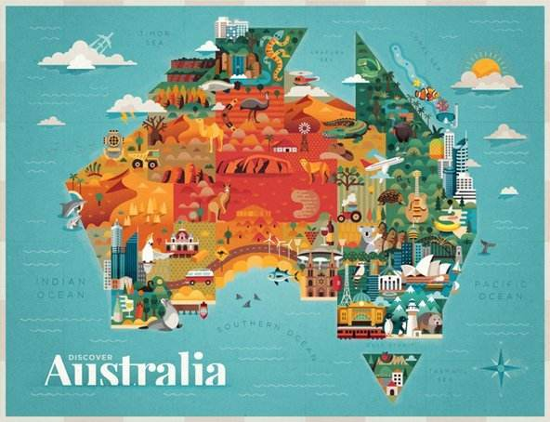
are the statements that can be proved.
Careful Reading
facts
mix of people (50% born overseas)
mix of cultures (Western + minority + immigrant)
=multicultural
Blog 4：Reflections on multiculturalism
feelings
like the people most
straightforward
free & easy attitude to life
friendliness, warmth
Reasons
unique people
unique Aus. Culture
There is nothing like Australia.

Slide 18
Careful Reading
Make a summary of the blog entries.
01
02
03
04
There is nothing like Australia.
Location Landmarks
Unique animals
Real interests
open-air BBQ
typical Aus food
Herbs,
Aus version dim sim
Aboriginals: be close to nature
the didgeridoo: a musical instrument
Preparation
Food
Natives
Multiculturalism
The mix of peoples and cultures.
Their personalities

Slide 19
Why does the writer choose different angles to introduce the iconic features of Australia in her eyes?
How did the writer organize the four blog entries?
Reread the blog entries and fill in the blanks.
Post-reading
Theme: Experience the iconic features of Australia
(Example of travel routes and perspectives)
Travel route 1
I’m here in Sydney! My first impressions of Australia have been _________.
Perspective 1
As I major in social studies, I’m more interested in ___________ in Australia and _____________, food, and _________.
meeting people
experiencing culture
all about food
way of life
Travel route 2
My friend and I have arrived in Katherine, ______________. We’re here to learn about ________________________.
Perspective 2
My biggest impression is the _________________________ that make up the nation.
a town in Northern Territory
the complicated mix of peoples and cultures
the life and customs of the Aborigines

Slide 20
Critical Thinking
1. Why was Australian cuisine influenced by different cultures?
4. What’s the author’s feeling after experiencing Australia?
1
4
3.How do you understand the sentence “There is nothing like Australia” ?
2. How does multiculturalism reflect in Australia?
2
3

Slide 21
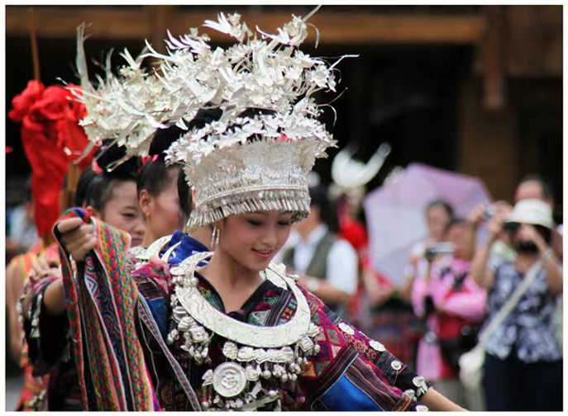
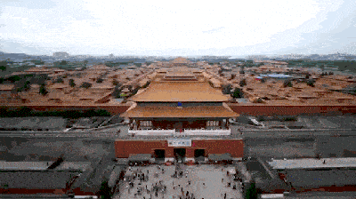
Homework
Discuss what iconic Chinese attractions you would like to introduce to a foreigner and explain why. Then, write what you discuss within 100 words.
Tourist sites
Food and drinks
Ethnic minority groups
Musical instruments
Clothes
title
key sentence
perspective/reasons
sample
conclusion

Slide 22
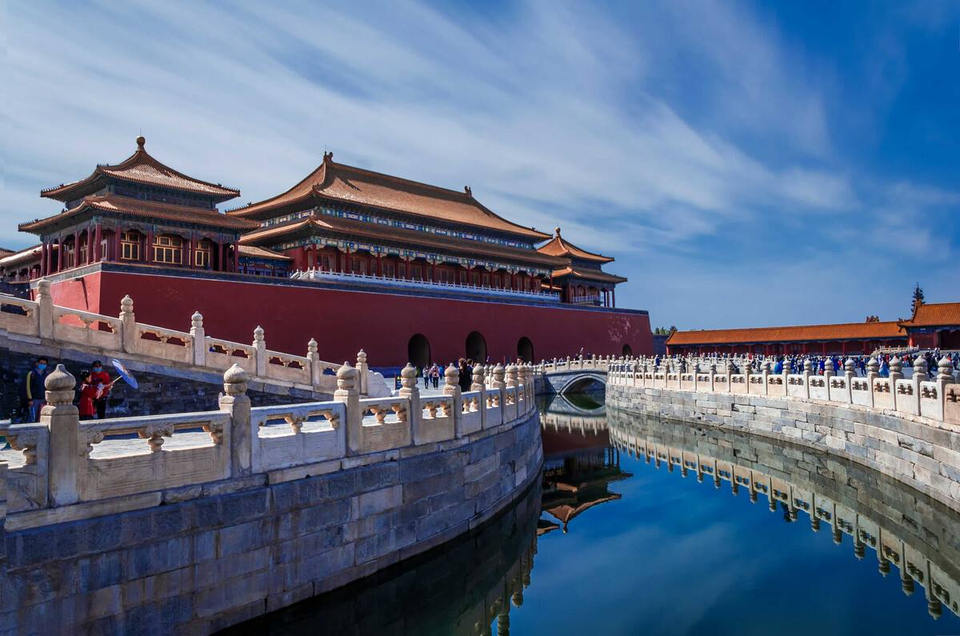
Homework
The Palace Museum, known as the Forbidden City, is one of the most popular iconic places in Beijing. It took ten million workers 14 years to complete the whole palace in 1407. When visiting this palace, you can find there are many valuable historic treasures with a history of more than 5,000 years.
Amazingly, the number of rooms in the palace is up to 9,999, because 9 is considered to be a lucky number in Chinese traditional culture. As is known to all, in the old days, the Palace Museum is a place where the emperors lived, but now it is open to visitors from all over the world. What’s more, the Palace Museum is free for Chinese students on Tuesdays.
Sample

Slide 23
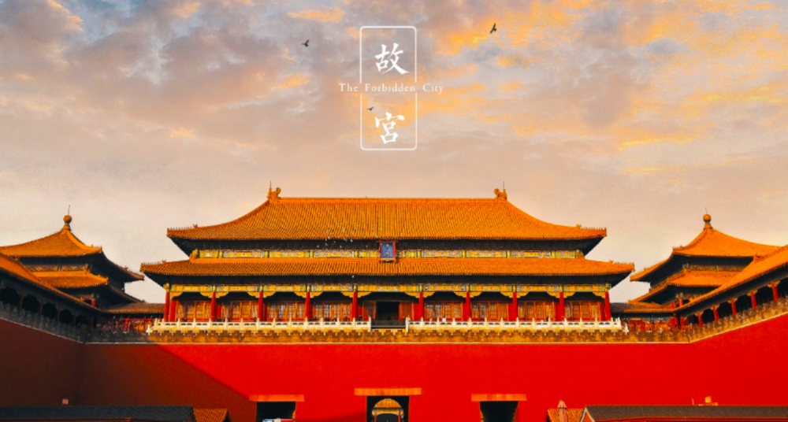
Thank you !

