Slide 1
感恩遇见，相互成就，本课件资料仅供您个人参考、教学使用，严禁自行在网络传播，违者依知识产权法追究法律责任。
更多教学资源请关注
公众号：溯恩高中英语
知识产权声明

Slide 2
Write a letter of advice
M1U1 Teenage Life
Reading for Writing
浙江省桐乡市高级中学 沈萃萃
Notes:
www.515ppt.com

Slide 3
Free talk
As a teenager, what problems do you have in your daily life?
generation gap with parents
poppy love
being addicted to the Internet/computer games
great pressure from heavy school work
feeling lonely and isolated
conflicts between friends/classmates
high expectations from parents and teachers
...
...

Slide 4
Free talk
Facing these problems, how will you seek for help?
1
communicating sincerely face to face
2
turning to trustworthy friends for help
3
asking for advice on social media
4
writing a letter to a professional adviser
...
5
ringing help hotlines

Slide 5
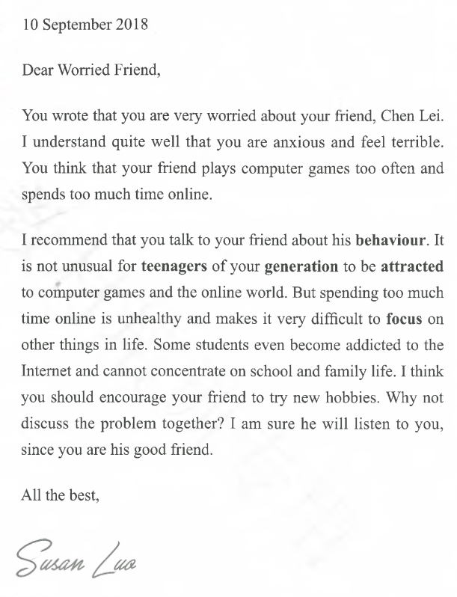
Reading
Susan Luo
___________ writes a letter of _______ to ________________.
What is Worried Friend's problem?
What suggestions does Susan Luo give to Worried Friend?
Besides suggestions, what else does Susan Luo say in her letter?
advice
Worried Friend
She understands Worried Friend's feeling and talks about the negative effects of computer addiction.

Slide 6
Thinking
Why does Susan Luo show her understanding and talk about the negative effects of computer addiction?
To make her suggestions more
acceptable and persuasive.
Do you think Susan Luo's advice is useful? Why or why not?
What other kinds of advice would you give?

Slide 7
Date
Organization
Greeting
Find out the organization of the letter.
Mark the parts of the letter that match the following points.
A. I know what the problem is.
B. I understand how you feel.
C. This is my advice and reason.
D. I think my advice will help.
Problem
Body
Advice
Close
Signature

Slide 8
Language Features
What expressions does Susan Luo use to make suggestions? Circle them in the letter.
Can you think of more expressions of making suggestions?
What expressions does Susan Luo use to show her understanding? Can you think of other ways to express understanding?

Slide 9
More Expressions
Making suggestions
Why don't you ...?
It couldn't be better if you could ...
I think it would be beneficial if you could ...
I'd like to propose that you should ...
It's advisable/ recommended to do ...
You may/ might as well do ...
You may consider doing...
From my point of view, it would be wise/ reasonable/ a good idea to do ...

Slide 10
More Expressions
Showing understanding
I feel terribly sorry to hear/ know/ learn that ...
I know well how it feels to ...
I know you didn't mean to ...
I know you have trouble in ...
It happens to everyone.
Everyone will have one of those periods when things seem to be going wrong.
Take it easy and things will be better.

Slide 11
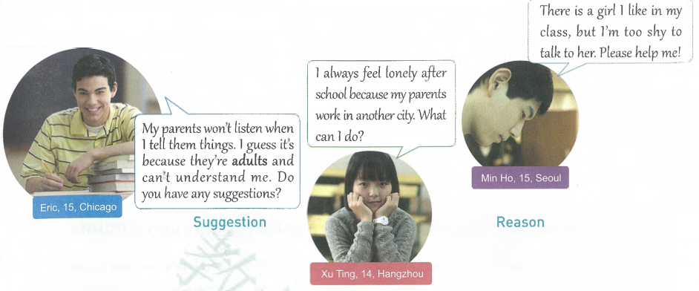
Group discussion
Work in groups. Choose one of the three situations and discuss his/ her problem. List possible suggestions and reasons.

Slide 12
Individual writing
__________
Dear _________,
You wrote that ____________.
I understand that __________.
I think ___________________
because _________________.
I'm sure that ______________.
Best wishes,
__________
Write the date and greet the reader.
Show the reader that you know what the problem is.
Tell the reader that you understand how he/ she feels.
Tell the reader what you think he/ she should do.
Explain your reason(s).
Tell the reader what you think will happen.
Close and sign the letter.

Slide 13
Exchanging ideas
Checklist
Use the checklist to give feedback on your partner's draft.
Are all the parts of a letter included and organized in good order?
Does the writer give reasons for the advice?
Does the writer use proper expressions to give suggestions?
Does the writer use commas and stops correctly?
Is the handwriting easy to read?

Slide 14
Revising and sharing
Get your draft back and revise it.
Recommend one group member to share his/ her letter of advice.
Select the “Best Adviser of the Class”.
Those who haven't shared in class put up the letters onto the “Advice Corner” in the classroom.

Slide 15
After-class assignment
假定你是李华， 你的英国朋友Tom将在暑假期间来中国交流学习。他学了两年中文，但仍然担心中文交流时遇到困难，写信向你求助。请你用英语给Tom回信，要点如下：
1.宽慰对方；2.提出建议；3.期待收获。
词数要求：80词左右。

Slide 16
Goodbye
Thank You

