Slide 1
感恩遇见，相互成就，本课件资料仅供您个人参考、教学使用，严禁自行在网络传播，违者依知识产权法追究法律责任。
更多教学资源请关注
公众号：溯恩高中英语
知识产权声明

Slide 2
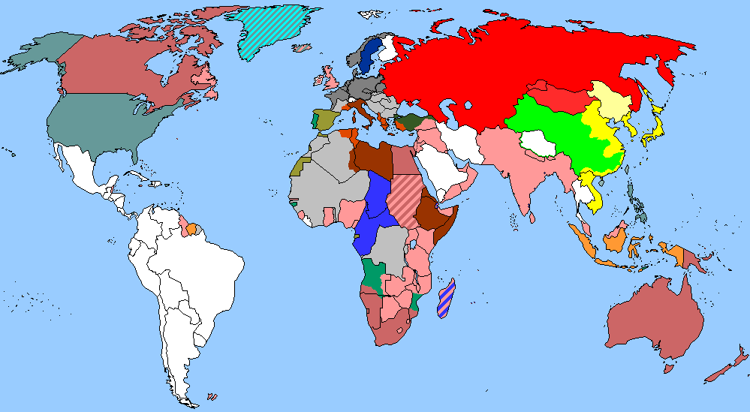
The World
January 1st-15th, 2023

Slide 3
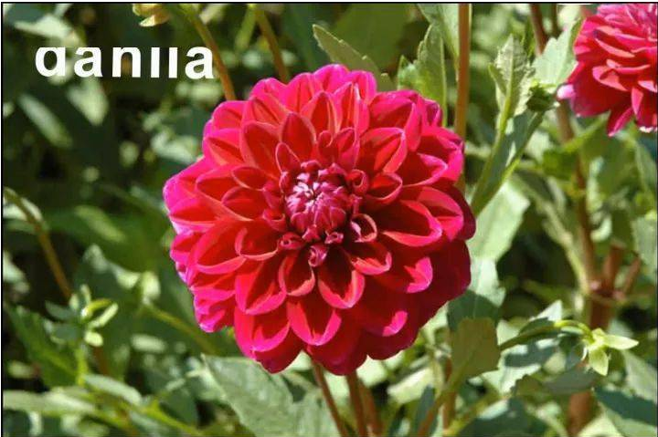
1. Year of extraordinary temperatures bears fruit in winter
异常高温的年份对冬天的影响

Slide 4
语篇填空
（《泰晤士报》2023年1月3日 7页）
Flowers that have rarely, if ever, opened ______________ (blossom) in English gardens,while figs were ripe and ready ______ (eat) in the second week of December.
Horticultural experts have described _____ last year’s unusual weather led to extraordinary trends that could herald a bountiful spring. People have reported fruits such as figs growing and ________ (ripe) on trees until well into December.
Guy Barter, chief horticulturist of the Royal Horticultural Society, suggested that the long hot summer last year, with extra light and heat, _________ (combine) with a relatively late frost may have contributed to certain plants and flowers deciding to give the unthinkable ___ go.
“The flowering season was ______ (vast) extended,” he said. “When I was young, we’d expect frost in late September, early October.
“But the growing season [in 2022] has been extraordinary. Roses have been still in flower late into the season, and there are plants ______ will just keep going until the weather gets too cold that have been going until December, like fuchsias and dahlias.”
A single year’s _________ (evident) was not enough to say that climate change was the cause, Barter said. But “it’s certainly consistent ____ what we expect [to become] the norm under climate change”.
have blossomed
to eat
how
ripening
combined
a
vastly
which
evidence
with

Slide 5
词汇讲解
1. herald: to be a sign that sth is going to happen 是（某事）的前兆；预示
It happened on the sultry evening that heralded the end of the hot summer.
这事发生在预示着炙热的夏天即将结束的那个闷热的夜晚。
2. consistent: always behaving in the same way, or having the same opinions, standards, etc. 一致的；始终如一的
It is vital that parents give children clear and consistent messages about study. 至关重要的是，父母们给子女提供关于学习明确一致的观点。
翻译句子
这些谈判可能预示着新的和平时代的来临。
These talks could herald a new era of peace.
翻译句子
她对待孩子反复无常。
She's not very consistent in the way she treats her children.

Slide 6
句子翻译
Guy Barter, chief horticulturist of the Royal Horticultural Society, suggested that the long hot summer last year, with extra light and heat, combined with a relatively late frost may have contributed to certain plants and flowers deciding to give the unthinkable a go.
英国皇家园艺学会首席园艺学家盖伊·巴特认为，去年漫长炎热的夏天，光照和热量都格外充足，再加上霜冻时间相对较晚，这可能是某些植物和花卉决定尝试这种难以想象的生长方式的原因。
翻译
Roses have been still in flower late into the season, and there are plants which will just keep going until the weather gets too cold that have been going until December, like fuchsias and dahlias.
玫瑰在季末仍在开花，而有些植物会一直开到12月，直到天气变得太冷，比如紫红色和大丽花。
翻译

Slide 7
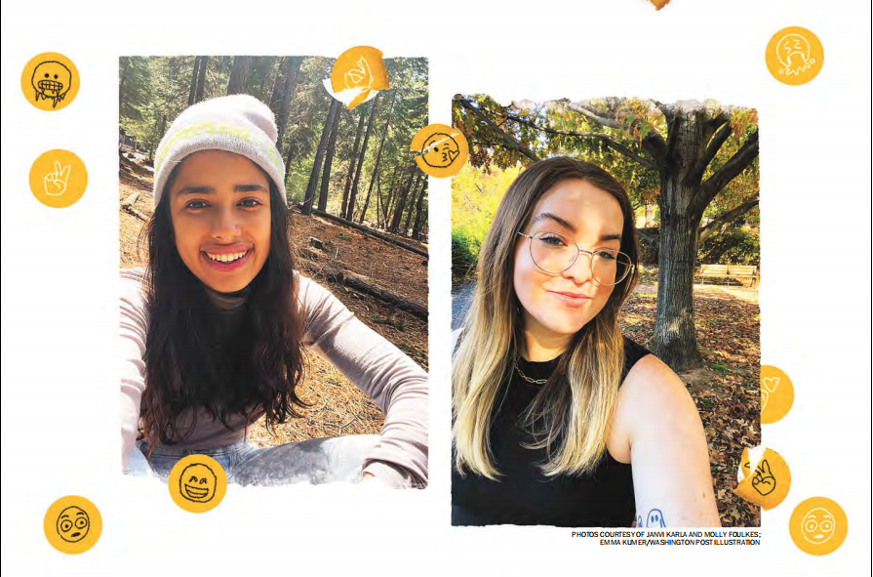
2.Gen Z brings new language to workplace communication
Z世代为职场沟通带来了新的语言

Slide 8
语篇填空
（《华盛顿邮报》2023年1月8日 G1&G4版面）
Digital natives communicate _________ (different) — and confuse older colleagues. When 24-year-old Mary Clare Wall read a message __________ said her colleague would be “out of pocket,” she and her young co-workers _______ (giggle). As Generation Z workers, Wall and her peers interpreted the phrase to mean that their colleague planned to do something crazy or inappropriate, not that they would be unavailable. But in ____ same manner, she confused her older colleagues with her regular use of the word “slay.” Generation Z—_______ (define) by the Pew Research Center as those born between 1997 and 2012 — is bringing its own style of communication to the workplace. Wall said ______ (use) “slay,” which to Gen Z means “good job” or “killing it,” is one of the many examples of _____ she and some of her older colleagues miscommunicate.
Miscommunication also happens ________ uses of punctuation, phrases and emoji. Given that Gen Z grew up communicating digitally and through text, they’ve had to develop ways to incorporate tone and intention. That means adding visual ________ (element) such as memes and emoji and often using them ironically. And with their prolific use of social media, Gen Z workers are GEN Z FROM G1 able to spread new trends to their peers much faster, _______ (lead) to widespread adoption.
differently
that / which
giggled
the
defined
using
how
through
elements
leading

Slide 9
词汇讲解
1. interpret: to decide that sth has a particular meaning and to understand it in this way 把…理解为；领会
I didn't know whether to interpret her silence as acceptance or refusal. 我不知该把她的沉默看作是接受还是拒绝。
2. incorporate: to include sth so that it forms a part of sth. 将…包括在内；包含；吸收；使并入
Many of your suggestions have been incorporated in the plan. 你的很多建议已纳入计划中。
翻译句子
这份资料可以从多方面解读。
The data can be interpreted in many different ways.
翻译句子
新的汽车设计包括了所有最新的安全配备。
The new car design incorporates all the latest safety features.

Slide 10
句子翻译
As Generation Z workers, Wall and her peers interpreted the phrase to mean that their colleague planned to do something crazy or inappropriate, not that they would be unavailable.
作为Z世代的员工，沃尔和她的同事将这句话理解为他们的同事计划做一些疯狂或不合适的事情，而不是说他们会有事。
翻译
Wall said using “slay,” which to Gen Z means “good job” or “killing it,” is one of the many examples of how she and some of her older colleagues miscommunicate.
沃尔说，使用“slay”(对Z世代来说意味着“干得好”或“杀了它”)是她和一些年长同事沟通不畅的众多例子之一。
翻译

Slide 11
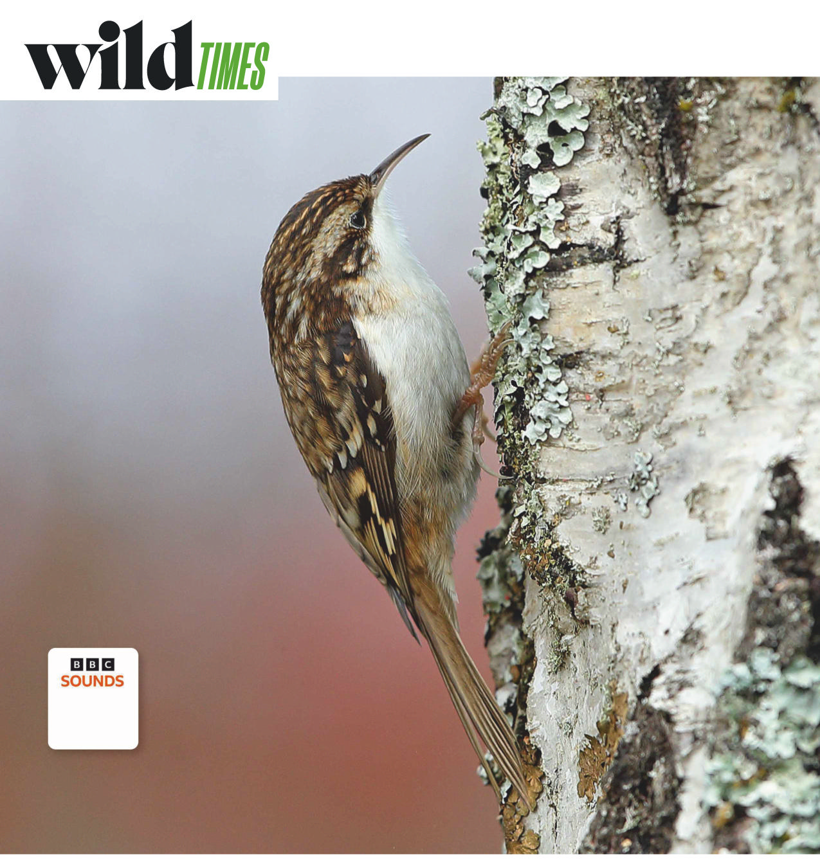
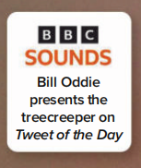
3. Moving On Up 天天向上
Usually a loner, the mouse-like treecreeper joins flocks of tits in winter

Slide 12
语篇填空
（《BBC野生生物》 2023年1月刊 26页）
Thanks ___ its beautifully patterned, bark-like plumage (全身羽毛), the treecreeper is one of the easiest woodland birds ___________ (overlook). Things are not helped by its mousy demeanour. It hesitantly inches up trunks and along and under ________ (branch), gripping the bark so ______ (tight) with its extra-long, strong claws, it could almost be part of the tree. The species _____ (feed) on insects and spiders from crevices (裂缝).
But in winter, the treecreeper’s _________ (behave) changes. It joins mixed flocks of great, blue, coal and long-tailed tits, _______ (move) through woods with them in search of food. Colourful and _____ (noise), these flocks are far more likely to catch your attention.
In truth, the treecreeper is more of a flock follower, since it stays on the fringes of the group. And, usually, there will be only one or two treecreepers per flock - listen out for a high-pitched “srreee” sound - so they are ______ (great) outnumbered by the tits. Being in a flock is worth it though, _______ there are more eyes to spot danger.
to
to overlook
branches
tightly
feeds
behaviour
moving
noisy
greatly
because

Slide 13
词汇讲解
1. demeanour: the way that sb looks or behaves 外表；风度；行为；举止
He maintained a professional demeanour throughout. 他始终保持着专业人才的风度。
2. fringe: the outer or less important part of an area, group, or activity（地区或群体的）边缘，外围；（活动的）次要部分
The party remained on the fringe of the political scene until last year. 直到去年该党还一直处于政治舞台的外围。
翻译句子
从外表上看，他没有任何焦虑的神态。
There was nothing in his demeanour that suggested he was anxious.
翻译句子
尼娜仍然在人群的边上。
Nina remained on the fringe of the crowd.

Slide 14
句子翻译
It hesitantly inches up trunks and along and under branches, gripping the bark so tightly with its extra-long, strong claws, it could almost be part of the tree. The species feeds on insects and spiders from crevices.
它犹豫地爬上树干，沿着树枝和树枝下，用它超长而有力的爪子紧紧抓住树皮，它几乎可以成为树的一部分。该物种以裂缝中的昆虫和蜘蛛为食。
翻译
But in winter, the treecreeper’s behaviour changes. It joins mixed flocks of great, blue, coal and long-tailed tits, moving through woods with them in search of food. Colourful and noisy, these flocks are far more likely to catch your attention.
但在冬天，旋木雀的行为会发生变化。它加入了大山雀、蓝山雀、煤山雀和长尾山雀的混合群体，与它们一起穿过树林寻找食物。色彩鲜艳、吵闹的鸟群更有可能吸引你的注意。
翻译

Slide 15
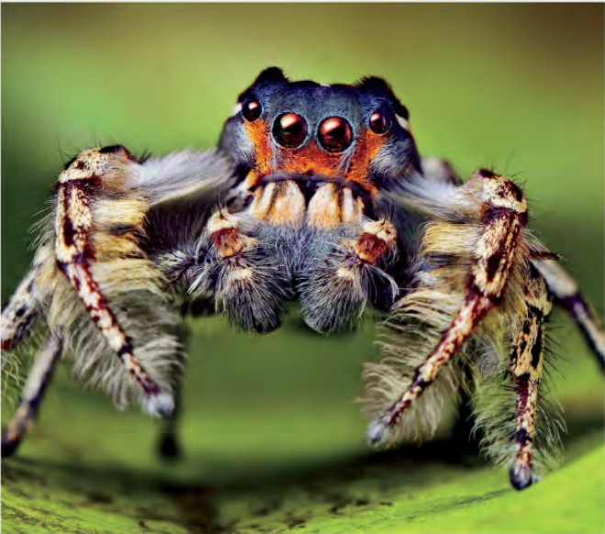
4. Dream Weavers, in REM 跳蛛或可在快速眼动阶段做梦

Slide 16
语篇填空
（《国家地理》2023年1月刊 EXPLORE | BREAKTHROUGH版面）
Turns out the sandman may visit arachnids too. When ecologist Daniela Roessler at the University of Konstanz, Germany, ________ (observe) jumping spiders at night, they mostly were immobile, _________ (suspend) upside down on a silk thread with their eight legs curled inward. But ___________ (periodical) their spinnerets—the silk-producing organs on their rumps—would wiggle, or a leg would jerk. It reminded Roessler ___ how a dozing puppy’s foot may twitch. Could the spiders be dreaming?
____________ (investigate) that is made easier by jumping spider anatomy: For the first 10 days of life, the babies’ heads are see-through, ___ Roessler could look straight in. Using magnifying _______ (glass) duct-taped to night-vision goggles, she watched the spiderlets’ retinas flickering back and forth during bouts of movement. It suggested they were experiencing visual dreams—the first time REM-like sleep has been observed in ___ animal without a backbone. The more we learn about jumping spiders’ cognitive abilities, the less alien they seem and the more ______ (worth) of respect, Roessler contends. “If they dream, I mean, what can you do? You cannot smoosh a spider ___________ dreams.”
observed
suspended
periodically
of
Investigating
so
glasses
an
worthy
that / which

Slide 17
词汇讲解
1. wiggle: to move from side to side or up and down in short quick movements; to make sth move in this way （使）扭动，摆动，摇动，起伏
Her bottom wiggled as she walked past.
她屁股一扭一扭地走了过去。
2. anatomy: the structure of an animal or a plant （动植物的）结构，解剖
He had worked extensively on the anatomy of living animals. 他在活体解剖方面经验丰富。
翻译句子
如果你挠他的下巴，他的耳朵就会摆动。
His ears will wiggle if you scratch his chin.
翻译句子
她对马的身体构造非常熟悉。
She is familiar with the anatomy of the horse.

Slide 18
句子翻译
When ecologist Daniela Roessler at the University of Konstanz, Germany, observed jumping spiders at night, they mostly were immobile, suspended upside down on a silk thread with their eight legs curled inward.
翻译
当德国康斯坦茨大学的生态学家Daniela Roessler在夜间观察跳蛛时，它们大多是一动不动的，倒挂在一根蛛丝上，八条腿向内卷曲。
Using magnifying glasses duct-taped to night-vision goggles, she watched the spiderlets’ retinas flickering back and forth during bouts of movement. It suggested they were experiencing visual dreams—the first time REM-like sleep has been observed in an animal without a backbone.
用粘在夜视镜上的放大镜，她观察到小蜘蛛的视网膜在运动过程中来回闪烁。这表明他们正在经历视觉梦——这是第一次在无脊椎动物身上观察到类似快速眼动睡眠的现象。
翻译

Slide 19
5. BBC World's Smallest Wild Dog

Slide 20
听力填空
Five and a half million square miles of sand. The size of China. The Sahara smothers six percent of the world’s land. Yet this vast, ___________ place is home to the world’s smallest wild dog, the fennec fox. _______ the size of a walking boot, this tiny fox goes head-to-head with the desert every day. The Sahara is filled with millions upon millions of grains of sand, and every grain acts as a radiator. Sand ________ heat, and the hotter it gets, the more heat it radiates. The temperature here spirals to over 100 degrees. In such sizzling conditions, the fennec’s size _______. A small body can shed heat faster than a large one, and to lose heat even faster, the fennec’s ears act like ____________ air conditioning units. The network of veins cools the blood to lower the temperature. Despite such capable cooling, not even a fennec can endure the heat of the Saharan Sun. There’s no shade. But fennecs are _______ of their environment. Moisture concentrates at the foot of the dunes, so the sand here is firm enough to dig a burrow. Home sweet home for a pair of fennecs. They have shelter from the worst of the heat, but they must eventually leave the safety of their den to find food. And this enormous desert is a dangerous place for a tiny, wild dog. An _______ fennec is small enough to be caught by feral dogs and even eagle owls. But their camouflaged coats make them less conspicuous. In the ______ light of dusk, she makes a run for it. Zig-zagging and jumping, she uses the dunes to ______ her location. The grains of sand are constantly _______, but the pads on her feet are furry for maximum traction. Few can keep tabs on her whereabouts.
unforgiving
Barely
absorbs
matters
sophisticated
masters
unwary
fading
mask
shifting

Slide 21
词汇讲解
1. conspicuous: easy to see or notice; likely to attract attention
易见的；明显的；惹人注意的
You may feel tearful in situations where you feel conspicuous.
觉得自己身处众目睽睽之下时，你可能会有想哭的感觉。
2. whereabouts: the place where sb/sth is （人或物）所在的地方；下落；行踪
The police are anxious to hear from anyone who may know the whereabouts of the firearms.
警方急盼任何可能知道这批武器下落的人提供线索。
翻译句子
Mary的红头发在学校里总是很惹眼。
Mary’s red hair always made her conspicuous at school.
翻译句子
他仍下落不明。
His whereabouts are/is still unknown.

Slide 22
句子翻译
A small body can shed heat faster than a large one, and to lose heat even faster, the fennec’s ears act like sophisticated air conditioning units. The network of veins cools the blood to lower the temperature. Despite such capable cooling, not even a fennec can endure the heat of the Saharan Sun.
小身体可以比大身体更快地散热，而为了更快地散热，耳廓狐的耳朵就像精密的空调装置一样。静脉网络冷却血液以降低温度。尽管有如此强大的冷却能力，但即使是耳廓狐也无法忍受撒哈拉太阳的高温。
翻译
They have shelter from the worst of the heat, but they must eventually leave the safety of their den to find food. And this enormous desert is a dangerous place for a tiny, wild dog. An unwary fennec is small enough to be caught by feral dogs and even eagle owls.
它们可以躲避最炎热的天气，但它们最终必须离开安全的巢穴去寻找食物。这片巨大的沙漠对一只小小的野狗来说是一个危险的地方。一个不小心的耳廓狐小到足以被野狗甚至鹰鸮抓住。
翻译

