Slide 1
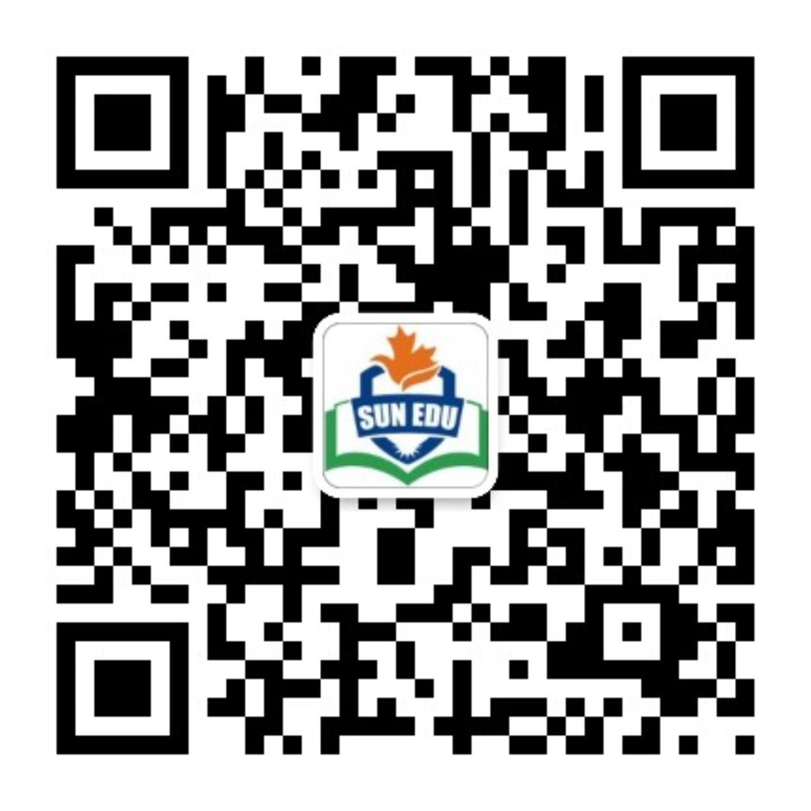
感恩遇见，相互成就，本课件资料仅供您个人参考、教学使用，严禁自行在网络传播，违者依知识产权法追究法律责任。
更多教学资源请关注
公众号：溯恩英语
知识产权声明

Slide 2
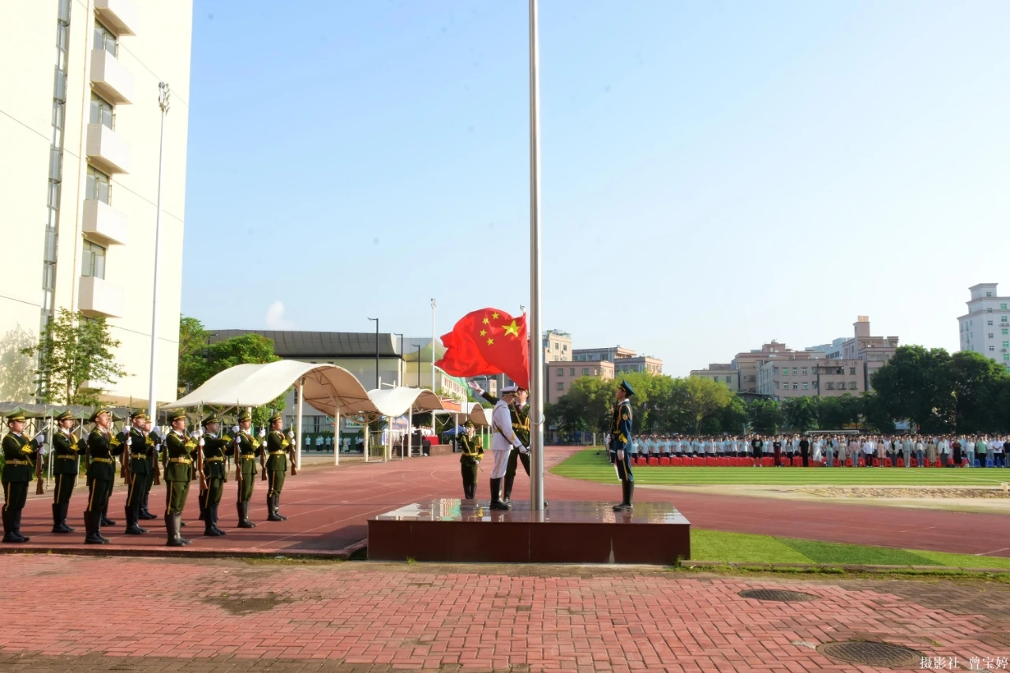
高考应用文专题之活动介绍
How to introduce activities?
东莞第十高级中学
Nancy

Slide 4
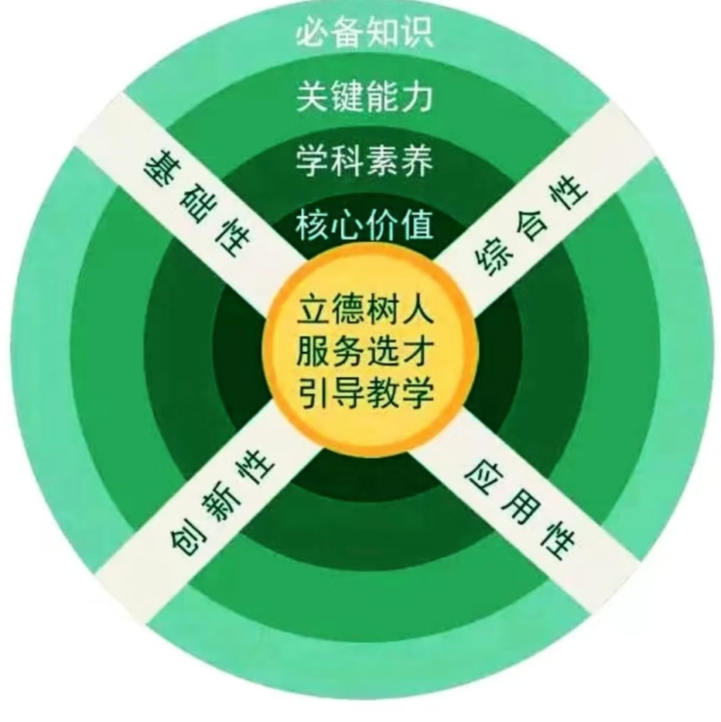
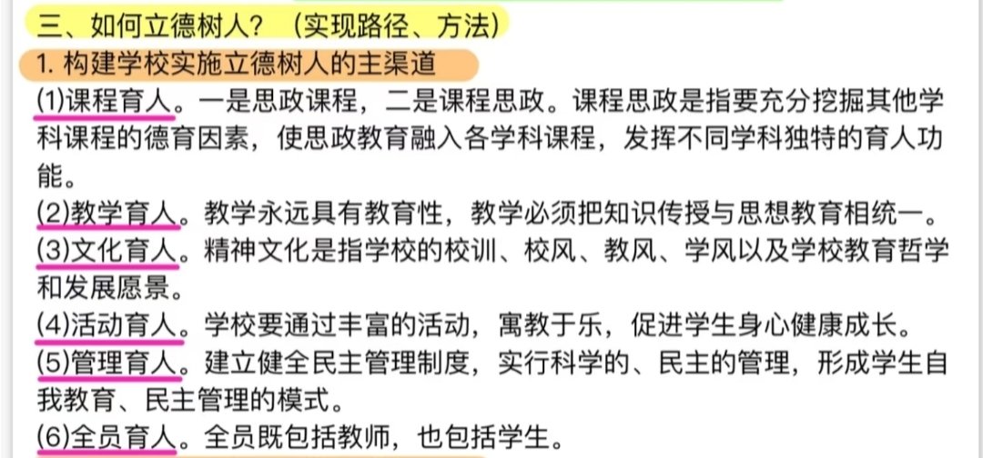
Gaokao Evaluation System

Slide 5
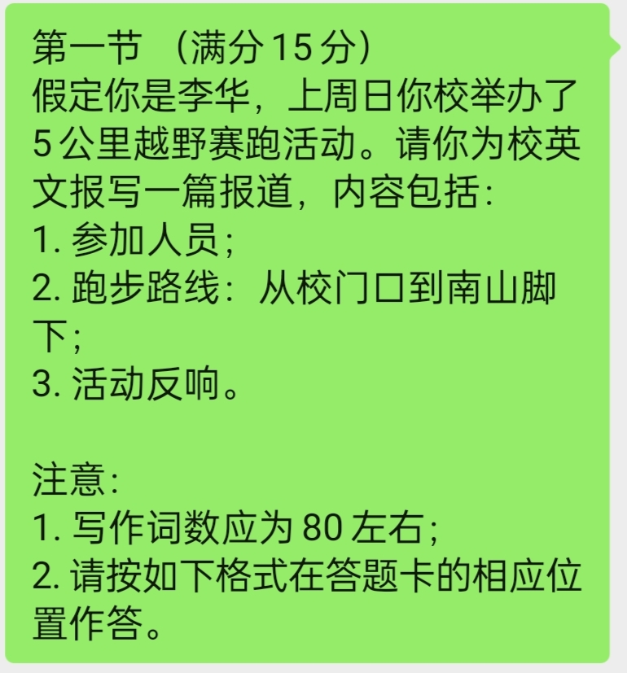
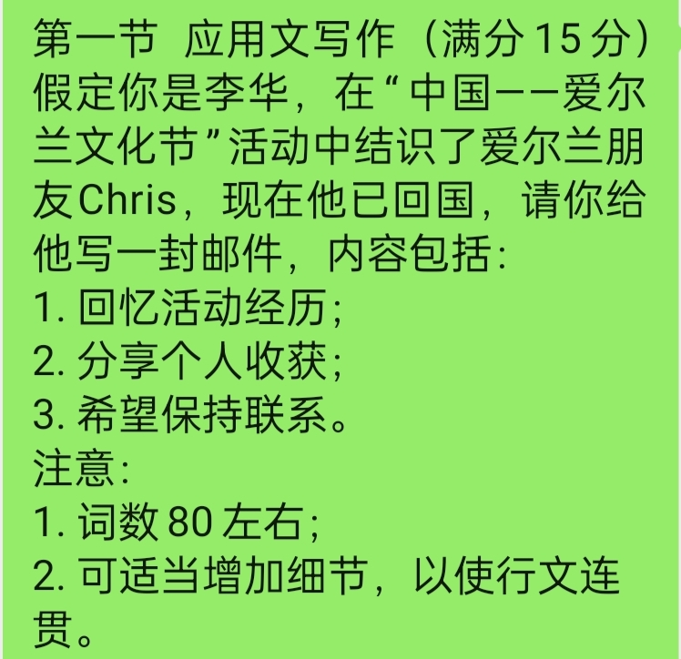
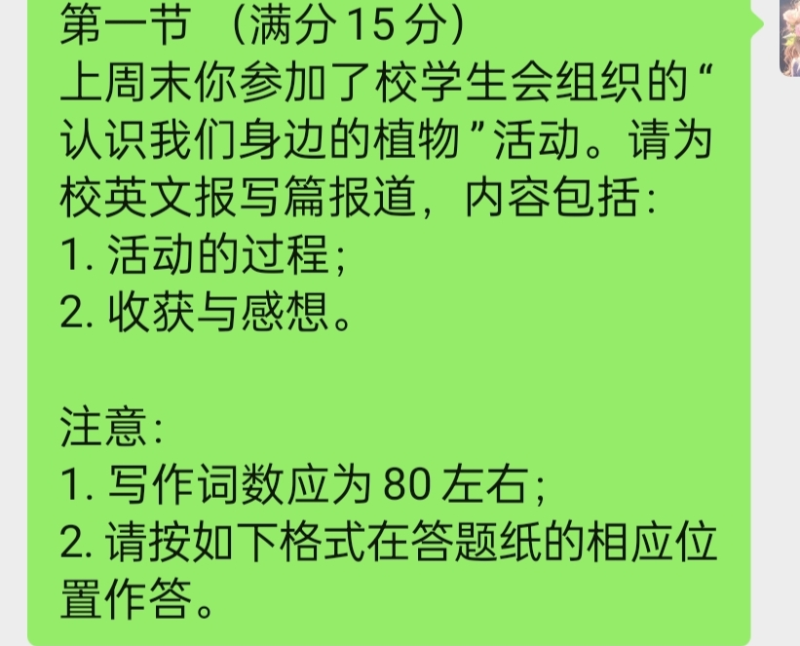
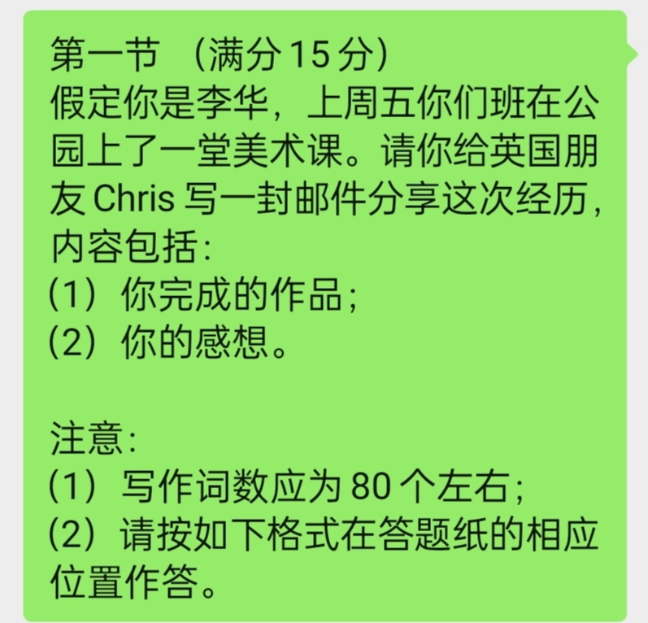
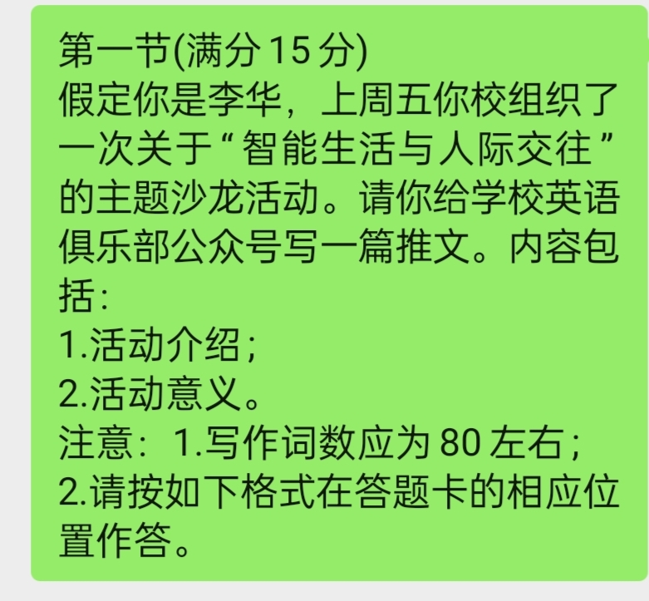
2020新课标1卷
2021浙江卷
2022浙江卷
东莞市2024-2025高三第一学期期末考卷
2023浙江卷
2024新课标1卷

Slide 6
Learning objectives
1.We will know the components of an activity.
2.We will know how to pre-write a practical writing about activities.
3.We will know how to introduce an activity properly.

Slide 7
Activity 1: Brainstorm the types of activities
cultural and art activities
文化艺术类活动：
festival/ exhibition/ performance/ class/ ceremony/ party/ outing/ lecture/ salon
文化艺术节、展览、表演、各种课、典礼、派对、外出活动、演讲、沙龙
Types of activities
sports activities and competitions
体育比赛类活动:
competition/ sports meet
比赛、竞赛、运动会

Slide 8
2020新课标1卷
2021浙江卷
2022浙江卷
东莞市2024-2025高三第一学期期末考卷
2023浙江卷
2024新课标1卷

Slide 9
Activity 2： Brainstorm the components of an activity?
theme /title / topic
主题、题目、话题
purpose
目的
Components of an activity
time and place
时间、地点
contents or procedure
内容、过程
significance
意义

Slide 10
2020新课标1卷
2021浙江卷
2022浙江卷
东莞市2024-2025高三第一学期期末考卷
2023浙江卷
2024新课标1卷

Slide 11
Theme or title or topic of an activity
(期末考)你校组织了一次关于“智能生活与人际交往”为主题的沙龙活动。
themed
with the theme of
Our school held a salon________________ smart living and interpersonal communication
主题/题目/主题为...
...themed/ titled...
...with the theme/title/topic of...

Slide 12
Time and place of activities
(期末考)上周五你校组织了一次关于“智能生活与人际交往”为主题的沙龙活动。
Last Friday __________ a salon themed smart living and interpersonal communication in our school.
witnessed
活动后的新闻报道、宣传稿、活动推文
时间、地点见证了...的举办
你校将在下周五组织一次关于“智能生活与人际交往”为主题的沙龙活动。
A salon themed smart living and interpersonal communication ______________________ next Friday in our school.
will be scheduled for
be scheduled for...
be arranged in...
be held in...
安排在...

Slide 13
Purpose of an activity
为了让同学们更了解智能科技，上周五你校组织了一次关于“智能生活与人际交往”为主题的沙龙活动。
___________________________________________________________, our school held a salon themed smart living and interpersonal communication last Friday.
Aiming to give students deeper insight into smart technology
cultural and art activities:
students’ after-class life/school life
students’ horizons
Chinese traditional culture
students deeper insight into AI
students’ passion/ enthusiasm for science
students’ awareness of protecting the environment
cultural exchange
enrich
broaden/widen
为了...
promote
give
In order to do...
Aiming to do...
In an attempt to do...
spark
arouse/raise
enhance
sports activities or competitions
students’ physical and mental health
students’ willpower and perseverance
students’ sense of teamwork and collective honor
strengthen
sharpen
cultivate

Slide 14
Procedure or contents of activities
活动伊始，由一个AI方面的专家给我们做了一个关于科技如何影响我们社会生活的讲座。然后，我们一起讨论了社交媒体的优缺点，面对面交流的意义和如何让科技把我们联系得更紧密。最后是本次活动最精彩的部分--亲自体验和人工智能互动，让我们兴奋不已。
_____________________________, an expert in AI delivered a lecture about how technology influence our social life. ________________, we discussed the cons and pros of social media, the significance of face-to-face interaction and how can technology connect us deeper. ___________________________________________
---experience AI interaction in person, which left us more than excited.
At the beginning
Subsequent to it
Finally came the highlight
At the beginning,....Subsequent to it/ Following it, ....At the end, / Finally came the highlight
procedure

Slide 15
为了让更多的人了解智能生活对我们的影响，此次沙龙举办了一系列的活动，由一个AI方面的专家给我们做了一个关于科技如何影响我们社会生活的讲座到亲自体验和人工智能互动不等。此次活动中，让我印象最深刻的是亲自体验环节，让我感受了AI的力量。
In an attempt to make the influence of smart life on us known to more people, ______________________________, ____________ a lecture delivered by an AI expert on how technology influences our social life _____ hands-on experience of interaction with AI. _____________________________________________________, which made me feel the power of AI.
a variety of activities were held
ranging from
to
What impressed me most was the hands-on experience
A variety of activities will be held, ranging from...to... What impressed me most was ....
contents

Slide 16
东莞市2024-2025高三第一学期期末考卷

Slide 17
How to brainstorm the specific activities in a short time?
enjoy splendid performance/ exhibition related to......
attend brilliant lecture/ speech on... delivered by a knowledgeable expert/professor.
get hands-on experience of making crafts.
experience AI interaction.

Slide 18
为了让更多的人了解智能生活对我们的影响，此次沙龙举办了一系列的活动，由一个AI方面的专家给我们做了一个关于科技如何影响我们社会生活的讲座到亲自体验和人工智能互动不等。此次活动中，让我印象最深刻的是亲自体验环节，让我感受了AI的力量。
In an attempt to make the influence of smart life on us known to more people, a variety activities were held, ranging from _______________________________________
__________________to _____________________________ . What impressed me most was the hands-on experience, which made me feel the power of AI.
a lecture delivered by an AI expert on how technology
influences our social life
hands-on experience of interaction with AI.

Slide 19
:
Significance of an activity
这次沙龙不仅丰富了我们的校园生活，而且让我们对智能生活与人际交往的关系有了更深的了解。
____________________ a new flavor to campus life, __________________
the relation of smart living and interpersonal communication.
but also it enabled us to gain deeper insight into
Not only did the salon add
add
a new flavor / luster/brilliance to campus life
our horizons
Chinese traditional culture
AI
our physical and mental health
our willpower and perseverance
our passion/ enthusiasm for
our awareness of protecting the environment/ wildlife
some friends sharing the same interest
mutual understandings between various cultures
us relaxation and relief from school work
broaden
promote
Not only can/did it...
but also we will/it enabled us to do
gain a deeper insight into
strengthen
sharpen
spark
arouse/ raise
make
boost
give

Slide 20
Activity 3： Figure out the type of each practical writing
Conclusion：
Letters: 活动分享；邀请信
Non-letters: 新闻报道；推文；宣传稿；欢迎辞
2021浙江卷
2022浙江卷
2020新课标1卷
东莞市2024-2025高三第一学期期末考卷
2023浙江卷
2024新课标1卷

Slide 21
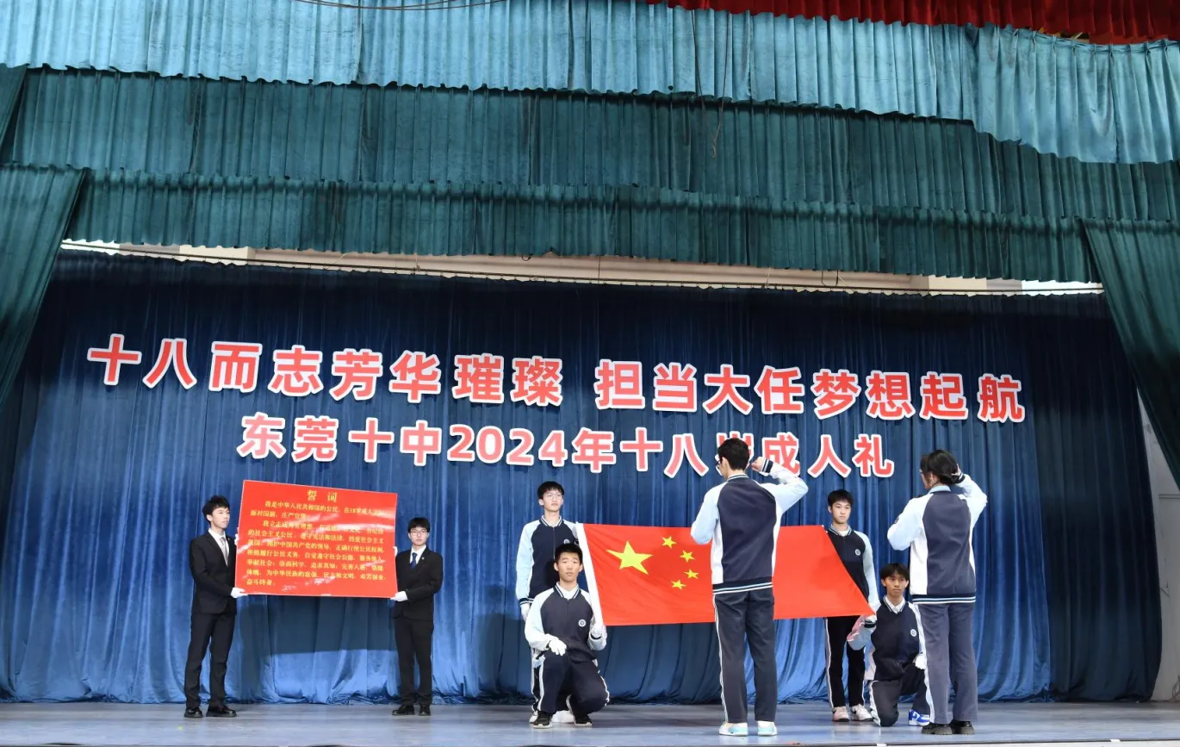
成人礼活动（the coming-of-age ceremony）

Slide 22
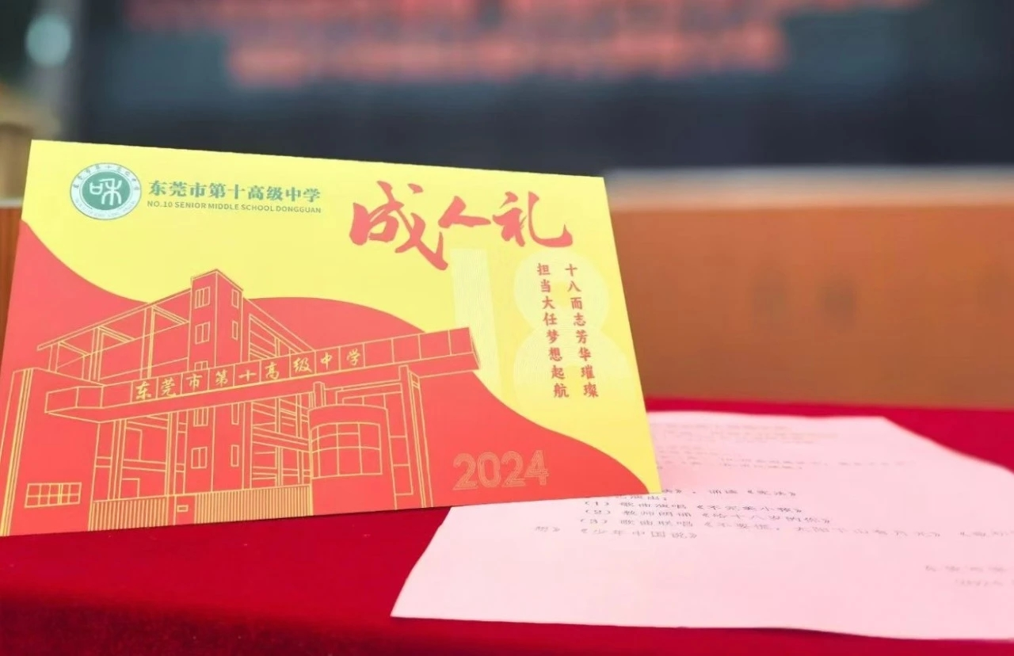
Activity 4 ： Pre-writing (Type-Tense-Outline)
1.假定你是李华，你校将为高三学生举办成人礼活动（the coming-of-age ceremony）。请你以高三年级的名义写一则通知，欢迎家长来参加活动：
1.活动目的； 2.活动安排和意义； 3.欢迎参加
注意：1.写作词数应为80左右； 2.请按如下格式在答题卡相应位置作答。
2. 假设你是李华，上周六参加了学校为高三学生举行的成人仪式。你的外国朋友David想了解成人礼，请根据以下要点，介绍成人仪式的有关情况：
1.活动过程； 2.你的感受。
注意：1.写作词数应为80左右； 2.请按如下格式在答题卡相应位置作答。
3.假如你是李华，你校下周六将组织高三年级学生举行成人礼。请你给外教David写一封电子邮件邀请他参加。内容包括：1.举行成人礼的时间和地点； 2.成人礼的具体内容； 3.欢迎参加。
注意：1.写作词数应为80左右； 2.请按如下格式在答题卡相应位置作答。
4.假定你是李华，上周六你校举行了高三成人礼仪式。请你为校公众号写一篇推文，内容包括： 1. 活动时间、地点： 2. 活动内容：走龙门、成人宣誓等； 3. 个人感悟。
注意：1.写作词数应为80左右； 2.请按如下格式在答题卡相应位置作答。
5.假定你是李华，你校将为高三学生举办成人礼活动（the coming-of-age ceremony）。请你代表高三年级给前往参加的家长们致欢迎辞：
1.活动目的； 2.活动安排和意义； 3.欢迎参加
注意：1.写作词数应为80左右； 2.请按如下格式在答题卡相应位置作答。

Slide 23
Pre-writing
1.假定你是李华，你校将为高三学生举办成人礼活动（the coming-of-age ceremony）。请你以高三年级的名义写一则通知，欢迎家长来参加活动,内容如下
1.活动目的； 2.活动安排和意义； 3.欢迎参加
注意：
1.写作词数应为80左右；
2.请按如下格式在答题卡相应位置作答。
Notice
通知
Type:
一般现在/将来
In an attempt to celebrate senior 3 students’ transition from adolescence to adult,...
Tense:
para1
目的
活动安排-see（poetry recitation）
-hear（congratulations and wishes delivered by principal）
-experience (take an oath/ go past the adult door)
意义：gain deeper insight into ...
arouse ss’ awareness of
para2
活动安排+意义
Outline:
para3
欢迎参加

Slide 24
Practice makes perfect!
Group 1.
假设你是李华，上周六参加了学校为高三学生举行的成人仪式。请根据以下要点，你的外国朋友David想了解你们成人礼，请你介绍成人仪式的有关情况：
1.活动过程； 2.你的感受。
注意：1.写作词数应为80左右； 2.请按如下格式在答题卡相应位置作答。
Group 2.
假如你是李华，你校下周将组织高三年级学生举行成人礼。请你给外教David写一封电子邮件邀请他参加。内容包括：1.举行成人礼的时间和地点； 2.成人礼的具体内容； 3.欢迎参加。
注意：1.写作词数应为80左右； 2.请按如下格式在答题卡相应位置作答。
Group 3.
假定你是李华，上周六你校举行了高三成人礼仪式。请你为校公众号写一篇推文，内容包括： 1. 活动时间、地点： 2. 活动内容：走龙门、成人宣誓等； 3. 个人感悟。
注意：1.写作词数应为80左右； 2.请按如下格式在答题卡相应位置作答。
Group 4.
假定你是李华，你校将为高三学生举办成人礼活动（the coming-of-age ceremony）。请你代表高三年级给前往参加的家长们致欢迎辞：
1.活动目的； 2.活动安排和意义； 3.欢迎参加
注意：1.写作词数应为80左右； 2.请按如下格式在答题卡相应位置作答。

Slide 25
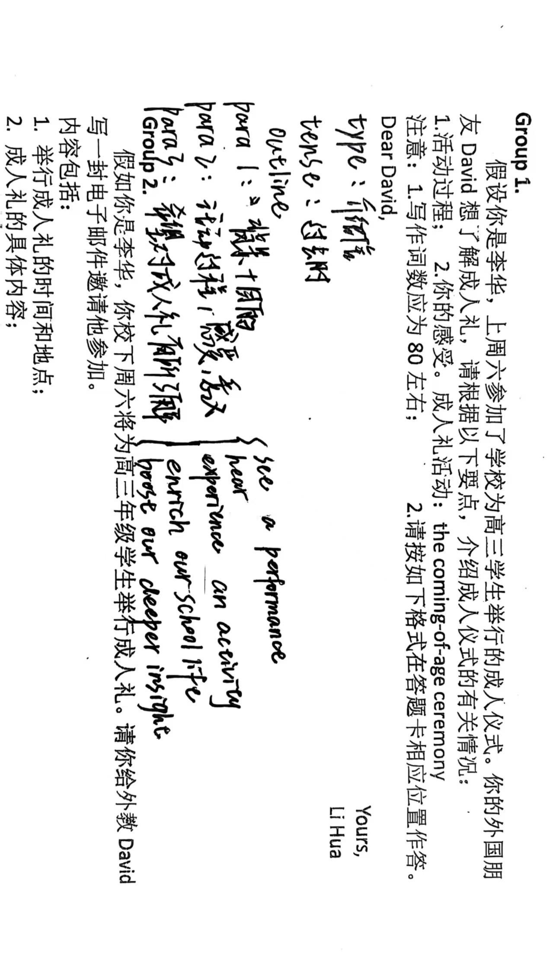
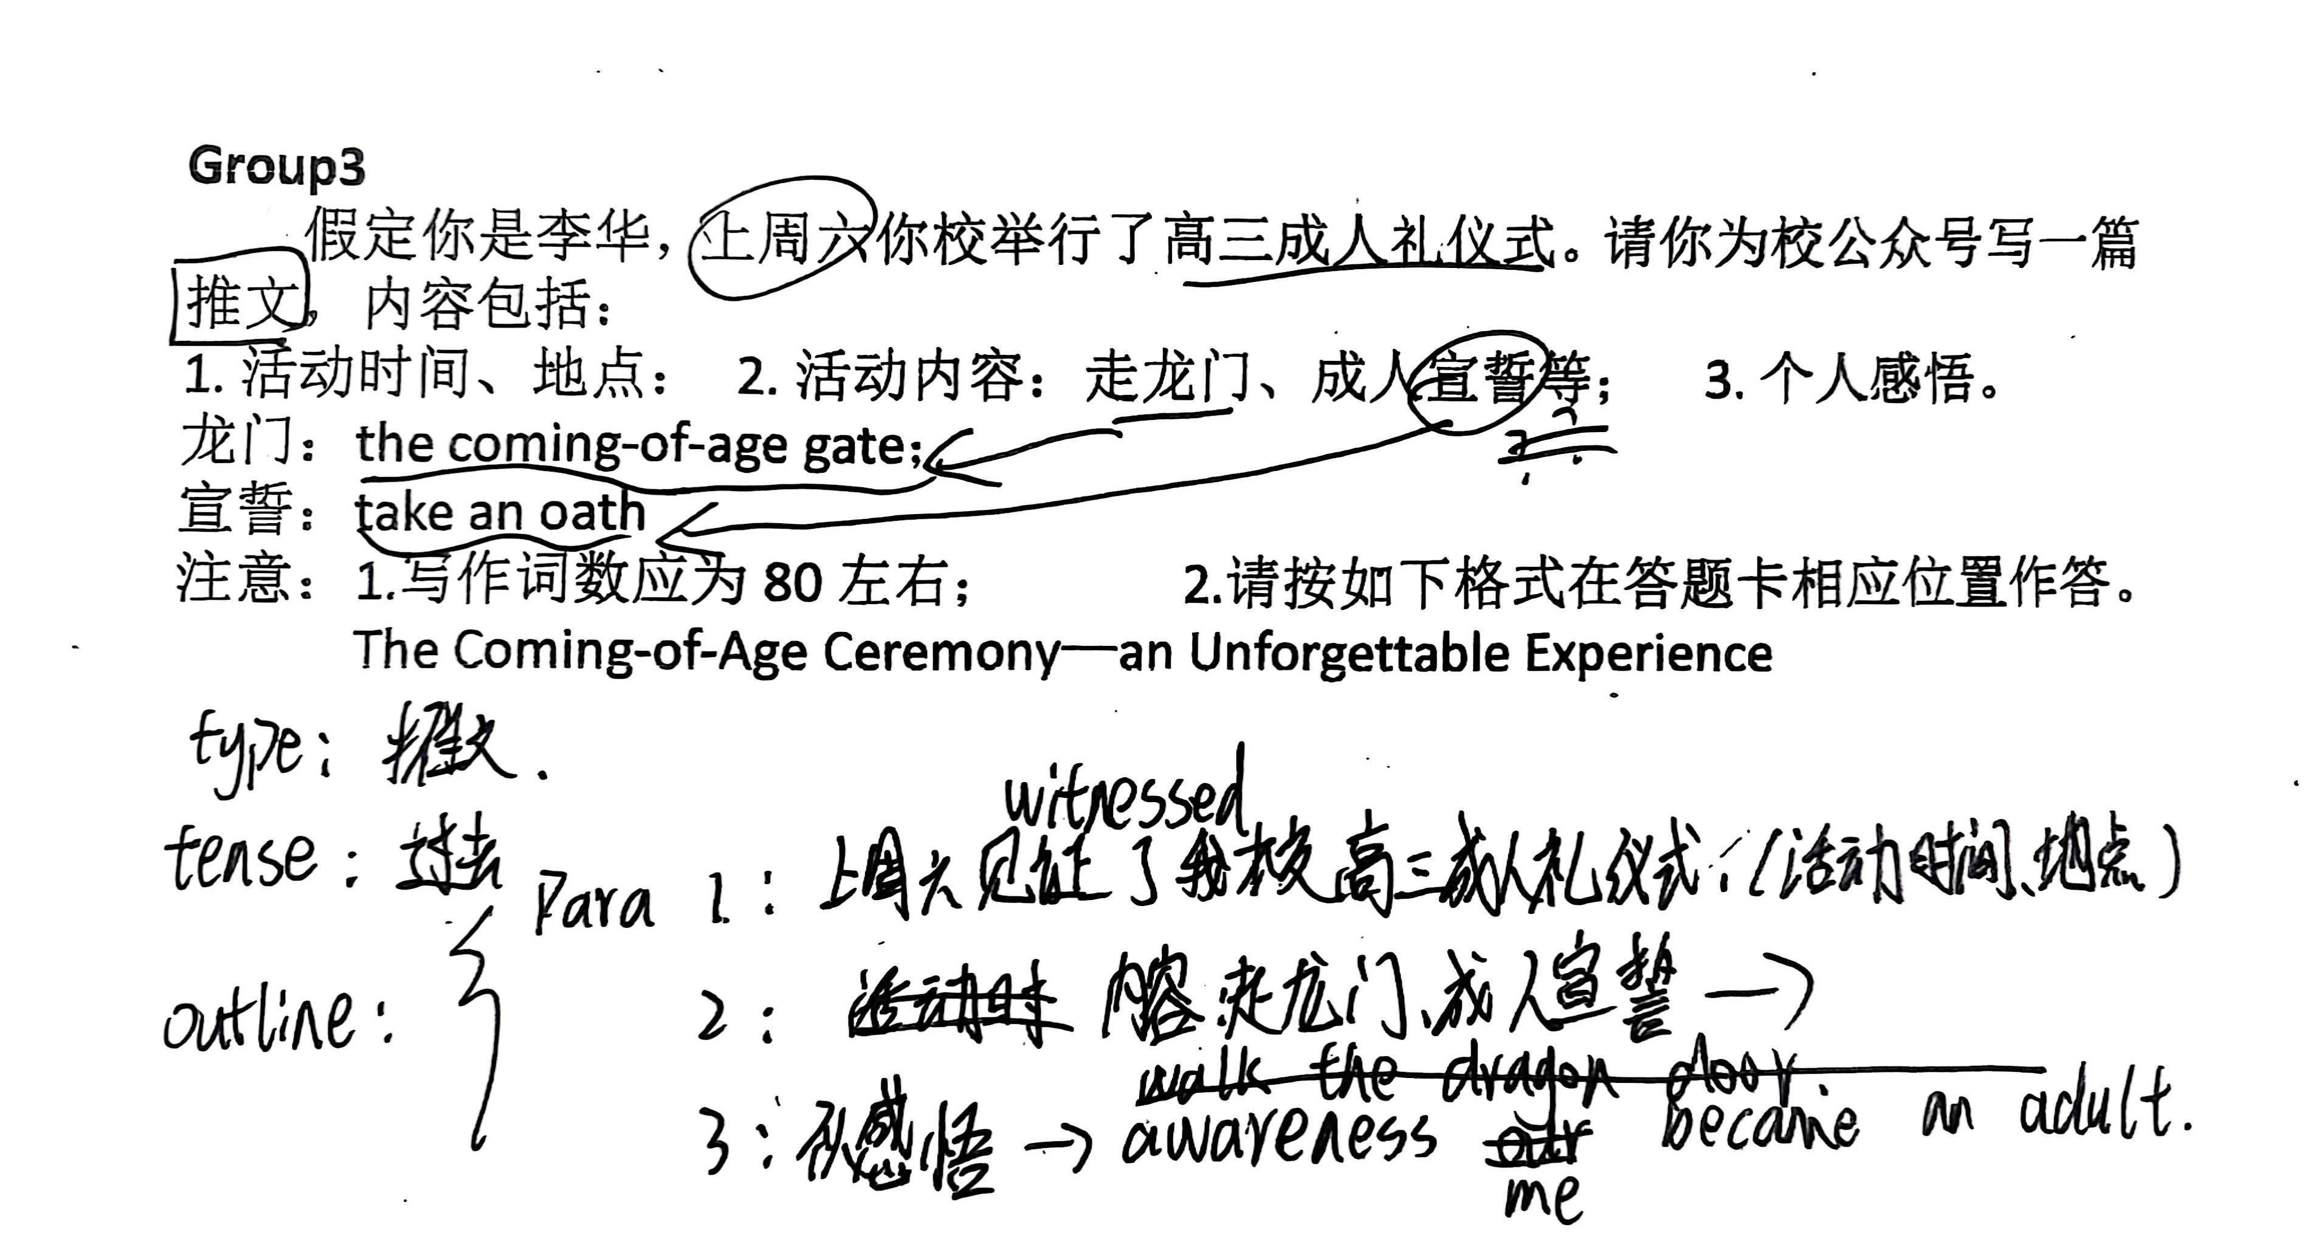
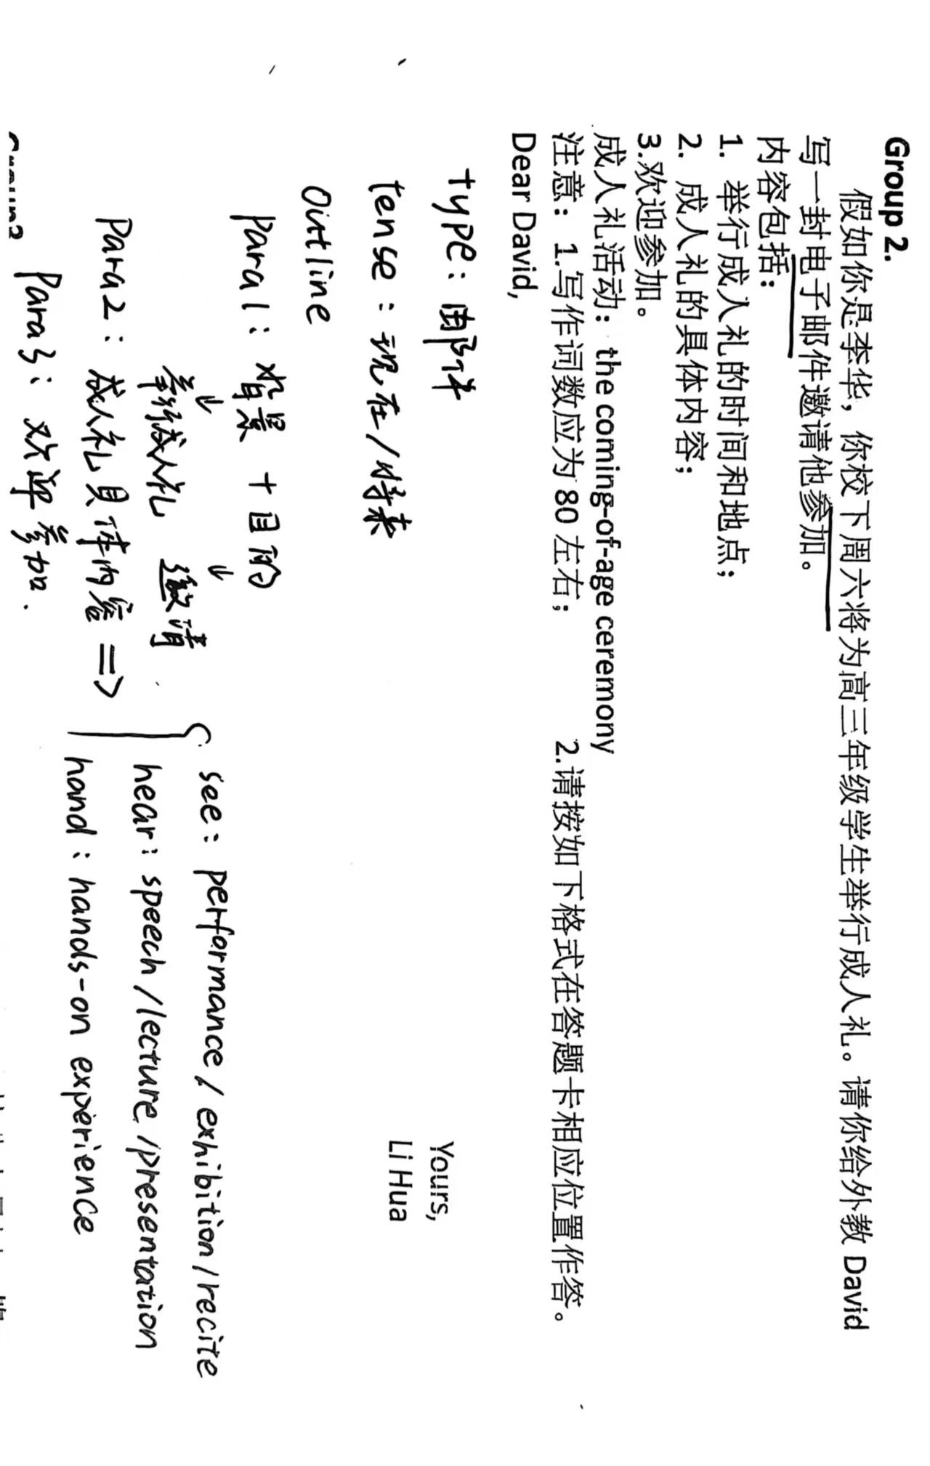
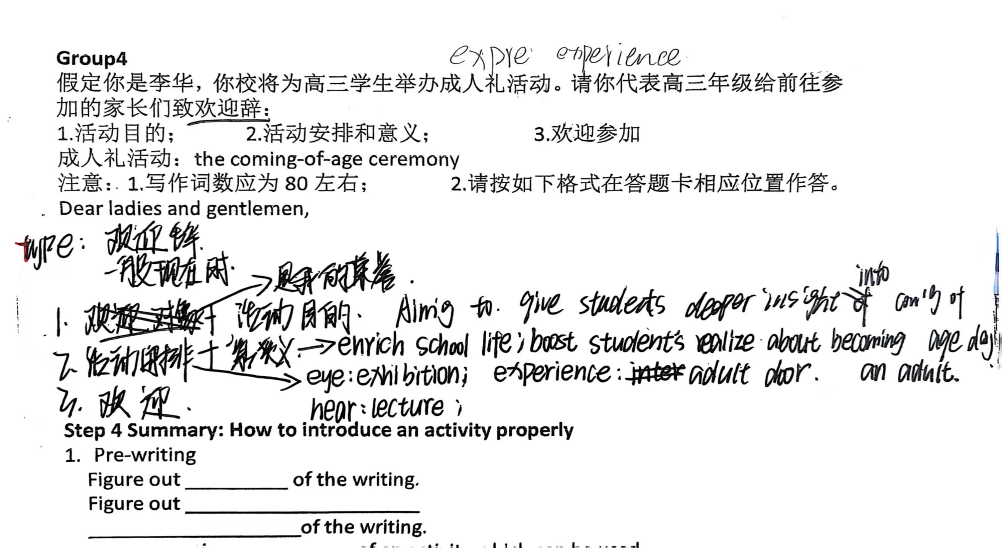
Students’ showtime

Slide 26
Summary: How to introduce an activity properly
Step 1.Pre-writing
Figure out the _________ of the writing.
Figure out the _____________________
__________the structure of the writing.
Brainstorm the _________ of an activity which can be used.
Step2.Set out to write with_______________handwriting.
type
tense
Outline
components
nice and neat

Slide 27
Self assessment | Criteria | Yes | No
1 | I know the components of an activity.
2 | I know how to identify the type and tense of an activity.
3 | I know how to lay out the given information in each paragraph accordingly and coherently.
4 | I know how to apply the transitions properly.

Slide 28
Be active to light up your life!
积极参与活动，点亮人生火花

Slide 29
Homework
Grade the writing
Correct and grade the writing according to your own outline and evaluation criteria

Slide 30
一篇好的文章由以下四部分构成：完整性、准确性、连贯性和创造性
第五档 （13-15分） | 完全达到了预期的写作目的。 ● 覆盖所有内容要点，表达清楚、合理； ● 词汇和语法结构多样、准确、恰当； ● 语言有个别错误，但为尽力使词汇和语法结构多样所致，完全不影响理解； ● 有效地使用了语句间的连接手段，结构紧凑、意义连贯。
第四档 （10-12分） | 达到了预期的写作目的。 ● 覆盖所有内容要点，表达比较清楚、合理； ● 词汇和语法结构比较多样，且准确、恰当； ● 少数语言错误主要是因尝试词汇和语法结构多样化所致，不影响理解 ● 有效地使用了语句间的连接手段，全文结构比较紧凑、意义比较连贯。

Slide 31
Evaluation dimension | Evaluation criteria | Scores | Self-Assessment
Structure | 1. Clear structure. 2. Effective transitions between sentences and paragraphs. | 3
Content | All the points are included and they are laid out accordingly and coherently. | 4
Language | 1.Correct grammar,spelling or punctuation. 2.The writing use proper, advanced and various sentence patterns | 6
Handwriting | Good handwriting and neat layout. | 2

Slide 32
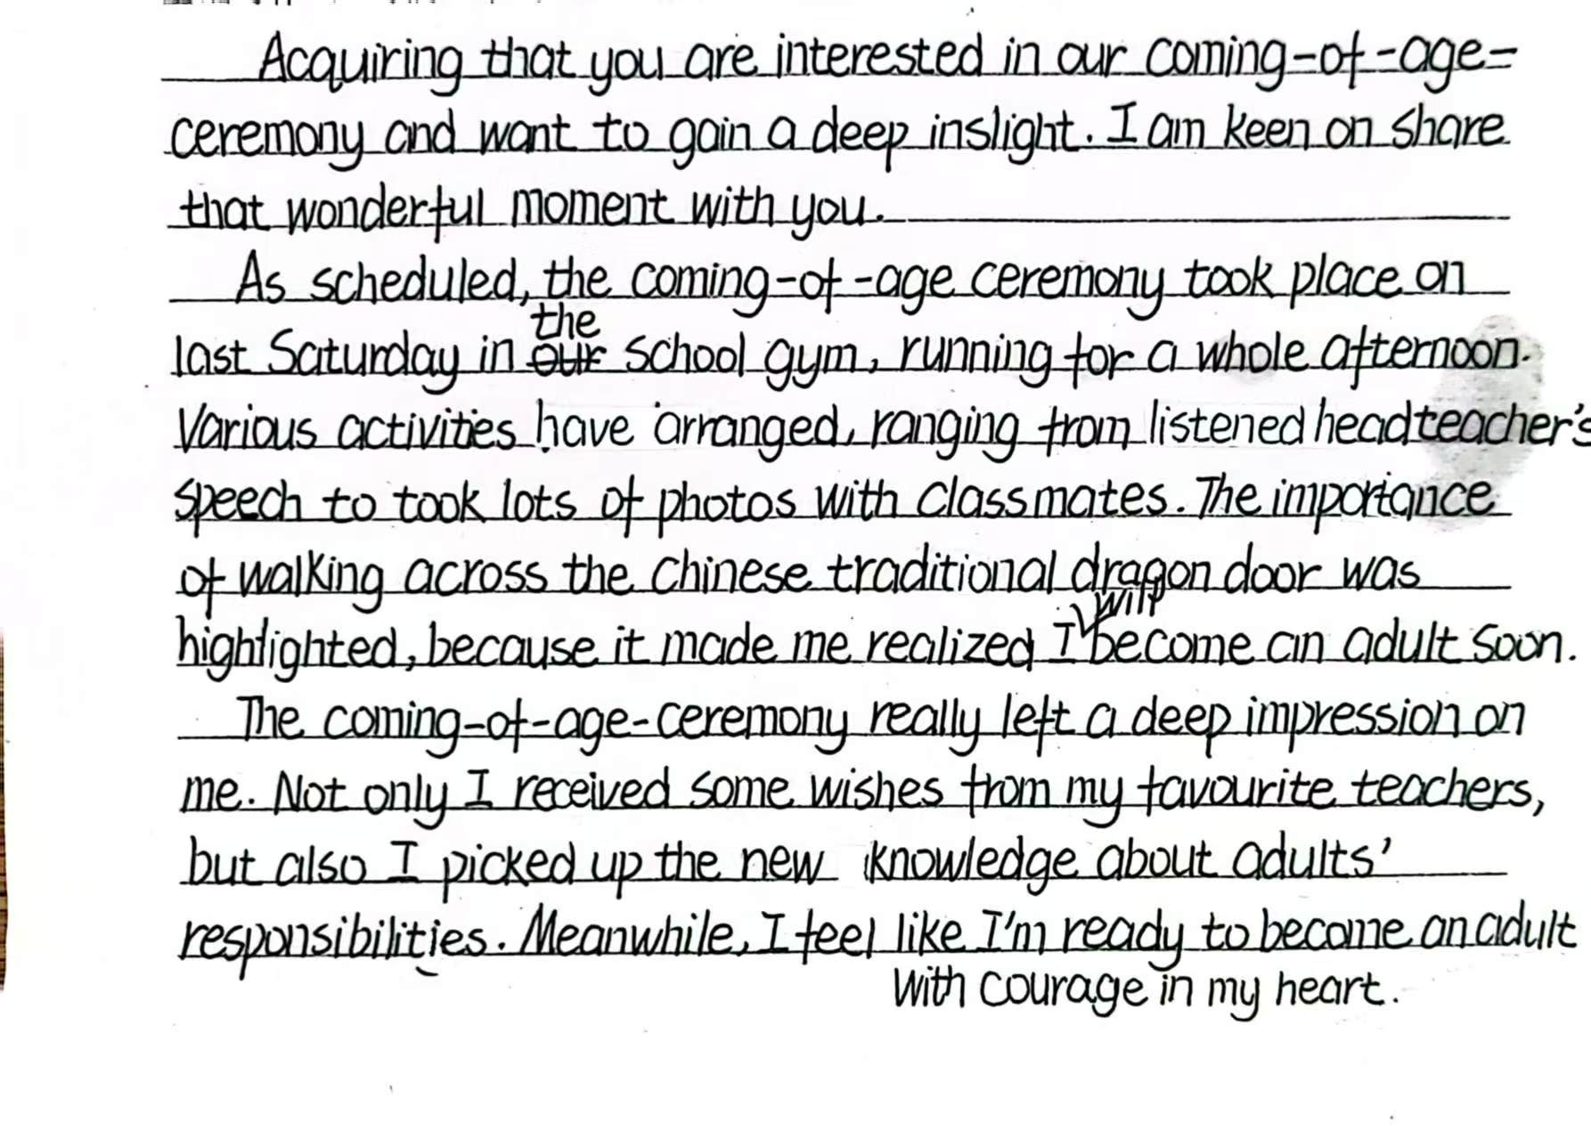

Slide 33
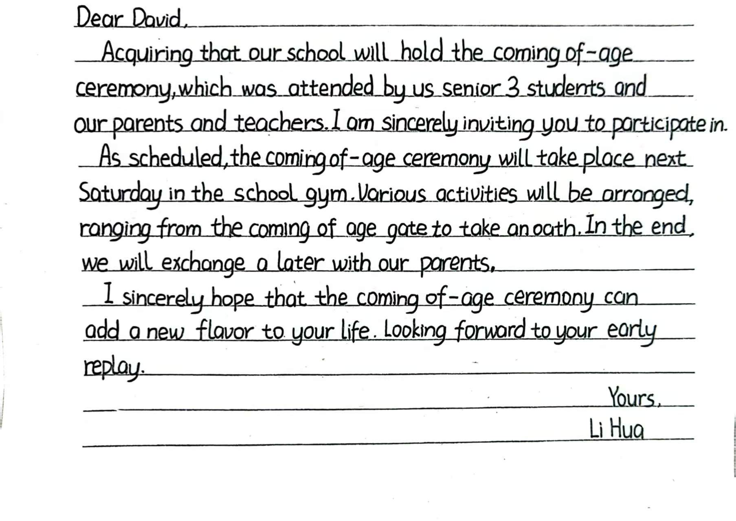

Slide 34
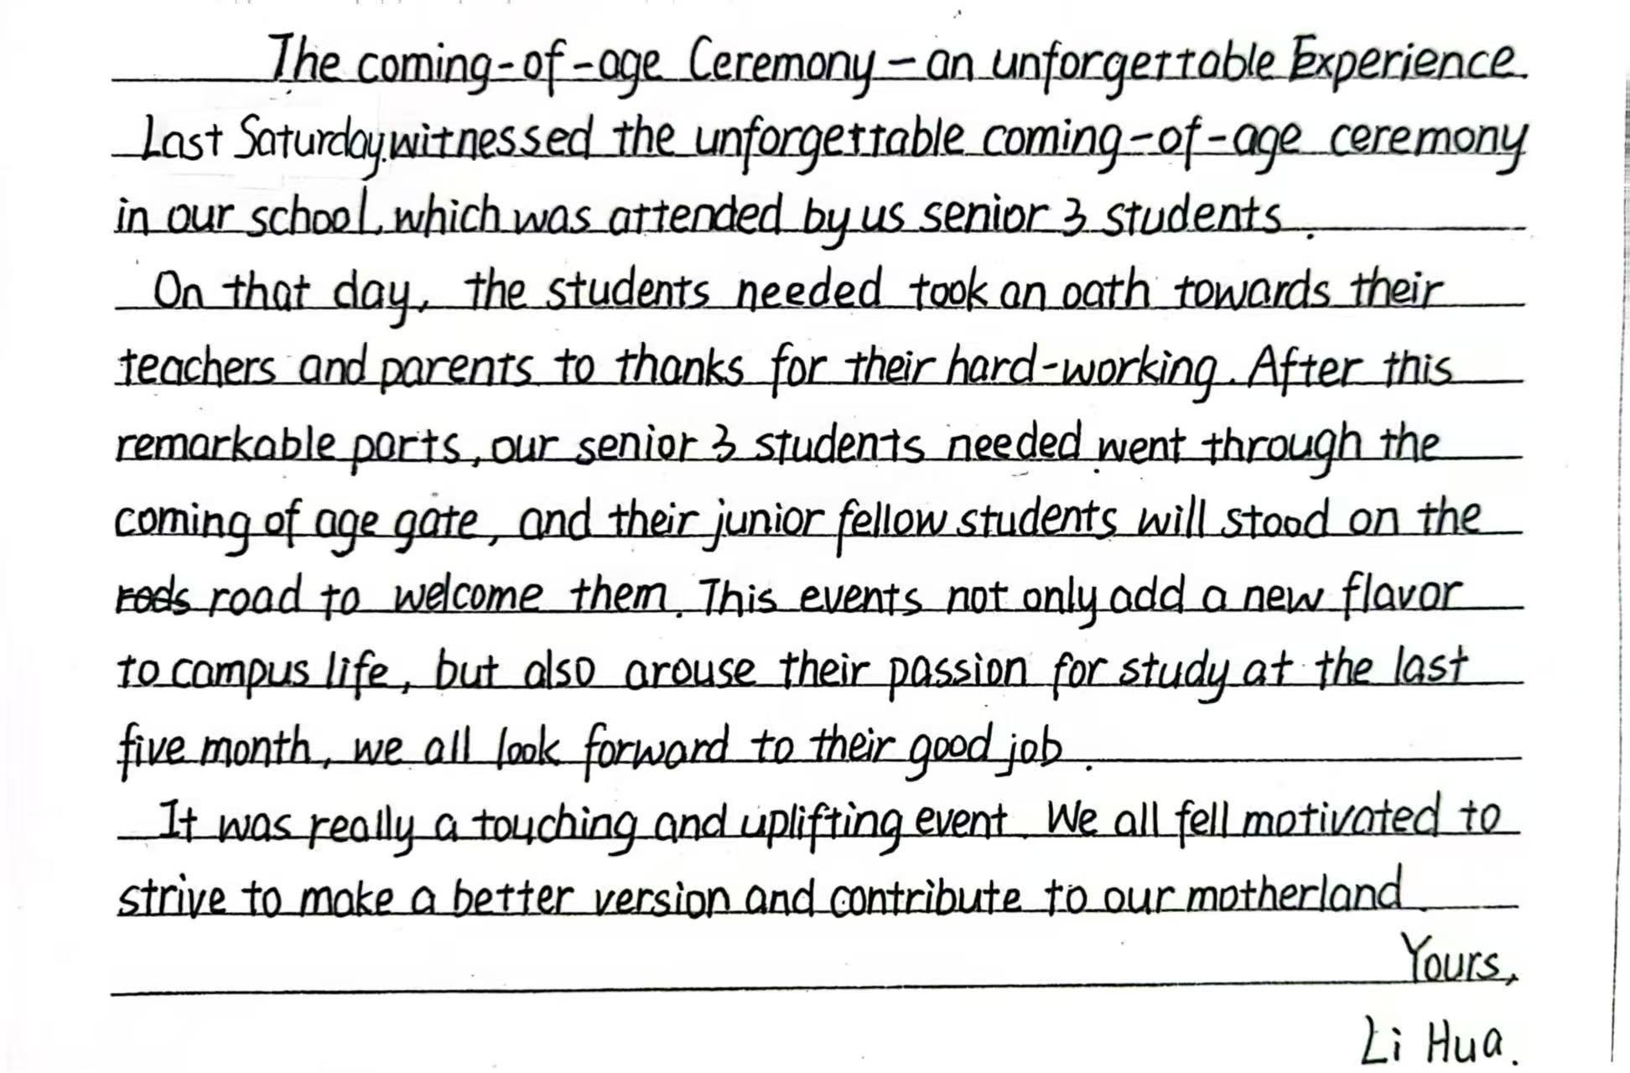

Slide 35
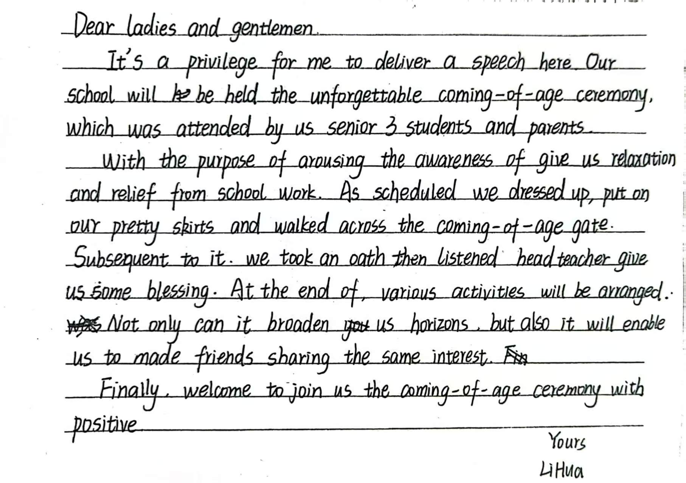

Slide 36
Thank you for your attending!

