Slide 1
感恩遇见，相互成就，本课件资料仅供您个人参考、教学使用，严禁自行在网络传播，违者依知识产权法追究法律责任。
更多教学资源请关注
公众号：溯恩高中英语
知识产权声明

Slide 2
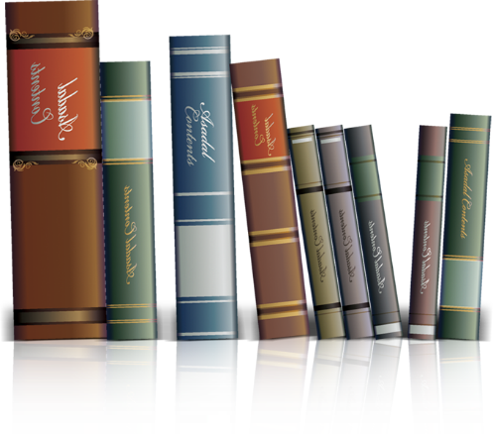
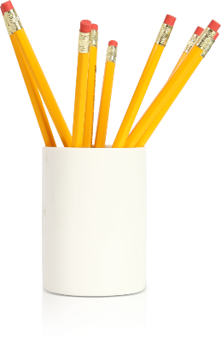
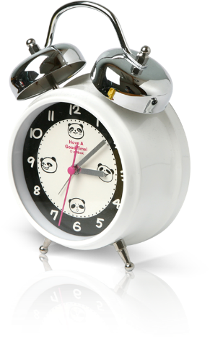
概要写作 语料库-1--形容词1-1
Word bank for paraphrase
浙江省常山一中 吴俊峰
http://www.sunedu.com
01

Slide 3
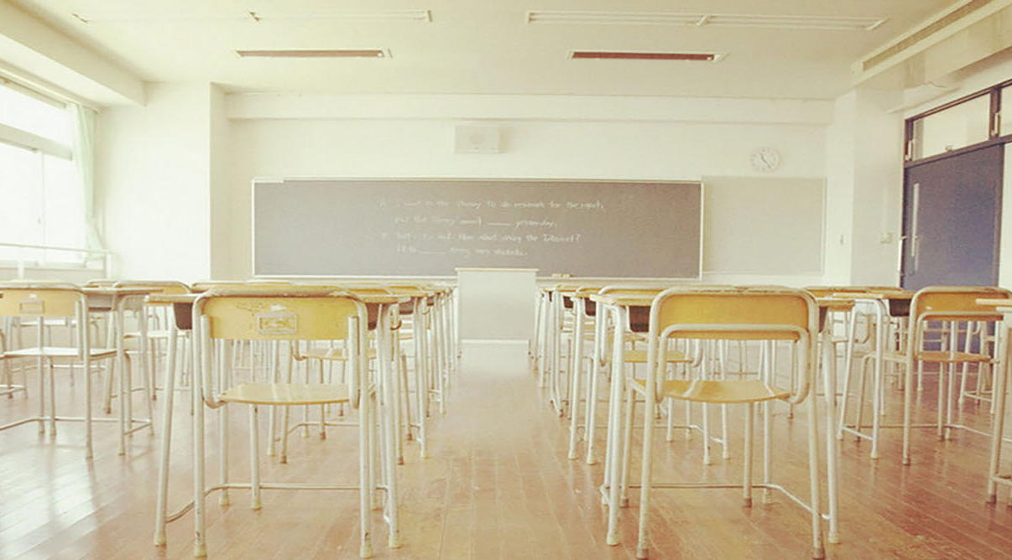
形容词
01
重要的
important
02
富裕的；充足的
rich；enough
03
过多的
目录
too much/many
CONTENTS
04
贫乏的、缺少的
poor，lacking
05
坏的
bad, harmful
06
好的
good, best

Slide 4
01
重要的
important
occupy an important position
matter/ count
02
01
important
be essential to
indispensable
basic
vital
critical
play a vital role in...
03
/ˈvaɪtl/ adj. 至关重要的；生死攸关的
06
04
life-and-death
05
significant /sɪɡˈnɪfɪkənt/
be increasingly significant

Slide 5
01
重要的
important
1.生死攸关的事/问题/决定；生死存亡的斗争 2.一些研究发现抑郁症在医生中很普遍，因为该职业需要面临处理生和死的事件导致更有得抑郁症的倾向。
life-and-death
1. life-and-death affair/ issue / decision/ struggle
2. Some studies have suggested that depression is more common among doctors, as the high demands of a job dealing with life-and-death issues make them prone.
/prəʊn/ adj.有…倾向的

Slide 6
01
重要的
important
3. 毫无疑问，合作在当今极具竞争和活力的社会是相当重要的。为了更高效更有效益地完成任务，我们有必要具备团队合作精神。 4. 一个人可以是一个团体的关键要素，但一个人永远不能成为一个团队。
crucial /ˈkruːʃl/ / significant/ be of vital significance
3. There is no denying that cooperation is of vital significance in the fiercely competitive and dynamic world. It’s essential for us to be equipped with teamwork spirits in order to complete our task efficiently and effectively.
/daɪˈnæmɪk/ adj. 动态的；有活力的
4. One man can be a crucial ingredient on a team, but one man cannot make a team.
/ɪnˈɡriːdiənt/ n. 原料；要素；组成部分

Slide 7
01
重要的
important
5. 更少的汽车出行意味着更少的空气污染，因此其好处将越来越显著。 6. 高等教育可以在某种程度上激发学生的想象力和创造力，这在他们未来的生活中起着至关重要的作用。 7.真正重要的不是你来自哪里,而是你的工作能力。
be increasingly significant/ play a vital role/ matter/ count
5. Fewer car journeys mean less air pollution, so the benifit will be increasingly significant.
6. Advanced education can motivete students' imagination and creativity in someway, which play a vital role in their future life.
/ˈvaɪtl/ adj. 至关重要的；生死攸关的
7. It is not the place you are from but your ability to do the job that really counts/matters.

Slide 8
01
重要的
important
8. 人们普遍认为计算机已经成为我们社会必不可少的一部分。 它们使我们的生活更舒适，减少了大量劳动。 9. 这种本质上的差别是决定使用哪种技术的主要因素。
be essential/ indispensable/ basic/ vital to
8. It is widely acknowledged that computers have become indispensable to our society，which make our life and work more comfortable and less laborious.
/ˌɪndɪˈspensəbl/adj. 不可缺少的；绝对必要的
9. This essential difference is the primary factor in determining which technology to use.
/ɪˈsenʃl/adj. adj. 基本的；必要的；本质的；精华的
/ˈpraɪməri/ adj. 主要的；初级的；基本的 n. 最主要者

Slide 9
01
重要的
important
10. 申请大学之前，调查研究做出正确决策很重要。 (2018年11月浙江高考文本原句： keep in mind that you are making decision about the next four years of your life, and do all the research you can to make sure you are making the right one.)
essential/ critical / crucial
① Applying to colleges is a crucial decision in your life.
②It's essential for senior students to do research to make wise selection of the colleges they will apply for.
③The senior students face a critical crossroad upon the college they will attend, which is bound to influence the next four years.

Slide 10
02
富裕的；充足的
rich；enough
1
abundant
2
ample
3
plentiful
4
affluent
5
adequate
6
sufficient

Slide 11
02
富裕的；充足的
rich；enough
1. 有足够的证据表明气候模式正在改变。 2. 美国人出生时的平均预期寿命大约是78岁，这比大多数富裕国家的国民寿命要低。 3. 多年来，许多海洋专家一直在说，我们需要开始热爱水母——因为在不远的将来，它们也许是我们周围最丰富的海洋物种。
abundant/ ample /'æmp(ə)l/ / plentiful/ affluent /'æflʊənt/ adj. 富裕的
1. There is ample/abundant evidence that climate patterns are changing.
2. An American's life expectancy at birth is about 78 years, which is lower than in most other affluent countries.
3.Many marine experts have been saying for several years that we need to start loving jellyfish – because in the not too distant future, they may be the most plentiful marine species around.

Slide 12
02
富裕的；充足的
rich；enough
1. 这些理由不足以证明实施禁令有理。 2. 虽然这些定义中的每一种都包含对治理的重要观点，但是没有一个是充分的。 3. 丰富的相关经验，良好的沟通能力和团队合作精神可以增强对工作的信心。
adequate(ly) /'ædɪkwət/ / sufficient(ly) /sə'fɪʃəntlɪ/
1. These reasons are not sufficient to justify the ban.
/ˈdʒʌstɪfaɪ/vi. 证明合法；证明…是正当的
2. While each of these kinds of definitions contains an important perspective on governance, none of them is sufficient.
/pəˈspektɪv/ n. 观点
3. Sufficient relevant experience, communication skills and teamwork spirit can enhance confidence in the job.
/ˈreləvənt/ adj. 相关的；切题的

Slide 13
03
excessive
1
/ɪkˈsesɪv/ adj. 过多的，极度的；过分的
too much/many
over-
2
inordinate
3
/ɪnˈɔːdɪnət/adj. 过度的；无节制的
4
exaggerated
/ɪɡˈzædʒəreɪtɪd/ adj. 夸张的，言过其实的

Slide 14
03
过多的
too much/many
1. 过多的阳光会导致皮肤的变化，其中一些可以是有害的。 2. 能源危机将会威胁到我们的生存，因为我们过度地开采和人口的爆炸。
excessive /ɪkˈsesɪv/ adj. 过多的，极度的；过分的
1. Excessive sunlight can lead to skin changes, some of which can be detrimental.
/ˌdetrɪˈmentl/adj. 不利的；有害的 n. 有害的人（或物）
2.Energy crises will threaten our existence because of our excessive exploitation and because of the growing population.
/ˌeksplɔɪˈteɪʃn/ n. 开发，开采；广告促销

Slide 15
03
过多的
too much/many
3. 与父母最初的期望相反，过分表扬孩子可能会导致适得其反的结果，如动机的衰减、没有成就感。 (2019年6月浙江高考文本原句：By giving kids a lot of praise, parents think they're building their children’s confidence, when, in fact, it may be just the opposite.Too much praise can backfire and, when given in a way that's insincere, make kids afraid to try new things or take a risk for fear of not being able to stay on top where their parents' praise has put them.
over- / inordinate /ɪnˈɔːdɪnət/adj. 过度的；无节制的 / exaggerated /ɪɡˈzædʒəreɪtɪd/ adj. 夸张的，言过其实的
① Contrary to parents' original expectations, overpraising one's child could contribute to unintended outcomes like a decline of motivation and non-fulfillment.
② Parents' inordinate praise, though assumed to promote confidence, tends to produce shrinking children.
③ Exaggerated praise may be counter-productive—kids are promoted on the summit, unwilling to take up challenges.

Slide 16
04
poor，lacking
deficient
/dɪˈfɪʃnt/
adj. 不足的；有缺陷的；不充分的
meagre
/'miːgə/
adj. 瘦的；贫弱的；贫乏的
01
02
insufficient
/ˌɪnsəˈfɪʃnt/
adj. 不足的；不适当的；不充分的
inadequate
/ɪnˈædɪkwət/
adj. 不充分的，不适当的
03
04

Slide 17
04
贫乏的、缺少的
poor，lacking
1. 稀少的来源枯竭了。 2. 但是，这一学说却存在着严重的理论缺陷。 3. 饮食中缺乏维生素可能导致疾病。 4. 对于人类，不吃早餐会减低血糖水平，因而可能被身体解释为环境贫乏恶劣和缺少食物供给的标志。
meagre /'miːgə/ adj. 瘦的；贫弱的；贫乏的
deficiency /dɪ'fɪʃ(ə)nsɪ/ n. 缺陷，缺点；缺乏 -- deficient adj. 不足的；有缺陷的；不充分的
1. Meagre supply dried up.
2. But there exists very serious deficiency of the theory.
3. Vitamin deficiency in the diet can cause illness.
4. In humans, skipping breakfast depresses glucose levels and so may be interpreted by the body as indicating poor environmental conditions and deficient food availability.
/skɪp/ vt. 跳过；遗漏
/dɪˈpres/vt. 压抑；使沮丧；使萧条; 降低

Slide 18
04
贫乏的、缺少的
poor，lacking
5.相反，不适当的表扬也同样有害，可能打击孩子取得更大成就的信心。 (2019年6月浙江高考文本原句： Still, don't go too far in the other direction. Not giving enough praise can be just as damaging as giving too much. Kids will feel like they're not good enough or that you don't care and, as a result, may see no point in trying hard for their accomplishments.)
insufficient/ inadequate
① Conversely, inadequate praise is equally damaging , for it may to a certain extent
knock down kids' confidence to achieve far more .
② Deficient praise also impairs children's self-trust and motivation.
③ On the contrary, insufficient praise also casts a shadow impact on children.
④ Inadequate praise is also detrimental to them which results in no progress.

Slide 19
05
deteriorate
/dɪ'tɪərɪəreɪt/
v. 恶化，变坏
deteriorated / deteriorating
bad, harmful
1
detrimental
2
/,detrɪ'mentəl/
adj. 不利的；有害的 n. 有害的人（或物）
3
deleterious
/ˌdeləˈtɪəriəs/
adj. 有毒的，有害的

Slide 20
05
坏的
bad, harmful
1.不断恶化的天气/ 经济/ 健康状况 2.人们担心局势会恶化为全面战争。 3.长时间工作的人的生活方式有可能随着时间的推移而恶化，例如由于饮食不良或饮酒增加。
deteriorate /dɪ'tɪərɪəreɪt/ v. 恶化，变坏
deteriorated adj. 恶化的；已变质的 / deteriorating adj. 日益恶化的
1. deteriorating weather conditions /economy /health
2. There are fears that the situation might deteriorate into full-scale war.
3. It was possible that the lifestyle of people working long hours deteriorated over time, for example as a result of poor diet or increased alcohol consumption.

Slide 21
05
坏的
bad, harmful
4. 许多食物因所含的化学成分和添加剂被怀疑有害健康。 5. 之前做过的动物实验显示，污染物质能对海洋生物产生有害作用。 6. 越来越多的证据表明，过量的摄取某种微量营养素会对人体有害。
detrimental /,detrɪ'mentəl/ adj. 不利的；有害的 n. 有害的人（或物）
deleterious /ˌdeləˈtɪəriəs/ adj. 有毒的，有害的
4. Many foods are suspected of being detrimental to health because of the chemicals and additives they contain.
/ˈædətɪv/ n. 添加剂，添加物
5. Prior research on laboratory animals has shown that the pollutants can cause deleterious effects.
/ˈpraɪə(r)/ adj. （时间、顺序等）先前的；优先的
/pəˈluːtənt/ n. 污染物
6. There is increasing evidence that excessive intake of certain micronutrients is deleterious.

Slide 22
06
02
awesome
['ɔːsəm]
极好的
fabulous
optimal
03
['fæbjʊləs]
adj. 难以置信的；极好的
/'ɒptɪm(ə)l/
最佳的；最理想的
01
good，
best
04
spectacular
07
amazing
[spek'tækjʊlə]
adj. 壮观的，惊人的；公开展示的
惊艳的
05
06
fantastic
fascinating
/fænˈtæstɪk/
奇妙的；不可思议的
/ˈfæsɪneɪtɪŋ/
迷人的；吸引人的；使人神魂颠倒的

Slide 23
06
好的
good, best
1. 智能手机是一项了不起的发明。 2. 在某些情况下，可以用一个最理想的模式来验证每个“好的”消息并拒绝每个“坏的”消息。 3. 帮助拯救他人的生命会得到最好的心情。
optimal /'ɒptɪm(ə)l/最佳的；最理想的 /awesome ['ɔːsəm] 极好的
fabulous ['fæbjʊləs] adj. 难以置信的；传说的，寓言中的；极好的 / amazing 惊艳的
1.Smart phones are an amazing and awesome invention.
2.In some cases, you can have an optimal schema that validates every "good" message and rejects every "bad" message.
/'skiːmə/ n. [计][心理] 模式；计划
/'vælɪdeɪt/ vt. 证实，验证；确认
3. Helping save the life of another person will gain the most fabulous mood.

Slide 24
06
好的
good, best
4. 迷人的故事/ 趣味无穷的话题/ 迷人的魅力/ 引人入胜的书/ 迷人的历史遗迹/ 迷人的旅行/迷人的东方大都市 5. 旖旎的海滩/了不起的成就/ 宜人的天气/ 好消息/ 巨款/ 奇妙的颜色/ 奇妙的爱情故事
fascinating 迷人的；吸引人的；使人神魂颠倒的
fantastic 奇妙的；不可思议的
4. fascinating story/ subject/ charm/ book/ historical monuments/ journey/ oriental metropolis
5. fantastic beach/ achievement/ weather / news/ amount of money / colors/ love story.

Slide 25
06
好的
good,best
6. 壮丽的景色/ 精彩的入球/ 了不起的成就/ 辉煌成绩/ 惊人的努力 7.大幅上升/ 最引人注目的是 8. 本周发表在《科学》的一份研究报告以一种惊人的方式证实了那种趋势。 9. 测试结果显示，中国已出色地重建了现代、高效和平等的教育系统，至少在一些城市如此。
spectacular [spek'tækjʊlə] adj. 壮观的，惊人的；公开展示的
6. spectacular scenery/ goal/ achievement/ success/ efforts
7.increase spectacularly/ most spectacularly
8. A study published this week in Nature bears out that trend in a spectacular way.
9. But as the tests showed, education in China has been spectacularly rebuilt as a modern, high-performance and egalitarian system, at least in some cities.

Slide 26
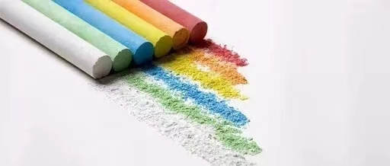
http://www.sunedu.com
THANKS

