Slide 1
感恩遇见，相互成就，本课件资料仅供您个人参考、教学使用，严禁自行在网络传播，违者依知识产权法追究法律责任。
更多教学资源请关注
公众号：溯恩英语
知识产权声明

Slide 2
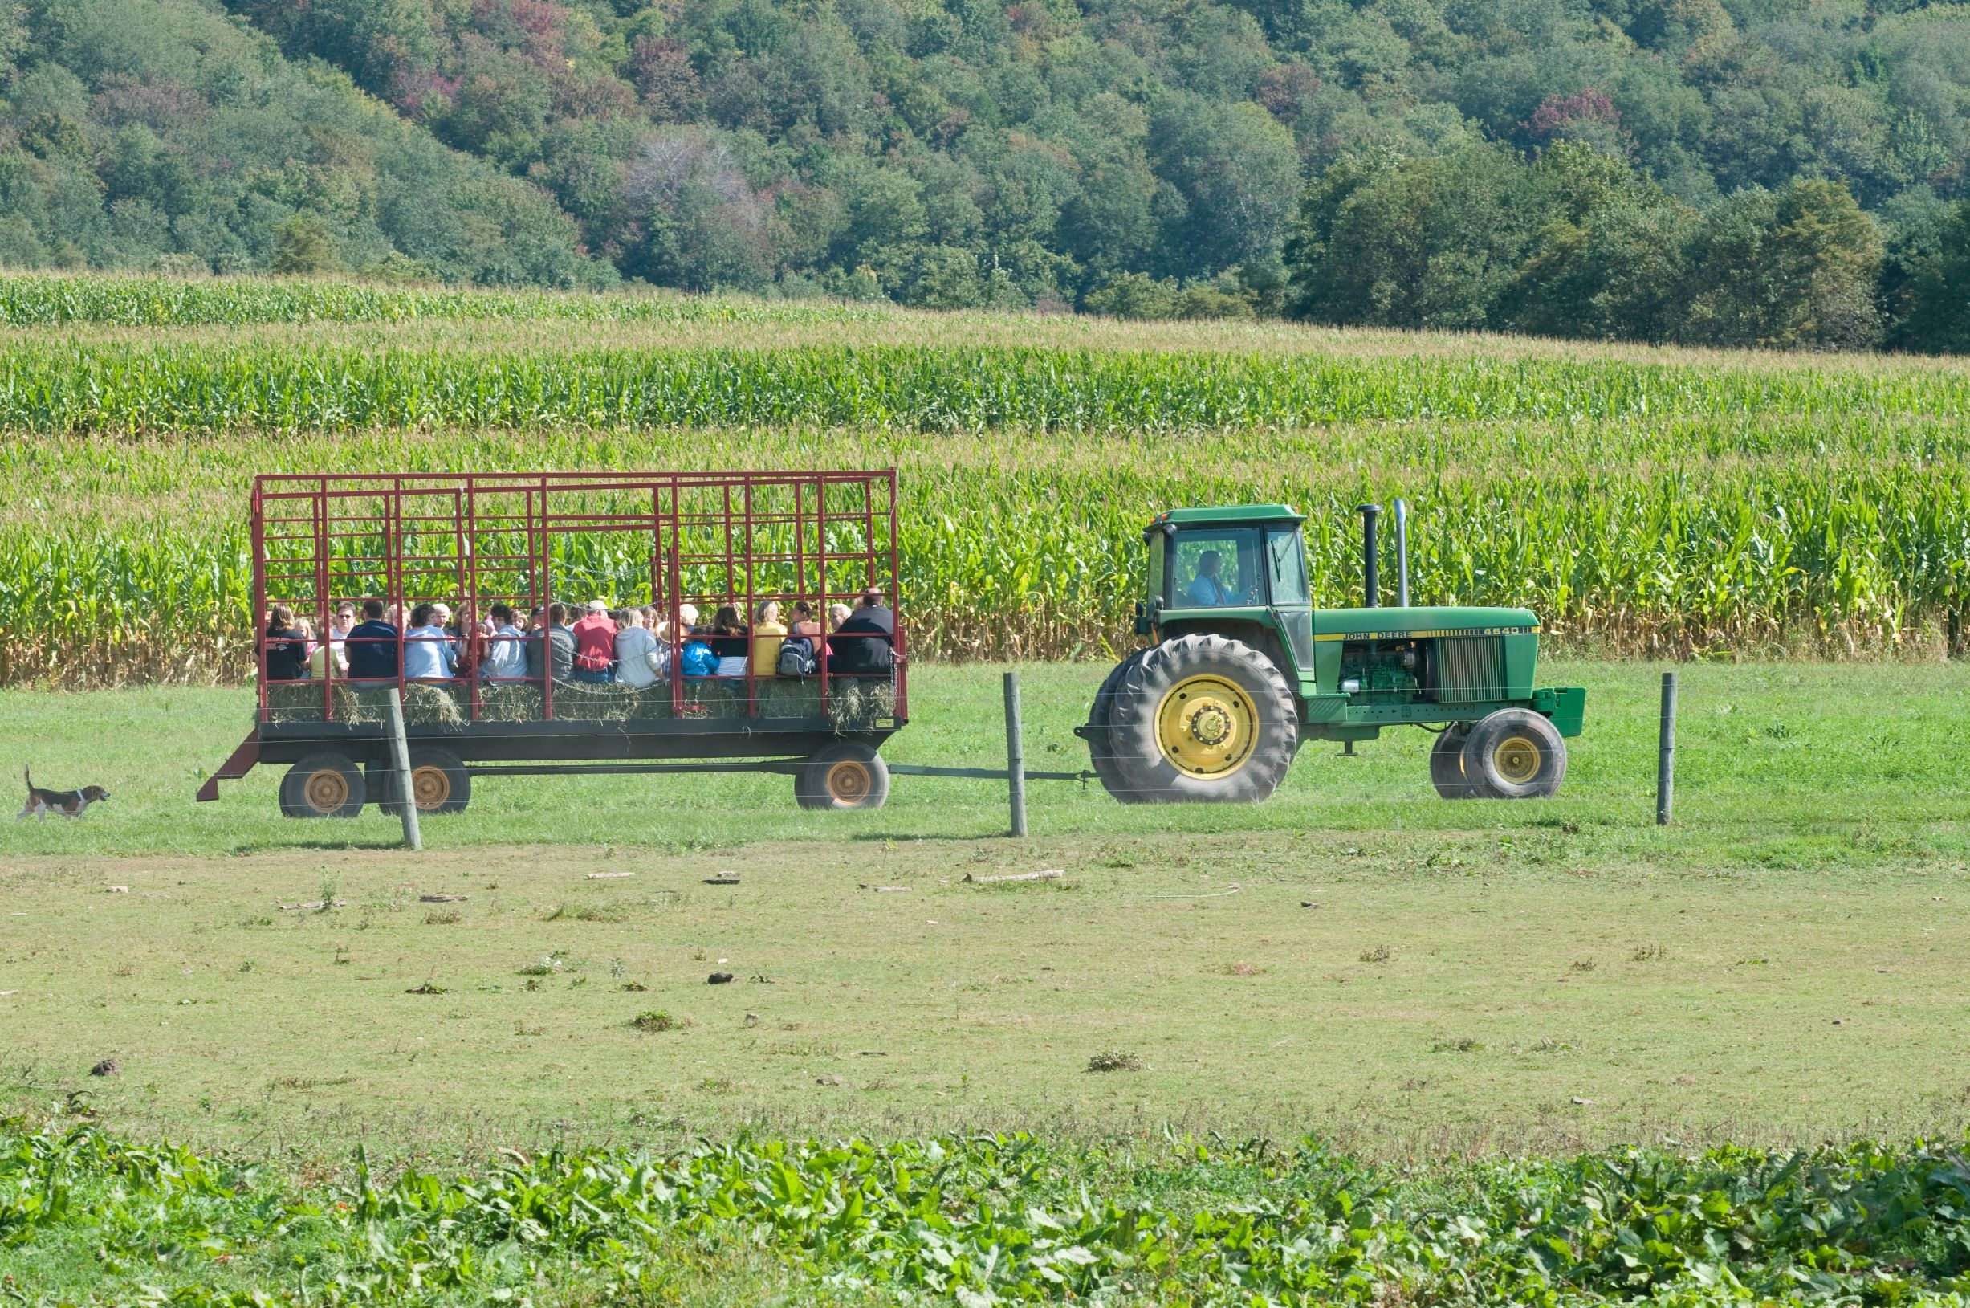
之劳动话题
五校联考 农场研学

Slide 3
What is agritourism?
What is agritourism?
Agritourism is ________________________________ .
假定你是李华，你班计划在周末组织农场研学（agritourism），请给你的外教Chris写封邮件邀请他参加，内容包括：
1. 活动时间和内容；
2. 注意事项。
a type of tourism that involves visiting farms, old plantations, gastronomic (美食的) festivals, or other agricultural businesses for the purpose of experiencing rural life, culture, and food.
combines agriculture and tourism to promote sustainable tourism, support local agriculture, and provide economic benefits to rural communities.
refers to any activity carried out on a farm or ranch (牧场) that allows people, for recreational, entertainment, or educational purposes, to view or enjoy rural activities, including farming, ranching, historic, cultural, harvest-your-own activities, or natural activities and attractions.

Slide 4
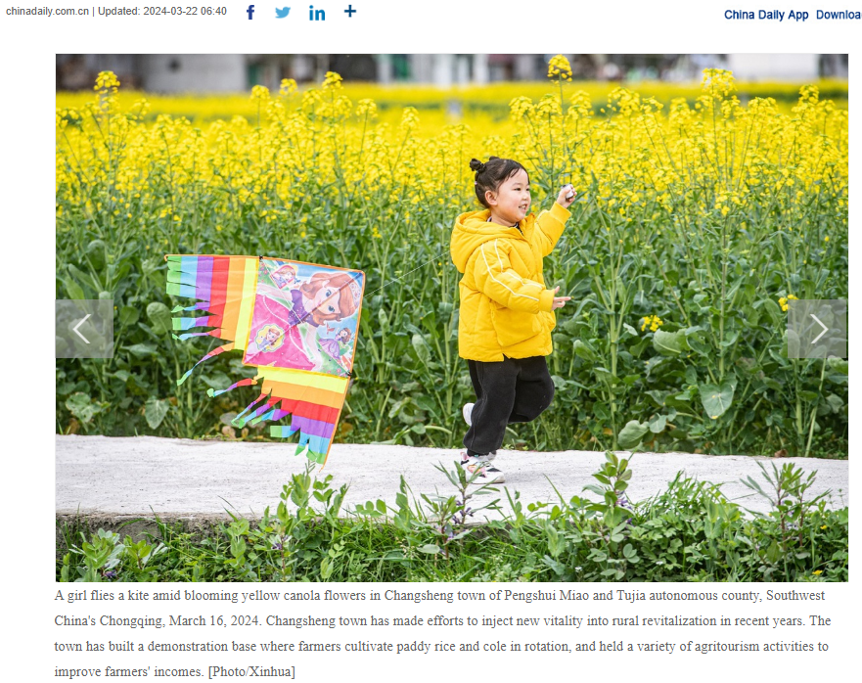

Slide 5
Why do I invite Chris, the foreign teacher?
How to invite?
Why do I invite Chris, the foreign teacher?
Chris’ interest in agriculture, tourism, or both.
Agritourism’s advantages over other travel forms.
假定你是李华，你班计划在周末组织农场研学（agritourism），请给你的外教Chris写封邮件邀请他参加，内容包括：
1. 活动时间和内容；
2. 注意事项。
interest- captivating activities
- benefits of going on agritourism
sincerity-concrete time and venue; politeness

Slide 6
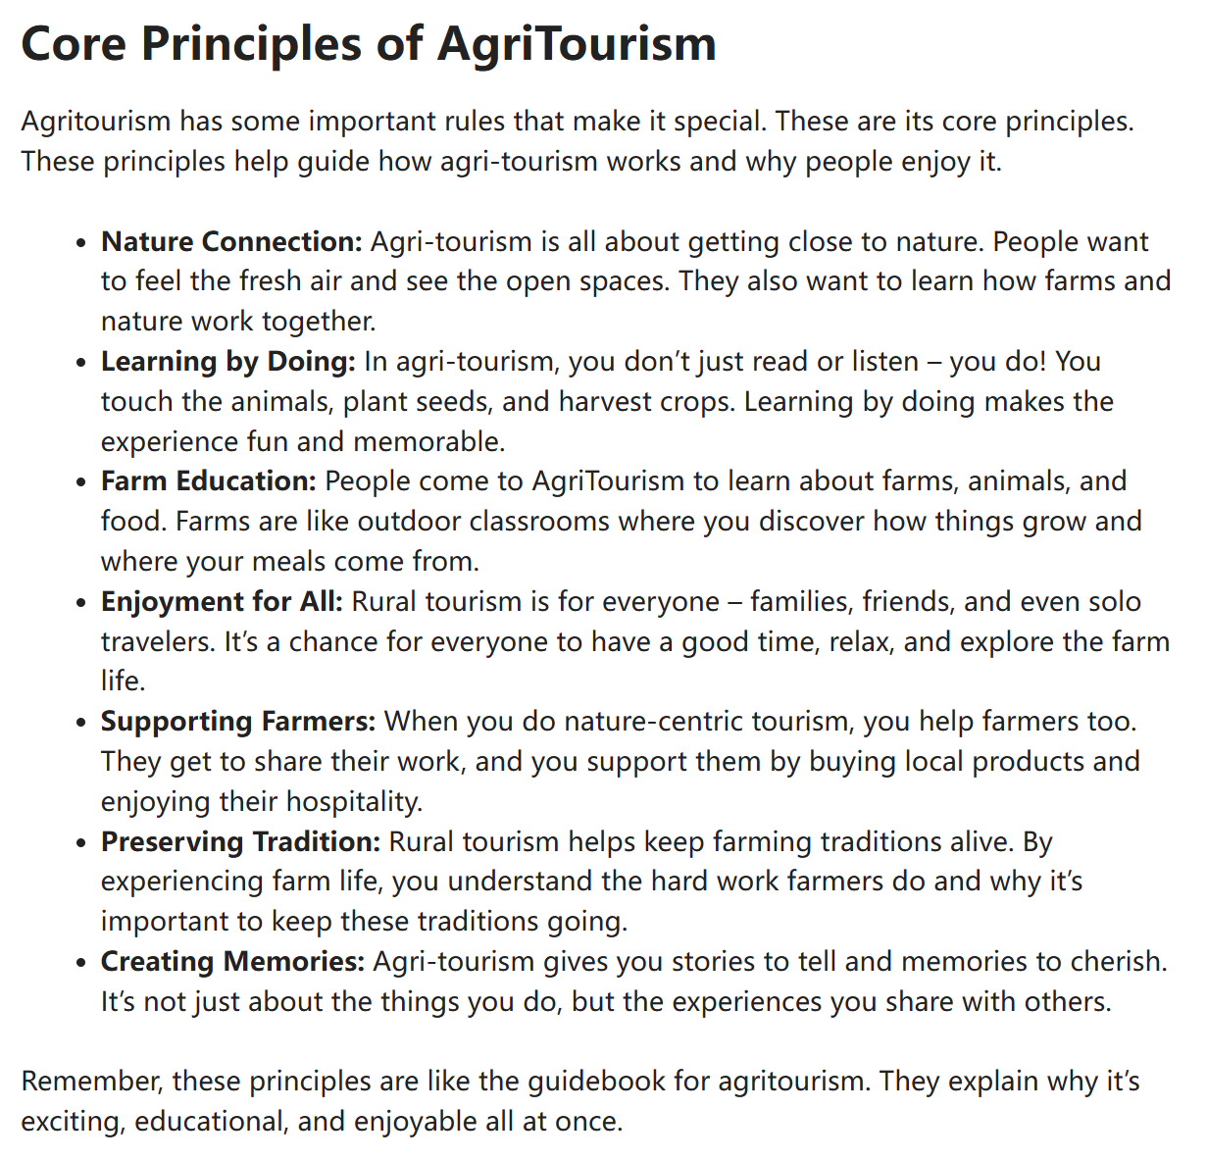
engage the reader
Ever thought about swapping city bustle for farm life? (设问激发兴趣) Come to the agritourism organized by our class at 9:00 a.m. this weekend at XX Farm! (点明邀请目的) ➊It’s like a farm-fueled adventure. ➋Imagine picking fruits, exploring fields, and getting cozy with nature. ➌This isn’t just any trip. (这可不是一般的旅行) It’s a chance to breathe farm air, taste fresh treats, and make stories you’ll share with friends back in your country forever. (农场研学特色所在)
Ever thought about swapping city bustle for farm life? Come to the agritourism organized by our class at 9:00 a.m. this weekend at XX Farm! It’s like a farm-fueled adventure. Imagine picking fruits, exploring fields, and getting cozy with nature. This isn’t just any trip. It’s a chance to breathe farm air, taste fresh treats, and make stories you’ll share with friends back in your country forever.
concrete time and venue
activities
benefits

Slide 7
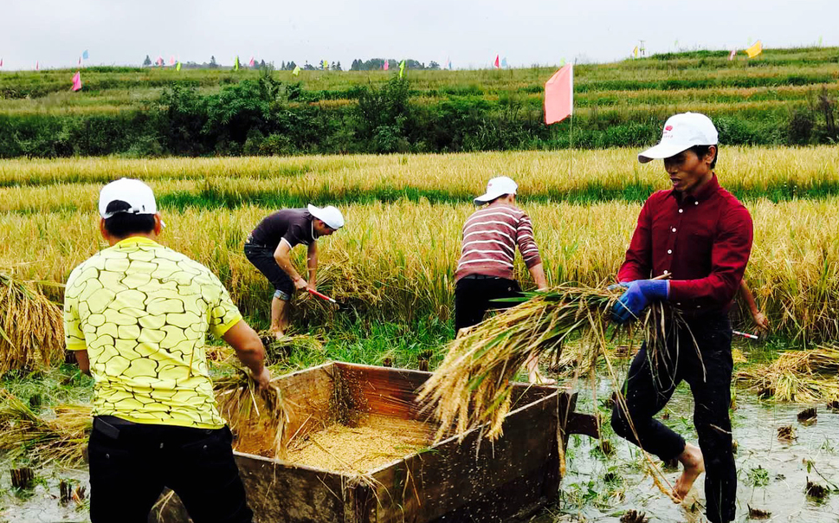
More examples
concrete time and venue
When it comes to options, you have got a spectrum of/ an array of (一系列的) choices to explore during agri-tourism from 2:00 to 5:00 p.m. this weekend. There is an orchard (果园) filled with fruits like apples and peaches, and an animal farm with cows, chickens, and goats. Either way, it will tell a unique story of how food is grown and nurtured and offer you a lavish buquet of natural delicacies.
When it comes to options, you have got a spectrum of/ an array of (一系列的) choices to explore during agri-tourism from 2:00 to 5:00 p.m. this weekend. There is an orchard (果园) filled with fruits like apples and peaches, and an animal farm with cows, chickens, and goats. Either way, it will tell a unique story of how food is grown and nurtured and offer you a lavish buquet of natural delicacies (美食) .
At 9:00 a.m. this weekend, you will be exposed to places with stunning countryside views- green fields, rolling hills, and clear blue skies. These landscapes will definitely offer a break from the city hustle, giving you a chance to relax and breathe in nature’s tranquility. But it isn’t just about sightseeing; it’s also about savoring flavors. You might get to sample wine made from the grapes you see, try freshly picked apples, or enjoy a farm-to-table meal using ingredients right from the fields.
At 9:00 a.m. this weekend, you will be exposed to places with stunning countryside views- green fields, rolling hills, and clear blue skies. These landscapes will definitely offer a break from the city hustle, giving you a chance to relax and breathe in nature’s tranquility. But it isn’t just about sightseeing; it’s also about savoring flavors. You might get to sample wine made from the grapes you see, try freshly picked apples, or enjoy a farm-to-table meal using ingredients right from the fields.
activities
benefits
总——分——总
分——分

Slide 8
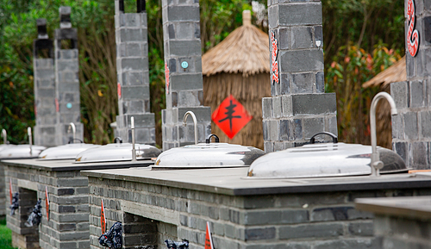
engage the reader ?
Agritourism at 5:00 p.m. this Saturday offers cooking workshops where you can learn traditional Chinese recipes using what’s in season. There are also tasting sessions where you can sample jams and wines made on the farm. I bet you’ll fall in love with it since you are such a big fan of Chinese food.

Slide 9
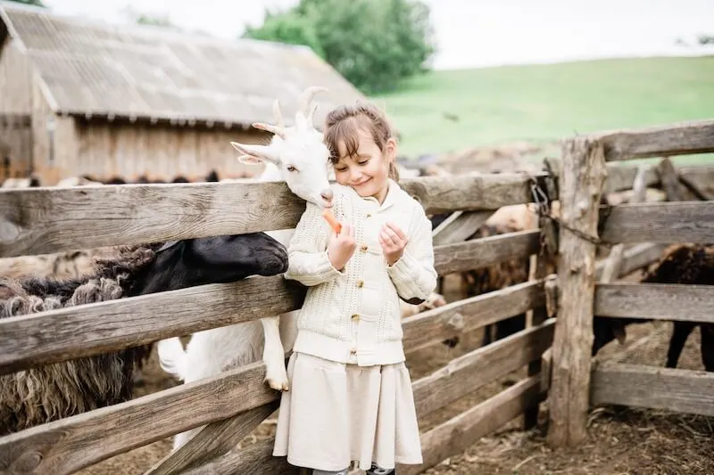
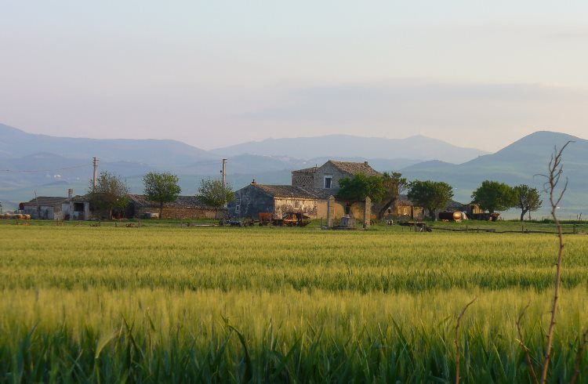
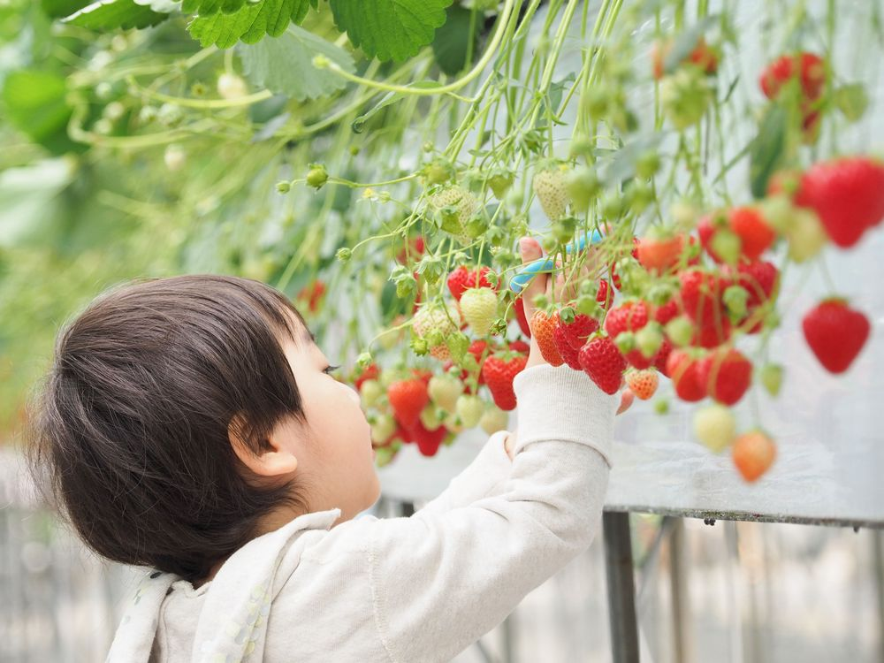
Agritourism combines __________________________ .
nature
farm
animal
All add to the fun!
All mutiply the delights/ thrills!

Slide 10
A possible version:
Dear Chris,
How is everything going recently? (寒暄) I’m writing to invite you to join us in an exciting agritourism this Saturday (写信目的——具体时间), which promises to be both educational and enjoyable (总).
As scheduled, we will gather at school gate at 8:00 a.m. and depart promptly at 8:30 a.m. by bus (具体起止时间和地点——读者意识). This agritourism covers a wide range of agricultural activities (总), ranging from visiting a workshop on organic farming to enjoying a farm-to-table meal (例举略写活动). You can not only gain much hands-on experience in planting, harvesting, as well as interacting with farm animals, but also exploring the natural surroundings (好处+具体活动). Remember to wear hats for outdoor activities, and to protect the environment, we encourage everyone to bring reusable water bottles and minimize waste.(注意事项)
Your participation will be highly expected and we’re all looking forward to your favorable reply. (期待参与)
Warmest regards,
Li Hua

Slide 11
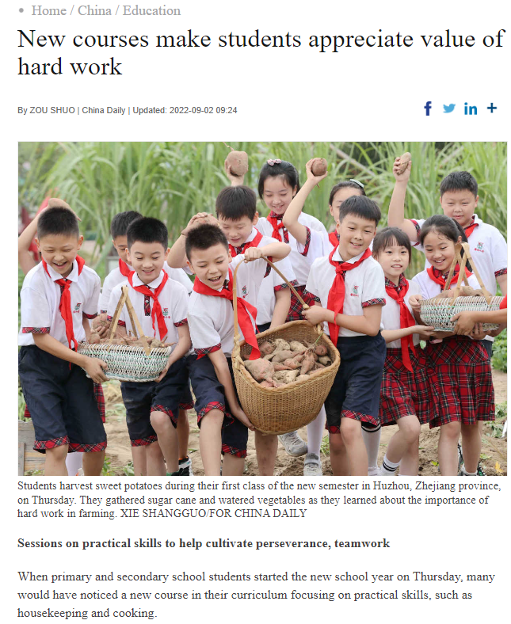
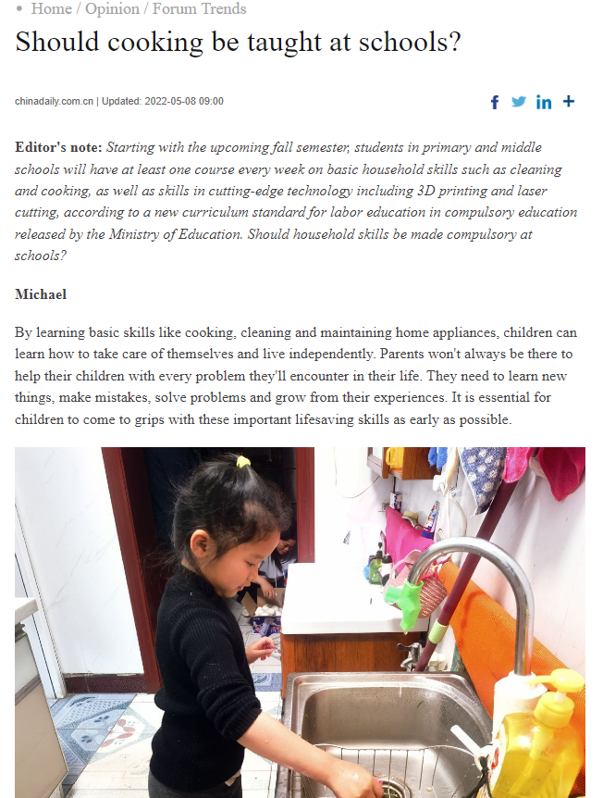
劳动教育
是推进学校教育高质量发展的重要举措，也是培养全面发展的人的重要途径，使学生树立正确的劳动观点和劳动态度，热爱劳动和劳动人民，养成劳动习惯的教育，是人德智体美劳全面发展的主要内容之一。学生对劳动的态度关系到国家发展、民族进步。
①树立学生正确的劳动观点，使他们懂得劳动的伟大意义。了解人类的历史首先是生产发展的历史，是劳动人民创造的历史；懂得辛勤的劳动是建设社会主义和共产主义的根本保证；劳动是公民的神圣义务和权利；轻视体力劳动和体力劳动者，是数千年来剥削阶级思想残余；懂得把脑力劳动同体力劳动相结合的重要意义。
②培养学生热爱劳动和劳动人民的情感。养成劳动的习惯，形成以劳动为荣，以懒惰为耻的品质。抵制好逸恶劳、贪图享受、不劳而获、奢侈浪费等恶习的影响。

Slide 12
同话题作文
1. 写信+分享家务劳动经历
（2024届大湾区普通高中毕业年级联合模拟考试 一）假定你是李华。请给你的外国朋友 Ryan写一封信，分享你最近的一次家务劳动经历。内容包括：1. 劳动过程；2. 劳动感受。
Dear Ryan,
I hope this letter finds you well. I am writing to share with you a recent housework experience.
One morning, I woke to the realization that my room was in a complete mess. Determined to tidy up, I immediately sprang into action. I began by throwing away garbage and unnecessary items, and then proceeded to neatly arrange the books that were scattered across my sofa, floor, and desk back onto the bookshelf. It was quite a laborious process, but the end result was truly satisfying. Not only did my room look sparkling clean, but I also felt a sense of accomplishment and pride in my hard work.
I hope to hear from you soon. Best wishes!
Yours,
Li Hua

Slide 13
2. （2023年1月浙江高考）上周末你参加了校学生会组织的“认识我们身边的植物”活动。请为校英文报写篇报道，内容包括：1. 活动的过程；2. 收获与感想。
Getting to Know the Plants Around Us
Last week we participated in a wonderful activity called “Getting to Know the Plants Around Us” on the campus.
The activity began with our students taking and drawing pictures of different plants, ranging from daisies, orchids, bamboos to gingkoes. Then students recording similar plants formed groups to give adequately-prepared presentations. The highlight of this event was a lecture given by a distinguished botanical expert, who not only shared medical application of several plants, but also instructed us on a variety of literary values behind them.
Considered as a perfect combination of study and practice, the activity has apparently exposed us to the charm of plants and fostered our consciousness of plant protection. We are all looking forward to having one next time.

