Slide 1

感恩遇见，相互成就，本课件资料仅供您个人参考、教学使用，严禁自行在网络传播，违者依知识产权法追究法律责任。
更多教学资源请关注
公众号：溯恩高中英语
知识产权声明

Slide 2
A letter of recommendation
Practical writing
以2020年5月9+1联盟考应用文为例
2020
浙江省平桥中学 洪天锋

Slide 3
那些年我们考过的推荐信
01
（2018.6北京卷）：假设你是红星中学高三学生李华，你的英国朋友 Jim 在给你的邮件中提到他对中国文化感兴趣，计划明年来北京上大学。他向你咨询相关信息。请给他回邮件，内容包括：
1.表示欢迎；2.推荐他上哪所大学；3.建议他做哪些准备工作。
（台州市二模2019.4）假如你是李华，你校的美国交换生Steven给你发了一封邮件，请你为他推荐一门选修课（optional course).现请你给他回复，推荐白老师的“唐诗”选修课，内容包括:
1.写信目的：2.推荐理由
(浙江十校2020.4) 假定你是李华，你校学生会将进行主席换届选举，请给负责学生会的格林先生写一封英文信， 推荐自己, 内容包括：
1. 性格特点；2. 个人优势；3. 希望获准。

Slide 4
Draw a conclusion
We provide the best way to your business.
推荐人
自荐，推荐他人
常见推荐内容
推荐物
优秀的英语书籍，适合送给家人（朋友）/有中国特色的礼物。
适合旅游的城市，适合生活的城市，适合求学的城市/大学
推荐地方

Slide 5
审题
Tip1 审题常用审题五问法
审题五问
一问类型:
二问人称:
三问时态:
四问要点:
五问结构:
01
推荐信
第三人称为主,兼用第一人称
一般现在时
所推荐的大学 ,理由,表示欢迎
遵循交际原则，表达具有逻辑性
第一节：应用文写作 (满分15分)
假定你是李华,你的美国朋友Mike即将高中毕业，想来中国的大学学习一年中文。请你给他写封邮件推荐合适的学校，内容包括:
1.你推荐的大学；
2.你的理由；
3.表达欢迎。
注意：
1.词数80字左右；
2.可适当增加要点，以使行文连贯。
第一节：应用文写作 (满分15分)
假定你是李华,你的美国朋友Mike即将高中毕业，想来中国的大学学习一年中文。请你给他写封邮件推荐合适的学校，内容包括:
1.你推荐的大学；
2.你的理由；
3.表达欢迎。
注意：
1.词数80字左右；
2.可适当增加要点，以使行文连贯。

Slide 6
Tip2 推荐对象可以在第一段就出现，也在第二段的开头出现。推荐信的开头可以出现表现情绪的词也可以比较客观。
02
高分开头长啥样
We provide the best way to your business.
I'm delighted to learn that you are coming to China to learn Chinese. Welcome! Here, I'd like to share my idea with you about which university to apply for.
Hearing /learning that you have a desire to study Chinese in china, I'm writing to recommend a suitable one for you.
Upon hearing that you are eager to improve your Chinese in Chinese university , I can hardly wait to recommend Zhejiang university to you.
Informed of your fervent anticipation to study Chinese in china, I'm writing to extend my heartfelt welcome and offer you my suggestions.
Thrilled to know your anticipation of learning Chinese in china, I highly recommend you to get the application to Zhejiang university.

Slide 7
02
小试牛刀
We provide the best way to your business.
(2018温州二模)假如你是张文，你的美国笔友Jack一家人要来温州度暑假，特别来信询问特色旅游的情况。请你给他回复一封电子邮件。内容包括：
1．推荐地点； 2．推荐理由。
Informed of your fervent anticipation to Wenzhou for summer holiday, I'm writing to extend my heartfelt welcome and offer you my suggestions.
Hearing /learning that you and your family are coming to Wenzhou for the summer holiday, I'm writing to recommend a suitable one for you.
Thrilled to know your anticipation of coming to Wenzhou for summer vacation, I highly recommend that you should go to Yangdang Mountain.

Slide 8
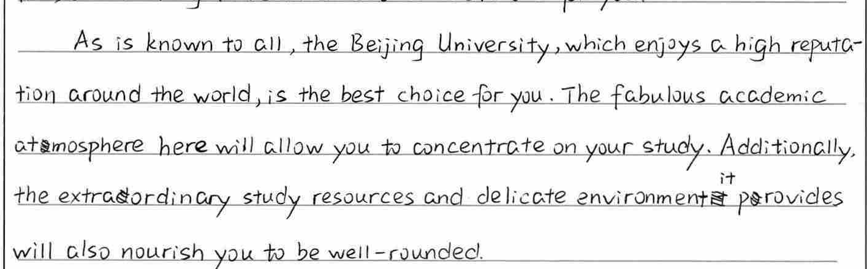
03
怎样推荐你要推荐的对象
We provide the best way to your business.
As is known to all , the Beijing university , which enjoys a high reputation around the world , is the best choice for you.
The fabulous academic atmosphere here will allow you to concentrate on your study.
Additionally ,the extraordinary study resources and delicate environment it provides will also nourish you to be well-round.
As is known to all , the Beijing university , which enjoys a high reputation around the world , is the best choice for you.
The fabulous academic atmosphere here will allow you to concentrate on your study.
Additionally ,the extraordinary study resources and delicate environment it provides will also nourish you to be well-round.
定语从句
总起句
无灵主语
理由1
理由2
定语从句+精准的高级词汇

Slide 9
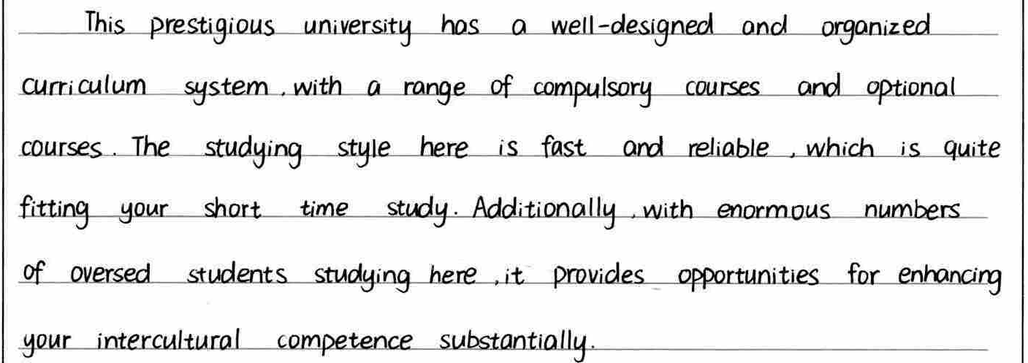
Tip3推荐的理由部分可以采纳多种结构，常用的有“总---分”结构和并列结构。句式常采用的有定语从句，with的复合结构，非谓语和同位语。
03
怎样推荐你要推荐的对象
We provide the best way to your business.
The prestigious有威望的; 声誉高的 university has a well-designed and organized curriculum system, with a range of compulsory courses必修课 and optional courses.
The studying style here is fast and reliable , which is quite fitting your short time study.
Additionally , with enormous numbers of oversea students here, it provides opportunities for enhancing your intercultural competence substantially非常; 大大地 .
The prestigious有威望的; 声誉高的 university has a well-designed and organized curriculum system, with a range of compulsory courses必修课 and optional courses.
The studying style here is fast and reliable , which is quite fitting your short time study.
Additionally , with enormous numbers of oversea students studying here, it provides opportunities for enhancing your intercultural competence substantially非常; 大大地 .
理由1
With 短语和高级词汇
定语从句
理由2
理由3
With 的复合结构+连接词+准确的高级词汇

Slide 10
03
牛刀小试
We provide the best way to your business.
(2018温州二模)假如你是张文，你的美国笔友Jack一家人要来温州度暑假，特别来信询问特色旅游的情况。请你给他回复一封电子邮件。内容包括：
1．推荐地点； 2．推荐理由。
As is known to all , Yandang Mountain , which enjoys a high reputation around the world , is the best choice for you. The fantastic landscapes here will allow you to immerse yourself in. fascinating scenery of mountains and rivers . Additionally ,the unique local customs and delicious food it provides will also be rooted in your memory.

Slide 11
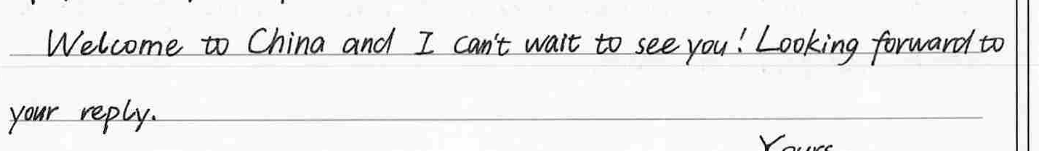
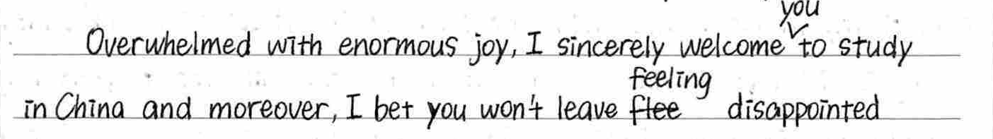
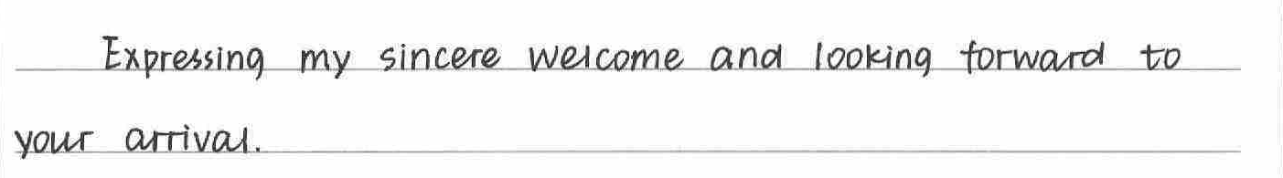
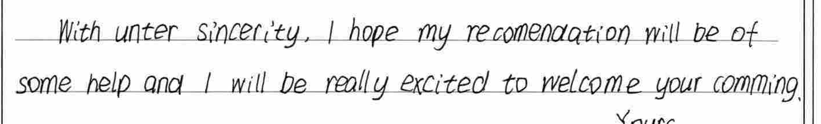
Tip4 应用文的结尾可以将真情实感融入套路句中。
04
怎样完美结束
We provide the best way to your business.

Slide 12
05
答案赏析
We provide the best way to your business.
Dear Mike,
I am so glad you are planning to learn Chinese and I’d like to recommend a university where you can absolutely have a fruitful learning experience.
My recommendation is Beijing University, a most distinguished university with great Chinese learning programs intended for foreigners. With the finest language teachers, Beijing University is capable of offering a professional guidance and systematic training. Surely, you will experience the wonder of the Chinese language.
I sincerely welcome you to China and wish you a fulfilling year ahead.
Yours,
Li Hua

Slide 13
06
下水作文1
We provide the best way to your business.
Dear Mike,
I’m thrilled to hear about your plan to study in China. As for the appropriate school, Beijing Language University ranks top of my recommendation list.
As a prestigious university, it boasts well-received Chinese-learning programs, specially designed for overseas students. Moreover, it lays considerable emphasis on students’ all-round development, so you will find a great variety of activities on campus, offering a valuable platform to put what you learn into practice. Most significantly, under the professional guidance of top-ranking language teachers, you will surely fall in love with the charm of the Chinese language.
I hope my recommendation will be of some help. Welcome to China and never hesitate to contact me if you need more information.
Yours,
Li Hua

Slide 14
06
下水作文2
We provide the best way to your business.
Dear Mike,
I’m so delighted to have received your letter. I'm writing to express my warmest welcome to you and I'm sure you will have the most unforgettable college experience.
Given your keen interest in Chinese culture, I'd like to recommend Zhejiang University to you. You can immerse yourself in our profound history and splendid culture in its Chinese Literature major. Moreover, Zhejiang University is located in Hangzhou , which will attract you with its beautiful scenery and harmonious cultural environment.
I sincerely welcome you to China and I can’t wait to see you! Look forward to your reply.
Yours,
Li Hua

Slide 15
07
作业与巩固
We provide the best way to your business.
假如你是高中生李华，你的美国笔友Jack热爱中国传统文化，最近打算来中国工作生活一段时间，但是不确定应该去往哪个城市，写信向你咨询。请你给他写一封回信，内容包括：
1.你推荐的城市；
2.推荐的理由（不少于两条）；
3.美好祝愿

Slide 16
Dear Jack,
I am so pleased to learn that you are to spend some time in China. I recommend you stay in Beijing, the capital and cultural center of China.
The city enjoys a high reputation for its abundance of ancient architecture, which represents the traditional local lifestyles. And there are also plenty of museums where precious relics of historical interest are waiting for you to explore. Besides, the exceptional Peking Opera performances there are also what you can't miss.
I wish you a very happy and meaningful time in China!
Yours
Lihua

Slide 17
Thank you~
THANK YOU FOR LISTENING
2020

