Slide 1
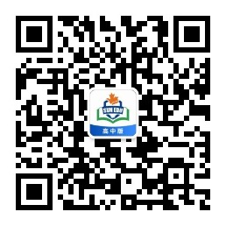
感恩遇见，相互成就，本课件资料仅供您个人参考、教学使用，严禁自行在网络传播，违者依知识产权法追究法律责任。
更多教学资源请关注
公众号：溯恩高中英语
知识产权声明

Slide 2
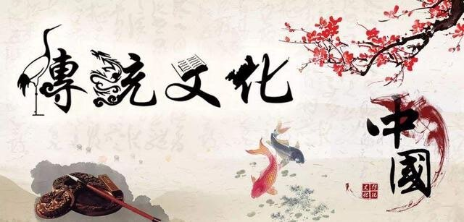
2022学年第二学期四校联盟高一期中考试应用文
新闻报道：“了解我们身边的非物质文化遗产”
（Getting to Know the Intangible Cultural Heritage Around Us）
杭州二中 许丽君

Slide 3
2022学年第二学期四校联盟期中-新闻报道（了解我们身边的非物质文化遗产）
第一节：应用文写作(满分15分)
上周末你参加了校学生会组织的“了解我们身边的非物质文化遗产(intangible cultural heritage)”活动。请为校英文报写篇报道，内容包括：
1.活动的过程；
2.收获与感想。
注意：
1.写作词数应为80左右；
2.请按如下格式在答题纸的相应位置作答。
报道要素：审题找要点
Time：
Who/attendee/participator
Organizer
Activity

Slide 4
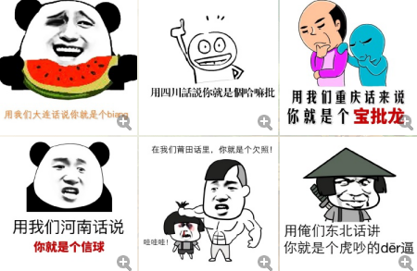
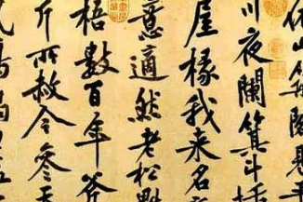

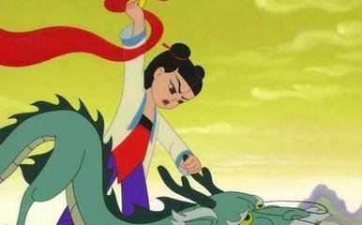
2. Various Forms of Intangible Cultural Heritage
（细分非物质文化遗产的种类和形式，任选熟悉的，有话可说的作为切入点小点）
Chinese dialect
Chinese calligraphy
Chinese myth/fairy tale
Chinese folk tale

Slide 5
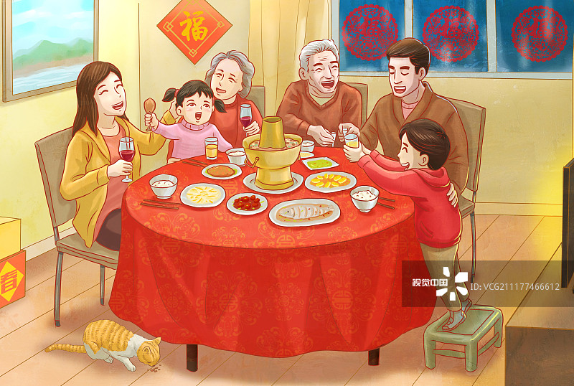


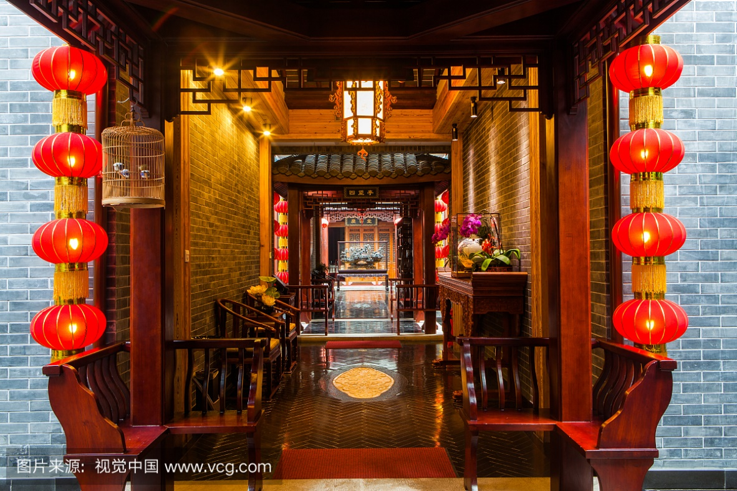
Chinese Features：Traditional festivals
The Spring Festival
Chinese New Year’s Day
Dragon Boat Festival
The Lantern Festival

Slide 6
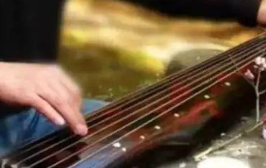
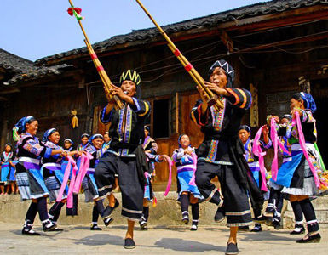
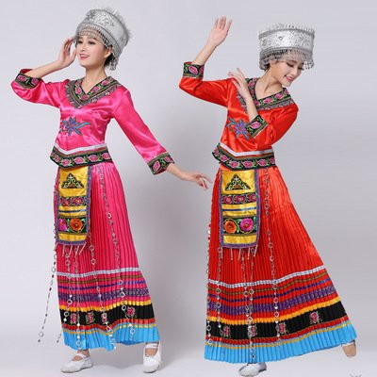
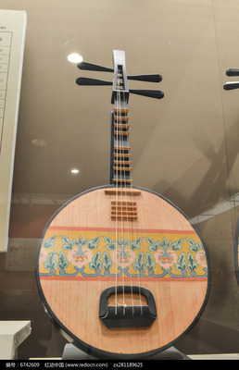
Traditional music and instrument
Minority music
古筝guzheng
Minority dance
琵琶 PiPa

Slide 7
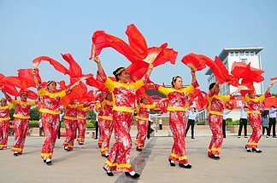
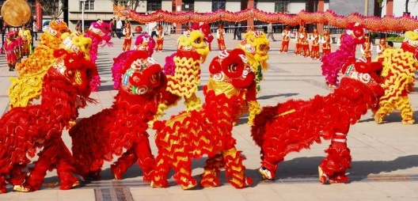
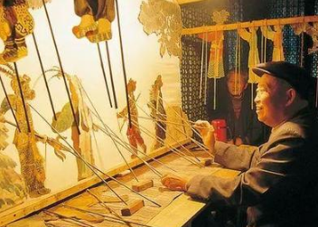
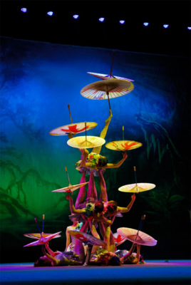
Chinese Features：Traditional folk art
秧歌 Yongko dance
舞狮lion dance
皮影戏shadow play
杂技 acrobatics

Slide 8
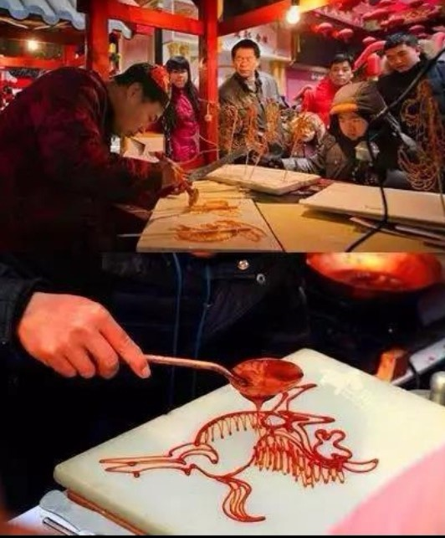
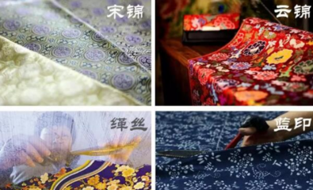
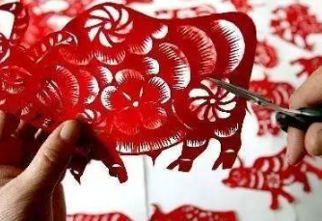

Chinese Features：Traditional handcraft
吹糖人（糖画）
sugar-figure blowing
丝织品 Silk fabrics
silk
剪纸 paper-cutting

Slide 9
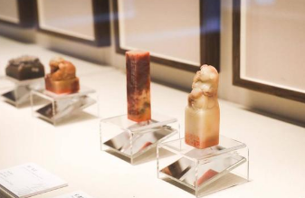
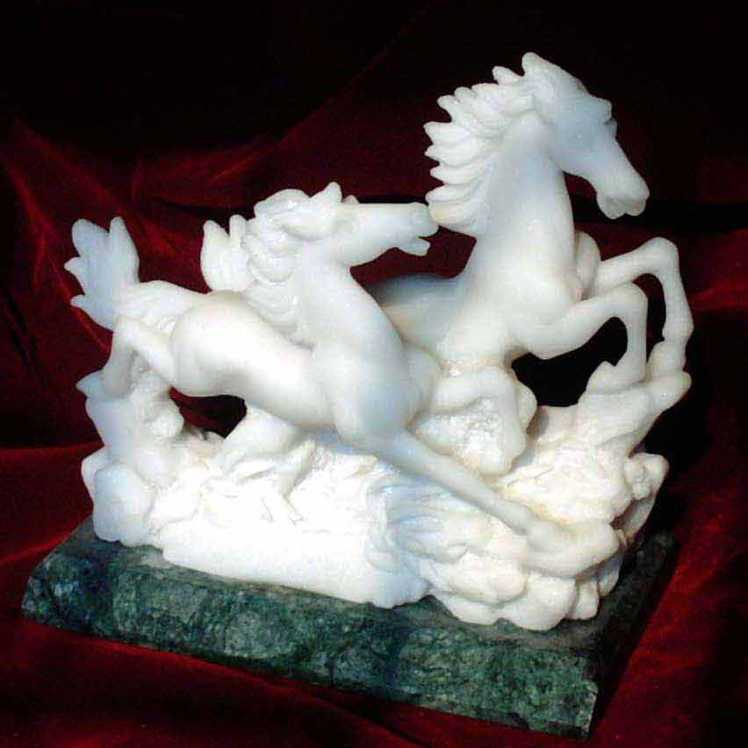
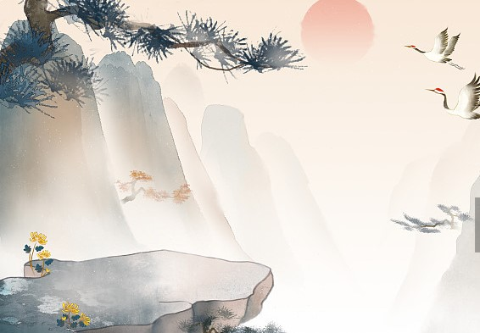
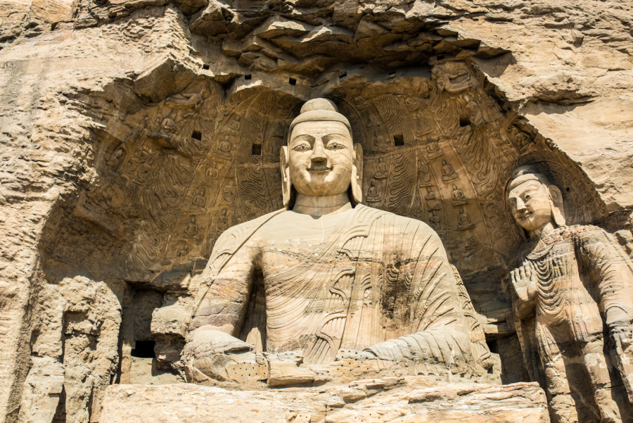
Chinese Features：Traditional art and skills
Chinese seal
玉雕jade carving
Chinese painting
Chinese sculpture

Slide 10
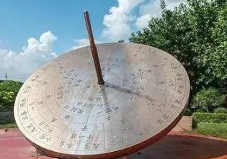
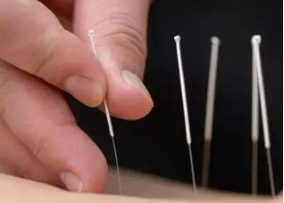
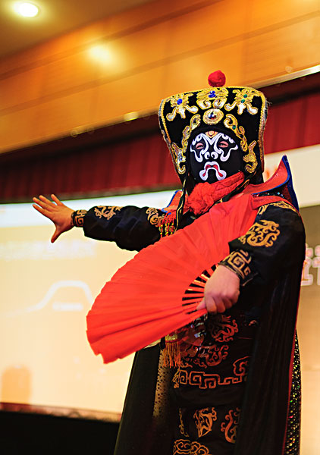

Chinese Features：Traditional heritage
The 24 solar terms （二十四节气）
针灸（Acupuncture）
fast mask-changing川剧变脸
茶文化 tea culture

Slide 11
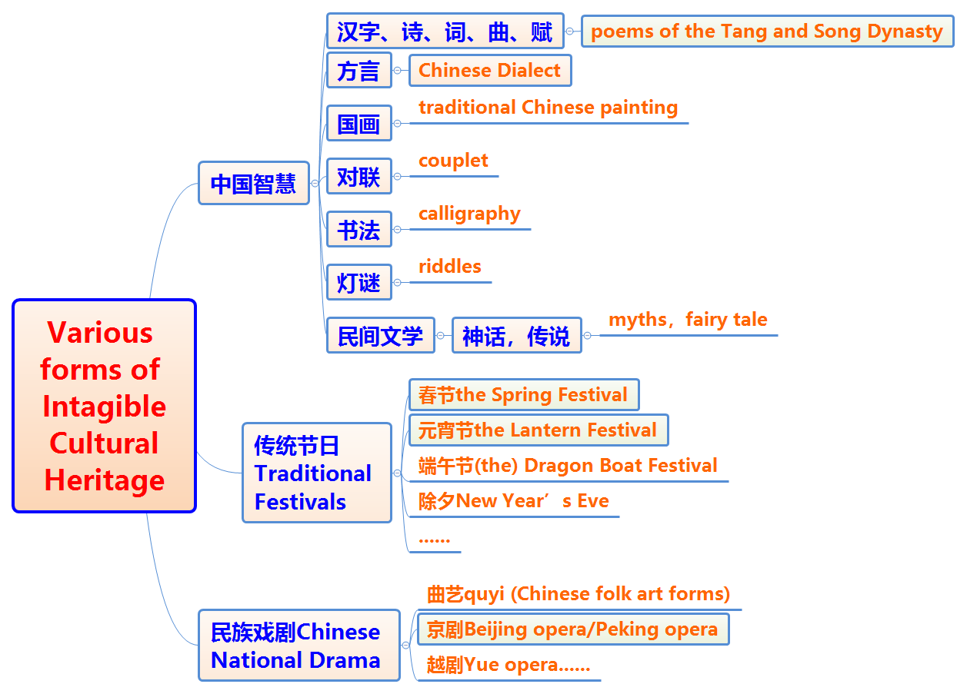

Slide 12
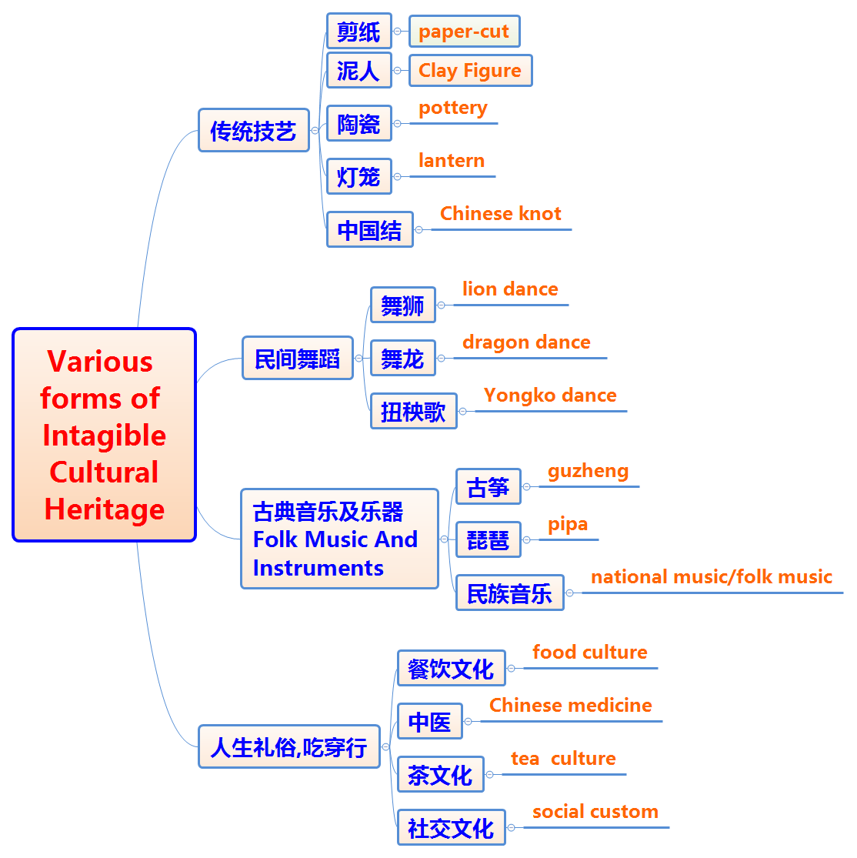

Slide 13

Step 2：深挖要点
Process of the activity:(several possibility)
展开活动过程的几种可能性
理论知识层面：
Offer us a report on getting to know intangible cultural heritage around us(做相关的报告，讲座)
Learn about the ways to protect intangible cultural heritage (了解保护非物质文化遗产的方法)

Slide 14
Step 2：深挖要点
实践体验层面：
Experience and learn about the process of making the art works about intangible cultural heritage（亲身体验，学习制作艺术作品的过程，突出我们身边）
A display of art works and handicrafts or a live performance of music or a play or a dance（现场艺术作品和手工艺品展示和即兴表演歌舞和演奏器乐）
Record and collect images of intangible cultural heritage and show it to the public（记录和收集非物质文化遗产）

Slide 15
Step 2：深挖要点
实践体验层面：
4) Visit local museums, comprehensive museums, such as Zhejiang Museum，Liangzhu Cultural Site Museum （参观当地博物馆或综合性博物馆）
5) Visit local characteristic museums, such as Chinese Tea Museum, Silk Museum, Zhang XiaoQuan Scissors Museum, Southern Song Street, etc （参观当地特色的博物馆）
6) Interview craftsmen and have a conversation with the master of intangible cultural heritage（采访和对话大师）

Slide 16
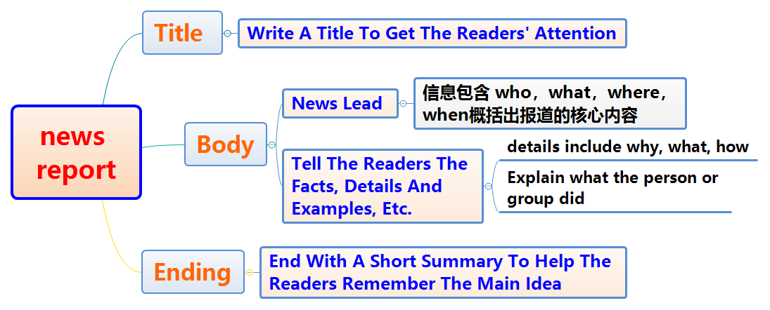
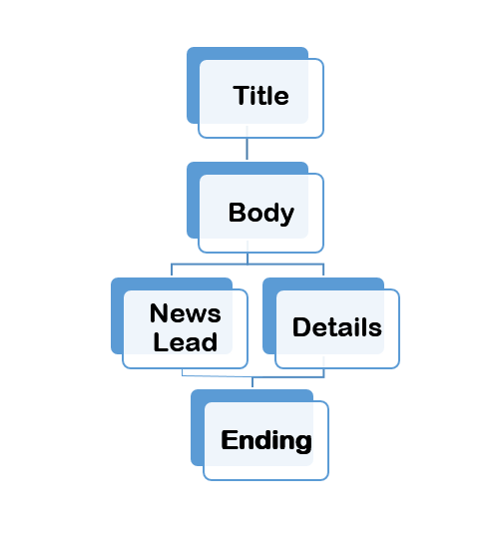
Step 3：Mind map of a news report:(全文构思—structure)
discuss the main points of the body of the news report
Headline：Getting to Know the Intangible Cultural Heritage Around Us

Slide 17
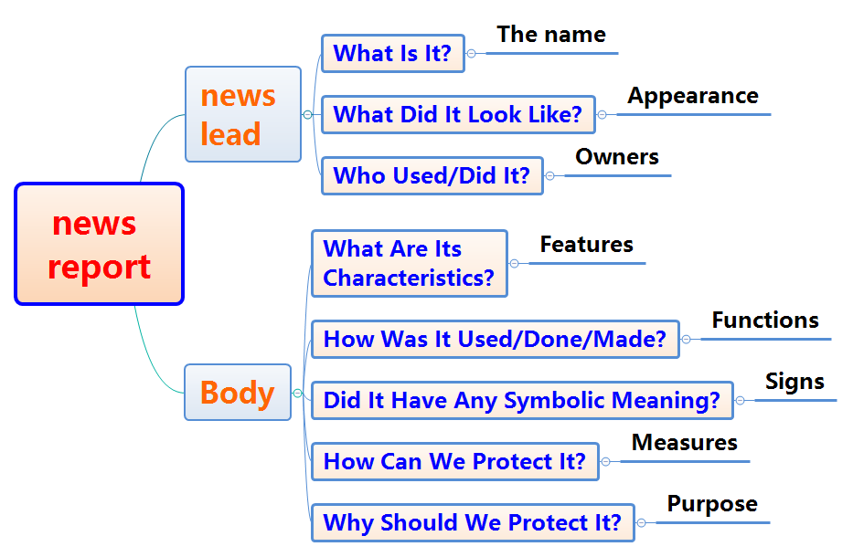

Step 3：Mind map of a news report:(全文构思—structure)

Slide 18
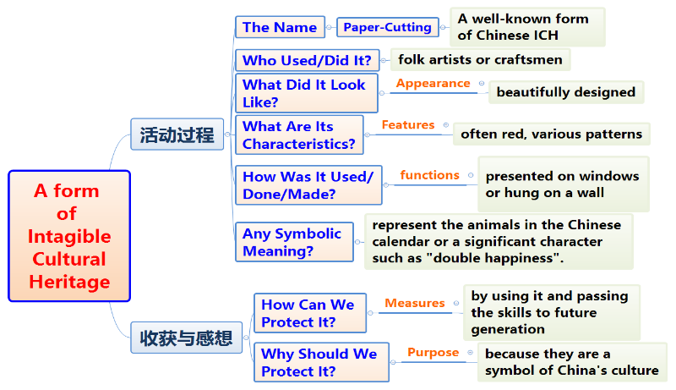
Step 4：Take a form of Intangible Cultural Heritage Around Us as an example(以剪纸为例说说对非物质文化遗产的了解和认识)

Slide 19
Step 5：Find the useful phrases and sentences from the textbook. _{(Book 2 Unit 1)}
Appreciating our own Intangible Cultural Heritage is very important to understand ourselves.
The program prevents our motherland’s Intangible Cultural Heritage from disappearing.
We need to establish a committee of experts to preserve the cultural heritage and prevent it from being harmed.(P5)
The activity aimed to promote wider interest in China’ s ancient history, culture and traditions.
They also hope to further educate people about the importance of safeguarding historic and cultural relics for future generations to understand and appreciate.
Intangible Cultural Heritage includes our country’s traditions, customs, and knowledge, such as the books and stories from throughout our history.

Slide 20

可借鉴的短语和词块：
Pass on to future generation
Prevent world cultural heritage from disappearing
Help increase knowledge and appreciation of China’s ancient cultural heritage

Slide 21
Step 6：Description in details
活动的过程：
Chinese paper cutting was listed in the UNESCO Intangible Cultural Heritage lists, because it has a history of more than 1500 years and it represents cultural values of people throughout China.
A lecture about Chinese Intangible Cultural Heritage was given by a craftsman.
The craftsman explained to us the process of …
He showed us many of his art works, which are highly awarded.
It is amazing that there were various Intangible Cultural Heritage around us which is the soul of my country.
We saw a variety of handcrafted pottery pieces, including vases, bowls, and sculptures.

Slide 22
Step 6：Description in details
活动的过程：
7. A learned scholar delivered a speech about traditional Chinese culture, talking about the history of Chinese characters, paintings and Tang poetry. After that, he interacted with some students, which surely promoted our knowledge.
8. It’s a great opportunity to appreciate the art of pottery.
9. The writing brush has a long history in China. It represents one of the four treasures of study, which also include paper, ink and ink stone.
10. Professor Zhang from University told us about the history and Spread of Chinese tea, followed by a tea party and we tasted different kind of tea.
11. We had a chance to see beautiful works of art.
12. The museum ran a program aiming at helping visitors realize the importance of Intangible Cultural Heritage protection.

Slide 23
Step 6：Description in details
收获与感想：
As a saying goes, “Our Intangible Cultural Heritage are both sources of life and inspiration.”
Our heritage is created and looked after by our ancestors and is therefore our responsibility to take care of and add to.
After the lecture, we visited the museum, we learned that Intangible Cultural Heritage is so important that it cannot be replaced, and preserving and protecting it promises great benefits for our future.
We learnt many things from cultural heritage, such as our history how we used to live in the past and how we developed as a culture, which taught us important lessons.
I’m so proud of Chinese cultural heritage.

Slide 24
Step 6：Description in details
收获与感想：
6. The craftsmen have been working hard to promote the awareness of promoting Chinese cultural heritage among the young people.
7. All the cultural heritage are natural treasures.
8. The activity served as a stage where we can promote the awareness of protecting Intangible Cultural Heritage and improve our knowledge.
9. It’s an honor to get to know the Chinese tea culture and we felt so proud that our country has…
10. As for us students, it’s our responsibility to enhance the cultural knowledge to spread all over the world.
11. Only when we learn to value the Intangible Cultural Heritage, can we prevent them from extinction.
12. Human life lasts only a short time but art and culture last forever.

Slide 25
Step 6：Description in details
收获与感想：
13. We youth generation must attempt to protect and preserve the best of human history.
14. All these masterpieces reminded us of what we can achieve at our finest and inspired us to live up to our great past in the future.
15. They are a link to our past and history and teach us a great.
16. Special measures should be taken to safeguard the Intangible Cultural Heritage, we make sure they will be passed on from generation to generation.
17. In brief, not only did the special activity bring us a lot of fun, but also fueled our passion in Intangible Cultural Heritage.

Slide 26
Step 6：Appreciation
Getting to know the Intangible Cultural Heritage Around Us
Aiming to help increase our knowledge and appreciation of China’s intangible cultural heritage, a group of us students participated in the activity with the theme of “Getting to know the Intangible Cultural Heritage Around Us” organized by Student Union last weekend.
A lecture themed on clay figure was delivered by a famous craftsman, who showed us how to make them and displayed many of his art works, which are highly awarded. After the lecture, we did it with the help and guidance of the master, from which we learnt many things from cultural heritage.
Not only did we have an opportunity to see beautiful works of art, but also fuel our passion and promote our awareness in protecting the Intangible Cultural Heritage Around Us.

Slide 27


THANKS

