Slide 1
感恩遇见，相互成就，本课件资料仅供您个人参考、教学使用，严禁自行在网络传播，违者依知识产权法追究法律责任。
更多教学资源请关注
公众号：溯恩高中英语
知识产权声明

Slide 2
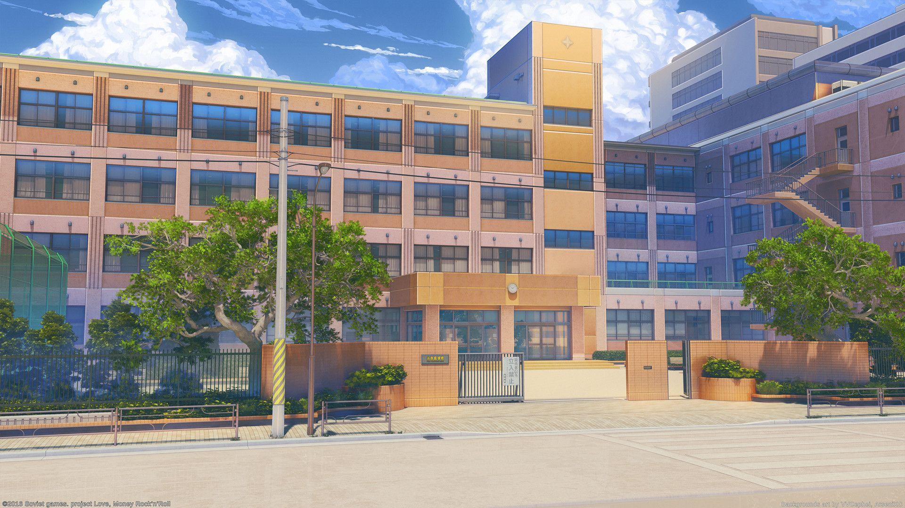
基于SCR框架
2024年1月首考续写讲评

Slide 3
conflict
complication
call & response
SCR框架
situation
resolution
context
change
characters
conclusion
clues given
central
message

Slide 4
situation
complication
resolution
Who is the main character?
What problem(s) does she face? Why?
Did she settle the problem? How?
How does she feel?

Slide 5
Eva spent the first week of high school trying to keep her head above water. One of the major headaches for her was finding her way in the huge school building. It was a six-story building. On each floor, hallways stretched in four directions, leading to classrooms, laboratories, and teachers’ offices. Somewhere in the building, there was also a library, a cafeteria, and a gym.
Having a poor sense of direction, Eva found it impossible to get around in such a huge building. All the different hallways and rooms were too much to think about, let alone commit to memory. She decided that she would memorize where her classes were and then pretend that the rest of the place didn’t exist.
In her fast P.E. class, Eva was shocked when Coach Pitt announced that everyone had to run one mile around the track outside. She searched the faces of her classmates for signs of panic. There was nothing she feared more than having to run a whole mile. To Eva, “a mile” was used to describe long distances. It was ten miles from her home to her grandfather’s, and that always seemed like a long way, even in a car!
When Coach Pitt blew his whistle (哨子), Eva figured she would be left in the dust. However, while some of her classmates edged ahead, others actually fell behind. “It’s just the beginning,” she thought. “I’ll come in last for sure.”
Soon Eva began to breathe hard, with her heart pounding and legs shaking. Feeling desperate, Eva started using a mind trick on herself. She stopped thinking about the word “mile.” Instead, she focused on reaching the shadow east on the track by an oak tree up ahead. Then she concentrated on jogging to the spot where the track curved (拐弯). After that, she tried to see if she could complete her first lap. One lap turned into two, then three, then four.
Paragraph 1: When Coach Pitt said “Nice work!” to her at the finish line, Eva was surprised.
Paragraph 2: Eva decided to use the same trick to deal with the school building.

Slide 6
situation
complication
resolution
… spent the first week… trying hard to keep head above water.
①One of the major headaches for her was finding her way in the huge school building…
Having a poor sense of direction, Eva found it impossible to get around in such a huge building.
②There was nothing she feared more than having to run a whole mile… “a mile” was used to describe long distances… and that always seemed like a long way, even in a car!
Plot Line
Emotion Line
decided to use the same trick to deal with the school building
fear
confused
confident
surprised
run one mile around the track outside
“Nice work!”
use a mind trick - focused on; concentrated on
dedicated
attentive
shocked
panicked
unconfident
nervous
desperate
When Coach Pitt blew his whistle
Eva
smart, intelligent
persistent

Slide 7
Paragraph 1: When Coach Pitt said “Nice work!” to her at the finish line, Eva was surprised.
Paragraph 2: Eva decided to use the same trick to deal with the school building.
Paragraph 1: When Coach Pitt said “Nice work!” to her at the finish line, Eva was surprised.
Paragraph 2: Eva decided to use the same trick to deal with the school building.
Focus: How Eva felt about her completion of running a mile?
（How Coach and other students react?）
How Eva felt about her mind trick?
Focus: How Eva applied the trick?
How did it work?
How Eva felt about it? Still a headache?

Slide 8
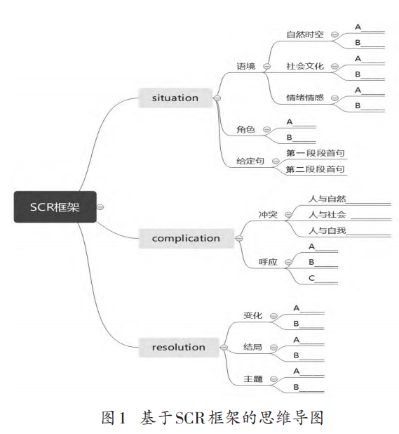
time: PE class & first week in high school
venue: long track & huge school building
headaches
fearful; unsettled
Eva (主角) Coach Pitt/ classmates/ her grandfather
-long track vs. There was nothing she feared more than having to run a whole mile.
-huge school building vs. Having a poor sense of direction
It was a six-story building. On each floor, hallways stretched in four directions, leading to classrooms, laboratories, and teachers’ offices. Somewhere in the building, there was also a library, a cafeteria, and a gym.
Eva figured she would be left in the dust… she thought. “I’ll come in last for sure.”
she focused on reaching the shadow east on the track by an oak tree up ahead. Then she concentrated on jogging to the spot where the track curved.
Theme: wisdom & personal growth

Slide 9
原文好词好句
spend some time doing
keep her head above water
headaches
a six-story building
hallways stretched in four directions
have a poor sense of direction
get around
commit to memory
searched the faces for signs of panic.
There was nothing she feared more than doing sth.
blow one’s whistle
be left in the dust
edge ahead
fall behind
come in last for sure.
breathe hard
with her heart pounding and legs shaking
a mind trick
a lap
花时间做某事
勉强度日
让人头疼的事
一个六层的建筑
走廊朝四个方向延伸
方向感差
四处走动
记住；牢记于心
想从他们的脸上找到害怕的神情
没有什么比……更让她害怕的了
吹口哨
轻易击败或被超过
领先
落后
肯定是最后
喘气；费力呼吸
她的心怦怦直跳，双腿颤抖
心理战术
一圈

Slide 10
学生佳作赏析
Para. 1: When Coach Pitt said “Nice work!” to her at the finish line, Eva was surprised. “Nice work? By no means can I make it!” Filled with a mixture of shock and curiosity, Eva stopped and turned around. To her great astonishment, on the track there were still quite a few students lagging behind! Exhausted as she was, Eva could feel the ecstasy dancing inside--the once mission impossible was eventually completed. After class, Eva reflected on this little incident and credited her improvement to the small trick she employed-- find signs, break down goals and then stay focused till the end. The one-mile run instilled in her a surge of confidence and fulfillment, and her following high school life seemed smoother afterwards, except the huge confusing school building. (112 words)
协同：延续前一句的surprised，符合自我认知
变化：与预期相反，说明改变发生
协同+变化
协同：再现原文的small trick，为下文做铺垫
变化

Slide 11
Para. 2: Eva decided to use the same trick to deal with the school building. From that day on, she paid special attention to different decorations on each floor and the signs hanging on the doors. In class intervals, instead of staying indoors to avoid mistakes, she would wander around to acquaint herself with the previous “enormous school building monster”. Though several attempts failed, Eva never quit trying. Whenever walking into a wrong classroom or going to the opposite direction on the hallway, Eva just adopted her methods one more time. The day progressed alongside with Eva’s sense of direction as she gradually got familiar with the whole building. She knew she would never lose faith, neither in the one-mile run nor in her new school life. (113 words)
协同：如何用same trick搞定路痴问题
协同+变化
协同：跑步时体现的坚持
协同：跑步时体现的坚持
变化：方向感变强；更熟悉学校

Slide 12
老师下水作文
Para. 1: When Coach Pitt said “Nice work!” to her at the finish line, Eva was surprised. How could it even be possible? Assuming that she should have come in the last, Eva turned around, only to amazingly find that she ended up top 3 in the one-mile run. Instantly, a current of delight streamed through her body and it dawned on her that this special mind trick really served her well in her running. After class, she took the same way back to her classroom. When catching sight of the colored signs on the hallway, this smart girl hatched a plan--although the four laps had ended, it was just the beginning of her change. (98 words)

Slide 13
Para. 2: Eva decided to use the same trick to deal with the school building. Initially, the hallways still seemed endless, leading to nowhere, or rather, places she didn’t remember. Despite that, with strong determination and rapt attention, she managed to make her way to classrooms and laboratories, and even the library and cafeteria. The trick was that she focused on and memorized the signs of different venues on the way, which were already mapped in her memory. One week fleeted into two, then three, then four. Even Eva herself couldn’t believed how much progress she had been making! Now, she’s adapted to high school life and everything beyond that, certainly with the help of her special trick. (103 words)

