Slide 1
感恩遇见，相互成就，本课件资料仅供您个人参考、教学使用，严禁自行在网络传播，违者依知识产权法追究法律责任。
更多教学资源请关注
公众号：溯恩高中英语
知识产权声明

Slide 2
UNIT 3
SEA EXPLORATION
They (oceans) provide a breeding ground for life, connect the world and promote development.
--- Xi Jinping
海洋孕育了生命、联通了世界、促进了发展
--- 习近平

Slide 3
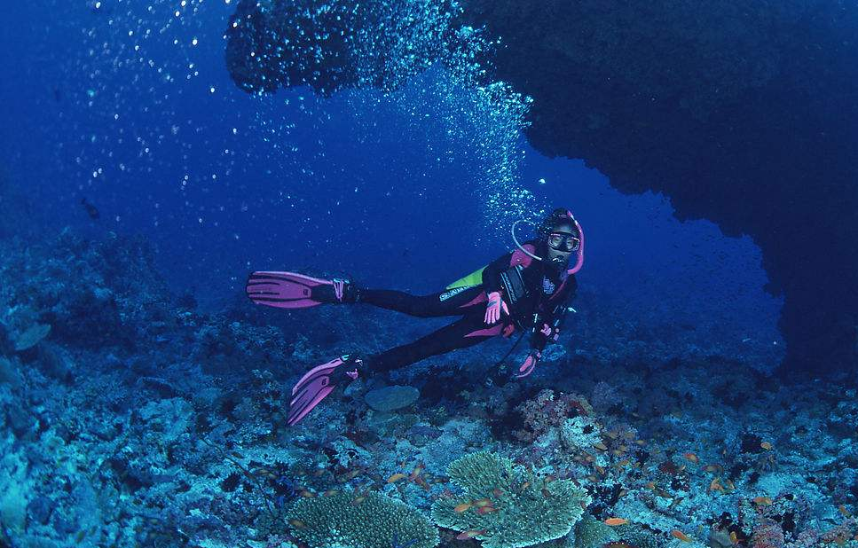
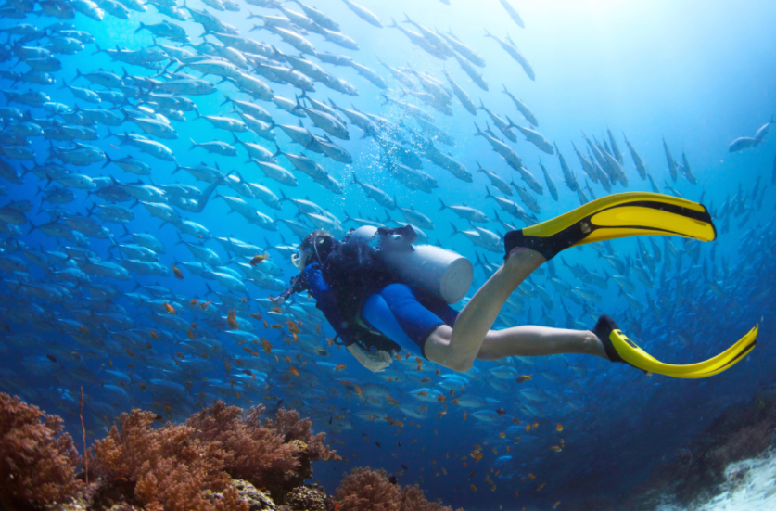
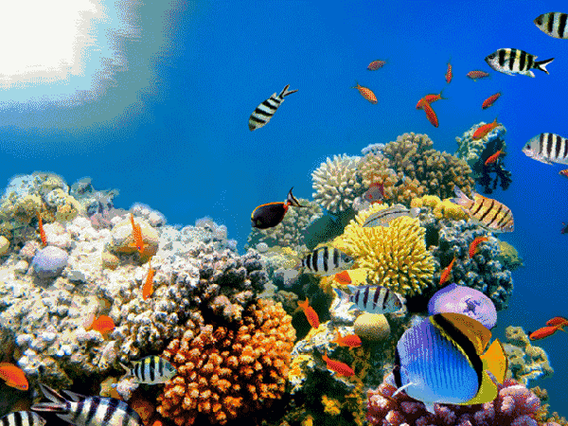
Lead-in
1. What do you think of when you see the photos?
2. Can you describe ocean using your own language?
invader, corals, fish, harmony…
The ocean is the cradle of life. (metaphor)
The ocean hides secrets like mankind. (simile, personification)
The ocean gave my face a salty slap as his tides rose. (personification)

Slide 4
Lead-in
What do you know about sea exploration?
What do you want to know about sea exploration?
Sea voyages, sea exploitation, sea protection, the development of a harmonious relationship between humans and the sea …
Do you know any stories about sea voyages?

Slide 5
Lead-in
Zheng He was a Chinese admiral and explorer who made seven voyages to the Western Sea. The first voyage started in Yongle three years (1405), and the last voyage ended in Xuande eight years (1433), totaling seven times. Zheng He's voyages are one of the world navigation feats in history.

Slide 6
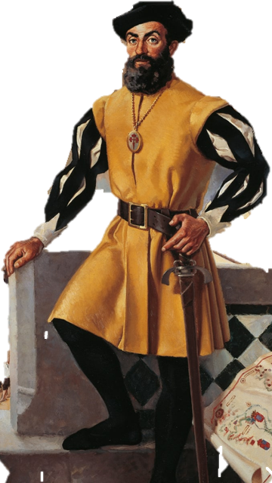
Lead-in
Ferdinand Magellan is a Portuguese navigator and explorer who made the first voyage around the world in 1519. He sailed around South America, discovering the Strait of Magellan, and across the Pacific.

Slide 7
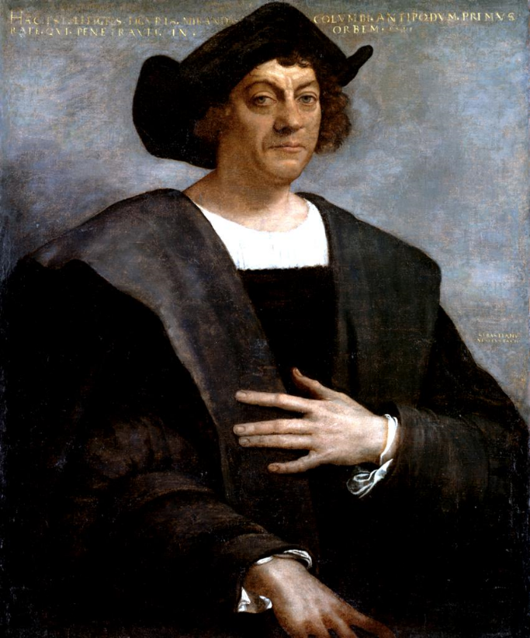
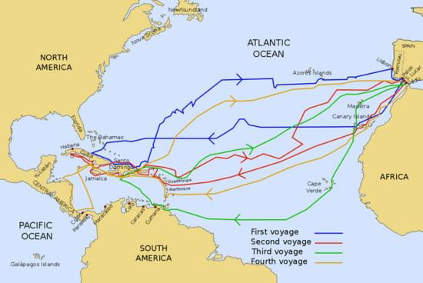
Lead-in
Christopher Columbus was an Italian explorer whose journeys kicked off centuries of exploration and exploitation on the American continents. He discovered a new world in 1492.

Slide 8
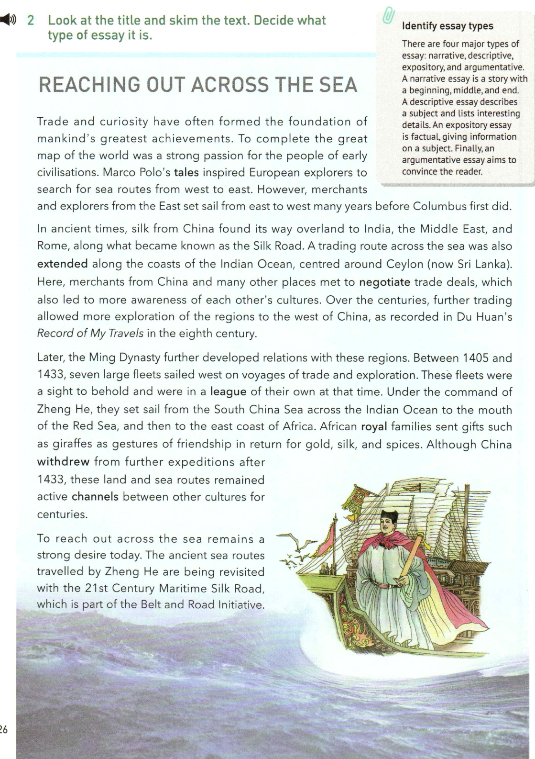
Prediction
1. What the content of the text is?
2. What is the style of the text?
3. What are the four major types of essay do you know?
The text is mainly about how Chinese people conduct sea explorations over time.
A title usually covers the main point of the subject or keywords of the essay. It shares the theme of the essay and tells the reader what to expect.
It is an expository essay.
Narrative, descriptive, expository, and argumentative.

Slide 9
Prediction
1
A narrative essay is a story with a beginning, middle, and end.
A descriptive essay describes a subject and lists interesting details.
An expository essay is factual, giving information on a subject.
An argumentative essay aims to convince the reader.
2
3
4

Slide 10
Fast-reading
Read the text quickly and match the main idea of each paragraph.
Para. 1
Para. 2
Para. 3
Para. 4
Para. 5
Para. 6
A. China is also joining with other countries on other important projects.
B. Travel from east to west began long before Columbus.
C. In ancient times, travel east to west was on the Silk Road.
D. China will continue to explore the sea and enhance relationships with other countries.
E. The 21st Century Maritime Silk Road has encouraged cooperation and strengthened the bonds between China and the rest of the world.
F. Zheng He’s sea voyages built relations with other countries.
The main idea is sometimes stated in either the opening or closing sentence. If not, look for another “standout” sentence, or summarize the paragraph in your mind by asking yourself “ What is it mainly about?”.
opening sentence
closing sentence
opening sentence
summary sentence
“standout” sentence
opening sentence

Slide 11
Fast-reading
Draw the structure of the text
Para. 1
Introduction to the topic: Reaching out across the sea
Para. 2~3
Para. 4~5
Para. 6
In the past
At present
In the future
How is the passage developed?
The passage is developed chronologically.
Which is introduced in each exploration?
Region
Event
Purpose

Slide 12
Fast-reading
the Arctic
What are the routes during different periods?
Rome
China
the Middle East
India
China & the rest of the world
Ceylon
The Maritime Silk Road,
A trading route across the sea
In the past
the ancient sea routes travelled by Zheng He,
The 21st Century Maritime Silk Road,
The Belt and Road Initiative
At present
unknown
In the future?
Which event has happened during these periods?
What’s the purpose in different time?

Slide 13
Fast-reading
Para. 1
Introduction to the topic: Reaching out across the sea
Para. 2~3
Para. 4~5
Para. 6
Time
In the past
At present
In the future
Indian Ocean
The east coast of Africa, the Arctic
China & the rest of the world
Region
To build a community of a shared future for mankind and achieve win-win development
Purpose
To trade
To exchange culture and cooperate

Slide 14
Detailed Reading
Trade and curiosity
stories
Topic sentence
1. What drives people to reach out across the sea?
2. Why did Marco Polo’s tales inspire European explorers to search for sea routes from west to east?
Because Polo wrote extensively about his travels and what he discovered during his years abroad, which attracted European explorers who believed that they could import more items from the East.

Slide 15
Detailed Reading
Topic sentence
The origin the Silk Road
The benefits
To arrange or settle by discussion and mutual agreement.
1. What is the result of the Maritime silk road?
Merchants met to negotiate trade deals.
2. What benefit can be got from negotiating trade deals ?
introduction of new species,
enhancing friendship…
More awareness of each other’s cultures,

Slide 16
Detailed Reading
Topic/ transitional sentence
The purpose
pull back or move away
What is the purpose of the sea exploration during the Ming Dynasty?
What’s the difference between the ancient Silk Road and the Ming Dynasty Silk Road?
It Zheng He’s voyages successful and meaningful? Why?

Slide 17
Detailed Reading
What is the purpose of sea exploration during the Ming Dynasty?
What’s the difference between the ancient Silk Road and the Ming Dynasty Silk Road?
It Zheng He’s voyages successful and meaningful? Why?
The purpose is to further build relation with other countries.
The travelling route of the land and the sea.
Yes, his voyages developed the friendship and relationship between China and other countries,
enhance foreign trade and show Chinese power.

Slide 18
Detailed Reading
transitional
Topic sentence
What is the function of the first sentence?
What is the purpose of the Belt and Road Initiative?
What bonds do you think can be strengthened between China and the rest of the world in the Belt and Road Initiative?

Slide 19
Detailed Reading
What is the function of the first sentence?
What is the purpose of the Belt and Road Initiative?
What bonds do you think can be strengthened between China and the rest of the world in the Belt and Road Initiative?
It is a transitional sentence.
To encourage cooperation and trade, strengthen the bonds between China and the rest of the world, explore the Arctic.
The economic/ bond.
culture/
political/
technological/ friendly

Slide 20
Detailed Reading
Topic sentence
1. Why will China continue to reach out the sea far into the future?
2. Why does China join its friends and other nations on other important projects?
3. What is the meaning of reaching out across the sea?

Slide 21
Detailed Reading
1. Why will China continue to reach out the sea far into the future?
2. Why does China join its friends and other nations on other important projects?
3. What is the meaning of reaching out across the sea?
It is the need of trade and the desire to enhance relationships.
Possible answer:
China wants to guide its friends to build a community with a shared future for mankind.
We want to promote joint development, enhance mutually beneficial cooperation and develop common prosperity.
It benefits the trade, cooperation and culture exchange.

Slide 22
Group Discussion
1. What achievements has China made in reaching out across the sea?
2. What effects did China’s reaching out across the sea in the last past have on the world?
3. What about other countries?
Make notes under two columns: Facts and Opinions.
Facts are statements that can be proven. Facts may be true or false. Opinions are statements that cannot be proven and argued; Opinions may be supported with facts.

Slide 23
Group Discussion
1. Which countries reached out across the sea in the past and why?
2. What benefits and problems did those countries get from doing this?
3. What effects did reaching out across the sea in the past have on the world?
4. What do you think is the significance of the Belt and Road Initiative?

Slide 24
Question
1
2
3
4
European explores, China, India, Ceylon, African royal families;
They got new products from many countries and became more aware of other cultures;
The land and sea routes remained active channels between different cultures for centuries;
The aim of it is to encourage cooperation and trade across the historical Silk Road areas, and strengthen the bonds between China and the rest of the world
Fact
It will lead to greater integration with China and other countries.
It advanced the spread of knowledge, technology, and goods, and made the world a smaller place.
It will promote joint development, enhance mutually beneficial cooperation and develop common prosperity
Opinion
It led to invasion and conquest.
For trade

Slide 25
Group Discussion
Are there questions discussed on the same aspect?
When you think about one historical or contemporary event, which aspects should you consider to gain a full understanding?
Time, event, region, purpose or significance…

Slide 26
Homework
Think about the following question and write a short essay
As students what contributions could we make to the Belt and Road Initiative?

Slide 27
Homework
There is no doubt that the Belt and Road is the hottest issue recently. As students, what contributions can we make to it?
Firstly, we can participate in social volunteer activities which benefit understanding the development of society deeply. In addition, we should study hard and learn more about Chinese culture so that we can spread our excellent culture to the world through our professional knowledge. Finally, English learning is important for us because we can introduce the advantages of the Belt and Road Initiative to foreigners in English and encourage more countries to join it.
All in all, we should start with little things and keep doing them.

Slide 28
REACHING OUT ACROSS THE SEA
THANKS

