Slide 1
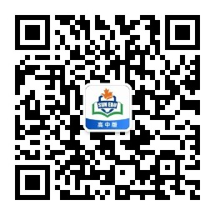
感恩遇见，相互成就，本课件资料仅供您个人参考、教学使用，严禁自行在网络传播，违者依知识产权法追究法律责任。
更多教学资源请关注
公众号：溯恩高中英语
知识产权声明

Slide 2
Continuation Writing
Believe in Miracles

Slide 3
Reading
Believe in Miracles
My friend Annette and I had decided to go to a writer’s conference over Valentine’s Day weekend in Livermore, California. We were taking a mini vacation together and couldn’t have been more excited. We wanted to get there the day before the conference and settle into our hotel room.
The weather forecast was predicting high winds and rain, so we decided to take an early morning train and then connect with a city bus to our hotel. We arrived early enough to enjoy breakfast in the hotel. We even had the good fortune to be able to get our room. All was going well. We were off to a perfect start.
Once in our room, the terrible storm hit the earth! The wind and rain made staying in the only sensible option. As lunchtime approached, we decided to try a phone app that would bring almost any restaurant’s food to us. We decided on hamburgers from a well-known chain.
The food-delivery app promised a 45-minute wait time. Forty-five minutes came and went, then an hour, and then an hour and a half. After two hours, I called the restaurant. They explained that our hamburgers were under a heat lamp the entire time, just waiting for the driver. We canceled the order and decided to go out in an Uber car to continue our quest for hamburgers.
The front-desk manager suggested a restaurant that had great hamburgers. So we took the Uber car and set off. But when we arrived at the restaurant, we found it was closed due to the bad weather. And our car had already left. We stood outside the building on that miserably cold and wet day, trying to decide what to do next. Of course, the solution was easy: Just order another Uber car.
I began digging in my purse for my phone, but it wasn’t there！

Slide 4
1
Read the title
Believe in Miracles
Miracles
Theme?
kindness/goodness of stranger(s)

Slide 5
2
Read the structure
Para.5 took a Uber car to quest hamburgers
Climax
Para.3-4 failed to order hamburgers
Para.6 lost the phone
?
Para.2 arrived in the morning
rising action
falling action
?
Para.1 planned a vacation
Beginning
Ending

Slide 6
3
Read detailed information
winter: terrible storm,cold,wet
Believe in Miracles
My friend Annette and I had decided to go to a writer’s conference over Valentine’s Day weekend in Livermore, California. We were taking a mini vacation together and couldn’t have been more excited. We wanted to get there the day before the conference and settle into our hotel room.
The weather forecast was predicting high winds and rain, so we decided to take an early morning train and then connect with a city bus to our hotel. We arrived early enough to enjoy breakfast in the hotel. We even had the good fortune to be able to get our room. All was going well. We were off to a perfect start.
Once in our room, the terrible storm hit the earth! The wind and rain made staying in the only sensible option. As lunchtime approached, we decided to try a phone app that would bring almost any restaurant’s food to us. We decided on hamburgers from a well-known chain.
The food-delivery app promised a 45-minute wait time. Forty-five minutes came and went, then an hour, and then an hour and a half. After two hours, I called the restaurant. They explained that our hamburgers were under a heat lamp the entire time, just waiting for the driver. We canceled the order and decided to go out in an Uber car to continue our quest for hamburgers.
The front-desk manager suggested a restaurant that had great hamburgers. So we took the Uber car and set off. But when we arrived at the restaurant, we found it was closed due to the bad weather. And our car had already left. We stood outside the building on that miserably cold and wet day, trying to decide what to do next. Of course, the solution was easy: Just order another Uber car.
I began digging in my purse for my phone, but it wasn’t there！
failed to have hamburgers
lost the phone

Slide 7
4
Read given sentences
Para.1 I realized I had left it in the Uber car.
Para.2 As we pulled into the parking lot, I suddenly saw our first Uber car.
Used Annette's phone
How did I feel?
How to order a car?
Took a car
How did we get there?
by chance
How did I feel then?
What did I do?
prediction:
1.The driver knew there was a phone.
2. The driver didn't know there was a phone.
He planned to return it.
I found it on the seat

Slide 8
Writing
1
How to describe anxiety?
worried 担忧的
anxious 担心的，焦虑的
upset 心烦的，沮丧的
depressed 抑郁的; 沮丧的
frustrated 懊恼的，沮丧的
glum 忧郁的; 闷闷不乐的
...
Adjectives

Slide 9
1
How to describe anxiety?
Expressions
I felt my brain was like a scribble.
A flutter of anxiety swept over my body.
I scratched my head, standing there rooted in the street.
Worried and anxious, I stood there with a glum look on the face.
I had never encountered such a case, so I didn't know what to do.
My mind was all confused, going round like a washing machine on fast spin.
Thinking that there was so much crucial information in the phone, I sank into depression.
...

Slide 10
Writing
2
How to echo the earlier text?
Earlier text
Continuation writing
failed to get hamburgers
enjoyed hamburgers
miracles
lost the phone
got the phone back

Slide 11
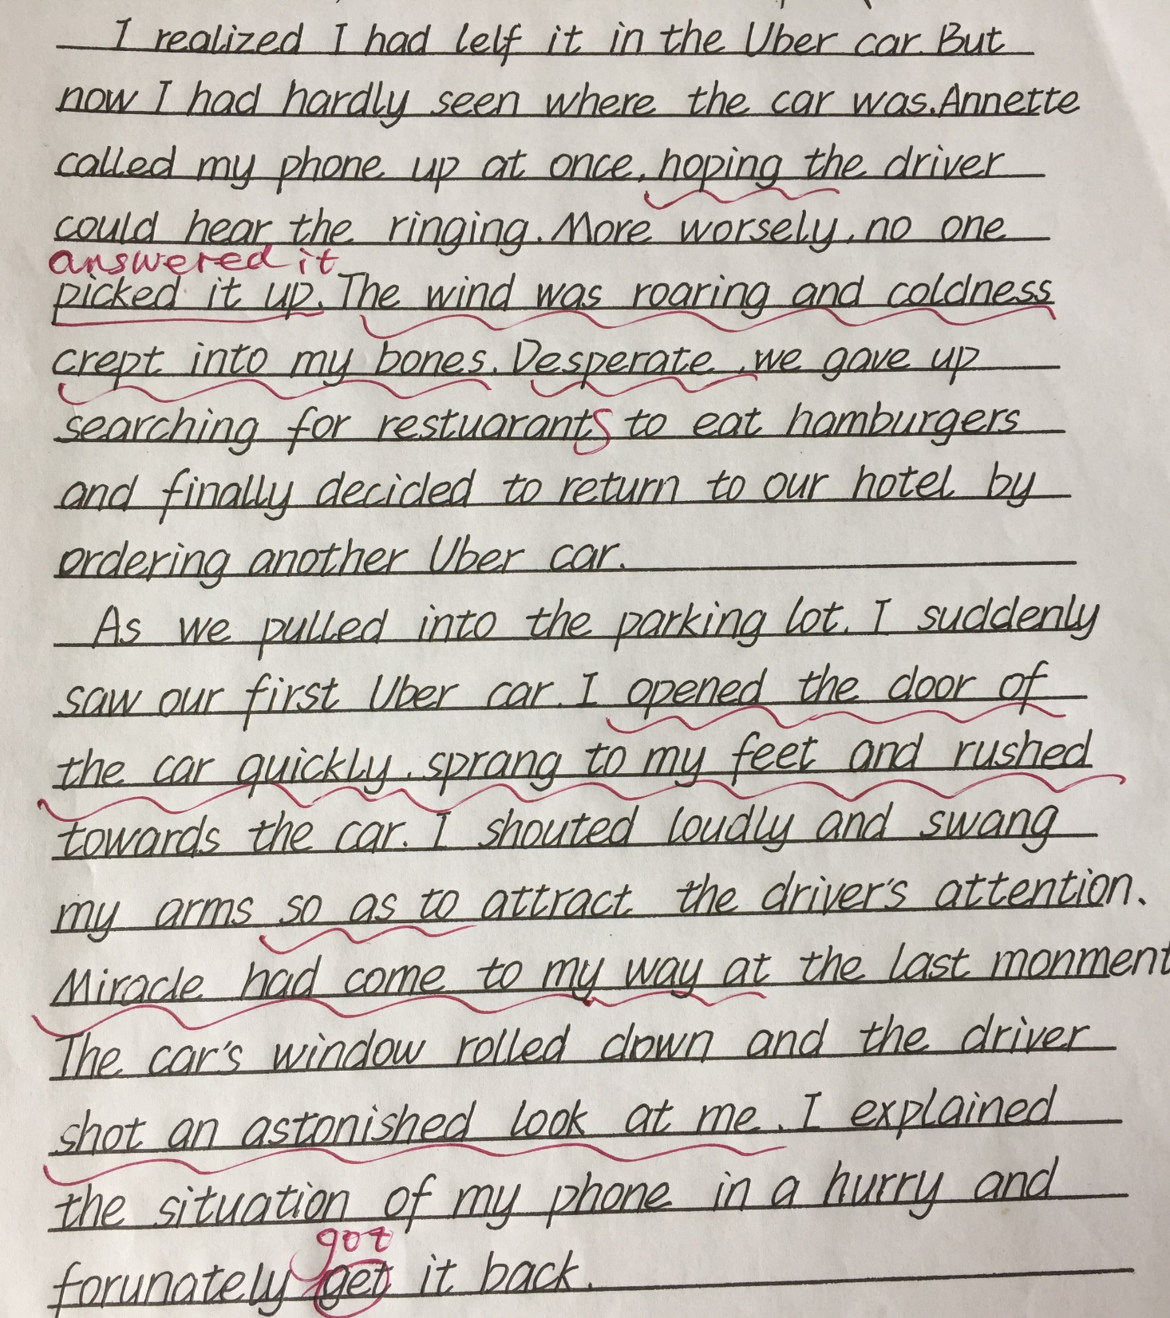
Appreciating
1
学生习作
点评：整体情节合乎逻辑，与段首句衔接合理，天气描写、心理描写比较自然，表达上有少许错误，但语言形式比较丰富，第二段的miracle与原文有所呼应，但文末似乎意犹未尽。另外该同学忘记了下划线，须引起重视。

Slide 12
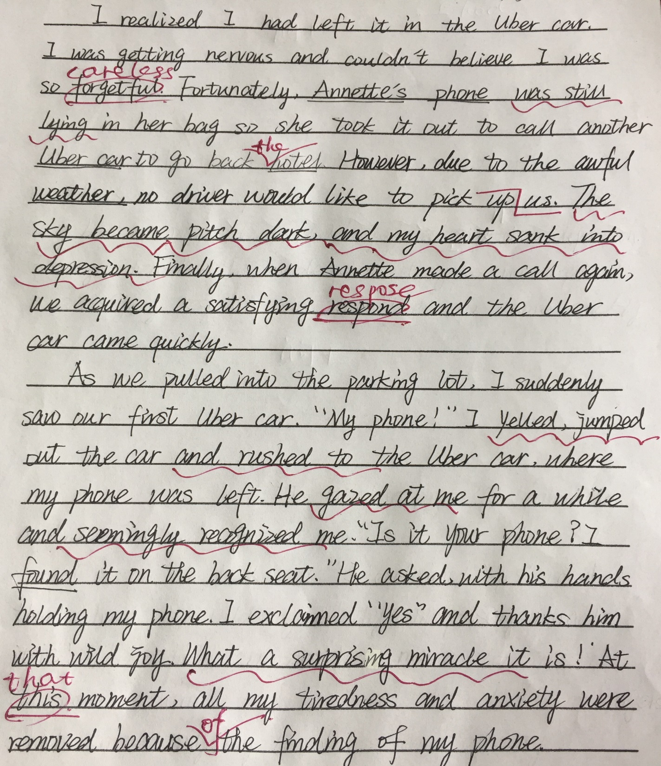
Appreciating
1
学生习作
点评：情节合理，第一段中有情节波动，与天气状况相吻合。与段首句的衔接自然，表达上有少许错误，但语言形式比较丰富。第二段用感叹句呼应标题miracle，但文末若能写到“汉堡”，情节会更完整。另外该同学的书写有待提高。

Slide 13
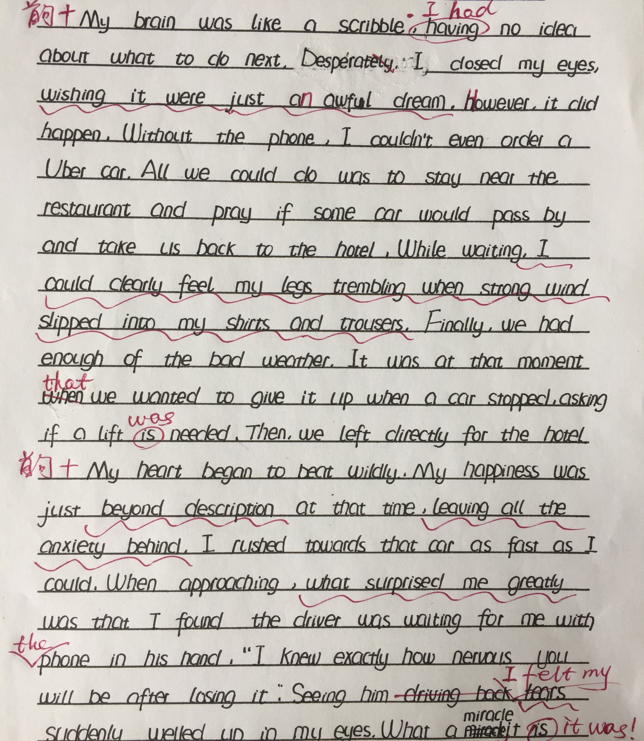
Appreciating
1
学生习作
点评：第一段中“朋友没有手机”这事应该有所交代，否则情节漏洞太明显。语言表达上力求形式丰富，但非谓语作状语时应注意逻辑主语的准确使用。文末的
miracle回应了标题，若能写到“汉堡”，情节将更完整。

Slide 14
2
参考范文
I realized I had left it in the Uber car. The car was long gone, and so was my phone. Worried and anxious, I stood there with a glum look on the face. Annette tried to comfort me as she took out her phone and ordered another Uber car. While waiting, I felt my mind was all confused. “What if my phone was taken by other passengers?” I muttered, sinking into depression. At that moment, the car arrived and drove us back to the hotel.
As we pulled into the parking lot, I suddenly saw our first Uber car. “Annette, that’s the car.” I yelled excitedly and rushed to it. The driver seemingly recognized me. “I spotted a phone on the back seat just now and was wondering how to get you. It is really a miracle.” he smiled brightly when he handed the phone to me. Holding the phone, I thanked him millions of times. Then he took us to another restaurant and we finally had hamburgers. Never had I ever eaten such tasty hamburgers.
Plot
Theme
Language

Slide 15
Thank You!

Slide 18
1. 注意时态的准确性：续写（过去式）
2. 注意原文的细节：
时间：
Uber car
parking lot
4. 回应原文：
Valentine’s Day
建议：不要写电闪雷鸣！
We wanted to get there the day before the conference…
故事发生在开会当天吗？
优步
泛指的概念
hamburger、miracle

Slide 19
形容词：
worried/concerned 担心的
anxious 担心的，焦虑的
depressed 抑郁的; 沮丧的
frustrated 懊恼的，沮丧的
glum 忧郁的; 闷闷不乐的
with a glum/gloomy look 带着忧郁的表情
sit in gloomy silence 闷闷不乐地坐着
knock at the window/door

Slide 20
Para.1 I realized I had left it in the Uber car.
Thinking that there was so much crucial information in the phone, I sank into depression. (潘凤婷)
Annette comforted me and called my phone, hoping someone would answer. Unfortunately, there was no response. (孙诗镱)
I scratched my head, standing there rooted in the street. (傅郁儿)
I had never encountered such a case, so I didn’t know what to do.(陈恺权)
The wind was roaring and coldness crept into our bones. Desperate, we gave up our quest for hamburgers and finally decided to return to our hotel. (任诚盼) So Annette took out her phone and ordered another Uber car.
.

Slide 21
Plot
Theme
Language

